Slide 1
Mainframe – Control-M
www.srinimf.com

Slide 2
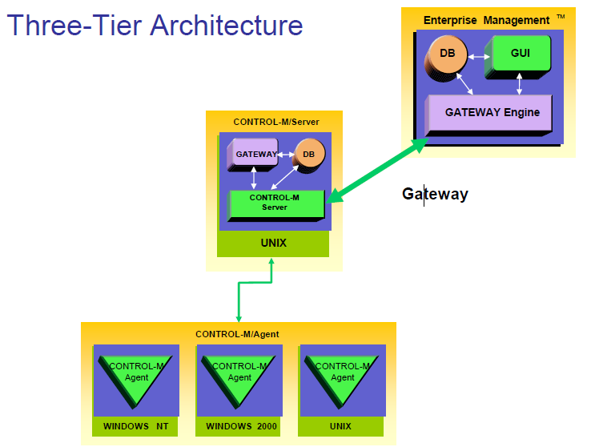
Architecture

Slide 3
Control-M Agent
Run under Windows NT/200, Unix, etc …
Receive order from Control-M Server
Submit, monitor, control and manage jobs
Send result to Control-M Server

Slide 4
Control-M Server
It’s the engine of Control-M
Contain all calendars
Contain all job definitions
Activate and Control the « up to plan »

Slide 5
Enterprise Management
Focal point of control
Responsible for cross-platform dependencies
Standard GUI for all the Production platforms
Give graphic tools to develop jobs

Slide 6
Job Definitions
What ?
Where ?
When ?
Resource Requirements
Flow Control ?
Results Control

Slide 7
What do we schedule
Unix shell scripts
/export/home/hipfeed/interfaces/scripts/ft_process.pl
NT Batch Files (.bat .cmd)
d:\prod\Ctm\Copy_Logs\del_logs.cmd
Executable
Operator Commands

Slide 8
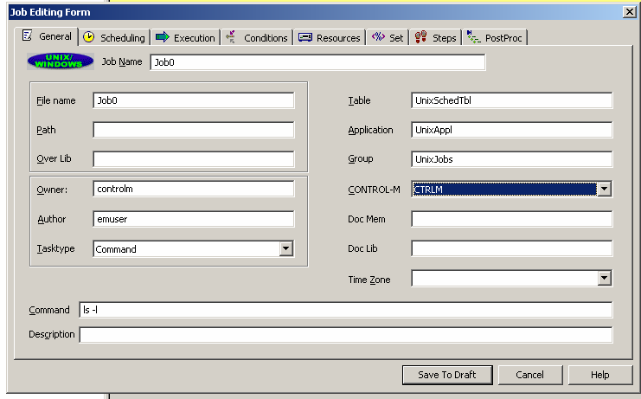
Contd…
Execute Command
ls -l

Slide 9
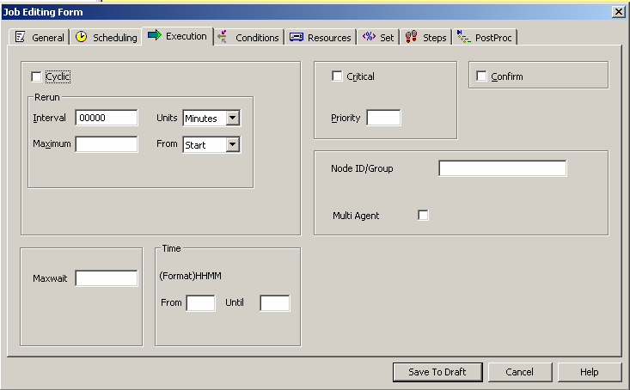
Where do we run
Which server do we use

Slide 10
Contd…
Does it have a Control-M Agent
Is it a Production or a Uat agent

Slide 11
Who can execute it
is needed to run the job
Which user login

Slide 12
Contd…
Does the user login have access right to run the job.

Slide 13
When : Date & time Scheduling Criteria
Specific days of the month/week/period
Automatic holiday processing
The nth workday
Time window
The nth last workday
When
Job can be executed in several times in cyclic mode
with personnal interval

Slide 14
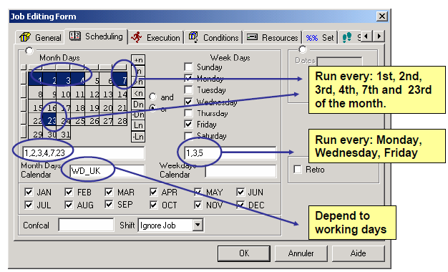
When : Selecting a Date

Slide 15
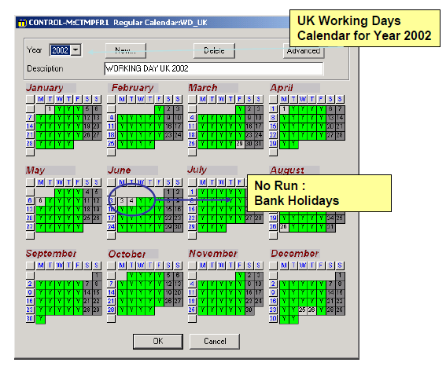
When : Calendars

Slide 16
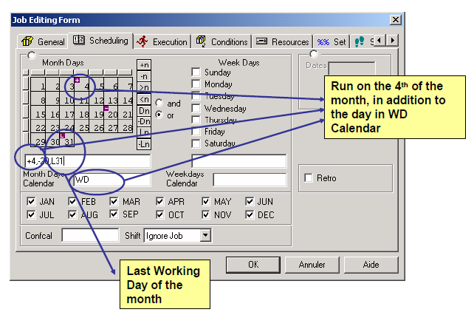
When : Complex Dates

Slide 17
What is a condition
Is a Flag sent in PREREQUISITE CONDITIONS BOX under Enterprise ControlStation
A condition depends to the ODAT (Control-M Systeme Date)
This Flag can be expected by one or several other jobs.
It is not a « goto » command

Slide 18
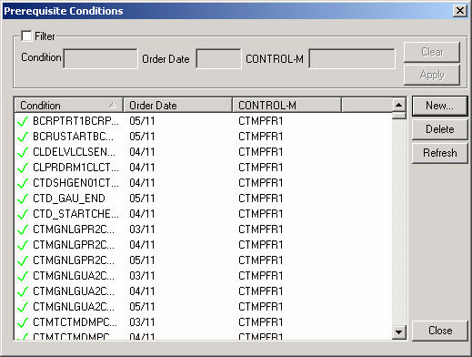
Contd…

Slide 19
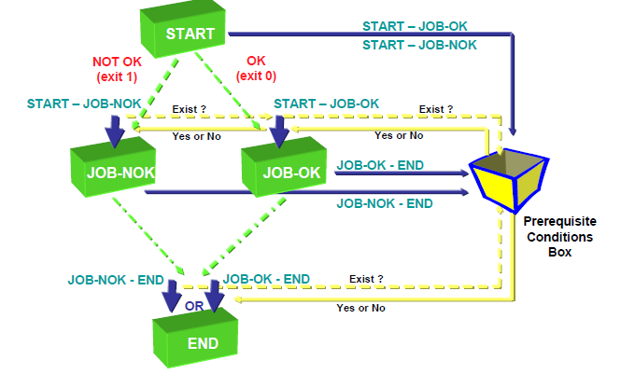
Condition Process

Slide 20
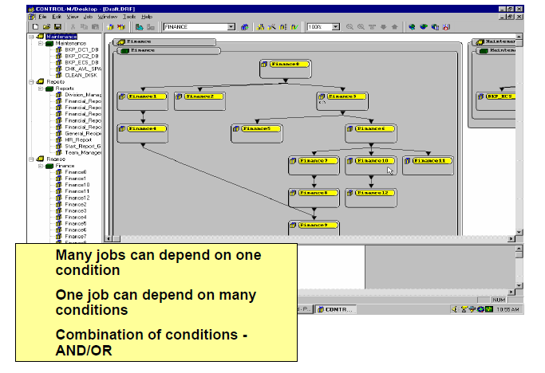
Complex Dependencies

Slide 21
Benefits
Cross-platform automation flow
No need for manual intervention
Create a Business Process View
Create a Focal Point of Control

Slide 22
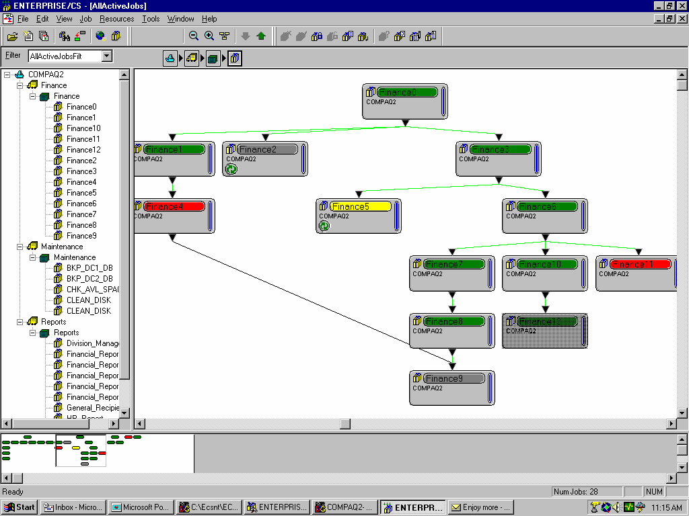
Contd…

Slide 23
Resource Requirement
Prevents resource contentions between jobs
Provides workload balancing
Eliminates contention bottlenecks

Slide 24
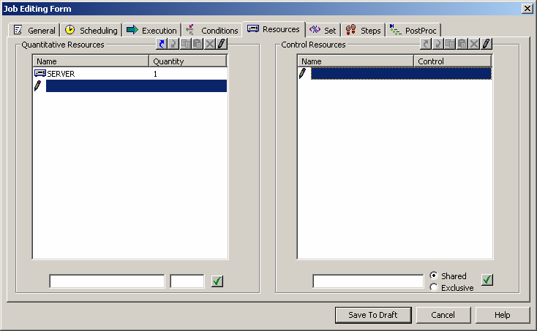
Contd…

Slide 25
Results Control
Capture Standard OUTPUT in Sysout
Sysout contain and Error Code will be tested
Shout Message can be sent to User Mail, Distribution
List, Console ...
Rerun Facility
Runs same job « n » times
Runs another job
Stop a Cyclic Job
Results Control
Sysout contain and Error Code will be tested

Slide 26
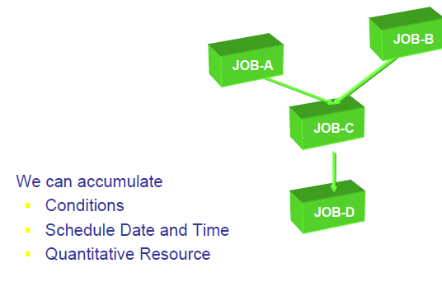
Dynamic Scheduling

Slide 27
Schedule PLAN
To be executed, a job should be up to plan.
A plan is a period of 24 hours
The plan begins at 7:00 AM (for that example)
The plan stops at 6h59 AM the following day
The Control-M System Date isn’t a System Date

Slide 28
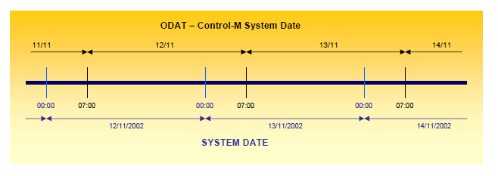
Contd…

Slide 29
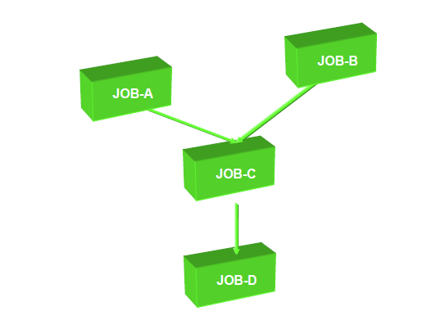
Dynamic Scheduling

Slide 30
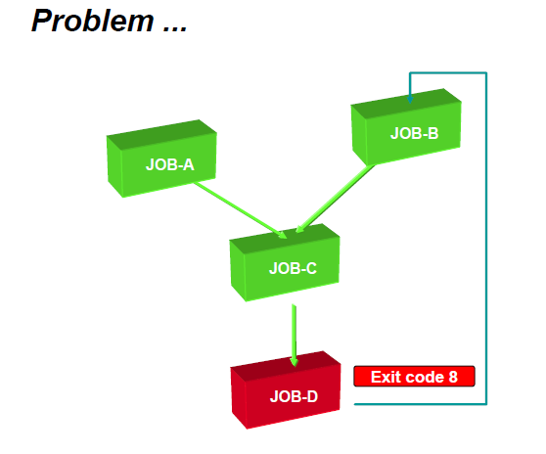
Problem

Slide 31
Other Problems

Slide 32
Many Problems

Slide 33
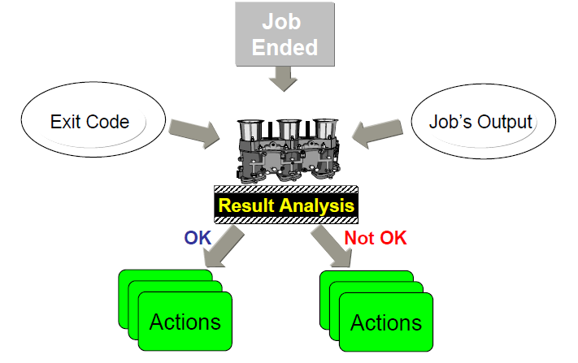
Error Recovery Process

Slide 34
Results Analysis
CONTROL-M is capable of detecting errors and react
to them dynamically
Analyze contents of the Job Log
Match Line of statement with statement ouput and
errors (contain of sysout)
Actions :
Set completion status to Ok or NOTOK
Set a parameter value (counter)
Create or delete a condition
Force a job to run
Notify a user or console message
Rerun the job
Stop Cyclic

Slide 35
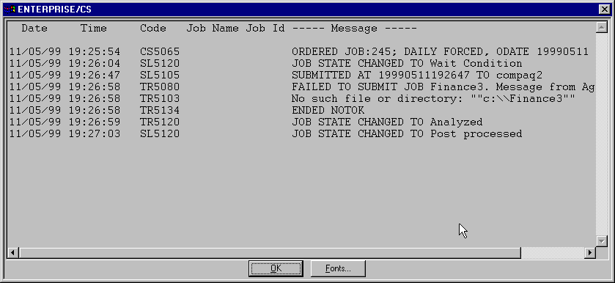
Logs

Slide 36
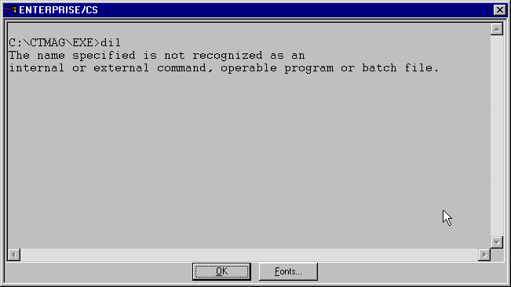
Job Sysout

Slide 37
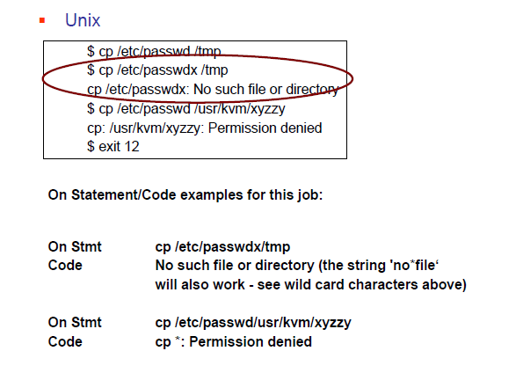
Analysis on UNIX

Slide 38
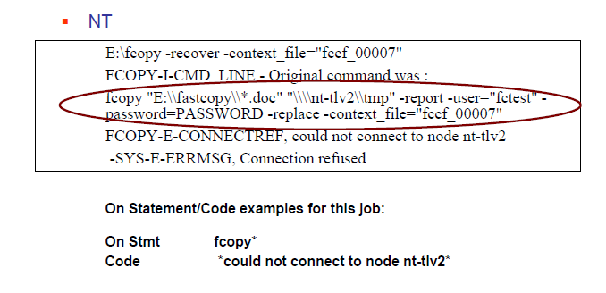
Result Analysis - NT/2000

Slide 39
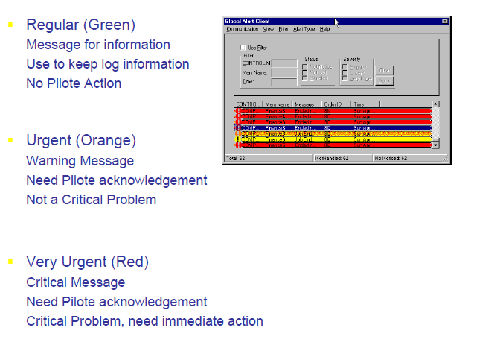
Error messages

Slide 40
What do we need
For the Control-M Diagram
A Organization Chart of the treatments
An Application Architecture Diagram
For Each Job Definitions
Command Line or Executable
User Login
Scheduling Criteria (Date, Time, Calendar...)
Error code and Error Message Received and To be
Sent
Actions List, Order for each error

Slide 41
Thank You
www.srinimf.com

