Slide 1
CONTROL-M TRAINING
Training / courses
March 2016
Benjamin LISAN

Slide 2
Thanks to :
Vinil Gopalkrishnan
www.srinimf.com

Slide 3
Introducing CONTROL-M
CONTROL-M is an interoperable solution for the integration of production control from a focal point of management across diverse environments
Challenges
. Managing the enterprise vs. Platforms
. Controlling the Business Process
. Alert reactivity

Slide 4
Logging In
To start the CONTROL-M/EM GUI:
1. Double-click the CONTROL-M/EM GUI icon on the Microsoft Windows desktop.
CONTROL-M Enterprise Manager GUI
-or
Choose Shift => Programs => CONTROL-M/Enterprise Manager 6.1.00 => CONTROL-M/Enterprise Manager GUI.
The following dialog box is displayed when the CONTROL-M/EM GUI is started:

Slide 5
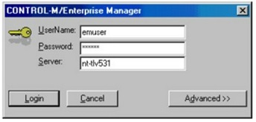
Logging In
Specify your Username and Password. The name of the default CONTROL-M/EM GUI Server is automatically displayed in the Server text box.

Slide 6
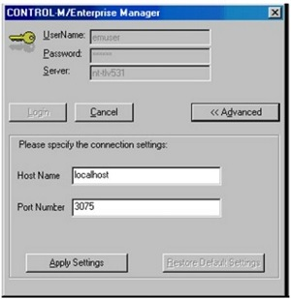
Enter your username and your password. The name of the default GUI Server is displayed in the Server text box.
Enter a different GUI Server into the Server text box. If required.

Slide 7
Control-M / EM Windows

Slide 8
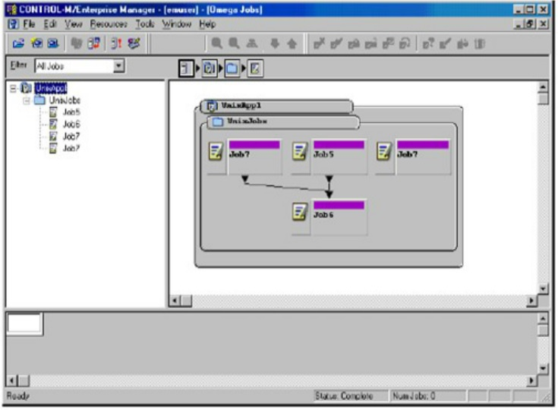
The CONTROL-M Enterprise Manager window is used to view and access jobs in the active environment.

Slide 9
The CONTROL-M Enterprise Manager window consists of the following parts:
• Navigation Tree — Hierarchical view of jobs in the current environment.
• Flow Diagram — Graphic representation of job production flow, based on job dependencies established by prerequisite conditions specified in job processing definitions. Components of the active environment are represented by boxes called nodes. The information displayed in a node varies depending on the type of node and on how certain customization options.
• Net Overview — Miniature version of the flow diagram, indicating the part of the network currently displayed in the Flow Diagram view. By dragging the selected area in this view to a different part of the network, you can quickly navigate in a complex environment.

Slide 10
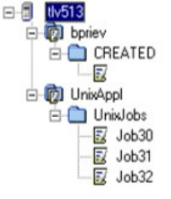
Navigation Tree
The left part of the CONTROL-M Enterprise Manager window displays a tree representing the nodes in the current ViewPoint. This tree (called the Navigation tree) can be used to navigate quickly through the active environment.
The following operations can be performed using the Navigation tree:
Hide or display sets of nodes in the tree (e.g.. groups in an application, jobs in a group). This makes viewing selected nodes in the Navigation Tree easier.
Click on a node in the tree, to select it simultaneously in the Navigation tree. the Flow Diagram view and the Net Overview.
Displaying/Hiding Nodes
Each node in the Navigation tree that contains lower-level nodes is referred to as a high-level node. For example, a CONTROL-M, an application or a group is represented by a high-level node.
Initially, the Navigation Tree is displayed with only the highest level nodes visible (for example, CONTROL-M installations). Each high-level node has a + or - next to it. You can expand or collapse the tree by either clicking the + and -, or by double-clicking the node names.

Slide 11
Flow Diagram
The Flow Diagram view displays job production flow in a graphic format. The job flow displayed reflects job dependencies. Job dependencies are established by prerequisite IN and OUT conditions in job processing definitions.
The nodes displayed in the Flow Diagram view are easily identified. Each node is displayed with its name at the top of the node. Additional information about the node is provided in a graphical manner, such as pictures, icons, shapes, and color. Conditions and resources that affect nodes on any particular level can also be viewed in the Flow Diagram view.
High-Level Node Types
All the types of nodes are represented by unique icons in the upper left : corner of the node.
Node Type | Symbol
CONTROL-M
Disconnected CONTROL-M
Application
Group
Group Scheduling table

Slide 12
Job Node Types
Job nodes are represented by an icon in the upper left-hand corner of the node as shown below. Additional icons and text appear in the job node.
Job type | Sample node
Regular job
Cycle job
Job status
The status of a job is indicated by the color of its node's title bar.

Slide 13
Status | Color | Meaning
Wait Condition | Gray | Waiting for the specified date, time, or prerequisite conditions. Note: Jobs with this status may have any of the following statuses in CONTROL-M/Server: CYCLIC WAITTIME WAIT_ODAT POST_ODAT
Ended OK | Green | Processing finished successfully
Executing | Yellow | Executing.
Wait Resource | Blue | Waiting for Control or Quantitative resources, or waiting for a CONTROL-M/Agent to be available.
Wait User | Pink | Waiting for user confirmation Note: Jobs with this status are assigned WAITCONFIRM status in CONTROL-M/Server.
Ended Not OK | Red | Processing finished unsuccessfully For example: The Agent platform on which the job was running was changed to Disabled by a user
Unknown | White | Communication with the Agent platform was interrupted

Slide 14
Job Note Operational Status and State
A job node is displayed with the title bar colored according to its status. In addition to the node status, each job node is assigned a state that provides more information about the node, as indicated in the following table :
State | Description | Node Appearance
Free | Default state. The job is not Held or Deleted
Held | The Job is held by an CONTROL-M/EM user
Deleted | The job was deleted by an CONTROL-M/EM user.

Slide 15
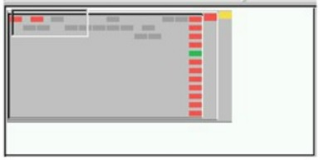
Net Overview
The bottom pane of the “CONTROL-M Enterprise Manager ViewPoint” window contains a graphical overview of die current displayed ViewPoint. It is displayed on a miniature scale and provides an overview of what is displayed in the “Flow Diagram” view. The part of the “Net Overview” window that is enclosed in a rectangle is displayed in the “Flow Diagram” in the pane above. The “Net Overview” allows you to navigate more easily in the current environment.
When there are too many codes in the current level to be displayed in the “Net Overview” pane, only a part of the current level is displayed. “Net Overview” contains a scroll bar at the bottom and side of the panel that allows you to view other parts of the current display level.

Slide 16
Control-M Architecture

Slide 17
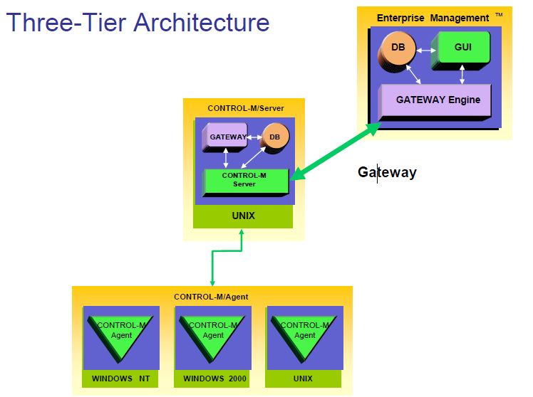

Slide 18
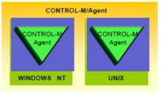
Control-M Agent
• Run under Windows NT/2000 , Unix, etc ...
• Submit, monitor, control and manage jobs
• Receive order from Control-M Server
• Send result to Control-M Server

Slide 19
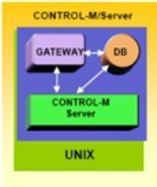
Control-M Server
• It’s the engine of Control-M
• Contain all job definitions
• Contain all calendars
• Activate and Control the « up to plan »

Slide 20
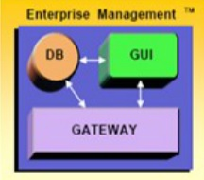
Enterprise manager
• Focal point of control
• Standard GUI for all the Production platforms
• Responsible for cross-platform dependencies
• Give graphic tools to develop jobs

Slide 21
A typical job execution proceeds as follows:
1. A job waiting to be submitted "waits" on the server computer.
2. When all its prerequisite conditions, resource requirements, and all other scheduling constraints are satisfied, CONTROL-M/Server instructs CONTROL-M/Agent to submit the job.
3. Upon receiving a request to submit the job, CONTROL-M/Agent submits the job for execution according to the job definition. CONTROL-M/Agent can connect to a remote host and can perform requests and actions on that remote host.
4. CONTROL-M/Agent monitors the job and reports any exceptional situation to CONTROL-M/Server.
5. Upon completion of the job, CONTROL-M/Agent and CONTROL-M/Server perform the post-processing analysis.

Slide 22
Job definitions

Slide 23
Control-M jobs definition
. What ?
. Where ?
. Who ?
. When ?
. Flow control ?
. Resource requirements
. Results control

Slide 24
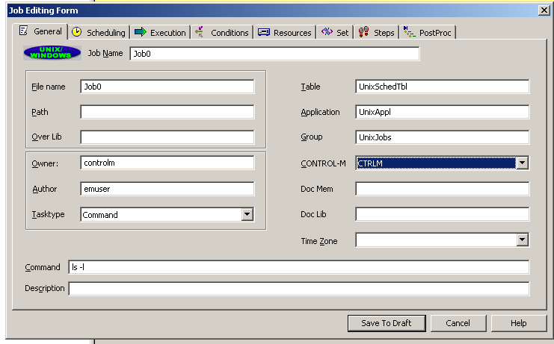
What do we schedule
Unix shell scripts
/export/home.hipfeed/interfaces/scripts/ft_process.pl
NT Batch file (.bat, .cmd)
d:\prod\Ctm\Copy_Logs\del_logs.cmd
Executable
Operators commands
Execute command
ls -l

Slide 25
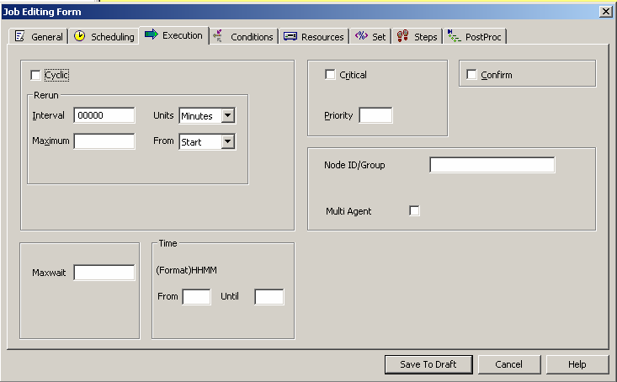
Where do we run
. Which server do we use
. Does it have a Control-M agent
. It is a production or a Uat agent

Slide 26
Who can execute it
Which user login is needed to run the job
Does the user login have access right to run the job.

Slide 27
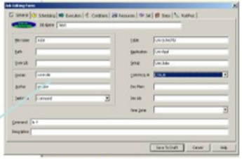
Who can execute it ?
Which user login is needed to run the job.
Does the user login have access right to run the job.

Slide 28
When : Date & time Scheduling Criteria
• Specific days of the month/week/period
• Automatic holiday processing
• The nth workday
• The nth last workday
• Time window
• Job can be executed in several times in cyclic mode with personnal interval

Slide 29
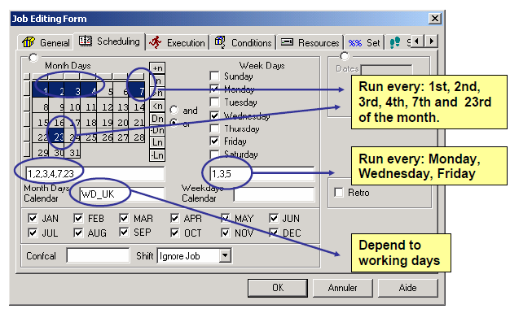
When : Calendars

Slide 30
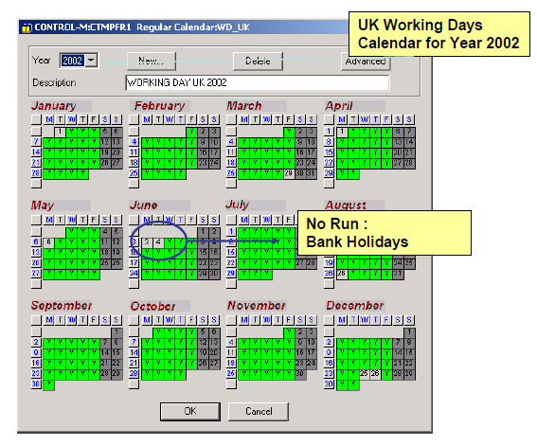
When : Calendars

Slide 31
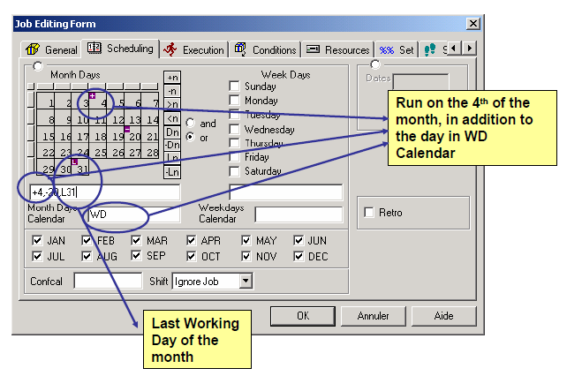
When : Complex dates

Slide 32
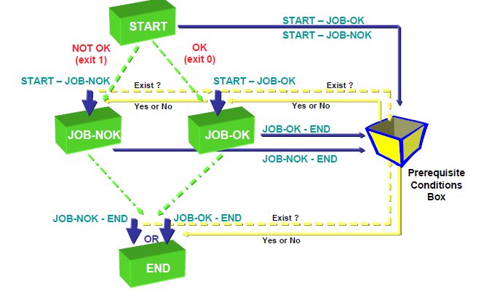
What is a condition

Slide 33
Complex dependencies
Many jobs can depend on one condition
One job can depend on many conditions
Combination of conditions AND/OR

Slide 34
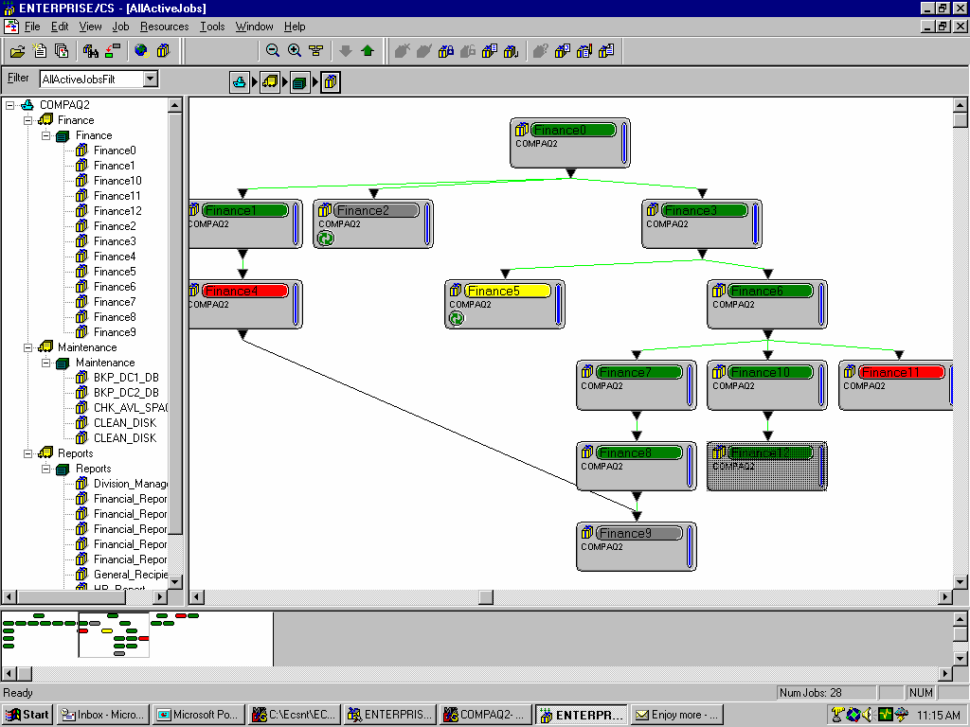
Benefits
Cross-platform automation flow
No need for manual intervention
Create a Business Process View
Create a Focal Point of Control

Slide 35
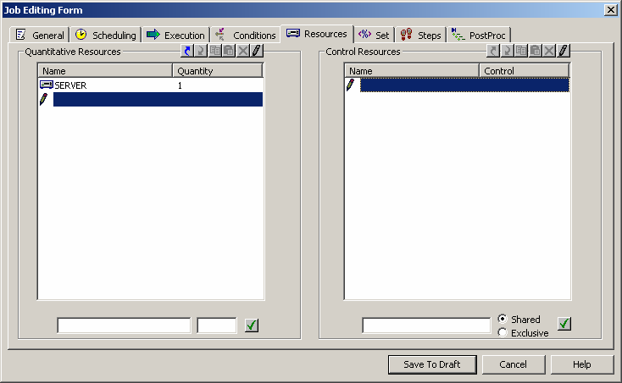
Resource Requirement
Prevents resource contentions between jobs
Provides workload balancing
Eliminates contention bottlenecks

Slide 36
Results Control
Capture Standard OUTPUT in Sysout
Sysout contain and Error Code will be tested
Shout Message can be sent to User Mail, Distribution
List, Console ...
Rerun Facility
Runs same job « n » times
Runs another job
Stop a Cyclic Job
Results Control
Sysout contain and Error Code will be tested

Slide 37
Job process

Slide 38
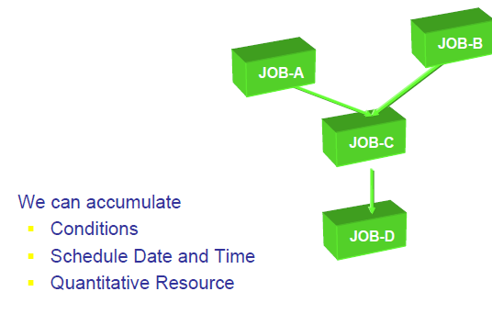
Dynamic Scheduling
We can accumulate
Conditions
Schedule Date and Time
Quantitative Resource

Slide 39
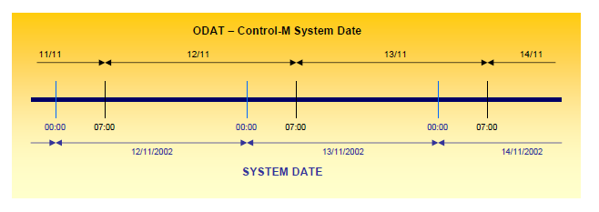
Schedule PLAN
To be executed, a job should be up to plan.
A plan is a period of 24 hours
The plan begins at 7:00 AM (for that example)
The plan stops at 6h59 AM the following day
The Control-M System Date isn’t a System Date

Slide 40
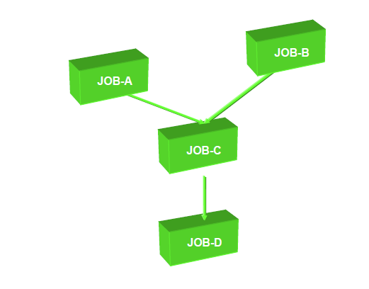
Dynamic Scheduling
If all goes well ..

Slide 41
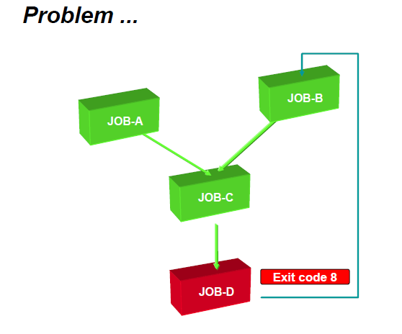
Problem
Dynamic Scheduling

Slide 42
Other problems
Dynamic Scheduling

Slide 43
Dynamic Scheduling
Many problems

Slide 44
Result Analysis

Slide 45
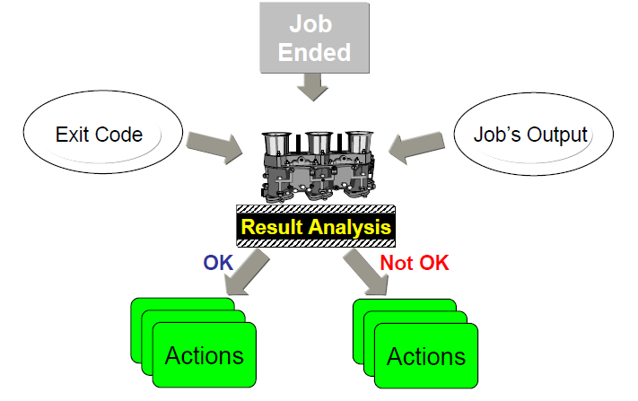
Error Recovery Process

Slide 46
Results Analysis
CONTROL-M is capable of detecting errors and react to them dynamically
Analyze contents of the Job Log
Match Line of statement with statement ouput and errors (contain of sysout)
Actions :
Set completion status to Ok or NOTOK
Set a parameter value (counter)
Create or delete a condition
Force a job to run
Notify a user or console message
Rerun the job
Stop Cyclic

Slide 47
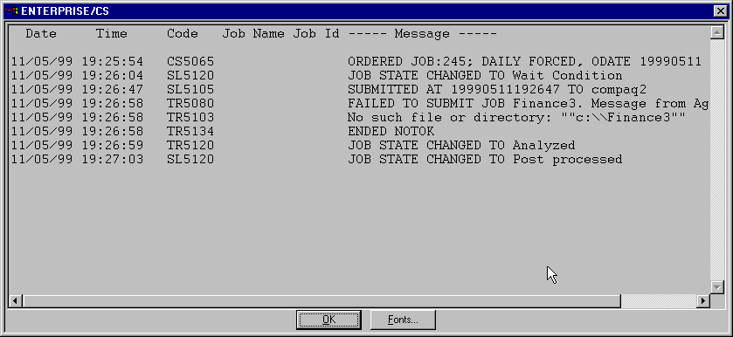
Result Analysis - Control-M logs

Slide 48
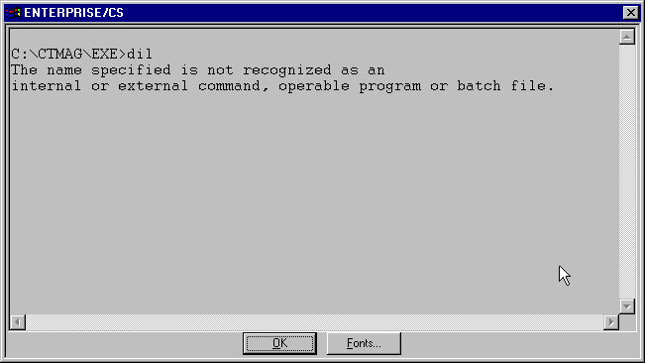
Result Analysis - Control-M SYSOUT

Slide 49
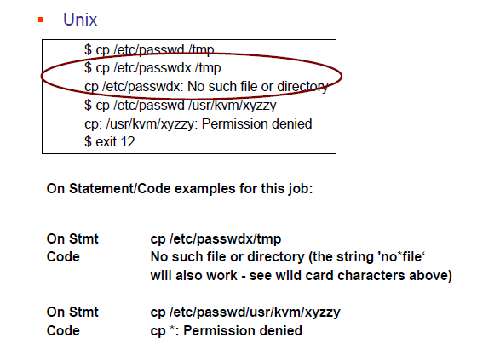
Unix Analysis

Slide 50
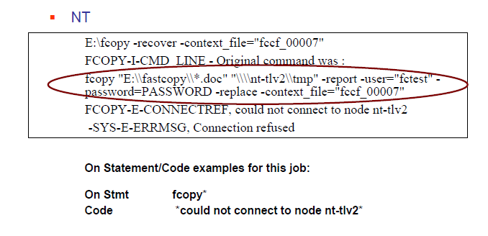
Result Analysis - NT/2000

Slide 51
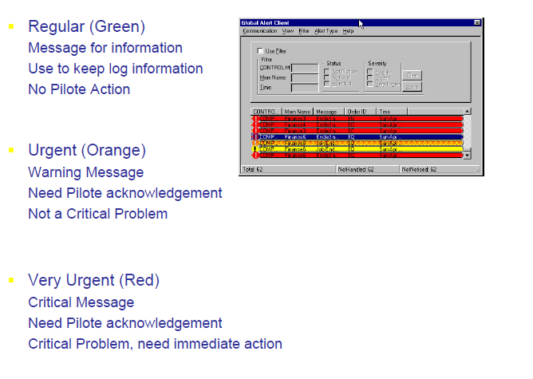
Error messages

