Slide 1


BMC Control-M: Secret Weapons for a Successful Transformation
Qiang Ding (VPMA Group | GSS Infotech)
Senior Consultant | 16 Oct 2014

Slide 2









A Typical IT Landscape in the Banking Industry
Overdrafts
Commercial Lending
Finance
HR
Deposit and
Withdraw
Consumer Lending
POS
ATM
AML
3rd Party
Data Exchange
Foreign Exchange
Bills and collections
Insurance
Securities Trading
Call Center
Branch
CRM
GL
Wealth Management
Money Markets
Online Banking
Syndication
Payment
Risk Engine
Online Banking
Mobile Banking
Customer Relationship
Bonds
DW/BI
Imaging
Trade Finance
Derivatives
FOREX
Third Party
Information Flow

Slide 3
Paradigm Shift #1
Mergers and Acquisitions

Slide 4
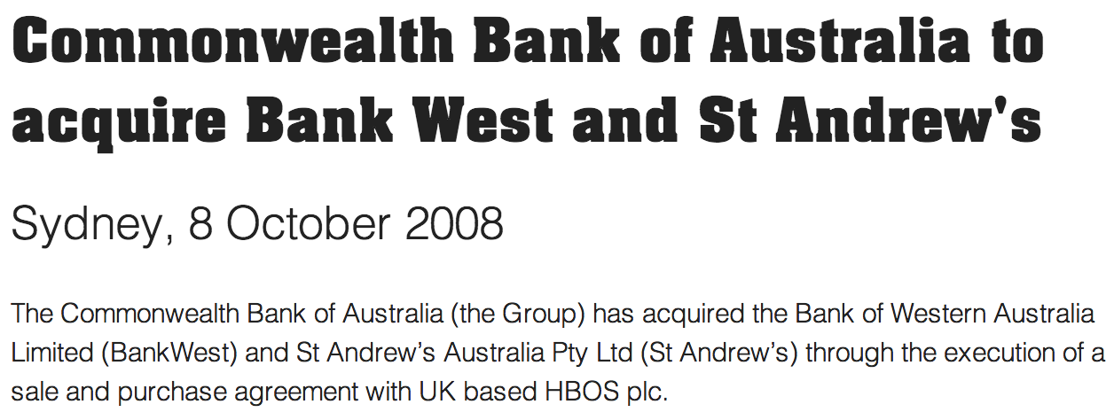
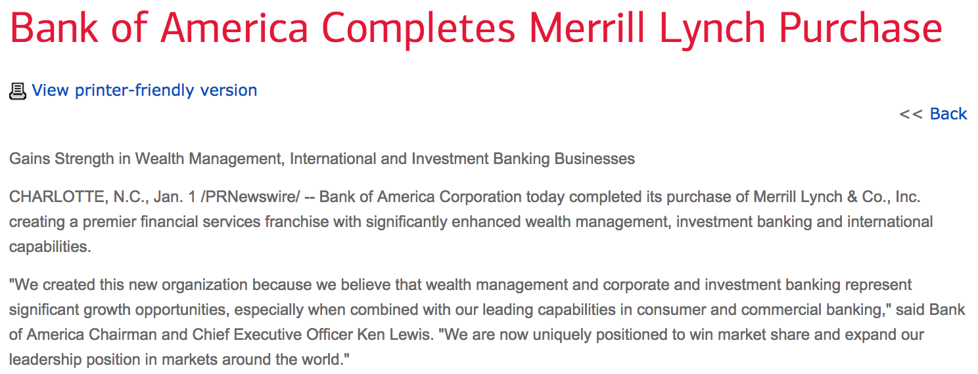



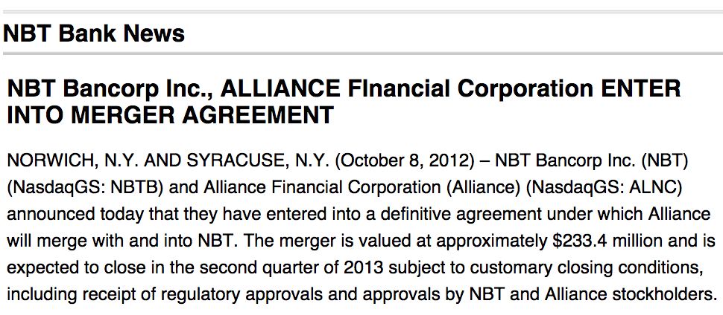
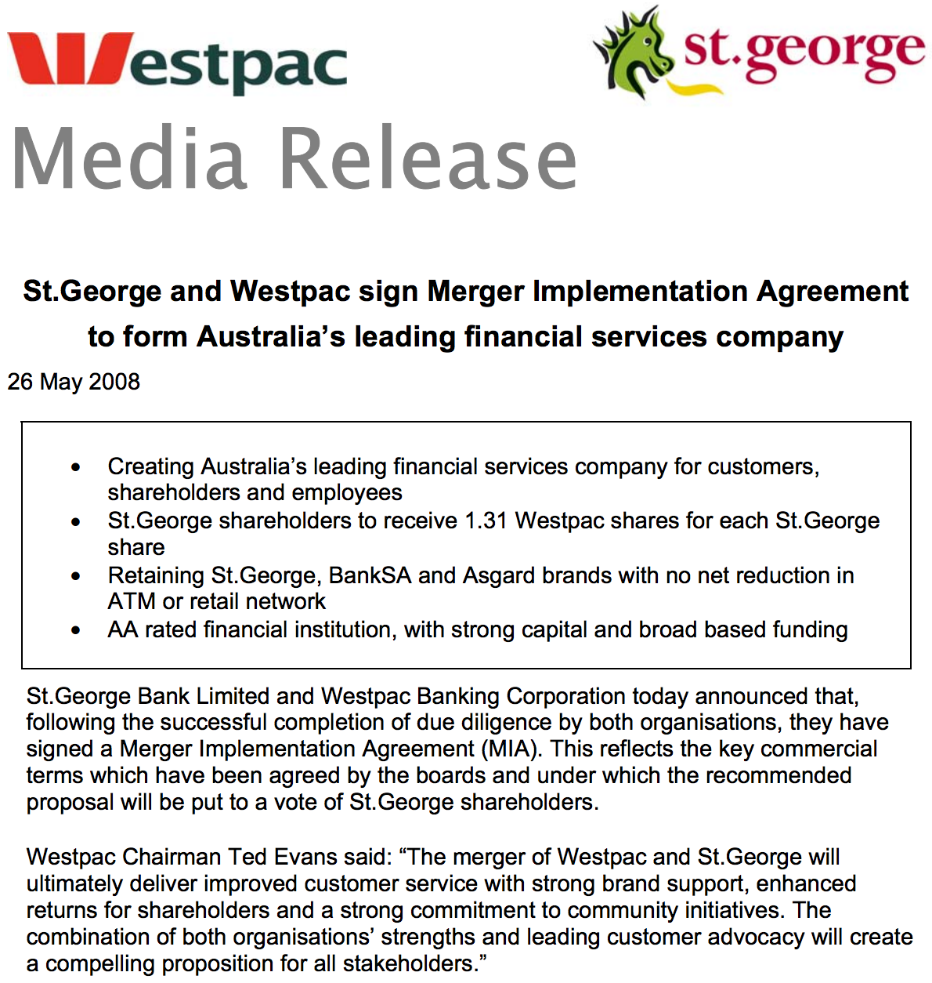
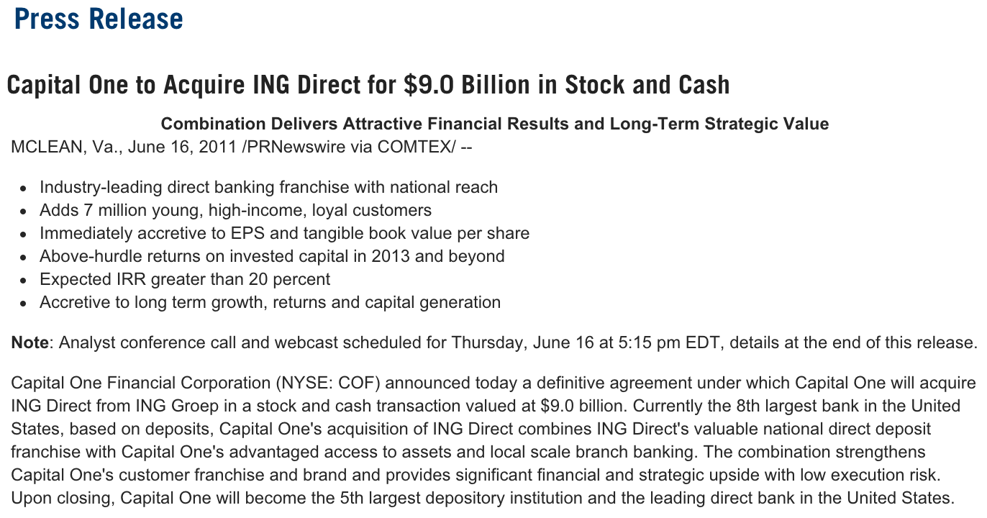


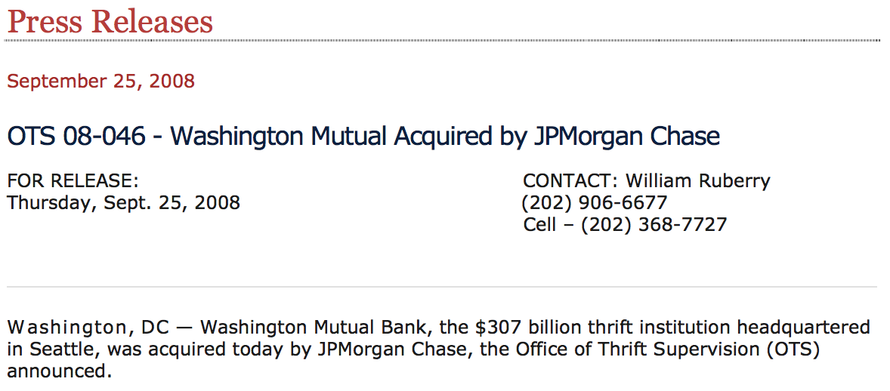

Recent Acquisitions in the Banking Industry

Slide 5


Why do banks merge?
To increase revenues and market share
To diversify product and service offerings
To obtain a foothold in a foreign market
To cut costs and increase their profitability
To provide better ROI for share holders

Slide 6
Paradigm Shift #2
Platform consolidation and modernization

Slide 7
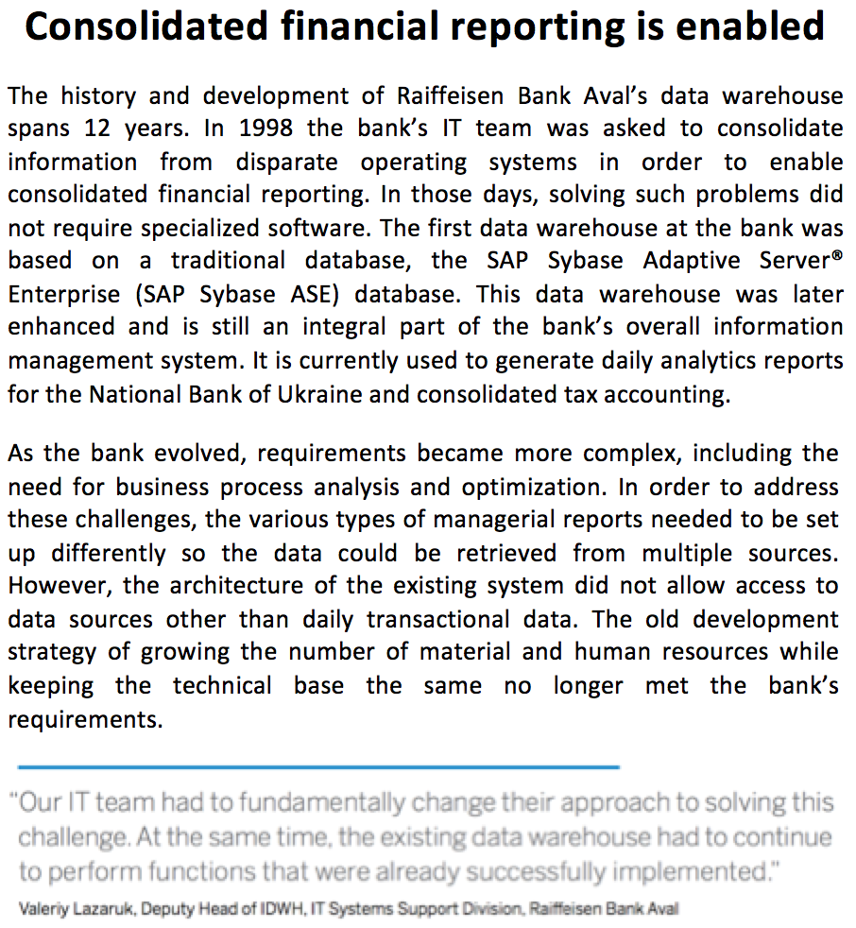

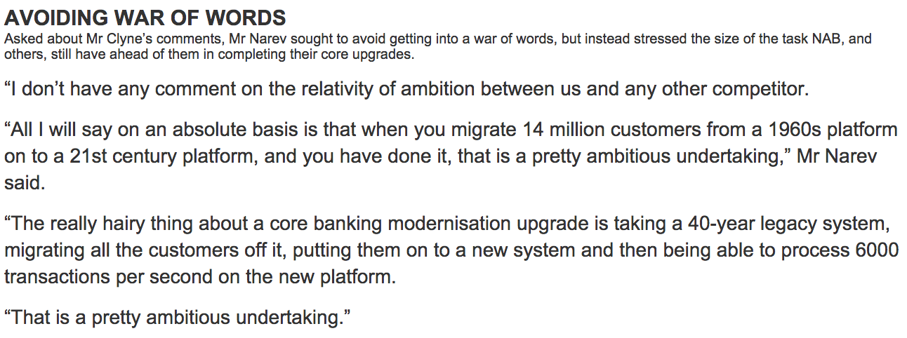
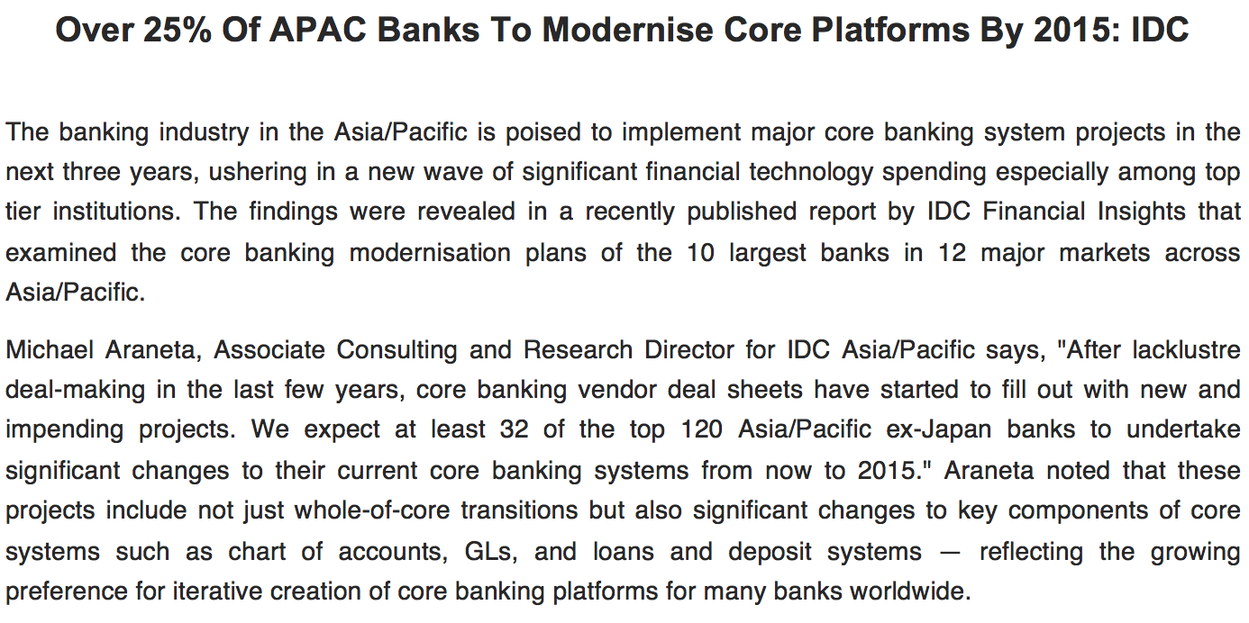



Platform consolidation and modernization
Core Banking platform modernization
Enterprise
data consolidation
Notes:
IDC - http://firstbiz.firstpost.com/biztech/over-25-of-apac-banks-to-modernise-core-platforms-by-2015-idc-14674.html
CBA - http://www.afr.com/p/technology/technology_prowess_front_and_centre_OJqpjo46HvnR9lNnbmMkIN
SAP - http://www.sdn.sap.com/irj/scn/go/portal/prtroot/docs/library/uuid/201c69e6-5250-3010-329b-d35838970e10?QuickLink=index&overridelayout=true&57973468620306

Slide 8
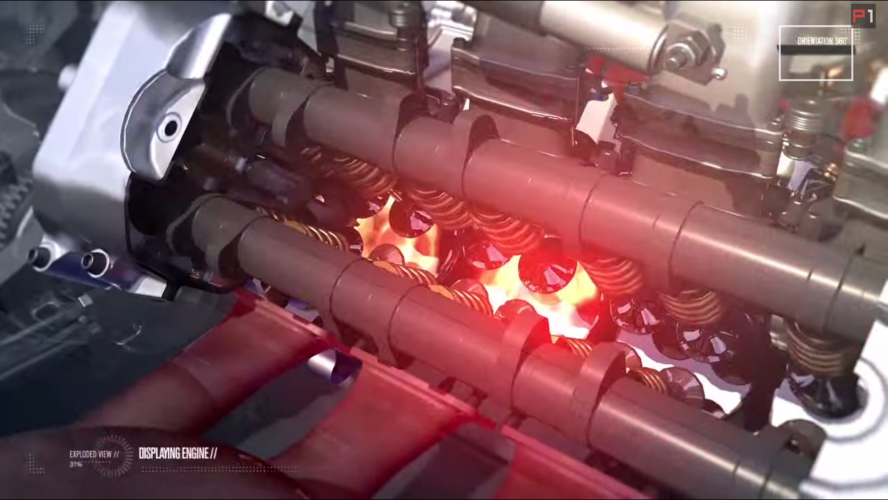
Initiatives
Risk mitigation for aging systems
Simplify processes and product offerings
Raise service standards – e.g. same day transaction
Enhance online and mobile banking support
Handle transaction spikes

Slide 9
What does it mean to us?
You name it!

Slide 10
Completed foundations for core modernization
Upgrade Bank B to the latest version of Hogan (Celeriti)
Consolidate Bank A onto single core platform
Bank A
Channels
Bank B
Channels
Bank A
Channels
Bank B
Channels
Bank A
Channels
(New)
Bank B
Channels
Systems Access Layer
System Access Layer
Systems Access Layer
Systems Access Layer
Trading Bank
Hogan
Trading Bank
New Hogan (Celeriti)
New Hogan (Celeriti)
2009 - 2013
2013 - 2015
2015 - 2017
People and process changes
System integrations between the old and new
Platform consolidations – one will take over another
A case study

Slide 11

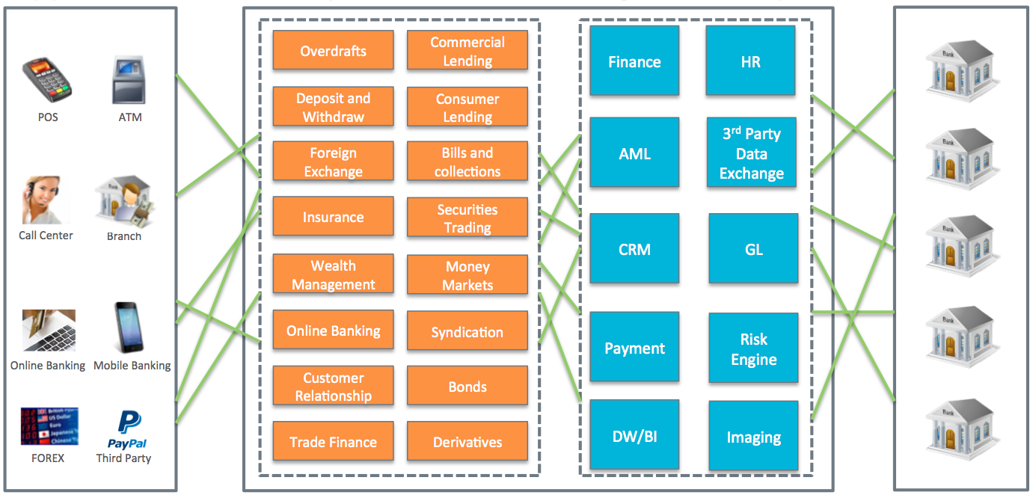

Why is it difficult to transform?
Complex
Inflexible
Unable to scale
CRON jobs
Windows Tasks
Other scheduling tools
Insecure file transfers
Non-compliance
Homegrown methods
24/7 non-stop
“The process of transforming or replacing key banking applications presents co-challenges that are at odds with each other - like trying to perform an engine replacement during F1 racing.” - Scott Simmons, Executive IT Architect, EMC
Notes:
Quotes: http://www.ibm.com/developerworks/cn/websphere/techjournal/0809_col_simmons/0809_col_simmons.html

Slide 12


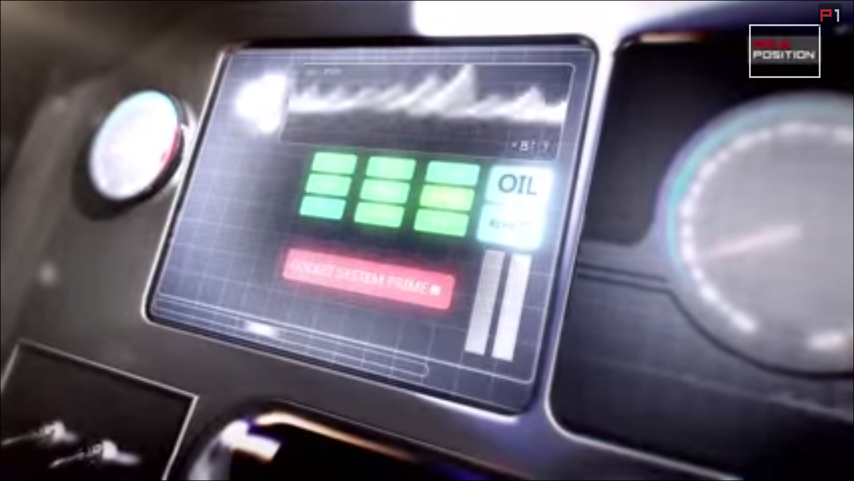
What does it mean to us?
Operational Changes
Ultimately becomes…
Less resources, more work
Learning new toolsets in a limited time frame
Job uncertainty
System outages
Missed SLAs
Poor customer experience
Staff goes on stress leave

Slide 13
How to Overcome the Challenges?
Bring out the secret Weapons!
Notes:
Once you know the WHY, the HOW is easy.
Questions have changed!
Old: Can you trigger jobs on machine abc?
New: Do you have a solution for xyz?

Slide 14
Use Case #1: Core Banking Processing
SOD Batch
File Watch job
Allows complex file watching rules
File Transfer job
Powerful pre and post commands
Restart from point of failure
SAP ABAP job
APAB/4 program: Module Pools or Reports (can also be used to modify data)
Running external command or program
Supports load balancing (job submission via SAP messaging server)
Job interception, event watcher and extractor functions (XBP 2.0)
Temporary variants, event history and interception profiles (XPB 3.0)
SAP BW job
Info Package and Process Chain
Restart from point of failure
Web Service job
Notifying external systems to trigger down flow processing
File Watch
Other Banks
AFT Job
Intraday processing
SAP Job #1
SAP Job #2
Web Service
SAP BW Job
EOD Batch
Notes:
We have automated the core banking batch, but that’s not the end of the story.
Mirror image of SAP jobs
Control-M creates a mirror image of the jobs
Control-M can cancel the job in SAP
At the job’s completion, output is sent to Control-M
The mirror image can trigger post processing
What is Variant?
A set of pre-defined user-defined parameter values for SAP reports and transactions
A temporary variant is created for the job and deleted once the job has finished

Slide 15
Use Case #2: Business Intelligence
Data Mart
Analysis
ODS
ETL
Reporting
User Requirements
Report output layout
Report output file format (PDF, CSV, Word etc.)
Bursting reports (Cognos & Oracle BI)
Export destination (file system, email, FTP etc.)
Sending notifications
Data mining
Each holds only one subject area
Integrating information from a set of source systems
Analysis
ODS
EDW
Control-M
for SAP
Business Objects
ETL
Reporting
Control-M
for IBM Cognos
Control-M
for Oracle BI
Holds multiple subject areas
Holds very detailed information
Works to integrate all data sources
Data mining
Notes:
We have automated the core banking batch, but that’s not the end of the story.
Data mart is single-subject focus, identify a subset of clean data from a single source
IBM Cognos: Burst a report to distribute its contents to various recipients. Bursting is the process of running a report once and then dividing the results for recipients who each view a subset of the data.
Control-M for IBM Cognos
Bursting Reports (e.g. reports for 500+ branches)
Save reports to Cognos Server (content store) or file system
Use down flow jobs to rename and/or transfer the report files
Control-M for Oracle Business Intelligence
Run “Agent (iBot in 10g)” jobs jobs to deliver targeted analytics to users
Define output layout, format and report calendar
Delivery output to email or FTP (in-built feature) or bursting report
Control-M for SAP Business Objects
Define output format
Define output destinations

Slide 16
Use Case #3: Enterprise Data Consolidation
Department A
Department B
Department A
Department B
GL
DW
SAS
Excel
GL
DW
SAS
Excel
Frontend Targets and Reporting Tools
Frontend Targets and Reporting Tools
Risk
AML
Cognos
Access
Risk
AML
Cognos
Access
Data Hub
CIS
Core Banking
Term deposits
Merchants
Loans
Mortgage
Back End Data Sources
CIS
Core Banking
Term deposits
Merchants
Loans
Mortgage
Back End Data Sources
Quick Fixes accumulated over time
Assorted scheduling methods
Homegrown file transfer scripts
Data standardization
Data processed and cleansed once for multiple target systems
Centralized scheduling platform
Uniformed file transfer mechanism

Slide 17
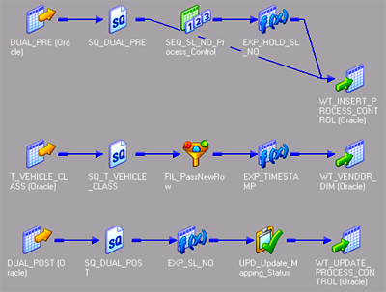
Use Case #3: Data Hub Part I – Data Acquisition
External Source
(File)
External
Source
(DB)
Cycle EXT1923819
Cycle CIS1923819
Data Acquisition
Acquires (pulls) source data from the Producer
  Source database (e.g. Oracle, MSSQL)
  Flat files (e.g. z/OS datasets, Windows files, UNIX files)
Source data is staged within staging database tables
During staging
  Data validations
  Data transformations
  New data derivations
Data transfer methods
  Secure tunnel using SSH for Databases
  SSL (ftps), SSH (sftp, scp) and other file transfer methods for flat files
File Watch
Processing
File Transfer
Table Clean
Processing
Direct DB extraction
Table Clean
File Clean
Incoming File Processing
Process Flow in ETL tool

Slide 18
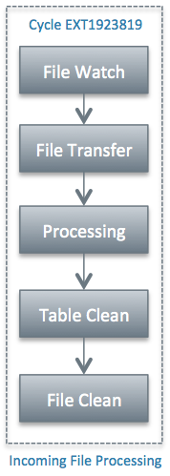


Use Case #3: Data Hub Part II – Data Publication
Data Acquisition
Data Publication
Announces the availability of data for consumption (dummy job)
Data is available via a Standard Data Interface for consumers to pull
Dummy
Notifying downstream
Batch (data consumers)
AML
Batch
GL
Batch
CRM
Batch
Data Consumers

Slide 19
Use Case #3: Data Hub Part III – Data Delivery
Data Acquisition
Data Delivery
Physically delivers (pushes) data to consumers using the SDI
Data delivering methods:
  Directly to a database (e.g. Oracle, MSSQL)
  Via files (e.g. z/OS datasets, Windows files, UNIX files)
Provide data transformations and new data derivations depending on:
  Business requirements
  Design considerations such as performance and degree of re-use
Data transfer methods
  Secure tunnel using SSH for Databases
  SSL (ftps), SSH (sftp, scp) and other file transfer methods for flat files
DB Export
DB Write
Data Delivery
Direct Target DB Load
Data Delivery
File Transfer
Down Flow Batch
File Clean
DB to File Processing
Down Flow Batch
Notes:
The Data Delivery component is an optional service provided to those Consumers who cannot or do not wish to pull data out of SDI.

Slide 20
Use Case #3: EDI – Batch Processing
Consumer ETL Application
Data Acquisition
Data Publication
Data Delivery
Producer Database
Load Source Data
Data Staging
Extract staged data
Extract SDI data
Consumer
Database
Check source data
Transform staged data
Transform SDI data
Derive new data
Derive new data
Derive new data
Producer
File
Data Landing Inbound File
Data Landing Inbound File
Consumer
File
Access
Discover
Cleanse
Integrate
Deliver
Data Producers
Other Testing Phases
Data Acquisition, Data Publication and Data Delivery phases are implemented as individual sets of batch jobs
Fixed job schedules (e.g. intraday, daily, weekly, monthly, quarterly or yearly basis) and for a fixed number of executions
Ad-hoc or on-demand job schedules (e.g. intraday, daily, weekly, monthly, quarterly or yearly basis) but for a variable number of executions
Notes:
Time delay between each intraday run of an EIG job is constrained by the volume of data involved. The larger the volume of data, the larger the time delay between each intraday run of the EIG job.

Slide 21
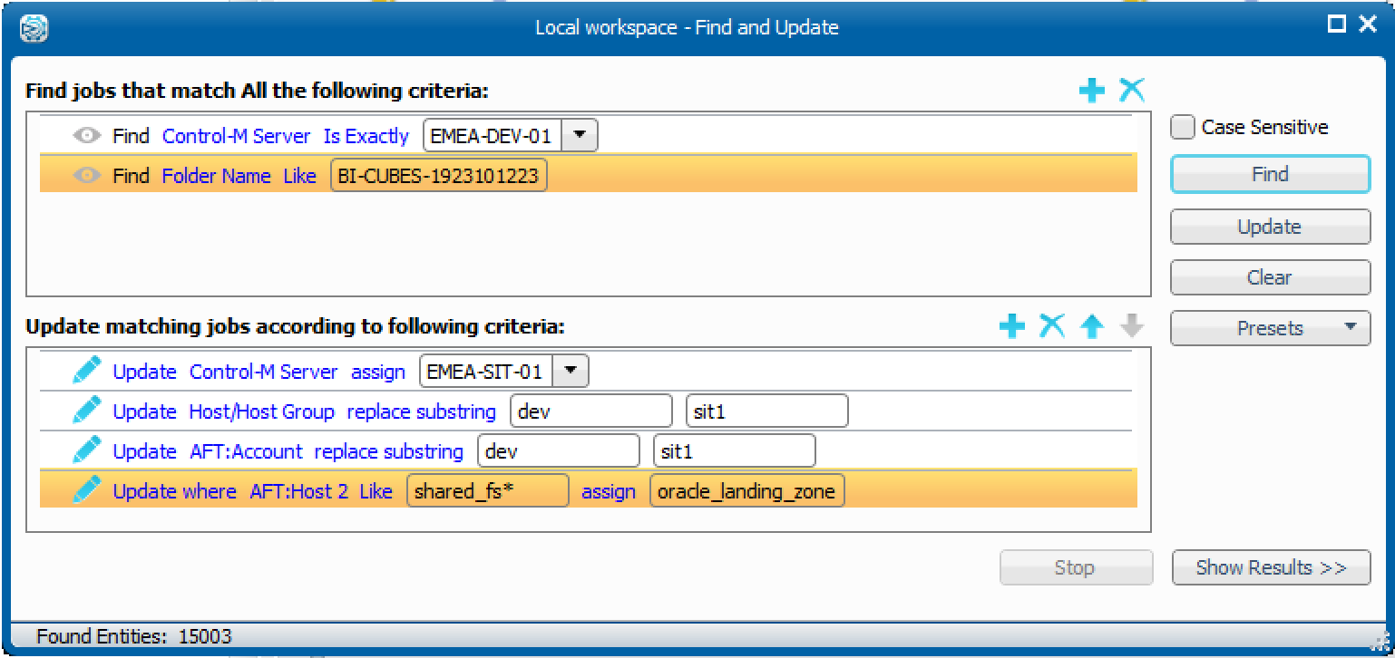
Use Case #4: System Integration Testing
APP A
APP A
Production
SIT 1
SIT 2
SIT 3
SIT 4
SIT 5
APP B
APP B
APP C
APP C
APP D
APP D
APP E
APP E
APP F
APP F
Other Testing Phases
Other Testing Phases
Challenges
Coordinating among offshore testing teams and different vendors
Working with on-demand infrastructure and SaaS
Dealing with multiple environments with different machine names and file paths
System specific skill requirements
Extremely short testing cycles

Slide 22

Supercharged!
Applications go-live faster
Shorter testing cycles
Problems are identified and resolved quicker
Able to handle peak transaction periods
Improve customer satisfaction
Allows the business to scale

Slide 23
Take on a Challenge!
Attack is the best form of defense

Slide 24
Identify the “Super rich” and the “middle class”
In this diagram:
32% of the jobs are owned by APP A
The other 4 applications each owns more than 10% of the jobs but less than 20%
Other applications all together own 18% of the jobs
Usually we find:
Less than 10% of Agents run more than 60% of the total jobs
More than 50% of Agents have less than 20 jobs defined

Slide 25

Three Steps
Discover major shifts in the organization
Get in early, influence the design of the “super rich”, use Control-M to address their challenges
Have the right license model, infrastructure and processes in place to handle the workload

Slide 26


GSS Infotech
15 years of BMC Control-M Experience
1,500+ BMC Control-M Deployments
Certified Control-M Consultants Nationwide
Thank You.
Steve McCormick
VP Workload Automation Solutions
T: 609-799-0969
E: Steve.McCormick@gssinfotech.com
w: www.gssinfotech.com

