Slide 1
BMC Control-M
Control your future

Slide 2
Disclaimer
Ail other trademarks, service marks and logos used in this webinar are the trademarks, service marks or logos of their respective owners.
The views expressed in this webinar are views of the speakers and do not necessarily reflect the views of Vyom Labs Pvt. Ltd.

Slide 3
Agenda
• Business Challenge
• Control-M Overview
• Control-M Architecture
• Control-M Flow
• Control-M Features
• Control-M Modules
— Advance File Transfer
— SAP
— Business Process Integration
— AIX
• Focal Point for Enterprise
• BMC Batch Impact Manager
• Result Analysis
• Control-M Forecast
• BMC Control-M Reporting Facility
• BMC Batch Incidents
• Control-M as a WLA Consolidated solution
• Questions?

Slide 4
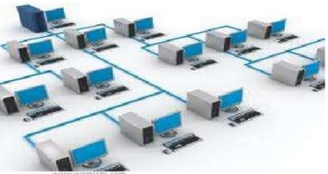
Business challenge
Most organizations have one or more job scheduling solutions that automatically submit and monitor simple batch job or script workflows. However, in many cases typical job schedulers do not handle large, modern, complex, enterprise workloads. They tend to be platform-specific and time-driven, with limited integration and poor scalability, unable to orchestrate dynamic workloads, and unconnected to business needs.

Slide 5
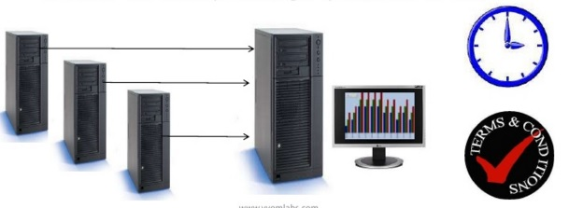
Control-M oveview
BMC Control-M helps you meet production deadlines, reduce management costs, integrate diverse platforms and applications, plan for future growth, and ensure that your IT processes can be audited - all while providing a auick time to value.

Slide 6
Key business benefits
Functionality | Your IT Benefit | Your Business Benefit
Self Service | Give Business users visibility into workloads | Reduce Costs and Deliver unprecedented service
Batch Impact Manager | Proactively evaluate impact of delays or failures | Ensure on-time completion of Batch Processes
Advance File Transfert | Integrate file transfer and batch scheduling | Ensure Data lntegrity and Minimize risk
Forecast | Predict the expected flow batch processes | Minimize disruption to critical services
Application Integration | Centralize Management and Monitoring | Increase availability and Eliminate Costs

Slide 7
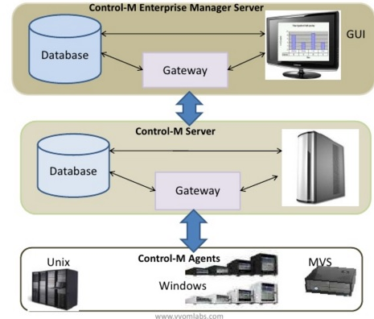
Control-M Architecture

Slide 8
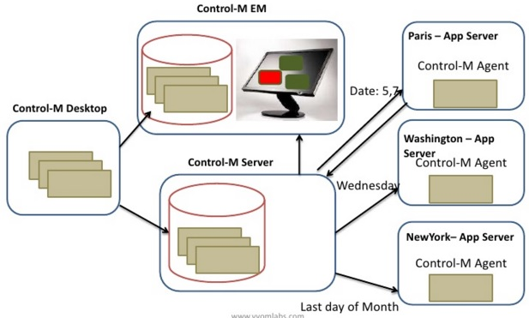
Control-M Flow

Slide 9
Control-M Features
Features | Components
Jobs | Simple jobs | Create Batch Jobs
 | Complex tasks | Monitor Jobs in Batches
Actions | Rerun the job | ECS Notification
 | Email notification | Alert to Remedy
Others features | Job forecasting | Probable Cause Analysis
 | Global Job Parameter Conditioning

Slide 10
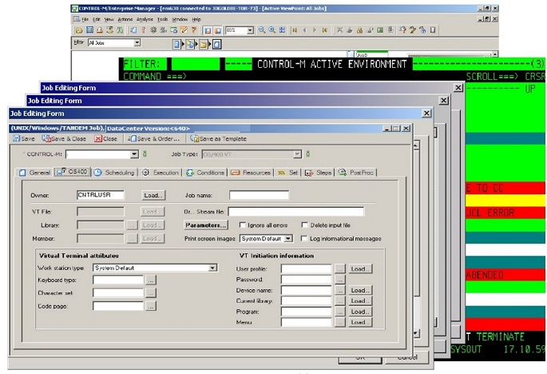
Control-M Modules

Slide 11
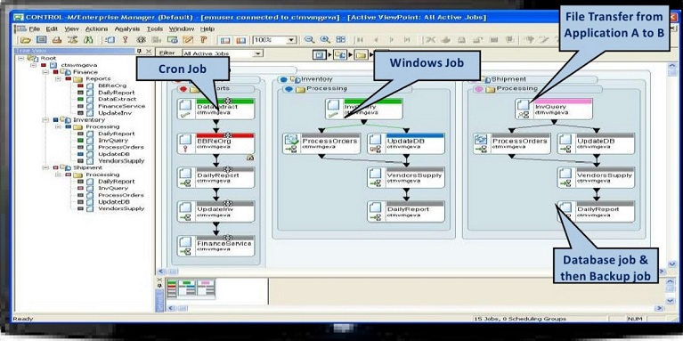
Focal point for enterprise

Slide 12
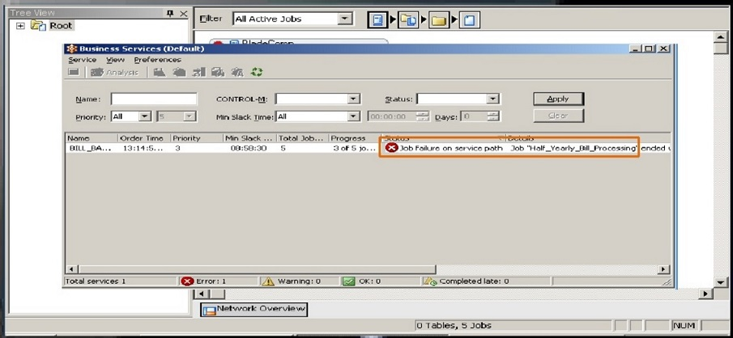
BMC Batch Impact Manager

Slide 13
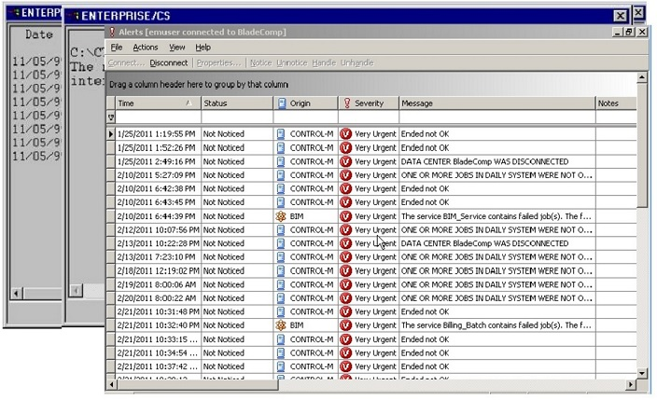
Result analysis

Slide 14
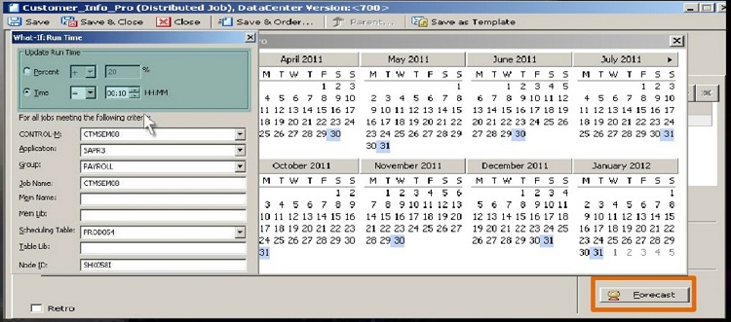
Control-M Forecasts

Slide 15
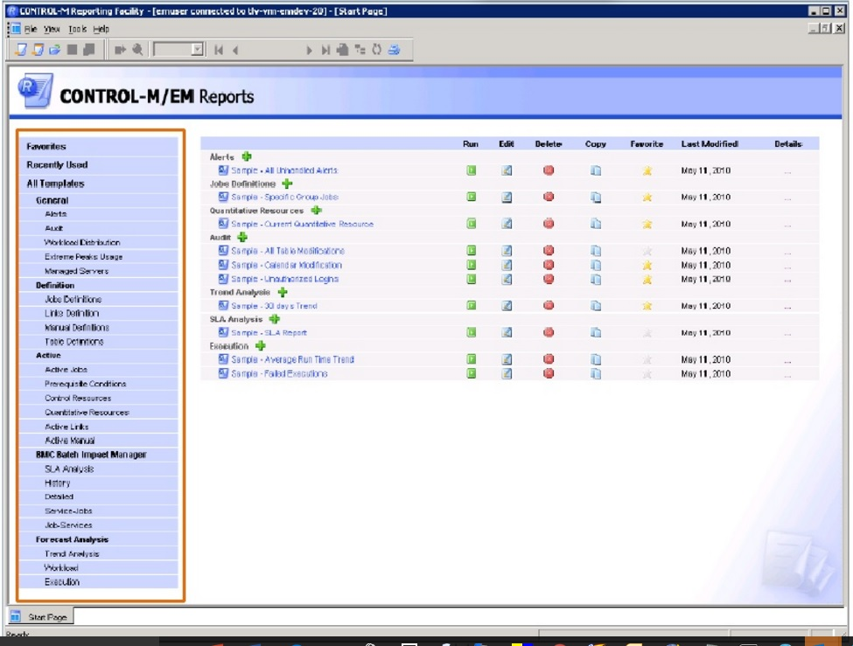
Control-M Reporting facilities

Slide 16
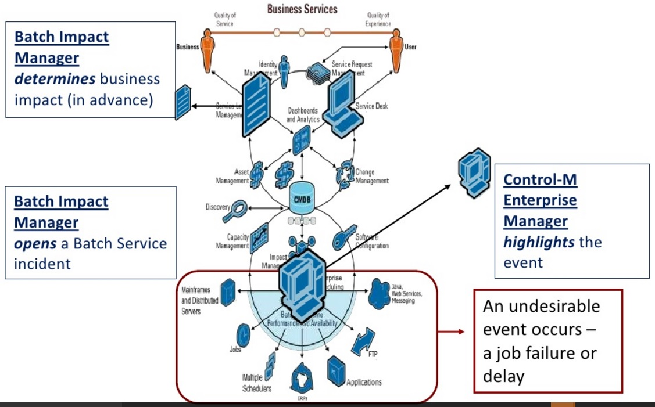
BSM-Batch inci-dents
Highlights the event
An undesirable event occurs _ a job failure or delay

Slide 17
BMC CONTROL-M as a WLA Consolidated Solution
BMC Software is among the leaders in IT and data center automation. Its solution for WLA, BMC CONTROL-M, has many features that make it an excellent choice for en-terprise-wide WLA consolidation.
- Extensive and flexible core scheduling capabilities including Web Services
- Scalability through its distributed architecture and extensive platform and application support
- Business alignment that integrates business impact analysis with workload forecasting
- Business-driven forecasting of real business workflow
- Extensive reporting capabilities

Slide 18
BMC Software's ITSM solutions
BMC Software Services: Wide Range Of BMC Solutions
- Service Support (e.g. BMC Remedy ITSM 7)
- Service Assurance (e.g. BMC Performance Manager, BMC Impact Manager)
- Service Automation (e.g. Control•M, BMC Configuration Automation)
- Atrium (CMDB, CMDB Orchestrator, SLM etc.)
- Foundation (REMEDY ARS)
Technical Team Size
- 350+ in BMC Skills
Questions ?

