Slide 2
DF 5362 Cloud Automation Use Case Implementation
Bernd Kammholz / 04 Dec 2014
#HPDiscover

Slide 3
Please give me your feedback
DF 5362 Bernd Kammholz
Use the mobile app to complete a session survey
Access “My schedule”
Click on this session
Go to “Rate & review”
If the session is not on your schedule, just find it via the session scheduler, click on this session and then go to “Rate & review”.
Thank you for providing your feedback, which helps us enhance content for future events.
Bernd Kammholz
HP Software
Senior Business Consultant

Slide 4
Agenda
End user order in the marketplace
Use Case
Role concept
Findings and experiences
D

Slide 5
Use Case

Slide 6
Use Case: “3-Tier application - design and deploy”
The scenario consists of a common 3-tier architecture: (design and deploy)
Combine buildings blocks into a service design:
Two firewalls (1st http, 2nd database protocol)
One load balancer in front of two web application servers from the same infrastructure pool “A”
One database server from infrastructure pool “B” – the DB should be placed in the SAN
Select application and database (a simple application is sufficient)
The functionality is shown using a web client/webpage
(Web) Client
FW
Load balancer
Tomcat Server
Tomcat Server
FW
DB Server
SAN
Given by customer

Slide 7
Use Case: “3-Tier application - design and deploy”
Browser
Client
(Web) Client
RedHat 6.4 iptables
Environment
FW
Load balancer
RedHat pyranha LB
Tomcat Server
Tomcat Server
Tomcat Application Server
RedHat 6.4 iptables
FW
DB Server
MySQL
SAN
HP 3PAR

Slide 8
Role concept and architecture

Slide 9
Use Case: Component Overview
HP Cloud Service Automation
MySQL Database
Tomcat Application Server
Load balancer Pyranha (RedHat)
RedHat Firewall (iptables)
Browser / Jumphost
HP Operations Orchestration
HP Network Automation
vCenter
HP Helion CloudSystem 8 / HP Converged System / 3PAR SAN Storage

Slide 10
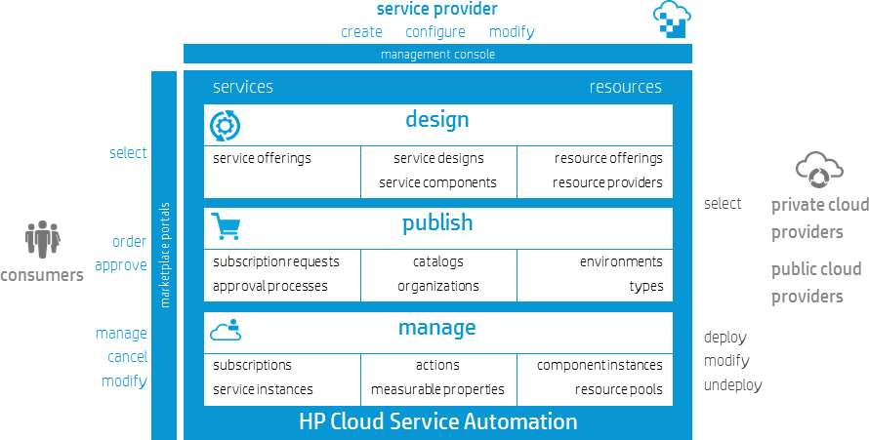
HP Cloud Service Automation
Functional overview

Slide 11
HP Cloud Service Automation
Roles and functionality
OPEN HP IT and cloud
management
platform
HP Operations Orchestration

Slide 12
HP Cloud Service Automation
Roles and functionality
OPEN HP IT and cloud
management
platform
HP OO
HP DevOps

Slide 13
HP Cloud Service Automation
Roles and functionality
OPEN HP IT and cloud
management
platform
HP OO
HP DevOps

Slide 14
HP Cloud Service Automation
Roles and functionality
OPEN HP IT and cloud
management
platform
HP OO
HP DevOps

Slide 15
Roles within the Use Case
Role | Description
HP CSA Administrator | The HP CSA Administrator has access to all functionality in the HP CSA Management Console and initially configures authentication and authorization for HP CSA access
Service Designer | The Service Designer designs, implements, and maintains service designs (also referred to as blueprints)
Resource Supply Manager | The Resource Supply Manager creates and manages cloud resources, such as providers and resource offerings
Service Business Manager | The Service Business Manager creates and manages service offerings and service catalogs
Service Operations Manager | The Service Operations Manager views and manages subscriptions and service instances
Subscriber | Enterprise business users who subscribe to HP CSA cloud services. A subscriber initiates service delivery and resource provisioning by making a service request in the Marketplace Portal, which must be approved according to a pre-configured process.

Slide 16
A step-by-step demonstration with screenshots from a live demo system

Slide 17
Prerequisites: HP CSA Setup & Configuration
Role: Service Business Manager
A. Setup Organizations
B. Define Catalogs
C. Approval Process
HP CSA Management Console
Organizations are created to define and separate rights and views on tenants
The catalog will be defined and linked to an organization
External approval process will be defined

Slide 18
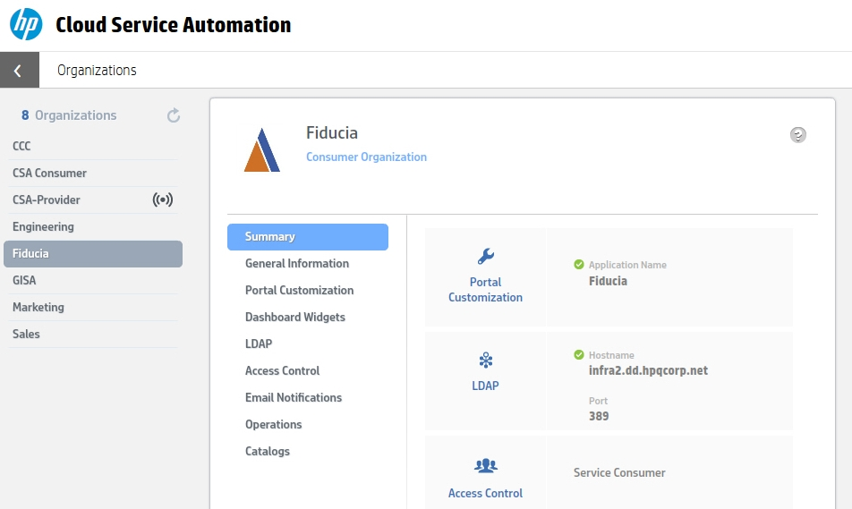
Organizations
A. Setup Organizations
B. Define Catalogs
C. Approval Process
Germany
Germany
Germany

Slide 19
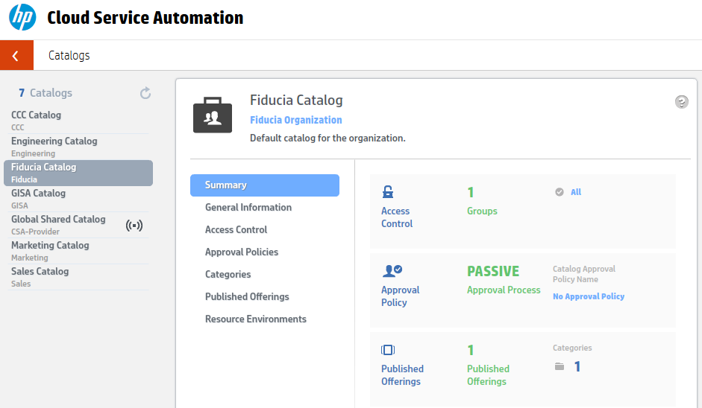
Catalogs
A. Setup Organizations
B. Define Catalogs
C. Approval Process
Germany
Germany Organization
Germany Catalog

Slide 20
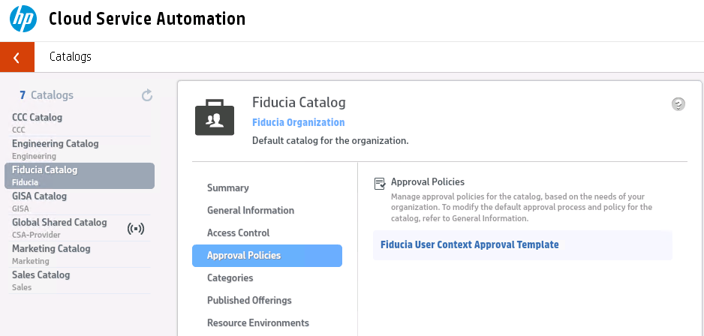
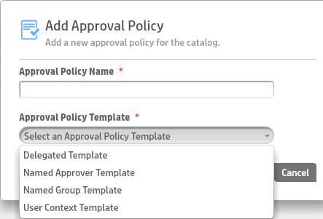
Approval Process
A. Setup Organizations
B. Define Catalogs
C. Approval Process
Germany
Germany Organization
Germany Catalog
Germany User Context Approval Template

Slide 21
HP Cloud Service Automation
Roles and functionality
3. Create an order
1. Create design
2. Create offering
4. Manage orders

Slide 22
HP Cloud Service Automation Role Concept
1. Create design
3. Create an order
4. Manage orders
2. Create offering

Slide 23
Create Service
1. Create design
3. Create order
4. Manage order
2. Create offering
1. Create Design
3. Create Order
4. Manage Order
2. Create Offering
HP CSA Management Console
HP CSA Marketplace Portal

Slide 24
Create Service
1. Create design
3. Create order
4. Manage order
2. Create offering
Roles: Resource Supply Mgr, Service Designer
A. Define Service
C. Create Service Tree
B. Check and create Resources
Paper
HP CSA Management Console
Service planning
Investigate economics of the services
Check the existing resources
Provides new resources
Implementation of service design in HP CSA Designer

Slide 25
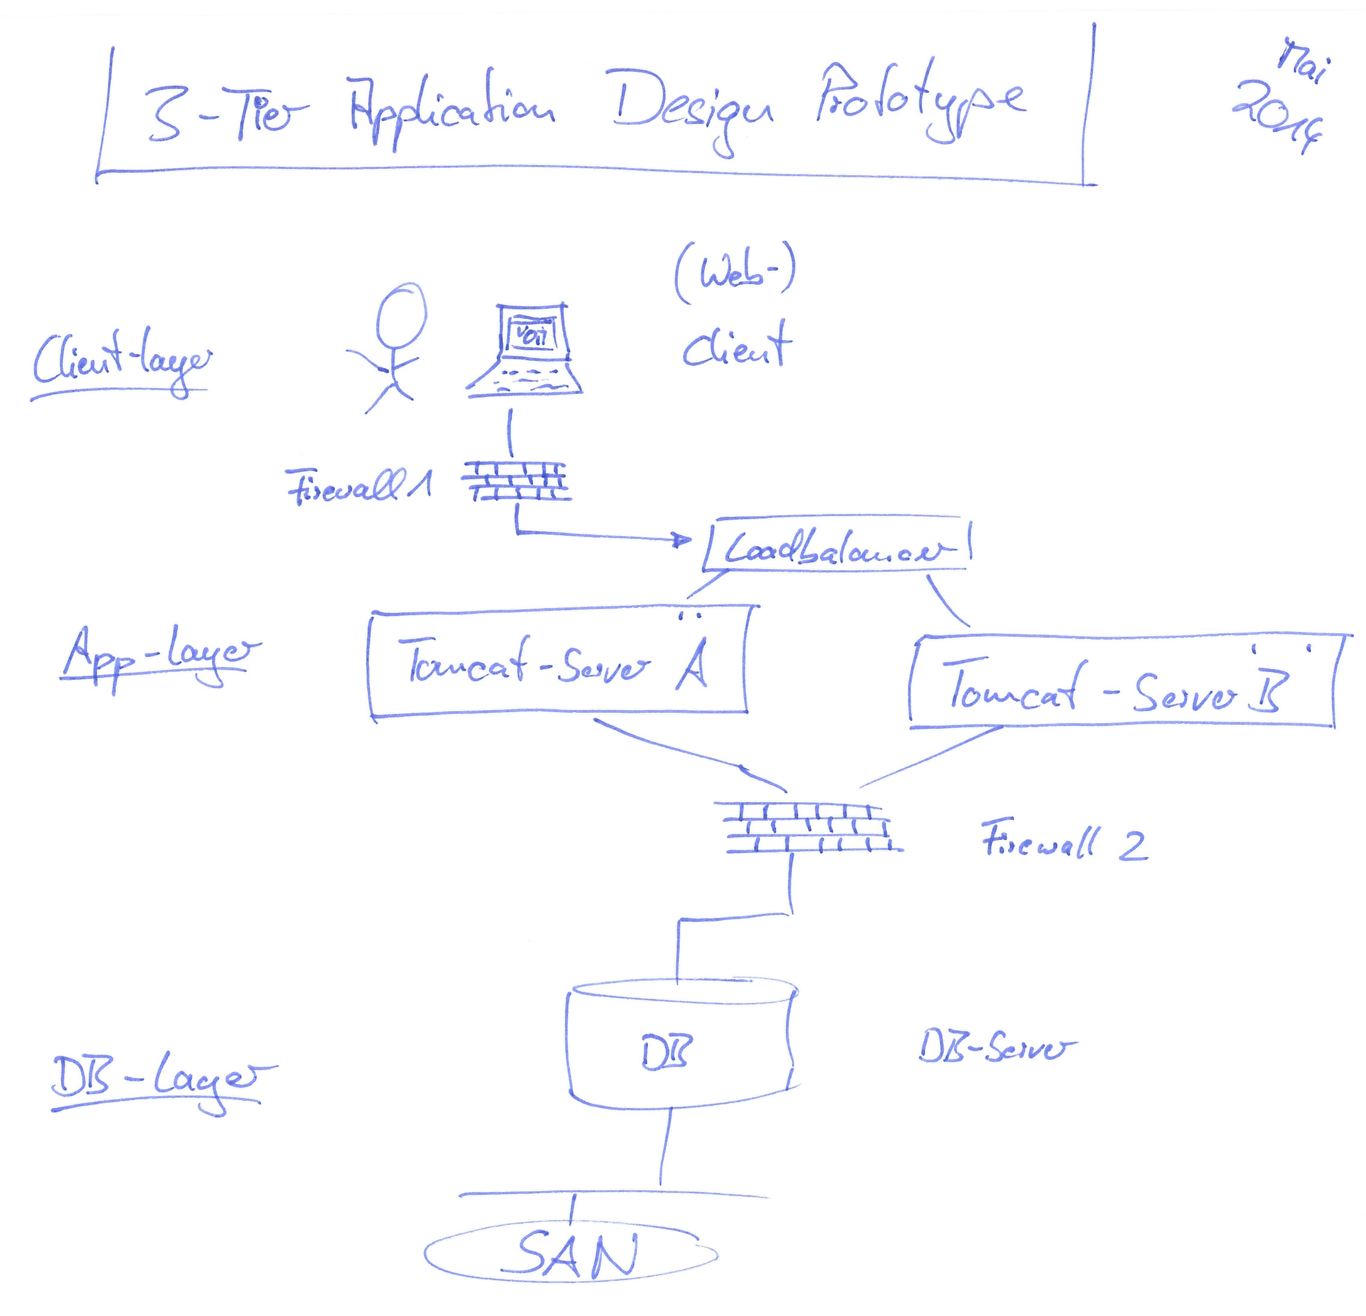
Create Service
1. Create design
3. Create order
4. Manage order
2. Create offering
Role: Service Designer
A. Define Service
C. Service-Baum erstellen
D. Manage orders
B. Ressourcen prüfen
Paper
CSA Management Console

Slide 26
Define Service
1. Create design
3. Create order
4. Manage order
2. Create offering
A. Define Service
C. Create service-tree
B. Check/create resources
Role: Service Designer
What should be offered at which price? (economics)
For which customers / catalogs will the service be created?
In which category will the service appear?
In which environment should the service be available?
Rome, Munich, etc.
Development, Test/QA, Staging, Production
Are resources available? How is this being determined?
What will be installed by default? What are the options / limits?
What is allowed to change after provisioning (Lifecycles)
Dismantling of the service. How?
Backup, virus-scanner, CMDB
How are resources being released? (e.g., licenses)
Governance: how is the approval process?
Create documentation for the service
Approval for realization (Business)

Slide 27
Check Resources
1. Create design
3. Create order
4. Manage order
2. Create offering
A. Define Service
B. Check/create resources
C. Create service tree
Role: Resource Supply Manager
Do the needed Resource Provider exist?
Do the needed Workflows exist?
Do the needed Environments exist?
HP Helion OpenStack®
D

Slide 28
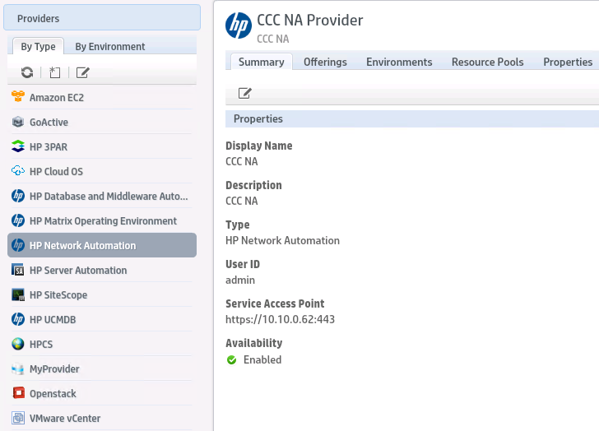
Resource Provider and Workflows
1. Create design
3. Create order
4. Manage order
2. Create offering
A. Define Service
B. Check/create resources
C. Create service tree
Role: Resource Supply Manager
HP Helion OpenStack®

Slide 29
Create Resources
1. Create design
3. Create order
4. Manage order
2. Create offering
A. Define Service
B. Check/create resources
C. Create service tree
Role: Resource Supply Manager
1. Create Providers
2. Import Provider Capabilities
HP CSA Server
HP CSA Management Console
Resource Provider will be used to manage the resources. They usually exist or can be created.

Slide 30
Create Resources
1. Create design
3. Create order
4. Manage order
2. Create offering
A. Define Service
B. Check/create resources
C. Create service tree
Role: Resource Supply Manager
1. Create Providers
2. Import Provider Capabilities
HP CSA Server
HP CSA Management Console
Create provider workflows
Create workflows for sync of resource pools
Create external approval workflows
The directories are defined in XML-format to tell HP CSA where to find them

Slide 31
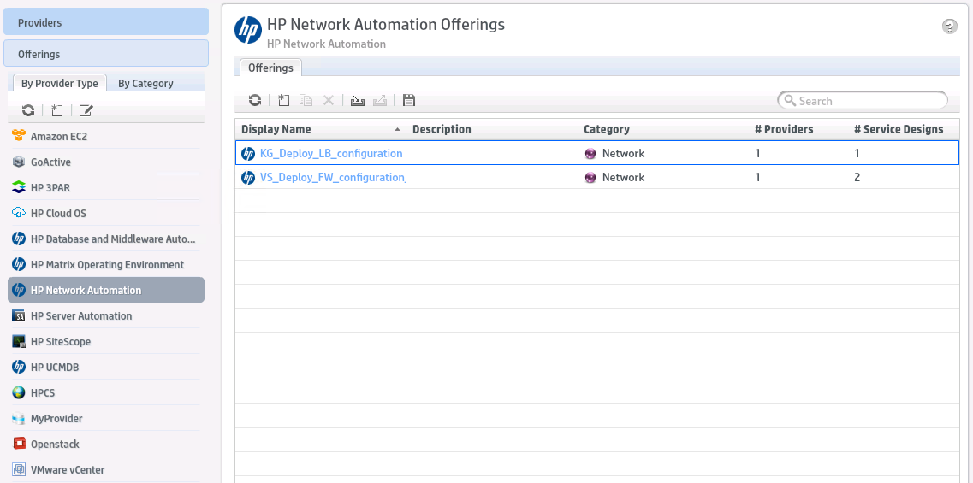
Resource Providers and Workflows
1. Create design
3. Create order
4. Manage order
2. Create offering
A. Define Service
B. Check/create resources
C. Create service tree
Example: HP Network Automation
HP Helion OpenStack®

Slide 32
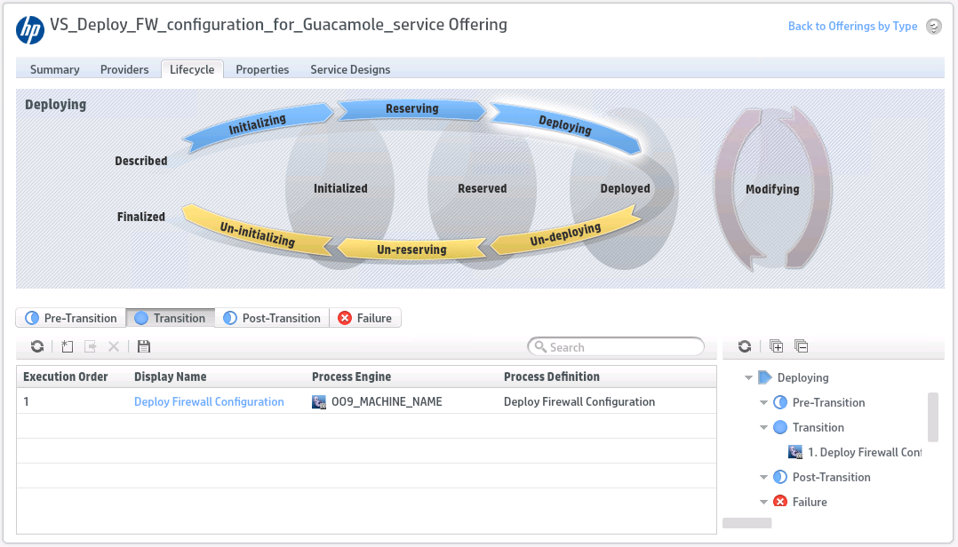
Resource Providers and Workflows
1. Create design
3. Create order
4. Manage order
2. Create offering
A. Define Service
B. Check/create resources
C. Create service tree
Example: HP Network Automation

Slide 33
Overview: Architecture
1. Create design
3. Create order
4. Manage order
2. Create offering
A. Define Service
B. Check/create resources
C. Create service tree
Role: Resource Supply Manager
Resource Provider
IT consumers and users
Mobile
Dev
Test
Enterprise user
Partner user
LOB user
IT teams and administrators
Server
Network
Storage
Database
QA
IT Process Automation & Orchestration
App
Security
Release
Infrastructure, platforms, services
●●
Platforms, databases, middleware
●●
Physical/Virtual servers
Public/Managed services
Storage
Network

Slide 34
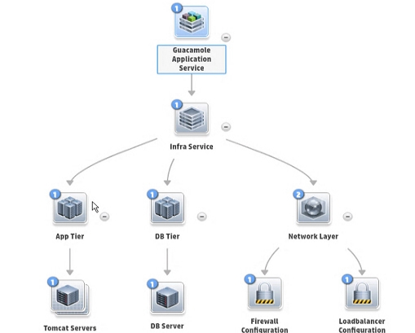
Create Service
1. Create design
3. Create order
4. Manage order
2. Create offering
A. Define Service
B. Check/create resources
C. Create service tree
Role: Service Designer (technical)
D

Slide 35
Service Design
1. Create design
3. Create order
4. Manage order
2. Create offering
2. Create offering
1. Create design
3. Create order
4. Manage orders
2. Create offering
HP CSA Management Console
HP CSA Marketplace Portal

Slide 36
The HP CSA Setup & Configuration
1. Create design
3. Create order
4. Manage order
2. Create offering
Role: Service Business Manager
B. Setup Pricing
C. Documentation
A. Setup Options
D. Select Approval Process / Publishing
HP CSA Server
HP CSA Management Console
Define service options
Define price model
Add documentation
Select approval process and publish service

Slide 37
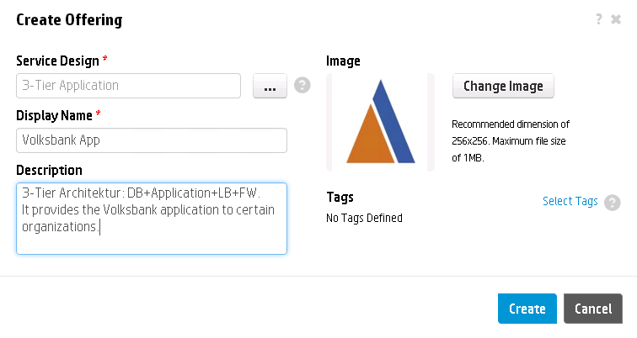
Create Offering
1. Create design
3. Create order
4. Manage order
2. Create offering
B. Setup Pricing
C. Documentation
A. Setup Options
D. Select Approval Process / Publishing
City App
City App

Slide 38
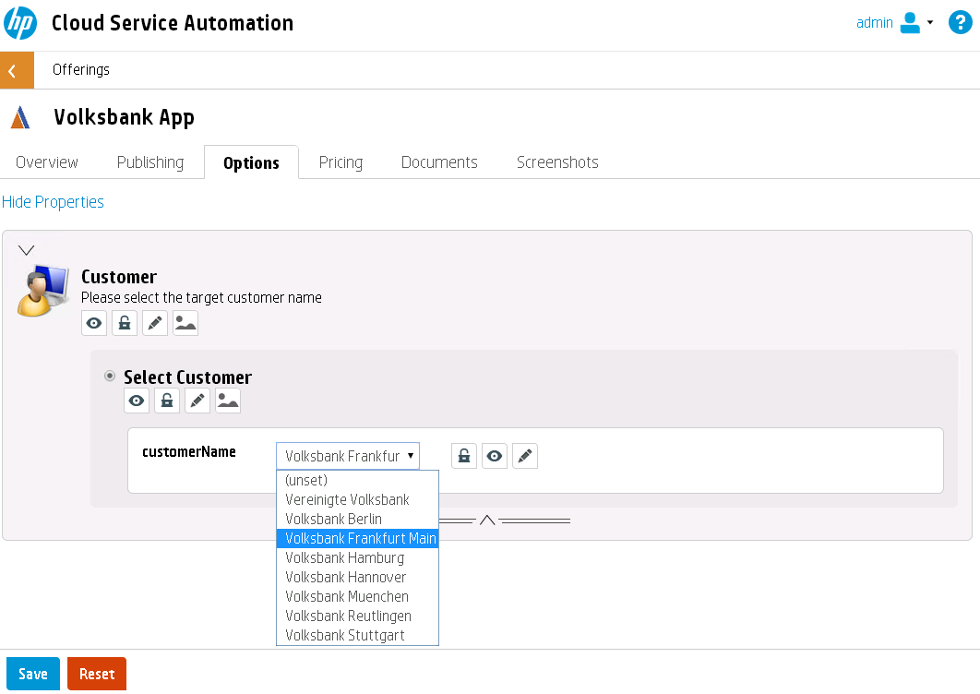
Create Offering
1. Create design
3. Create order
4. Manage order
2. Create offering
B. Setup Pricing
C. Documentation
A. Setup Options
D. Select Approval Process / Publishing
City App

Slide 39
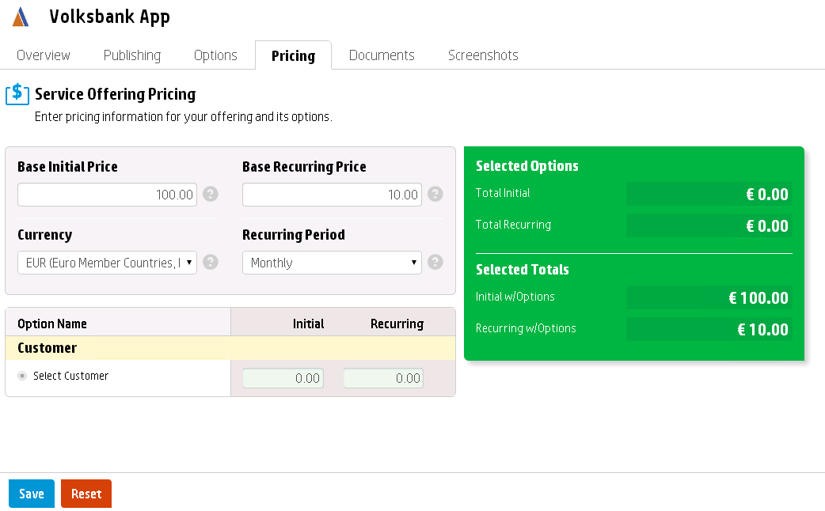
Set Up Pricing
1. Create design
3. Create order
4. Manage order
2. Create offering
B. Setup Pricing
C. Documentation
A. Setup Options
D. Select Approval Process / Publishing
City App

Slide 40
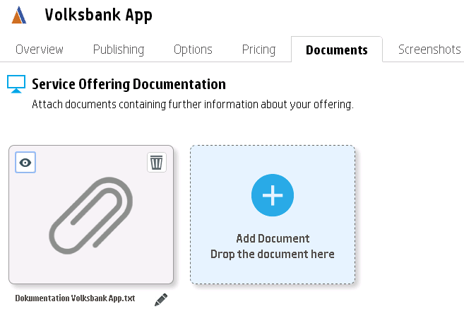
Add Documentation
1. Create design
3. Create order
4. Manage order
2. Create offering
B. Setup Pricing
C. Documentation
A. Setup Options
D. Select Approval Process / Publishing
City App
Documentation City App.txt

Slide 41
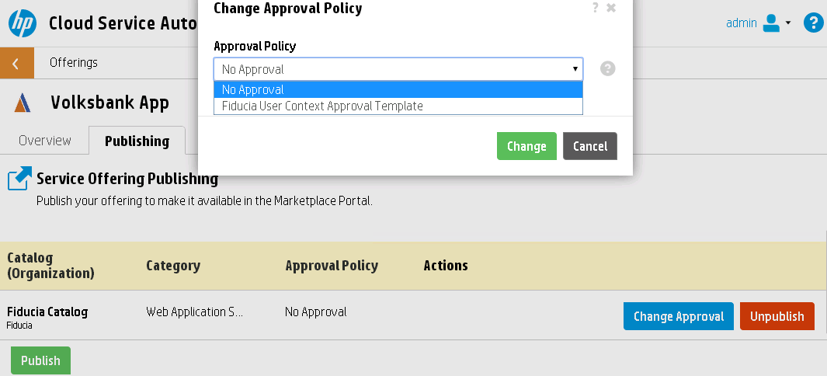
Select Approval Process
1. Create design
3. Create order
4. Manage order
2. Create offering
B. Setup Pricing
C. Documentation
A. Setup Options
D. Select Approval Process / Publishing
City App
Germany User Context Template
Germany Catalog

Slide 42
Service Design
1. Create design
3. Create order
4. Manage order
2. Create offering
Create design
3. Create order
4. Manage orders
2. Create offering
HP CSA Management Console
HP CSA Marketplace Portal

Slide 43
Create an Order
1. Create design
3. Create order
4. Manage order
2. Create offering
Role: User
C. Select service and options
D. Order service
B. Select catalog
A. Logon to portal
HP CSA Marketplace Portal

Slide 44
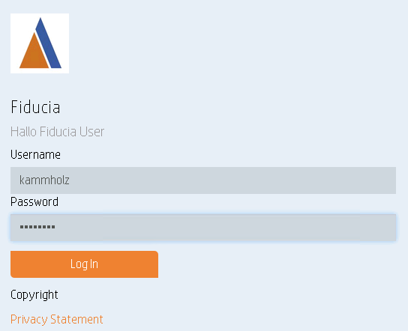
Portal Log In
1. Create design
3. Create order
4. Manage order
2. Create offering
A. Logon to portal
B. Select catalog
C. Select service and options
D. Order service
Germany
Germany User

Slide 45
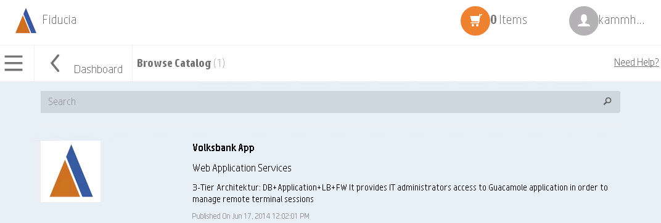
Select Catalog
1. Create design
3. Create order
4. Manage order
2. Create offering
A. Logon to portal
B. Select catalog
C. Select service and options
D. Order service
Germany
City App

Slide 46
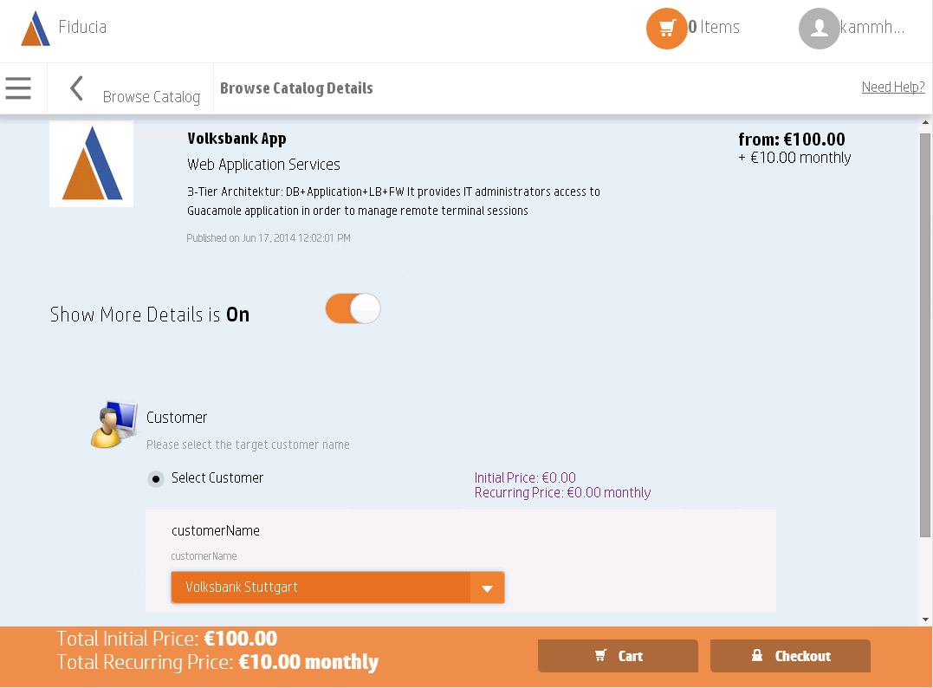
Service Overview
1. Create design
3. Create order
4. Manage order
2. Create offering
A. Logon to portal
B. Select catalog
C. Select service and options
D. Order service
Germany
City App

Slide 47
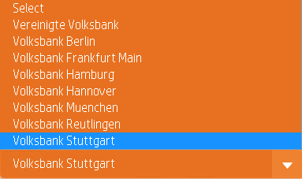
Select and Order Options
1. Create design
3. Create order
4. Manage order
2. Create offering
A. Logon to portal
B. Select catalog
C. Select service and options
D. Order service
Germany
City App
Select

Slide 48
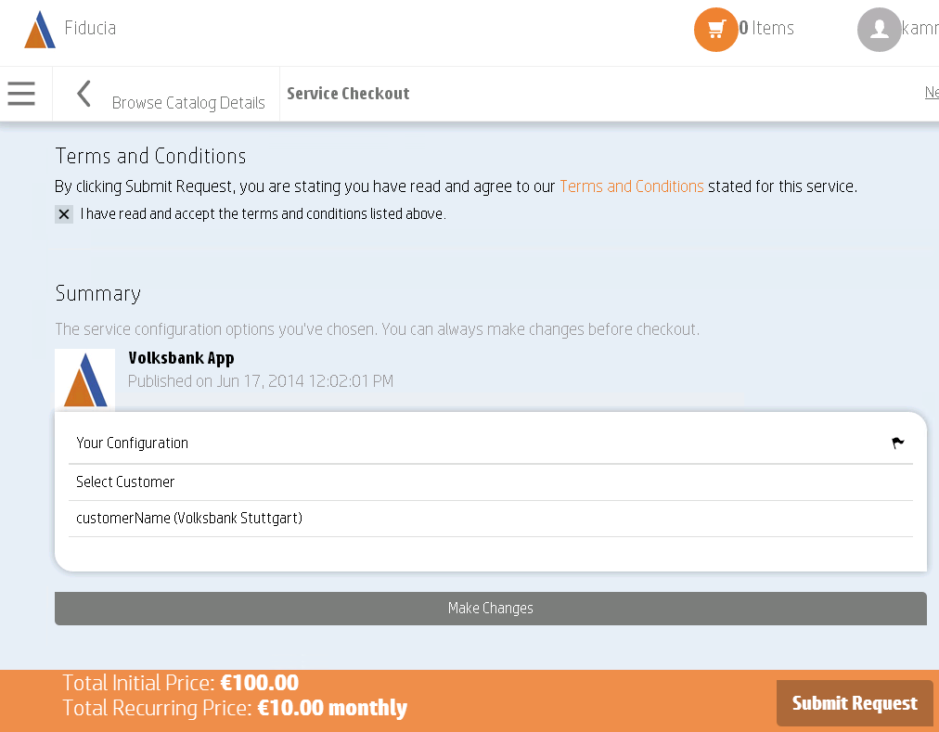
Check Terms and Conditions
1. Create design
3. Create order
4. Manage order
2. Create offering
A. Logon to portal
B. Select catalog
C. Select service and options
D. Order service
Germany
City App
(Stuttgart)

Slide 49
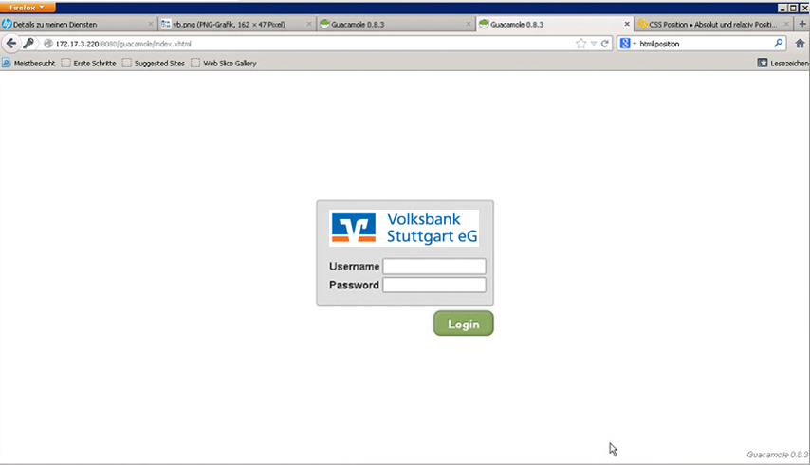
City App
1. Create design
3. Create order
4. Manage order
2. Create offering
Service is provisioned with options
Nach einer Weile …
Stuttgart

Slide 50
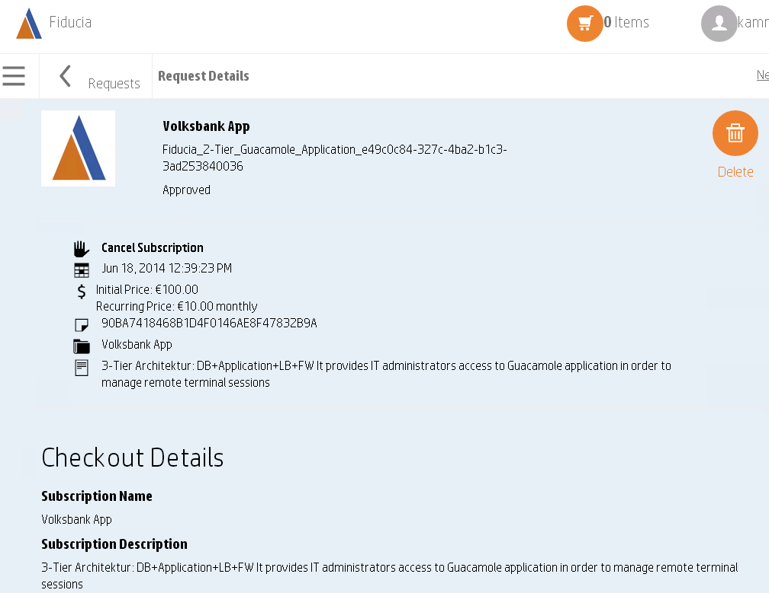
Manage Order Requests
1. Create design
3. Create order
4. Manage order
2. Create offering
Germany
City App Stuttgart
Germany_2T
City App
City App

Slide 51
Some project internal detail information

Slide 52
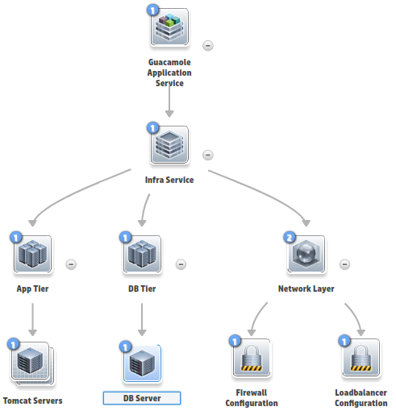
Process Order of the Components

Slide 53
Use Case: Network Overview
10.10.0.0/24
Jumphost:
(Web) Client
End User PC
11.1.1.0/24
.1
FW 1
172.17.0x.0/24
Separates VLAN per customer
.1
.250
.10
.11
customer city …
Load balancer
Tomcat Server A
Tomcat Server B
172.17.1x.1
172.17.1x.0/24
VLAN | TIER | CUSTOMER NAME | App-Tier1 | App-Tier2 | DB-Tier
250 | 1 | Berlin | 172.17.0.0 | 172.17.10.0 | 172.17.20.0
251 | 1 | Heidelberg | 172.17.1.0 | 172.17.11.0 | 172.17.21.0
252 | 1 | Frankfurt Main | 172.17.2.0 | 172.17.12.0 | 172.17.22.0
253 | 1 | Reutlingen | 172.17.3.0 | 172.17.13.0 | 172.17.23.0
254 | 1 | Stuttgart | 172.17.4.0 | 172.17.14.0 | 172.17.24.0
255 | 1 | Hamburg | 172.17.5.0 | 172.17.15.0 | 172.17.25.0
256 | 1 | Munich | 172.17.6.0 | 172.17.16.0 | 172.17.26.0
257 | 1 | Hanover | 172.17.7.0 | 172.17.17.0 | 172.17.27.0
FW 2
172.17.2x.1
172.17.2x.0/24
DB-Server
(*) separates management network is not displayed

Slide 54
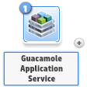
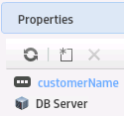
Components Process
Properties:
maxServerCount: 4
minServerCount: 2
serverCount: 2
xlsHeaderName: APPTIER
VS_VCENTER_2TIER Resource Binding / Deploy/Un-Deploy: Transition Phase:
vCenter 2tier wo Custspec - Deploy
vCenter 2tier wo Custspec - Undeploy
Lifecycle / Deploy: Post-Transition Phase:
1. LCA – Configure Tomcat
Properties:
maxServerCount: 2
minServerCount: 1
serverCount: 1
xlsHeaderName: DBTIER
VS_VCENTER_2TIER Resource Binding / Deploy/Un-Deploy: Transition Phase:
vCenter 2tier wo Custspec - Deploy
vCenter 2tier wo Custspec - Undeploy
Lifecycle / Deploy: Post-Transition Phase:
1. LCA – Configure DB
VS_Deploy_FW_configuration_for_Guacamole_service (NA) Resource Binding / Deploy/Un-Deploy: Transition Phase:
Properties:
dhcpEnabled: false
dhcpRange:
vlanId: 0
vlanIPSubnet:
vlanSubnetMask:
vlanTag:
Deploy Firewall Configuration
Undeploy Firewall Configuration
KG_Deploy_LB_configuration (NA) Resource Binding / Deploy/Un-Deploy: Post-Transition Phase:
Deploy Load Balancer Configuration
Undeploy Load Balancer Configuration

Slide 55
Use Case Project
Efforts and challenges
Know-How / skill of foreign technologies
Build up of demo-environment / network-layout
Resource provisioning
Technical implementation
Workflow creation
Etc.
Project management
Biggest challenges?
Internal coordination – different departments, roles, etc.
Interfaces / processes
Know-How / skill for foreign technologies

Slide 56
Summary
1. Create design
3. Create order
4. Manage order
2. Create offering
Resource Provider can be added and used easily (VMware, HP Helion CloudSystem, Microsoft, etc.)
Integrated Management Platform for Private/Public or Managed Cloud and Traditional IT
Easy to integrate of different known and unknown resources
HP Cloud Service Automation: safe, HA, for small and enterprise customers, common management platform
No vendor lock-in
Fully automated with an open, flexible and extensible architecture
Use of industry-standards (OpenStack/TOSCA)
State-of-the-art Service Designer, to easily integrate multiple and hybrid cloud services
Native integration with the OpenStack-based HP Helion solution

Slide 57
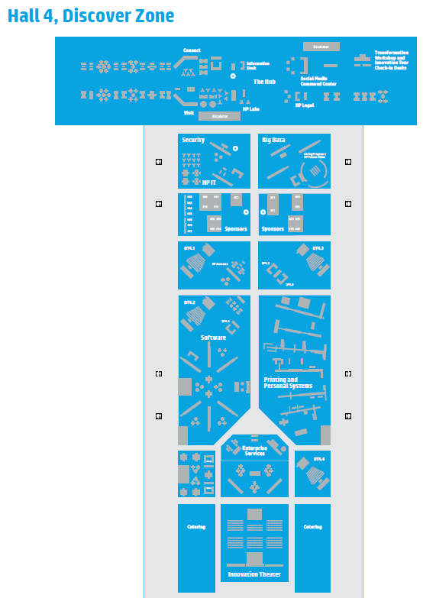
More information at Discover Booths: Hall 4 – Software Area
The OpenStack Word Mark is either a registered trademark/service mark or trademark/service mark of the OpenStack Foundation, in the United States and other countries and is used with the OpenStack Foundation’s permission. We are not affiliated with, endorsed or sponsored by the OpenStack Foundation, or the OpenStack community.

Slide 58
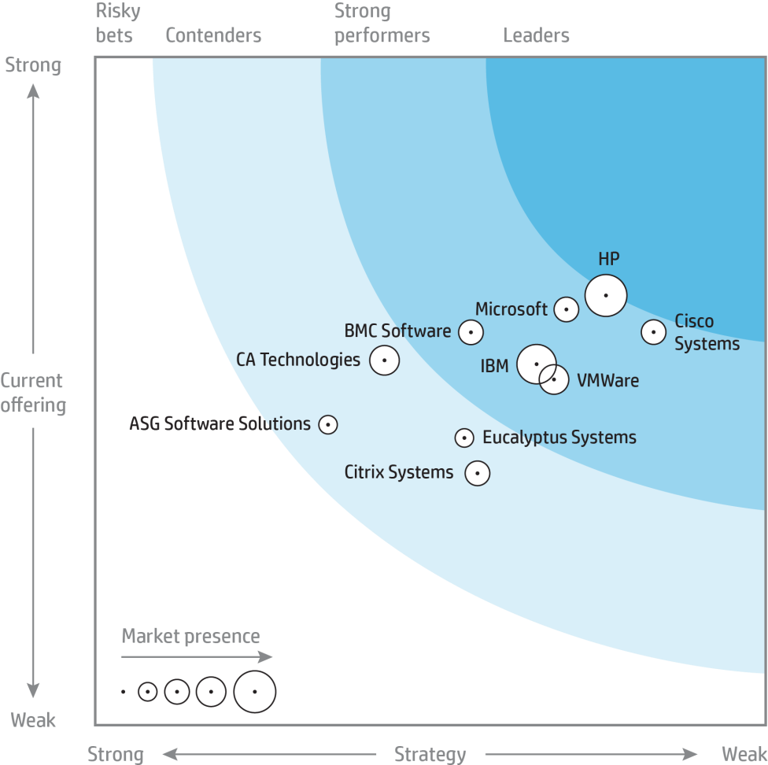
HP Helion
Now cloud runs through your business
Forrester names HP the leader in private cloud solutions¹
Committed to open platforms and technology
HP Helion customers experience:
2,000+ customers 1/3 of Fortune 500
$1B investment
in cloud technology
Up to 30% cost reduction
OpenStack project leadership
#1 contributor to OpenStack²
2 board members³
5 members of Technical Committee
9 Program Technical Leads (PTLs)
Indemnification⁴
Up to 98% faster deployment
Up to 99.99% availability
Instant scalability
Open source
Open technology
Open APIs
The Forrester Wave™: Private Cloud Solutions, Q4 2013, November 25, 2013
1st in Contributions, Code Reviews, and # of Contributors, and second in lines of code for Juno
1 designated member, 1 elected Individual member
For qualified customers and subject to the terms and conditions of a separate indemnity agreement

Slide 59
The OpenStack Word Mark is either a registered trademark/service mark or trademark/service mark of the OpenStack Foundation, in the United States and other countries and is used with the OpenStack Foundation’s permission. We are not affiliated with, endorsed or sponsored by the OpenStack Foundation, or the OpenStack community.

