Slide 1
Strengthening partnership to promote climate-smart agriculture in West Africa
Robert Zougmoré
CCAFS West Africa Program Leader

Slide 2
Length of growing season is likely to decline..
Length of growing period (%)
>20% loss
5-20% loss
No change
5-20% gain
>20% gain
To 2090, taking 14 climate models
Four degree rise
Thornton et al. (2010) ILRI/CCAFS

Slide 3
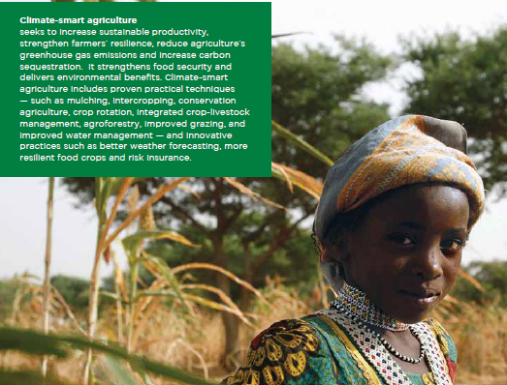
What is Climate Smart Agriculture?
Agriculture that sustainably:
increases productivity
resilience (adaptation)
reduces GHG (mitigation)
And enhances achievement of national food security and development goals (FAO, 2010)
www.fao.org/climatechange/climatesmart/en

Slide 4
Food Security
Ecological foot print
Adaptation
“Climate smart means landscape and policy smart”
Notes:
So, we have three grand challenges.
A key focus of CCAFS is understanding the synergies and trade-offs amongst these objectives, working from plot to global levels

Slide 5

CSA is not business as usual?
Multiple benefits
Attention to synergies and trade-offs
New partnerships
New types of finance

Slide 6
It’s a multitude of trade-offs…
•Across sub-sectors (e.g. residues to soils or livestock?)
•Across spatial scales (e.g. more productive agriculture can result in forest clearance)
•Different kinds of households (e.g. some risk insurance exclude female-headed households)
•Short-term vs. long term benefits (e.g. livestock risk insurance can promote land degradation)

Slide 7
It’s all about scale
CSA can have different meanings depending upon the scale at which it is being applied:
At local scale: opportunities for higher production, e.g. through improved management
At national scale: e.g. providing frameworks that incentivize sustainable management practices
At global scale: e.g. setting rules for global trade
For smallholders: greater food security and resilience against shocks
For intensive agriculture: opportunities to reduce emissions
Effective partnership to ensure that the different temporal and spatial scales work together properly

Slide 8
Some climate-smart agricultural
practices
Crop management | Livestock management | Soil and water management | Agroforestry | Integrated food energy systems
Intercropping with legumes Crop rotations New crop varieties Improved storage and processing techniques Greater crop diversity | Improved feeding strategies Rotational grazing Fodder crops Grassland restoration and conservation Manure treatment Improved livestock health Animal husbandry improvements | Conservation agriculture Contour planting Terraces and bunds Planting pits Water storage Alternate wetting and drying (rice) Dams, pits, ridges Improved irrigation (drip) | Boundary trees and hedgerows Nitrogen-fixing trees on farms Multipurpose trees Improved fallow with fertilizer shrubs Woodlots Fruit orchards | Biogas Production of energy plants Improved stoves
All practices presented here improve food security and lead to higher productivity, but their ability to address adaptation and mitigation varies

Slide 9
Total annual GHG emissions
1,000 t CO₂e, from land-use change, livestock, nitrogen fertilizer consumption and fires in grazing lands (Brown et al 2011)
Notes:
Livestock 83% total, fertilizer 0.7%, burning (Ch4 and N20) 4%
500 m resolution HIGH uncertainty likely

Slide 10
We need mitigation options
GHG reduction
Cropland management
Land cover change
Management of organic soils
Grazing land management
Manure-biosolid management
Bioenergy
Livestock management
Restoration of degraded lands

Slide 11
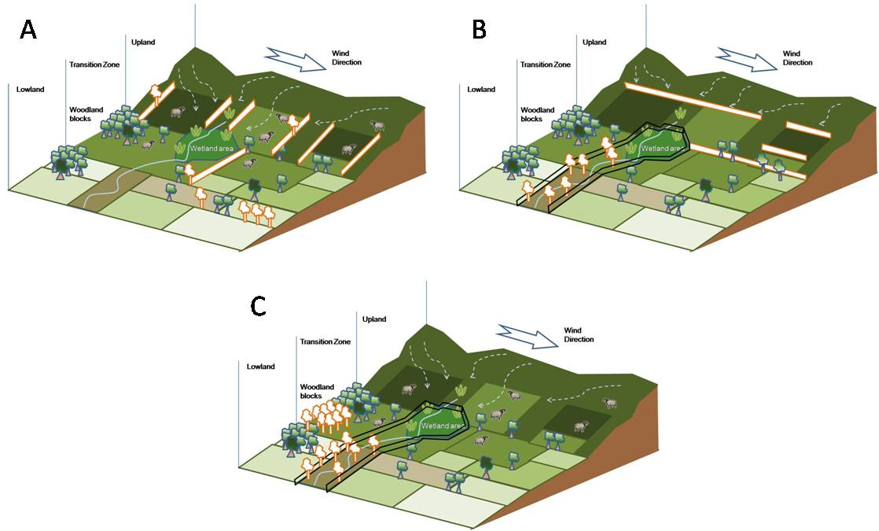
Importance of trees in fields and farming landscapes

Slide 12
Are there opportunities to reduce emissions or increase sequestration?
Management option | Mitigation Potential | Actions required
Livestock | High | Technical options?
Soil C sequestration | Moderate | Incentives? Monitoring?
Reduced burning | Moderate | Technical options?
Land rehabilitation | Moderate | Investment
Fertilizer | Low | Future efficiencies, sustainable intensification?

Slide 13
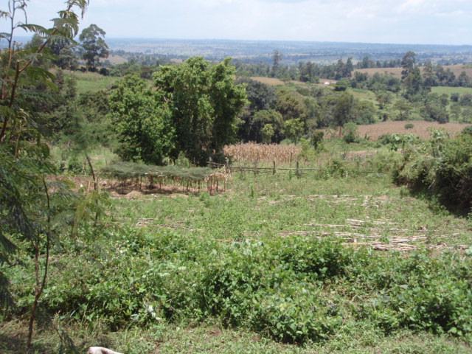
Mitigation: Changes in agricultural and landscape management
Agriculture
Energy
Permanent plantings (trees, shrubs, grasses)
Mixed farming systems-grasslands systems
Conservation agriculture practices
Manure management
Ruminant nutrition
Solar
Biogas
Tillage
Transport

Slide 14
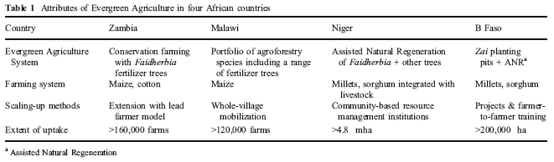
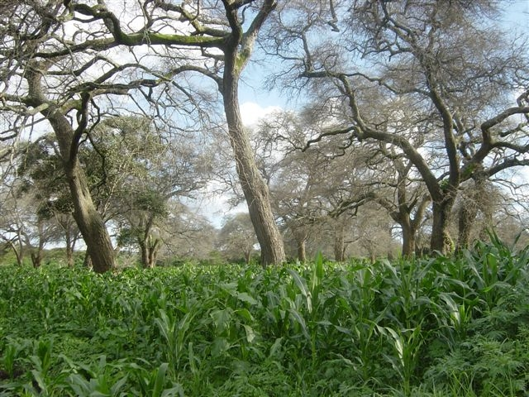
Evergreen agriculture with
Faidherbia albida

Slide 15
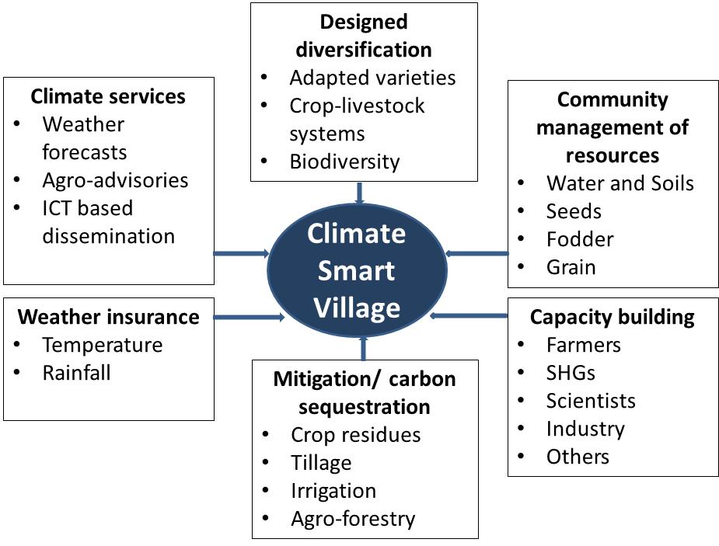
Engaging multiple stakeholders to facilitate enhanced climatic risk management
Notes:
Agricultural communities need to be empowered to manage frequent climatic risks. Several technologies are available today that can facilitate this. However, a comprehensive participatory evaluation of these by farming communities has not been done. CCAFS is testing and validating, in partnership with rural communities and other stakeholders, a scalable climate-smart model for agricultural development that includes a range of innovative agricultural risk management strategies that potentially enable communities and households to build more resilient livelihood and sequester more carbon in the soil. The key interventions are weather insurance, agro-advisories based on weather, designed diversification including climate analogues based selection of adapted stress tolerant crop and fodder varieties, and landraces, agri-silvi-horti-pastoral farming systems, and mixed crop-livestock systems; and community- based management of soil, water, seeds and fodder resources (shown as boxes).

Slide 16
Early action: building on proven technologies, practices and approaches
Agroforestry systems-Conservation agriculture
Soil and nutrient management
Water harvesting and use
Pest and disease control
Resilient ecosystems
Genetic resources
Harvesting, processing and supply chains
On-the-ground implementation (PAR)

Slide 17
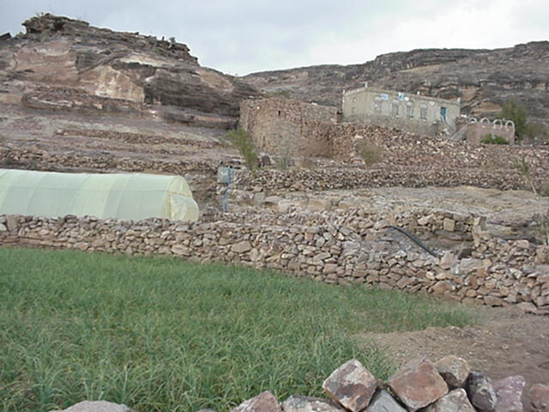
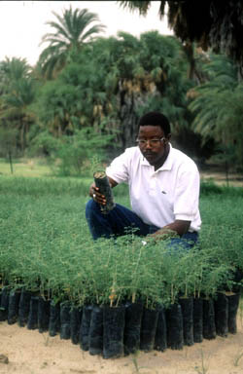
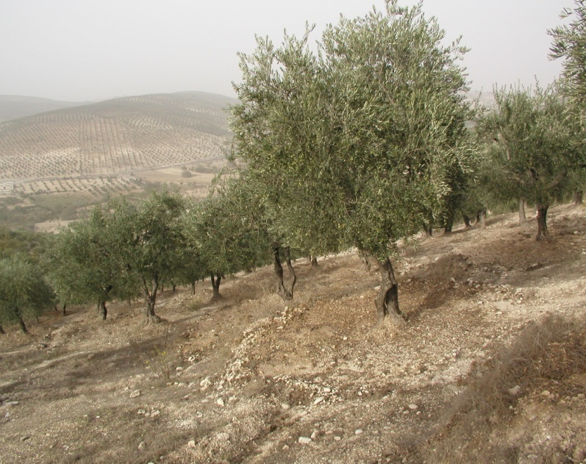
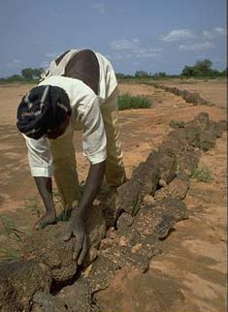
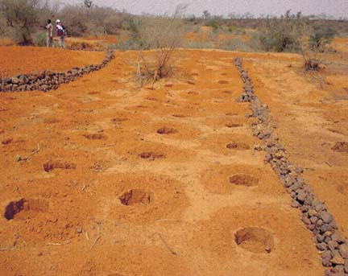
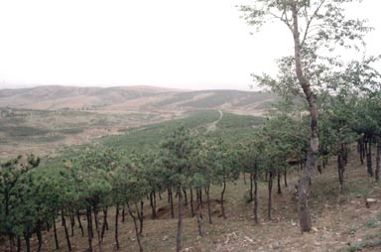
But not only coping strategies
Rehabilitation, Prevention, sustainable intensification…

Slide 18
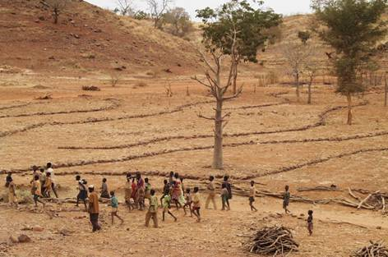
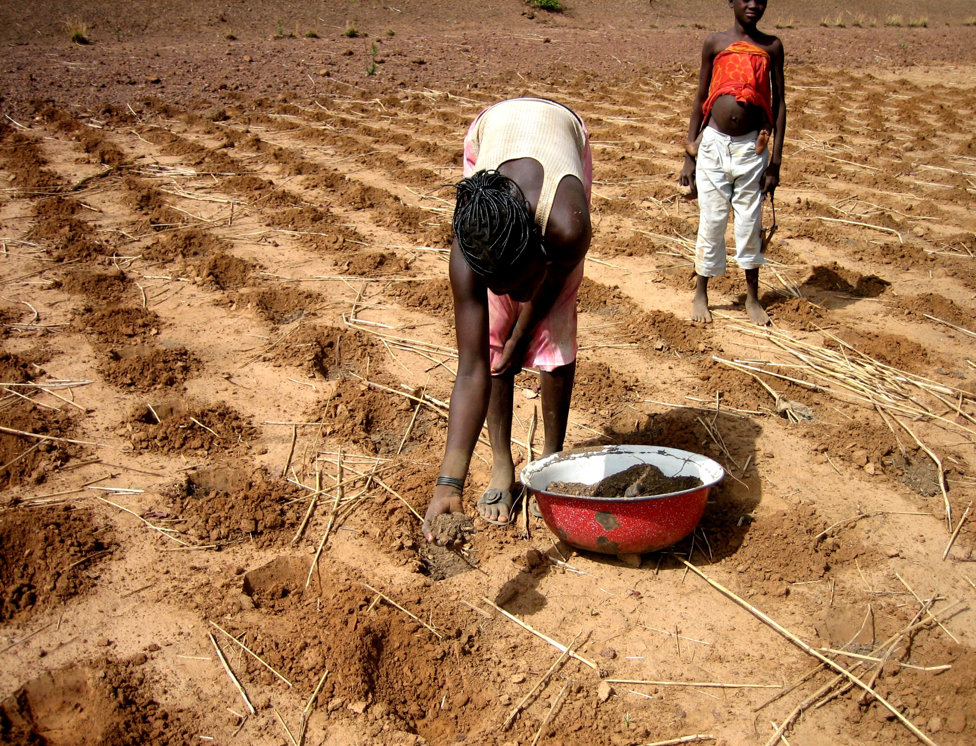
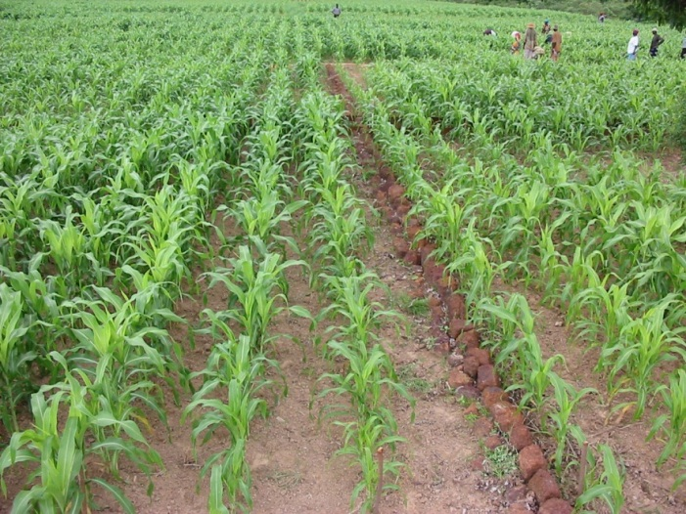
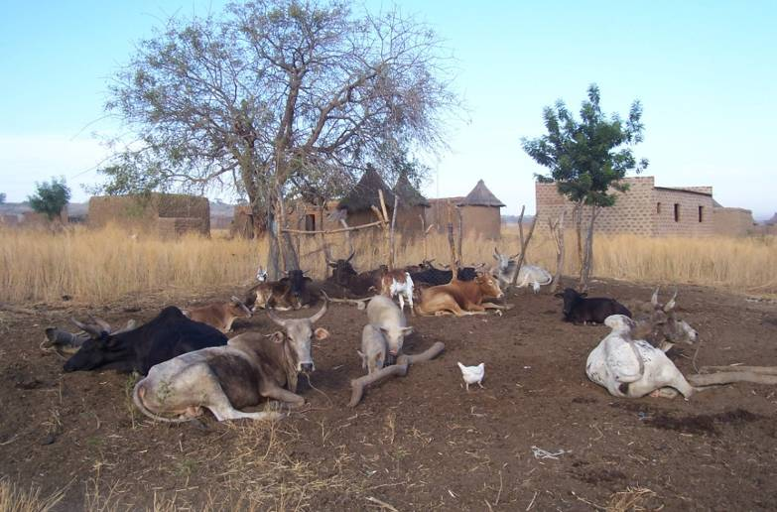
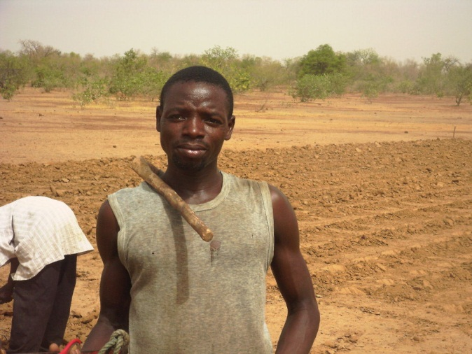
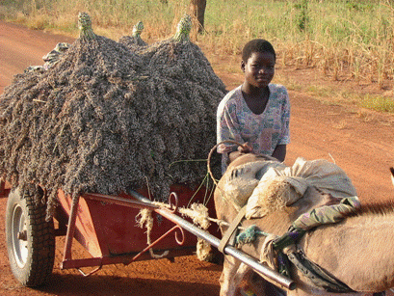
Integrated soil fertility and water management

Slide 19
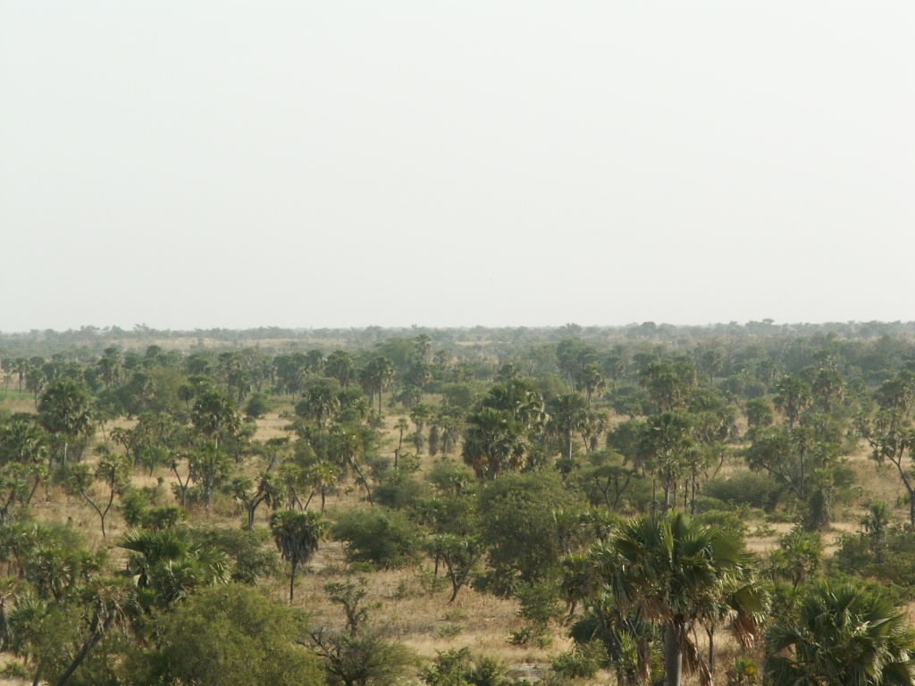
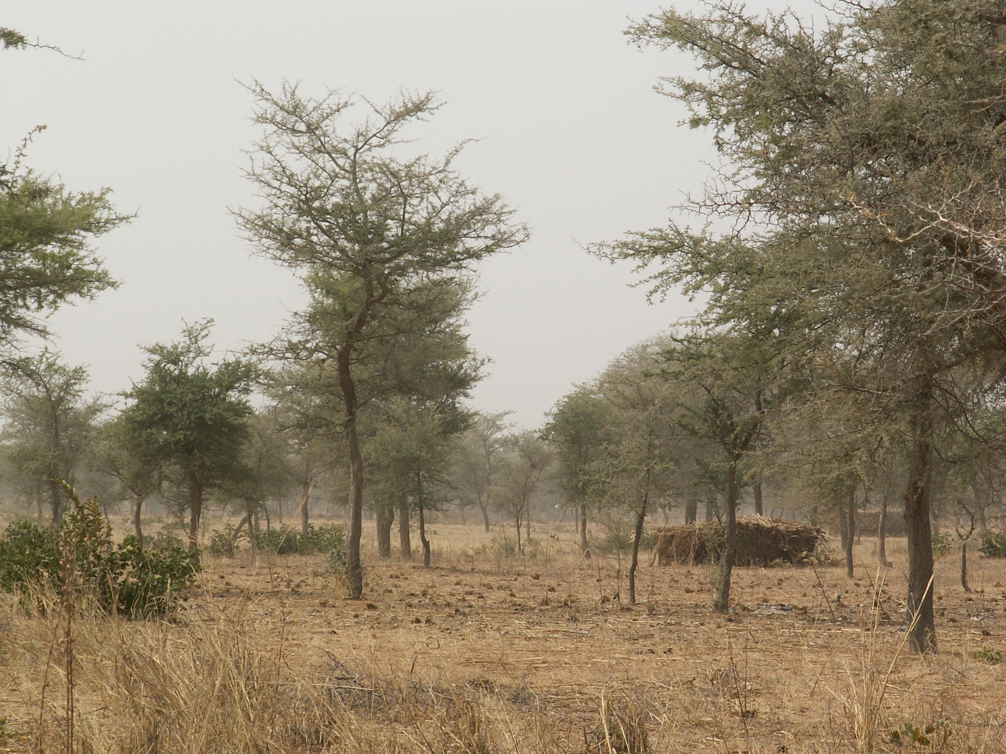
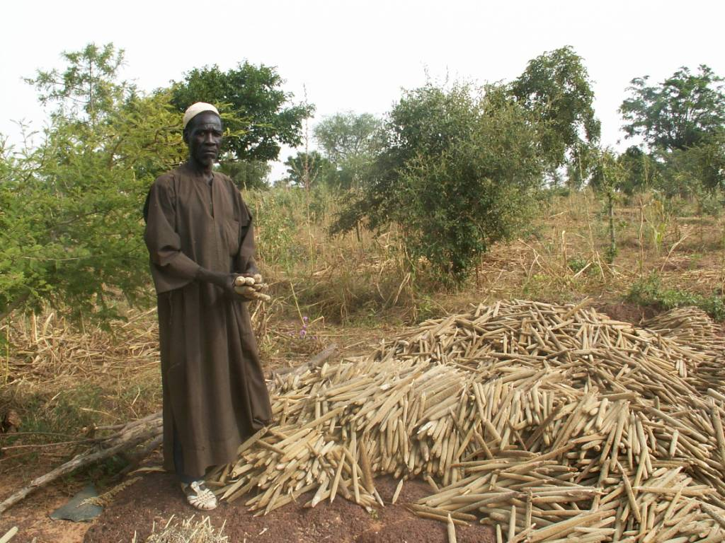
Naturally assisted tree regeneration in Niger
This farm family has been food secure since they began rehabilitation
New AGF parklands in Zinder (Faidherbia Albida, ≈ 1 M ha

Slide 20
Increased resilience to inter-annual rainfall variability in improved fallow systems in Malawi
Yield (t ha⁻¹)

Slide 21
Institutional & policy options
Enabling policy environment
Information production and dissemination
Climate data and information gaps
Dissemination mechanisms
Preparing institutions at the grassroots
Institutions to support financing and insurance needs
Adaptation through awareness creation and empowerment
Education of future generations (curricula)

Slide 22
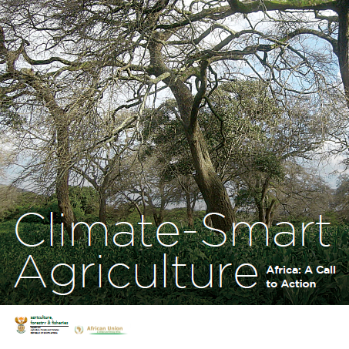
The Political Dimension:
African Union’s pre-Durban COP17 publication

Slide 23
Way forwards?
Provide an enabling legal and political environment
Improve market accessibility
Involve all stakeholders in the project-planning process
Improve access to knowledge and capacity strengthening (short & long-terms)
Introduce more secure tenure
Overcome the barriers of high opportunity costs to land
Improve access to farm implements and capital
Communication efforts for widespread dissemination of information

Slide 24
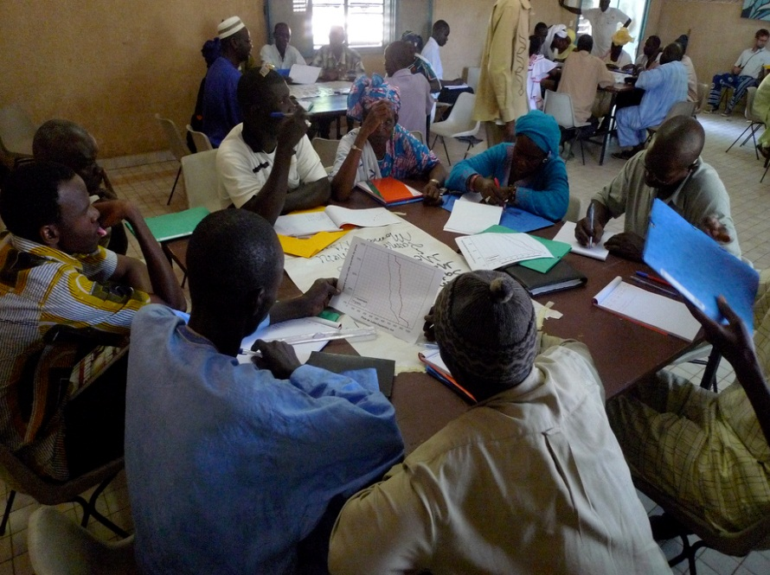
Regional and national learning platforms
For information exchange, capacity strengthening, building consensus around issues and priorities
National and regional agencies | Regional economic community
Research providers | Advisory services
NGOs & policy think tanks | Farmer organisations

Slide 25
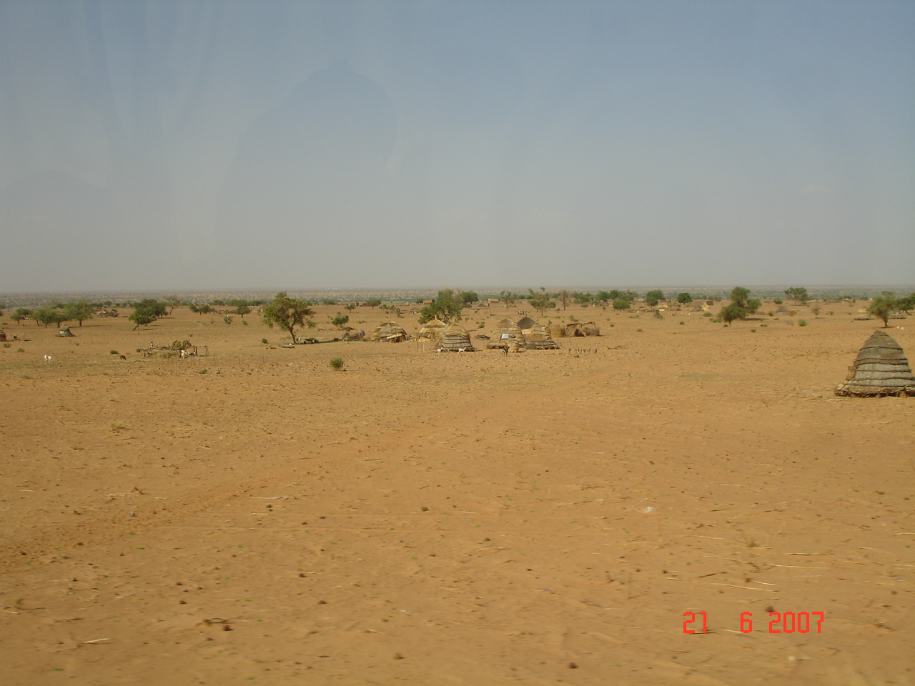
PARTNERS
CCAFS PARTICIPATORY ACTION RESEARCH
Objective: Test, adapt and monitor strategic innovations supporting climate-smart agriculture
Approach: particular actions, interventions tested and implemented simultaneously with local communities, partners, researchers & development workers, cooperating closely
CCAFS (CGIAR + ESSP)
FO/CBO
RECs (CILSS, INSAH, etc.)
PRIVATE
NGOs
NARES
ARIs
UNIVs
CSO
PILOT SITES IN WEST AFRICA
Kaffrine (Senegal)
Kollo (Niger)
Ségou (Mali)
Lawra-Jirapa (Ghana)
Yatenga (Tougou)

