Slide 1
Genetic Modification of Plants
Laboratory research to advance knowledge
and their use in the real world
March 1, 2014.
Alice Y. Cheung, Hen-Ming Wu
Professors, Biochemistry and Molecular Biology, Dept.,
Umass, Amherst
Yanjiao Zou, Postdoctoral Associate
Many of the slides are downloaded from Google Images

Slide 2
How to generate genetically modified plants?
a potential high school classroom module
The standard method: Agrobacterium Ti plasmid-
mediated plant transformation (9:00 am)
The exercise – the work from two summer interns (9:45 am)
Genetic analyses of transformed plants (a teacher
and student exercise) (10:15am, in LGRT1105, Dr. Zou)
Break (10:15 am), Q @ A (during break and 11 am,
after class reassembles)
Some examples – Golden Rice; Blue Rose
The start of RNA interference (RNAi) [the work led
ultimately to a Nobel prize for work done in worm]

Slide 3
A step-wise summary of the method
Determine the gene of interest to be introduced and generate the necessary recombinant DNA molecule: this involves basic DNA cloning technology, such as (1) DNA isolation, (2) gel electrophoresis, (3) use of different enzymes to create the recombinant DNA. This step is carried out in the most commonly used lab bacterium, Escherichia coli (E. coli).
To express the gene,
i.e. to make the product of
interest
For experimental examples, we’ll use a pollen-specific promoter (LAT52);
we’ll use β-glucuronidase (gives a blue color); green fluorescent protein (GFP)
and red fluorescent protein (RFP) as our genes of interest.

Slide 4
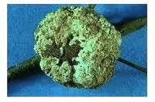
2. Introduce the recombinant DNA from E. coli into Agrobacterium (the agent that transforms plant, i.e. genetically modify, plants; this involves (1) basic microbiological techniques: (2) DNA isolation; (3) DNA characterization by polymerase chain reaction (PCR).
Agrobacterium is a plant pathogen: it causes “crown gall disease”,
e.g. on grapevines

Slide 5
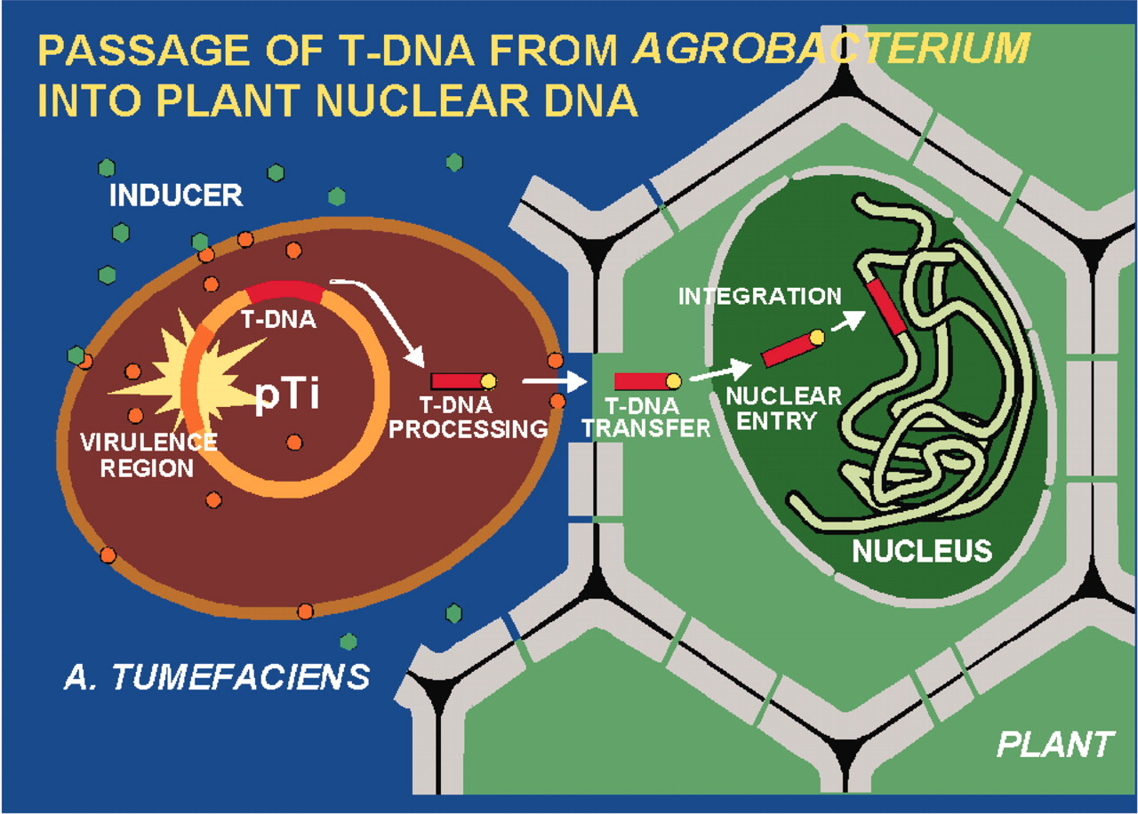
The Agrobacterium Ti plasmid system

Slide 6
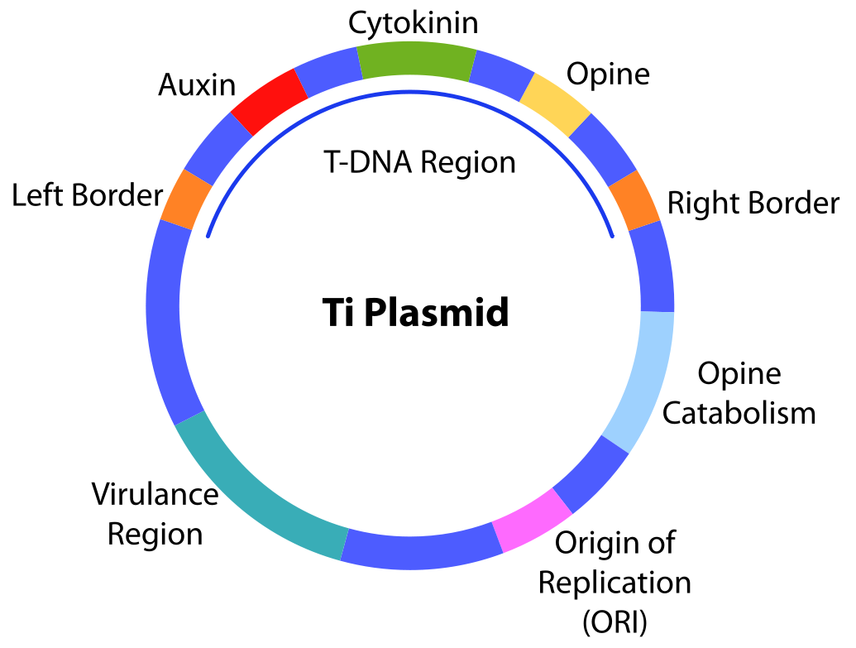
The Agrobacterium Ti plasmid system

Slide 7
The Agrobacterium Ti plasmid system – a “vehicle”, a “vector
To introduce foreign DNA into plant cells –mid to late -- 70’s

Slide 8
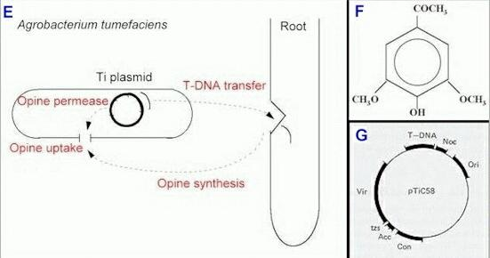
Inducer made by plant:
acetosyringone, induces
T-DNA excision

Slide 9
The Agrobacterium Ti plasmid system – a “vehicle”, a “vector
To introduce foreign DNA into plant cells –mid to late -- 70’s

Slide 10
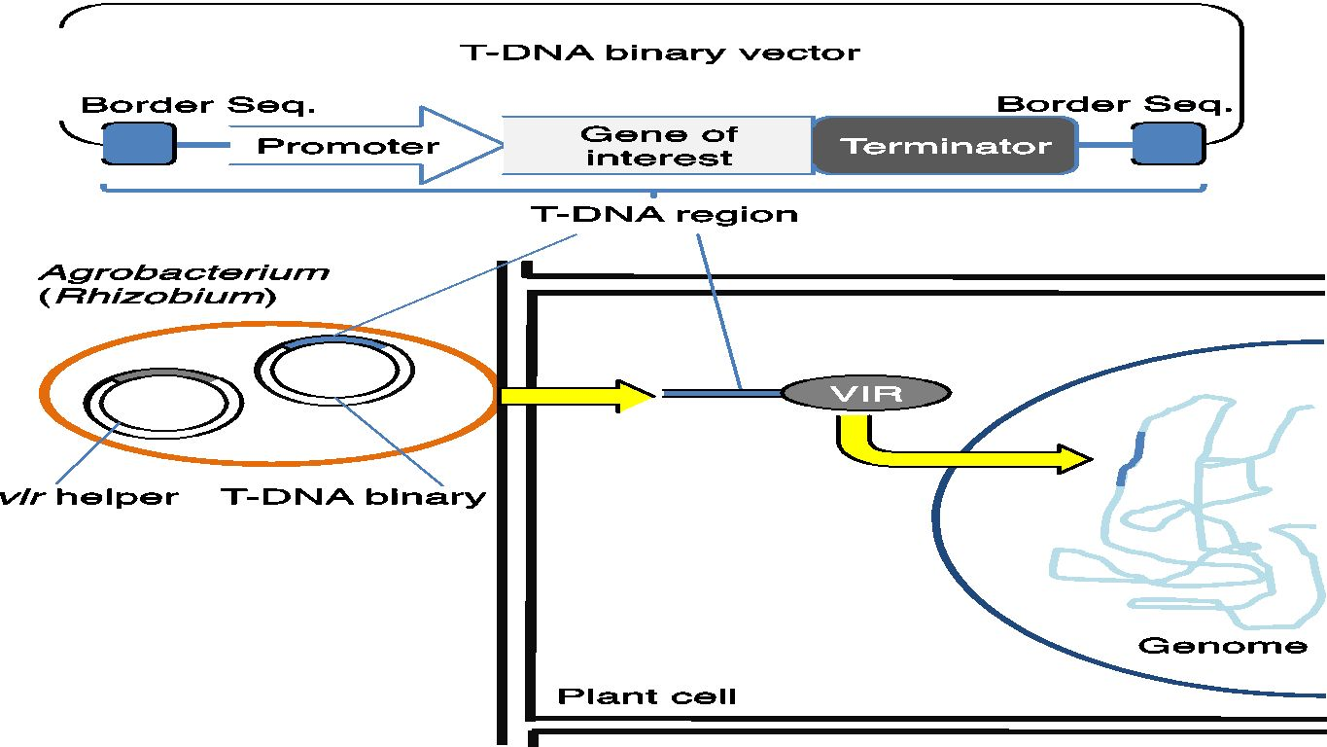
Introducing your gene of interest into plant cells

Slide 11
Gene for selection: e.g. antibiotics resistance,
Herbicide resistance

Slide 12
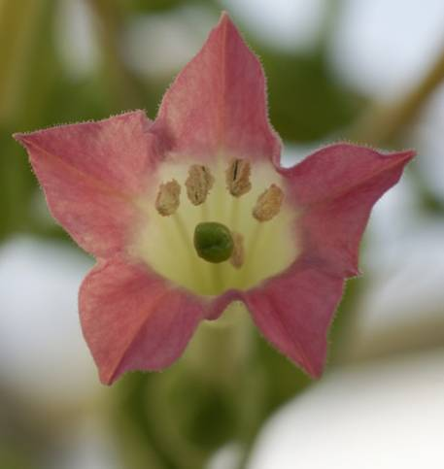
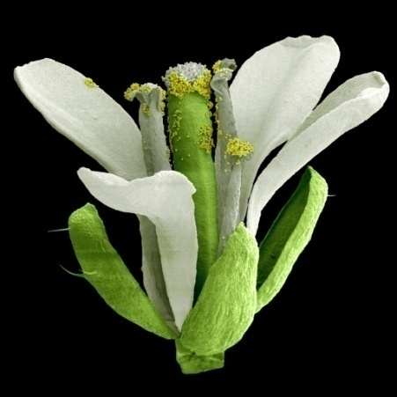
3. Transform plants: Use model plants in the lab. Tobacco is the more traditional plant used, and was most important in earlier studies to work out the transformation method. Arabidopsis is the most commonly used model plant.
The principle is the same, the methods are very different. From start to finish will take about 4 months (Arabidopsis) to 6 months (tobacco).

Slide 13
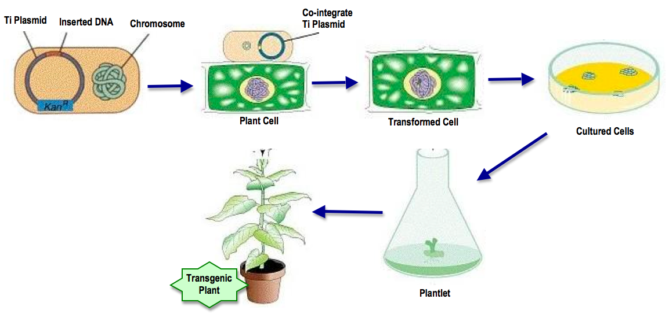
The Agrobacterium Ti plasmid-mediated
transformation – an overview
Selection:
Transformed plants
Survive;
Non-transformed ones
died

Slide 14
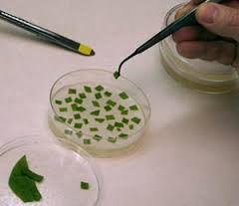
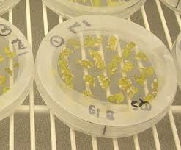
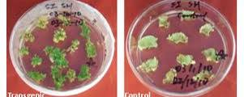
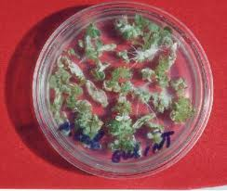
Tobacco leaf disc transformation

Slide 15
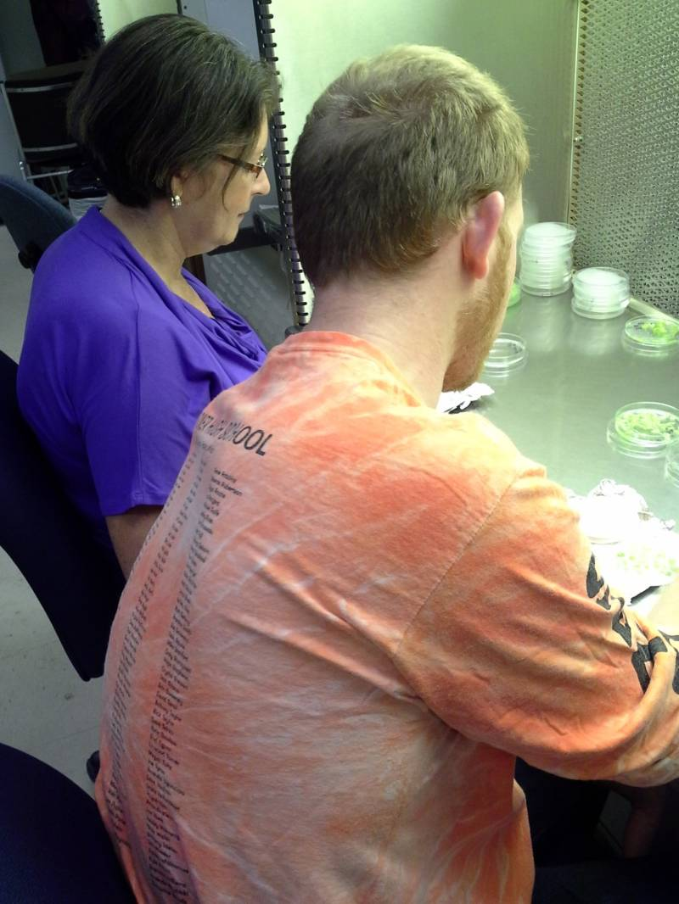
Jason DeFuria and Norice McGrath’s summer ‘13 internship
Jason and Norice making leaf discs
Go to video

Slide 16
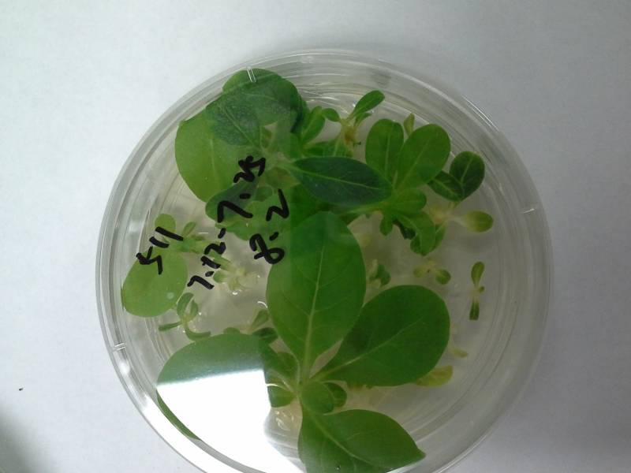
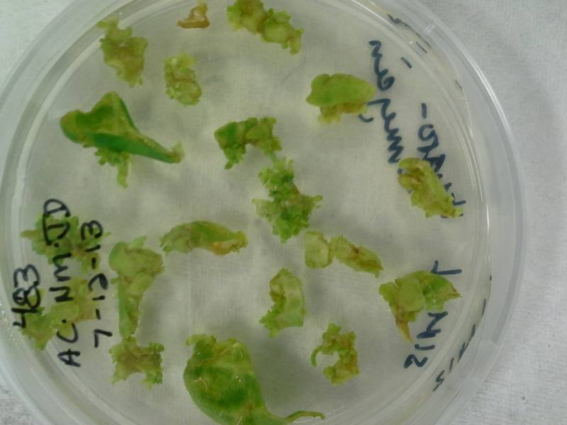
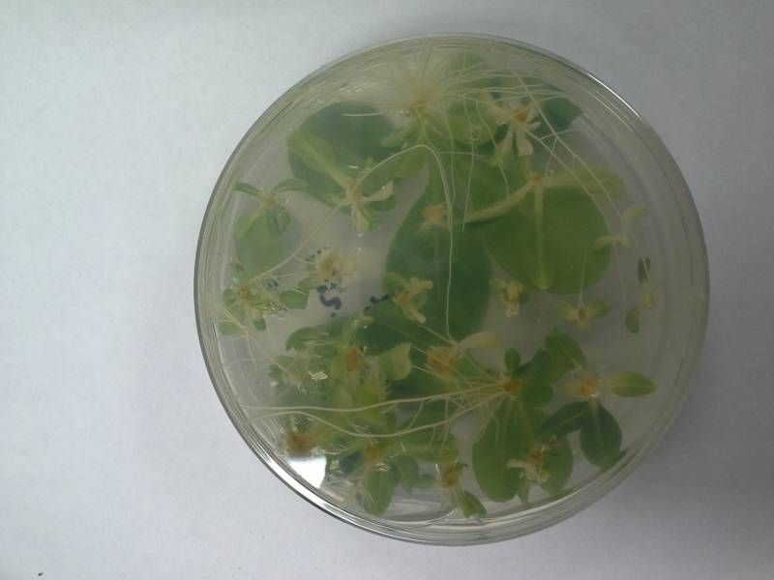
After the transformation step:
4. Selecting transformed plants [transformation event is very low, need a way
to identify the transformed plants/cells from the non-transformed ones.
Gene for selection:
e.g. antibiotics resistance,
Herbicide resistance
One month later, on kanamycin-containing
medium to select for transformed plants

Slide 17
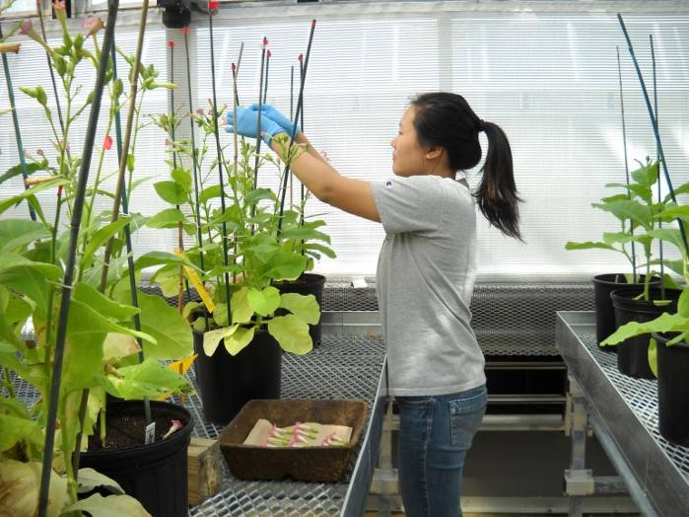
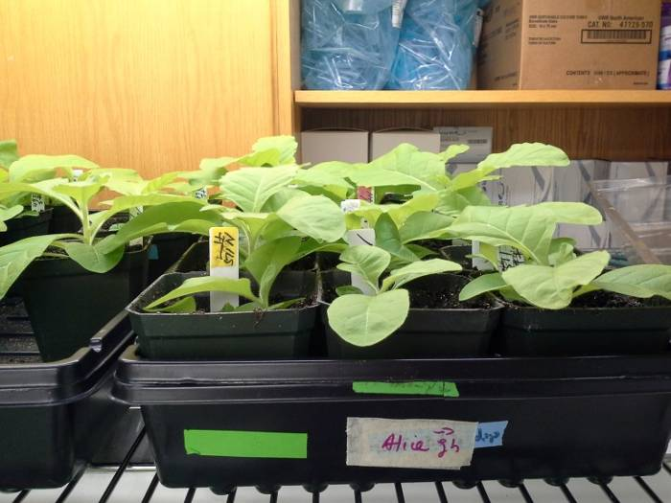
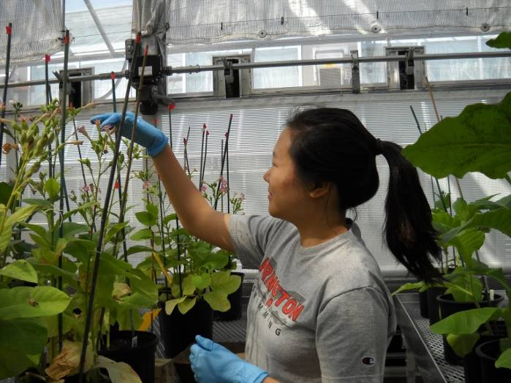
Grown in soil in the lab, one month
In the greenhouse, takes about three months
to flower; pictures show a high school student
from a couple of summers ago, collecting seeds
(she is now a first year student in
Carnegie-Mellon University)

Slide 18
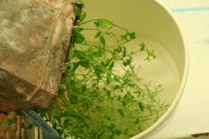
Arabidopsis transformation by floral dip

Slide 19
Show video, Norice preparing the plants, Jason preparing the dunking medium

Slide 20
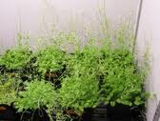
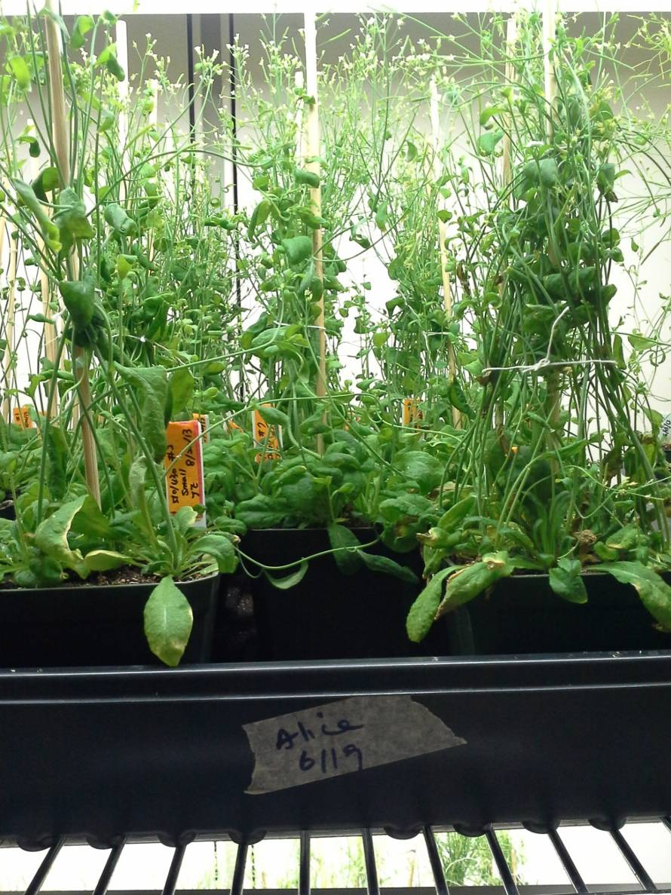
Jason and Norice’s plants
Jason and Norice’s

Slide 21
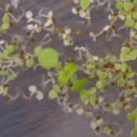
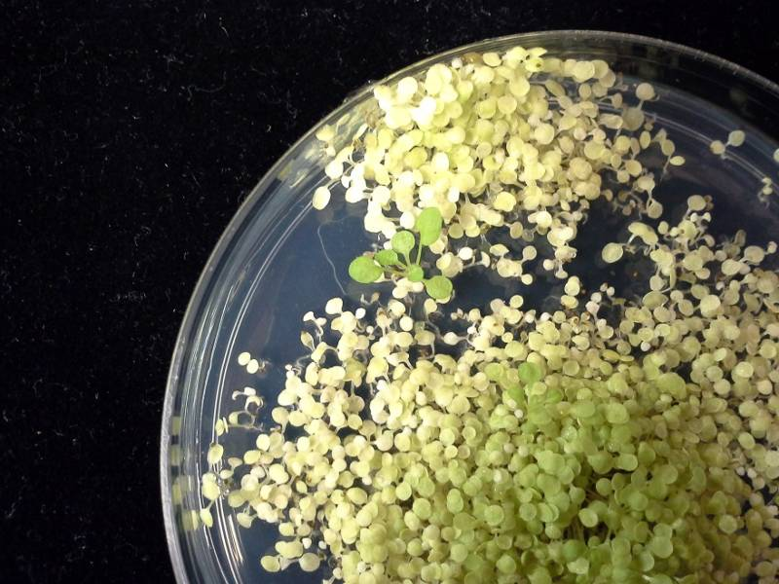
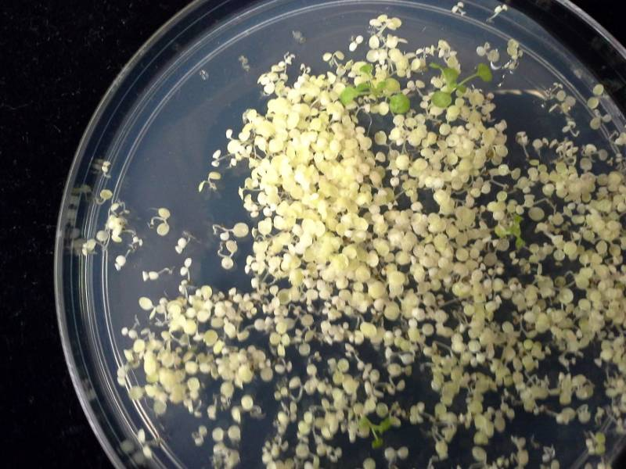
Select transformed seedlings
on kanamycin containing medium
Jason and Norice’s

Slide 22
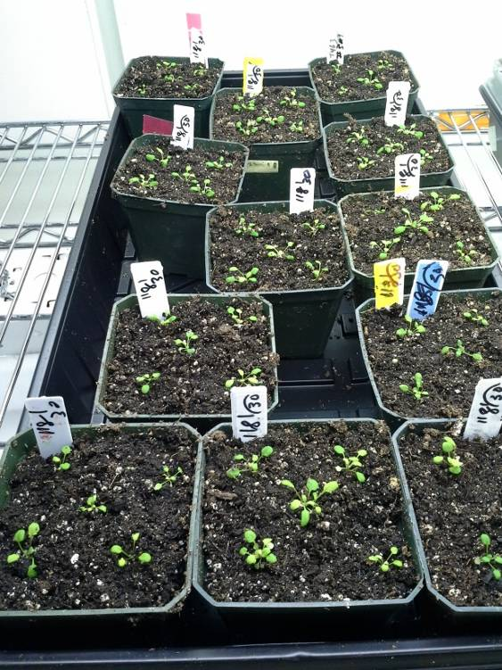
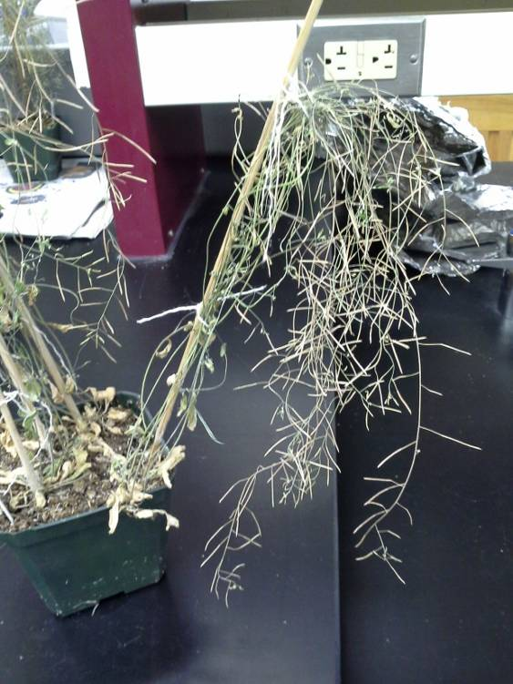

Slide 24
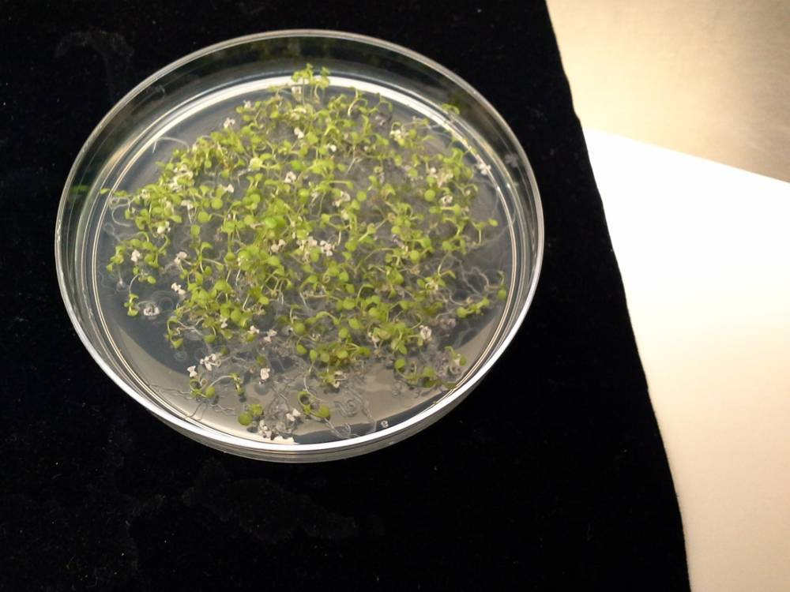
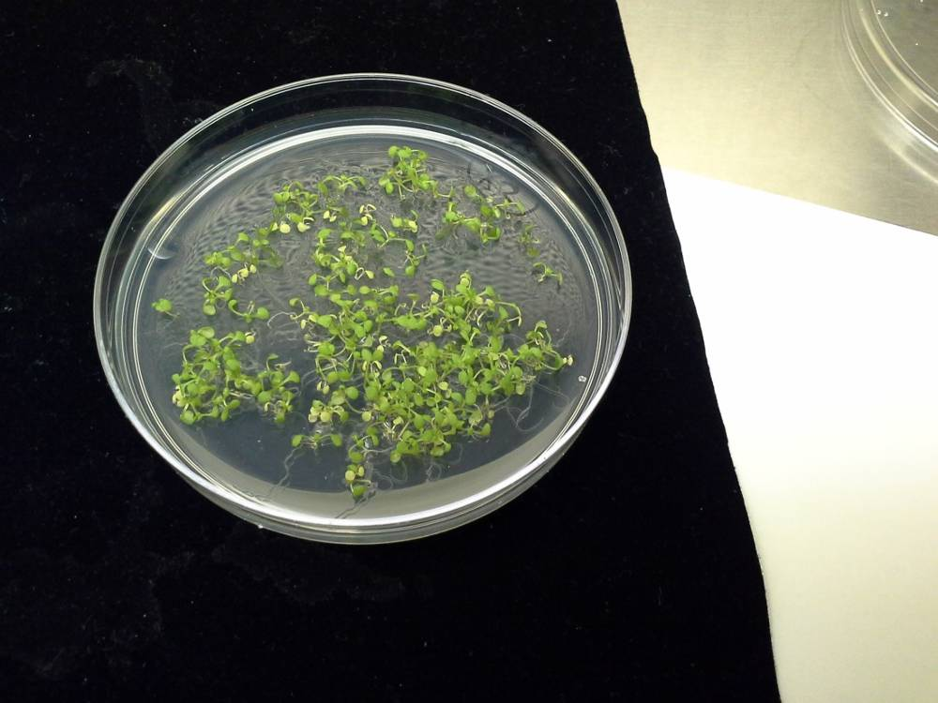
5. Genetically characterize the transformed plants: this can be done in different ways to determine the presence of the transgene and its inheritance (basic genetic characterization -- Mendelian principles). We can use visual characterization, e.g. using resistance to kanamycin – easiest. Or we can use molecular analysis, by PCR.
These are second generation seedlings, the green plants inherited the transgene,
the white ones did not

Slide 25
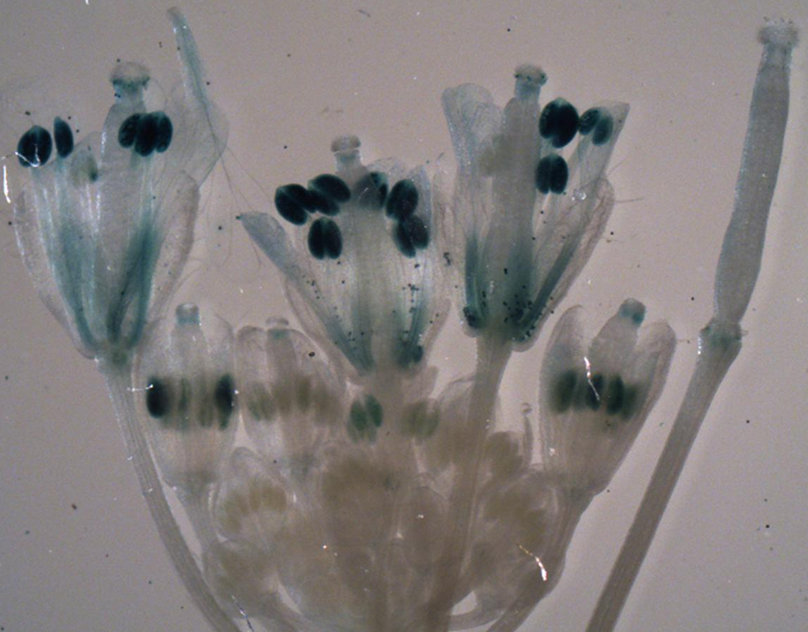
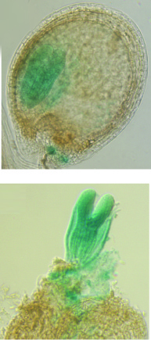
6. Analyze transgenic plants.
An example, we have introduced “the blue color” gene into the plant.

Slide 26
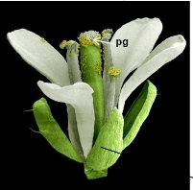

Slide 27
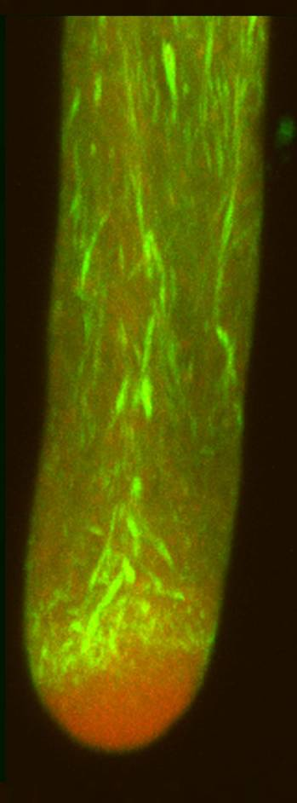
Pollen Tubes
Apical vesicular
zone
Subapical
actin
Actin
Vesiclese
Cheung and Wu, 2008 Ann. Rev.
Plant Biol;,
Cheung et al., 2010. PNAS

Slide 29
High school teacher summer internship
Sponsored by the NSF support Research Coordination Network on
Integrative pollen biology
http://pollennetwork.org/
A stipend is provided.
Contact Alice Cheung
acheung@biochem.umass.edu

Slide 30
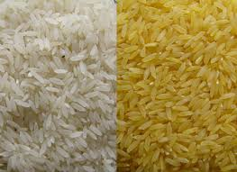
Golden Rice
White rice – lacks vitamin A; a major health problem
Genetically engineer vitamin A accumulating
rice grains.

Slide 32
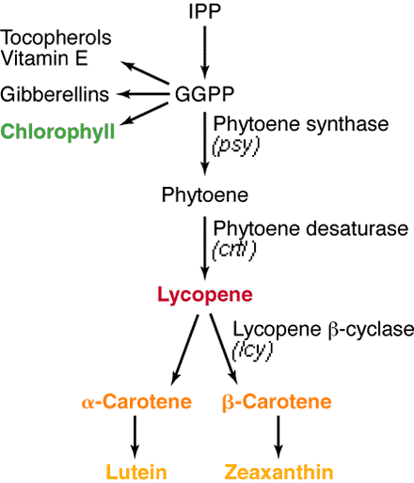

Slide 33
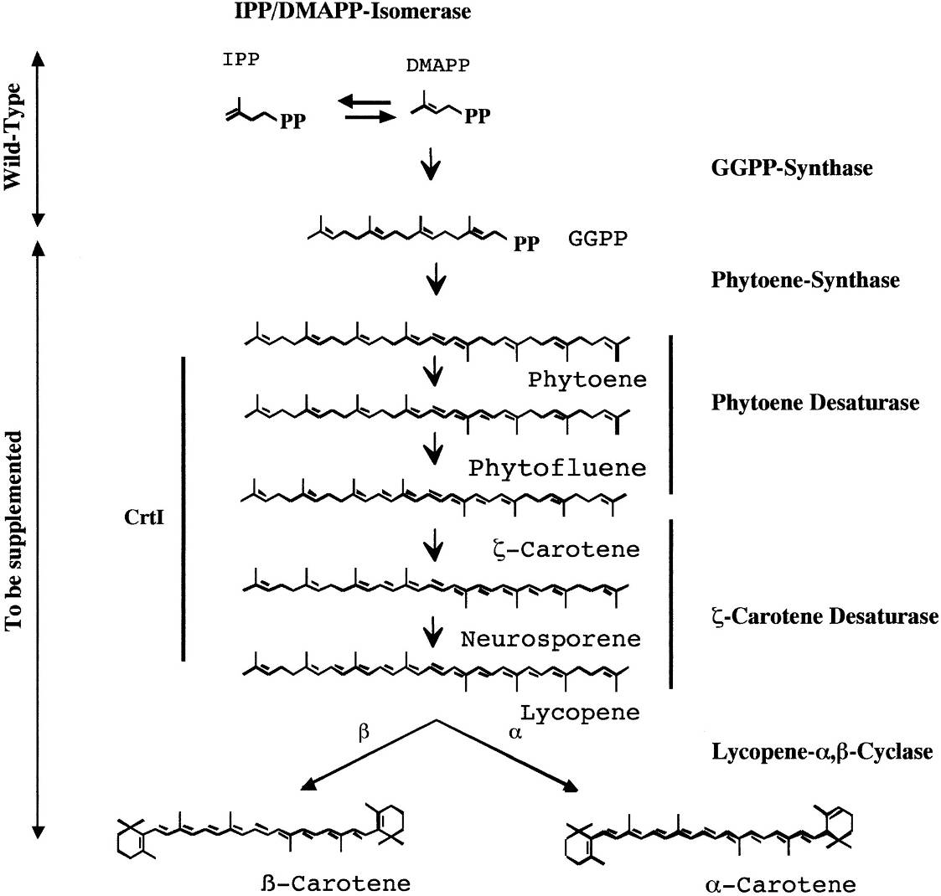
Provitamin A biosynthetic pathway.
Beyer P et al. J. Nutr. 2002;132:506S-510S
©2002 by American Society for Nutrition
Notes:
Provitamin A biosynthetic pathway. The names of enzymes are given. CrtI denotes a bacterial carotene desaturase capable in performing all necessary desaturation reactions for which two enzymes are required in plants. Arrows indicate the prenyllipid biosynthetic capacity of wild-type rice endosperm and the necessary reaction sequence to be completed to yield provitamin A.

Slide 34
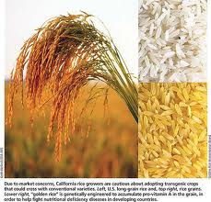

Slide 35
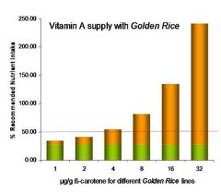
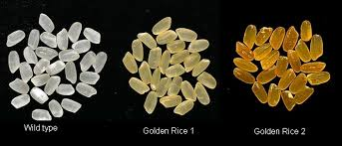

Slide 36
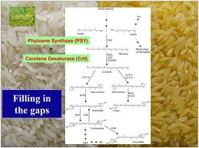

Slide 37
Blue Rose

Slide 38
Suntory Creates Mythical Blue (Or, Um, Lavender-ish) Rose
http://www.popsci.com/science/article/2011-09/suntory-creates-mythical-blue-or-um-lavender-ish-rose

Slide 39
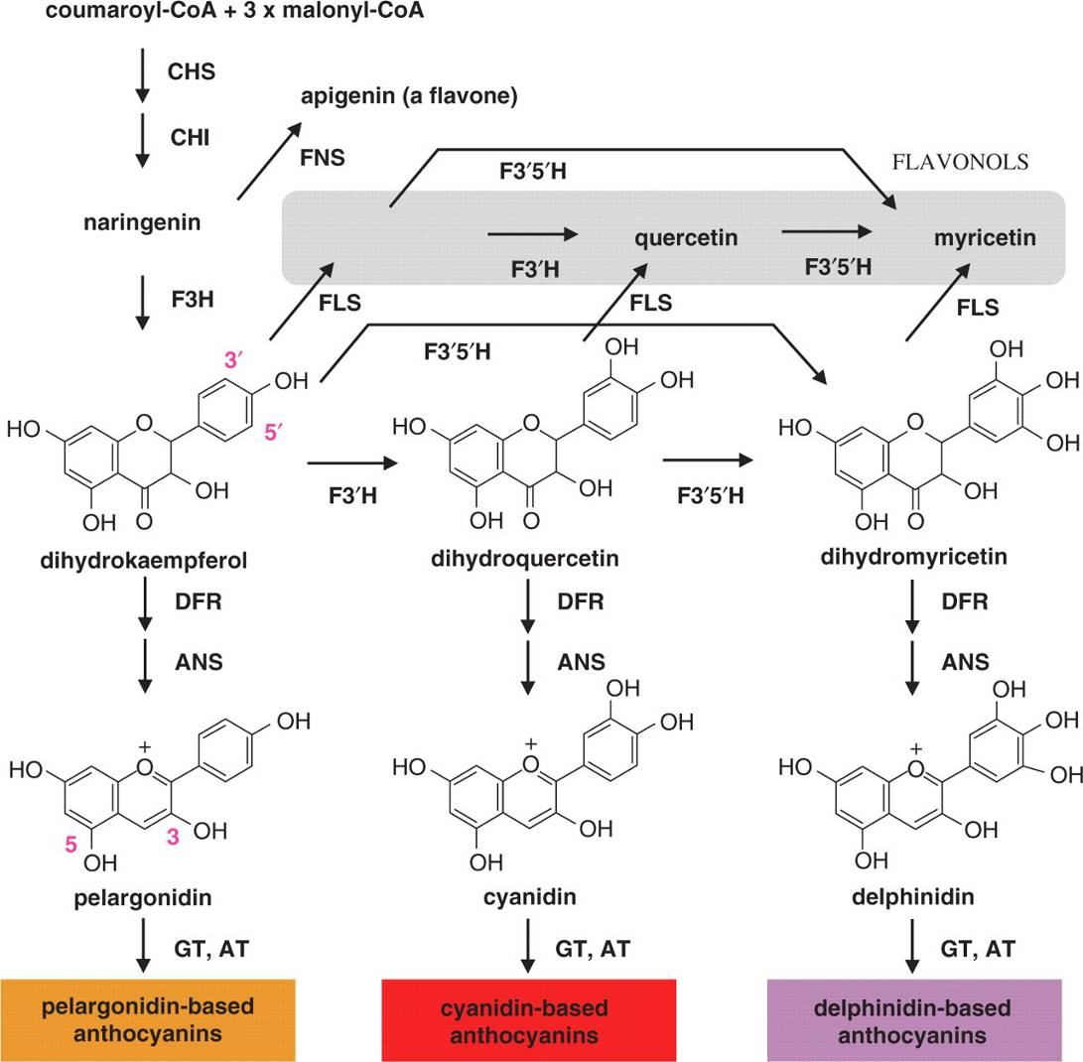
Generalized flavonoid biosynthetic pathway relevant to flower color.
Katsumoto Y et al. Plant Cell Physiol 2007;48:1589-1600
© The Author 2007. Published by Oxford University Press on behalf of Japanese Society of Plant Physiologists. All rights reserved. For permissions, please email: journals.permissions@oxfordjournals.org
Notes:
Generalized flavonoid biosynthetic pathway relevant to flower color. Native rose petals only accumulate pelargonodin and cyanidin-based anthocyanins, mainly pelargonidin and cyanidin 3,5-diglucoside. Lack of delphinidin-based anthocynanins, which is attributed to deficiency of F3′5′H, has hampered the generation of rose flowers having blue and violet hues. The expression of a hetelorogous F3′5′H gene in rose is expected to generate delphinidin and, thus, a novel flower color with a blue hue. CHS, chalcone synthase; CHI, chalcone isomerase; F3H, flavanone 3-hydroxylase; F3′H, flavonoid 3′-hydroxylase; F3′5′H, flavonoid 3′,5′-hydroxylase; FLS, flavonol synthase; FNS, flavone synthase; DFR, dihydroflavonol 4-reductase; ANS, anthocyanidin synthase; GT, anthocyanidin glucosyltransferase; AT, anthocyanin acyltransferase.

Slide 40
Fig. 1 Generalized flavonoid biosynthetic pathway relevant to flower color. Native rose petals only accumulate pelargonodin and
cyanidin-based anthocyanins, mainly pelargonidin and cyanidin 3,5-diglucoside. Lack of delphinidin-based anthocynanins, which is
attributed to deficiency of F3050H, has hampered the generation of rose flowers having blue and violet hues. The expression of a
hetelorogous F3050H gene in rose is expected to generate delphinidin and, thus, a novel flower color with a blue hue. CHS, chalcone synthase; CHI, chalcone isomerase; F3H, flavanone 3-hydroxylase; F30H, flavonoid 30-hydroxylase; F3050H, flavonoid 30,50-hydroxylase;
FLS, flavonol synthase; FNS, flavone synthase; DFR, dihydroflavonol 4-reductase; ANS, anthocyanidin synthase; GT, anthocyanidin
glucosyltransferase; AT, anthocyanin acyltransferase.

Slide 41
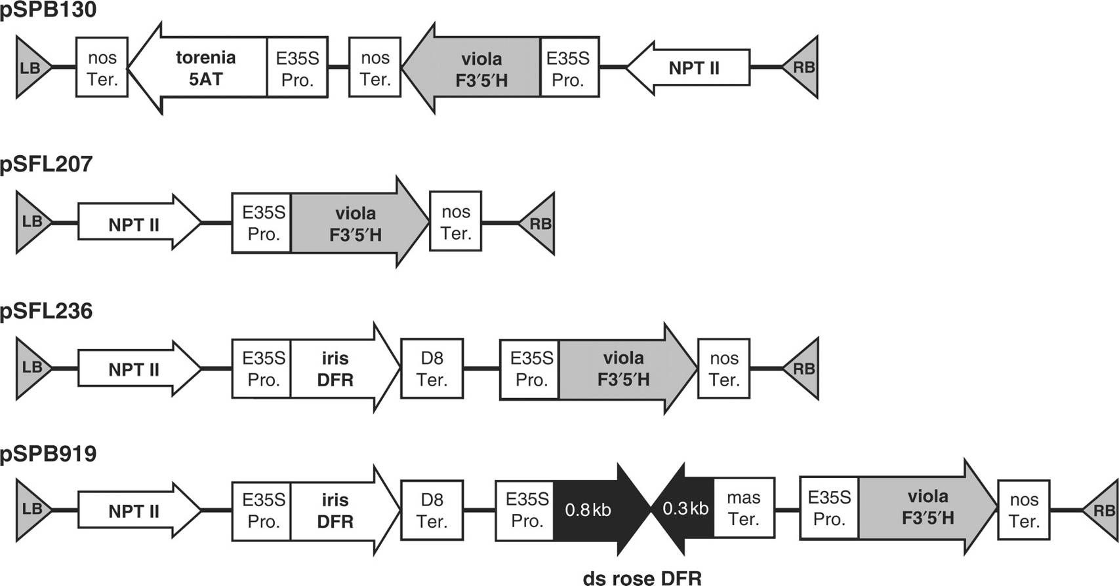
Schematic representation of binary vectors constructed for color modification.
Katsumoto Y et al. Plant Cell Physiol 2007;48:1589-1600
© The Author 2007. Published by Oxford University Press on behalf of Japanese Society of Plant Physiologists. All rights reserved. For permissions, please email: journals.permissions@oxfordjournals.org
Notes:
Schematic representation of binary vectors constructed for color modification. Only some T-DNA regions are shown. The directions of the cDNA sense strand are shown by arrows. All of them have the nptII gene as the selectable marker for plant transformation. E35S Pro., enhanced CaMV 35S promoter; mas Ter., terminator region from manopine synthase; nos Ter., nopaline synthase gene terminator; D8 Ter., terminator region from a petunia phospholipid transfer protein gene (D8) (Holton 1996); F3′5′H, flavonoid 3′,5′-hydroxylase; DFR, dihydroflavonol 4-reductase; 5AT, anthocyanin 5-acyltransferase.

Slide 42
Fig. 2 Schematic representation of binary vectors constructed for color modification. Only some T-DNA regions are shown. The
directions of the cDNA sense strand are shown by arrows. All of them have the nptII gene as the selectable marker for plant transformation.
E35S Pro., enhanced CaMV 35S promoter; mas Ter., terminator region from manopine synthase; nos Ter., nopaline synthase gene
terminator; D8 Ter., terminator region from a petunia phospholipid transfer protein gene (D8) (Holton 1996); F3050H, flavonoid
30,50-hydroxylase; DFR, dihydroflavonol 4-reductase; 5AT, anthocyanin 5-acyltransferase.

Slide 43
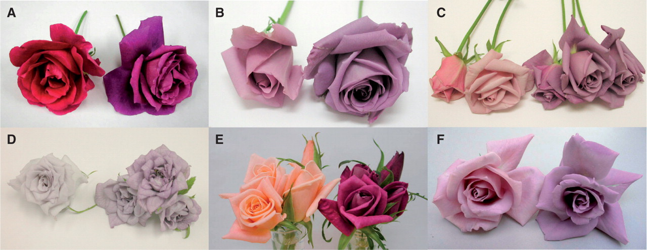
Flower color changes by delphinidin production.
Delphinidin
WKS77 0 1.068 WKS 82 0 0.139 WKS100 0 0.152 mg/g
WKS116 0 0.051 WKS124 0 1.017 WKS 140 0 0.114
Katsumoto Y et al. Plant Cell Physiol 2007;48:1589-1600
© The Author 2007. Published by Oxford University Press on behalf of Japanese Society of Plant Physiologists. All rights reserved. For permissions, please email: journals.permissions@oxfordjournals.org
Notes:
Flower color changes by delphinidin production. The rose cultivars WKS77, WKS82, WKS100, WKS116, WKS124 and WKS140 were transformed with pSPB130, and their flower color changed (left, host; right, a transformant). A flower of the line exhibiting the most significant color change is shown. (A) WKS77, (B) WKS82, (C) WKS100, (D) WKS116, (E) WKS124, (F) WKS140.

Slide 44
Fig. 3 Flower color changes by delphinidin production. The rose cultivars WKS77, WKS82, WKS100, WKS116, WKS124 and WKS140
were transformed with pSPB130, and their flower color changed (left, host; right, a transformant). A flower of the line exhibiting the most
significant color change is shown. (A) WKS77, (B) WKS82, (C) WKS100, (D) WKS116, (E) WKS124, (F) WKS140.

Slide 45
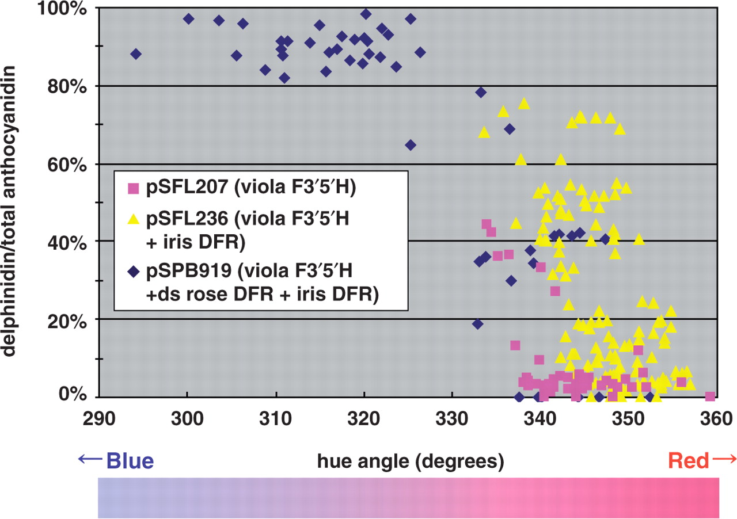
Correlation of delphinidin content and petal colors in transgenic Lavande.
Katsumoto Y et al. Plant Cell Physiol 2007;48:1589-1600
© The Author 2007. Published by Oxford University Press on behalf of Japanese Society of Plant Physiologists. All rights reserved. For permissions, please email: journals.permissions@oxfordjournals.org
Notes:
Correlation of delphinidin content and petal colors in transgenic Lavande. The percentage of delphinidin in the petals of individual transgenic plants was plotted against the flower color represented by the hue value in degrees (hue angle). Pure red and blue have hue values of 360 and 270° in the hue angle, respectively. The higher the percentage of delphinidin was, the bluer the flower color became. The color gradation bar approximately indicates the corresponding petal color of transgenic Lavande petals.

Slide 46
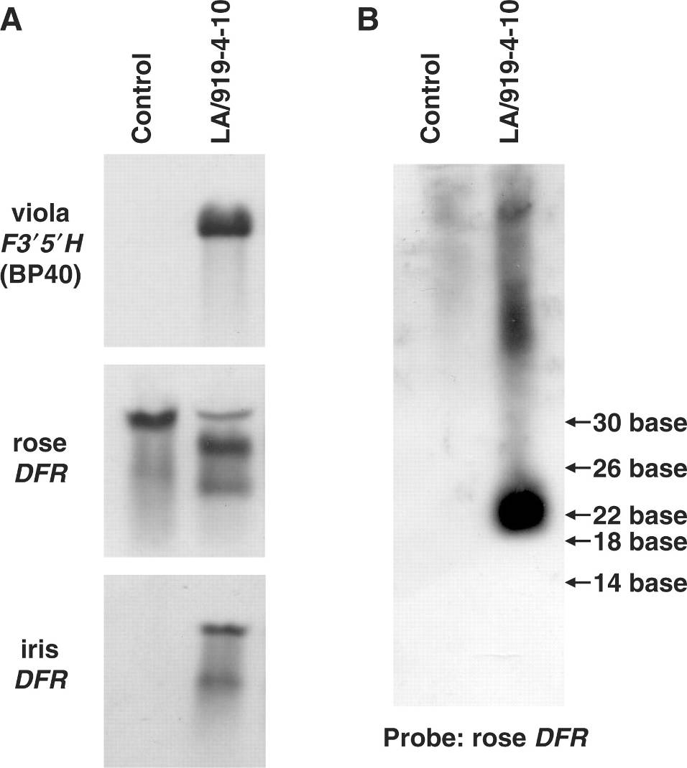
Northern blot analysis of LA/919-4-10.
Katsumoto Y et al. Plant Cell Physiol 2007;48:1589-1600
© The Author 2007. Published by Oxford University Press on behalf of Japanese Society of Plant Physiologists. All rights reserved. For permissions, please email: journals.permissions@oxfordjournals.org
Notes:
Northern blot analysis of LA/919-4-10. The expected sizes of the transcripts of viola F3′5′H BP40 (1.8 kb) and iris DFR (1.7 kb) genes were observed, while only the smaller size was detected for rose DFR mRNA (A). A rose DFR probe detected about 23 bp of the small sized RNA, which was supposed to be a degraded endogenous rose DFR transcript with RNAi (B).

Slide 47
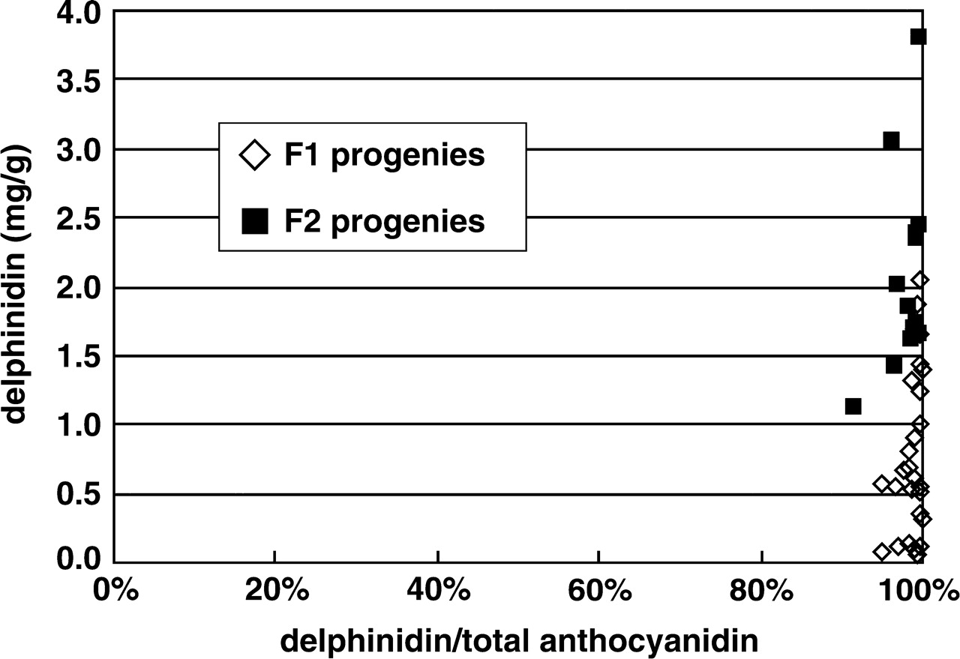
Delphinidin contents of the transgenic progeny.
Katsumoto Y et al. Plant Cell Physiol 2007;48:1589-1600
© The Author 2007. Published by Oxford University Press on behalf of Japanese Society of Plant Physiologists. All rights reserved. For permissions, please email: journals.permissions@oxfordjournals.org
Notes:
Delphinidin contents of the transgenic progeny. The accumulation of delphinidin was confirmed in all of the KmR progeny of LA/919-4-10. The flowers of the F1 and F2 progeny contained exclusively delphinidin.

Slide 48
Suntory Creates Mythical Blue (Or, Um, Lavender-ish) Rose
http://www.popsci.com/science/article/2011-09/suntory-creates-mythical-blue-or-um-lavender-ish-rose
Suntory to sell blue roses overseas
Kyodo
Sep 16, 2011
The world’s first blue roses will hit stores in the United States and Canada in early November, with the aim of selling 300,000 of them in 2012, said its developer, Suntory Flowers Ltd.
The flowers will be sold under the brand name “Applause” by selected florists in North America. They first hit stores in Tokyo in 2009 for ¥2,000 to ¥3,000 each and became popular gifts, the subsidiary of beverage maker Suntory Holdings Ltd. said.
After selling 50,000 of the roses in 2010, the firm expanded sales across Japan, except for Okinawa Prefecture, last January, it said.

Slide 49
http://www.telegraph.co.uk/news/worldnews/asia/japan/3329213/Worlds-first-blue-roses-after-20-years-of-research.html
World's first blue roses after 20 years of research
The world's first blue roses have been unveiled following nearly two decades of scientific research.

Slide 50
The start of the road to RNAinterference – a Nobel Award winning work

Slide 51
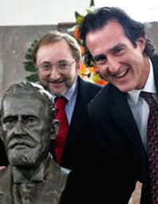
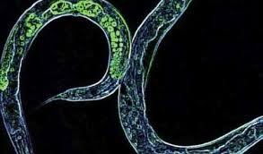
2006 Nobel Prize -- RNAi

