Slide 1
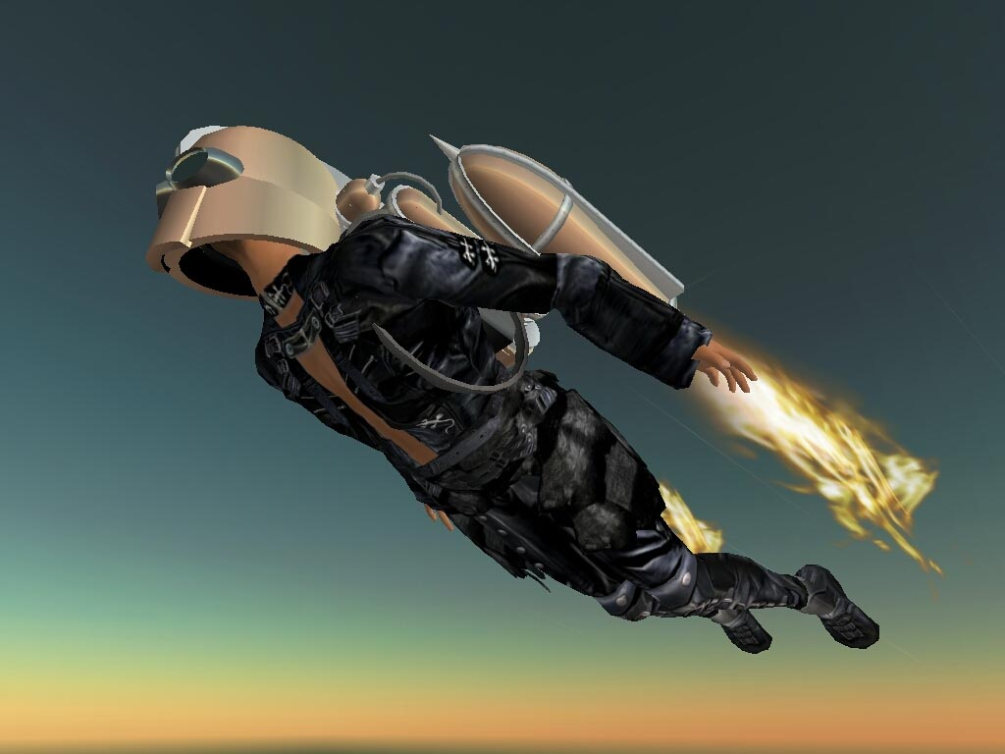
History of the Jetpack
http://jetpack.legazpi.biz/index.html
By Benjamin LISAN

Slide 2
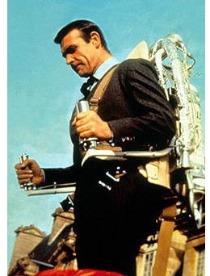
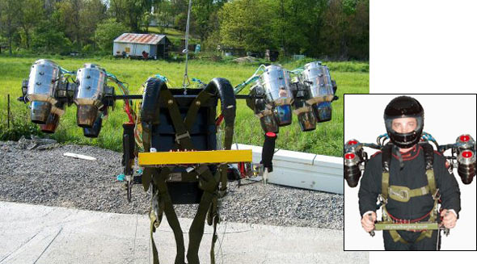
History of the Jetpack
1) Introduction
who has not dreamed of flying like a bird, easily, without effort, as you can move from one point to another through the air? Even the middle of a city, a garden, a roof of a building, street by vertical takeoff? Easy to unpack (eg the trunk of a car or station wagon 4x4) and assemble and disassemble ? Many have dreamed of flying, light, easy to drive, with sufficient autonomy. To go to his office, and jump over the traffic jam. They were embodied in the form of a jetpack (a rocket-powered seat / reaction, by a helicopter jet engine ...), backpack or put in the back ... all these solutions have materialized man's obsession to fly almost unhindered.
In this paper, we trace the history of this idea.
Note: A light disposal (devices) such as paragliders and ultralight is unsuitable to takeoff anywhere. Thus these last two solutions are not the good key solution.
← Jetpack powered by 8 micro-jets or turbo-jets (?).
http://dvice.com/archives/2006/07/jet-pack-the-rocketeer-takes-o.php
Scène du film de James Bond, Thunderball (1965)

Slide 3
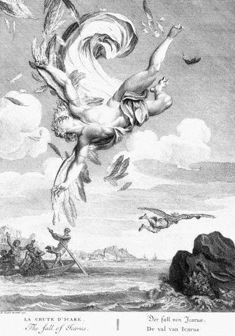
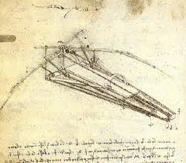
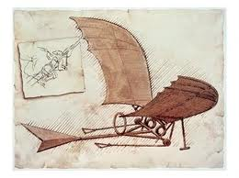
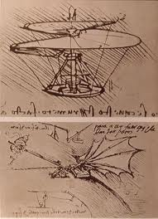
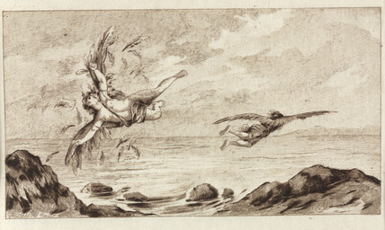
History of the Jetpack
Daedalus and Icarus myth
http://alicestrology.wordpress.com/2009/11/22/cazimi-daedalus-creation-and-loss
Leonardo Da Vinci Flying machines (dreams)
2) The Dream time
For thousands of years people have dreamed of flying. For most of this time, the only term of reference was birds. Not surprisingly, myths and stories had us strapping wings or feathers to our arms and flapping! Source : http://martinjetpack.com/history.aspx

Slide 4
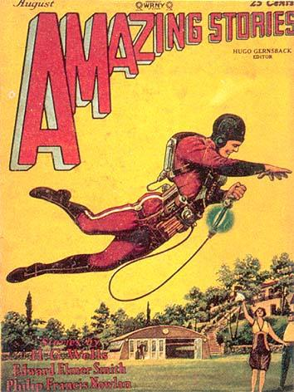
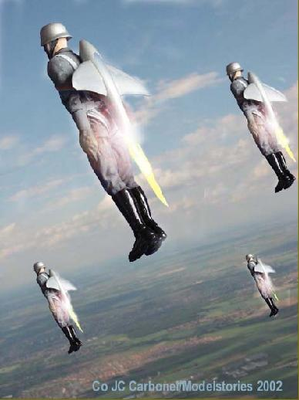
History of the Jetpack
www.time.com/time/photogallery/0,29307,2030642_2209285,00.html
2) The Dream time
2.1) Skylark Of Space 1920s (de E. E. "Doc" Smith's, in Amazing Stories, pulp comic, August 1928)
As the general public became more technically educated, the idea of strapping feathers to your arms was replaced by a rocket or jet strapped to your back. This concept was so appealing and persuasive that it has been ingrained in our collective psyche. Ask any 5-year old boy what a flying jetpack is and he will draw one! The “jetpack” first appeared in the science-fiction novel The Skylark of Space. Comic-book hero Buck Rogers soon adopted the contraption, and in 1928 it graced the cover of Amazing Stories. Source : http://martinjetpack.com/history.aspx

Slide 5
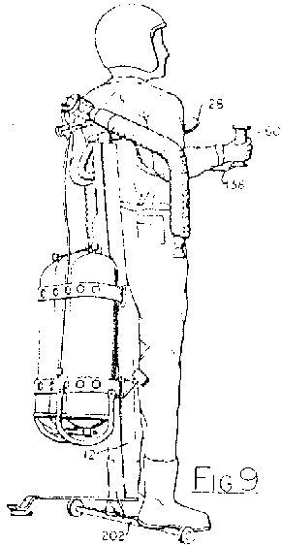
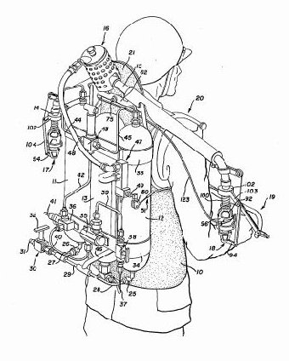
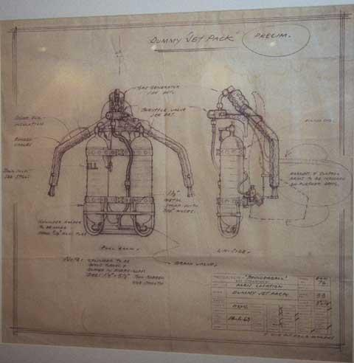
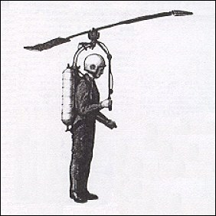
History of the Jetpack
6) American Military 1950s – Pre-projects
The first serious attempts to build a Jetpack were instigated by the U.S. military in the 1950s. The idea was to build the ultimate "all terrain vehicle" to move military commanders around a battlefield. Source : http://martinjetpack.com/history.aspx
www.uncleodiescollectibles.com/html_lib/lis/00041.html

Slide 6
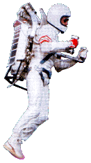
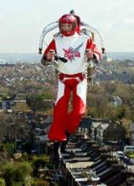
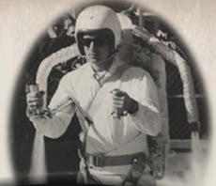
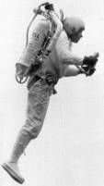
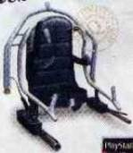
History of the Jetpack
Rocket Bell 1961
7) Bell Jetpack and avatars 1960s
7.1) Jetpack developed by Bell Textron for U.S. Army (1961)
The Jetpack was developed for the U.S. Army by Bell Textron Laboratories in 1961. The high-pressure gas of nitrogen dioxide was released from the nozzles to give a powerful rocket propulsion, but without combustion. It could be a person over the obstacles of 9 meters, at speeds of 11-16km / h. Its flying time is 30 seconds. Nitrous oxide was chosen as the safest fuel for personal use, because no combustion was taking place, just the expulsion of pressurized gas peroxide. The pilot was wearing a corset fiberglass, adjusted for safety. The unit is very light, but its flight range is very low, less than a minute on average 30 s (it is also expensive). Source : http://www.flying-contraptions.com/history.html
In 1969 Bell tried to build a version turbojet (jet engines), whose autonomy was almost 5 minutes.

Slide 7
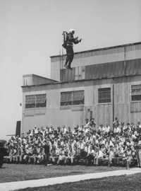
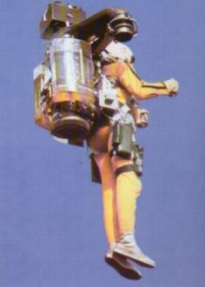
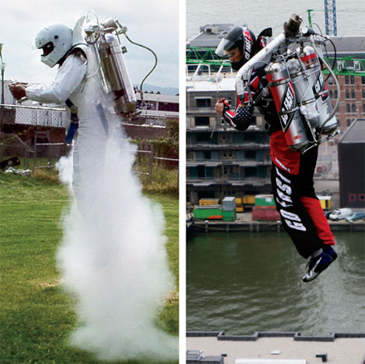
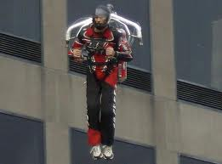
History of the Jetpack
7) Bell Jetpack and avatars 1960s
Autonomy : ~ 30 s max !
Ed Clark/Time Life Pictures/Getty Images
A rocket belt demonstration at Fort Bragg.
http://tesla3.com/general/f_transport_jetpack.html
TAM ROCKET BELT | MODEL | JET PACK H202
More than 60 mph | TOP SPEED | 70 mph
30 seconds | FLIGHT TIME | 33 seconds
$250,000 | PRICE | $155,000
http://www.popularmechanics.com/technology/aviation/diy-flying/4217989

Slide 8
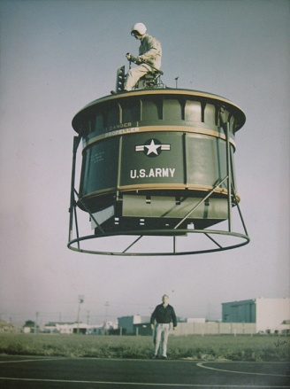
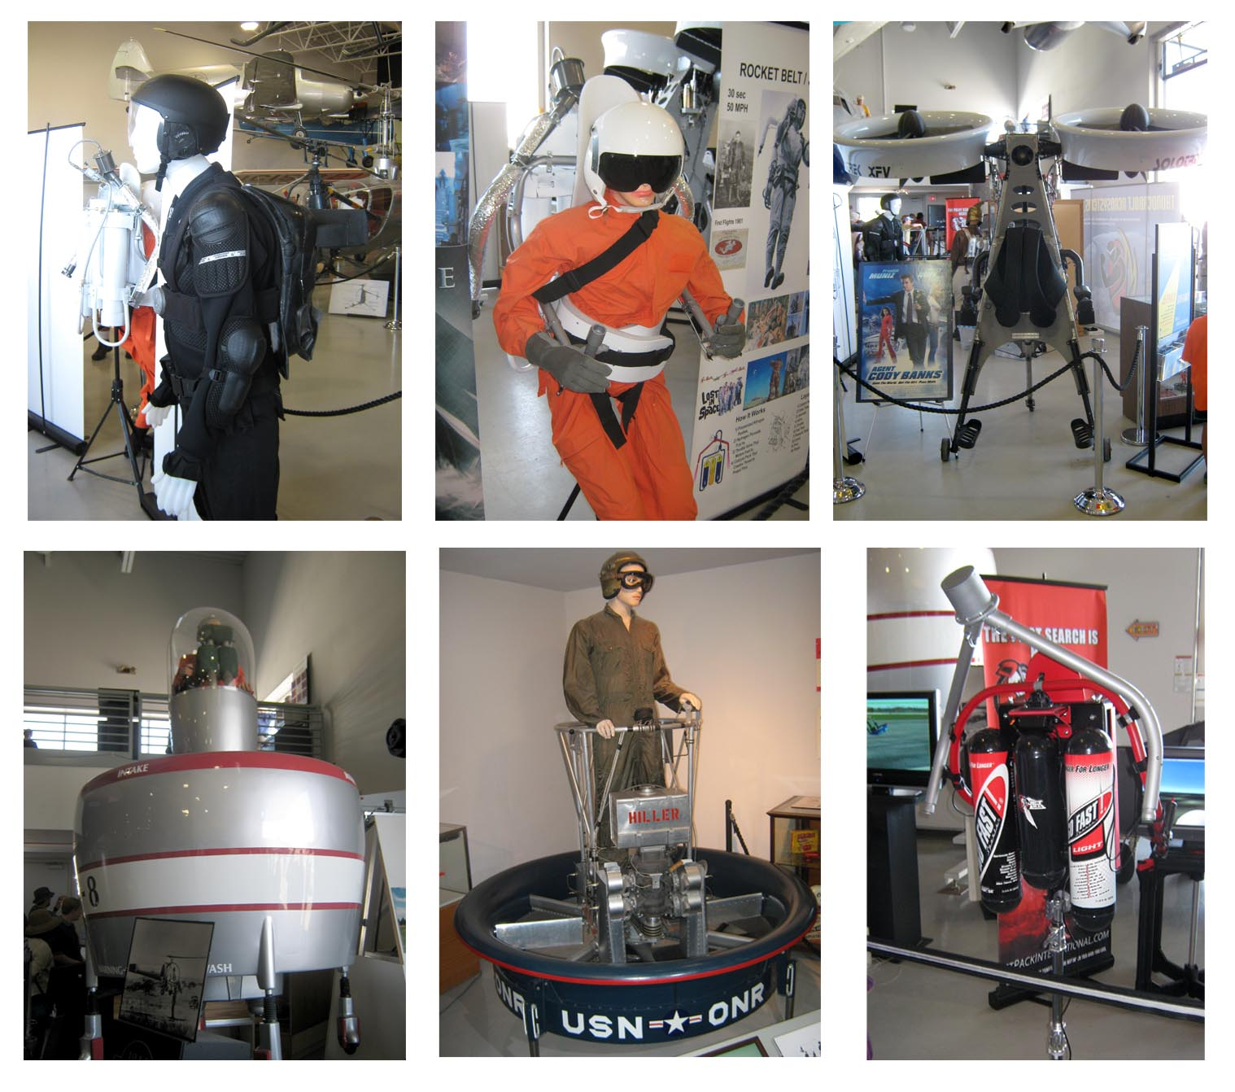
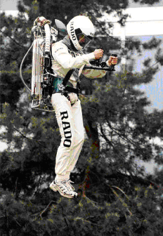
History of the Jetpack
7) Jetpack and avatars 1960s
Stability problems !
→
http://blog.squarelight.com/technology/jet-pack-show
The Hiller Aviation Museum in San Carlos, California is hosting a Jetpack Show!
www.blogadilla.com/2008/09/06/jetpack-show
Pic. found at: Aerodium.ca, Aerodium Canada inc.
http://wikiality.wikia.com/File:Jetpack.gif

Slide 9
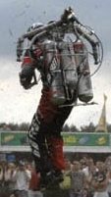
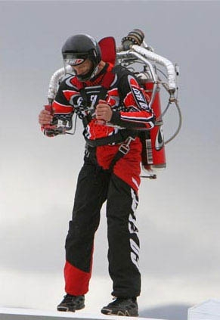
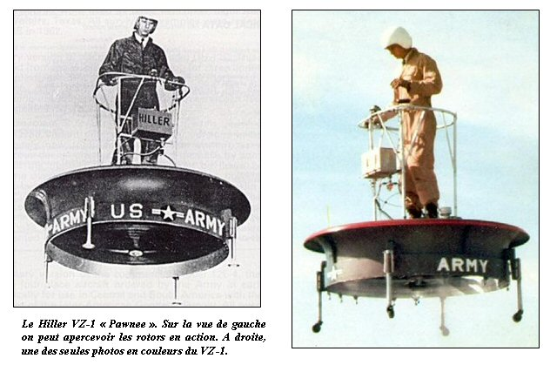
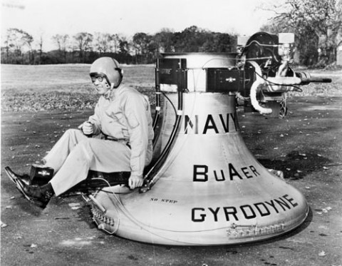
History of the Jetpack
7) Jetpack and avatars 1960s
Jet Pack International's T-73 Jet Pack
August 31, 2007
www.jetpackinternational.com &
http://uk.cars.ign.com/objects/960/960591.html
← Gyrodyne Model GCA-55 single-seat ground cushion (1959)
Hiller VZ-1 (~1950) - Stability problems
This machine, called the VZ-1 "Pawnee" was very easy to handle. Also, the USAF decided she to test it as a platform shooting. The results of these trials were disappointing because every time the pilot made the slightest movement, the center of gravity was moving and the flying device was moving.
http://forum.aviation-ancienne.fr/t1330-ventilateur-plate-forme-jeep-volante-avrocar-aerodyne
← www.barbariangroup.com/posts/2625-xplanes_the_gyrodyne_model_gca_55_single_seat_ground_cushion

Slide 10
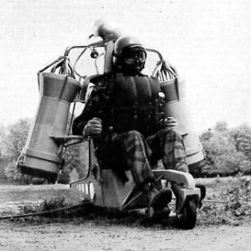
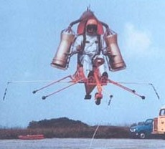
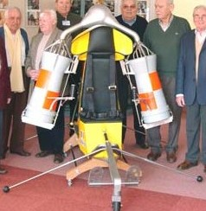
History of the Jetpack
8) Le « Ludion » de Sud-Aviation (1967 - France)
In 1967, the company Sud-Aviation and SNECMA have the Ludion, other equipment and autonomous individual with a SEPR rocket engine. It was a cumbersome and costly demonstration that nobody cares. 64 flights Ludion (while credits) were made in 1968, including five free flights without any hindrance. His best performance: a path of 190 meters in 32 seconds, facing a wind of two nodes, representing no wind 520 meters distance to 59 km / h. Its purpose to allow infantry to cross rivers easily and ditches with a payload. But considered eccentric by many, it was abandoned. Source : http://www.museesafran.com
His best performance: a path of 190 meters in 32 seconds, facing a wind of two nodes, representing no wind at 520 meters distance 59 km / h. Weight: ~ 90 kg

Slide 11
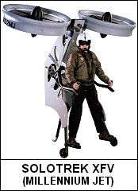
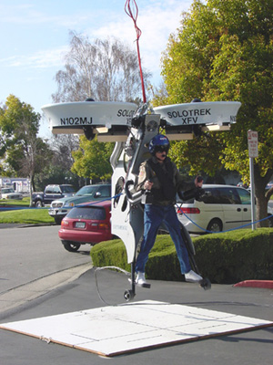
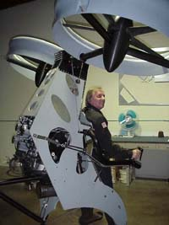
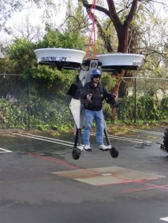
History of the Jetpack
11) Solotrek XFV (2001-2002)
www.autocentre.ua/ac/02/06/images/01/news_1.jpg
http://eurekaweb.free.fr/td3-solotrek.htm
Solotrek XFV (Trek Aerospace Inc.), www.trekaero.com
Specification and predicted performance
(sea level;std. day)
Normal gross take off weight : 88 Lbs.
Fuel (15 U.S. Galons) : 98 Lbs.
Mission Payload, net of fuel : 352 Lbs.
Empty Weight : 350 Lbs; ~ 160 kg.
This project have stoped because lack of fund.
Takeoff/Landing Distance : 0 (VTOL)
Maximum speed : 70 Mhp
Range : 120+ Miles
Hover/Lofter Endurance : 2+ Hours
Engine Type : Advanced Int. Combustion
Fuel Requirements : Heavy-fuel of Gasoline.
Source : http://en.wikipedia.org/wiki/SoloTrek_XFV

Slide 12
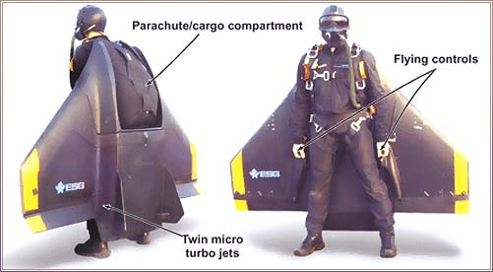
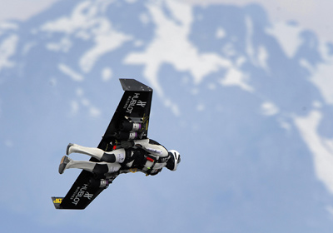
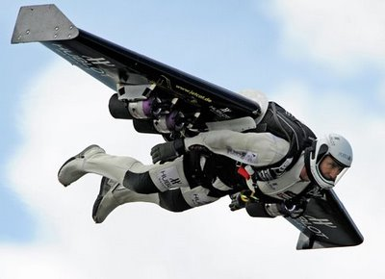
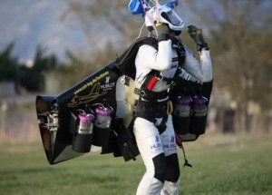
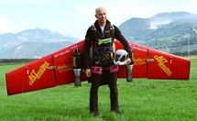
History of the Jetpack
You cannot take off from everywere !
↑ FABRICE COFFRINI/AFP/Getty Images
Yves Rossy flies his jet-powered winged suit over the Alps in 2008.
http://science.howstuffworks.com/transport/engines-equipment/jet-pack2.htm
Dangerous and stability problems !! Experimental.
http://www.espritcritik.fr/article-revolution-de-nos-deplacement-segway-cam-am-spyder-power-sky-jetboard-powerstrider--41956163.html
12) Yves Rossy jet-powered wing and avatars
http://pleasedonotspinthemoon.blogspot.com/2009/01/theres-your-damn-jetpack-now-quit-your.html
↑
www.nickcarnes.com/2009/03/ive-got-my-wings-on

Slide 13
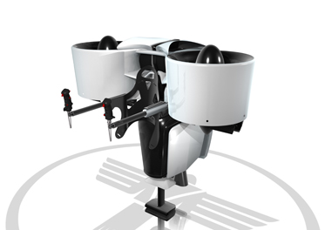
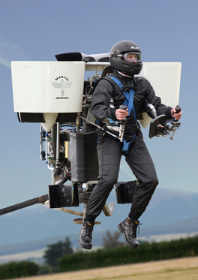
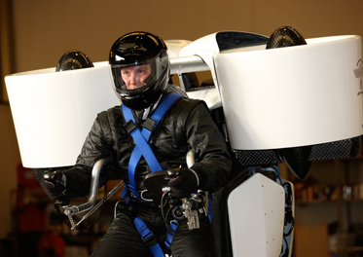
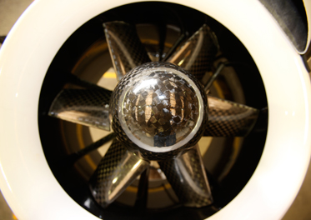
History of the Jetpack
15) Martin Jetpack (2008) (New-zeland)
Martin Jetpack works.
~ Safe but expensive.
Constructed from carbon fiber composite, the Martin Jetpack weighs 250 lbs _ 113 kg _ (excluding safety equipment as parachute …) and is 5 ft high by 5.5 ft wide by 5 ft long. Gizmag reports it's driven by a 2.0 L V4 2 stroke engine rated at 200 hp (150 kw) and two 1.7 ft wide rotors made from carbon/Kevlar composite. It runs on regular gasoline, can reach heights of 8,000 ft and has a maximum flight time of 30 minutes. Burn 10.5 GPH, fly at a max of 61 MPH and has a 31.5 mile range.
Martin Aircraft says that as sales and production volume increase they expect the $86,000 => $100,000 to drop to the price of a mid-range car.
Safety equipment : The Martin Jetpack’s extensive safety features include a rapid deploying parachute, roll cage structure and shock absorbing undercarriage.
Source : http://martinjetpack.com

Slide 14
History of the Jetpack
15) Martin Jetpack 2008 (New-zeland)
Martin Jetpack Specifications http://martinjetpack.com/technical-information.aspx
Height | 5 ft (1,52 m)
Width | 5.5 ft (1,67 m)
Length | 5 ft (1,52 m) / Volume : 3,858368 m2 or 3858 L (⬄ volume of the trunk of a hummer : 2450 L)
Structure | Carbon fibre composite
Empty weight | 250 lbs (excluding safety equipment) (113 kg)
Gross weight | 535 lbs
Useful (Pilot) Load | 280 lbs+
Maximum thrust | 600 lbs+
Fuel Capacity | 5 US gallons (as required by FAA Part 103,Ultralight Regulations)
Fuel burn | 10.0 gph
Engine | Martin Aircraft 2.0 L V4 2 stroke, rated at 200 hp (150 kw). Max 6000 rpm.
Electrical system | 12 V DC Battery, starter, 360 w alternator.
Rotor | Carbon / Kevlar composite diameter 1.7 ft
Max | 7058 rpm
Range | 31.5 miles (at max speed of 63 mph as required by FAA part 103).
Hover in ground effect | 8000 ft (estimated)
Hover above ground effect | 8000 ft (estimated)
Standard Equipment | Flight and Engine displays Harness Ballistic Parachute Retractable undercarriage Energy absorbing undercarriage.
Classification | Meets the requirements of the FAA Part 103, Ultralight Regulations
Pilot License | The Ultralight class does not require an FAA recognised pilots license.

Slide 15










History of the Jetpack
15) Martin Jetpack 2008 (New-zeland) - Key Partners
 | Dynamic Composites | www.dynamic-composites.co.nz
 | SRD Titanium | www.srdtitanium.com
 | No.8 Ventures | www.no8ventures.co.nz
 | Air New Zealand | www.airnewzealand.co.nz
 | Ballistic Recovery Systems | www.brsparachutes.com
 | Formworks Design | www.formworks.co.nz
 | Infinity Aerospace | www.infinityaerospace.com
 | University of Canterbury, New Zealand | www.mech.canterbury.ac.nz
 | Intercad | www.intercad.co.nz
 | SolidWorks | www.solidworks.com
Source : http://martinjetpack.com/key-partners.aspx

Slide 16
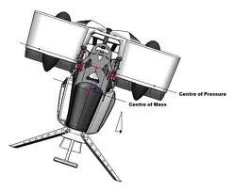
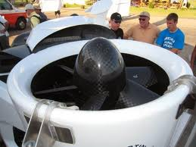
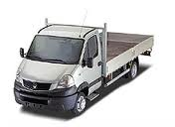
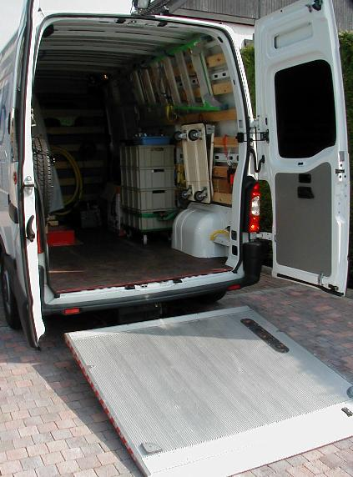



History of the Jetpack
15) Martin Jetpack 2008 (New-zeland)
Advantages :
Safety
10 key partners
Disadvantages
Autonomy : less than < 30 mn.
Difficulties to translocate the Martin jetpack with a personal break car.
Weight with fuel : more > 160 kg => difficult to move / to displace with only one person.
High cost with all the equipments (safety equipments etc.) : ~ US$ 100.000
reserved for the rich and the military.
Perhaps, possible future military use.
Center of Pressure
Center of Mass
Must be transported on the truck or the transmission range of a van
volume of the trunk of a hummer: 2450 L

Slide 17

History of the Jetpack
17) Bibliography
Jetpack Dreams: One Man’s Up and Down (But Mostly Down) Search for the Greatest Invention That Never
Was, Author: Mac Montandon, Publisher: Da Capo, 2008
Web sites in English :
http://en.wikipedia.org/wiki/Jet_pack
http://www.jetpackinternational.com
http://martinjetpack.com
Jet Man Yves Rossy : http://www.fusionman.ch/prod/index.html/?page_id=24
Uncle Odies Jet pack photo gallery (a wonderfull jetpack pictures collection) :
http://www.uncleodiescollectibles.com/html_lib/lis/00040.html
http://www.uncleodiescollectibles.com/html_lib/lis/00041.html
Ultra-light helicopters pictures : http://zeeoo.free.fr/forum/forum_2.php?msg=6715
Web sites in French :
http://fr.wikipedia.org/wiki/R%C3%A9acteur_dorsal
http://fr.wikipedia.org/wiki/Rocketbelt
Ultra-light (one seat) helicopters kits and spare parts :
www.vortechonline.com/kits
www.vortechonline.com/engines
Site on homebuilt helicopters :
www.prismz.com/helio
http://www.ultralightmarket.com/results.asp?view=Gruppe&Gruppe=24
http://ultralight-airplanes.info/How-To-Obtain-Ultralight-Helicopter-Kits-And-Plans.html
Homebuilt Coaxial Helicopter : www.rotaryforum.com/forum/showthread.php?t=10464&page=2
http://io9.com/5073639/i-dream-of-jetpacks--mac-montandon-bears-all

Slide 18






History of the Jetpack
18) Appendix: solutions which do not meet the criteria selected
Mosquito micro-helicopter (New-Zealand) (°)
This helicopter, cheap (<$ 30,000 U.S. All taxes included) is not removable and foldable so it can be stowed in the trunk
of a break car.
(°) The price of the kit Mosquito Ultralight Helicopter AIR, full is: € 26,800 tax not included; including, the "kit rapid manufacturing", the MZ-202 engine, instruments, rotors, tank option "Large capacity".
MOSQUITO AVIATION, Blair Hollands, Po Box 439, Kumeu, 0841, Auckland, New Zealand, Web Site: www.mosquito.net.nz, Email: info@mosquito.net.nz, Phone: +64 (0)21 2994122

Slide 19


History of the Jetpack
18) Appendix: solutions which do not meet the criteria selected
Ultrasport-254 kit helicopter (1994)
Specifications :
Top Speed, mph 63 (101,39 km/h)
Cruise, mph 63
Range S.M 70
Stall, mph na
Rate of Climb, fpm 1000
Take Off Distance, ft 0
Landing Distance, ft 0
Service Ceiling , ft --
HP/HP Range 55
Fuel Capacity, gal 5 (19 l)
Empty/dry Weight, lbs 252 (115 kg).
Gross Weight, lbs 525 (239 kg).
Useful load : 273 lbs (124 kg).
Height, ft 7.5 (2.2 m)
Length, ft 16.7 (5.8 m)
Engines: HIRTH 2706 65 hp (or HIRTH 2703 55 hp).
Main Rotor Diameter: 21 ft. (6.4 m)
Tail Rotor Diameter: 2.6 ft (79 cm / 0,79 m)
Drive System: 12:1 Planetary
Endurance: 1.25 h.
Wing Span, ft 21
Wing Area, sq.ft --
Number of Seats 1
Landing Gear type skids
Building Materials C
Building Time, Man Hours 60
Number of Completed & Flown 1
Information Package $$5
Plans Cost $none
Kit Cost $33900
Certified : FAA ultralight regulations FAR Part 103.
American Sportscopter International, Inc., 11712 Jefferson Ave Unit #C228, Newport News VA, 23606, USA,
Phone: 757-872-8778, email : assi@visi.net, www.ultrasport.rotor.com (restricted use).
Sources : http://www.airsport.com/homebuilt4.ihtml?id=53&cid=16
www.freqofnature.com/photos/cma2002/index.html
www.ultralightflyer.com/americansportcopter & www.aviastar.org/helicopters_eng/ultra-254.php

Slide 20






History of the Jetpack
18) Appendix: solutions which do not meet the criteria selected
Furia, amateur construction helicopter(°)
Furia Helicopter e-Plans $49.95, www.plansdelivery.com & www.plansdelivery.com/furia.htm#
(short free plans : www.sfu.ca/~jst4/plans/docs/misc/Ultralight%20Furia%20Helicopter%20Plans.pdf ).
Main Rotor Diameter: 19 ft.
Tail Rotor Diameter: 3.6 ft.
Height: 6.9 ft.
Length: 12.5 ft.
Max Gross Weight: 700 lbs.
Empty Weight: 325 lbs.
Payload (with full fuel) : 350 lbs.
Fuel capacity: 8 gal.
Seats: 1
Range: 80 sm.
Take Off Distance: 0 ft.
Landing Distance: 0 ft.
Vmax.: 95 mph (max. allowable speed level, flight sea level std. day)
Vcr: 70 mph
Climb Rate @ msl: 1100 fpm.
Service Ceiling: 12500 ft.
Engine: Rotax 65 hp.
Potential danger of amateur construction

Slide 21


History of the Jetpack
18) Appendix: solutions which do not meet the criteria selected
Airscooter II, coaxial personal helicopter (2004)
AirScooter II Specifications
Markets : Recreational Personal Air Vehicule
Government and Military
Uses : Recreation
Search and Rescue
Surveillance
Dimensions : Height ... 11' (3,35 m)
Wigth ... 7' (2,13 m)
Length ... 12,5' (3,81 m)
Rotor Blades: 14' Composite Coaxial (4,2 m).
Four Rotor Design
Air Frame : Composite Torque I-Box
Speed : Minimum ... Hover
Maxmmum ... 55 Knot (100 km/h)
Empty Weight: ~254 lbs (115.2 kg) (i.e. Curb Weight).
Useful Load : Approximately 250 lbs (113 kg).
Features : Coaxial Stability
No Tail Rotor
Floats for Cushioned Landing and Water
Power System: Aero Twin Four-stoke 65 HP Aerobatic Engine
with Quiet Belt Drive Reduction
Power weight: 95 lbs (43 kg)
Endurance : 5 Gallon (19 L) (Approximately 2 hours).
Price : < US$50.000
Although its operating ceiling is around 10,000 ft (2 700 m), the AirScooter II is incapable of autorotation emergency descent, and is intended for recreational flying at low altitude, ie, at or below 50 ft (15 m) above ground level (AGL).
Sources : www.airscooter.com/pages/airscooter_specs.htm
http://en.wikipedia.org/wiki/AirScooter_Corporation
In French : www.jeunes-ailes.org/t3182-airscooter-2

Slide 22





History of the Jetpack
18) Appendix: solutions which do not meet the criteria selected
Skylar, Choppy, G-1, Kestrel, kit & 1 seat helicopters(°)
Kestrel
SKYLAR Features: • Full Standard helicopter. • All-alu. main- & tail-rotor blades • Aircraft-grade steel & aluminum airframe & major components, plus all AN hardware • Full instrumentation Specs : Height 7 ft Length 17-1/2 ft Empty Weight 350 lbs Gross Weight 725 lbs Payload Weight 375 lbs Main Rotor Diameter 19 ft Tail Rotor Diameter 3-1/2 ft Engine Rotax 582 Horsepower 65 Power Loading (lbs/h.p.) 10.8 Disc Loading (lbs/sq ft) 2.5 Maximum Speed 95 mph Cruise Speed 70 mph Rate Of Climb 1,000 fpm Maximum Altitude 12,500 ft Price : Assembled & Tested : $45,500 www.vortechonline.com/skylark | CHOPPY (1950 et after) Configuration: Bolted aluminum-tube airframe. CONTROL: Main rotor: full cyclic and collective pitch, incorporating a swash plate system. Tail rotor pitch: bellcrank operated. Autorotation accomplished by manual-disengagement lever at cyclic stick. POWER PLANT (Prototype): Any engine of 450cc to 1100cc, or 45 hp. consumption approximately 4.2 gals. (U.S.) per hour at sea level. Specs: Height 6 ft Length 15 ft Empty Weight 300+ lbs* Gross Weight 600 lbs** Payload Weight 300 lbs Main Rotor Diameter 21½ ft Tail Rotor Diameter 3½ ft Power Loading (lbs/h.p.) 11.5 Disc Loading (lbs/sq ft) 1.8 Maximum Speed 85 mph Cruise Speed 65 mph Rate Of Climb 950 fpm Maximum Altitude 8500 ft Price : Assembled & Tested : $45,500 www.vortechonline.com/choppy | G-1 or Kestrel (Jet-powered) General Features: • Easy, low-cost construction • Takes off and lands vertically • Requires no license (ultralight) • Can be stored anywhere Spec: Length: 12 ft Width: 5.7 ft Height: 5½ ft Main rotor diameter: 12 ft Tail rotor diameter: 2 ft Empty weight: 150 lbs Gross weight: 420 lbs Useful payload: 270 lbs Engine (typical): Kawasaki/Rotax, 40+ hp Fuel capacity: 5 gals Fuel consumption: 4 gals/hour Speed (max.): 80 mph Altitude (max.): 10,000 ft asi Price : Kestrel Jet Helicopter—Fully Assembled & Tested : $26,500 www.vortechonline.com/g1 | A/W 95, latest update of the Choppy Features : • Full helicopter • Easy, low-cost assembly • Built from widely available materials • Uses Rotax 503 engine (or equiv.) Specs : Empty weight: 272 lbs* (123 kilos) Gross weight: 497 lbs** (222 kilos) Useful load: 225 lbs** (102 kilos) Main rotor chord: 7" (17.78 cm) Main rotor diameter: 19.5' (5.94 m) Tail rotor diameter: 3'4" (102 cm) Height: 6'5" (196 cm) Length: 15' (4.57 m) Width: 5.75' (175 cm) Cruise speed: 60 mph (97 kph) Horsepower range: 50 - 75** Engine: Rotax 503 (or equiv.)** Engine RPM: 6200 - 6500 Main / tail rotor RPM: 435-450 / 2800 Flight time (5 gal fuel): 1 hour± Max altitude: about 10,500 ft www.vortechonline.com/aw95

Slide 23






History of the Jetpack
19) Appendix: solutions which do not meet the criteria selected
Lonestar (Redback aviation), CH7 helicopter, Helicycle helicopter, Mamba Air
Lonestar (Redback aviation) Specs : Engine Rotax 582 UL Power 64 hp (46 kw) Gross weight 680 lbs (310 kg) Empty weight 420 lbs (190 kg) Useful load (pilot & fuel) 260 lbs (120 kg) Fuel capacity (seat tank) 8.3 gal (31.5 lt) Fuel weight (seat tank) 51 lbs (23 kg) Fuel consumption at cruise (4.8 gal/hr (18.2 lt/hr) Rate of climb 600 ft/min (180 m/min) Service ceiling 9000 ft (2740 m) Hover in ground effect (HIGE) 5500 ft (1675 m) Hover out of ground effect (HOGE) 4500 ft (1370 m) Range at cruise 105 miles (170 kms) Flight duration 1.7 hrs Range at cruise with auxillary tanks 235 miles (375 kms) Flight duration with auxillary tanks 3.9 hrs Cruise airspeed 60 mph (96 kmph) Maximum airspeed 85 mph (135 kmph) Velocity limit (VNE) 100 mph (160 kmph) Main rotor diameter 20.0 ft 6.10 (m) Tail rotor diameter 3 ft 6 inches (1.07 m) Length - nose of skid to tail 13.5 ft (4.09 m) Width - at skids 5.0 ft (1.52 m) Height - overall 7 ft 4 inches (2.23 m) Height - overall for garage storage 6 ft 9 inches (2.05 m) www.redbackaviation.com | CH7 Helicopter St.da Traforo del Pino 102, 10132 TORINO Italy, Tel: +39 011 899.67.30, Fax: +39 011 899.5550, kompress@ch7.it http://www.ch-7helicopter.com/ita/home.htm | Helicycle Helicopter, tel : 208-461-2567 Eagle Research & Development, 2321 Hemingway Blvd, Nampa, Idaho USA, Office & Fax: 208-466-4120, Factory: 208-461-2567 www.helicycle.com | MAMBA AIR (CZ) www.mamba-air.cz
Mamba Air CH7

Slide 24


History of the Jetpack
That’s all folk !
To contact the author of this document:
Benjamin.lisan@free.fr

