Slide 1
HRT
Teleconference UKM, 27 AUGUST 2014
DR JOSEPHINE TANG, HSJ
Supervisor: DR JULIANA , ONG SPECIALIST HSJ

Slide 2
Case
Menopause
recommendations
HRT and side effects
What is available in KKM

Slide 3
Case 1
4/9/2013
52 yo/c/lady , PARA 3
LCB 1998
Previously a teacher now pensioner
menopause x1 year -started on T livial 1/1 OD
by private, Pt happy with livial,
c/o feeling anxious, depressed, hot flushes
and whitish pv dc
TAS= UT normal no mass

Slide 4
Ps : VV atrophic, minimal withish dc
HVS cs taken
Ufeme nad
upon further questioning, c/o urinary incontinence when coughing or sneezing, tried pelvic floor exercise.
Plan
TCA urogynae 20/2/14
TCA gynae x4/12
Continue T livial 1/1 OD
Clotrimazole pessary 1/1 ON x 1/7
continue T livial 1/1 od
Rv x 3/12 with FLP/FBS/LFT

Slide 5
Case 2
Pn H, 51 yo, P1 but child passed away at 16 years old
UL Sheehan’s syndrome with Panhypopituitary since 1994 after PPH and hysterectomy/ DM + dyslipidemia – not on Rx
HRT on premarin 0.625mg since 39 years old.
RBS (2013) : 7.7
RBS(2014) : 16.4
Mammogram: BIRADS 2, benign
In view of age 51, pt was advised to stop premarin by slowly and reduced dosage to 0.3mg od first.
Case was referred to continue f/up at endocrine clinic and dietician
continue T Hydrocort 20 mg bd, ca lactate 300 mg od,
L thyroxine 100 mcg od
Given tca 3/12 to review sx with blood ix(FLP, FBS, LFT, RP, TFT)

Slide 6
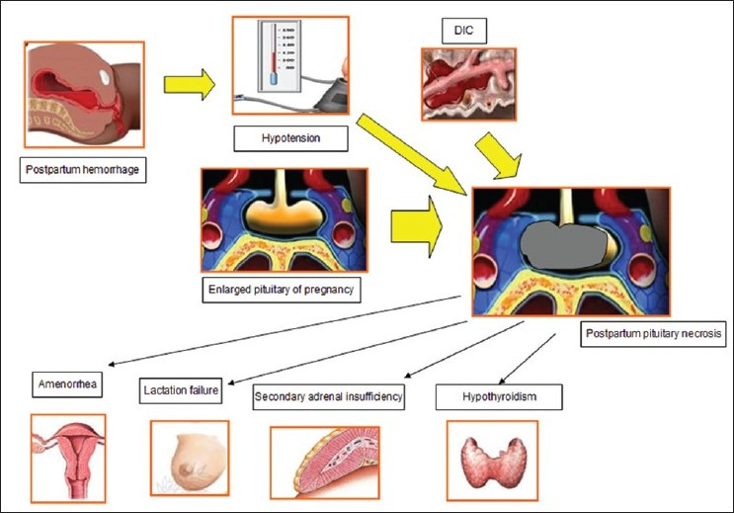

Slide 7
Sheehan’s syndrome
Sheehan syndrome is a condition that can occur in a woman who bleeds severely during childbirth result in necrosis of the pituitary gland,causes panhypopituitarism
The pituitary gland makes hormones that stimulate growth, production of breast milk, reproductive functions, the thyroid, and the adrenal glands
Treatment of young women with hypopituitarism usually includes replacement of hydrocortisone first and then replacement of thyroid hormone and estrogen with /without progesterone depending on whether she has a uterus.
Hydrocortisone is replaced first because thyroxine therapy can exacerbate glucocorticoid deficiency and theoretically induce an adrenal crisis

Slide 8
Case
Menopause
recommendations
HRT and side effects
What is available in KKM

Slide 9
Menopause is a state of natural ovarian senescence with accompanying estrogen deficiency. It also refers to states of ovarian failure and ovarian destruction/removal with accompanying estrogen deficiency. (Amenorrhea for 1 year.)
Premature Menopause- refers to menopause in a woman aged below 40 years.
Early Menopause -refers to menopause in a woman aged 50 years to 59 years.
Late Menopause -refers to menopause in a woman aged 60 years and over.
Surgical menopause- refers to menopause occurring as a result of surgical removal of both ovaries in a woman.
Medical menopause- refers to menopause occurring as a result of permanent damage to both ovaries in a woman following either chemotherapy or radiotherapy.

Slide 10
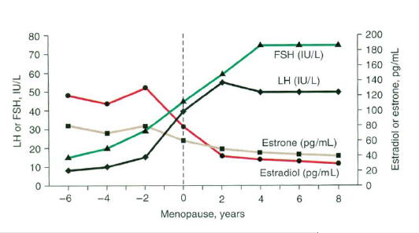
What is Menopausal transition?
Menopausal transition: from the first features of approaching menopause until up to 1 year after final menstrual period
Associated with significant hormonal variability over time
Overall, decline in estrogen levels over the menopausal transition
Notes:
The World Health Organization has defined the menopause as the permanent cessation of menstruation resulting from loss of ovarian follicular activity.
The perimenopause commences when the first features of approaching menopause begin until at least 1 year after the final menstrual period.
The term ‘menopausal transition’ has been applied to the portion of the perimenopause that ends with the final menstrual period.
The perimenopause is characterized by significant hormonal variability.
Levels of follicle-stimulating hormone (FSH) increase from about 2 years before menstruation ceases and plateau by 2 years after the final period.
Estrogen levels decline from about 2 years before the final menstrual period, decrease most rapidly around that time, and plateau 2 years later.
Reference:
Burger HG et al. Recent Prog Horm Res 2002;57:257–75.

Slide 11
Signs and Symptoms During the Menopausal Transition
Menopause
40 yrs
50 yrs
60 yrs
Vasomotor Symptoms
Sleep Disorders
Mood Changes
Urogenital Atrophy
Dyspareunia
Osteoporosis
Atherosclerosis
Coronary Heart Disease
Cerebrovascular Disease
Menstrual Disorders
Adapted from Bungay G et al. Br Med J 1980;281:181–3; Van Keep PA et al. Maturitas 1990;12:163–70.
Notes:
The menopause is characterized by a variety of symptoms and conditions associated with a deficiency of estrogen.^{1,2}
The prevalence of flushing and sweating, sleep disorders, and mood changes tends to peak around the occurrence of menopause, with menstrual disorders occurring in the years immediately preceding the last period.^{1,2}
Other symptoms, such as urogenital atrophy and dyspareunia, as well as conditions such as osteoporosis, atherosclerosis, and coronary heart disease (CHD), develop after menopause after a longer period of estrogen deficiency. ^{1,2}
References:
1. Bungay G et al. Br Med J 1980;281:181–3.
2. Van Keep PA et al. Maturitas 1990;12:163–70.

Slide 12
DIAGNOSIS OF MENOPAUSE
a. Clinical Criteria
1. age around menopause ( around 50 years )
2. no periods for 12 months
3. menopausal symptoms
However, where in doubt, laboratory testing of FSH
may support the diagnosis
b. Laboratory Criterion
1. FSH level > 35miu/ml

Slide 14
Case
Menopause
HRT and guidelines
HRT and side effects
What is available in KKM

Slide 15
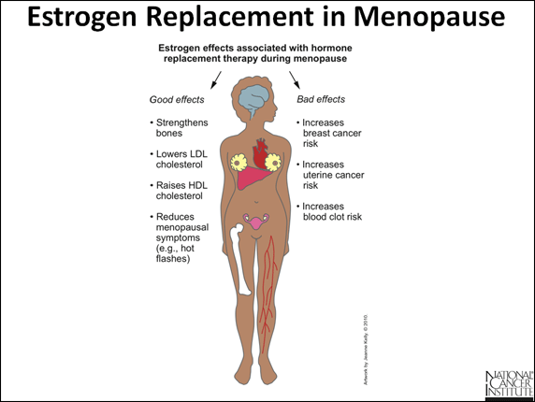

Slide 16
Hormone Therapy (HT) -refers to the use of estrogens (ET), estrogens plus progestins (EPT) and androgens (AT).
Estrogen-Progestin Therapy (EPT)
use of estrogens (ET), estrogens plus progestins (EPT) and androgens (AT).
Estrogen Therapy(ET)
estrogens alone
therapy with estrogen + progestin.
Estrogen-Progestin Therapy (EPT)
Standard Dose ET & EPT
• Conjugated equine estrogens 0.625mg
• Estradiol valerate 2.0mg
Low Dose ET & EPT
Conjugated equine estrogens 0.30mg or 0.45mg
Estradiol valerate 1.0mg

Slide 17
Estrogens Used in HRT
 | Equivalent dose for bone endpoints*
Estrogen | Ultra Low | Low | Standard | High
Conjugated equine estrogens (mg) | 0.15¹ | 0.3 | 0.625 | 1.25
Micronized 17β-estradiol (mg) | 0.5² | 1 | 2 | 4
Estradiol valerate (mg) |  | 1 | 2
Transdermal 17β-estradiol (μg) | 14³ | 25 | 50 | 100
‘Medium’ doses of oestrogen are generally effective against the onset of vasomotor and psychological symptoms.
For many women, low-doses of oestrogen provide adequate relief of symptoms with high rates of amenorrhea, and so higher doses are not required.
‘Low’-dose HRT schedules are effective in controlling subjective symptoms in postmenopausal women and still increase bone density in postmenopausal women.
Several types of estrogen are used in HRT, at varying doses. Different doses may be appropriate for different women at different menopausal stages.

Slide 18
HRT Use: New Guidelines From the British Menopause Society ‏
After receiving sufficient information from health professional to make a fully informed choice, each woman should decide whether to use HRT.
The clinician should individualize the HRT dosage, regimen, and duration and reassess risks and benefits annually.
One of the main indications for HRT in postmenopausal women is relief of vasomotor symptoms, which are most effectively relieved by estrogen.
When prescribed to women < 60 years, HRT has a favorable benefit/risk profile.
Women with premature ovarian insufficiency must be encouraged to use HRT, at least until the average age of the menopause.
If women > 60 years opt for HRT, they should start with lower doses, preferably via the transdermal route.
Routine management of all women in the menopause transition and beyond should include optimization of diet and lifestyle.
Pharmacological alternatives to HRT may include selective serotonin reuptake inhibitors such as fluoxetine and paroxetine for vasomotor symptoms, venlafaxine, gabapentin, and possibly clonidine.
Phytoestrogens offer some benefits for symptom relief and on the skeletal and cardiovascular systems.

Slide 19
Immediate effects of HRT( BMS)
Vasomotor symptoms
One of the main indications for prescribing HRT in postmenopausal women is the relief of vasomotor symptoms. Estrogen remains the most effective treatment
Mood
short-term use of HRT may improve mood and depressive symptoms during the menopausal transition and in the early menopause.
Women with severe depression and those who do not respond to HRT will require psychiatric assessment.
Urogenital symptom
effective in treating symptoms related to vaginal atrophy, such as vaginal dryness and superficial dyspareunia.
It also has a proliferative effect on the bladder and urethral epithelium and may help relieve symptoms of urinary frequency, urgency and possibly reduce the risk of recurrent urinary tract infections in women with urogenital atrophy. Low-dose vaginal estrogen preparations can be used long-term in symptomatic women as required

Slide 20
Musculoskeletal effects
estrogen therapy has a protective effect against connective tissue loss and may possibly reverse this process in menopausal women receiving HRT.
Progestogens/side effects
Non hysterectomised women using estrogen therapy should use progestogen to avoid endometrial hyperplasia and carcinoma.
If the last menstrual period occurred less than one year prior to starting HRT, a sequential combined regimen should be started, i.e. continuous estrogen with progestogen for 12–14 days per month.
After a minimum of one year of HRT, or one year after the last menstrual period, (two years in premature ovarian insufficiency, POI), women who wish to avoid a monthly withdrawal bleed may attempt a switch to a continuous combined regimen which aims to give bleed free HRT – this will also minimize the risk of endometrial hyperplasia.

Slide 21
a. VASOMOTOR SYMPTOMS (CPG)
Evidence Statements
i) Low-dose and standard dose ET and EPT are effective for relief of hot flushes and/or sweating.
Recommendation
Menopausal hot flushes and/or sweating are indications for the use of ET and EPT

Slide 22
HRT Remains the Most Effective Therapy for Vasomotor Symptoms 2006
No significant efficacy of botanicals in reducing vasomotor symptoms
8
7
6
Black Cohosh
5
Multibotanical
Vasomotor symptoms per day
4
Multibotanical + soy
3
HRT: CEE +/- MPA
2
Placebo
1
0
Baseline
3 months
6 months
12 months
Newton KM et al. Ann Intern Med 2006;145:869–79. Reprinted from Annals of Internal Medicine, 145, Newton et al, Treatment of Vasomotor Symptoms of Menopause with Black Cohosh, Multibotanicals, Soy, Hormone Therapy, or Placebo, 869-879, Copyright (2006), with permission from American College of Physicians.
Notes:
In the largest study to date comparing botanical therapies to hormone therapy, only hormone therapy was effective in reducing hot flushes.
Participants included 351 women age 45-55 with two or more vasomotor symptoms per day. 52% of the women were in the menopausal transition and 48% were postmenopausal.
The interventions included: 1) Black cohosh (160 mg/day); 2) a multibotanical with black cohosh, 200 mg/d and 9 other ingredients; 3) multibotanical plus dietary soy counseling; 4) hormone replacement therapy - conjugated equine estrogen, 0.625 mg daily, with or without medroxyprogesterone acetate, 2.5 mg daily; and 5) placebo.
As you can see, HRT was highly effective in treating hot flushes but the other treatments did not reduce hot flushes.

Slide 23
b. VAGINA /urogenital symptoms
i) Low-dose and standard dose Et and EPT are effective in relieving vaginal atrophy, and its related symptoms, e.g. vaginal dryness and dyspareunia ( painful coitus ).
Recommendation
i) Vaginal dryness due to vaginal atrophy during menopause is an indication for the use of ET and EPT.
ii) Low-dose and standard dose EPT are effective in relieving vaginal atrophy, and its related symptoms
iii) The use of vaginal estrogen products for the treatment
of atrophic vaginitis is well-documented.
iv) Low dose vaginal estrogen therapy is also effective in relieving symptoms of vaginal atrophy

Slide 24
c. URINARY SYSTEM
Evidence statements
i) EPT is effective for relief of lower urinary tract
symptoms related to estrogen deficiency.
ii) Most studies show that in postmenopausal women with urinary incontinence, ET and EPT are not beneficial and may worsen the condition.
Recommendation
i) Lower urinary tract symptoms due to estrogen
deficiency during menopause are indications for the use of ET and EPT.

Slide 25
d. DEPRESSIVE MOOD
1. ET, EPT and low-dose ET / EPT are effective in reducing depressive mood.
Evidence statements
i) Low-dose and standard dose ET are effective in relief of mood disorders, especially depressive mood.
ii) Low-dose and standard dose EPT are effective in relief of mood disorders, especially depressive mood.
Recommendation
i) Depressed mood during menopause is an indication for the use of ET and EPT.

Slide 26
e. SLEEP
1. EPT reduces the incidence of difficulty in sleeping, sleep disturbances, and sleep problems.
2. ET decreases the sum of time spent awake during sleep,and increases the total time spent in rapid-eye-movement sleep.
3. Sleep improvements with EPT may, however, be secondary to reduction in hot flushes.
Evidence statement
i) ET and EPT are associated with improved sleep patterns and less sleeplessness.
Recommendation
i) Sleep disturbance related to menopause, particularly sleeplessness, is an indication for the use of ET and EPT.

Slide 27
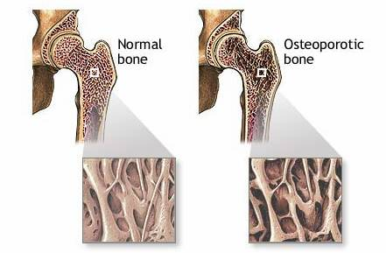
f. BONE
ET and EPT increase bone mineral density ( BMD ) at both the hip and vertebral spine
The effect of EPT on non-vertebral fractures is greater in women < 60 years of age compared to those >60
ET reduces the risk in women of having any arthroplasty, hip and knee arthroplasty, while EPT reduces the risk of any arthroplasty except for the hip
ET and EPT are first-line choices for the prevention of bone loss and fractures in post-menopausal women who have increased risk for fractures.
Other choices such as vit d,
biphosphonates and
raloxifene can also
be used for prevention of
bone loss

Slide 28
g. others
Evidence statement
i) ET and EPT use are associated with reduced incidences of colon and rectal cancers.
ii)EPT use improves skin health during menopause
iii)ET and EPT increase sexual desire, sexual arousal, sexual activity & its frequency, frequency and intensity of orgasm,sexual responsiveness, and overall sexual satisfaction
However HRT is not indication for these purposes.
Recommendation
i) Prevention of colon / rectal cancers is not an indication for the use of ET and EPT.
ii)Decreased sexual functioning during menopause is not a primary indication for the use of ET and EPT, but is a key factor to be considered
ii) In essence, ET and EPT, by their positive effects on the clinical benefits outlined above, definitely improve overall health-related quality of life.

Slide 29
Pre-treatment Evaluation
-medical history, relevant family history,
-physical examination including weight, height, BMI, BP and breast examination. Where possible, a bimanual vaginal examination and cervical
cytology should be done.
-Relevant investigations can be considered, either laboratory or
imaging - these are not mandatory. These include mammography /
sonography, Mammography should be undertaken according to age and national guidelines.
- Blood ix ( FLP, FBS, LFT)
-Assessment of bone mineral density (BMD) should be considered on a case-to-case basis.
-Other tests may be done on a case-to-case basis, e.g. liver function
tests, thyroid profiles, ultrasonography of the pelvis if indicated.

Slide 30
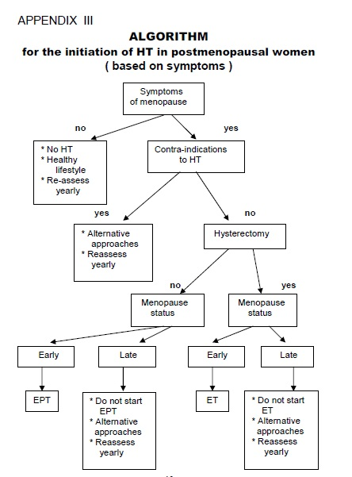

Slide 31
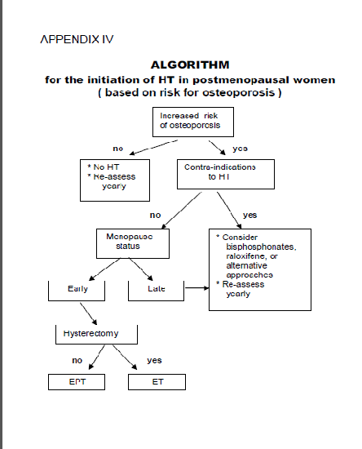

Slide 32
How is HRT Given?
Uterus
Continuous Estrogen
Estrogen
No tablet break
No bleeding as no uterus
Continuous Sequential HRT
Estrogen
Progestogen
Day 14
Sequential therapy without tablet break
Regular bleeding at end of cycle
Uterus
Continuous Combined HRT
Estrogen
Progestogen
Day 14
Combined therapy without tablet break
No bleeding at end of cycle
De Villiers TJ et al. Climacteric 2013;16:316–337.
.
Notes:
Hormone replacement therapy (HRT) includes a wide range of hormonal products with various methods and routes of administration, and potentially different risks and benefits.
Women who have had a hysterectomy can take continuous estrogen alone.
Progestogen should be added to systemic estrogen for all women with a uterus to help reduce the risk of endometrial hyperplasia and cancer. This can either be given sequentially for the second 2 weeks of each cycle or continuously with estrogen.
The International Menopause Society (IMS) recommends that consideration of HRT should be part of an overall strategy for maintaining the health of peri- and postmenopausal women. This should include lifestyle recommendations regarding diet, exercise, smoking cessation and safe levels of alcohol consumption. HRT must be individualized and tailored according to symptoms.
Reference:
De Villiers TJ et al. Climacteric 2013;16:316–337.

Slide 33
Case
Menopause
HRT and guidelines
HRT and side effects
What is available in KKM

Slide 34
HRT Risks and Benefits
Risks
Benefits
Endometrial Cancer
Metabolic Effects
CV Risk
Breast Cancer
Bone Mineral Density
Relief of Menopause Symptoms
Notes:
As with any medical therapy, the decision to prescribe HRT (and which dose regimen to choose) should involve a careful consideration of the benefits and risks of treatment.

Slide 35
Side-effects of hormone replacement therapy in general
Oestrogen: breast tenderness, leg cramps, bloating, nausea, headaches.
Progestogen: premenstrual syndrome-like symptoms, breast tenderness, backache, depression
starting towards the end, or soon after, the progestogen phase. Breakthrough bleeding is common in the first 3-6 months of continuous combined and long-cycle HRT regimens.

Slide 36
1)Coronary heart disease
i) ET use is not associated with any increase in risk of coronary heart disease(CHD)
ii) EPT use is not associated with an increase in risk of CHD when used in post-menopausal women in early menopause, and < 10 years of menopause.
iii) EPT use is associated with an increase in risk of CHD when used in post-menopausal women in late menopause, and if started > 10 years of the menopause
i) It is not recommended that ET or EPT be used for the prevention of coronary heart disease in postmenopausal women.
The results suggest that HRT reduces CHD events in younger postmenopausal women if not started less than 10 years of menopause.
Notes:
i) It is not recommended that ET or EPT be used for the
primary prevention of coronary heart disease in
postmenopausal women.
This is the current cautious approach and guideline. ( A )
ii) It is not recommended that ET or EPT be used for the
secondary prevention of coronary heart disease in
postmenopausal women. ( A )

Slide 37
2)STROKE
1. ET and EPT increase the risk of stroke.
2. ET increases the risk of ischaemic stroke in generally
healthy postmenopausal women, and this risk is present in
all subgroups of women, including younger and more
recently menopausal women.
3. Two studies showed that there is no increase in risk if HT is Used for < 5 years in younger postmenopausal women.
Evidence statement
i) ET and EPT use are associated with increased risk of stroke.
Recommendation
i) ET and EPT are not to be used in postmenopausal women
with high risk for stroke.

Slide 38
3) Breast cancer Statements from International Menopause Society 2013
International Menopause Society Statement on Breast Cancer¹
Women should be reassured that the possible increased risks of breast cancer associated with HRT are small
an incidence of <1.0 per 1000 women per year of use
Less than the increased risks associated with common lifestyle factors such as reduced physical activity, obesity and alcohol consumption
Micronized progesterone or dydrogesterone used with estradiol may be associated with a better risk profile for breast cancer than synthetic progestogens
USA Endocrine Society Scientific Statement on Breast Cancer²
Emerging data from 2 independent studies suggest that progesterone (and perhaps dydrogesterone) in combination with estrogen does not increase breast cancer risk if given for 5 years or less
1. De Villiers TJ et al. Climacteric 2013;16:316–337. 2. Santen R et al. J Clin Endocrinol Metab 2010;95(Suppl1):S1–S66.
Notes:
In 2013, the IMS presented their recommendations on Menopausal HRT.
Although the WHI combined HRT arm showed increased breast cancer diagnosis at an average follow-up of 5.6 years, this was not statistically significant after adjustment for confounding variables.
On the basis of the WHI combined HRT results, it appears that women who had not used prior HRT were not at higher breast cancer risk until 5–7 years after initiation of therapy.
Lifestyle factors associated with an increased risk of breast cancer diagnosis include postmenopausal obesity, increased alcohol intake and reduced physical activity.
When used in association with estradiol, micronized progesterone (a natural progesterone) and D (a synthetic progestogen) may be associated with a better risk profile for breast cancer than other synthetic progestogens.
Similarly, in their 2010 review of HRT, the US Endocrine Society stated that emerging data from two independent studies suggest that progesterone (and perhaps dydrogesterone) in combination with estrogen does not increase breast cancer risk if given for 5 years or less.
References:
De Villiers TJ et al. Climacteric 2013;16:316–337. Santen RJ et al. J Clin Endocrinol Metab 2010;95(Suppl 1):S1–S66.

Slide 39
Is HRT Associated with Increased Breast Cancer Risk? Evidence from WHI
WHI RR for breast cancer:
1.26 (95% CI 1.00–1.59)
for current use of HRT
(CEE + MPA)¹
Excess risk of breast cancer from HRT increases with increase in underlying risk⁵
Determination of risk should underlie decision to use HRT
WHI evidence
No increased risk was identified for women who had had hysterectomy receiving CEE alone 2012
Relative risk of 1.26 with combined HRT translates to an excess (attributable) risk of 4 per 1000 women taking HRT for 5 years⁴
1. Rossouw JE et al. JAMA 2002;288:321–33; 2. Langer R et al. Climacteric 2012;15:206–12; 3. Stefanik M et al. JAMA 2006;295:1647–57; 4. Santen R et al. J Clin Endocrinol Metab 2010;95(Suppl 1):s1–66; 5. Gompel A et al. Climacteric 2012;15:241–9.
Notes:
The WHI estrogen plus progestin study (n=16,608 women with an intact uterus) demonstrated a relative risk for breast cancer of 1.26 (95% CI 1.00 –1.59) with current use of HRT (CEE/MPA) vs. placebo.¹
This translates to an excess (attributable) risk of 4 women with breast cancer per 1000 women taking HRT for 5 years.²
However, later studies with adjusted confidence intervals have indicated that the results of WHI were not significant.³
In the estrogen-alone WHI study, no increased risk was identified for women who had had hysterectomy receiving CEE alone.⁴
The risk of breast cancer for women assigned to CEE vs. placebo was 0.80 (95% CI 0.62–1.04; p=0.09).
Excess risk of breast cancer from HRT increases with increase in underlying risk.⁵ Therefore, determination of risk should underlie the decision to use HRT.
References:
Rossouw JE et al. JAMA 2002;288:321–33.
Santen R et al. J Clin Endocrinol Metab 2010;95(Suppl 1):s1–66.
Langer R et al. Climacteric 2012;15:206–12.
Stefanik M et al. JAMA 2006;295:1647–57.
Gompel A et al. Climacteric 2012;15:241–9.

Slide 40
In the WHI study, Small increase risk of breast cancer detected after 5 years of HRT usage.
In the Estrogen alone trial, small but significant decrease in breast cancer risk detected
But in MWS ,It showed that HRT does increase the risk of breast cancer. Combined HRT is more likely to cause breast cancer than estrogen only HRT. But the risk lowers again when women stop taking HRT. The risk goes back down to normal within 5 years of stopping the HRT.
However many key flaws in WHI and MWS which limit the ability of trials to establish causal association between breast cancer and HRT.

Slide 41
An overview study reported in 2012. It supported earlier findings that combined HRT increases the risk of breast cancer in women over the age of 65
Not only does combined HRT increase the risk of developing breast cancer, but it also increases the chances that the cancer will be discovered at a more advanced stage. This is due to its influence in reducing the effectiveness of mammography by creating denser breast tissue.
The risk of breast cancer from EPT is increased only in current and recent users. The risk returns to that of a woman who never used HT (the usual risk) within 3 years of stopping.

Slide 42
HRT in Cancer Survivors
All except endometrial & breast CA
No evidence of increased recurrence
Endometrial cancer
Gynecol Obstet Invest 2008
Lack of conclusive data, no specific recommendations
HRT after EMC treatment does not appear to have an adverse effect on EMC.
Breast cancer
in 2004, the HABITS study shown that cancer survivors on HRT were more likely to develop a new or recurrent breast cancer.
At present it is contraindicated
Local endometrial sarcomas are estrogen sensitive and considered a contraindication.
Includes ovarian ca, cervical ca and vulval ca.
No data on use of hrt post granulosa cell tumours(ovarian) but hrt should be avoided on theoritical grounds.

Slide 43
4)Effects on VTE
ET and EPT increase the risks of VTE at least by 2-3 fold
Evidence statements
i) Oral ET and EPT use are associated with increased risks of
VTE.
ii) Transdermal estrogens do not appear to increase the risk of
VTE.
Recommendations
i) Oral EPT and ET should not be used in post-menopausal women
who have a history of VTE or who are at high risk for VTE.
In such women, transdermal EPT should be considered.

Slide 44
5)Endometrial cancer
In the WHI EPT study, the women taking EPT did not have an increased risk of getting endometrial cancer compared with the women taking placebos.
But more of the women getting EPT had abnormal vaginal bleeding. Because vaginal bleeding after menopause can be a symptom of endometrial cancer, these women needed further testing.
A woman who has had hysterectomy is not in danger of developing endometrial cancer, whether she takes ET or EPT.
Woman without a uterus will most likely be given ET.
Long term use of sequential EPT >5 years may be associated with small increased risk of endometrial ca. But continuous regimes significantly lower risk than untreated population.

Slide 45
Role of Progestogens in HRT
Estrogen provides the benefits of HRT on menopausal symptoms
For women who have not had a hysterectomy, the addition of a progestogen to HRT is necessary to protect the endometrium from the stimulatory effects of unopposed estrogen
PEPI Trial: multicenter RCT : Results of Endometrial Biopsy
 | Placebo | CEE alone | CEE+MPA sequential | CEE+MPA continuous
N | 119 | 119 | 118 | 120
Normal | 98% | 38% | 95% | 99%
Simple hyperplasia | 1% | 28% | 3% | 1%
Complex hyperplasia | 1% | 23% | 2% | 0%
Atypia | 0% | 12% | 0% | 0%
Adenocarcinoma | 1% | 0% | 0% | 0%
Conclusion: Adding a progestogen is needed to safeguard the endometrium
Writing Group for the PEPI Trial. JAMA 1996;275:370–5.
Notes:
The necessity of adding a progestogen to HRT for women who have not had a hysterectomy was demonstrated in this 3-year, multicenter, randomized, double-blind, placebo-controlled trial.
The effects of progestogen on the endometrium were examined in 596 postmenopausal women aged 45–64 years who received:
Placebo,
Conjugated equine estrogens (CEE) 0.625 mg/day alone,
CEE 0.625 mg/day plus sequential medroxyprogesterone acetate (MPA) 10 mg/day for the first 12 days,
CEE 0.625 mg/day plus continuous MPA 2.5 mg/day, or
CEE 0.625 mg/day plus micronized progesterone 200 mg/day for the first 12 days.
In women given CEE alone, 62% developed some type of endometrial hyperplasia and 34% had complex hyperplasia or atypia.
Incidence of abnormal biopsy specimens was low for women receiving combination regimens, with no significant difference between placebo and any of the three combined regimens (p=0.16).
The authors concluded that postmenopausal women with a uterus who receive estrogen replacement therapy should use regimens with additional progestogen for endometrial protection.
Reference:
Writing Group for the PEPI Trial. JAMA 1996;275:370–5.

Slide 46
The emerging concepts in HRT
Timing (window of opportunity)
Early start
Maintenance of estrogenic benefits
Patient selection
Avoiding generalized prescribing
Personalization
Tailoring dose to patient
Continuation and tapering the dose with age
(early menopause <50 years old 0.625mg) and late menopause 0.3mg
Follow-up Assessment & Frequency
Annual risk-benefit assessment should be carried out.
The same procedures as in the “Counselling” visit and the “PreTreatment Evaluation” should be considered.
Timely mammography is the key, including genital tract cancer studies, e.g. cervical cytology and other investigations.
A 12-monthly follow-up assessment is recommended.
As for mammography, if the initial mammogram is normal, 2-3 yearly mammography is recommended
Notes:
46
When considering prescribing of HRT, clinicians should aim to tailor the type, dose, and route of hormone therapy for each individual woman to achieve control of estrogen-deficiency symptoms.
Clinicians should balance the benefits vs. the risks to the patient at both the initiation of therapy and over time. Advances in technology and therapeutics have facilitated this approach.
TIMING : Sooner is better to maintain the beneficial action of estrogen on the woman’s body with an early start, whenever she needs it.
PATIENT SELECTION : Menopause is not a disease and does not always need a therapy. Hormones are not meant to cure a disease, but can be replaced and prevent the clinical and metabolic effects of hormone withdrawal.
PERSONALIZATION: There will never be one preparation that suits all women. Clinicians should aim to choose the right dose for the right woman. In the 80’s the vast majority of experts were saying that doses lower than 0.625 mg CE were ineffective…. Now we know that is not true.

Slide 47
Conclusion
Used by the right woman, at the right dose, HRT can:
Relieve vasomotor and other menopausal symptoms
Provide protection against bone loss (second line)
Provide acceptable bleeding patterns
Individualized HRT choice
Besides the role of life-style modifications and dietary adjustments in the prevention of menopause-related disease, HT remains a principal tool in preventing menopause-related illnesses and maintaining quality of life in the post-menopausal woman.
Notes:
According to treatment guidelines, HRT must be individualized and tailored according to symptoms and the need for prevention.
A number of studies have evaluated the effects of Femoston® vs. other HRTs and shown that, when used by the right woman, at the right dose, Femoston® can:
Relieve vasomotor and other menopausal symptoms
Provide protection against bone loss as a second-line therapy
Provide acceptable bleeding patterns.

Slide 48
Case Menopause recommendations HRT and side effects Short notes on POF What is available in KKM

Slide 49
Estrogen only
1)PREMARIN® (oral conjugated estrogens USP 0.625mg
Continuous or cyclical ( 3weeks on and 1 week off).
2)Progynova 1mg or 2 mg tablets(estradiol valerate 1.0 mg or 2.0 mg)
Estrogen only pills 28 pills in 1 pack for continous regime.
-for VMS, atrophic vaginitis and urethritis a/w estrogen deficiency: 0.2-1.25mg daily
For osteoporosis : 0.625mg daily dose required for bone mass conversion
Female hypoestrogenism: 0.3 – 1.25mg daily depending on individualized assessment.
for women with intact uterus, addition of progestrogens is essential
No need to add progesteron for women w/o uterus

Slide 50
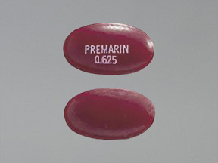
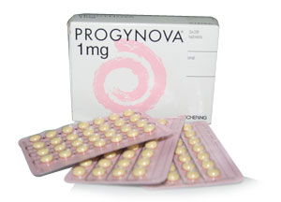
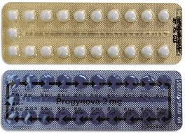

Slide 51
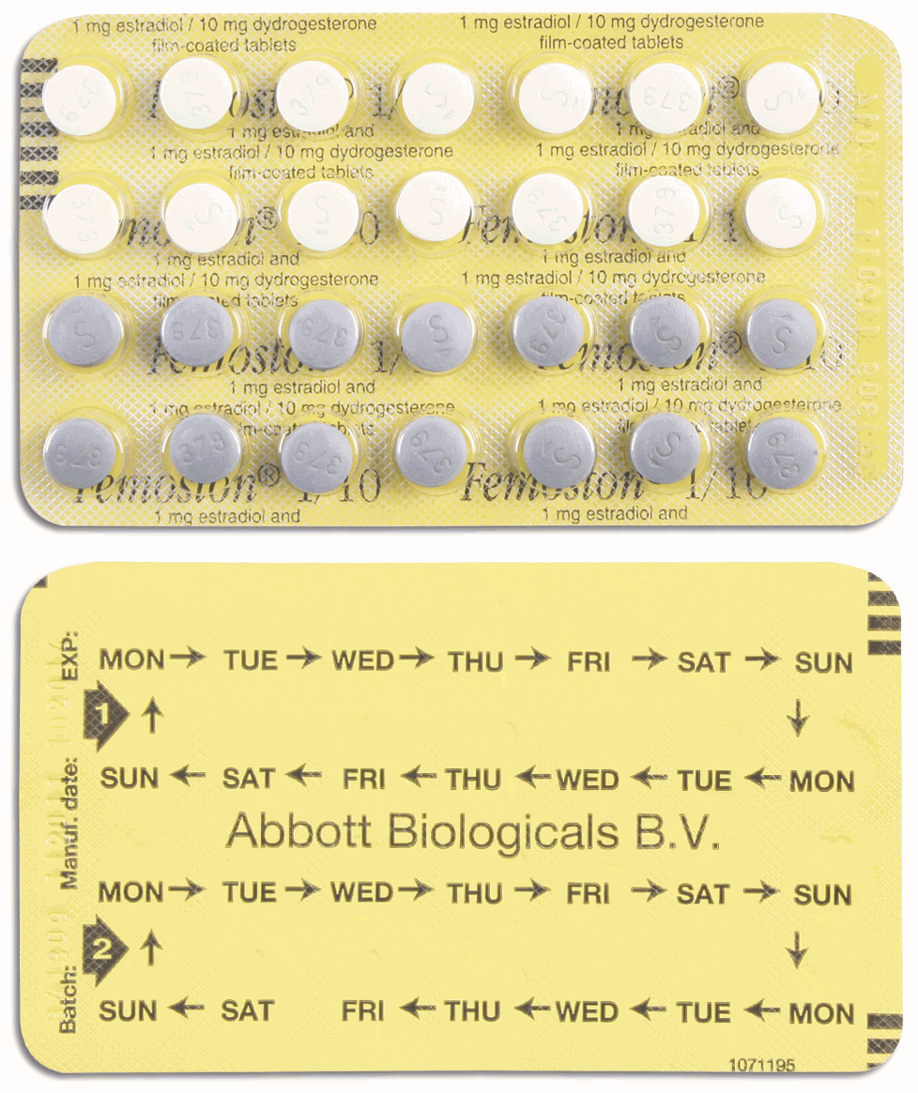
Combinations
1)Premelle 2.5 mg Tablet
-0.625mg CE at the core, coated with 2.5 mg medroxyprogesterone acetate /MPA
1 tab daily continous for non bleed regime.
For mod- severe VMS, mx of osteoporosis
2) Femoston 1/10 tablet
-1mg estradiol (14 white tablets )
-1mg estradiol plus 10mg dydrogesterone
(14 grey tablets) for bleed cycle
Open new pack after completed 28 tabs
cycle

Slide 52
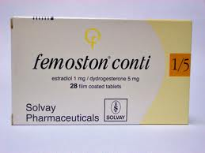
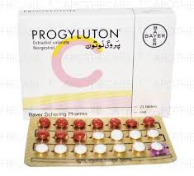
3)Femoston conti 1/5
1mg estradiol + 5 mg dydrogesterone in 1 tablet
Taken daily without break- non bleed regime
4) Progyluton
2.0 mg estradiol valerate
(11 white tabs)
2.0mg estradiol valerate + norgestrel 0.5mg
(10 light brown tabs)
Total 21 tabs in a pack with a 7 days break before new pack.

Slide 53
others
1)LIVIAL- 2.5 mg Tibolone
Tibolone is a selective oestrogen receptor modulator (SERM) which combines oestrogenic and progestogenic activity with weak androgenic activity.
It can be used in women with an intact uterus who have had no bleeding for more than one year, without the need for cyclical progestogen.
Randomised controlled trials suggest it may be helpful in improving sexual function and vasomotor symptoms. It may also reduce the risk of spinal fractures.
There may be a small increased risk of stroke, endometrial and increased chance detecting breast cancer in earlier stage as it does not increase breast tissue density in mammography with tibolone.
Tibolone is less effective than combined HRT in alleviating menopausal symptoms.
In women over the age of 60 years, the increased stroke risk means that the risks outweigh the benefits

Slide 54
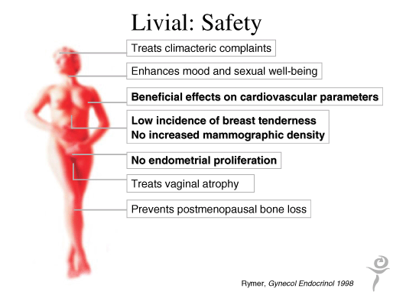
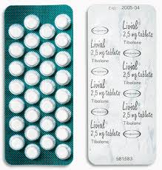

Slide 55
2)Evista- 60 mg raloxifene hydrochloride
Selective estrogen receptor modulator(SERM)
-widely used to prevent and treat osteoporosis.
-it has some estrogen-like properties, the most important of which is its ability to reduce bone loss and increase bone density (thus preventing and/or minimizing osteoporosis).
-It does not adversely affect the breast and uterus the way estrogen does, so it does not cause cancer of those organs, tenderness of the breast, or vaginal bleeding.
-On the other hand it does not relieve symptoms of menopause, such as hot flashes, either.
-Evista does appear to exert a beneficial effect on heart disease, stroke, and breast cancer. It has few adverse effects other than a small increased risk of clot formation in the veins. For that reason, anyone with varicose veins or a history of thrombophlebitis should not use it, nor should those who are premenopausal or pregnant.

Slide 56
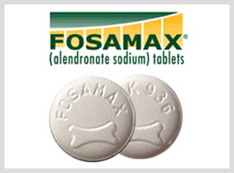
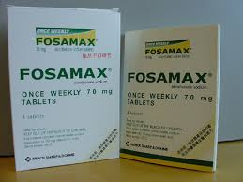
3) Fusamax-Bisphosphonates
FOSAMAX tablets for oral administration
It alters the cycle of bone formation and breakdown in the body. Alendronate slows bone loss while increasing bone mass, which may prevent bone fractures including those of the hip and spine (vertebral compression fractures)
Fosamax is used in women to treat or prevent osteoporosis that is caused by menopause
The recommended dose for treatment of osteoporosis is 5-10 mg daily or 35-70 mg weekly

Slide 57
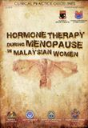
References
www.thebms.org.uk
as attached in google drive.
womenshealth.about.com
www.cancer.org
www.mims.com/malaysia
www.millionwomenstudy.org
www.nhlbi.nih.gov/whi/factsht.htm
-women’s health initiative.

Slide 58
Thank you

