Slide 1
Female To Male Change Surgery in Thailand
Change
Preecha Aesthetic Institute 898/1 Sukumvit 55 Wattana, Bangkok 10110 Thailand
Tel: (662) 715-0111, Email- Consult@pai.co.th

Slide 2
Female To Male exchange surgery in Thailand
FTM surgery is generally divided into three main groups:
1. Chest reconstruction surgeries (also referred to as “top” surgery or Mastectomy)
2. Hysterectomy and Ovary Removal (removal of the uterus and ovaries, respectively; and
3. Genital reconstruction surgeries (also referred to as “lower” or “bottom” surgery or GRS).
Within these three main groupings are different types of procedures and surgical methods that will be further described?
Mastectomy, Hysterectomy, Ovary and Genital reconstruction can be done at the same time.
Preecha Aesthetic Institute 898/1 Sukumvit 55 Wattana, Bangkok 10110 Thailand
Tel: (662) 715-0111, Email- Consult@pai.co.th

Slide 3
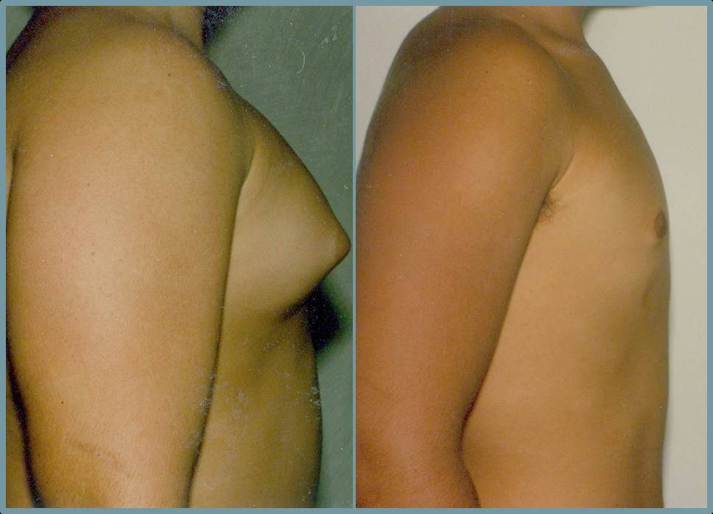
Female To Male exchange surgery in Thailand
Chest Reconstruction Surgeries
Male Chest Reconstruction usually precedes below the waist surgery for FTM patients as protruding breast contours are a sin qua non of the female presentation.
Preecha Aesthetic Institute 898/1 Sukumvit 55 Wattana, Bangkok 10110 Thailand
Tel: (662) 715-0111, Email- Consult@pai.co.th

Slide 4
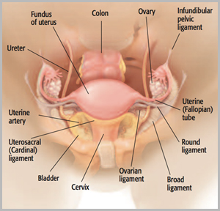
Female To Male exchange surgery in Thailand
Hysterectomy & Ovary Removal
During hysterectomy operations, surgeons often remove a woman's ovaries as well as her uterus. But new research suggests that for women are not at high risk for ovarian cancer, removing the ovaries during hysterectomy may adversely impact long-term health.
Preecha Aesthetic Institute 898/1 Sukumvit 55 Wattana, Bangkok 10110 Thailand
Tel: (662) 715-0111, Email- Consult@pai.co.th

Slide 5
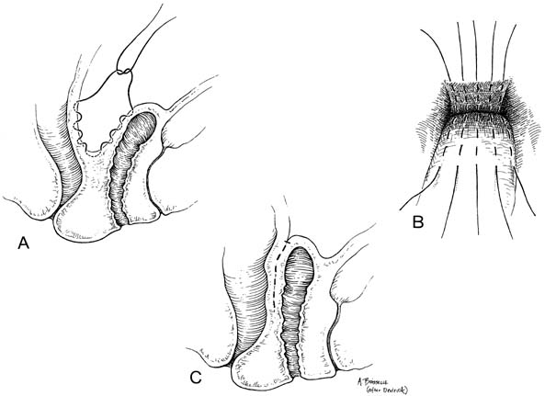
Female To Male exchange surgery in Thailand
Genital Reconstruction Surgeries
Preecha Aesthetic Institute 898/1 Sukumvit 55 Wattana, Bangkok 10110 Thailand
Tel: (662) 715-0111, Email- Consult@pai.co.th

Slide 6
Female To Male exchange surgery in Thailand
Phalloplasty FtM (Big Penis)
There are 4 stages for FtM with Phalloplasty. Each stage must require at least 4 month after surgery to continue the next stage.
If FtM with Phalloplasty surgery in Thailand,
Stage 1 = Prepare urethra for abdominal tube (can be perform with Hysterectomy and Ovary Removal).
Stage 2 = Penile Reconstruction from abdominal skin (not recommend reconstruction from back hand because from hand, it will create a lot of scars.
Stage 3 = Connect Urethra and retouch penis.
Stage 4 = Insert Ball Implants (Testicles).
Preecha Aesthetic Institute 898/1 Sukumvit 55 Wattana, Bangkok 10110 Thailand
Tel: (662) 715-0111, Email- Consult@pai.co.th

Slide 7
Female To Male exchange surgery in Thailand
FTM genital surgery techniques - creation of a penis
Metaidoioplasty : Small penis
Metaidoioplasty – Testosterone makes your clitoris grow (usually 1-3 cm). Metaidoioplasty involves cutting the ligament that hold your clitoris in place under the pubic bone, as well as some of the surrounding tissue. Your clitoris is then freed up so more of it is showing.
Vagina removed ? – Optional.
Result size – small penis.
Sexual function – Sexual sensation is generally good, as the clitoris is not impacted much. The new penis will get erect on its own when you’re sexually aroused, but won’t be large enough to penetrate a partner with.
Urinate standing up ? – Yes.
Visible scarring – Minimal.
Preecha Aesthetic Institute 898/1 Sukumvit 55 Wattana, Bangkok 10110 Thailand
Tel: (662) 715-0111, Email- Consult@pai.co.th

Slide 8
Female To Male exchange surgery in Thailand
FtM Phalloplasty – The most common involves removing a flap of skin/blood vessels/ nerves from waist area to hide the scar. Rolling this to make a tube within a tube and then using microsurgery to attach the new penis to your groin. (over the top of your clitoris). The end is surgically sculpted to look like the head of penis. A skin graft is taken to cover the graft area.
Vagina removed or closed vagina ? – Yes.
Result size: An adult male size penis.
Sexual function – Pulling on the penis will stimulate the clitoris that is buried at its base. At least 1 year after phalloplasty, a stiffening device can be inserted to create an erection firm enough for penetrative sex.
Urinate standing up – Yes. As part of phalloplasty urethroplasty is done.
Visible scaring – Large scar on the waist (where the tissue was removed). Scar on the graft sites.
Preecha Aesthetic Institute 898/1 Sukumvit 55 Wattana, Bangkok 10110 Thailand
Tel: (662) 715-0111, Email- Consult@pai.co.th

Slide 9
Female To Male exchange surgery in Thailand
Best candidate’s for Phalloplasty
You are physically healthy and emotionally stable with realistic expectations as to what the surgery can and cannot do
Psychologist’s letter or Hormone therapist may required
Must undertake hormone at least 6 month
Real-Life experience
Physically healthy and emotionally stable with realistic expectations
- Must be over 18 year old with good health condition
Preecha Aesthetic Institute 898/1 Sukumvit 55 Wattana, Bangkok 10110 Thailand
Tel: (662) 715-0111, Email- Consult@pai.co.th

Slide 10
Female To Male exchange surgery in Thailand
Hospital and recovery period (Phalloplasty):
Each stage is required at least 6 month to continue for next stage.
Stage 1: Hospital 2 nights and 7 days in hotel = 9 days in Thailand
Stage 2: Hospital 2 nights and 10 days in hotel = 12 days in Thailand
Stage 3: Hospital 2 nights and 10 days in hotel = 12 days in Thailand
Stage 4: Hospital 1 night and 5 days in hotel = 6 days in Thailand
Preecha Aesthetic Institute 898/1 Sukumvit 55 Wattana, Bangkok 10110 Thailand
Tel: (662) 715-0111, Email- Consult@pai.co.th

Slide 11
Female To Male exchange surgery in Thailand
Phalloplasty preparation :
- Inform us about any allergies, any serious medical condition(s), and all medications you are
taking (both prescription and non-prescription)
- Removal of hair on graft site by electrolysis
- Qualify letter from Psychiatrist doctor or Hormone Therapist
- No Aspirin 2 days before surgery
- Stop vitamin E Oil 1 day before surgery
- Stop smoking 2 days and a month after surgery
- Stop Hormone, if taken 2 weeks before surgery date
- Tell doctor if you have any serious medical condition(s)
Stop meal and water starting from midnight before surgery
Preecha Aesthetic Institute 898/1 Sukumvit 55 Wattana, Bangkok 10110 Thailand
Tel: (662) 715-0111, Email- Consult@pai.co.th

