Slide 1
TEACH NOT JUDGE
NJANSA Conference 2013
Atlantic City
Professor Scillieri
Dr. Murphy, Esq.

Slide 2
LGBPTTQQIIAA
Any combination of letters attempting to represent all the identities in the queer community represents:
  Lesbian
  Gay
  Bisexual
  Pansexual
  Transgender
  Transsexual
  Queer
  Questioning
  Intersex,
  Intergender
  Asexual,
  Ally

Slide 3
The Coming Out Continuum from
The Human Rights Campaign
“Coming out and living openly aren’t something you do once, or even for one year. It’s a journey that we make every single day of our lives. There are three broad stages that people move through on the coming out continuum. For each person it is a little different, and you may find that at times you move backward and forward through the phases all at once.”

Slide 4
The Coming Out Continuum from
The Human Rights Campaign
Opening up to yourself
Coming out
Living Openly
DO WE REALLY NEED TO KNOW IF SOMEONE IS GAY?

Slide 5
Statistics You Should Know About Gay & Transgender Students from PFLAG
Reliable estimates indicate that between 4 and 10% of the population is gay.
Gay teens are 8.4 times more likely to report having attempted suicide.
They are 5.9 times more likely to report high levels of depression compared with peers from families that reported no or low levels of family rejection.
LGBT youth who reported higher levels of family rejection during adolescence are three times more likely to use illegal drugs.

Slide 6
Statistics You Should Know About Gay & Transgender Students from PFLAG
Half of gay males experience a negative parental reaction when they come out and in 26% of those cases the youth was thrown out of the home.
Studies indicate that between 25% and 50% of homeless youth are LGBT and on the streets because of their sexual orientation or gender identity.
Nearly a fifth of students are physically assaulted because of their sexual orientation and over a tenth because of their gender expression.
About two-thirds of LGBT students reported having ever been sexually harassed (e.g., sexual remarks made, being touched inappropriately) in school in the past year.
The average GPA for students who were frequently physically harassed because of their sexual orientation was half a grade lower than that of other students.

Slide 7
The 2010 State of Higher Education for LGBT People
The study was conducted by Campus Pride and reported by The Chronicle of Higher Education.
  Almost one-quarter (23%) of LGBT staff, faculty, and students reported experiencing harassment (defined as any conduct that has interfered with your ability to work or learn).
  In addition, they feel a “chilly campus climate of harassment.” One-third of LGBT (33%) and transgender (38%) students, faculty, and staff have seriously considered leaving their institution.

Slide 8
The 2010 State of Higher Education for LGBT People
More than half of all LGBT faculty, students, & staff hide their sexual identity (43%) or gender identity (63%) to avoid intimidation.
*More than a third of all transgender students, faculty, & staff (43%) and 13% of LGBT respondents feared for their physical safety.
*LGBT respondents were twice as likely to be targets of derogatory remarks (61%), stared at (37%), and singled out as the “resident authority” regarding LGBT issues due to their identity (36%) when compared with their heterosexual counterparts (29%, 17%, and 18%, respectively).
The results were based on 4,159 surveys returned in spring 2009, by students, staff members, faculty members, and administrators representing all 50 states and all Carnegie Basic Classifications of Institutions of Higher Education.
http://voices.washingtonpost.com/answer-sheet/college-life/report-high-harassment-rates-o.html
http://www.huffingtonpost.com/2010/09/15/lgbt-students-harassed-at_n_717992.html

Slide 9
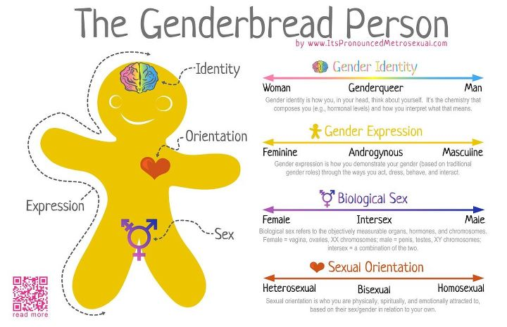

Slide 10
LGBTQQIAS Lingo
Ally | Asexual | Bear
MTF | Bisexual | Biphobia
Gay | Lipstick Lesbian | Butch
Queer | Closet | Cisgender
Transgender | Coming Out | Down-Low
Dyke | FTM | Gender Binary
Gender Expression | Gender Identity | Heterosexism
Heterosexual Privilege | Homosexual | Passing

Slide 11
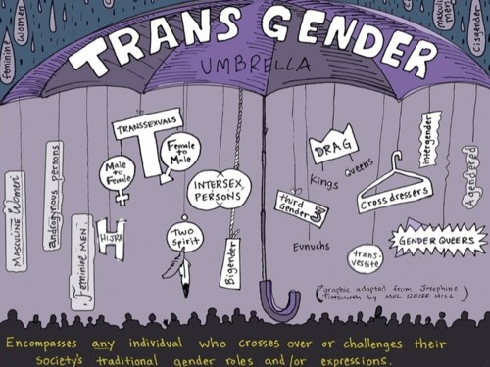
Transgender Umbrella

Slide 12
Understanding Transgender
Transgenders do not identify with their biological sex.
Biologists find beyond male (XX) and female (XY) some are born with chromosomes XXY or XYY.
The term transgender is also used as an umbrella term for all “trans” people.
  http://transequality.org/Resources/NCTE_UnderstandingTrans.pdf

Slide 13
Gender Queer
Genderqueer is most commonly used to describe a person who feels that his/her gender identity does not fit into the socially constructed "norms" associated with his/her biological sex.
Genderqueer is an identity that falls anywhere between man/boy/male and woman/girl/female on the spectrum of gender identities.

Slide 14
World Professional Association for Transgender Health
They set the guidelines called the Standards of Care (SOC) and they outline a series of steps that people may take to explore and complete gender transition.
Counseling with a mental health professional
A “real life” experience where an individual lives as the target gender for
a trial period
Learning about the available options and the effects of various medical
treatments
Communication between the person’s therapist and physician indicating
readiness to begin medical treatment (usually in the form of a letter)
Undergoing hormone therapy
Having various surgeries to alter the face, chest and genitals to be more
congruent with the individual’s sense of self
  http://transequality.org/Resources/NCTE_UnderstandingTrans.pdf

Slide 15
Real Life Experience
The act of fully adopting a new or evolving gender role for the events and processes of everyday life is known as the real-life experience. The real-life experience is essential to the transition process to the gender role that confirms with personal gender identity.
Professionals have a responsibility to discuss these predictable consequences. These represent external reality issues that must be confronted for success in the new gender role. This may be quite different from the personal happiness in the new gender role that was imagined prior to the real life experience.

Slide 16
Parameters of the Real Life Experience
When clinicians assess the quality of a person's real-life experience in the new gender role, the following abilities are reviewed:
1. to maintain full or part-time employment
2. to function as a student;
3. to function in community-based volunteer activity;
4. to undertake some combination of items 1-3
5. to acquire a new (legal) first or last name
6. to provide documentation that persons other than the therapist know that the patient functions in the new gender role.

Slide 17
Hormone Treatment
Transsexual people may undergo hormone therapy. Transwomen may take estrogen and related female hormones; transmen may take testosterone.
  Estrogen for MTFs
Softening the skin
Redistributing body fat to a more feminine appearance
Reducing some body hair
  Testosterone for FTMs
Lowering the voice
Causing the growth of body and facial hair
Redistributing body fat to a more masculine appearance
Causing the menstrual cycle to end
  http://transequality.org/Resources/NCTE_UnderstandingTrans.pdf

Slide 18
Intersexual Bodies:
The Herm, Merm and Ferm
Intersex Society of North America
  Mission: The Intersex Society of North America (ISNA) is devoted to systemic change to end shame, secrecy, and unwanted genital surgeries people born with an anatomy that someone decided is not standard for male of female.
http://www.isna.org/
“Hermaphrodites, (the “herms”), who possess one testis and one ovary (the sperm- and egg-producing vessels, or gonads).
The male pseudohermaphrodites (the "merms"), who have testes and some aspects of the female genitalia but no ovaries.
The female pseudohermaphrodites (the "ferms"), who have ovaries and some aspects of the male genitalia but lack testes.
4% of births are intersexual
Females XX and males XY chromosomes
From The Five Sexes: Why Male and Female Are Not Enough
By Anne Fausto-Sterling
The Sciences March/April 1993, p. 20-24

Slide 19
Asexuality
I am asexual.
I don’t feel sexually attracted to anyone.
Not men. Not women.
That’s all it is.
I’m not gay.
I’m not straight.
I’m not bi.
I’m none of the above.
Asexuality is real.
It’s not fake.
It’s not a hormone problem.
It’s not a way of running from a bad relationship.
It’s not a physical condition.
It’s not an attention grab.
It’s not an inability to have sex.
It’s not an inability to love.
It’s not some way to be “special”.
I don’t care if you have sex.
I don’t care if you don’t.
I don’t want to shame you.
I don’t want to convert you.
I don’t want to recruit you.
I just want you to understand me.

Slide 20
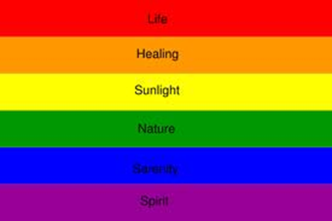

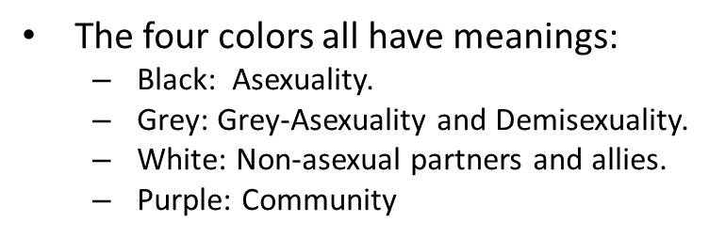
Sexual Orientations

Slide 21
Minorities within a Minority
Intersection of Identity
  LGB and
    Have a disability
    Identify as part of an ethnic minority
    Identify as Gender-nonconforming
Other identities that can add to oppression:
  Geography
  Age
  Gender Expression
  Religious/Spiritual background
  Etc.

Slide 22
Employment Discrimination
What is the Employment Non-Discrimination Act?
The Employment Non-Discrimination Act (ENDA) would provide basic protections against workplace discrimination on the basis of sexual orientation or gender identity.
ENDA simply affords to all Americans basic employment protection from discrimination based on irrational prejudice.
The bill is closely modeled on existing civil rights laws, including Title VII of the Civil Rights Act of 1964 and the Americans with Disabilities Act.
The bill explicitly prohibits preferential treatment and quotas and does not permit disparate impact suits. In addition, it exempts small businesses, religious organizations and the military.
from http://www.hrc.org/laws-and-legislation/federal-legislation/employment-non-discrimination-act

Slide 23
ENDA Update
What is the Current Status of the Bill?
ENDA was introduced in the 113th Congress in the House by Reps. Jared Polis (D-CO) and Ileana Ros-Lehtinen (R-FL) and in the Senate by Sens. Jeff Merkley (D-OR) and Mark Kirk (R-IL), as well as Sens. Tammy Baldwin (D-WI), Susan Collins (R-ME) and Tom Harkin (D-IA) on April 25, 2013.
ENDA was approved by the Senate Health, Education, Labor and Pensions Committee on July 10, 2013, by a bipartisan vote of 15-7.

Slide 24
States Protecting LGBT People Against Discrimination Based on Sexual Orientation
States that prohibit discrimination based on sexual orientation and gender identity
(16 states and the District of Columbia)
California (1992, 2003),Colorado (2007), Connecticut (1991, 2011), District of Columbia (1977, 2006), Illinois (2006), Iowa (2007), Massachusetts (1989, effective July 1, 2012), Maine (2005), Minnesota (1993), New Jersey (1992, 2007), New Mexico (2003),
Nevada (1999, 2011), Oregon (2008), Rhode Island (1995, 2001), Vermont (1991, 2007), and Washington (2006)
States that prohibit discrimination based on sexual orientation
(21 states and the District of Columbia) In addition to the states above:
Delaware (2009), Maryland (2001), New Hampshire (1998), New York (2003) and Wisconsin (1982)
From http://www.hrc.org/corporate-equality-index/

Slide 25
Imagine A World Where Being "Gay" The Norm & Being "Straight" Would Be The Minority! [Short Film]
http://www.youtube.com/watch?v=CnOJgDW0gPI
BE AN ALLY!!!
  Know the issue
  Provide support
  Educate yourself and others
  Advocate for change and equality
  Wear SWAG

Slide 26
What Can We Do As First Year Instructors?
Respect your students:
  Ask their name and preferred gender pronouns
Sensitivity and understanding of our students.
Be aware that students that are “coming out” are in danger of failing academically.
Don’t speak only in the binary – male /female or assume straight/gay…language used in the classroom should be inclusive and objective.

Slide 27
What Can We Do As First Year Instructors?
Be hypervigilant:
  Of homophobia in the classroom
  Of homophobic colleagues
  Look for signs of depression and suicide in their behavior and their writings – contact department chairs immediately and follow-up that action was taken.
  Microagressions
    A microassault is an explicit verbal or nonverbal attack meant to hurt the intended victim through name-calling, avoidant behavior, or purposeful discriminatory actions.
    A microinsult is characterized by communications that convey rudeness and insensitivity and demean a person's racial heritage or identity. Microinsults represent subtle snubs, frequently unknown to the perpetrator, but clearly convey a hidden insulting message to the recipient of color.
    Microinvalidations are characterized by communications that exclude, negate, or nullify the psychological thoughts, feelings, or experiential reality of a minority person.

Slide 28
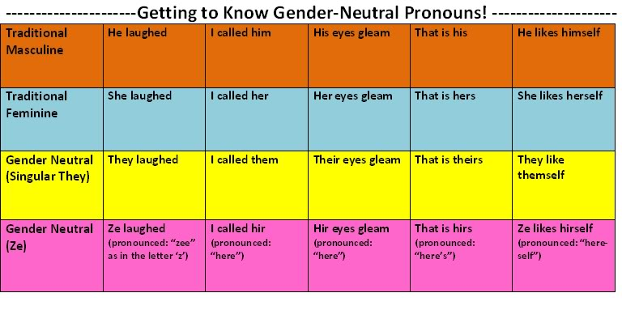
Preferred Gender Pronouns

Slide 29
Becoming an Ally
Defined as a heterosexual or cisgender person who cares about LGBT issues and works to challenge sexuality and gender related oppression.
Where are you in becoming at ally?
  Repulsion
  Pity
  Tolerance
  Accept
  Support
  Admiration
  Appreciation
  Nurturance
  from UC Riverside LGBT Resource Center

Slide 30
Ally Suggestions
Use inclusive language – partner, significant other
Don’t assume all gays and lesbians are attracted to all people of the same sex/gender
Challenge heterosexist curriculum
Celebrate National Coming Out Day – Oct 11
Ask for their PGP’s
Be patient
Offer the “buddy system”

Slide 31
Ally’s Don’t
“out” them
Compare their story to others
Assume people are gay or straight
Let homophobic comments slide
Make assumptions about their orientation
Tolerate trans comments
Ask personal physical questions

Slide 32
Safe Space Training for First Year Faculty
Safe Spaces:
  To strengthening, and creating, welcoming spaces that foster the development and flourishing of Gay, Lesbian, Bisexual, Transgender and Queer (LGBTQ) youth ( ages 13 – 25).
The Safe Spaces for LGBTQ youth as:
  affirming and welcoming of LGBTQ youth;
  being aware of their specific needs, perspectives, and strengths;
  willing and able to meet their needs; and
  operating from a Advancing/Positive Youth Development approach for all youth.
  From http://www.safespacesproject.org/

Slide 33
Safe Space Announcement - WPU
White Hall Lounge
Thursday October 17th, 2013
12:30 pm – 1:30 pm
Safe Space Training
Safe Space is a campus-wide initiative offering a visible message of inclusion, acceptance, and support to lesbian, gay, bisexual, transgender and questioning (LGBTQ) people in the University community. The program offers participants a one-hour training to raise awareness and knowledge of LGBTQ issues and to suggest ways to serve as an ally to LGBTQ individuals. Following the training, participants receive a Safe Space decal to display in their work or living space.
Open to administration, support staff, faculty, students, parents, alumni and guests
Lesbian, Gay, Bisexual, Transgender, Questioning, & Ally
WILLIAM PATERSON UNIVERSITY

Slide 34
Training (NJCBW)
Be conscious of who is in the room
Confidentiality
Respect
Open dialogue

Slide 35
Training (NJCBW)
Looking at orientation – A Turn Around Exercise
  What caused your heterosexuality?
  When and how did you decide to become heterosexual?
  Is it possible it is just a phase?
  Is it possible it stems from a neurotic fear of others of the same sex?

Slide 36
Training (NJCBW)
  If you never slept with someone of the same sex – do you need a good lay?
  To whom did you reveal your heterosexual tendencies? How did they react?
  Why do you feel compelled to seduce others to your life style?
  Why do you flaunt it? Can you just keep quiet about it?

Slide 37



Safe Space Symbols

Slide 38
Internalized Homophobia
“a set of negative attitudes and affects towards homosexuality in other persons and toward homosexual features in oneself”
from Lesbian and Gay Psychology, Greene/Herek

Slide 39
Gender Neutral Housing
William Paterson University seeks to provide a living environment welcoming to all gender identities; one not limited by the traditional gender binary. Gender Neutral Housing is available to students with sophomore status and above and allows for same-gender, opposite-gender or other-gender identities to live together regardless of sex. This provides a living/learning environment where residents can learn about and explore gender identity and expression in a comfortable and supportive environment.
Gender Neutral Housing participants must commit to maintaining an inclusive and welcoming living environment free of discrimination. Each resident accepted to live in Gender Neutral Housing must agree to the Gender Neutral Housing Agreement and will have responsibility to develop and uphold standards for the community in congruence with valuing all persons and seeking to learn from their diverse experiences and perspectives.

Slide 40
Gender Neutral Housing
Essay Questions (WPU)
All applicants are required to submit a separate typed attachment with this application answering the following questions regarding participation in the Gender Neutral Housing Community.
1. Why are you interested in living in Gender Neutral Housing?
2. Describe your current understanding of and comfort level with exploring issues of gender identity, gender expression and sexual orientation.
3. Describe the knowledge, training, and/or experiences that you possess that may be useful in helping your peers to develop a better understanding of gender identity and expression?
4. How will living in Gender Neutral Housing support you in achieving success at William Paterson University?
5. Is there anything else you would like us to consider in reviewing your application?

Slide 41
Student LGBT/Feminist Clubs and Resources (WPU)
Chosen, Feminist Collective
Resources
Human Rights Campaign
Working for Lesbian, gay, bisexual and transgender equal rights. Includes Corporate Equality Index
Out in the Workplace
Includes sections on how out do you want to be, researching organization policies and climates, resume writing - how much to include, interviewing strategies, coming out on the job.
ProGayJobs.com
Website listing jobs with companies that are committed to LGBT rights.
All LGBT Jobs
Queer Resources Directory
Gay Workplace Issues
ACLU

Slide 42


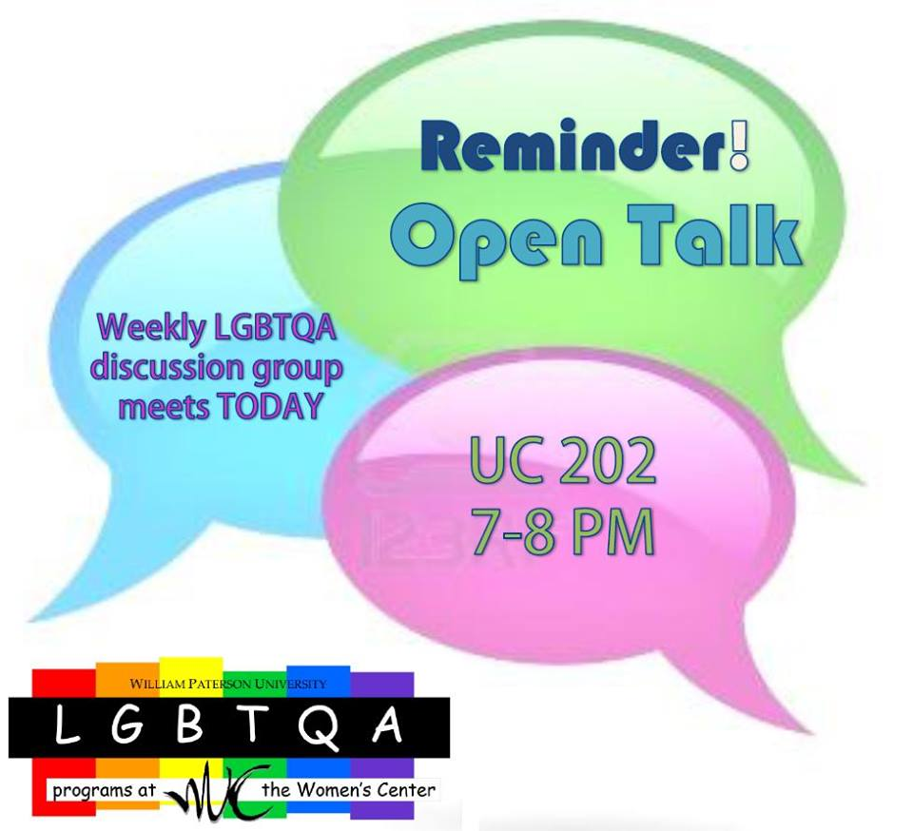

Slide 43
Include on your Syllabus
RESOURCE FOR CAMPUS COUNSELING ASSISTANCE
Counseling, Health and Wellness Office – Also, addiction and suicide
Available for immediate emergencies and regular appointments
Overlook South behind White Hall Appointments or Emergencies 973-720-2257
Campus Police
Available for all emergencies 973-720-2300
Office of Residence Life
Professional and student staffs are LGBTQA and Suicide Prevention trained
Located in each Residence Hall
Main Office located in the Lower Level of White Hall
Main Office: 973-720-2714 (during business hours only)
Residence Hall Offices (Business hours and 8pm - 10pm 7 days a week)
Apartments: x2600
High Mountain: x5460
White and Matelson: x3530
Overlook North and South: x2381
Century: 5310
Hillside: x3580
Women's Center
LGBTQA Programs & Veterans Affairs are also housed here UC313 973-720-2946
Women and Gender Studies 973-720-3405
Trevor Project Our trained counselors are here to support you 24/7. If you are a young person who is in crisis, feeling suicidal, or in need of a safe and judgment-free place to talk, call The Trevor Lifeline now at 866-488-7386 866-488-7386 FREE

Slide 44


Slide 45
Additional References
http://www.youthprideri.org/Resources/Statistics/tabid/227/Default.aspx
http://www.freedomtomarry.org/states/entry/c/new-jersey
http://www.americanprogress.org/wp-content/uploads/issues/2012/06/pdf/state_nondiscrimination.pdf
http://www.huffingtonpost.com/2012/05/09/gay-marriage-legal-world_n_1504054.html#slide=957718
http://www.freedomtomarry.org/landscape/entry/c/international
http://76crimes.com/76-countries-where-homosexuality-is-illegal/
http://www.ncsl.org/issues-research/human-services/same-sex-marriage-overview.aspx

