Slide 1
Representation of gender & Stereotypes

Slide 2
Starter Activity
Discuss your ideal man and/or woman in small groups.

Slide 3
What does this suggest you value most about men/women?

Slide 4
Today’s lesson
We are focusing on the representation of gender (one of the areas you may have to discuss in the exam)
We will also consider stereotypes and countertypes
You need to be able to apply the ideas discussed when analysing TV drama clips.

Slide 5
What is gender?
"Sex" refers to the biological and physiological characteristics that define men and women.
"Gender" refers to the socially constructed roles, behaviours, activities, and attributes that a given society considers appropriate for men and women.
(Taken from http://www.who.int/gender/whatisgender/en/)
...and transgender should be part of this too.

Slide 6
Consider birthday cards and girls/boys magazines.
What do these say about what it means to be a boy/girl? What do boys like and what do girls like?

Slide 7
Do you think this changes in men’s/women’s magazines?
Spend 5 minutes searching online for images of ‘men’s magazines’ and ‘women’s magazines’.
What do they feature?
What does this suggest is important about men/women?
What do you think about this?

Slide 8
Masculinity and femininity
Gender and representation of gender is tied up with ideas of masculinity and femininity...
Are the following ideas about the representation of men and women reinforced by what you found in the magazines?

Slide 9
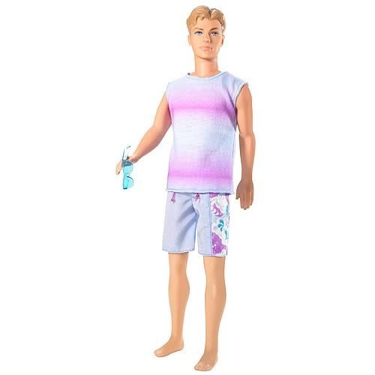
Representation of Men
'Masculinity' is a concept that is made up of more rigid stereotypes than femininity. Representations of men across all media tend to focus on the following:
Strength - physical and intellectual
Power
Sexual attractiveness (which may be based on the above)
Physique
Independence (of thought, action, finances)

Slide 10
Representation of Men
Male characters are often represented as isolated, as not needing to rely on others (the lone hero). If they submit to being part of a family, it is often part of the resolution of a narrative, rather than an integral factor in the initial balance.
It is interesting to note that the male physique is becoming more important a part of representations of masculinity.

Slide 11
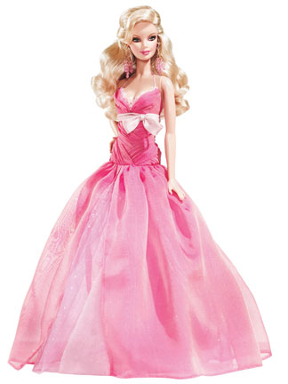
Representation of Women
Representations of women across all media tend to
highlight the following:
beauty (within narrow conventions)
size/physique (again, within narrow conventions)
sexuality (as expressed by the above)
emotional (as opposed to intellectual) dealings
relationships (as opposed to independence/
freedom)

Slide 12
Representation of Women
Women are often represented as being part of a context (family, friends, colleagues) and working/thinking as part of a team. In drama, they tend to take the role of helper (Propp) or object, passive rather than active.
Often their passivity extends to victimhood. Men are still represented as TV drama characters up to 3 times more frequently than women, and tend to be the predominant focus of news stories.

Slide 13
Media representations of gender
Consider the views put forward in these videos. Do you agree?
http://www.mediaed.org/cgi-bin/commerce.cgi?preadd=action&key=234
http://www.youtube.com/watch?v=NX3w4leth9I

Slide 14
Masculinity and femininity
How does society treat people who do not conform to gender norms (i.e. men who are feminine and women who are masculine)?
So what is our society's dominant ideology about gender (i.e. what gender attributes and behaviours are valued most in our society on the whole)?

Slide 15
Media representations of gender
Music video to consider: http://www.youtube.com/watch?v=2uMJ22Ijc40
What does this music video suggest it means to have a good time as a man? As a woman?
How are the male characters represented?
How are the female characters represented?
Do these representations draw on any cultural norms about gender?

Slide 16
It is useful at this point to consider Stereotypes in more detail...

Slide 17
Stereotypes
Assumptions that are held about a social group.
They are often used in a negative or prejudicial sense and are frequently used to justify certain discriminatory behaviours.
Stereotyping is an important concept in terms of representation.

Slide 18
Stereotypes
Stereotypes change with time
If you look at TV drama from the past it is strange to see how inappropriately some demographics (particularly minorities such as homosexuals or ethnic groups) were depicted or represented.
Love Thy Neighbour clip

Slide 19
Stereotype production is based on…
Simplification
Exaggeration or distortion
Generalisation
Presentation of cultural attributes as being 'natural'.
Does it matter?

Slide 20
The Countertype
A positive stereotype.
Focuses on positive elements of a group traditionally represented as bad.
Still an oversimplification of the enormous diversity featured with the group.

Slide 21
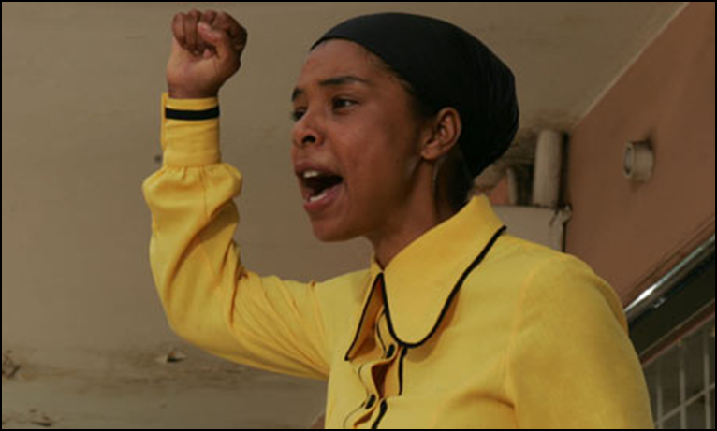
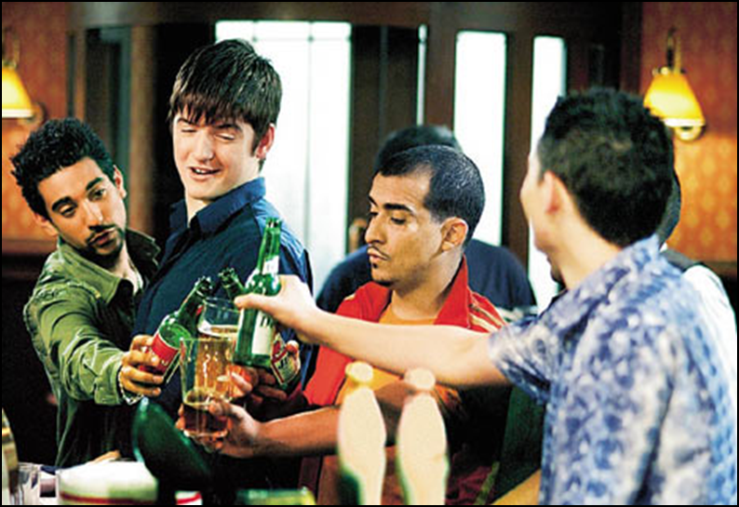
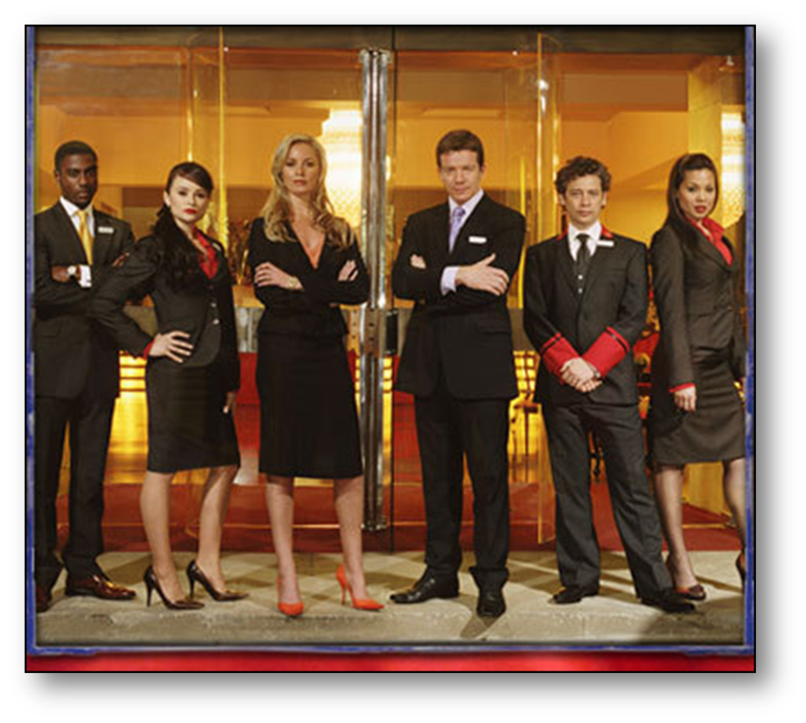
Stereotype or countertype?

Slide 22
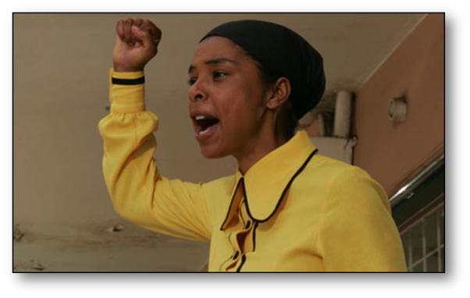
Stereotype or countertype?
What is denoted? (Describe what the image contains using the technical elements, e.g. details of mise en scene and camerawork.)
What is connoted? (Explain how the image might be interpreted, e.g. what do the denotations suggest about the characters?)
What is the significance of the representations? (Does the image present a stereotype or countertype? Why? – consider masculinity/femininity. Is this a common representation? Is it a positive or negative representation?)

Slide 23
Stereotype or countertype?

Slide 24
Stereotype or countertype?

Slide 25
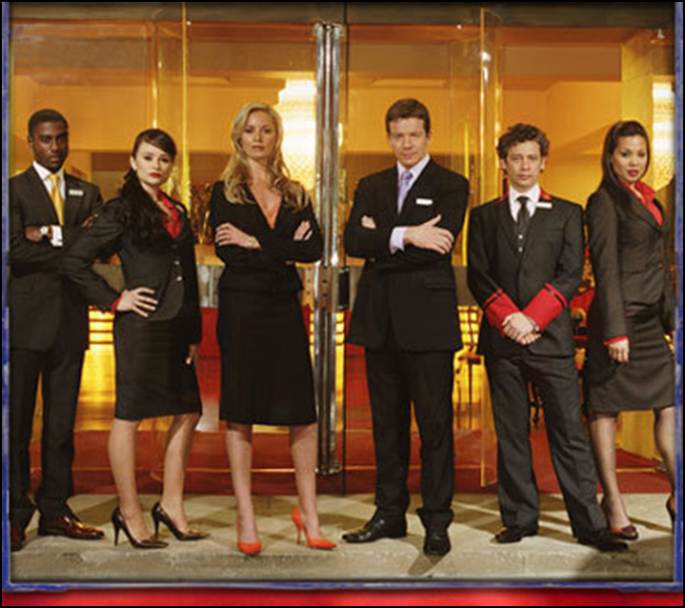
Stereotype or countertype?

Slide 26
Stereotype or countertype?

Slide 27
Homework
Find examples of TV Drama characters who you think,
1. reinforce gender stereotypes
2. challenge gender stereotypes
Create a collage of characters for each with annotations explaining your choice.
Post this on a new AS Media Exam journal. Email work to teacher if you have any problems posting on your journal.

