Slide 1
LGBT Issues
Professor Scillieri

Slide 2
LGBPTTQQIIAA
Any combination of letters attempting to represent all the identities in the queer community, this near-exhaustive one (but not exhaustive) represents:
  Lesbian
  Gay
  Bisexual
  Pansexual
  Transgender
  Transsexual
  Queer
  Questioning
  Intersex,
  Intergender
  Asexual,
  Ally

Slide 3
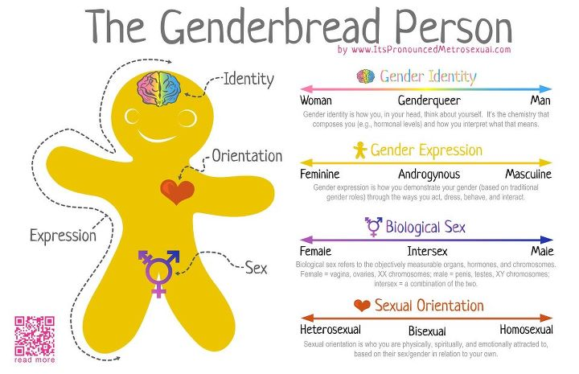

Slide 4
LGBTQQIAS Lingo
Ally | Asexual | Bear
MTF | Bisexual | Biphobia
Gay | Lipstick Lesbian | Butch
Queer | Closet | Cisgender
Transgender | Coming Out | Down-Low
Dyke | FTM | Gender Binary
Gender Expression | Gender Identity | Heterosexism
Heterosexual Privilege | Homosexual | Passing

Slide 5
2 Broke Girls S2Ep13 Bears
http://www.megashare.info/watch-2-broke-girls-season-2-episode-13-online-TlRnNE9BPT0
At 9 minutes

Slide 6
Heterosexism/Heterosexist
Heterosexism is a system of oppression which privileges heterosexuals and discriminates against lesbian, gay, and bisexual people. “The societal/cultural, institutional, and individual beliefs and assume that heterosexuality is the only natural, normal, acceptable, sexual orientation.” (Adams, et. Al., 162) It requires prejudice plus power.
Heterosexism presents homosexuality as abnormal, sick, unnatural, sinful, and/or criminal.
Heterosexist thinking encourages discriminatory behavior ranging from overt violence—“queer bashing” to the subtle (asking lesbian women and gay men, “How did you get this way?” without ever considering putting the question about heterosexuality to oneself or another; thinking that some lesbians and gay men are too blatant even though displays of heterosexuality are all around us (Kramarae and Treichler, 191).

Slide 7
Sexual Fluidity
Lisa M. Diamond (author of Sexual Fluidity) argues that for some women, love and desire are not rigidly heterosexual or homosexual but fluid, changing as women move through the stages of life, various social groups, and, most important, different love relationships.
This perspective clashes with traditional views of sexual orientation as a stable and fixed trait. But that view is based on research conducted almost entirely on men. Diamond is the first to study a large group of women over time. She has tracked one hundred women for more than ten years as they have emerged from adolescence into adulthood.
She summarizes their experiences and reviews research ranging from the psychology of love to the biology of sex differences. Sexual Fluidity offers moving first-person accounts of women falling in and out of love with men or women at different times in their lives. For some, gender becomes irrelevant: “I fall in love with the person, not the gender,” say some respondents.

Slide 8
Difference Between Bi-sexual, Pan sexual, Androgynous
Bisexual is being sexually attracted to both genders, male and female, while pansexual is being capable of having romantic feelings and attraction to males, females, and third gendered individuals. Bisexual identity more so establishes attraction to both genders, whereas pansexual identity more so recognizes the existence of other genders (third genders) and the capacity to be sexually attracted to individuals identifying as these various genders.
Third Gender is a gender identity. If someone is of the third gender, they are considered neither male nor female, whether by their will or by social consensus.
Androgynous neither specifically feminine nor masculine

Slide 9
Transgender
Transgender refers to people whose gender expression is not in accordance with society’s expectations for their biological sex.
For example, a woman whose gender expression is masculine is transgender (crosses the gender). Gender expression can include clothing, hairstyle, mannerisms, way of walking, preferred sitting positions, speech, etc.
For some transgender women, gender expression might be accentuated by the biological (broad shoulders, thick neck, deep voice, etc.)
Some transgender women identify as “butch” (a masculine woman).
A transgender male has a more feminine gender expression. He might have characteristics generally assumed to be relegated to the female sex. For example, he might have (but not necessarily) a slight build and a high-pitched voice. He might express himself with colors usually associated with females.

Slide 10
Transgender
Some transgender males prefer to wear clothing (sometimes or always) which society classifies as women’s wear. Some transgender males identify as “queens.” Some transgender people are homosexuals or bisexuals, and others are heterosexuals.
The term transgender is also used as an umbrella term for all “trans” people.
20/20 Barbara Walters http://www.youtube.com/watch?v=YfqmEYC_rMI
Transgender Resources: http://www.katiecouric.com/features/transgender-gender-identity-resources/
Discrimination at Every Turn (Transgender Report)
http://www.thetaskforce.org/downloads/reports/reports/ntds_summary.pdf

Slide 11
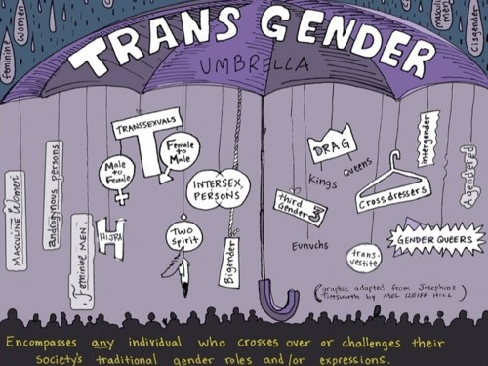
Transgender Umbrella

Slide 12
Gender Queer
Genderqueer is most commonly used to describe a person who feels that his/her gender identity does not fit into the socially constructed "norms" associated with his/her biological sex.
Genderqueer is an identity that falls anywhere between man/boy/male and woman/girl/female on the spectrum of gender identities.
Gender Rebel Documentary http://www.bing.com/videos/search?q=gender+rebel+documentary&view=detail&mid=0BBF82F735966AAB0C510BBF82F735966AAB0C51&first=0&FORM=NVPFVR&qpvt=gender+rebel+documentary
GenderSpectrum.org – definitions http://www.genderspectrum.org/images/stories/08%20a%20word%20about%20words.gender.pdf

Slide 13
Real Life Experience
The act of fully adopting a new or evolving gender role for the events and processes of everyday life is known as the real-life experience. The real-life experience is essential to the transition process to the gender role that confirms with personal gender identity.
Since changing one's gender role has immediate profound personal and social consequences, the decision to do so should be preceded by an awareness of what the familial, vocational, interpersonal, educational, economic, and legal consequences are likely to be.
Professionals have a responsibility to discuss these predictable consequences. These represent external reality issues that must be confronted for success in the new gender role. This may be quite different from the personal happiness in the new gender role that was imagined prior to the real life experience.

Slide 14
Parameters of the Real Life Experience
When clinicians assess the quality of a person's real-life experience in the new gender role, the following abilities are reviewed:
1. to maintain full or part-time employment
2. to function as a student;
3. to function in community-based volunteer activity;
4. to undertake some combination of items 1-3
5. to acquire a new (legal) first or last name
6. to provide documentation that persons other than the therapist know that the patient functions in the new gender role.

Slide 15
Real-Life Experience versus Real Life Test
Although professionals may recommend living in the desired gender as a step toward surgical assistance, the decision as to when and how to begin the real-life experience remains the person's responsibility. Some begin the real-life experience and decide that this often imagined life direction is not in their best interest.
Professionals sometimes construe the real-life experience as the real life test of the ultimate diagnosis. If patients prospered in the aspired-to gender, they were confirmed as "transsexual," if they decided against continuing, they "must not have been." This reasoning is a confusion of the forces that enable successful adaptation with the presence of a gender identity disorder.
The real-life experience tests the person's resolve, capacity to function in the aspired to gender, and the alignment of social, economic, and psychological supports. It assists both the patient and the mental health professional in their judgments how to proceed.
Diagnosis, although always open for reconsideration, precedes a recommendation for patients to embark on the real When the patient is successful in the real life experience, both the MHP and the patient gain confidence in the original decision to embark on the path to the irreversible further steps. life experience.
From http://www.tc.umn.edu/~colem001/hbigda/soc9.pdf

Slide 16
Neutrois v. Agender
Neutrois - Neutrois.com:
Neutrois is an identity used by individuals who feel they fall outside the gender binary. Many feel Neutrois is a gender, like a third gender while others feel agendered. What they have in common is that they wish to minimize their birth gender markers.
Agender - Nonbinary.org
Agender aka Genderless, Non-gender is an identity under the nonbinary, genderqueer, and transgender umbrellas. Agender individuals have no gnder identity and/or no gender expression. They may simply describe this in terms of having no gender or as identifying as a person rather than a gender.

Slide 17
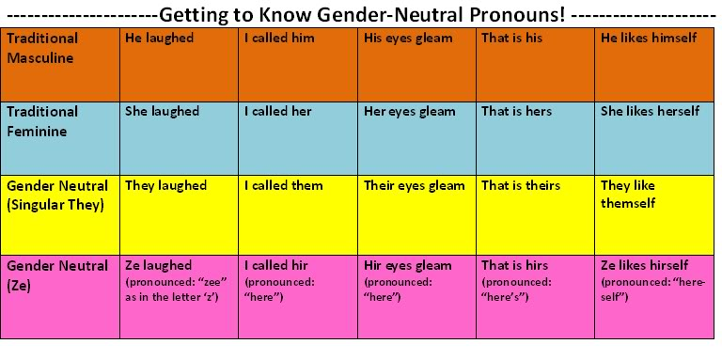
Preferred Gender Pronouns

Slide 18
Trans-Gender Specific Facts
  33.2% of transgender youth have attempted suicide.
  55% of transgender youth report being physically attacked.
  74% of transgender youth reported being sexually harassed at school, and 90% of transgender youth reported feeling unsafe at school because of their gender expression.
  In a survey of 403 transgender people, 78% reported having been verbally harassed and 48% reported having been victims of assault, including assault with a weapon, sexual assault or rape.
  In 2002, a study was published that found that bisexual students in Massachusetts and Vermont were three to six times more likely to use cocaine than their straight classmates.

Slide 19
Updated Documents for Trans
California – October 8, 2013
http://transequality.org/Issues/federal_documents.html

Slide 20
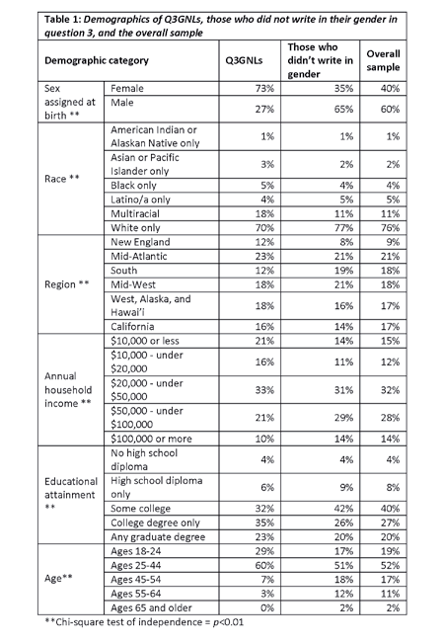
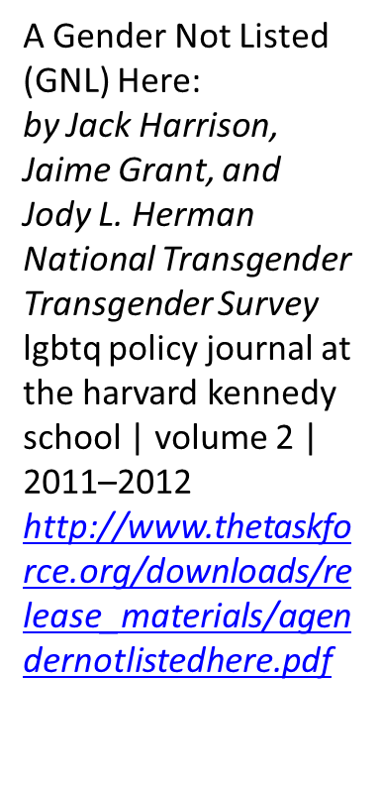

Slide 21
Intersexual Bodies:
The Herm, Merm and Ferm
“Hermaphrodites, (the “herms”), who possess one testis and one ovary (the sperm- and egg-producing vessels, or gonads).
The male pseudohermaphrodites (the "merms"), who have testes and some aspects of the female genitalia but no ovaries.
The female pseudohermaphrodites (the "ferms"), who have ovaries and some aspects of the male genitalia but lack testes.
4% of births are intersexual
Females XX and males XY chromosomes
From The Five Sexes: Why Male and Female Are Not Enough
By Anne Fausto-Sterling
The Sciences March/April 1993, p. 20-24

Slide 22
Intersexual Bodies:
The Herm, Merm and Ferm
Hermaphrodites - the testis and the ovary grow separately but bilaterally, in others they grow together within the same organ, forming an ovo-testis. Not infrequently, at least one of the gonads functions quite well, producing either sperm cells or eggs, as well as functional levels of the sex hormones-- androgens or estrogens. Although in theory it might be possible for a true hermaphrodite to become both father and mother to a child, in practice the appropriate ducts and tubes are not configured so that egg and sperm can meet.
Thus merms have testes and XY chromosomes, yet they also have a vagina and a clitoris, and at puberty they often develop breasts. They do not menstruate, however.
Ferms have ovaries, two X chromosomes and sometimes a uterus, but they also have at least partly masculine external genitalia. Without medical intervention they can develop beards, deep voices and adult-size penises.
http://capone.mtsu.edu/phollowa/5sexes.html

Slide 23
Different Cultures
Western: 2 genders - Male and female
Some cultures: 3 genders - male, female and berdaches (two-spirited) or hijas or xaniths.
Berdaches (Native American), hijas (Indian), xaniths (Arabic), Fa'afafine (Polynesian): generally biological men who behave, dress, work, and treated as woman. They are not male or female but “male female.”

Slide 24
Different Cultures
African and Native Americans: Manly hearted women – biological women who work, marry, and parent as men, “female male.”
They do not dress as men but have the money to buy a wife.
From Night to His Day by Judith Lorber

Slide 25
North American Intersex Society
Hermaphrodites Speak!
http://www.youtube.com/watch?v=VMER3_nxlN0
Our Mission: The Intersex Society of North America (ISNA) is devoted to systemic change to end shame, secrecy and unwanted genital surgeries for people born with an anatomy that someone decided is not standard for male or female.
We have learned from listening to individuals and families dealing with intersex that:
Intersexuality is primarily a problem of stigma or trauma, not gender.
Parents’ distress must not be treated by surgery on the child.
Professional mental healthcare is essential.
Honest, complete healthcare is good medicine.
All children should be assigned as a boy or a girl, without early surgery.
Click here to learn more about our agenda. With your help, we can make the world a safer place for families dealing with intersex conditions.
A New Era for Intersex Rights
http://www.newyorker.com/online/blogs/newsdesk/2013/12/a-new-era-for-intersex-rights.html

Slide 26
Definitions
Transsexuals are people who have “become” other than their birth sex. Some use hormones to become other and some also have surgery and “legally” become other than their birth sex.
Transvestites are those who dress in the clothing of the “opposite” sex and for whom that dressing is sexually exciting (Marcus, p, 200).
Queer was originally a derogatory label used to refer to lesbian and gay people or to intimidate and offend heterosexuals. More recently, this term has been reclaimed by some lesbians, gay men, bisexual people and transgender people as an inclusive and positive way to identify all people targeted by heterosexism and homophobia. (Adams, et. Al., 162 - 3)
Billy Tipton
http://www.nytimes.com/1989/02/02/us/musician-s-death-at-74-reveals-he-was-a-woman.html
Billy Tipton http://www.youtube.com/watch?v=2bg4b6V4eXY

Slide 27
Asexuality
I am asexual.
I don’t feel sexually attracted to anyone.
Not men. Not women.
That’s all it is.
I’m not gay.
I’m not straight.
I’m not bi.
I’m none of the above.
Asexuality is real.
It’s not fake.
It’s not a hormone problem.
It’s not a way of running from a bad relationship.
It’s not a physical condition.
It’s not an attention grab.
It’s not an inability to have sex.
It’s not an inability to love.
It’s not some way to be “special”.
I don’t care if you have sex.
I don’t care if you don’t.
I don’t want to shame you.
I don’t want to convert you.
I don’t want to recruit you.
I just want you to understand me.

Slide 28
ASEXUALITY
An asexual person is a person who does not experience sexual attraction. From asexual.org October 20 through 26, 2013 is Asexual Awareness Week. https://www.facebook.com/aceawareness
What is Asexuality? http://www.huffingtonpost.com/2013/06/17/what-is-asexuality_n_3360424.html?1371476978
Anatomy of an Asexual Relationship and Slides http://www.huffingtonpost.com/2013/06/20/asexual-discrimination_n_3380551.html?1371733068
Love Without Sex http://www.huffingtonpost.com/2013/06/19/asexual-relationships_n_3362206.html?1371648830
LGBT, Asexual Communities Clash Over Ace Inclusion http://www.huffingtonpost.com/2013/06/21/lgbt-asexual_n_3385530.html?1371820877
Asexuality as a Disorder and The Asexual Community http://www.huffingtonpost.com/2013/06/18/asexual-disorder_n_3361472.html?1371562287
Asexual Community Leaders Look Toward The Future http://www.huffingtonpost.com/2013/06/22/asexual-community_n_3386123.html?1371909647
http://www.ace-book.net/

Slide 29
Documentary and Interviews
(A) Sexual – the documentary
http://www.youtube.com/watch?v=AYMh9zkt6r4
Asexuality on 20/20 – March 24, 2006
http://www.youtube.com/watch?v=CeKGOMUVU7g
Asexuality on CNN – Showbiz
http://www.youtube.com/watch?v=kkoo1lUp3ns

Slide 30
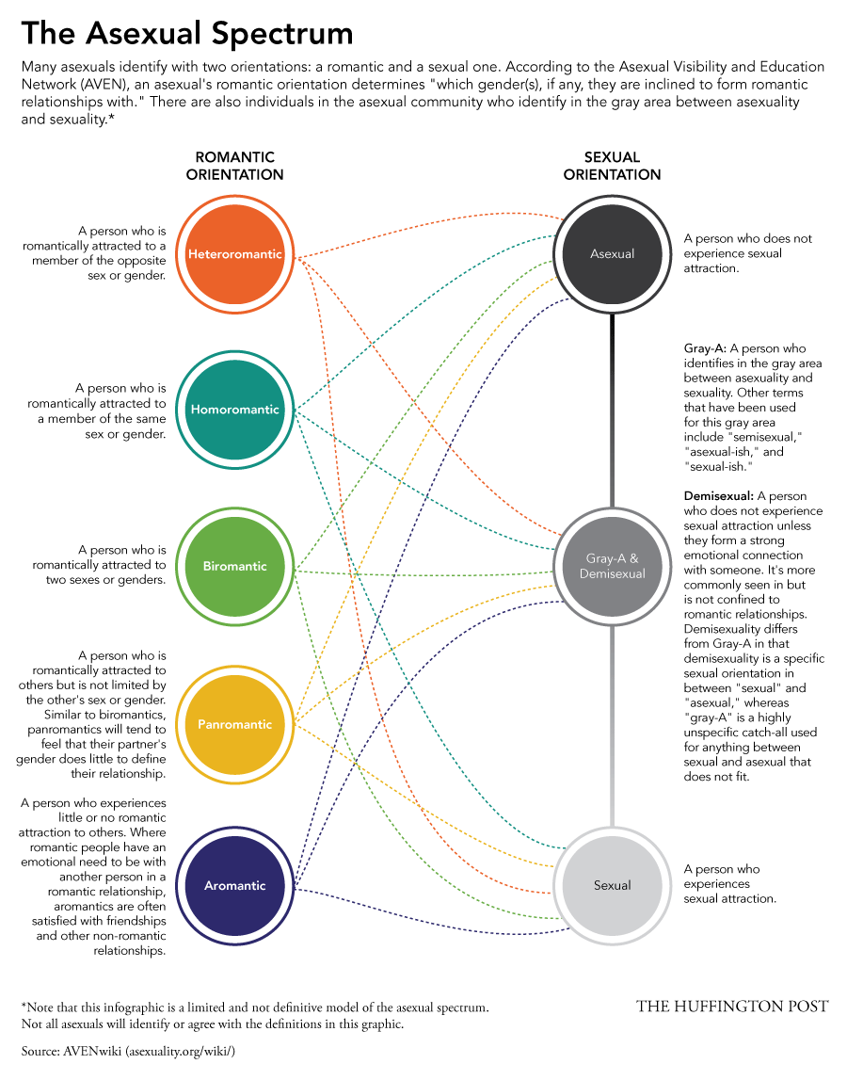
THE ASEXUAL SPECTRUM

Slide 31

A Sexuality Flag
GREY
Grey - Aces
Do not normally experience attraction but do experience it sometimes.
Experience sexual attraction, but a low sex drive.
Experience sexual attraction and drive, but not strongly enough to want to act on them.
People who can enjoy and desire sex, but only under very limited and specific circumstances.
Similarly, some people who might technically belong to the gray area choose to identify as asexual because it is easier to explain.
Demi-sexual
A person who does not experience sexual attraction unless they form a strong emotional connection with someone.
  Black - asexuals
  Grey - demisexuals and grey-aces
  White - Non-asexual partners and allies.
purple - the community around us, our community

Slide 32
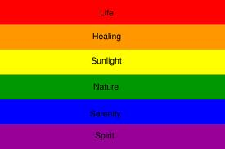

Symbolism of the Flag’s Colors
LGBT
ASEXUALITY
The four colors all have meanings:
  Black: Asexuality.
  Grey: Grey-Asexuality and Demisexuality.
  Purple: Community

Slide 33

The Purple Rhino
Use of the Purple Rhino dates back to the 1970's as a symbol for Gay power. The symbol never picked up steam but was chosen because the Rhino is usually a docile and often misunderstood creature but can put up a good fight if attacked. It was analogous to the fact that Gays and Lesbians are peaceful and loving but will fight back if bashed.

Slide 34
Sexual Orientations

Slide 35

Triangles

Slide 36

AIDS FLAG
The gay community has been one of the hardest hit by the AIDS epidemic. A San Francisco group suggested a modification to the traditional rainbow flag by adding a black stripe to the bottom of it to commemorate everyone who we've lost to the AIDS virus over the years. Sgt. Leonard Matlovich, a well-decorated Vietnam War Veteran who is dying of AIDS, proposed that when a cure for AIDS was found, all of the black stripes should be removed from these flags and ceremoniously burned in Washington D.C.
From lambda

Slide 37


Flags
Bear Brotherhood Flag Lipstick Lesbian
"Bear" is an affectionate term used for a gay man with an abundance of body hair, especially on his face and chest. Bears also tend to be a bit older and chubbier, but this is a convenient stereotype. The Bear Pride Flag symbolizes this group. It was developed by a Seattle bear bar named Spags. The blue stripes represents the sky and the green stripe represent the earth. In between these two are all the bears of the world- white for polar bears, black for black bears, and brown for brown bears. The yellow paw print is the sun, representing the spirit.
A feminine lesbian who is attracted to other feminine lesbians. they generally enjoy fashion, flowers, perfume, sex and the city, lingerie, lipstick of course, and passionate sex with other women.

Slide 38
Sexual Identity Symbols

Slide 39
Sexual Identity Symbols

Slide 40
Sexual Identity Symbols

Slide 41
Gender Symbols

Slide 42

Fetish Symbols

Slide 43
Minorities within a Minority
Intersection of Identity
  LGB and
    Have a disability
    Identify as part of an ethnic minority
    Identify as Gender-nonconforming
Other identities that can add to oppression:
  Geography
  Age
  Gender Expression
  Religious/Spiritual background
  Etc.

Slide 44
Issues Facing the Gay Community
Family Acceptance
Bullying and Suicide
  36.5 % of GLB youth grades 9-12 have attempted suicide. 20.5% of those attempts resulting in medical care.
  Gay and lesbian youth are 2 to 3 times more likely to attempt suicide than heterosexual young people.
  As many as 1 in 3 gay and lesbian youth have attempted suicide.
  In a 1998 health survey conducted by Youth Pride, Inc. aimed at LGBTQQ youth, 58% of respondents reported that they had felt suicidal as teenagers.
  Campus Pride http://www.campuspride.org/

Slide 45
Michael Sam
http://www.youtube.com/watch?v=v2Vld8duOik
http://www.nytimes.com/2014/02/12/sports/football/for-nfl-prospect-michael-sam-upbringing-was-bigger-challenge-than-coming-out-as-gay.html?src=xps

Slide 46
Arizona Governor Vetoes Bill on Refusal of Service to Gays
http://www.nytimes.com/2014/02/27/us/Brewer-arizona-gay-service-bill.html?hp
http://www.cnn.com/2014/02/26/politics/arizona-brewer-bill/index.html?hpt=hp_t1
http://www.advocate.com/comedy/2014/02/25/celebrities-and-comedians-skewer-arizonas-discrimination-bill-twitter

Slide 47
Mississippi Passes Discrimination Against LGBT Community Based on Religion
http://www.slate.com/blogs/outward/2014/04/02/mississippi_passes_anti_gay_segregation_bill_will_it_be_struck_down.html
Awaiting governor’s signature 4-2-2014

Slide 48
Verbal Harassment
  84% of LGBT students report being verbally harassed (name calling, threats, etc.) because of their sexual orientation.
  91.5% of LGBT students report hearing homophobic remarks, such as “faggot,” “dyke” or the expression “that’s so gay” frequently or often.
  44.7% of LGBT youth of color report being verbally harassed because of both their sexual orientation and race/ethnicity.
  Students who experience frequent verbal harassment because of their sexual orientation are less likely than other students to plan to attend college. 13.4% of LGBT students who report verbal harassment do not intend to go to college, twice the figure of those LGBT students who report only rare or less frequent verbal harassment (6.7%).

Slide 49
Issues Facing the Gay Community
  82.9% of LGBT students report that faculty or staff never intervened or intervened only some of the time when present and homophobic remarks were made.
  A 2006 report by the National Gay and Lesbian Task Force describes the 'Hell Houses' created by right-wing religious groups as an alternative to traditional haunted houses, with the intention of scaring children into a sin-free life. Homosexuality is featured as a damnable sin in these displays, with depictions of the 'sinner' burning in Hell, a lesbian teenager committing suicide, and a male couple at their marriage being forced to swear never to believe that they're 'normal.' It is estimated that 1.6 million people, some as young as 10 years old, visited 'Hell Houses' in 2006.
  http://www.youtube.com/watch?v=kcJCOou6dZk
  http://www.youtube.com/watch?v=5mLrscVsysM&feature=fvwberel
  http://www.youtube.com/watch?v=7IcVyvg2Qlo
  http://www.youtube.com/watch?v=w0qpbpmLJFc
  It Gets Better

Slide 50
Isolation
  80% of gay and bisexual youth report severe problems with cognitive, social, or emotional isolation.
  50% of lesbian and gay youth report parental rejection because of their sexual orientation.
  82.9% of LGBT students report that faculty or staff never intervened.

Slide 51
Depression
  In a study of depression and gay youth, researchers found depression strikes gay youth four to five times more severely than their non-gay peers.
  83% of respondents in YPI’s 1998 health survey considered themselves depressed.
  It Will Get Better Project https://www.youtube.com/watch?v=7IcVyvg2Qlo

Slide 52
Violence
  64.3% of LGBT students report feeling unsafe at their school because of their sexual orientation.
  In one study, 41% of self-identified gay and lesbian young people reported violence at the hands of families, peers, or strangers.
  Sexual minority students were more than twice as likely to report being in a physical fight at school in the prior year (31.5% of sexual minority students vs. 12.9% of others).
  Sexual minority students more often reported that they had missed school in the past month because they felt unsafe (19.1% of sexual minority students vs. 5.6% of others).

Slide 53
Violence
  A 2002 study found that bisexual students were three to six times more likely than their straight classmates to be threatened or injured with a weapon at school.
  FBI data shows that in 2005, 13.8% of hate crimes in the U.S.A., a total of 1,213 attacks, were motivated by bias against the victim's sexual orientation. 61.3% of those were committed against men who were or were perceived to be gay, while 1.9% of victims were or were perceived to be straight, a 2001 study found that LGBQ teenagers are more likely to experience, witness, and/or perpetrate violence than their straight peers.
  A 2002 study found that LGB students who are victims of violence at school have elevated risk of suicidal and other health-risk behavior.

Slide 54
Homelessness
  According to a 2006 report, between 20 and 40 percent of homeless youth in the US identify as lesbian, gay, bisexual or transgender. 26% of LGBT youth who come out to their parents are told to leave home. Many also report experiencing abuse both from family members and in shelters.
  65% of 400 homeless LGBTQ youth report having been in a child welfare placement at some point in the past.
  26% of gay youth are forced to leave home because of conflicts with their families over their sexual identities.
  Up to half of the gay or bisexual men forced from their homes engage in prostitution to support themselves, greatly increasing their risk for HIV infection.
  Half of a sampling of gay and lesbian young people in out-of-home care reported having been homeless at some point in the past. (Mallon, Gerald, P. (1998). We don’t exactly get the welcome wagon: the experiences of gay and lesbian adolescents in the child welfare systems. Columbia University Press.)

Slide 55
Harassment
Westboro Babtist Church
Russell Brand interviews anti-gay leaders
https://www.youtube.com/watch?v=OBA6qlHW8po
Westboro to protest Newtown Funerals
https://www.youtube.com/watch?v=ZtOU5h7Ws4M
Westboro Dating Site
http://www.huffingtonpost.com/2013/02/11/westboro-mingle-provides-dating-service-for-hateful-bigots_n_2662315.html?utm_hp_ref=online-dating
https://www.youtube.com/results?search_query=westboro+babtist+church+&sm=12 YouTube list

Slide 56
LGBT Youth Trafficked
Up to 5 times more likely to be trafficked than heterosexual youth
Due to feelings of rejection and alienation

Slide 57
Substance Abuse
  68% of adolescent gay males use alcohol and 44% use other drugs. 83% of lesbians use alcohol and 56% use other drugs.
  According to a 2005 report, alcohol dependence is greater among LGBTQ people, especially for women. The report emphasizes the need for including sexual orientation as a subgroup when monitoring alcohol abuse in population studies.
  A 2004 study found that "mostly heterosexual" adolescents and lesbian and bisexual girls are more likely to smoke than their heterosexual counterparts.
  A 2002 study found that LGB students who are victims of violence at school have elevated risk of substance abuse.

Slide 58
Imagine A World Where Being "Gay" The Norm & Being "Straight" Would Be The Minority! [Short Film]
http://www.youtube.com/watch?v=CnOJgDW0gPI
BE AN ALLY!!!
  Know the issue
  Provide support
  Educate yourself and others
  Advocate for change and equality
  Wear SWAG

Slide 59
Watch Sports Anchor Dale Hansen Destroy People Who Don't Want to Let Gay People Play in the NFL
http://www.motherjones.com/mixed-media/2014/02/watch-dale-hansen-michael-sam-gay-nfl-commentary-dallas-anchor

Slide 60
Ally Suggestions
Use inclusive language – partner, significant other
Don’t assume all gays and lesbians are attracted to all people of the same sex/gender
Challenge heterosexist curriculum
Celebrate National Coming Out Day – Oct 11
Ask for their PGP’s
Be patient
Offer the “buddy system”

Slide 61
Ally’s Don’t
“out” them
Compare their story to others
Assume people are gay or straight
Let homophobic comments slide
Make assumptions about their orientation
Tolerate trans comments
Ask personal physical questions

Slide 62
The Dangers and Lies of
Reparative Therapy from the Human Rights Campaign
Many right-wing religious groups promote the concept that an individual can change his or her sexual orientation, either through prayer or other religious efforts, or through so-called "reparative" or "conversion" therapy.
The limited research on such efforts has disproven their efficacy, and also has indicated that they can be affirmatively harmful.
Beyond studies focused solely on reparative therapy, broader research clearly demonstrates the significant harm that societal prejudice and family rejection has on lesbian, gay, bisexual and transgender (LGBT) people, particularly youth.

Slide 63
The Dangers and Lies of
Reparative Therapy from the Human Rights Campaign
Furthermore, there is significant anecdotal evidence of harm to LGBT people resulting from attempts to change their sexual orientation. Based on this body of evidence, every major medical and mental health organization in the United States has issued a statement condemning the use of reparative therapy.
Psychiatrist Dr. L. Spitzer, who once offered a study on reparative therapy, has since denounced the practice and has apologized for endorsing the practice
Psychiatry Giant Sorry for Backing Gay ‘Cure’ – The New York Times May 18, 2012
http://www.nytimes.com/2012/05/19/health/dr-robert-l-spitzer-noted-psychiatrist-apologizes-for-study-on-gay-cure.html?_r=1#__utma=149406063.1224642951.1381363343.1381363343.1381363343.1&__utmb=149406063.2.10.1381363343&__utmc=149406063&__utmx=-&__utmz=149406063.1381363343.1.1.utmcsr=google|utmccn=(organic)|utmcmd=organic|utmctr=(not%20provided)&__utmv=-&__utmk=264738447

Slide 64
Lou Reed
NBC news report of his death
http://www.nbcnews.com/entertainment/lou-reed-velvet-underground-founder-dies-71-8C11476676
I’ m Waiting for My Man – Lou Reed
Recorded at filming of Andy Warhol,1966, of the band in a rehearsal.
http://www.youtube.com/watch?v=hugY9CwhfzE
Lou Reed was institutionalized for reparative therapy for his bisexuality.

Slide 65
University San Francisco
Research on the issue of family acceptance of LGBT youth conducted at San Francisco State University found that "compared with LGBT young people who were not rejected or were only a little rejected by their parents and caregivers because of their gay or transgender identity, highly rejected LGBT young people were:
  8 times more likely to attempt suicide
  6 times more likely to suffer from depression
  3 times more likely to use drugs
  3 times more likely to contract HIV or STD’s

Slide 66
Banning Reparative Therapy
Banned in California (Sept 2012)
Banned in New Jersey (Aug 2013)
Under review Pennsylvania and Ohio

Slide 67
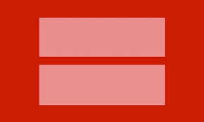
Equality

Slide 68
Defense of Marriage Act (DOMA)
January 3, 1996
‘‘No State, territory, or possession of the United States, or Indian tribe, shall be required to give effect to any public act, record, or judicial proceeding of any other State, territory, possession, or tribe respecting a relationship between persons of the same sex that is treated as a marriage under the laws of such other State, territory, possession, or tribe, or a right or claim arising from such relationship.’’
SEC. 3. DEFINITION OF MARRIAGE.
(a) IN GENERAL.—Chapter 1 of title 1, United States Code, is amended by adding at the end the following:
‘§ 7. Definition of ‘marriage’ and ‘spouse’ ‘‘In determining the meaning of any Act of Congress, or of any ruling, regulation, or interpretation of the various administrative bureaus and agencies of the United States, the word ‘marriage’ means only a legal union between one man and one woman as
husband and wife, and the word ‘spouse’ refers

Slide 69
Overturning of DOMA
http://www.nytimes.com/2013/06/27/us/politics/supreme-court-gay-marriage.html?_r=0
The decision on the federal law was decided by 5 to 4, with Justice Anthony M. Kennedy writing the majority opinion. He was joined by the four members of the court’s liberal wing.
The ruling striking down the federal Defense of Marriage Act will immediately extend many benefits to couples in the states where same-sex marriage is legal, and it will give the Obama administration the ability to broaden other benefits through executive actions.
The case concerning California’s ban on same-sex marriage, Proposition 8, was decided on technical grounds, with the majority saying that it was not properly before the court. Because officials in California had declined to appeal a trial court’s decision against them and because the proponents of Proposition 8 were not entitled to step into the state’s shoes to appeal the decision, the court said, it was powerless to issue a decision. That left in place a trial court victory for two same-sex couples who had sought to marry.
from The New York Times June 26, 2013 Supreme Court Bolsters Gay Marriage With Two Major Rulings

Slide 70
Tax Discrimination
What happens to tax laws after the overturning of DOMA - http://www.lambdalegal.org/publications/after-doma-summary
Same sex marriages are not recognized federally and so they cannot file jointly.
Inheritance/estate tax is applied: “PERHAPS most significantly for couples with major assets, DOMA prevents same-sex couples from taking advantage of estate tax exemptions, about $5.1 million for 2012 — but double that for couples — after indexing for inflation. If one member of a same-sex couple dies and leaves a spouse $5 million, those assets would be taxed. For heterosexual couples, there would be no tax.
That tax disparity is at the heart of the first challenge to DOMA to reach the United States Supreme Court. It was filed by Edith Windsor, who married Thea Spyer in 2007. When Ms. Spyer died in 2009, she left Ms. Windsor her share of their cottage in Southampton, N.Y., valued at $550,000 and an apartment on Fifth Avenue in Manhattan valued at $1.3 million. The result was a $600,000 federal and state estate tax bill. “
http://www.nytimes.com/2013/02/10/business/yourtaxes/same-sex-couples-may-find-tax-time-doubly-trying.html

Slide 71
Attorney General Confirms More Federal Protections for Married Same-Sex Couples by Susan Sommer, National Director of Constitutional Litigation http://www.lambdalegal.org/blog/20140211_atty-general-confirms-more-fed-protections
Since the Supreme Court ruling in June striking down Section 3 of the so-called Defense of Marriage Act (DOMA), the federal government has moved forward in recognizing the marriages of same-sex couples in important areas such as federal taxes, immigration and eligibility for housing and social welfare programs.
In particular, the memo confirms that marriages of same-sex couples will be recognized in programs administered by the DOJ, such as the September 11 Victim Compensation Fund and Public Safety Officers’ Benefits Programs;
the rules that govern bankruptcy proceedings;
federal prisons with respect to such areas as visitation and next-of-kin notifications;
rules administered by the Bureau of Alcohol, Tobacco, Firearms and Explosives with respect to licensed firearms or explosives businesses.
In addition, the memo confirms that same-sex spouses will be treated in the same manner as other spouses in criminal proceedings where marital privileges or protections are provided, such as the laws governing confidential communications and testimonial privilege.

Slide 72
A New Jersey Love Story
Video
http://www.huffingtonpost.com/2013/10/24/high-school-sweethearts-new-jersey_n_4159075.html
Slide Show
http://photos.nj.com/morris/2013/10/cindy_meneghin_and_maureen_kil_4.html
http://cindymeneghin.blogspot.com/

Slide 73
Zach Wahls Speaks About Family
http://www.youtube.com/watch?v=FSQQK2Vuf9Q

Slide 74
Gay Marriage
http://www.cnn.com/2012/05/11/politics/btn-same-sex-marriage/index.html
http://www.lambdalegal.org/
Issues marriage licenses to same-sex couples
    New York (2011), Iowa (2009), New Hampshire (2009), Vermont (2009), and District of Columbia (2009), Connecticut (2008), Massachusetts (2004), Maine (2012), Maryland (2012), Washington (2012), Illinois (2013), Delaware (2013), Minnesota (2013), Rhode Island (2013), Hawaii (2013), New Mexico (2013), California –reinstated with Hollingsworth v. Perry after Prop 8 reversed the original decision, New Jersey (Oct 21, 2013, Virginia Feb 2014, Illinois as of 6/1/14

Slide 75
Anti-Gay Constitutional Amendment
Alaska, Arizona, Arkansas, Florida, Georgia, Idaho, Kansas, Kentucky, Louisiana, Mississippi, Missouri, Montana, Nebraska, North Carolina, North Dakota, Ohio, South Carolina, South Dakota, Tennessee, Virginia

Slide 76
Balance of the States
Since December 2013, bans on gay marriage have been overturned by courts in Michigan, Texas, Oklahoma, Kentucky and Virginia, but appeals have put those cases on hold.
Domestic Partnership/Civil Unions – Anti-Gay Constitutional Amendment Marriage Laws – Colorado, Nevada, Oregon, Wisconsin
Neither same sex relationship nor constitutional amendment – Indiana, Pennsylvania, West Virginia, Wyoming

Slide 77
Native American Tribes That Allow Same-Sex Couples to Marry
Cheyenne and Arapaho Tribes
Confederated Tribes of the Colville Reservation
Coquille Tribe
Leech Lake Band of Ojibwe
Little Traverse Bay Bands of Odawa Indians
Pokagon Band of Potawatomi Indians
Santa Ysabel Tribe
Suquamish Tribe

Slide 78
A New Jersey judge ruled on Friday that the state must allow same-sex couples to marry, saying that not doing so deprives them of rights that were guaranteed by the United States Supreme Court in June.
It is the first time a court has struck down a state’s refusal to legalize same-sex marriage as a direct result of the Supreme Court ruling, and with lawsuits pending in other states, it could presage other successful challenges across the country.
The decision was a rebuff to Gov. Chris Christie, a Republican who vetoed a bill passed by the Legislature last year that would have allowed same-sex couples to marry. His office said it would appeal to the state’s highest court. And he is likely to seek a stay preventing same-sex marriages from beginning on Oct. 21, as the judge ordered.
Cindy Meneghin - http://www.lambdalegal.org/take-action/new-jersey-marriage

Slide 79
October 18, 2013
Same-Sex Marriages in New Jersey Can Begin, Court Rules
By Kate Zernike
Same-sex couples can start marrying on Monday across New Jersey, after the state’s Supreme Court denied Gov. Chris Christie’s attempt to block the weddings and suggested that he would have a difficult time winning an appeal of a lower-court ruling that allowed them.
A State Superior Court Judge ruled last month that the state had to allow same-sex marriage to comply with two decisions: the United States Supreme Court ruling in June that same-sex married couples have the same rights to federal benefits as heterosexual married couples, and a 2006 ruling by the New Jersey Supreme Court that same-sex couples were entitled to all of the rights and benefits of marriage.
The Superior Court judge, Mary C. Jacobson, ruled that the marriages could begin on Monday.
Mr. Christie’s office appealed the decision, and the state’s Supreme Court has agreed to hear the appeal, with oral arguments scheduled for early January. But on Friday, the court unanimously denied the Christie administration’s request for a stay on marriages until the appeal was settled.
While the court’s ruling on Friday applied only to the request for a stay, it also indicated that the justices did not think the appeal had a “reasonable” likelihood of success.
“The state has advanced a number of arguments, but none of them overcome this reality: same-sex couples who cannot marry are not treated equally under the law today,” Chief Justice Stuart Rabner wrote in his opinion. “The harm to them is real, not abstract or speculative.”
Mayors in Jersey City, Newark and Asbury Park, among others, had said they wanted to be the first to marry same-sex couples, and gay rights groups had begun helping couples file for marriage licenses and plan ceremonies to begin when the clock strikes 12:01 a.m. on Monday.
Gay rights groups are also pushing the State Legislature to overturn Mr. Christie’s veto of a 2012 bill that would have allowed gay marriage. Mr. Christie has said he believes that marriage is between a man and a woman, and he has suggested that the issue should be put before voters in a referendum.

Slide 80

LAMBDA LEGAL http://www.lambdalegal.org/
MISSION:
Founded in 1973, Lambda Legal is the oldest and largest national legal organization whose mission is to achieve full recognition of the civil rights of lesbians, gay men, bisexuals, transgender people and those with HIV through impact litigation, education and public policy work.
As a nonprofit organization, we do not charge our plaintiffs for legal representation or advocacy, and we receive no government funding. We depend on contributions from supporters around the country.
HISTORY:
http://www.lambdalegal.org/about-us/history
State Map http://www.lambdalegal.org/states-regions

Slide 81
Employment Discrimination
What is the Employment Non-Discrimination Act?
The Employment Non-Discrimination Act (ENDA) would provide basic protections against workplace discrimination on the basis of sexual orientation or gender identity.
ENDA simply affords to all Americans basic employment protection from discrimination based on irrational prejudice.
The bill is closely modeled on existing civil rights laws, including Title VII of the Civil Rights Act of 1964 and the Americans with Disabilities Act.
The bill explicitly prohibits preferential treatment and quotas and does not permit disparate impact suits. In addition, it exempts small businesses, religious organizations and the military.
From (open) http://www.hrc.org/laws-and-legislation/federal-legislation/employment-non-discrimination-act

Slide 82
Employment Non-Discrimination Act (ENDA)Update
What is the Current Status of the Bill?
ENDA was introduced in the 113th Congress in the House by Reps. Jared Polis (D-CO) and Ileana Ros-Lehtinen (R-FL) and in the Senate by Sens. Jeff Merkley (D-OR) and Mark Kirk (R-IL), as well as Sens. Tammy Baldwin (D-WI), Susan Collins (R-ME) and Tom Harkin (D-IA) on April 25, 2013.
ENDA was approved by the Senate Health, Education, Labor and Pensions Committee on July 10, 2013, by a bipartisan vote of 15-7.
November 4, 2013
Senate Vote 229 - Votes to Proceed on Measure to Ban Workplace Bias Based on Sexual Orientation and Gender Identity
How did your senators vote?
http://politics.nytimes.com/congress/votes/113/senate/1/229?ref=politics

Slide 83
States Protecting LGBT People Against Discrimination Based on Sexual Orientation
States that prohibit discrimination based on sexual orientation and gender identity
(16 states and the District of Columbia)
California (1992, 2003),Colorado (2007), Connecticut (1991, 2011), District of Columbia (1977, 2006), Illinois (2006), Iowa (2007), Massachusetts (1989, effective July 1, 2012), Maine (2005), Minnesota (1993), New Jersey (1992, 2007), New Mexico (2003),
Nevada (1999, 2011), Oregon (2008), Rhode Island (1995, 2001), Vermont (1991, 2007), and Washington (2006)
States that prohibit discrimination based on sexual orientation
(21 states and the District of Columbia) In addition to the states above:
Delaware (2009), Maryland (2001), New Hampshire (1998), New York (2003) and Wisconsin (1982)
From http://www.hrc.org/corporate-equality-index/

Slide 84
Don’t Ask Don’t Tell
Time line
http://www.washingtonpost.com/wp-srv/special/politics/dont-ask-dont-tell-timeline/

Slide 85
Russia
Anti-Gay Propaganda
http://www.washingtonpost.com/world/olympics/outside-the-olympics-pressure-on-gay-russians-grows/2014/02/16/288a944c-90e7-11e3-b227-12a45d109e03_story.html
http://www.independent.co.uk/news/world/europe/sochi-2014-gay-former-italian-mp-vladimir-luxuria-detained-in-russia-for-gay-is-ok-winter-olympics-protest-9133674.html
http://www.usatoday.com/story/news/world/2014/02/15/gays-in-russia/5372287/

Slide 86
Global Statistics
Full marriage rights: the Netherlands (first country in 2003), Belgium (2003), Spain (2003 - the only country to recognize heterosexual/gay marriages under the same law), Canada (2005), South Africa (2006), Sweden (2009), Norway (2009), Portugal (2010), Iceland (2010), Argentina (2010) and Denmark (2012), France (2013), Uraguay (2013), Brazil (2013), Great Britain (2013), New Zealand
Costa Rica, Australia, Colombia pending
Ireland expects gay marriage to pass by 2017 (currently has civil union).
In Brazil, civil union couples can petition the court for full marriage recognition.
In Mexico, same sex marriages must be recognized state to state and adoption by gays is legal.
Mexico and Israel do not perform same-sex marriage but recognize them if performed elsewhere.

Slide 87
Global Statistics
Broad Protections for Same-Sex Couple
  Countries that offer many rights to same-sex couples but stop short of marriage include Finland, Germany, Greenland, Hungary, New Zealand, Sweden, the United Kingdom, and Uruguay.
Limited Protections for Same-Sex Couples
  Countries that offer some spousal rights to same-sex couples, which are far from full marriage equality, include Andorra, Austria, Colombia, Croatia, Czech Republic, Ecuador, France, Liechtenstein, Luxembourg, Slovenia, and Switzerland.

Slide 88
Countries with Other Forms of Relationship Recognition for Same-Sex Couples
Broad Protections for Same-Sex Couple
Countries that offer many rights to same-sex couples but stop short of marriage include Ecuador, Finland, Germany, Greenland, Hungary, Ireland, Sweden, and Scotland.
Limited Protections for Same-Sex Couples
Countries that offer some spousal rights to same-sex couples, which are far from full marriage, include Andorra, Austria, Colombia, Croatia, Czech Republic, Liechtenstein, Luxembourg, Slovenia, and Switzerland.
Marriages Between Same-Sex Couples Recognized, but Not Performed
Countries that only recognize marriages between same-sex couples performed in other countries include Israel, Mexico, and Uruguay.
from
http://www.freedomtomarry.org/landscape/entry/c/international

Slide 89
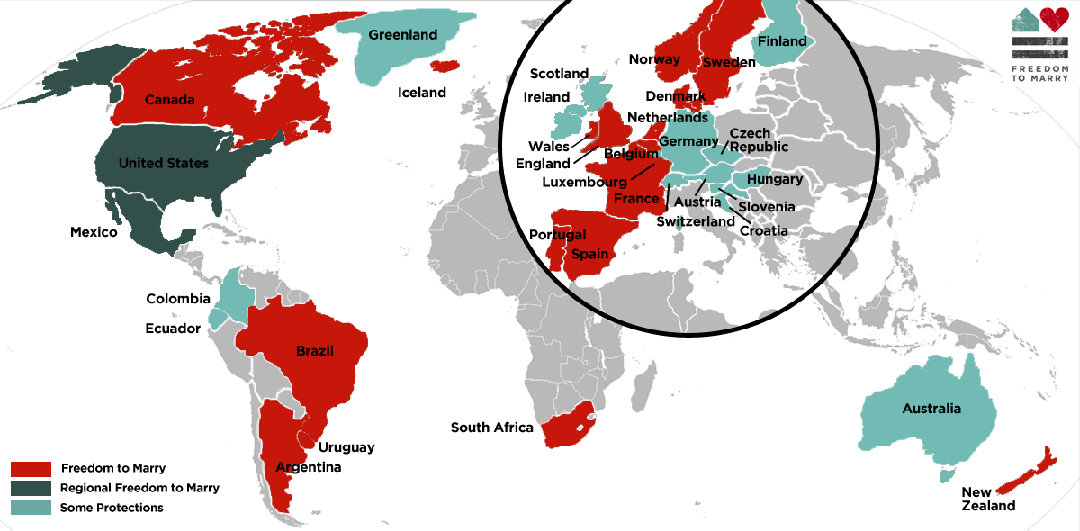
The Freedom to Marry Internationally

Slide 90
No recognition of same-sex marriage: most of Asia, Middle East, and Africa. Homosexuality is criminal and could be punishable by death.
Africa
1 Algeria
2 Angola
3 Botswana
4 Burundi
5 Cameroon
6 Comoros
7 Egypt
8 Eritrea
9 Ethiopia
10 Gambia
11 Ghana
12 Guinea
13 Kenya
14 Lesotho
15 Liberia
16 Libya
17 Malawi
18 Mauritania
19 Mauritius
20 Morocco
21 Mozambique
22 Namibia
23 Nigeria http://www.nytimes.com/2014/02/09/world/africa/nigeria-uses-law-and-whip-to-sanitize-gays.html
24 Sudan
25 Senegal
26 Seychelles
27 Sierra Leone
28 Somalia
29 South Sudan
30 Swaziland
31 Tanzania
32 Togo
33 Tunisia
34 Uganda http://www.nytimes.com/2014/02/17/world/africa/obama-condemns-tough-antigay-measure-in-uganda.html
removed death sentence
35 Zambia
36 Zimbabwe

Slide 91
No recognition of same-sex marriage: most of Asia, Middle East, and Africa. Homosexuality is criminal and could be punishable by death.
Asia
37 Afghanistan
38 Bangladesh
39 Bahrain*
40 Bhutan
41 Brunei
42 Iran
43 Iraq*
44 Kuwait
45 Lebanon
46 Malaysia
47 Maldives
48 Myanmar
49 Oman
50 Pakistan
51 Gaza Strip/Palestine*
52 Qatar
53 Saudi Arabia
54 Singapore
55 Sri Lanka
56 Syria
57 Turkmenistan
58 United Arab Emirates
59 Uzbekistan
60 Yemen

Slide 92
No recognition of same-sex marriage: most of Asia, Middle East, and Africa. Homosexuality is criminal and could be punishable by death.
Americas
61 Antigua & Barbuda
62 Barbados
63 Belize
64 Dominica
65 Grenada
66 Guyana
67 Jamaica
68 St Kitts & Nevis
69 St Lucia
70 St Vincent & the Grenadines
71 Trinidad & Tobago
72 Cuba
Oceania
73 Solomon Islands
74 Papua New Guinea
75 Cook Islands
Europe
76 Croatia
Russia
Ukraine

Slide 93
India
December 11, 2013
India’s Reversal on Gay Rights
By THE EDITORIAL BOARD
India’s Supreme Court issued a disgraceful ruling against human rights in reinstating a law that bans gay sex. On Wednesday, the court reversed a landmark 2009 decision by the Delhi High Court that decriminalized sex between consenting adults regardless of their gender.
At issue is Section 377 of India’s Penal Code barring “carnal intercourse against the order of nature,” a holdover from British colonial law dating back to 1861. In practice, this law had largely been used by police to threaten and blackmail gays, lesbians and transgender people.
Following the ruling, India’s crimes bureau stated ominously that it will begin compiling crime statistics under Section 377 as early as next year. Violation of the law is punishable by a fine and up to 10 years imprisonment.
http://www.nytimes.com/2013/12/12/opinion/indias-reversal-on-gay-rights.html?emc=eta1&pagewanted=print

Slide 94
Timeline: Milestones in the American Gay Rights Movement
Early History: Early Victorian Love- 1820 – 1860, before heterosexuality was defined – men and women were expected to marry for proper for procreation and legalities. Late Victorian 1860 – 1892, the family went from producer to consumer through dating and marketing. Male/female relationships included normal sex and eroticism; however, women lacking sexual drive and pleasure were diagnosed as frigid or mentally disturbed. During the Victorian Age, men and women rarely enjoyed meaningful relationships outside of family and middle-class young women attended finishing schools and colleges and developed physical bonds with each other. In 1873, Vassar women would court and send each other gifts to gain the attention of their desired. From 1870 – 1920, 50% of young college educated women opted out of marriage (compared to 10% of American women). Long-term partnerships were formed and Victorians felt this was acceptable; non-married women working was much preferred to married women employed. At the end of the 19th century, the trend turned and by the roaring ‘20’s girls and boys were “dating” and marriage statistics were rising.

Slide 95
Timeline
December 10, 1924 The Society for Human Rights is founded by Henry Gerber in Chicago. The society is the first gay rights organization as well as the oldest documented in America. After receiving a charter from the state of Illinois, the society publishes the first American publication for homosexuals, Friendship and Freedom. Soon after its founding, the society disbands due to political pressure.
The Kinsey Institute - Alfred Kinsey 1948 - Biologist and sex researcher Alfred Kinsey publishes Sexual Behavior in the Human Male. From his research Kinsey concludes that homosexual behavior is not restricted to people who identify themselves as homosexual and that 37% of men have enjoyed homosexual activities at least once. While psychologists and psychiatrists in the 1940s consider homosexuality a form of illness, the findings surprise many conservative notions about sexuality.

Slide 97
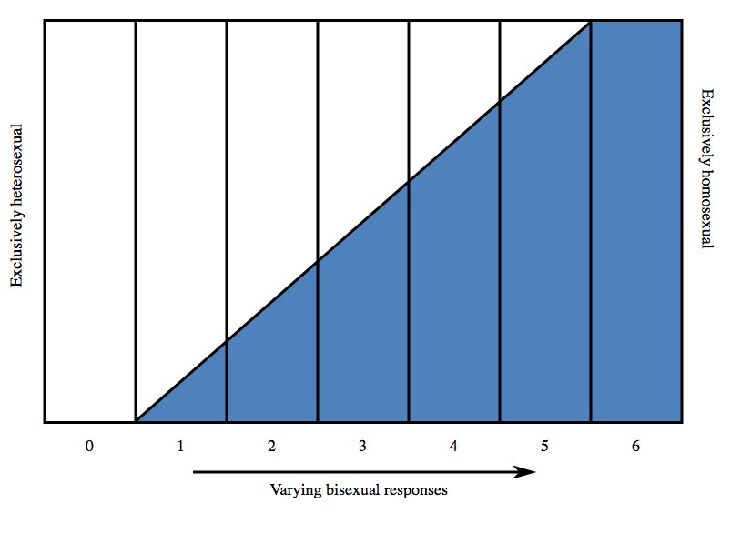
From the Kinsey Report
Kinsey's scale of sexual responses, indicating degrees of sexual orientation. Kinsey's category "X," which some academicians say refers to asexual individuals, is not represented in this graph.

Slide 98
Timeline
Fred Sargaent - A published list of gay-friendly organizations November 11, 1950 - In Los Angeles, gay rights activist Harry Hay founds America’s first national gay rights organization. In an attempt to change public perception of homosexuality, the Mattachine Society aims to "eliminate discrimination, derision, prejudice and bigotry," to assimilate homosexuals into mainstream society, and to cultivate the notion of an "ethical homosexual culture.“
December 15, 1950 - A Senate report titled "Employment of Homosexuals and Other Sex Perverts in Government" is distributed to members of Congress after the federal government had covertly investigated employees' sexual orientation at the beginning of the Cold War. The report states since homosexuality is a mental illness, homosexuals "constitute security risks" to the nation because "those who engage in overt acts of perversion lack the emotional stability of normal persons.“
Over the previous few years, more than 4,380 gay men and women had been discharged from the military and around 500 fired from their jobs with the government. The purging will become known as the "lavender scare."

Slide 99
Timeline
April, 1952 - The American Psychiatric Association lists homosexuality as a sociopathic personality disturbance in its first publication of the Diagnostic and Statistical Manual of Mental Disorders. Immediately following the manual's release, many professionals in medicine, mental health and social sciences criticize the categorization due to lack of empirical and scientific data.
April 27, 1953 – President Dwight Eisenhower signs Executive Order 10450, banning homosexuals from working for the federal government or any of its private contractors. The Order lists homosexuals as security risks, along with alcoholics and neurotics.
September 21, 1955 Barbara Gittings, editor of the Daughters of Bilitis publication "The Ladder."
In San Francisco, the Daughters of Bilitis becomes the first lesbian rights organization in the United States. The organization hosts social functions, providing alternatives to lesbian bars and clubs, which are frequently raided by police. Unfortunately, it causes a split among lesbian activists and end to DOB and The Ladder.

Slide 100
Timeline
August 30, 1956 American psychologist Evelyn Hooker shares her paper "The Adjustment of the Male Overt Homosexual" at the American Psychological Association Convention in Chicago. After administering psychological tests, such as the Rorschach, to groups of homosexual and heterosexual males, Hooker's research concludes homosexuality is not a clinical entity and that heterosexuals and homosexuals do not differ significantly. Hooker's experiment becomes very influential, changing clinical perceptions of homosexuality.
January 13, 1958 In the landmark case One, Inc. v. Olesen, the United States Supreme Court rules in favor of the First Amendment rights of the lesbian, gay, bisexual and transgender (LGBT) magazine "One: The Homosexual Magazine." The suit was filed after the U.S. Postal Service and FBI declared the magazine obscene material, and it marks the first time the United States Supreme Court rules in favor of homosexuals.
January 1, 1962 Corbis/Homosexuality was a punishable offense and directed towards males.
Illinois repeals its sodomy laws, becoming the first U.S. state to decriminalize homosexuality.
July 4, 1965 At Independence Hall in Philadelphia, picketers began staging the first Reminder Day to call public attention to the lack of civil rights for LGBT people. The gatherings will continue annually for five years.

Slide 101
Timeline
April 21, 1966 - Members of the Mattachine Society at Julius Bar - Members of the Mattachine Society stage a "sip-in" at the Julius Bar in Greenwich Village, where the New York Liquor Authority prohibits serving gay patrons in bars on the basis that homosexuals are "disorderly." Society president Dick Leitsch and other members announce their homosexuality and are immediately refused service.
Following the sip-in, the Mattachine Society will sue the New York Liquor Authority. Although no laws are overturned, the New York City Commission on Human Rights declares that homosexuals have the right to be served.
August, 1966 - After transgender customers become raucous in a 24-hour San Francisco cafeteria, management calls police. When a police officer manhandles one of the patrons, she throws coffee in his face and a riot ensues, eventually spilling out onto the street, destroying police and public property.
Following the riot, activists established the National Transsexual Counseling Unit, the first peer-run support and advocacy organization in the world.

Slide 102
Timeline
1968 – Columbia Student Homophile League (SHL) initiated an assault on the “psychiatric establishment.” A panel of experts discussed homosexuality as a “pathological adjustment.” SHL members invaded the meeting and demanded that “homosexuality be placed in its proper setting as a sociological problem of deeply entrenched prejudice and discrimination against a minority group.” That evening protests erupted about gay, black and US troops overseas.
June 28, 1969 Stonewall Inn – In the 50’s Stonewall had been a straight restaurant and nightclub. In 1966, it was taken over by 3 mafia figures from the Genovese family. Obviously gay and hiding it – pushing drugs…Ed Murphy was the corrupt bouncer – letting in underage patrons/drugs/prostitutes/on the take from the mafia/police (informer til beaten up by them). Patrons of the Stonewall Inn in Greenwich Village riot when police officers attempt to raid the popular gay bar around 1am. Since its establishment in 1967, the bar had been frequently raided by police officers trying to clean up the neighborhood of "sexual deviants."
Angry gay youth clash with aggressive police officers in the streets, leading to a three-day riot during which thousands of protestors receive only minimal local news coverage. Nonetheless, the event will be credited with reigniting the fire behind America's modern LGBT rights movement.
http://www.youtube.com/watch?v=cfUzcIEhEWE
http://www.youtube.com/watch?v=XeLwQCBNmec

Slide 103
Timeline
June 28, 1970 A gay rights demonstration - Christopher St. Liberation Day commemorates the one-year anniversary of the Stonewall riots. Following the event, thousands of members of the LGBT community march through New York into Central Park, in what will be considered America's first gay pride parade.
In the coming decades, the annual gay pride parade will spread to dozens of countries around the world.
December 15, 1973 The board of the American Psychiatric Association votes to remove homosexuality from its list of mental illnesses.
January, 1974 Kathy Kozachenko becomes the first openly gay American elected to public office when she wins a seat on the Ann Arbor, Michigan City Council.
June 7, 1977 Singer and conservative Southern Baptist Anita Bryant leads a successful campaign with the "Save Our Children" Crusade to repeal a gay rights ordinance in Dade County, Florida. Bryant faces severe backlash from gay rights supporters across the U.S. The gay rights ordinance will not be reinstated in Dade County until December 1, 1998, more than 20 years later.
November 8, 1977 Harvey Milk wins a seat on the San Francisco Board of Supervisors and is responsible for introducing a gay rights ordinance protecting gays and lesbians from being fired from their jobs. Milk also leads a successful campaign against Proposition 6, an initiative forbidding homosexual teachers.
A year later, on November 27, 1978, former city supervisor Dan White assassinates Milk. White's actions are motivated by jealousy and depression, rather than homophobia.

Slide 104
Timeline
May 21, 1979 Rioters in San Francisco - Dan White is convicted of voluntary manslaughter and is sentenced to seven years in prison. Outraged by what they believed to be a lenient sentence, more than 5,000 protesters ransack San Francisco's City Hall, doing $100,000 worth of property damage in the surrounding area. The following night, approximately 10,000 people gather on San Francisco's Castro and Market streets for a peaceful demonstration to commemorate what would have been Milk's 49th birthday. Upon White’s release from prison; he commits suicide.
October 14, 1979 An estimated 75,000 people participate in the National March on Washington for Lesbian and Gay Rights. LGBT people and straight allies demand equal civil rights and urge for the passage of protective civil rights legislature.
July 8, 1980 The Democratic Rules Committee states that it will not discriminate against homosexuals. At their National Convention on August 11-14, the Democrats become the first political party to endorse a homosexual rights platform.
July 3, 1981 The New York Times prints the first story of a rare pneumonia and skin cancer found in 41 gay men in New York and California. The CDC initially refers to the disease as GRID, Gay Related Immune Deficiency Disorder.
When the symptoms are found outside the gay community, Bruce Voeller, biologist and founder of the National Gay Task Force, successfully lobbies to change the name of the disease to AIDS.

Slide 105
Timeline
March 2, 1982 Wisconsin becomes the first U.S. state to outlaw discrimination on the basis of sexual orientation.
March 10, 1987 AIDS advocacy group ACT UP (The AIDS Coalition to Unleash Power) is formed in response to the devastating affects the disease has had on the gay and lesbian community in New York. The group holds demonstrations against pharmaceutical companies profiteering from AIDS-related drugs as well as the lack of AIDS policies protecting patients from outrageous prescription prices.

Slide 107
Timeline
Although AIDS had been reported first in 1981, it is not until the end of his presidency that Reagan speaks publicly about the epidemic.
May - June, 1988 The CDC mails a brochure, Understanding AIDS, to every household in the U.S. Approximately 107 million brochures are mailed.
December 1, 1988 The World Health Organization organizes the first World AIDS Day to raise awareness of the spreading pandemic.
August 18, 1990 President George Bush signs the Ryan White Care Act, a federally funded program for people living with AIDS. Ryan White, an Indiana teenager, contracted AIDS in 1984 through a tainted hemophilia treatment. After being barred from attending school because of his HIV-positive status, Ryan White becomes a well-known activist for AIDS research and anti-discrimination.
The Red Ribbon 1991 Created by the New York-based Visual AIDS, the red ribbon is adopted as a symbol of awareness and compassion for those living with HIV/AIDS.
December 21, 1993 The Department of Defense issues a directive prohibiting the U.S. Military from barring applicants from service based on their sexual orientation. "Applicants... shall not be asked or required to reveal whether they are homosexual, " states the new policy, which still forbids applicants from engaging in homosexual acts or making a statement that he or she is homosexual. This policy is known as "Don't Ask, Don't Tell."

Slide 108
Timeline
May 20, 1996 In the case of Romer v. Evans, the United States Supreme Court decides that Colorado's 2nd amendment, denying gays and lesbians protections against discrimination, is unconstitutional, calling them "special rights."
September 21, 1996 President Clinton signs the Defense of Marriage Act into law. The law defines marriage as a legal union between one man and one woman and that no state is required to recognize a same-sex marriage from out of state.
April 1, 1998 Coretta Scott King, widow of civil rights leader Martin Luther King, Jr., calls on the civil rights community to join the struggle against homophobia. She receives criticism from members of the black civil rights movement for comparing civil rights to gay rights.
April 26, 2000 Vermont becomes the first state in the U.S. to legalize civil unions and registered partnerships between same-sex couples.
June 26, 2003 In Lawrence v. Texas the U.S. Supreme Court rules that sodomy laws in the U.S. are unconstitutional.

Slide 109
Timeline
May 18, 2004 – 2013 Massachusetts becomes the first state to legalize gay marriage. The court finds the prohibition of gay marriage unconstitutional because it denies dignity and equality of all individuals. New York (2011), Iowa (2009), New Hampshire (2009), Vermont (2009), and District of Columbia (2009), Connecticut (2008), Massachusetts (2004), Maine (2012), Maryland (2012) and Washington (2012), Illinois (pending Feb 2013).
August 9, 2007 Sponsored by the Human Rights Campaign, the Logo cable channel hosts the first American presidential forum focusing specifically on LGBT issues, inviting each presidential candidate. Six Democrats participate in the forum, including Hillary Clinton and Barack Obama, while all Republican candidates decline.
November 4, 2008 Proposition 8 rally in San Francisco - California voters approve Proposition 8, making same-sex marriage in California illegal. The passing of the ballot garners national attention from gay-rights supporters across the U.S. Prop 8 inspires the NOH8 campaign, a photo project that uses celebrities to promote marriage equality.
June 17, 2009 President Obama signs a Presidential Memorandum allowing same-sex partners of federal employees to receive certain benefits. The memorandum does not cover full health coverage.

Slide 110
Timeline
October 28, 2009 The Matthew Shepard Act is passed by Congress and signed into law by President Obama on October 28th. The measure expands the 1969 U.S. Federal Hate Crime Law to include crimes motivated by a victim's actual or perceived gender, sexual orientation, gender identity or disability. Matthew Shepard was tortured and murdered near Laramie, Wyoming on October 7, 1998 because of his sexual orientation.
Video and website http://www.matthewshepard.org/
August 4, 2010 A federal judge in San Francisco decides that gays and lesbians have the constitutional right to marry and that Prop 8 is unconstitutional. Lawyers will challenge the finding.
December 18, 2010 President Obama signs the DADT Repeal Act -The U.S. Senate votes 65-31 to repeal "Don't Ask, Don't Tell" policy, allowing gays and lesbians to serve openly in the U.S. Military.
February 23, 2011 President Obama states his administration will no longer defend the Defense of Marriage Act, which bans the recognition of same-sex marriage.
June 24, 2011 New York State passes the Marriage Equity Act, becoming the largest state thus far to legalize gay marriage.
References:
http://www.pbs.org/wgbh/americanexperience/features/timeline/stonewall/
Duberman, Martin, Stonewall, Plume, New York, 1993
Zeitz, Joshua, Flapper, Three Rivers Press, New York, 2006
Rothenberg, Paula, Race, Class, Gender, in the United States, Worth, New York, 2010

Slide 111
October 11, 2013
Glaad Sees Improvement in Depictions of Gays and Lesbians on TV
By BRIAN STELTER
No television network is “excellent” when it comes to representations of gays and lesbians, but most of the nation’s biggest networks earn a grade of “good,” Glaad, formerly known as the Gay and Lesbian Alliance Against Defamation, said in a study released on Friday.
Two cable channels, History and TBS, were deemed “failing” by Glaad, which assigns the grades annually as part of its advocacy work for greater diversity in the media. CBS, which was labeled that way last year, was upgraded to “adequate.”
Over all, the study had a positive tone, as it has for the last few years, as the number of gay, lesbian, bisexual and transgender characters on TV shows steadily increases. After Glaad counted a record number of regular gay characters on prime time, broadcast and scripted shows last season, 31, it reported a slight decline this season, to 26. But it found that men and women are represented more equally this season, “showing an effort from networks to diversify story lines beyond the white, gay male narrative most commonly seen on television,” the group said in a summation of the study.
On the cable channels that Glaad monitors, there was an uptick in gay characters this season, to 42, from 35 last year. Still largely missing from television, the group said, were stories about transgender characters, though the Fox series “Glee” introduced one such character last year.

Slide 112



LGBT Propaganda
http://www.nytimes.com/2005/01/20/politics/20sponge.html
http://www.nytimes.com/2005/01/23/weekinreview/23lela.html?pagewanted=print&position=
http://www.nytimes.com/2005/01/27/arts/television/27bust.html?pagewanted=print&position=

Slide 113


Slide 114
Reference List
http://www.youthprideri.org/Resources/Statistics/tabid/227/Default.aspx
http://www.freedomtomarry.org/states/entry/c/new-jersey
http://www.americanprogress.org/wp-content/uploads/issues/2012/06/pdf/state_nondiscrimination.pdf
http://www.huffingtonpost.com/2012/05/09/gay-marriage-legal-world_n_1504054.html#slide=957718
http://www.freedomtomarry.org/landscape/entry/c/international
http://76crimes.com/76-countries-where-homosexuality-is-illegal/
http://www.ncsl.org/issues-research/human-services/same-sex-marriage-overview.aspx

