Slide 1
Gender Stereotypes
Lesson 1

Slide 2
✓ Define and use the term ‘gender stereotype’ correctly.
✓ List stereotypes for girls and for boys.
✓ Play ‘guess the occupation game’.
In today’s lesson we are
going to…

Slide 3

What jobs do these people have?

Slide 4
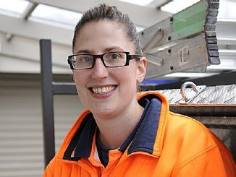
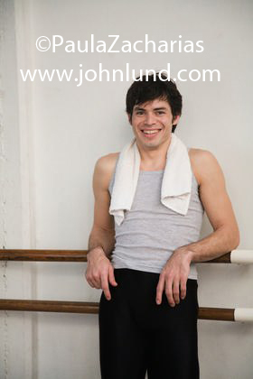

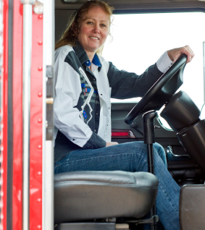
A)
C)
What reasons
do you
have for
your answer?
B)
D)

Slide 5
Carpenter
Dancer
Nurse
Truck Driver

Slide 6
Define gender stereotype…
A gender stereotype is an assumption about a person because they are female or male.
Gender stereotyping contributes to gender inequality because what we believe about girls/women and boys/men influences how we act towards them.

Slide 7





Use these to help you think of your own gender stereotypes.
Boys
should…
Girls
play…
Girls
can…
Boys
need…
Girls
want…
Boys
wear…
Boys
watch…
Girls
like…

Slide 8
Gender stereotypes
In what way are the following pictures gender stereotypes?

Slide 9
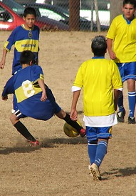
What gender stereotypes do you think this photo depicts ?
Boys…
Girls…

Slide 10
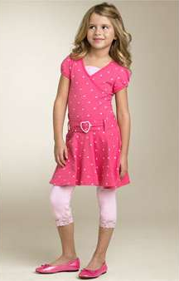
What gender stereotypes do you think this photo depicts ?
Girls…
Boys…

Slide 11
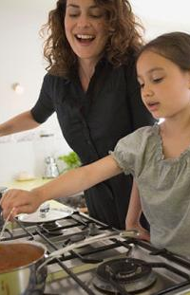
What gender stereotypes do you think this photo depicts ?
Women…
Men…

Slide 12
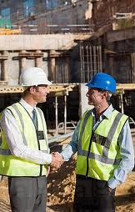
What gender stereotypes do you think this photo depicts ?
Men…
Women…

Slide 13
Gender stereotypes
In what way do the following pictures change our ideas about gender?

Slide 14
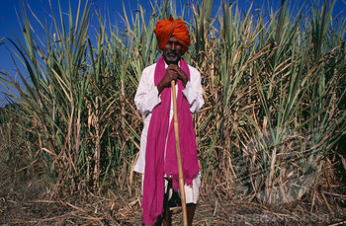
In what way does this picture change our ideas about gender?

Slide 15

In what way does this picture change our ideas about gender?

Slide 16
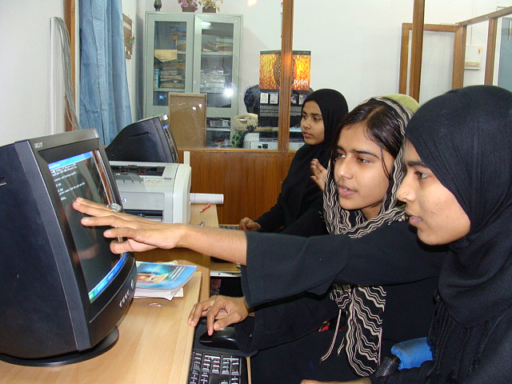
In what way does this picture change our ideas about gender?

Slide 17
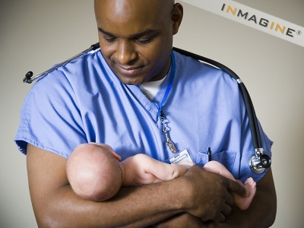
In what way does this picture change our ideas about gender?

Slide 18
Conclusions
What did you learn today?

Slide 19
Extension Activities
Visual Arts – (Working in groups of three) Imagine a future world in which the roles of women and men are very different from today: Make a group drawing that reflects that world and present it to the class.
Ethical Education / Geography / SPHE – children research a project on other forms of stereotypes (based on race, age, nationality etc.)
Ethical Education / History / Geography / SPHE – A collage can be done with images of boys/girls/men/women including famous faces who defy the stereotypes. Could involve some biographical research/project on people who defy our gender stereotypes – making sure to include people from other countries and cultures.
Ethical Education / Geography / SPHE - Teacher may review some of the stereotypes from the children’s lists during this lesson and ask the class if they think they are the cultural norm for girls/boys in Ireland. (see Lesson Plan for more details)

