Slide 1
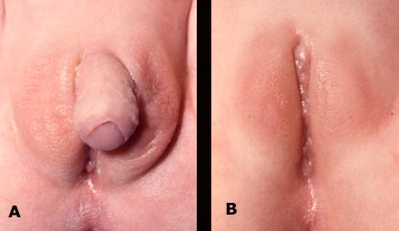
HERMAPHRODITISM
PRESENTED BY:
BALOGUN, Wasiu Gbolahan
(07/46KA027)
Anatomy Department,
Faculty of B.M.S,
University of Ilorin.

Slide 2
OUTLINE
Introduction
Human sexual development
Classification
Images of hermaphrodite
Causes
Defects
Diagnosis
Prevention
Treatment
Social and Legal implications
Conclusion
References

Slide 3
INTRODUCTION
Hermaphroditism is defined as a congenital disorder in which the development of chromosomal, gonadal, or anatomical sex is atypical.
It is the discrepancy that occur between the morphology of the gonads and the appearance of the external genitalia (Moore and Persaud, 2008).
Recently, the word intersex has come into preferential usage in humans as hermaphroditism is found misleading.

Slide 4
HUMAN SEXUAL DEVELOPMENT
Chromosomal sex
Gonadal sex
Internal genital sex
External genital sex
SEX ASSIGNMENT
Sex of rearing
Gender identity
and role
Table 1:sex development
(Yousef, 2009)

Slide 5
CLASSIFICATION
Hermaphroditism can be classified into 4:
True hermaphrodite
Male Pseudohermaphroditism
Female Pseudohermaphroditism
Androgen insensitivity syndrome (AIS) which can be subdivided into
Complete
Mild
Partial
(Anand , 2008)

Slide 6
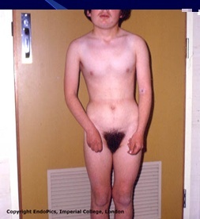
IMAGES OF HERMAPHRODITES
Fig 1:Image of a male pseudohermaphrodite
(Yousef , 2008)

Slide 7
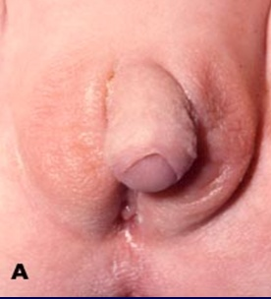
Fig 2:The external genitalia of a true hermaphrodite showing both male and female sex organs (Yousef , 2009)

Slide 8
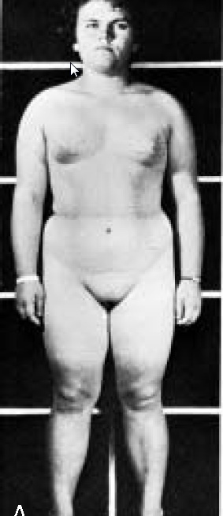
Fig 3: Picture of a female pseudohermaphrodite
(Moore and Persaud, 2008)

Slide 9
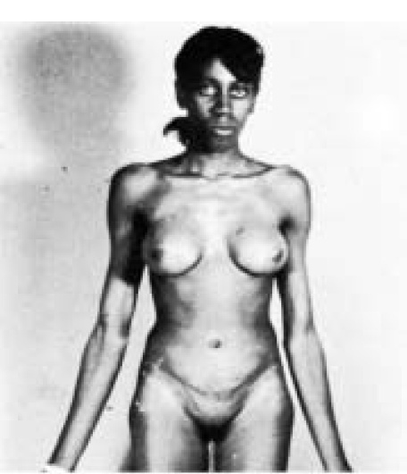
Fig 4:Picture of a patient with Androgen Insensitivity Syndrome (Sadler, 2008)

Slide 10
CAUSES
They include:
Error in sex determination (Moore and Persaud, 2008)
Congenital adrenal hyperplasia (Allen, 2008)
Male hormones taken or encountered by the
mother during pregnancy (Allen, 2008)
Excessive exposure of the female foetus to androgens (Sadler, 2008)
Genetic mutation

Slide 11
DEFECTS
All hermaphrodites have some defect in common which include
Infertility
Risk of malignant tumour
Amenorrhoea
True hermaphrodite have a cystic ovary-like gonad, AIS experience hirsutism, female pseudohermaphrodites have a small persistent urogenital sinus while the male pseudohermaphrodites have an unicorn uterus.

Slide 12
DIAGNOSIS
They can be diagnosed by
Karyotype analysis
Specific molecular testing
Gonadal biopsy
Endoscopic examination
Ultrasound
Federman’s rule
(Kliegman et al., 2007)

Slide 13
PREVENTION
Hermaphroditism is preventable, women having unprotected sex, pregnant women, sportsmen and sportswomen should not consume steroid drugs no matter it concentration as it is injurious to the developing child.

Slide 14
TREATMENT
Different methods have been devised, they include
Medications
Behavioural therapies
Intensive community support
Breast replacement surgery
Surgical correction of the genitalia
Vaginal repair and construction
Orchidectomy

Slide 15
SOCIAL AND LEGAL IMPLICATIONS
Intersex people are treated in different ways by
different cultures. In some cultures, they have to
conform to either a female or a male gender role (Gagnon and Simon, 1973).
Intersex has been subjected to undergo test which are humiliating genital photography as in Caster semanya case (Bryant, 2009). If the patient is managed incorrectly, she or he may be doomed to live as a sex freak (Yousef, 2009).
Intersex is a complex issue and its treatment has short- and long-term consequences.

Slide 16
CONCLUSION
Hermaphroditism is a form of genetic deception
Prevention is better than cure, hermaphroditism is real.

Slide 17
References
Allen L.(2009). Disorders of sexual development. Obstet Gynecol Clin North Am. 36:25-45.
Anand S. (2008). Oxford Concise Medical Dictionary 6th Edition.
Bryant Tom (2009). "Caster Semenya subjected to 'humiliating' sex test, claims coach". The Guardian (London).
Gagnon and Simon (1973). Sex, Sexual instruction, socialization and homosexuality. Aldine pub.co (Chicago), 310-14
Intersex Society of North America (2006): A world free of shame, secrecy, and unwanted genital surgery.

Slide 18
Kliegman et al., (2007). Nelson Textbook of Pediatrics. 18th ed. Philadelphia, Pa: Saunders Elsevier; chap 589.
Michidelis et al., (1984). “Inguinal hernia leading to the diagnosis of internal male pseudo hermaphroditism” Acta chir. Belg. 84 (4): 255-8.
Moore and Persaud (2008). Clinically oriented anatomy :the developing human 8th edition 273-5
Thomas Sadler (2008). Langman's medical embryology. Hagerstown, MD: Lippincott Williams & Wilkins. p. 252
Yousef Jehad, (2009). intersexuality powerpoint presentation Alhayat ART Center Amman Jordan

Slide 19
THANK YOU FOR YOUR
ATTENTION

