Slide 1
RESPECTFUL AND INCLUSIVE LANGUAGE-LGBTQ+ EDITION
Courtney East,
BA Psychology, Second-Year MS CMHC
University of South Alabama
Kristine Ramsay,
MS CMHC, First-year PhD Counselor Ed
Auburn University
2013 ALCA Conference, Birmingham, AL

Slide 2
Why should we even care?
Terminology
Genderbread People
Politically Correct VS Inclusive

Slide 3
Inclusive Forms
How to be an ALLY
Resources to check out!
Proof that I didn’t make this all up

Slide 4
DISCLAIMER:
YOU WILL MOST LIKELY BE CONFUSED AT SOME POINT DURING THIS PRESENTATION AND YOU MIGHT EVEN LEAVE CONFUSED.
That’s OK!...
As long as you don’t choose to stay confused.

Slide 5
First, A Word From ALGBTICAL
Counselors are expected to be ethical. They are committed to serving the lesbian, gay, bisexual and transgender community with integrity and professionalism. They adhere to codes of ethical behavior.
Ethical counselors do not consider homosexuality a choice. Nor do they consider it a disorder or a disease. They do not consider their clients sick or confused. They do not consider homosexuality unnatural or immoral. They, in fact, are proud to be allies, advocates, and activists in behalf of the issues and concerns of their LGBT students and clients.
Ethical counselors provide professional and compassionate advising, therapy, consultation, and counseling to LGBT students and clients in a manner that is respectful, affirming, supportive, and non-judgmental.
Ethical counselors avoid attitudes and behavior that are oppressive to LGBT persons, including homophobia and heterosexism. They are informed professionals. Their perspectives on LGBT issues are based on solid medical, psychological, sociological, therapeutic, and scientific research.
Ethical counselors are proud to label themselves as LGBT-friendly or LGBT-affirming. They would like for their clients and prospective clients to know that they will be treated with respect.

Slide 6
Why Counselors Should Know These Things
Research has shown countless times that the therapeutic relationship is a key factor in treatment (put on your Rogers hat for this)
That means positive, unconditional regard, and creating an air of acceptance
That means using respectful and inclusive language all the time and with everyone
That means (at minimum) getting comfortable with a few terms first
We have the opportunity to choose language that promotes self-acceptance in LGBTQ+ clients and also models respect and fairness for others
Our nation is in the midst of an exciting civil rights movement!
Right, but what does this have to do with us?
“ Language plays a central role in the way
human beings behave and think” -(WILLA)

Slide 7
TERMS TO KNOW ABOUT

Slide 8
Before We Get Started…
GLBT, BLTG, LGBTQ+, LGBTQQ, LBTQIA, LGBTTQQIAANPO…LGBT-lmnop!?!
I tend to stick with LGBTQ+, Inclusive of everyone, but not explicitly everyone…doesn’t super-marginalize any one group
Use of term “communities” instead of a singular “community”
Scrap the usage of “homosexual”, “lifestyle”, and “life-choice”
Think twice before using term “queer”

Slide 9
Here We Go…
HETERONORMATIVE: (adj) Assumption that heterosexuality is superior to other sexualities and that it is the norm, meaning that anything different is abnormal
LESBIAN: (noun) Woman with emotional and sexual attraction to persons of the same gender
GAY: (adj) Common word for men with emotional and sexual attraction to other men, but often used in reference to both genders.
BISEXUAL: (adj) Person with emotional and sexual attraction to both men and women, not necessarily at the same time or to the same extent (typically in regards to cisgendered people, not trans* people….debatable)
GENDER BINARY: (noun) Idea that only two genders exist: Male and Female
CISGENDER: (adj) A person who’s gender identity and biological sex were aligned at birth

Slide 10
TRANSEXUAL: (adj) Individual who expresses him/herself and lives as a gender different than his/her genetic gender at birth.
TRANSGENDER: (noun) Umbrella term that covers a range of identities that transgress social gender norms (adj) A person who lives as a member of a gender not correspond with their genetic sex. (May identify as gay, straight, lesbian, bi-, or pan- OR as simply andro-, gyne-, or skolio-philic)
GENDERQUEER (GENDER NONCONFORMING, NON-GENDER CONFORMING):A person who redefines or plays with gender, or who refuses gender altogether. A label for people who bend/break the rules of gender and blur the boundaries
TRANS*: (adj) Umbrella term for people whose gender identity and/or expression differs from the sex they were assigned at birth. (May identify as descriptor term: transgender, transsexual, genderqueer, etc.)

Slide 11
INTERSEX: (adj) A person born with sex chromosomes, external genitalia, or internal reproductive systems that are not considered "standard" for either male or female. The existence of intersexuals is evidence of the reality that there are not just two sexes and that our ways of thinking about sex is socially constructed.
PANSEXUAL: (adj) A person who is fluid in sexual orientation and/or gender or sex identity.
ANDROGYNOUS: (adj) A gender expression that that has elements of both masculinity or femininity.
AGENDER: (noun) A person who sees themselves as existing without gender. They have no (or little) connection to the traditional system of gender and no personal alignment with either “man” or “woman”.
ASEXUAL: (adj) Designation or self-designation for people who lack feelings of “sexual attraction” and/or “sexual desire.” There is debate as to whether this is a “sexual dysfunction” or an actual “sexual orientation.” The term is also sometimes used as a “gender identity” by those who believe their lack of sexual attraction places them outside the standard definitions of “gender.”
AROMANTIC: (adj) A person who experiences little or no romantic attraction to others and/or a lack of interest in forming romantic relationships.

Slide 12
ANDROPHILIC/SEXUAL: (adj) Attraction to men, males, and/or masculinity.
GYNEPHILIC/SEXUAL: (adj) Attraction to women, females, and/or femininity.
SKOLIOPHILIC/SEXUAL: (adj) Attraction to genderqueer and transsexual people and expression (non-cisgendered people).

Slide 13
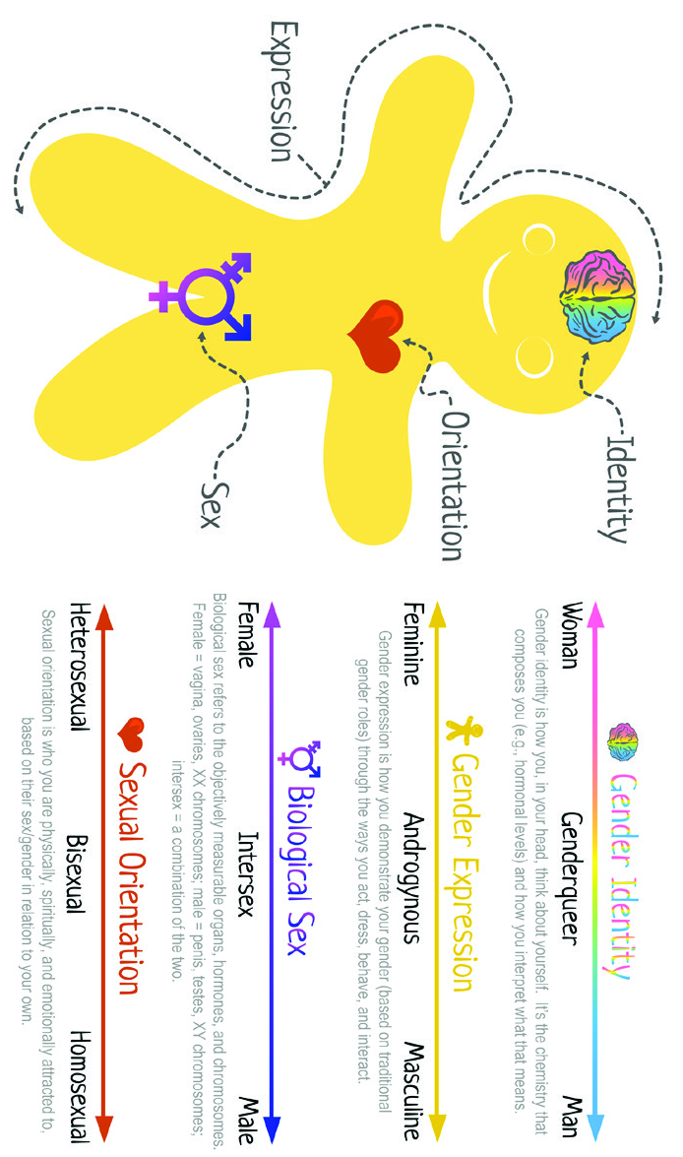
GENDERBREAD PERSON
(1st Edition)

Slide 14
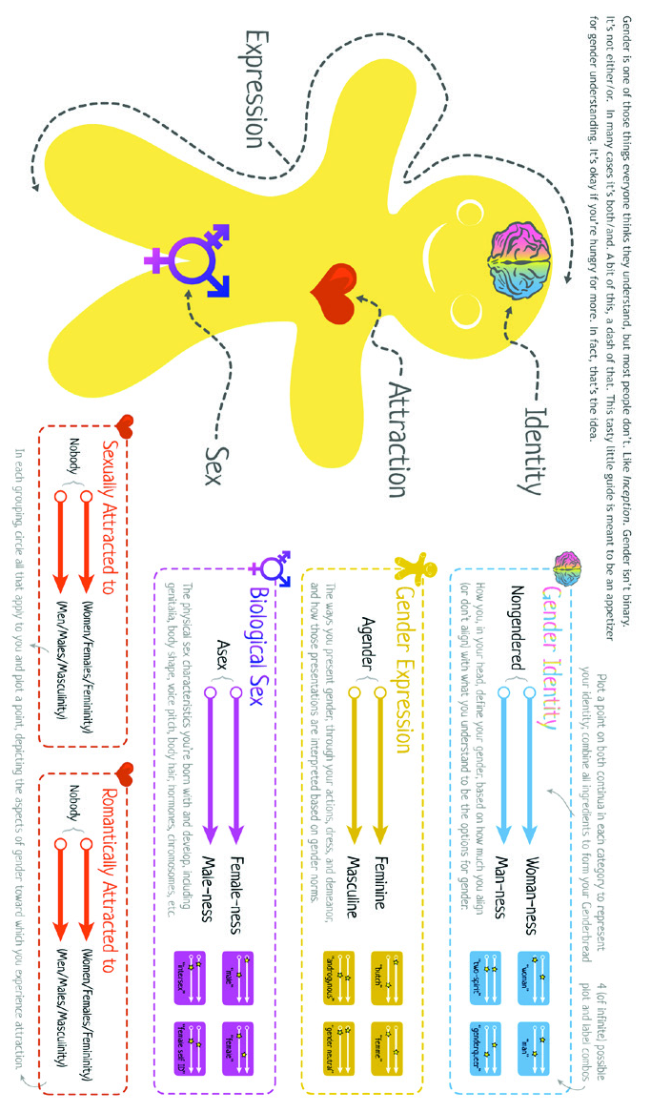
GENDERBREAD PERSON
(2nd Edition)

Slide 15
GENDER IDENTITY
Non-gendered-existing without a gender
All about how you think about yourself
Typically form identity by age 4

Slide 16
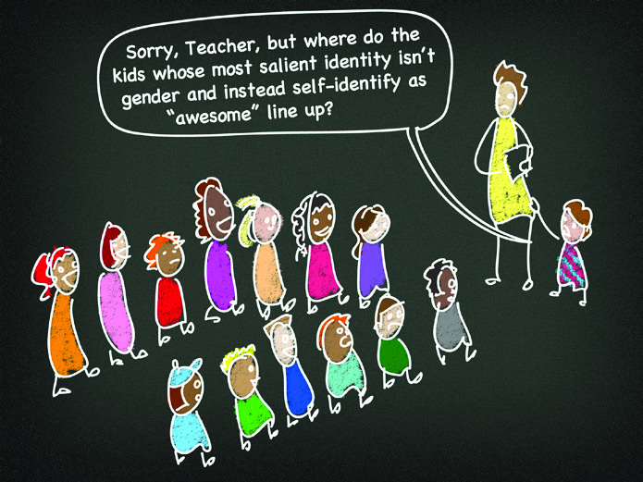

Slide 17
Expression
Cannot be determined based on biological sex, sexual orientation, or attraction
Can be aligned with bio sex and attraction or not, depends on the individual
Agender- “genderless”; presenting in a neutral manner, neither masculine nor feminine
Androgynous-presenting with some aspects of both masculinity and femininity

Slide 18
Biological Sex
Objectively measurable organs, hormones, chromosomes, etc.
Intersex-born with both male and female characteristics in some variation
Asex-”without sex”

Slide 19
Distinguishing Intersex Factor | Frequency
Not XX and Not XY | 1 in 1,666 births
Klinefelter (XXY) | 1 in 1,000 births
Androgen Insensitivity Syndrome | 1 in 13,000 births
Partial Androgen Insensitivity Syndrome | 1 in 130,000 births
Classical Congenital Adrenal Hyperplasia | 1 in 13,000 births
Late Onset Adrenal Hyperplasia | 1 in 66 individuals
Vaginal Agenesis | 1 in 6,000 births
Ovotestes | 1 in 6,000 births
Idiopathic (no discernible medical cause) | 1 in 110,000 births
Iatrogenic (caused by medical treatment) | no estimate
5 Alpha Reductase Deficiency | no estímate
Mixed Gonadal Dysgenesis | no estimate
Complete Gonadal Dysgenesis | 1 in 150,000 births
Hypospadias (in perineum or penile shaft) | 1 in 2,000 births
Hypospadias (between corona and tip of penis) | 1 in 770 births
Total number of people whose bodies differ from standard male or female | 1 in 100 births
Total number of people receiving surgery to “normalize” Genital appearance | 1 or 2 in 1,000 births
Source: Intersex Society
of North America (2008)

Slide 20
Attraction (formerly Sexual Orientation)
Another main change in the Genderbread Person is the move from “orientation” to “attraction”
This change accompanies sexual and romantic, but also considers emotional and spiritual attraction
NOT sexually attracted to anyone=Asex
NOT romantically attracted to anyone=Aromantic

Slide 21
GENDER IDENTITY
Gender Expression
Sexual Orientation
Biological Sex
Sexual orientation, gender expression, and biological sex are not dependent on each other, but rather, are interconnected

Slide 22
ONE MORE TIME…
ATTRACTION
Gay
Lesbian
Bisexual
Pansexual
Asexual
Aromantic
Androphilic
Gynephilic
Skoliophilic
GENDER IDENTITY
Cisgender Man
Cisgender Woman
Trans*
Genderqueer
GENDER EXPRESSION
Masculine
Butch
Feminine
Femme
Androgynous
Agender
BIOLOGICAL SEX
Male
Female
Intersex

Slide 23
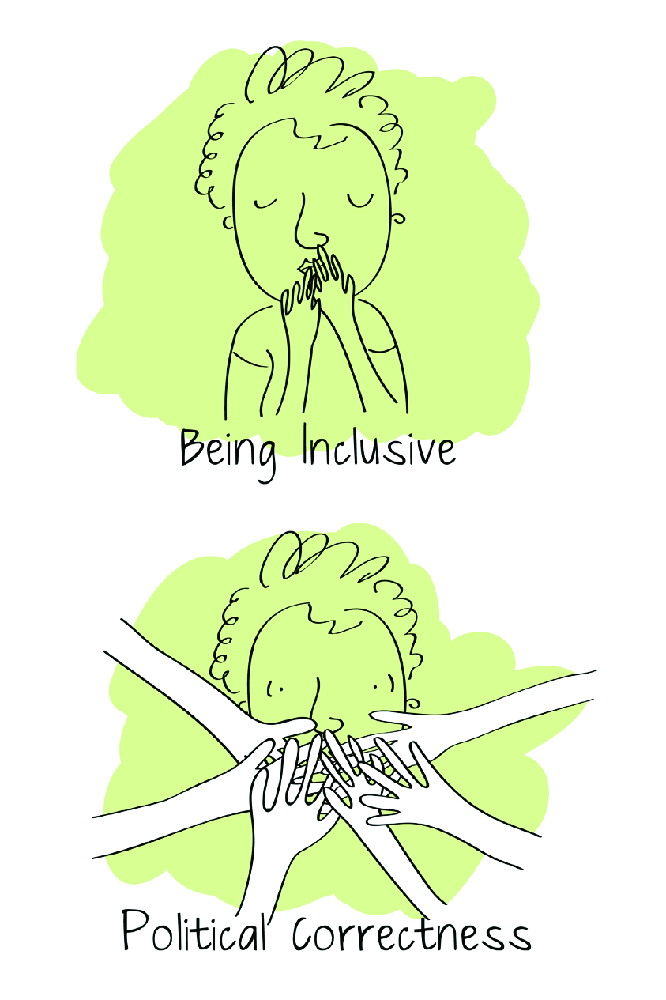
INCLUSIVE VS. POLITICALLY CORRECT

Slide 24
But aren’t they basically the same…?
POLITICALLY CORRECT
INCLUSIVE
EXTERNALLY driven
Behaving in a way that will gain approval from others
Compromises value of free speech
Can be equated with censorship
INTERNALLY driven
Being better to the other person
Follows “Platinum Rule”
Is a mind-set

Slide 25
GENDER INCLUSIVE FORMS

Slide 26
1. I identify my gender as… __________ (fill in the blank) If you don’t need gender, but would prefer to have it, here is one way you could do it: 2. I identify my gender as… [ ] Man [ ] Woman [ ] Trans* [ ] __________ (fill in the blank) [ ] Prefer not to disclose If you absolutely need to know gender, my next easy suggestion would be to simply remove the “not disclose” option: 3. I identify my gender as… [ ] Man [ ] Woman [ ] Trans* [ ] __________ (fill in the blank) If you’d rather not have a fill in the blank because it will complicate things (e.g., make it harder to sort a spreadsheet), but you want to be incredibly inclusive and specific, here’s another suggestion: 4. I identify my gender as… [ ] Man [ ] Woman [ ] Transgender [ ] Transsexual [ ] Genderqueer [ ] Nongendered [ ] Agender [ ] Genderless [ ] Non-binary [ ] Trans Man [ ] Trans Woman [ ] Third-Gender [ ] Two-Spirit [ ] Bigender [ ] Genderfluid [ ] Transvestite And if you’d rather have fewer options, even at the expense of inclusivity/specificity: 5. I identify my gender as… [ ] Man [ ] Woman [ ] Trans* And finally, if you need to know sex rather than gender (the only examples that pop into my mind for a reason why are medical), here’s a way you can do it and still be inclusive: 6. I identify my sex as… [ ] Female [ ] Male [ ] Intersex [ ] MtF Female [ ] FtM Male

Slide 27
Other Ways to be Inclusive
Ask for “preferred pronoun” instead of gender
He/his
She/her
Ze/hir (pronounced zee and here)
They/their
Create a safe zone in your space (office, classroom, school, etc.)
Other ideas??

Slide 28
Let’s Wrap Things Up!
Whatever your client identifies as, go with it! They are free to use whatever term they are most comfortable with regardless of the definition you know to be “true”.
There is no way to accurately guess someone’s sexual orientation or gender based on their appearance. So don’t.
Your “genuine curiosity” doesn’t allow you to question people who seem different. The session is not about you so fill your curiosity in on your own time.

Slide 29
FURTHER READING
ALGBTICAL
Sam Killerman’s book-The Social Justice Advocate’s Handbook: A Guide to Gender
GLSEN.org
HRC.org
Journal of Gay and Lesbian Mental Health
Itspronouncedmetrosexual.com
Wikiqueer.org
Thesafezoneproject.com
Transwhat.org

Slide 30
PEOPLE WHOSE IDEAS I BORROWED
Association of Lesbian, Gay, Bisexual, and Transgender Issues in Counseling. (2013). LGBT affirming counselors: Professional and ethical. Retrieved from http://www.algbtical.org/2A%20COUNSELING.htm.
Heck, N. C., Flentje, A., & Cochran, B. N. (2013). Intake interviewing with lesbian, gay, bisexual, and transgender clients: Starting from a place of affirmation. Journal of Contemporary Psychotherapy, 43(1), 23-32. doi:10.1007/s10879-012- 9220-x
Intersex Society of North America. (2008). How common is intersex? [data set]. Retrieved from http://www.isna.org/faq/frequency.
Killerman, S. (2013). The social justice advocate’s handbook: A guide to gender. Austin, TX: Impetus Books.
Lemoire, S. J. & Chen, C. P. (2005). Applying person-centered counseling to sexual minority adolescents. Journal of Counseling & Development, 83, 146–154. doi: 10.1002/j.1556-6678.2005.tb00591.x
Weinburg, M. (2009). LGBT-inclusive language. English Journal, 98(4), 50-51.

Slide 31
