Slide 1
Jesus and Gender
Patricia Weerakoon
Honorary Senior Lecturer
The University of Sydney

Slide 2
God’s Pattern [Genesis 1& 2]
God said, "Let us make man in our image, in our likeness…..”
In the image of God - Relational
“Male and Female he created them…”
Gendered
“Be fruitful and multiply…”
Sexual
“God saw all that he had made, and it was very good…”
Perfect

Slide 3
The Present
Transgender
Intersex
Hermaphrodite
Queer
Gay
Transvestite
Ambiguous Genitalia
Questioning
LGBT
Gender Dysphoria
Transsexual
Gender Identity Disorder
Lesbian
Fluid
Bisexual
Notes:
The fall affects the totality of what it means to be human. All the different aspects of our gender – of being male or female – are susceptible to the consequences of the fall.
Transgender: Someone whose physical appearance, behaviour, feelings of gender identity goes against what other people in the same culture would normally expect from someone of that gender.
Because of the fall, we now have GID, LGBT, transgender, transsexual...
Not all of us have our gender messed up. Sin doesn’t affect us all in exactly the same way.
But, in our pastoral work and / or our personal lives, we will come across people who have aspects of their gender out of alignment with the created pattern.
This part of the presentation will help us understand the range of this gender variance, and help us to be comfortable to deal with these gender-variance issues in a pastoral and personal level.

Slide 4
The Complexity of Sex and Gender
Biological Sex
What do you look like?
Gender role
How do you behave?
Gender identity
Do you identify as male or female?
Sexual orientation
Are you attracted to a male or female?
Notes:
There are four aspects to gender – to being male or female.
Biological Sex
The biology forms a foundation but is not the whole story.
Biological sex is driven by chromosomes. Men have XY, women XX. This is determined at fertilisation. The ovum always carries an X; the baby’s gender is determined by whichever chromosome the man’s sperm carries. (More on next slide.)
Men have testis, male internal and external genitals (penis, scrotum), develop secondary sexual characteristics of a male at puberty (brought about by testosterone) (muscles, body hair, deep voice) and have a male sexual arousal pattern of erection and ejaculation.
Women have ovaries (= female gonads) and the external (vulva – labia major, labia minor & clitoris) and internal (uterus and tubes) genitalia of females. They respond with a female pattern of arousal (more later). Women develop secondary sexual characteristics (breasts & body shape & menstruation) at puberty (brought about by oestrogen & progesterone).
Gender Role
Men act masculine and females act feminine. This is partly culturally determined. We would also assert a Biblical-Evangelical-Christian framework for gender roles – more later.
Gender identity
This has to do with a person’s core identity – who you deeply know yourself to be – as either male or female . A boy says he knows he’s a boy, a girl knows she’s a girl.
Sexual orientation
This has to do with whom you’re sexually attracted to..
Variations
In our fallen world – this created goodness can be messed up at each of these stages.
Please refer to Appendix One in your pre-reading.
Not going to explain each one. Some defined in Appendix 2. This is FYI the potential range of gender diversity.

Slide 5
Biological Sex
Chromosomes | XY Sex Chromosomes | XX Sex Chromosomes
The Gonads, Testis or Ovaries | Testis | Ovary
Hormones | Testosterone | (Oestrogen)
The Genitalia | Male | Female
Brain Sex | Male | Female
Intersex: Person born with mixed sexual biology (encompasses true and pseudo – hermaphrodites, ambiguous genitalia)
[1 in 2000 children – probably higher ]
Notes:
BIOLOGICAL SEX
When a sperm and ovum meet, an XY sex chromosome combination determines a BOY baby and an XX combination a GIRL baby.
In the presence of this “Y” chromosome – we have testis. An OVARY will not develop without the “X” sex chromosome
Once the testis starts developing – it produces the male hormone Testosterone.
Testosterone now starts ‘masculinising’ the internal and external genitalia. This happens about 6-7 weeks after fertilisation of the ovum by the sperm. If there is no testosterone (as in a female baby) or for some reason the tissues in the body cannot respond to the testosterone then the internal and external genitals will develop as a female.
At some time in utero, our brain is ‘sexed’ to be either male or female. This both physiological (as in the patterns of hormone production at and after puberty) and other aspects such as identity, behaviour and orientation. We are not yet certain how this brain sexualisation happens in the womb.
Created goodness in sexual anatomy: A perfect fit - complementary male and female genitalia.
While all other body systems are similar in men and women, the sexual and reproductive systems are uniquely complementary.
The penis if made to fit perfectly into the shape and direction of the vagina.
The vagina is made to moisten when aroused to enable entry of the penis. It is also covered with a lining that does not traumatise easily.
Also: The only organ in the body God created solely for pleasure is the clitoris.

Slide 6

WORLD athletics is in crisis with tests showing champion runner Caster Semenya is a hermaphrodite - a person with both female and male sexual characteristics.
The Daily Telegraph September 11, 2009
According to her mother Dorcus, the family has no doubts Caster is a female. "I gave birth to her, and as a mother I know she's a girl, not a boy," she says.
Herald Sun July 04, 2012
Notes:
Here is one example of how biological gender can be inconsistent, and how important the sexing of the brain is.
Castor Semenya was NOT a hermaphrodite. A true hermaphrodite has BOTH testis and ovarian tissue. She has testes but no ovarian tissue. She probably had Partial Androgen Insensitivity Syndrome. [AIS]
Semenya:
is a Chromosomal MALE (with testis – usually undescended testis inside the abdomen or in the groin)
has male levels of testosterone.
BUT in her, the tissues of her developing genitals (early in her development in the womb of her mother) did not respond to the testosterone (didn’t have what we call a receptor for the hormone). She has the external genitals of a female. But she does not have female internal genitalia – she has no womb and cannot get pregnant.
Maybe: Her muscles had the receptors and responded to the testosterone. Giving her a ‘male’ muscle development.
What about her brain?
Most AIS individuals see themselves as FEMALE – so their brains are NOT masculinised. Semenya fits into this – she sees herself clearly as a female.
So what is Semenya?
A male because she has ‘XY’ Chromosomes and un-descended testis...?
A female because she sees herself as a woman and looks like one...?

Slide 7
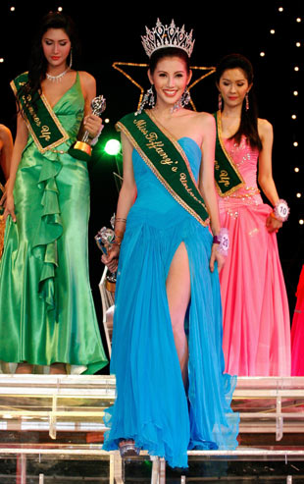
Gender Role
‘Culturally’ defined male/female behaviour.
Biblical definition:
Headship & helper-submission
(Ephesians 5; 1 Corinthians 7; 1 Tim 2; Titus 2)
Problems:
Oppression (eg: abuse, rape...)
Radical voluntarism (cross-dressing)
Notes:
Gender roles are culturally defined behaviours that are seen as appropriate for males or females, including the attitudes, personality traits, emotions, and even postures and body language. Gender roles also extend into social behaviours (occupation, dress, talk, intimacy patterns).
Children learn patterns early: Being different leads to being bullied.
In Gods Created Goodness: Equal but not identical – Male and Female with complementary roles in life and love.
Loving Leadership and enthusiastic Respect!
In our fallen nature:
Rigid gender roles leads to Oppression (Abuse)
On the other extreme – belief that all gender roles are socially constructed leads to Radical voluntarism – I do whatever I want, with no consideration of any external boundaries or responsibilities.
Some people might simultaneously feel like engaging in gender variant behaviour, and recognise that this behaviour they desire is inconsistent with their gender. Eg: a man wanting to wear female underwear. This conflict of desire against recognised gender role will cause them much distress.
Another pastoral issue might be parents where a child engages in gender variant behaviour. Eg: a boy wants to play dolls with girls instead of sport; a girl wants to climb trees & play rugby. Parents may get frightened that their child is homosexual or transsexual. It’s true that transsexuals demonstrate gender variant behaviour very early in life. However, most children who engage in gender variant behaviour grow up to be heterosexual adults; it’s just part of exploring who they are. Tell the parents to relax.

Slide 8
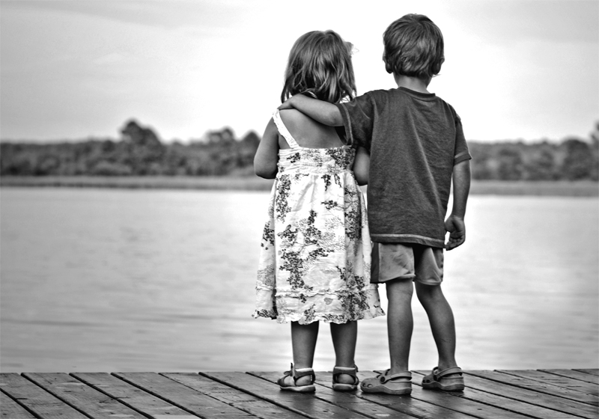
Gender Identity
Your conception of yourself as male or female.
Brain Sex
Starts very young – 2-3 years of age
Notes:
Gender identity is our personal conception of ourselves as either male or female. It refers to how a person develops a fundamental sense of belonging to one gender and not the other.
Very young children (three years) typically would unequivocally state “I am a boy” or “I am a girl”.

Slide 9

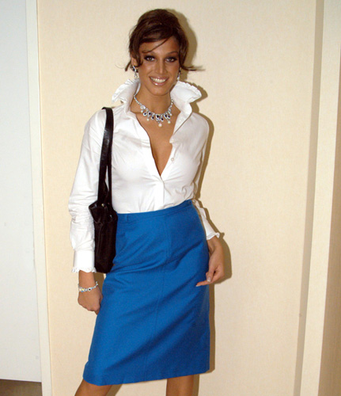
Gender Identity Disorder [GID]
F2M
M2F
1 in 11,900 males and 1 in 30,400 females
Notes:
A transexual person would ‘know’ that they belonged to the other gender, from when they were very young. Often 2-3 years old.
Transition is traumatic, painful, expensive and takes a long time. People don’t do it lightly – “hmm – I think I’ll be a woman today”.
Diagnosis my more than one professional
Live in the chosen sex for a period (usually 3 years)
Hormone therapy
Body changes (mastectomy, depilation for body hair)
Finally genital surgery.
Many transgendered people don’t get surgery done. They live in their chosen gender, without biological change, as a transgendered person.
So:
a biological male who knows herself to be a female would live and dress and conduct herself as a female, while remaining in a male body;
a biological female who knows himself to be a male would live and dress and conduct himself as a male, while remaining in a female body.
The question is not WHY?
But: How do we support and care for these gender variant or dysphoric people?

Slide 10
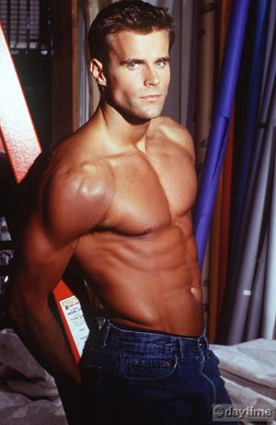
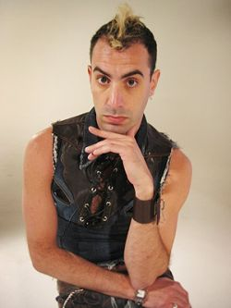
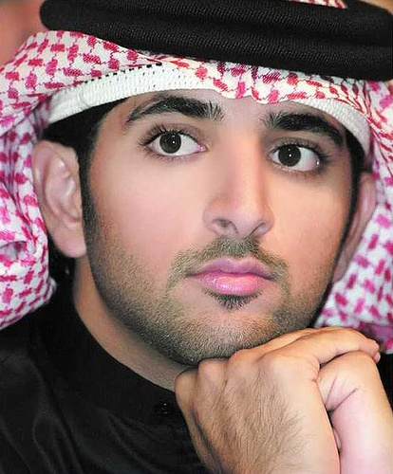
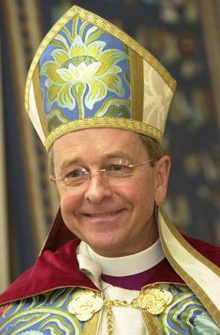
Sexual Orientation
Sexual Orientation refers to the gender of the person you are sexually attracted to and sexually aroused by.
Orientation (attraction) Behaviour, Identity.
Gay, Lesbian, Homosexual, Bisexual, Fluid.
Nature? Or Nurture?
1-2% 0f Australian population
Notes:
There is no ‘gay gene’: There are other genes, beyond XX & XY, that influence behaviour – including sexual behaviour – but there is no specific gay gene.
Research does demonstrate there is some biological tendency towards homosexuality (NATURE)
Twin studies: twins, even when separated at birth, if one is gay, the other tends to be gay.
Birth order: if there are a lot of boys in the family, the younger boys demonstrate more feminine behaviour (including, but not limited to, homosexuality).
However: there is evidence that factors such as sexual abuse and neglect are also commoner in homosexuals (NURTURE)
Pastorally:
Amongst those who are genuinely converted, some will be “healed” – their orientation will change to heterosexual – some will not.
For some people, faithful alignment of their sexual desires with their body will remain an eschatological hope – something they will only experience in the resurrection body.
The real issue is: are we controlling those desires which we know to be contrary to healthy functioning as defined by the bible.
And:
How are we as a church supporting people who are of homosexual orientation? Do we give them a community? Or drive them to seek it in the bath houses and gay bars?
Do we of straight heterosexual desires recognise the pain of calling a sister or brother to lifelong celibacy?
Do we grieve with them? Or condemn? Are we as a church homophobic?
(Extra notes)
The difference between:
Sexual orientation
Sexual community identity
Sexual behaviour

Slide 11
What did Jesus say about Gender?
Matthew 19:4
“’Haven’t you read,’ he replied, ‘that at the beginning the Creator “made them male and female," and said, “For this reason a man will leave his father and mother and be united to his wife, and the two will become one flesh” So they are no longer two, but one flesh.”.

Slide 12
What did Jesus say about Singleness and Sex?
Matthew 19:11-12
“Not everyone can accept this word (on single life), but only those to whom it has been given. For there are singles who were born that way, and there are singles who have been made so by others—and there are those who choose to live as singles for the sake of the kingdom of heaven. The one who can accept this should accept it.”.

Slide 13
What is our response?
How do we help:
People who trust & follow Christ who are struggling with these issues?
their families?
the Christian community?
Where do WE place our identity? Significance?
Are we comfortable with our sexuality?
Do we strive to control our desires? And appetites? Feel the pain of unfulfilled desires?
How do we live our lives?

Slide 14
What is our response?
"You were washed, you were sanctified, you were justified in the name of the Lord Jesus Christ and by the Spirit of our God”
(1 Corinthians 6:11).
As Christians we are amazed that we are saved.
And offer this grace to everyone.

Slide 15


