Slide 1
Intersex and Microscopic Identification of Sex
Moderator : Prof H. Nabachandra
Presenter: Dr Soreingam Ragui A

Slide 2
Introduction
Intersex : intermingling of sexual characters of both sexes in varying degrees in one individual.
Physical form
Reproductive organs
Sexual behaviors

Slide 3
Types( Davidson) :
Gonadal agenesis
Gonadal dysgenesis
True hermaphroditism
Pseudo hermaphroditism

Slide 4
Gonadal agenesis :
In this condition , the testis or the ovaries have never developed and the abnormality occurs in early fetal life.
Nuclear sex in negative.
Physical characters may contain features of both sexes or may have dominance of one particular sex.

Slide 5
Gonadal Dysgenesis
In this condition, the external sexual features are present but at puberty, the testis or ovaries fail to develop.
Turner’s syndrome
Klinefelter syndrome

Slide 6
Turner’s syndrome
Type : female
Anatomically : female
Nuclear : male
Cause : complete or partial monosomy of
X-chromosome
Karyotype : 45XO (45 chromosomes )
Physical features : short stature, low posterior hair line , webbing of neck, broad chest ,widely spaced nipples ,congenital defect like cubitus valgus ,lymphedema , coarctation of aorta and primary ammenorrhea
Ovaries : infantile and streak like

Slide 7
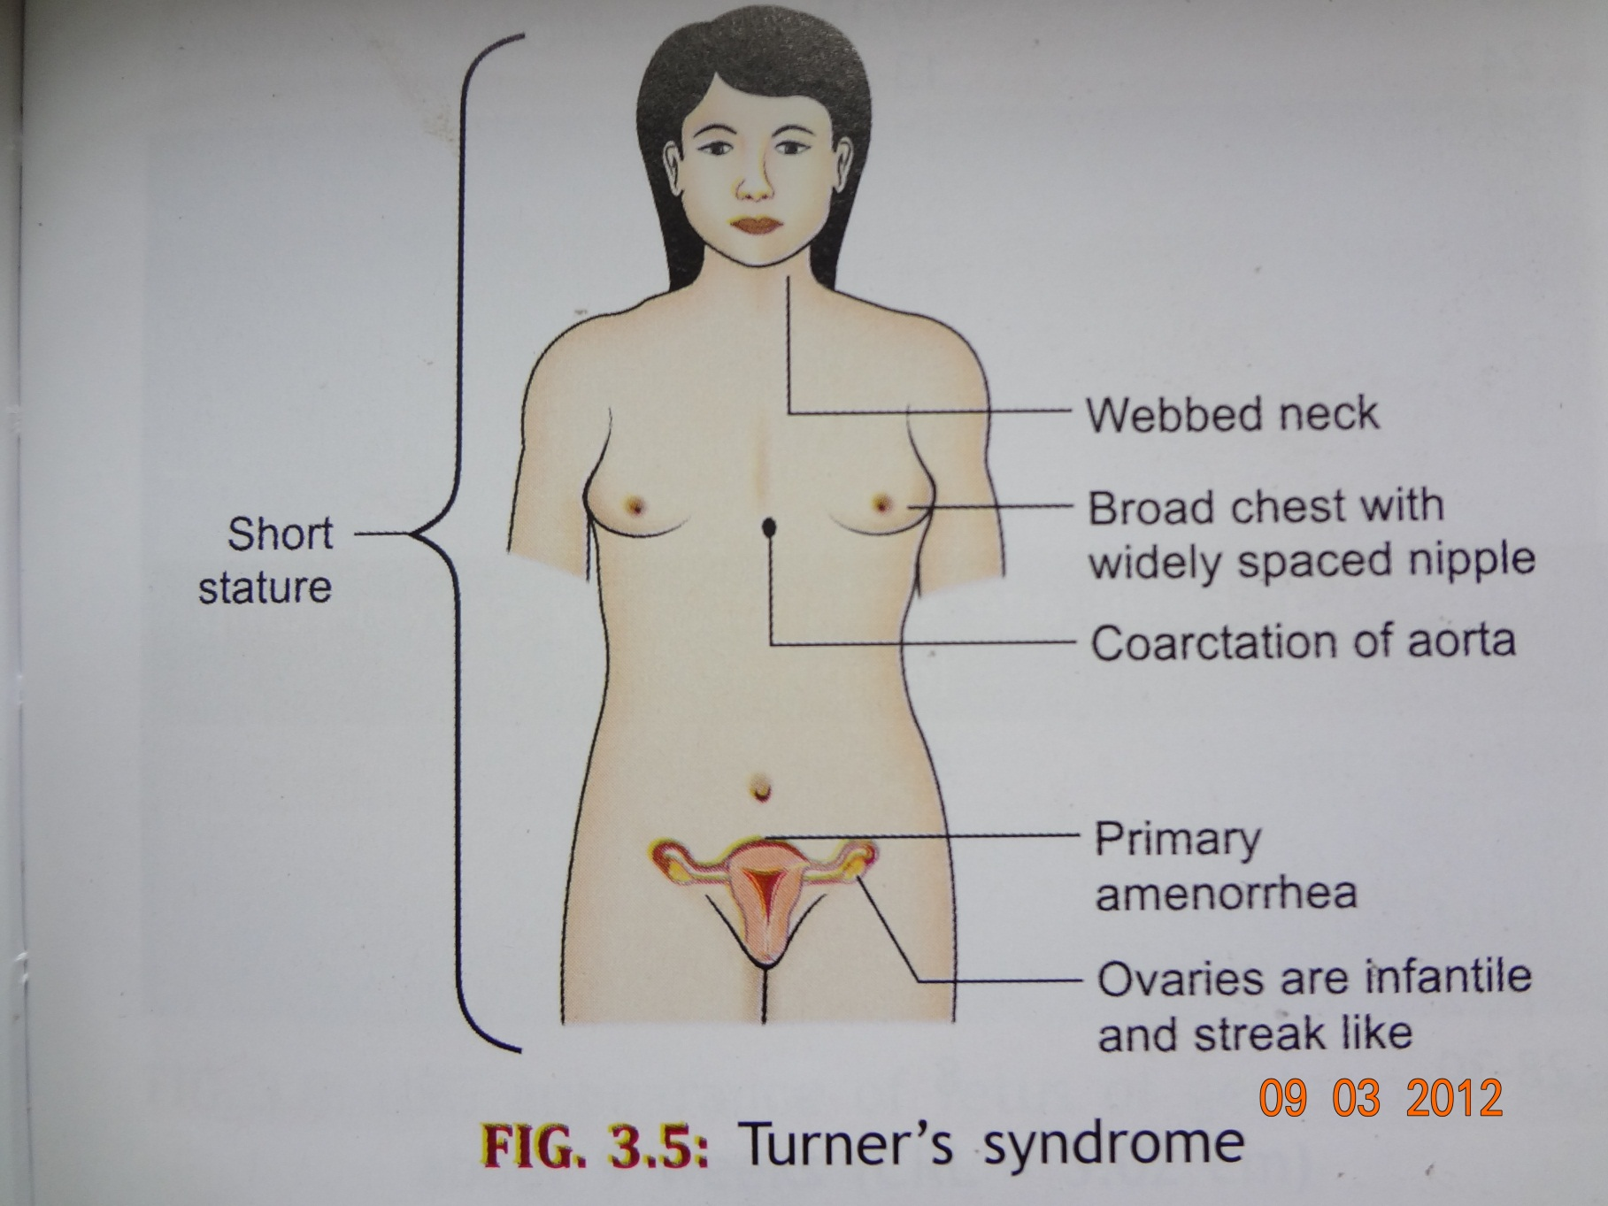

Slide 8
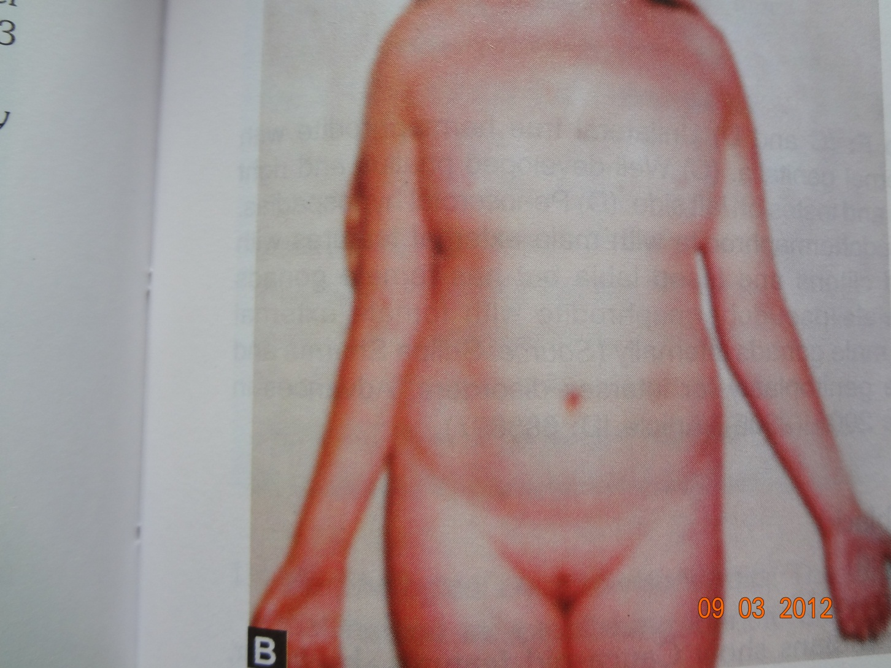
Turners syndrome

Slide 9
Klinefelter syndrome
Type : male
Anatomically : male
Nuclear sex : female
Karyotype : XXY (47 chromosomes)
Physical features : eunuchoid tall appearance with abnormally thin long legs, there are small atrophic testes with small penis , gynecomastia, axillary and pubic hairs are absent.

Slide 10
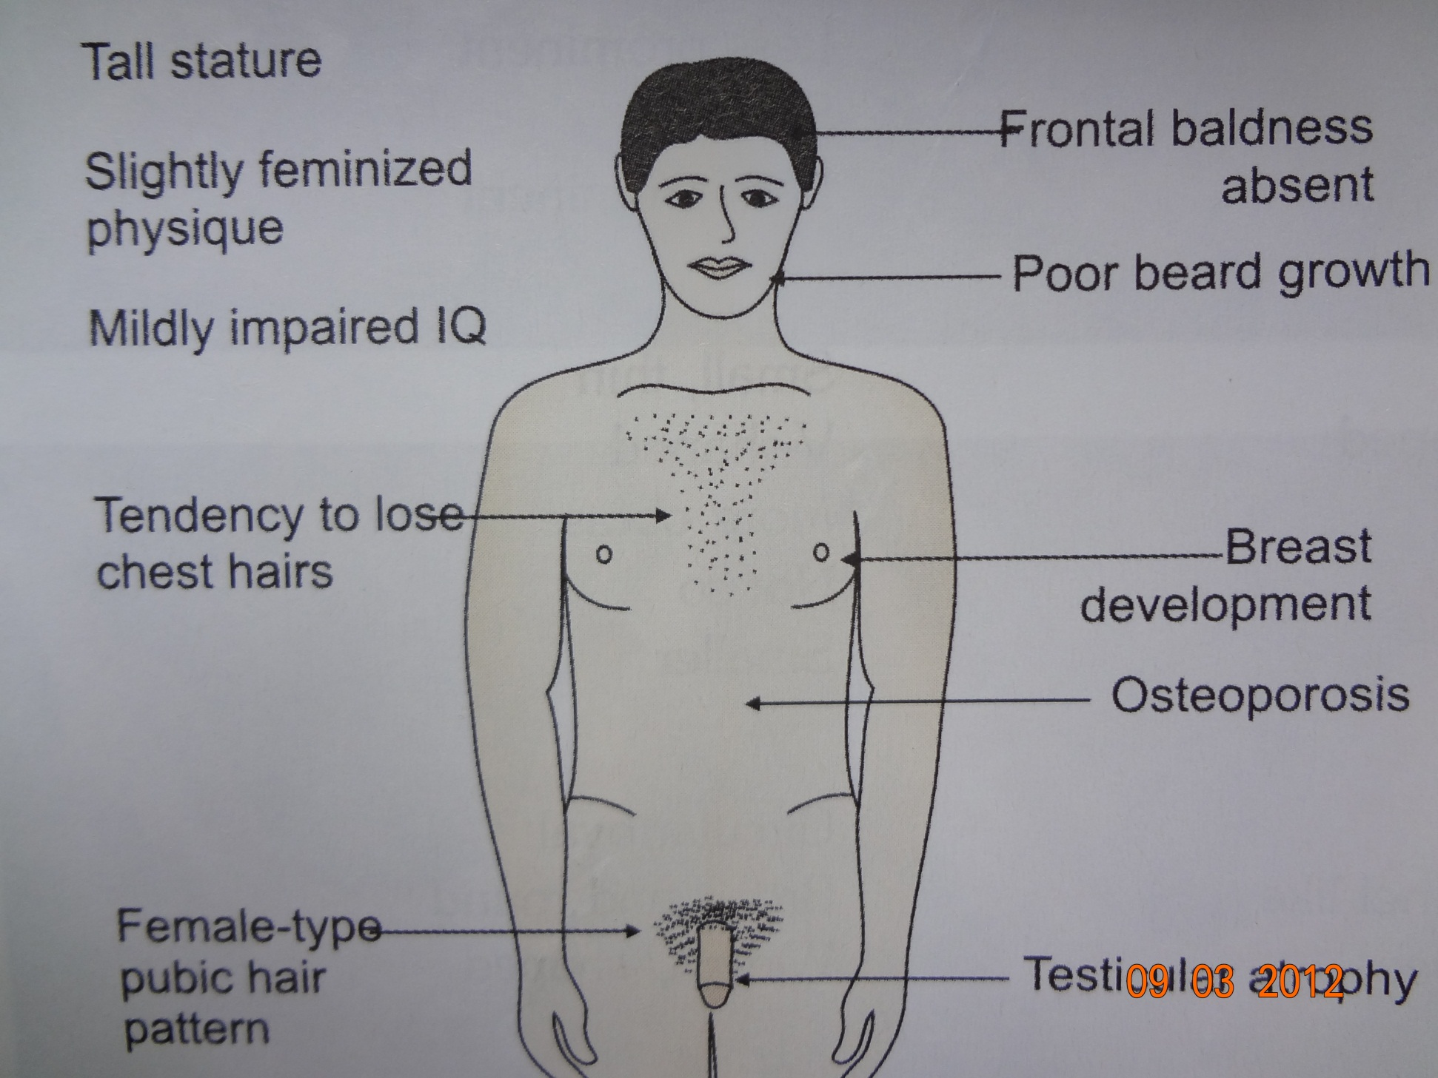

Slide 11
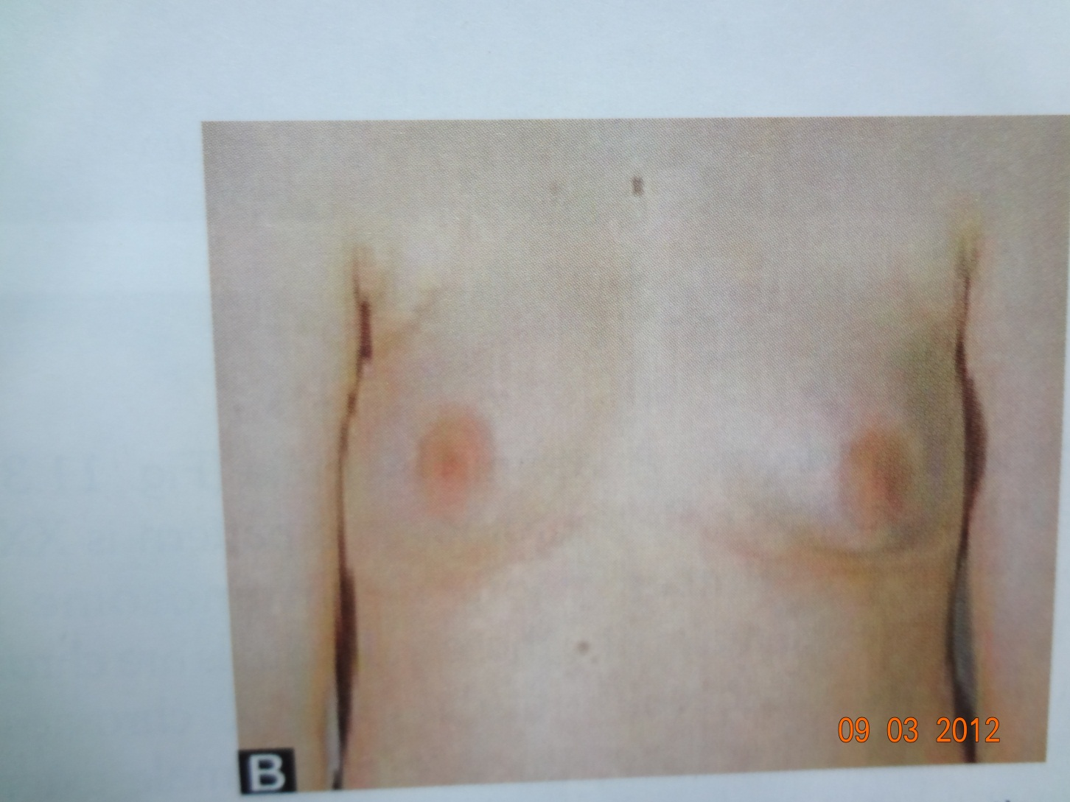
Gynaecomastia and no chest hairs

Slide 12
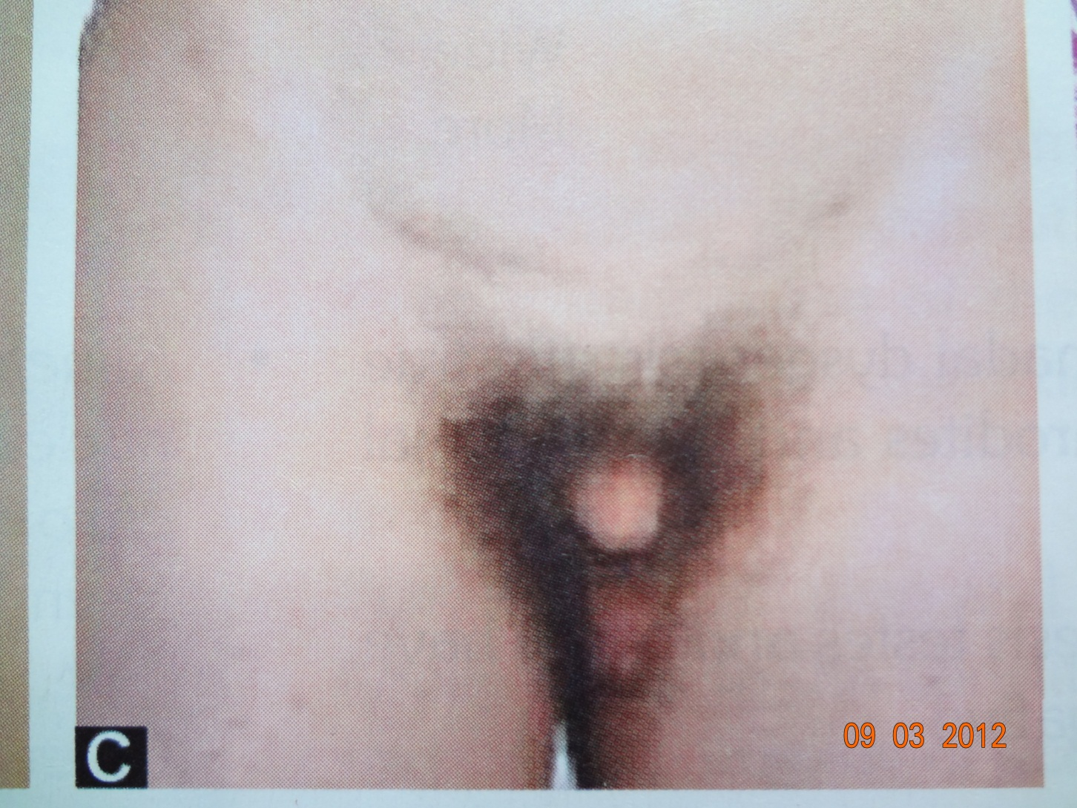
Smaller penis, normally placed but smaller testis, feminine distribution of pubic hairs

Slide 13
Hermaphroditism :implies to the discrepancy between the morphology of gonads and that of external genetiles. Thus hermaphroditism means presence of both ovaries and testis in a person
True hermaphroditism
Pseudo hermaphroditism

Slide 14
True hermaphroditism :
Rare condition , may have gonads of both sexes
According to watanabe there are three types
Bilateral true hermaphrodism :there is a testis and ovary (Ovotestis) on each side.
Unilateral true hermaphrodism :there is a testis and ovary(ovotestis) on one side and either a testis or an Ovary on the other side
Alternating true hermaphrodism :testis on one side and ovary on the other side
External features : may pose character of both sexes with phallus penile or clitorial
The labias may be bifid as in females or fused resembling scrotum of males
Chromosomal pattern:
XY (males)
XX (females)

Slide 15
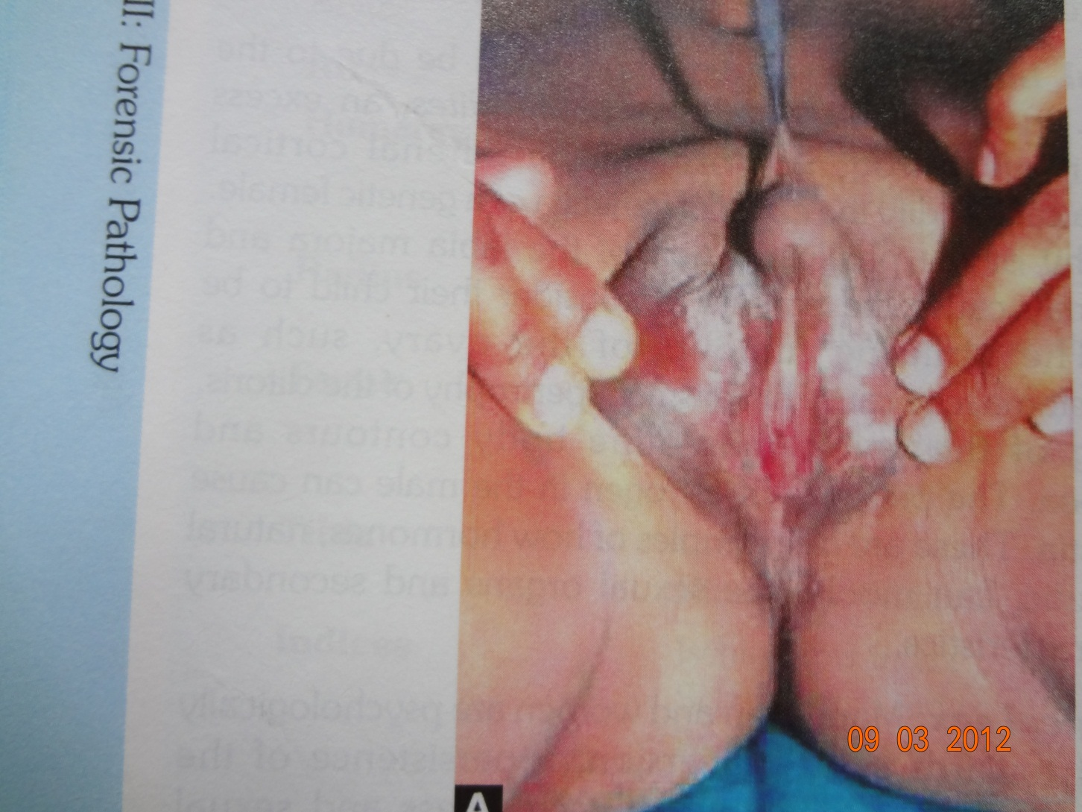
Bilateral true hermaphrodite :well developed phallus, bilateral ovotestes, with fish mouthed urethra below the phallus and vaginal opening in between the scrotum

Slide 16
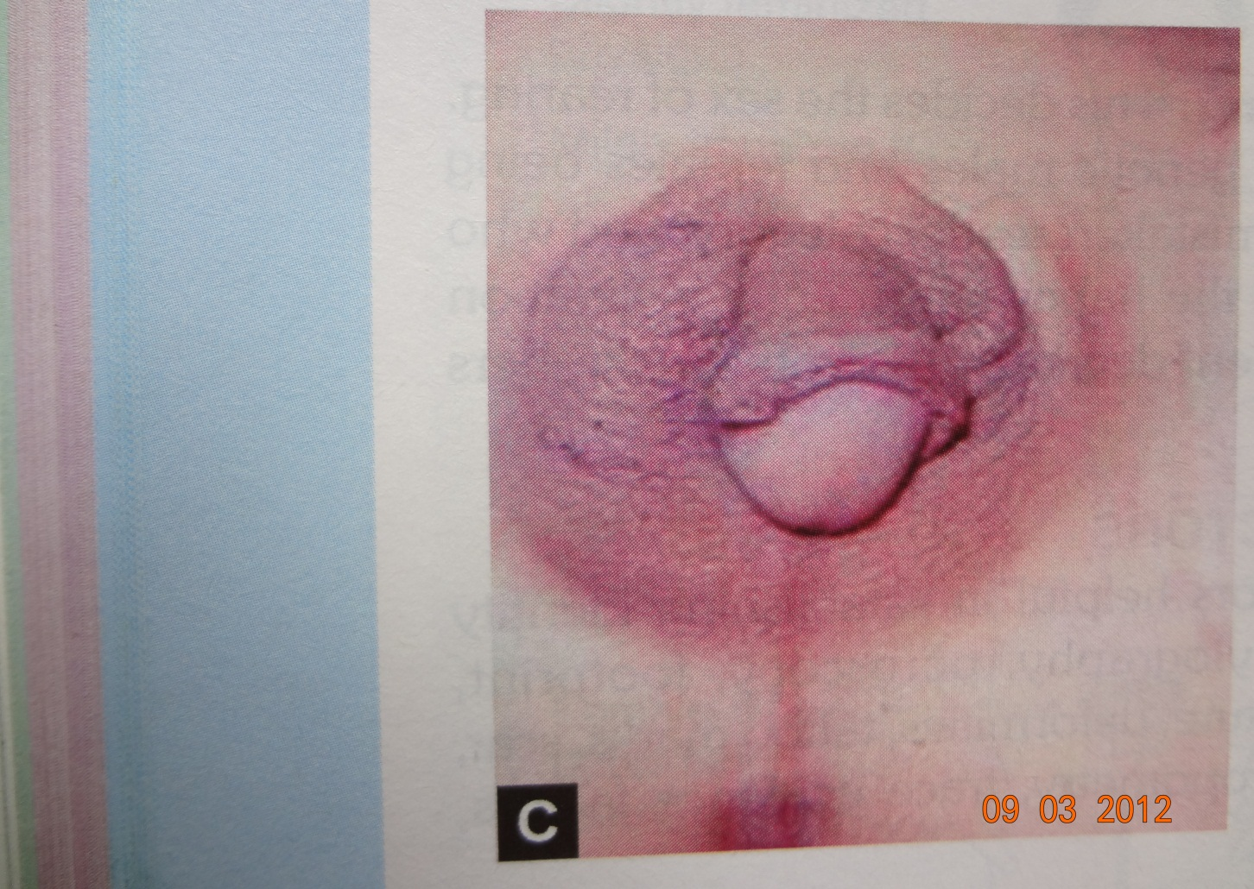
Unilteral true hermaphrodite with embigous external genetilias :well developed phallus and right scrotal ovotestis and testis on the left side

Slide 17
pseudo hermaphroditism
The gonads of one sex is present internally but external appearance is that of the opposite sex
Two types
Male pseudo hermaphroditism
Female pseudo hermaphroditism

Slide 18
Male pseudo hermaphroditism
The gonads are testes internally with chromosal pattern 46XY but externally features are of female type.
Cause : underdeveloped penis and testicular feminization
Inability
Testosterone dihydro testosterone
Causes
Defective androgen synthesis
Defective androgen action
Defective Mullerian duct regression
Uncertain cause

Slide 19
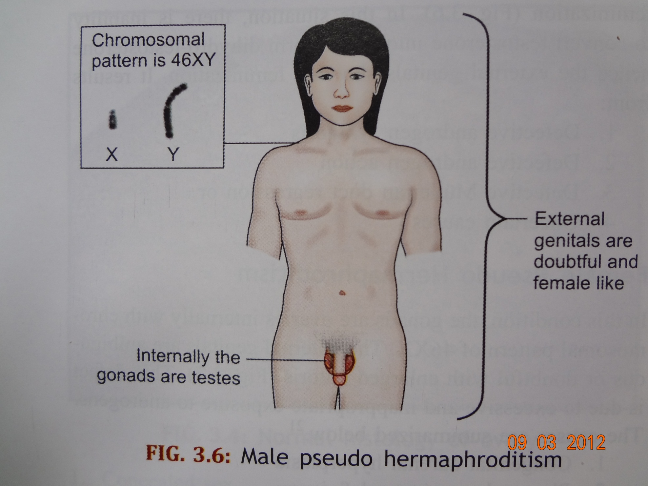

Slide 20
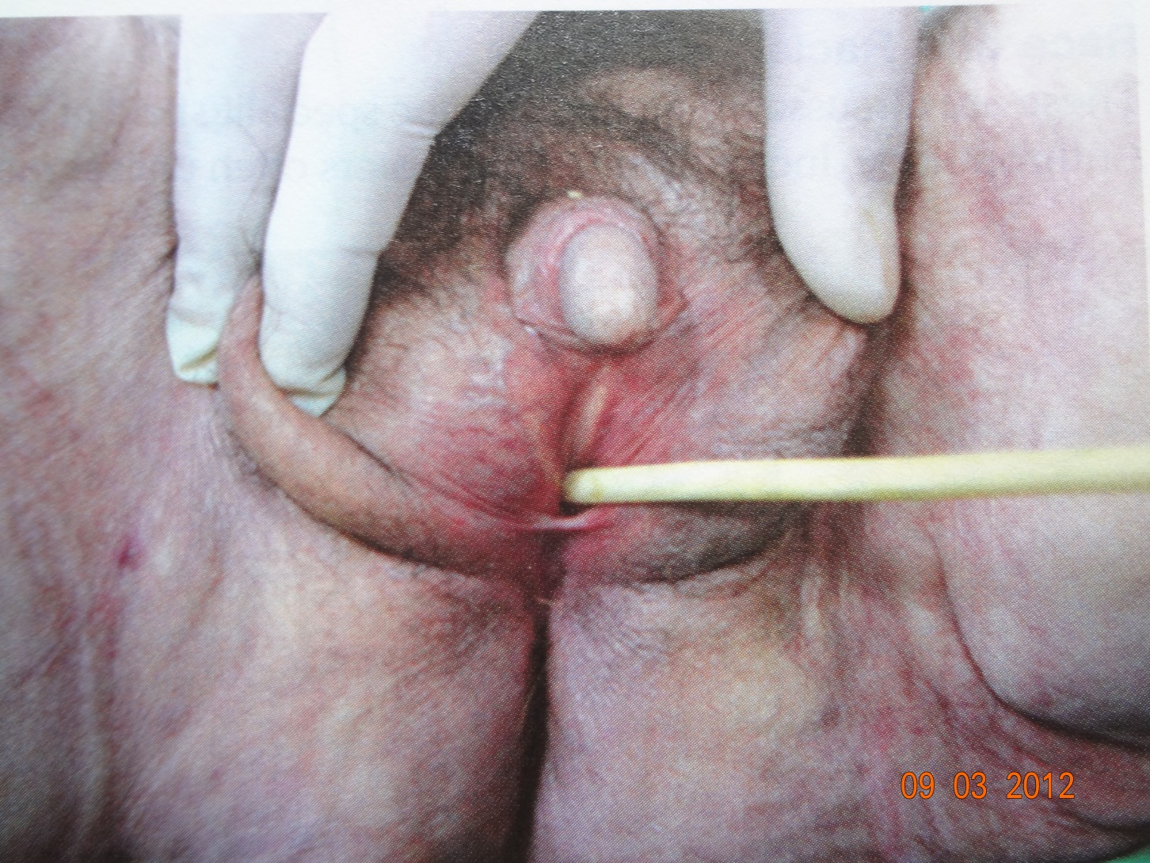
male Pseudohermaphrodite with external female features but has a male gonads internally

Slide 21
Female Pseudo Hermaphroditism
The gonads are ovaries internally with chromosomal pattern of 46XX.externally genitals are ambigous or doubful with enlarged clitoris.
Cause
Due to excessive and in appropriate exposure to androgens
Causes
Congenital adrenal hyperplasia
Placenta aromatase deficiency
Arrhenoblastomas of mother
Luteomas of mother
Developmental disorders of mullerian ducts

Slide 22
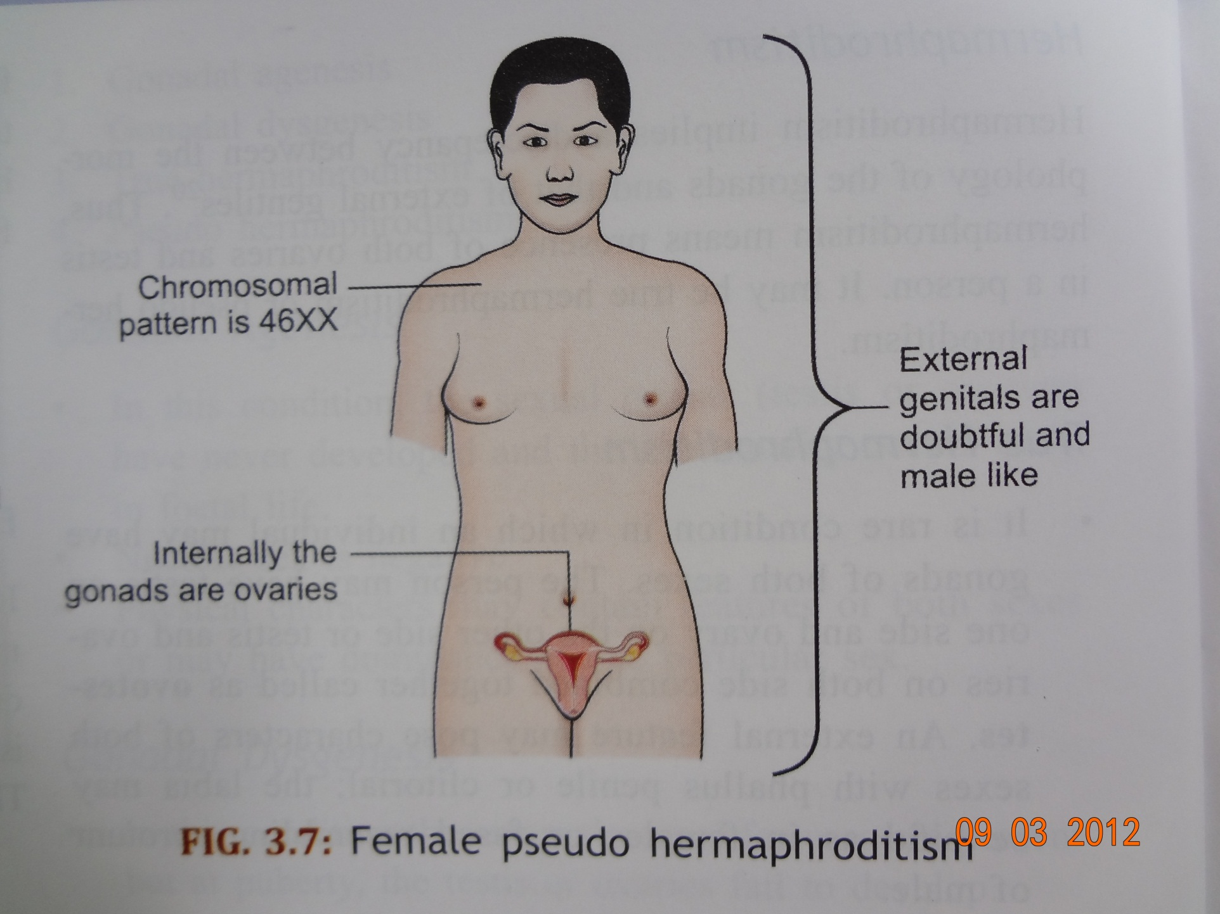

Slide 23
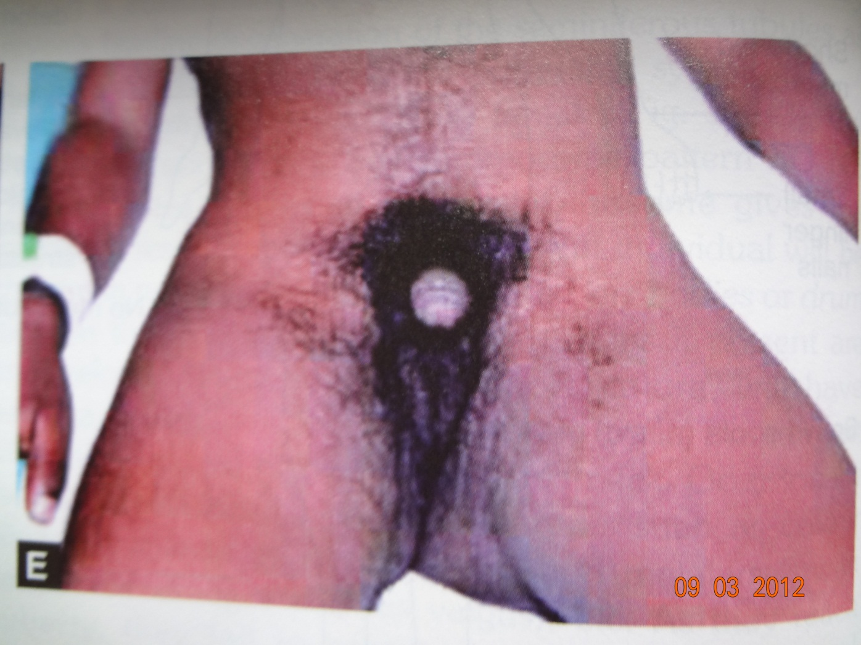
Female pseudohermaphrodite with male external features with a hypertrophied clitoris and fused labia but has female gonads internally

Slide 24
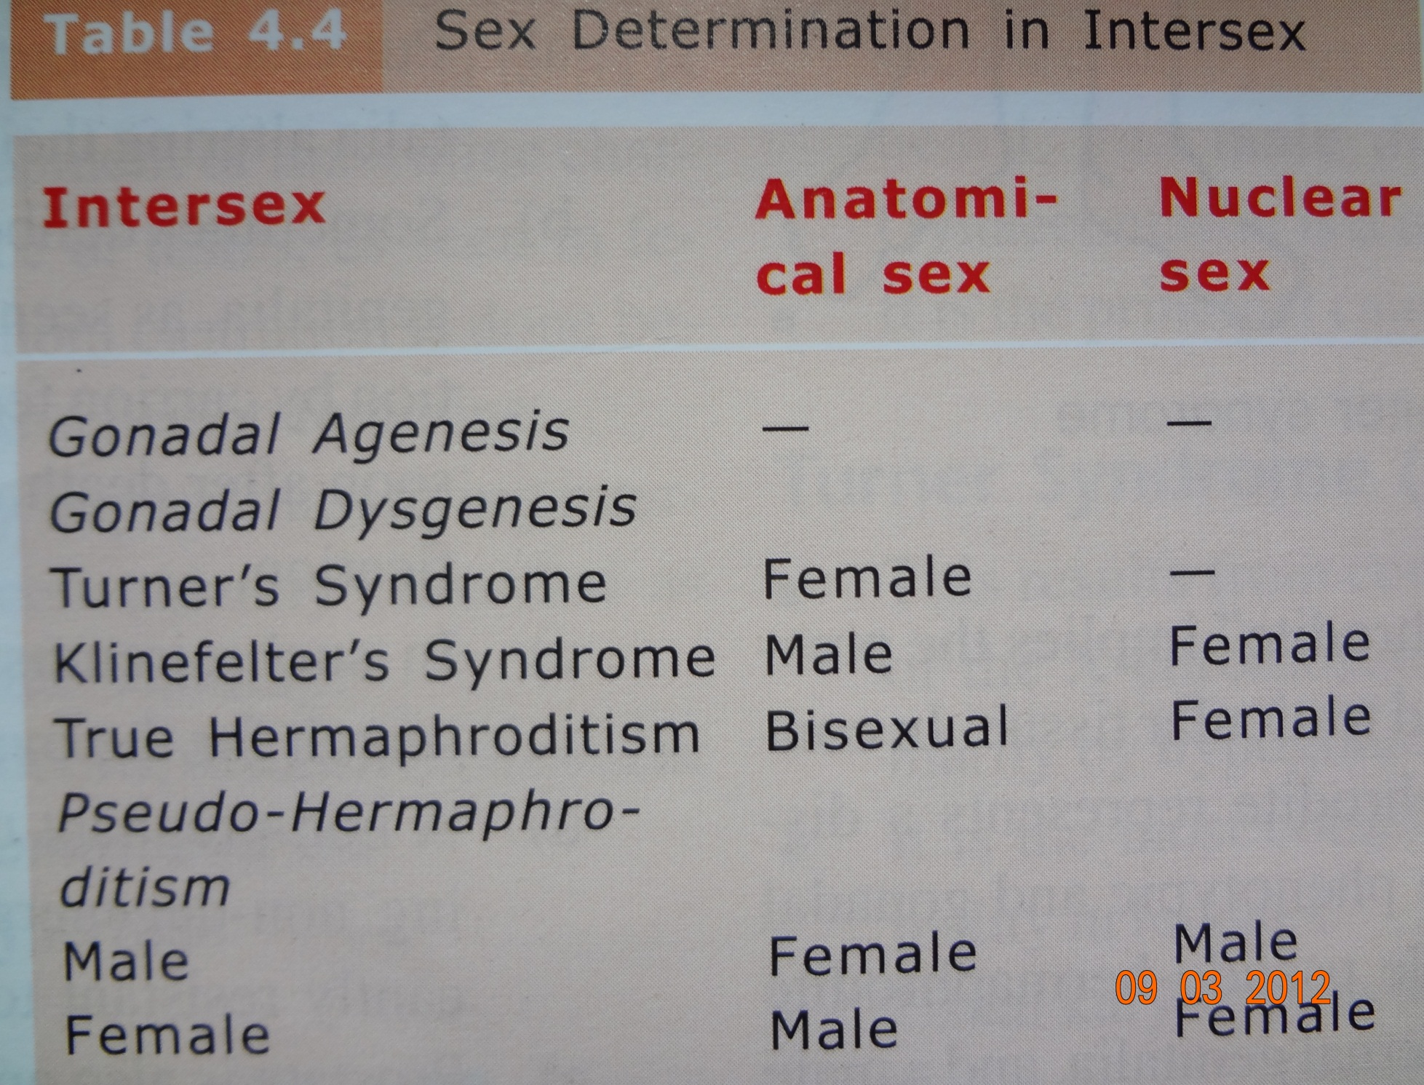

Slide 25
Medicolegal aspect of Intersex
1) Selection of sex for rearing up
Depends upon : Development of the anatomical feature
Rather than on the Gonads, Chromosomal pattern.
Female pseudohermaphodite
It should be reared up as females as most of them have normal internal sex organ,capable of developing into normal fertile female
person having large phallus or labro-scrotal fusion may require surgery

Slide 26
Male pseudo-hermaphrodite
Having small phallus may be reared as female,orchidectomy needs to be done in infancy to be supported by estrogen therapy.
If phallus is sufficiently well develop the child may be reared as male. Surgical correction for Hypospadius, scrotal cleft with or without hysterectomy or tubectomy
Individuals with unilateral testis and contralateral gonadal aplasia should better be reared as female, as genetalia are poorly masculanised.
subject having small penis and rudimentary testis not responding to testosterone therapy should be reared as female

Slide 27
True hermaphrodite
proper development of the external genetalia of a particular sex
if ovo-testis on one side and ovary on the other, remove the ovo-testis and the external genitalia need to be corrected as to make a the subject female type
in case of presence of Vagina,Uterus and tubes even with external genetalia well masculanised ,necesary surgical operation need to be done to make the subject female type

Slide 28
2) Perfection of sex
practically the correct sex is that which the individually wants to do or desire
Inclination
Orientation
Not unethical to use medical, Psychiatric or surgical means to perfect the sexual characteristic of intersex
3) Paraphilias
homosexuality ,transvestism, exhibitionism,voyerism, sadist, masochism etc..
Often associated more with anomalies of sex differentiation.

Slide 29
Effect of change of sex
English court held Decision that the reversal of sex state does not invalidate a legacy, person remaining the same- no matter he is regarded as son or daughter. There is no such law in India.

Slide 30
Microscopic examination
It can be done by determination of :
Barr body or sex chromatin
Barr M.L and Bertram L.F(1949 )
basophilic intranuclear condensed structure located near the nuclear membrane of the somatic cells in females.
Appreciated in cells of : buccal mucosa, skin ,cartilage ,nerve , amniotic fluid etc
Routinely used : Buccal smear

Slide 31
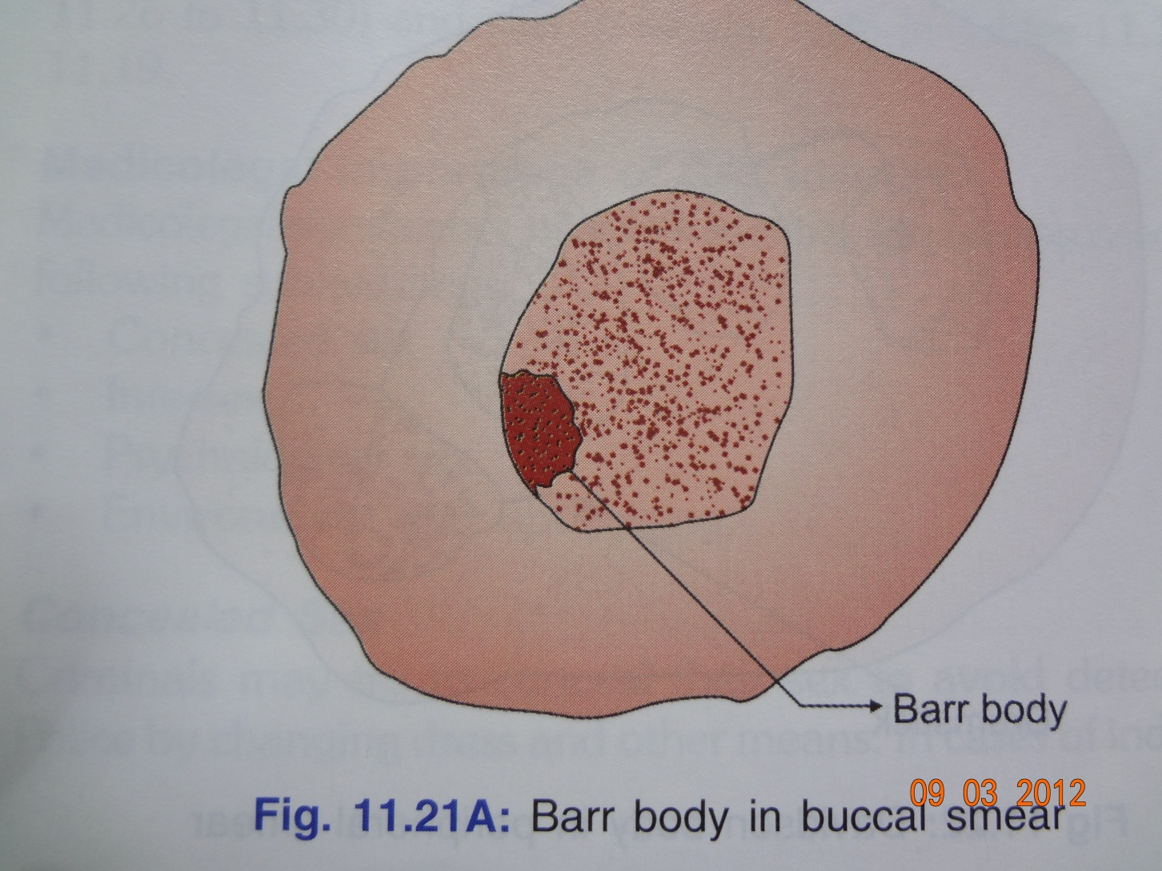
Diagrammatic representation of Barr bodies

Slide 32
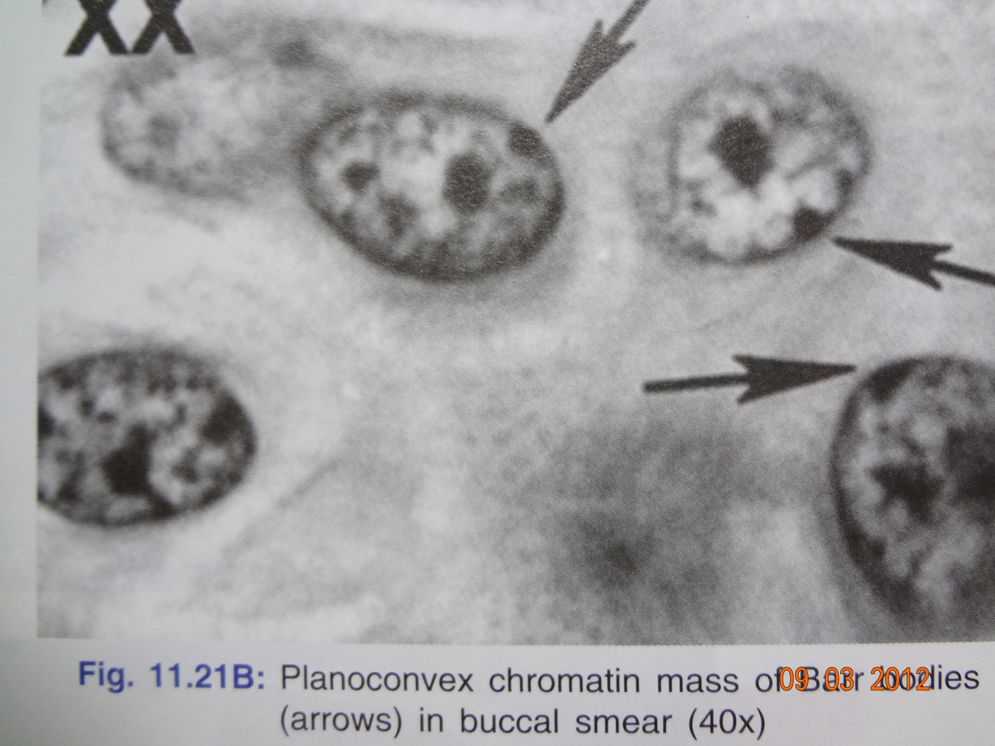
Plano convex chromatin mass of barr bodies(arrow )

Slide 33
Davidson bodies
Davidson W.M and Smith D.R (1954)
some neutrophils in female demonstrate an additional lobe( drumstick)
rare in males
Davidson describe it as : dense chromatin head 1.5 micrometer in diameter and are attached to nucleus by a thread like connective tissue.
peripheral smears : Leishman or Geimsa stains
Diagnostic : peripheral smear min of six percent count.

Slide 34
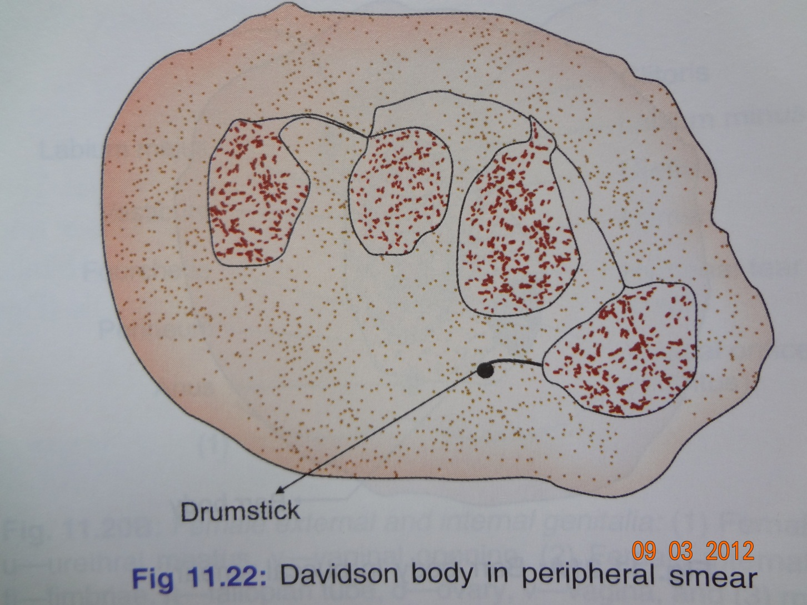
Drumstick like Davidson body in peripheral smear

Slide 35
Karyotyping :
Human chromosome are studied in detail
Human cells are grown in tissue culture
colchicine
Arrest mitosis
Metaphase of developing cell
Cell are exposed to hypotonic solution
Chromosomes swell and disperse
put on the slide
Staining or fluorescent technique
Individual chromosomes are arraged in an arbitary pattern (Karyotype)

Slide 36
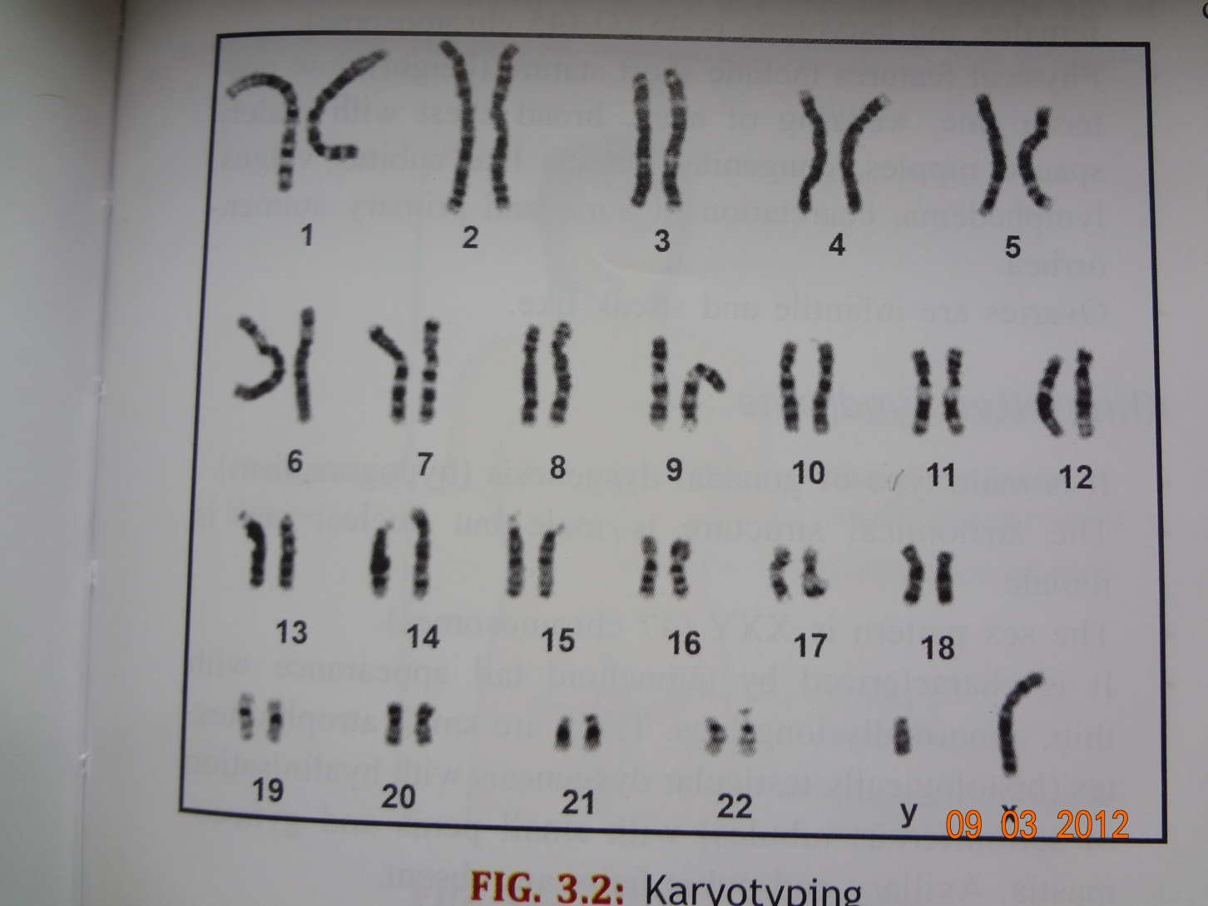
karyotyping

Slide 37
Demonstration of Y – chromosome
can be demonstrated by
Quinacrine Stain under flourescent Micro
Acridine Stain
Cells usually used :
Buccal mucosa
Hair follicles
Leucocytes
Dental pulp

Slide 38
Conclusion
Determination of sex is very important for the identification of both living and dead person.
Microscopic examination is one of the most important positive sign of sex identification just next to gonadal biopsy
Intersex may result in an error in diagnosis of true sex from external genital examination therefore a thorough knowledge of this subjects is a must for every forensic expert to identify the true sex of an individual.

Slide 39

Thank - you

