Slide 1
Hermaphroditism (Ovotesticular DSD)
Shridhan A Patil
DNB Trainee
RCC, Trivandrum
06 December 2011

Slide 2
Disorders of Sexual Development (DSDs)

Slide 3
Terminology
Chromosomal sex
Describes X and/or Y complement
Determined at fertilization
Presence of Y chromosome means testes development will occur irrespective of number of X chromosomes
45 Y fetus not viable
Absence of X chromosome impairs development

Slide 4
Gonadal sex
Refers to tissue assigned as testis or ovary
Embryonic gonad is bipotential i.e. can develop into either ovary or testis depending on gene expression( from 42nd day of gestation)
SRY gene – expressed transiently in cells destined to become Sertoli cells and serves as a pivotal switch to establish the testis lineage.

Slide 5
SRY mutation – Prevents testicular development
SRY translocation in 46 XX – testis development and male phenotype

Slide 6
Ovarian development once thought to be default process
Certain genes expressed in ovarian development (e.g., WNT4, R-spondin-1 – Impair testes development)

Slide 7
Phenotypic sex
Refers to the structures of the external and internal genitalia and secondary sex characteristics
The male phenotype requires the secretion of AMH/MIS from Sertoli cells
And testosterone from testicular Leydig cells

Slide 8
AMH – Mullerian duct regression (from 60–80 days gestation)
AMH- member is TGF-β family
Testosterone – Wolffian structure development ( Vas, seminal vesicles ,epididymides) 60-80 days
DHT – promotes development of male external genitalia ( 65- 100 days)

Slide 9
Sexual ambiguity is present whenever there is disagreement among these various criteria for determining sex.

Slide 10
The genetic regulation of gonadal development

Slide 11
Internal genital organs development

Slide 12
External genital organs development

Slide 14
Male External Genitalia Development
Testes
Leydig Cells
Sertoli
Cells
Testosterone
AMH/MIS
DHT
Wolffian duct
Urogenital Sinus
Regression of Mullerian ducts
Male External Genitalia

Slide 15
Female External Genitalia Development
Ovary
Absence of androgen exposure
Urogenital sinus
Mullerian ducts
Female external genitalia
-Lower part of vagina
Female internal genital organs
-Most of vagina
-Uterus
-Fallopian tubes

Slide 16
Normal Sex Differentiation
Genetic sex is determined at fertilization.
Testes develop in XY fetus, ovaries develop in XX fetus.
XY fetus produces MIS and androgens and XX fetus does not.
XY fetus develops Wolffian ducts and XX fetus develops Mullerian ducts.
XY fetus masculinizes the female genitalia to make it male and the XX fetus retains female genitalia.

Slide 17
Classification of DSD
Sex Chromosome DSD
47,XXY (Klinefelter's syndrome and variants)
45,X (Turner's syndrome and variants)
45,X/46,XY mosaicism (mixed gonadal dysgenesis)
46,XX/46,XY (chimerism/mosaicism)
46,XY DSD
Disorders of gonadal (testis) development
Complete or partial gonadal dysgenesis (e.g., SRY, SOX9, SF1, WT1, DHH)
Impaired fetal Leydig cell function (e.g., SF1/NR5A1, CXorf6/MAMLD1)
Ovotesticular DSD
Testis regression

Slide 18
Disorders in androgen synthesis or action
Other
46,XX DSD
Disorders of gonadal (ovary) development
Gonadal dysgenesis
Ovotesticular DSD
Testicular DSD (e.g., SRY+, dup SOX9, RSPO1)
Androgen excess
Fetal enzyme def. , Aromatase def.
Maternal virilizing tumours
Androgenic drugs
Other
Mullerian agenesis (MRKH), Vaginal atresia, Syndromic

Slide 19
46,XX DSD (Androgenized Females) , Prev. Female pseudohermaphroditism
EXCESS FETAL ANDROGENS
Congenital adrenal hyperplasia
 21 -hydroxylase deficiency
 11-hydroxylase deficiency
 3ß-hydroxysteroid
dehydrogenase deficiency
EXCESS MATERNAL ANDROGENS
Maternal androgen secreting tumours (ovary, adrenal)
 Maternal ingestion of androgenic drugs

Slide 20
Congenital adrenal hyperplasia
The commonest cause of genital ambiguity at birth
21-Ohas deficiency is most common form
Autosomal reccessive
Salt wasting form may be lethal in neonates
SERUM 17OH-progesterone (21OHase)
 SERUM deoxycorticosterone, 11-deoxycotisol (11- OHase)

Slide 21
21-hydrxylase deficiency (congenital adrenal hyperplasia)
Cholesterol
Pituitary
Pregnenolone
Progesterone
ACTH
17-OH progesterone
Adrenal cortex
21-hydroxylase

Androgens
Cortisol
Androgens
Cortisol

Slide 22
Drugs with Androgenic side effects ingested during pregnancy
- Testosterone
- Synthetic progestins
- Danocrine
- Diazoxide
- Minoxidil
- Phenytoin sodium
- Streptomycin
- Penicillamine

Slide 23
46 XY DSD (Unandrogenized males) prev. male pseudohermaphroditism
Failure to produce
testosterone
 Pure XY gonadal dysgenesis (Swyer’s syndrome)
 Anatomical testicular failure (testicular regression syndrome)
 Leydig-cell agenesis
 Enzymatic testicular failure
Failure to utilize
testosterone
 5-alpha-reductase deficiency
 Androgen receptor deficiency
* Complete androgen Insensitivity (TFS)
* Incomplete androgen Insensitivity

Slide 24
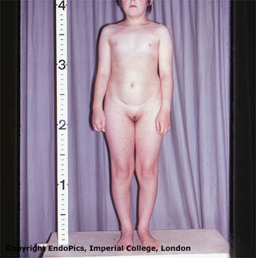
Swyer syndrome
46, XY
No SRY OR its receptors
STREAK GONADS - NO MIF (Uterus +) - NO SEX STEROIDS
Female external
Genitalia
Female Internal Genitalia

Slide 25
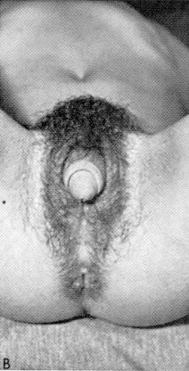
Testicular regression syndrome (congenital anorchia)
46-XY/SRY
Testis  MIF
(self destruction)
± testosterone
± DHT
Female or
ambiguous
External
genitalia
± Male Internal genitalia

Slide 26
Leydig-cell agenesis
46-XY/SRY
TESTIS  MIF
( partial/ complete absence
Of leydig-cells)
No or  testosterone
No or  DHT
Female or ambiguous external Genitalia
± Male Internal
Genitalia

Slide 27
Testicular enzymatic failure
46-XY/SRY
Testis  MIF
(defects in testosterone
Synthesis)
Autosomal recessive enzyme deficiency : -20-22 desmolase -3-ß-ol-dehydrogenase -17- ∝ -hydroxylase -17,20-desmolase -17-ß –hydroxysteroid oxyreductase
 testosterone precursors DHT
Ambiguous
External
Genitalia
Male Internal Genitalia

Slide 28
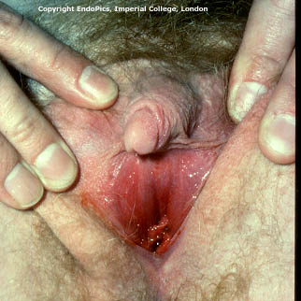
46-XY/SRY
5-alpha-reductase deficiency
Testis  MIF
Testosterone
5-∝-rductase
DHT
Female or Ambiguous external Genitalia
Male Internal Genitalia

Slide 29
46-XY/SRY
Androgen Insensitivity Syndrome
TESTIS  MIF
Testosterone
5-∝-reductase
DHT
Incomplete form  Ambigious genitalia
Absent androgen receptors
Female External Genitalia
Male Internal Genitalia

Slide 30
Diagnosis
of XY Female
Testosterone concentration
Low
Normal
Male level
Concentration of
Testosterone precurcers
DHT
High
Low
Low
Normal
Testicular
enzyme
Failure
Absent testes or
Absent leydig-cell
5 ∝-reductase
Deficiency
Testicular
Feminization
Syndrome
Surgical exploration

Slide 31
MIXED GONADAL DYSGENESIS
Combined features of Turner’s syndrome and male pseudohermaphroditism
Short stature
Streak gonad on one side with a testis on the other
Unicornuate uterus & fallopian tube- side of streak gonad
Karyotype 46XY / 45X0
Considrable variation in the sexual phenotype

Slide 32
Ovotesticular DSD (prev. True Hermaphroditism)
• Gonads :
- ovary one side and testis on the other or
- bilateral ovotestis
• Karyotype :
46,XX most common(57%); XY(13%) and XX/XY(30%)
• Internal genitalia :
Both mullerian and wolffian derivates
• Phenotype is variable
• Gonadal biopsy is required for confirming diagnosis

Slide 33
References
Harrison’s Internal Medicine 18th edition
Robbin’s Pathologic Basis Of Disease 8 th edition
THANK YOU

