Slide 1
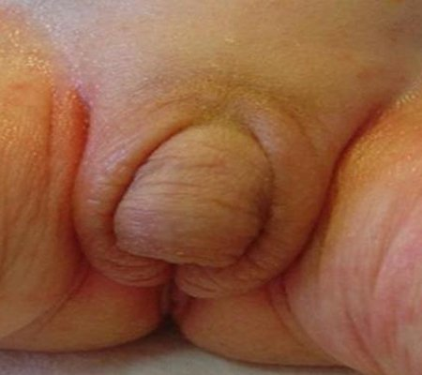
APPROACH TO A CASE OF AMBIGUOUS GENITALIA
MODERATOR – DR M. L. BARMAN
PRESENTED BY- DR. NISHANT PRABHAKAR
DEPT OF PEDIATRICS NSCB MCH JABALPUR(M. P.)

Slide 2
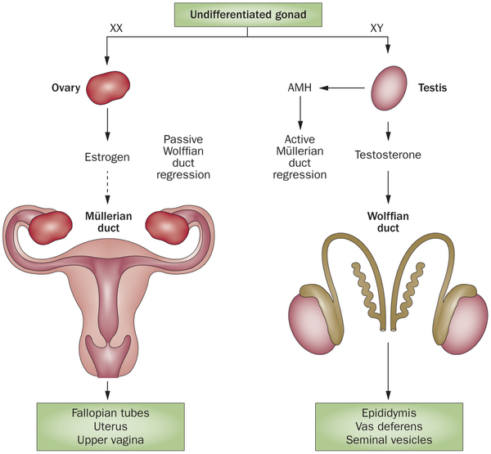
SEXUAL DIFFERENTIATION
Germ cells arise from celomic epithelium of hindgut & migrate into gonadal ridge at 4-6 weeks of gestation. These cells combine with somatic cells to give rise to bipotential gonads
1-undeferentiated stage (4-8 wk)
genital tubercle (phalus)
labioscrotal swellings
urogenital folds
urogenital sinus
45XO embryo the ovaries develop but undergo atresia
 streak ovaries
Gonadal differentiation at 6-8 wk gestation
TDF gene ie SRY gene(Y-chromosome):
stimulates gonads towards testicular differentiation
Absence of TDF: gonads differentiate into ovaries
Wolffian duct from mesonephros
Müllerian duct from coelomic epithelium
Endocrine effect during this phase is crucial:
paracrine action of hormones produced by ipsilateral gonad
testis (MIS, T) ⇒ male internal genitalia
ovary (nil) ⇒ female internal genitalia

Slide 3
Fetal LH, placental HCG necessary for normal growth of penis, scrotum, descent of testes
Hypopituitarism (congenital gonadotrophin deficiency) – micropenis, bilateral cryptorchidism
Müllerian-inhibiting substance:-produced by fetal testes( chr.19)
Causes almost complete regression of Müllerian duct derivatives:i.e.
utriculus masculinus, appendix testis
Important in testicular differentiation
Testosterone:
produced by fetal Leydig cells
Regulates male phenotypic development
Multiple steps in effect of testosterone:
production, 5-alpha reductase, AR
T ⇒ Wolffian duct (male internal genitalia)
DHT ⇒ male external genitalia (includes prostate,scrotal fusion,& development of corpus spongiosum & penile corpus cavernosa)

Slide 4
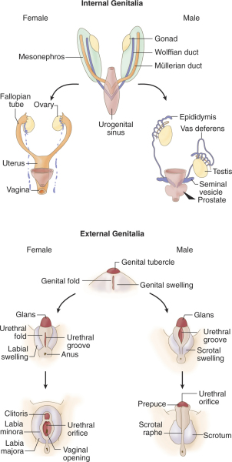
FLOW CHART

Slide 6
Feminisation is a default process of sexual development
Male (requires DHT):
labioscrotal fold = scrotum
urethral fold / groove = urethra
genital tubercle = glans penis
Female (requires nil):
labioscrotal fold = labia majora
urethral fold = labia minora
genital tubercle = glans clitoris
Ambiguity of the external genitalia may result from chromosomal aberration or aberrant sex differentiation with the XX or XY genotype. The appropriate term for what wa previously called intersex is DISORDER OF SEX DEVELOPMENT in which development of chromosomal,gonadal or anatomical sex is atypical

Slide 7
REVISED NOMENCLATURE
PREVIOUS | CURRENTLY ACCEPTED
INTERSEX | DISORDER OF SEX DEVELOPMENT
MALE PSEUDOHERMAPHRODITE | 46,XY DSD
UNDERVIRILISATION OF AN XY MALE | 46,XY DSD
UNDERMASCULINISATION OF AN XY MALE | 46,XY DSD
46, XY INTERSEX | 46,XY DSD
FEMALE PSEUDOHERMAPHRODITE | 46,XX DSD
OVERVIRILISATION OF AN XX FEMALE | 46,XX DSD
OVERMASCULINISATION OF AN XX FEMALE | 46,XX DSD
46, XX INTERSEX | 46,XX DSD
TRUE HERMAPHRODITE | OVOTESTICULAR DSD
GONADAL INTERSEX | OVOTESTICULAR DSD
XX MALE OR XX SEX REVERSAL | 46, XX TESTICULAR DSD
XY SEX REVERSAL | 46,XY COMPLETE GONADAL DYSGENESIS

Slide 8
ETIOLOGICAL CLASSIFICATION OF DISORDER OF SEX DEVELOPMENT
46 XX DSD
ANDROGEN EXPOSURE
Fetal /fetoplacental Source
21 hydroxylase deficiency
11β hydroxylase deficiency
3β hydroxysteroid dehydrogenase II deficiency
Cytochrome p 45o oxidoreductase deficiency
Aromatase deficiency
Glucocorticoid receptor gene mutation
Maternal source
Virilizing ovarian tumor
Virilizing adrenal tumor
Androgenic drugs
DISORDER OF OVARIAN DEVELOPMENT
XX gonadal dysgenesis
Testicular DSD (SRY+, SOX9 Duplication)
UNDETERMINED ORIGIN
Associated with genitourinary & GIT defects

Slide 9
ETIOLOGICAL CLASSIFICATION OF DISORDER OF SEX DEVELOPMENT
46 XY DSD
DEFECTS IN TESTICULAR DEVELOPMENT
Denys drash syndrome( WT1 gene mutation)
WAGR syndrome( 11p13 deletion)
Campomelic syndrome & SOX9 mutation
XY pure gonadal dysgenesis( Swyer syndrome)
Mutation in SRY gene
XY gonadal dysgenesis
DEFICIENCY OF TESTICULAR HORMONES
Leydig cell aplasia
Mutation in LH receptor
Lioid adrenal hyperplasia;mutation in StAR(steroidogenic acute regulatory protein)
3β HSD II deficiency
17- hydroxylase/ 17,20 lyase deficiency
Antimullerian hormone gene mutation/ receptor defect for antimullerian hormone
DEFECT IN ANDROGEN ACTION
5α- reductase II mutation
Androgen receptor defect (complete or partial AIS)
Smith- Lemli-Opitz syndrome ( defect in conversion of 7- dehydrocholesterol to cholesterol)

Slide 10
ETIOLOGICAL CLASSIFICATION OF DISORDER OF SEX DEVELOPMENT
OVOTESTICULAR DSD
XX
XY
XX/XY chimeras
SEX CHROMOSOME DSD
45,X ( turner syndrome and variant)
47, XXY ( Klinefelter syndrome and variants)
45,X/46,XY (mixed gonadal dysgenesis,sometimes a cause ovotesticular DSD
46,XX/46,XY (chimeric, sometimes a cause of ovotesticular DSD)

Slide 11
A short overview of two cases
CASE- 1
A full term normal delivered baby presented with mild respiratory distress, reticular pattern &prolonged CRT with sign of shock
LAB reports-
CBC-WNL
CRP-negative
S. Na- 128 meq/dl
S. K- 5.4 meq/dl
RFT- blood urea-64mg/dl
S. Creat- 1.1
ABG shows- met. Acidosis
pH-7.14

Slide 12
WHAT NEXT…????
USG ABDOMEN = Presence of uterus
KARYOTYPE = 46XX
17 HYDROXY PROGESTERONE = Markedly elevated
Baby was resuscitated with fluids ; Started upon initially with injectable hydrocort; Then on oral hydrocort & fludrocort…
DIAGNOSIS= 46XX FEMALE DSD WITH 21 HYDROXYLASE DEFICIENCY

Slide 13
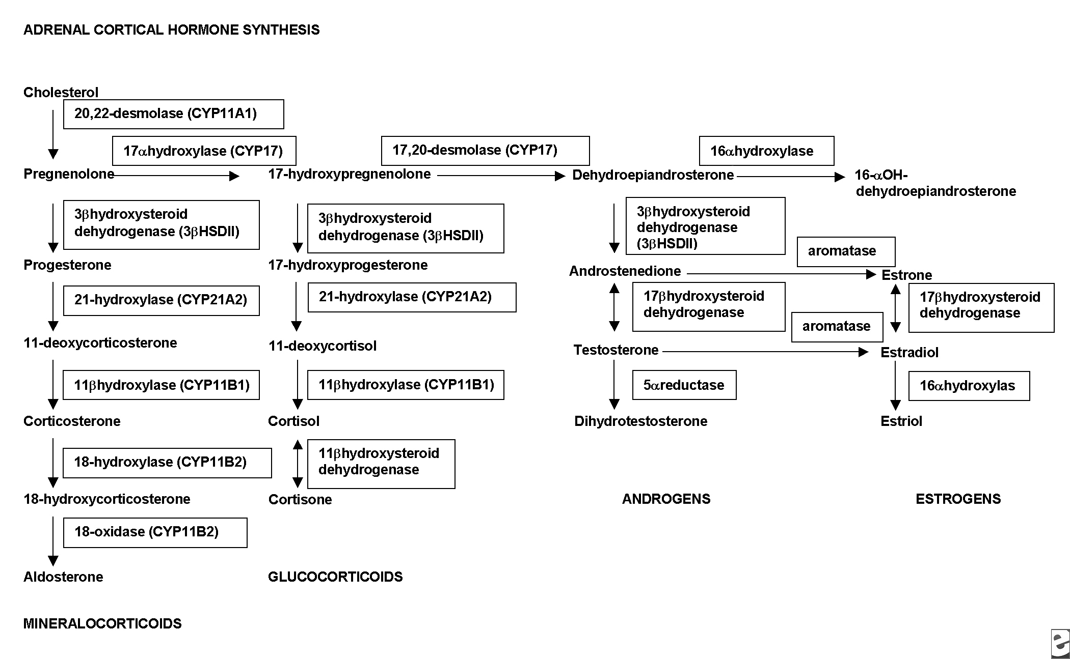
FLOW CHART

Slide 14
DISCUSSION
21 hydroxylase deficiency leads to mineralocorticoid, glucocorticoid deficiency & androgen excess.
So baby fail to conserve sodium normally.Progressive weight loss ,vomitting, refusal to feed, dehydration & shock
Infants generally present at the age of 6 to 14 days
pigmentation in nipples, axilla, umbilicus, genitalia are due to feed back rise of ACTH level
Diagnostic clue= 17 hydroxyprogesterone level >50 ng/ml
24 hours after birth
= 11 deoxycorticosterone elevated in
CYP11B1 deficiency

Slide 15
MANAGEMENT
Initial first aid management
Correction of hypovolemia
& hyponatremia.
Cortisol replacement in virilized female
with hydrocort @ 20 mg/m2/day
Close monitoring of weight; fluid balance; & electrolyte should be done
Fludrocortisone acetate should be given @ 0.05 – 0.2 mg/kg for mineralocorticoid replacement

Slide 16
CONGENITAL ADRENAL HYPERPLASIA (CAH)
21 HYDROXYLASE DEFICIENCY ( CLASSIC FORM)-
SIGN & SYMPTOME-
Of glucocorticoid & mineralocorticoid deficiency(salt-wasting crisis)
Ambiguous genitalia in females
Postnatal virilisation in males & females
LAB FINDINGS
Decrease cortisol, increase ACTH; elivated both baseline as well as ACTH stimulated 17 hydroxy-progesterone
Hyponatremia & hyperkalemia with raised plasma renin level
Elivated serum androgen levels
THERAPEUTIC MEASURES
glucocorticoid (hydrocort) & mineralocorticoid (fludrocortisone) replacement ;
Sodium chloride supplimentation
Vaginoplasty & clitoral recession for ambiguous genitalia
For raised androgen levels suppression with glucocorticoids is used

Slide 17
CONGENITAL ADRENAL HYPERPLASIA
21 HYDROXYLASE DEFICIENCY (NON CLASSIC FORM)-
May be asymptomatic precocious adrenarch, hirsutism, acne, menstrual irregularity, infertility
LAB FINDINGS-
Raised baseline & ACTH stimulated 17 hydroxyprogesterone
Raised androgen
THERAPEUTIC MEASURES-
Sippression with glucocorticoids

Slide 18
CONGENITAL ADRENAL HYPERPLASIA
11 β- HYDROXYLASE DEFICIENCY
PRESENTATION-
With features of glucocorticoid deficiency
Ambiguous genitalia in females
Postnatal virilisation in males & females
Hypertension
LAB FINDINGS-
decreased cortisol & raised ACTH levels
Raised both basline as well as ACTH stimulated 11- deoxycortisol & deoycorticosterone
Raised serum androgens
Decreased plasma renin & hypokalemia
THERAPEUTIC MEASURES
Glucocorticoid ( hydrocort) replacement
Vaginoplasty & clitoral recession for ambiguous genitalia
Glucocorticoid suppression for raised androgen & decreased renin

Slide 19
CONGENITAL ADRENAL HYPERPLASIA
3β- HYDROXYSTEROID DEHYDROGENASE DEFICIENCY( CLASSICAL FORM)
PRESENTATION
With glucocorticoid & mineralocorticoid deficiency( salt wasting crisis)
Ambiguous genitalia in males & females both
Precocious adrenarch, disordered puberty
LAB FINDINGS
Decreased cortisol & raised ACTH
Raised baseline & ACTH stimulated Δ5 steroids( pregnenolones,17 hydroxy pregnenolone, DHEA)
Hyponatremia,hyperkalemia & raised plasma renin
Raised DHEA; decreased androstenedione,testosterone & estradiol
THERAPEUTIC MEASURES
Glucocorticoid & mineralocorticoid replacement sodium chloride supplimentation
Surgical correction of genitals & sex hormone replacement as necessary as consonant with sex of rearing

Slide 20
CONGENITAL ADRENAL HYPERPLASIA
17 α HYDROXYLASE / 17, 20 LYASE DEFICIENCY
PRESENTATION
With cortisol deficiency( corticosterone is an adequate glucocorticoid)
Ambiguous genitalia in males
Sexual infantilism
Hypertension
LAB FINDINGS
Decreased cortisol,
Raised ACTH,DOC,corticosterone;
Low 17α- hydroxylated steroids; poor response to ACTH
Low serum androgens or estrogens; poor response to Hcg
Low plasma renin; hypokalemia
THERAPEUTIC MEASURES
Glucocorticoid administration & suppresion
Orchidopexy or removal of intra-abdominal testes; sex hormone replacement consonant with sex of rearing

Slide 21
CONGENITAL ADRENAL HYPERPLASIA
CONGENITAL LIPOID ADRENAL HYPERPLASIA
PRESENTATION
Glucocorticoid & mineralocorticoid deficiency( salt wasting crisis)
Ambiguous genitalia in males
Poor pubertal development or premature ovarian failure in females
LAB FINDINGS
Raised ACTH, low levels of all steroid hormones,decreased or absent response to ACTH
Hyponatremia, hyperkalemia, low aldosterone,raised plasma renin
Decreased or absent response to hCG in males
Raised FSH & LH & low estradiol ( after puberty) in females
THERAPEUTIC MEASURES
Glucocorticoid & mineralocorticoid replacement & sodium chloride supplimentation
Orchidopexy or removal of intra-abdominal testes;sex hormone replacement consonant with sex of rearing
Estrogen replacement in females

Slide 22
CONGENITAL ADRENAL HYPERPLASIA
P450 OXIDOREDUCTASE DEFICIENCY
PRESENTATION
Glucocorticoid deficiency
Ambiguous genitalia in males & females
Maternal virilization Antley- Bixler syndrome
LAB FINDINGS
Low cortisol; raised ACTH, pregnenolone & progesterone
Raised serum androgen prenatally, low androgen & estrogens at puberty
Decreased ratio of estrogen to androgen
THERAPEUTIC MEASURES
Glucocorticoid replacement
Surgical correction of genitals and sex hormone replacement as necessary,consonant with sex of rearing

Slide 23
CASE II
A 22 day old baby was brought by mother for routine checkup as she found unusual genitals. no other complaints.bilaterally the folds had palpable round body.
Lab test- S. Na- 138; S. K – 4.4
Karyotype 46XY
17 Hydroxyprogesterone- Normal

Slide 24
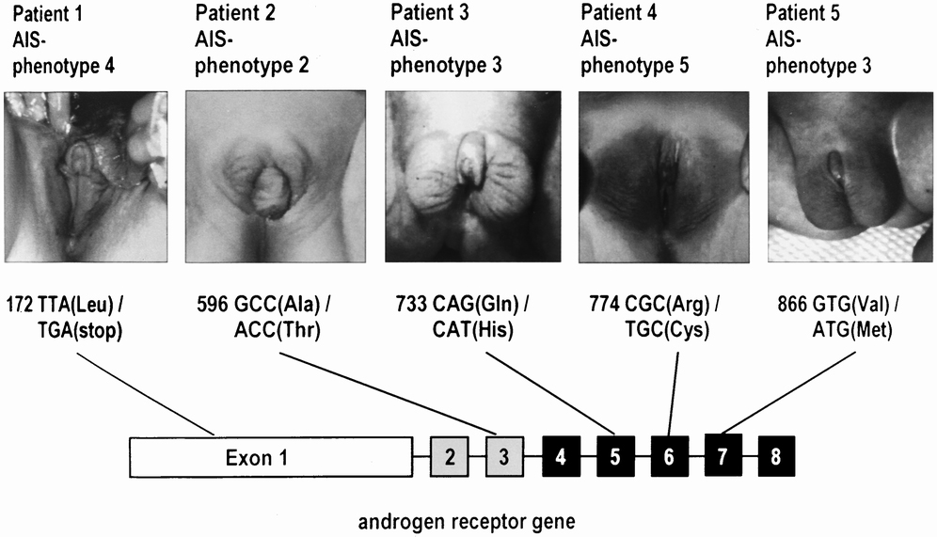
WHAT NEXT
Testosterone/DHT ratio= normal
Increased LH;Testosterone; & Androgen levels
DIAGNOSIS= Complete androgen insensitivity
Also called testicular feminisation (female phenotype)
In utero loss of androgen & MIS secretion means loss of internal genitalia
Females with inguinal hernia with complete androgen insensitivity diagnosed with amenorrhea absence of pubic hair or hormonal profile.
Treated with Gonadectomy & Estrogen replacement therapy
PARTIAL ANDROGEN INSENSITIVITY- Reifenstein”s syndrome
Incomplete male pseudohermaphroditism
Ambiguous genitalia
Normal testosterone,LH & Testosterone/DHT ratio

Slide 25
HOW TO APPROACH
HISTORY
Family history
Ambiguous genitalia, infertility or unexpected changes at puberty may suggest a genetically transmitted trait
-CAH ---autosomal recessive--occur in siblings
-Partial androgen insensitivity---X-linked
-XY gonadal dysgenesis ---sporadic
Consanguinity ↑↑the risk of autosomal recessive disorders
A Hx of neonatal death may suggest a missed diagnosis of CAH
Pregnancy history
Maternal Hx of virillization
-Placental aromatase def. allows fetal adrenal androgens to virilize both mother & fetus
-Maternal poorly controlled CAH
-Androgen secreting tumors
Medications
-Progestins
-Androgens
-Antiandrogens
 Adolescent Pt
When ambiguity first noted?
Any pubertal signs?

Slide 26
PHYSICAL EXAMINATION
Overall assessment
Abnormal facial appearance or other dysmorphic features suggesting a multiple malformation syndrome
Evidence of salt wasting skin turgor, poor tone ,dehydration, low BP, vomitting, poor feeding
Hyper pigmentation of the skin due ↑↑ ACTH
Abdominal masses
In adolescent evidence of hirsutism/ virilization
Gonadal Examination
Palpate labioscrotal tissue & inguinal canal for presence of gonads
Note No. of gonads, size, symmetry, position.
Palpable gonads below the inguinal canal are almost always testicles excluding gonadal female eg. CAH
Rectal exam
To palpate for presence or absence of the uterus
Tanner staging

Slide 27
EXAMINATION OF EXTERNAL GENITALIA
Phallus
development may be in-between a penis & a clitoris
note size : length & breadth should be measured
(N mean stretched penile length 3.5 cm+_0.5)
the penis may appear bent buried or sunken
erectile tissue should be detected by palpation
Labioscrotal folds
separated or fused fusion is an androgen effect
skin texture rugosity suggestes exposure to androgens
color of the skin ↑↑ pigmentation may be evidence for CAH
Orifices
should be determined & recorded on a diagram
are there two openings ? or single perineal orifice (urogenital sinus)
urethral meatus on glans, shaft or perineum
vaginal introitus

Slide 28
EXAMINATION OF EXTERNAL GENITALIA
Quigley’s 6 stages
Grade 1- N, M external genitalia  infertile with azoospermia, virilization at puberty
G 2- M phenotype with mildly defective musculinization  hypospadias & or micropenis
G 3- M ph.with severely defective musculinization  perineal hypospadias , micropenis, cryptorchidism & or bifid scrotum
G 4- Ambiguous ph.  phallic structure between clitoris & penis, urogenital sinus & labioscrotal folds
G 5- F ph.with minimal androgen action  separate urethra & vagina, mild clitromegaly or mild post labial fusion
G 6- N, F phenotype mild virilization at puberty
G 7- N,F external genitalia

Slide 29
INVESTIGATION
Urgent RFT & SE & Glucose
Hormonal assay
17-OHP D3 & D6 (normally elevated in the 1st 2 days of life)
N =82-400 ng/dl
>400 CAH
200-300 ACTH stim test
 Urinary 17-ketosteroids
N <= 1 mg/24 h
Testosterone, DHT, androstenedione D2 & 6
N T at birth  100ng/dl  50 in the 1st WK ↑T at
4-6Wk T at 6M barely detectable
↑ T:DHT 5α reductase def
↑ ASD:T 17 ketosteroid reductase def.
 Cortisol, ACTH, DHEA

Slide 30
INVESTIGATION
Karyotyping  several days/wks
FISH (florescent in situ hybridization) for Y chromosome material
PCR analysis of the SRY gene on the Y chromosome  1D
Radiographic imaging
abdominal & pelvic U/S uterus & gonadal location
genitogram single perineal orifice (urogenital sinus)  detect the level of implantation of the vagina on the urethra
MRI
Cystoscopy
Rarely laporoscopy & gonadal biopsy

Slide 31
INTERPRETATION OF RESULT
↑↑ 17-OHP + 46XX CAH due to 21-hydroxylase def.
N 17-OHP + 46XX  ACTH stim test check (11-deoxycorticosterone, 11-deoxycortisol, 17-hydroxypregnenolone ) to detect other adrenal enzymatic defects
N 17-OHP + N ACTH stim  gonadal dysgenesis or true hermaphroditism
46 XY + ↑↑T: DHT  5α-reductase def.
Basal T levels  presence of functioning leydig cells

Slide 32
INVESTIGATION OF PREPUBERTAL CHILDREN
Leydig cell function is active in the 1st 3M of life then quiescent till puberty
hCG stimulation test
To determine the functional value of testicular tissue
 hCG 1000 IU/D  3-5 D T responce < 3ng/ml gonadal dysgenesis or inborn error of T biosynthesis (there will be also ↑↑ 17-OHP, DHEA, ASD)
 T ↑↑ /N  androgen insensitivity or 5α-reductase def
Under musculinized external genitalia + ↑↑ T
To test the adequacy of penile response to T
hCG stim may be prolonged  2-3 inj/wk  for 6 wks
T 25-100 mg IM Q 4 Wks 3M ↑↑ phallic length &diameter
An ↑↑ < 35mm is insufficient
Androgen receptor concentration < 300 fmol/mg of DNA partial androgen insensitivity

Slide 33
TREATMENT
It requires multidisciplinary team including:
Endocrinologist
Gynecologist
Surgeon
Ped urologist
Psychologist
Geneticist
Radiologist
Psychological support for the parents
Gender assignment
Medical treatment
Surgical treatment

Slide 34
PSYCHOLOGICAL SUPPORT FOR THE PARENTS
Show the baby to the parents
Counsel both parents together
What to tell the parents?
The baby is healthy but the external genitalia is incompletely developed & tests are necessary to determine the sex
There are other babies with similar condition
A No. of treatable conditions can result in atypical genetalia
Reassurance that a good outcome can be anticipated
How long the process of investigation will take ? Around 3-4 Wk
Give them appt times & names of the people who will see them
To talk about their fears of future sexual identity & sexual orientation of their child  preferably with psychologist or social worker
Support when it comes to facing their friend & relatives

Slide 35
GENDER ASSIGNMENT
It is extremely distressing for the parents & must be dealt with as an emergency
There is profound pressure on the medical team to announce gender .....however
Postpone making a gender assignment until sufficient information is available & the results of investigation has enabled the most appropriate choice of the sex of rearing
The choice must be the result of full discussion between parents & medical team
The decision is guided by
Anatomical condition & functional abilities of the genitalia
Fertility potential (presence of F internal genital organs)
The etiology of the genital malformation
The family’s cultural & religious background
Girls with CAH are fertile & must always be assigned a female sex

Slide 36
GENDER ASSIGNMENT
In cases which can not be fertile, gender assignment will depend on:
The appearance of the external genitalia
The potential for unambiguous appearance
The potential for normal sexual functioning
True hermaphroditism  F since ovarian function may be preserved & may be fertile
Great care should be taken in declaring a male sex considering:
Potential for reconstructive surgery
Probability for pubertal virilization
Response of the external genitalia to exogenous & endog. T
Pt with small phallus & poor response to androgens may be reared as F In cases which can not be fertile, gender assignment will depend on:
5α-reductase M sex assignement 
pubertal virilization  penile growth (subnormal) & male sexual identity
Inborn errors of T biosynthesis F effective M reconstructive surgery is highly unlikely
Complete Androgen Insensitivity  F
Partial A I  preferably F

Slide 37
MEDICAL TREATMENT
CAH
Monitor electrolytes & glucose
Hypoglycemia can appear in the first hours
Serum electrolytes will become abnormal D 6-14
Hydrocortisone 10-20 mg/m2/D PO
Fludrocortisone acetate (florinef) 0.1 mg/D
Prenatal RX CAH
Mothers with family Hx Dexamethasone is started at 5 wks
If confirmed DX of CAH in F fetus (by chorion villus sampling/amniocentesis)  continue Rx till term 90% N genitaliaSex steroid replacement therapy at puberty
T enanthate 200-300 mg IM/ M:
M Pt with steroid enzyme def
M Pt with partial gonadal dysgenesis, low leydig cell No, true hermaphrodite
Estrogen premarin 0.625 mg PO/D
for one year . Then cyclic estrogen progesterone or OCP (if there is uterus)
F Pt with enzyme def  3β-OH –steroid dehydrogenase & 17-hydroxylase
F 46 XY partial gonadal dysgenesis, true herma, M pseudohermaphrodites

Slide 38
SURGICAL TREATMENT
1-Genital surgery for F
Timing of surgery …..controversial
 Clitroplasty 3-6M of age for F with CAH
Vaginoplasty delayed until the individual is ready to start sexual life
2-Genital surgery for M
More difficult & involves several steps
3-Gonadectomy to prevent cancer
What are the facts?
XY Partial gonadal dysgenesis  Gonadolblastoma 55%
XY complete gonadal dysgenesis  Gonadoblastoma 30-66%
All gonadoblastomas progress to seminoma.? age
Seminoma has a 95% 5-Y survival
Testicular enzyme defects, 5α-red, partial androgen insensitivity  Risk of malignancy is negligible before adulthood
True Herma risk is low in XX & higher inXY

Slide 39
SURGICAL TREATMENT
Pt raised as F  gonadectomy must be performed in childhood
Pt raised as M  cantroversial
1-Gonadectomy is recommended by many physicians followed by HRT
2- Close medical surveillance
-Biopsy in childhood & excising gonads with
gonadoblastoma
-Repeated biopsy at puberty
-Follow up /palpation by experienced Dr every
6-12 M 4-Gonadectomy to remove source of T
 in Pt raised as F to prevent progressive virilization especially at puberty
5-Laparoscopy
For evaluation of internal genitalia & gonadal biopsy
 For excision of mullarian structures in pt raised as M or Pt raised as F with non communicating mullarian structures
 For gonadectomy

Slide 40
THANK YOU

