Slide 1
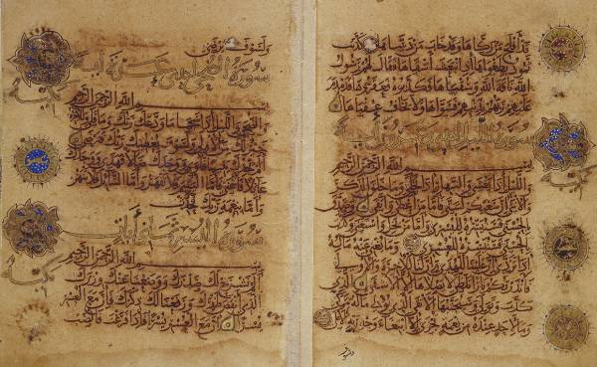
Apologetics and Islam
John Oakes
5/4/2013
Sana’a Codex

Slide 2
Apologetics and Islam
Outline
Positive Apologetics of Islam and the Qur’an
Islamic Criticism of the Old and New Testaments
Apologetic Issues in Islam and the Qur’an

Slide 3
Positive Apologetics and the Qur’an
No internally fulfilled prophecies, no miracles, no historical verification, so……

Slide 4
I. Positive Apologetics of Islam and the Qur’an
In a recent debate, Shabir Ally made these points:
1. The word yom in the Arabic text of the Qur’an 365 times is evidence of inspiration.
  360 days in the Arab year
2. The use of the number 19 is evidence of inspiration.
  Sura 74:30 19 angels
  Sura 1:1 19 letters
  114 Suras 19 x 6
  Sura 96 19th from the last has 19 verses and 209 letter (19 x 11)

Slide 5
Purported Prophecies (I)
Deut 18:15-18
¹⁵The Lord your God will raise up for you a prophet like me from among your own brothers. You must listen to him. ¹⁶For this is what you asked of the Lord your God at Horeb on the day of the assembly when you said, "Let us not hear the voice of the Lord our God nor see this great fire anymore, or we will die.“ ¹⁷The Lord said to me: "What they say is good. ¹⁸ I will raise up for them a prophet like you from among their brothers; I will put my words in his mouth, and he will tell them everything I command him.

Slide 6
Purported Prophecies (II)
Deut 18:15-18—“From among their brothers”
Cf. Deut 17:15 (brother ≠ foreigner)
Deut 34:10—“Since then no prophet has risen in Israel like Moses, whom the Lord knew face to face, who did all those miraculous signs and wonders the Lord sent him to do in Egypt”
Like Moses = miraculous signs and wonders, which Mohammed never did, but Jesus clearly did.

Slide 7
Purported Prophecies (III)
Deut 33:1-2This is the blessing that Moses the man of God pronounced on the Israelites before his death. ² He said:
“The LORD came from Sinai
and dawned over them from Seir;
he shone forth from Mount Paran.
He came with myriads of holy ones
from the south, from his mountain slopes.”
Muslims claim: Sinai = Moses
Seir = Jesus
Paran = Mohammed
Paran is nowhere near Mecca (Hab 3:3)

Slide 8
Purported Prophecies (IV)
Isa 21:7 ”when he sees…riders on donkeys or riders on camels, let him be fully alert”
Muslim claim: riders on donkeys = Jesus, riders on camels = Mohammed. Context: fall of Babylon!
Jn 14:16—parakletos → periclytos (praised one)—without any MS supp. Moreover, 14:26 shows the helper is the Spirit. Jn 16—The helper to abide forever. (M is dead.) 14:26—Helper to be sent in Jesus’ name; but no Muslim would allow this! Besides, Acts 1:5—helper to come in not many days – not in the 7th century!

Slide 9
More Positive Evidence
The Qur’an is perfect, beautiful and pure Arabic, despite the fact that Muhammad was illiterate.
We can concede that the poetry is pretty good.
Muhammad was illiterate?
Pure Arabic? Sura 12:1-2, Sura 13:37, Sura 16:103
Hundreds of non-Arabic words in the Qur’an.
Much of the writing is virtually impenetrable.

Slide 10
Other arguments
“Changed lives” Not completely without validity. obviously, if someone believes fervently enough…
“Rapid spread!”—slow at first, picking up only when Mohammed “picked up” the sword.
“So many converts!”—promise of paradise, alternative of slavery, taxes, death

Slide 11
II. Islamic Criticisms of the Bible and Christianity
The most common apologetic of Islam is not to support Islam or the Qur’an, but to undermine Christianity and the Bible.
Islam has a huge problem. The Qur’an makes it clear that the Old and New Testaments are from Allah, but if the Bible is true then Muhammad is a liar.
Note: the claim of corruption comes hundreds of years after the time of Muhammad.

Slide 12
“Bible corrupt!”
“Qur’an only is pure.”

Slide 13
• Early Period in Mecca. Muhammad sees
himself as following tradition of Judaism.
Muslims pray toward Jerusalem.
• Early Medina period. Mohammad begins
to be politically powerful. The idea of Jihad
introduced.
• Later Medina and Meccan period.
Muhammad strongly opposed to Jews and
Christianity. Islam definitely a distinct
religion.

Slide 14

Quranic view of biblical inspiration
Follow the Injil sura 5:47
( euvaggelion )
Follow the O.T. 6:92, 37:117, 40:53
“Qur’an unchanged” MS Discoveries...
“The people of the Injil shall rule in accordance with Allah’s revelations therein. Anyone who does not rule in accordance with Allah’s revelations -- these are the wicked!”

Slide 15
Quranic view of biblical inspiration
Inconsistency: Use OT and NT to refute Christians. Why, if the scriptures are “corrupt”?

Slide 16
A Question: When was the Old Testament Corrupted?
Dead Sea Scrolls + Muhammad says to obey the Torah
“the people of the book” (ie Jews) are told to follow the Old Testament teachings. Sura 6:91-92 says that Allah sent the Book of Moses “And this is the book which we sent down”

Slide 17
Old Testament Corrupt?
Sura 3:83 We believe in Allah and that which is revealed to us, and that which was revealed to Abraham and Ishmael and Isaac and Jacob and the tribes, and that which was given to Moses and Jesus and the prophets from their Lord; we make no distinction between any of them, and to Him we submit.
Sura 29:46 And dispute ye not with the people of the book but say: We believe in the revelation which has come down to us and that which came down to you.
So….. When was it corrupted? Manuscript evidence?

Slide 18
New Testament Corrupt?
Sura 4:157 And for their saying: We have killed the Messiah, Jesus, son of Mary, the messenger of Allah, and they killed him not, nor did they cause his death on the cross, but he was made to appear to them as such.
Question: When was the New Testament (injil) corrupted?
John 1:1 If Jesus is not God, when was John 1:1-18 corrupted?
Rylands Papyrus, Washington Manuscript, Codex Alexandrinus
There is NO ANSWER to this question.

Slide 19
What About the Qur’an?
Uthman burned all competing manuscripts about AD 650
Ibn Masud Codex (Kufa) 150 variants in Sura 2 alone
Sana’a Manuscript about AD 710 missing suras
Irony and circular reasoning.
Muslims avoid all study of Qur’an manuscripts and history. What are they afraid of?

Slide 20
Christians:
Original autographs are perfect and inspired.
Copiers and human and not inspired.
Muslims:
Original autographs are perfect and inspired.
Copiers are inspired and all copies are perfect.
Which view holds up to the evidence?
:

Slide 21
More Muslim Criticisms of Christianity
Christianity is tritheism
Only Allah is eternal (but the Qur’an is eternal)
Unjust for Jesus to die for someone else’s sins
Qur’an includes the idea of substitutionary sacrifice
Both of these criticisms are based on human logic,
The Bible descriptions of Abraham, David, Samson is disrespectful and inaccurate
Which is more likely to be accurate, an whitewashed account 2000 years after the event, or an embarrassing account 2000 years earlier?

Slide 22
III. Apologetic Issues in Islam and the Qur’an
World View Issues
Historical Errors
Scientific Errors
Satanic Verses and Abrogation

Slide 23
World View Issues: Is Islam a Better Religion?
Islam and women
Works salvation
Predestination
Fate: Problem of Pain and Suffering
Islam: God unapproachable.

Slide 24
Qur’an and women
“Men have authority over women because Allah has made the one superior to the other, and because they spend their wealth to support them. Good women are obedient… If they are rebellious, rebuke them, beat them, and send them to bed.”
-- 4:34

Slide 25
Qur’an and wives
“Marry women of your choice, two, three, or four.” -- 4:3
Sexual relations with captive female slaves is acceptable
23:5,6 70:30

Slide 26
Islam on Sin
“Surely good deeds take away evil deeds” (11:114).
Kabira (big sins)—murder, adultery, drunkenness, disobeying parents, neglecting Ramadan or Friday prayers, gambling, dancing, shaving the beard, forgetting the Koran after reading it, usury… Forgiveness with repentance.
Saghira (little sins)—deceit, anger, lust. Forgiveness if greater sins are avoided and good deeds are performed.
Shirk—association (of other gods with Allah). No forgiveness.

Slide 27
Qur’an and paradise
“The true servants of Allah will be well provided for, feasting on fruit and honored in gardens of delight. Reclining face to face upon soft couches, they shall be served with a goblet filled at a gushing fountain… delicious to those who drink it. They shall sit with bashful, dark-eyed virgins, chaste as the sheltered eggs of ostriches.”
-- 37:40-49. See also 78:32ff.

Slide 28
Salvation by own effort
(40:9, 39:61, 7:43)
Charity atones for sins
(2:271,277)
Earn grace.
Earn favor of Allah.
Earn salvation.
Earn paradise.

Slide 29
Islam: Salvation is earned through the efforts of those who were pre-selected by Allah to inhabit a very sensual paradise.
Christianity: Salvation is granted by the grace of a loving God to those who, through faith and repentance and baptism accept that love.

Slide 30
Initiative
Human approach Christianity
(Islam)
God God
Mankind Mankind

Slide 31
Predestination
In Islam, Allah determines everything, even who will choose to follow him.
2:142, 6:39 6:125
Islam and suffering: Inshallah
Christianity and suffering: Compassion
.

Slide 32

Historical errors in the Qur’an
Ishmael = Isaac 37:102
2 trees in Eden = 1 tree 20:120
Noah’s 4th son drowns 11:43
Zechariah silent 3 days (not 9 months) 3:41
Pharaoh’s magicians repent 20:70
Judges 7 / 1 Sam 17 conflated 2:249
Jesus’ childhood miracles 3:46, 3:49, 5:110

Slide 33
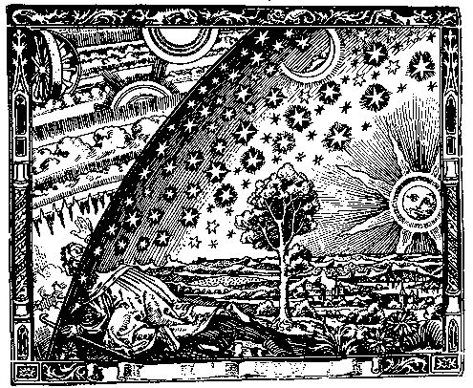
Islamic Cosmology
The cosmology of Islam is not unlike that of the Bible, except that it takes incorrect popular ideas more literally.
The main difference is that the Qur’an is not inspired, so the statements contained in the Muslim scripture has rather obvious scientific problems.

Slide 34
Scientific errors in Qur’an (I)
23:14—Creation from the clot of blood
“Then we made the sperm into a clot of congealed blood; then from that clot we made a lump; and we made out of that lump bones and clothed the bones with flesh.”
36:4 Man deposits child into the mother
18:86—Traveling west…
“… till, when he reached the setting-place of the sun, he found it setting in a muddy spring.”

Slide 35
Scientific errors in Qur’an (II)
21:32-33—Sun and stars orbit the earth
12:4—11 planets? (probably not…)
34:9, 52:44—Piece of sky falls and kills someone

Slide 36
Theory of Abrogation
Sura 6:34 “no one can alter Allah’s promises”
Sura 6:115 “No one can change His words”
Sura 10:64 “There is no changing the promises of Allah”
vs.
Sura 2:106 None of Our revelations do We abrogate or cause to be forgotten, but We substitute something better or similar: Knowest thou not that Allah hath power over all things?
Whatever Mohammad said later “abrogates” his previous sayings.

Slide 37
Abrogation (cont.)
Sura 53:19 In “a moment of weakness” Muhammad said: “Have you thought of Al-lat, al Uzza and AManat? These are exalted intermediaries whose intercession is to be hoped for.” Later abrogated, of course.
Examples: More than four wives for Muhammad 33:50 and 33:52
Praying toward Jerusalem abrogated by praying toward Mecca.
Sura 9 “Ultimatum” 9:5 “Verse of the sword” abrogates milder statements about unbelievers.

Slide 38
Summary
Positive Apologetics of Islam and the Qur’an
Islamic Criticism of the Old and New Testaments
Apologetic Issues in Islam and the Qur’an
Reaching out to Muslims: Focus on Jesus. Remember that Muslims respect Jesus and deal with reliability of the Old and New Testaments.

