Slide 1

Summary of Presentation
1. Recalling the original project
2. Tackling the challenges in Kameshwaram (2011- 2012)
3. Launching of FIN-SWAM – July 2012.
4. The first results
5. Our rationale for continuing and the future…
In lieu of missed annual reports – The story of what
happened during the last 2.5 years – Jan 2011-June 2013

Slide 2
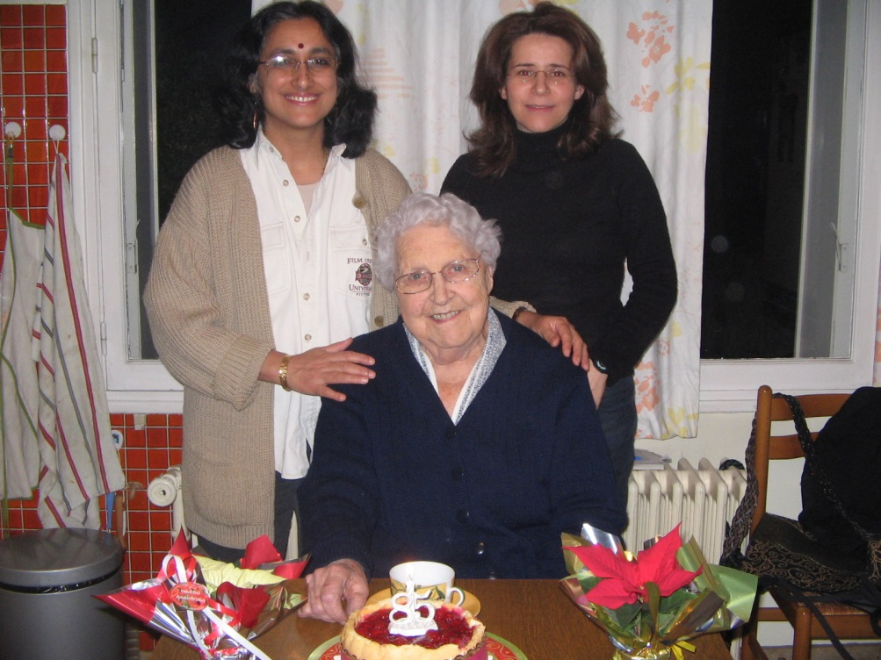
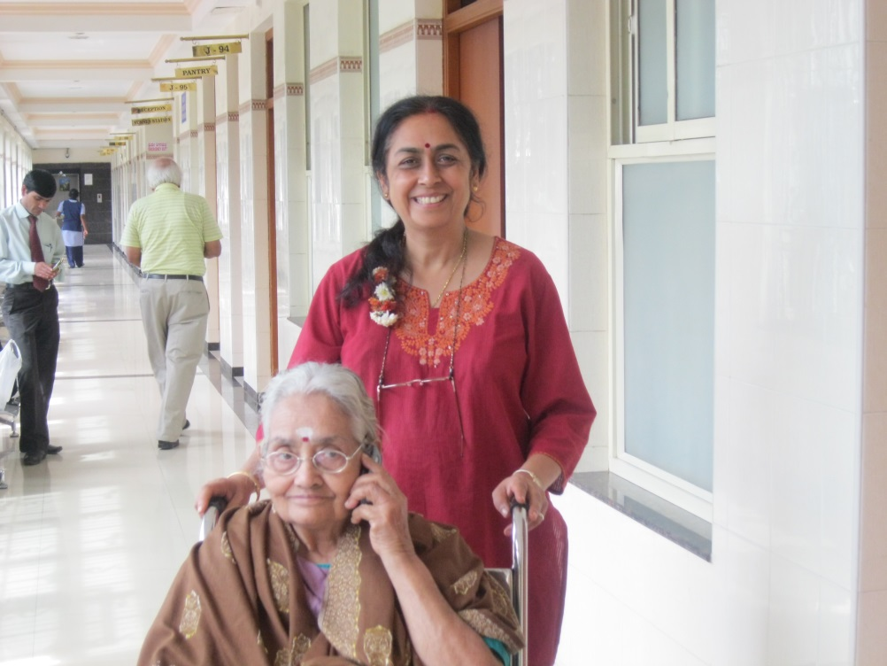
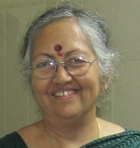
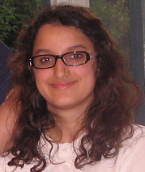
This report is dedicated to…….
Odette Claver 6-12-1925 to 17-07-2012
In loving remembrance and gratitude – to Mamie(grand mother in French), my mother in law, without whose help and support, this project would never have been born. This memoir is dedicated to her memory. She was a great lady.
To all the women who are with me and helping me – starting with my mother, Amma, who is struggling to learn to walk again, my sisters, my daughter and all my girl friends – Thank you! ( All guys who are helping me will be thanked in 2014 – I promise!).

Slide 3

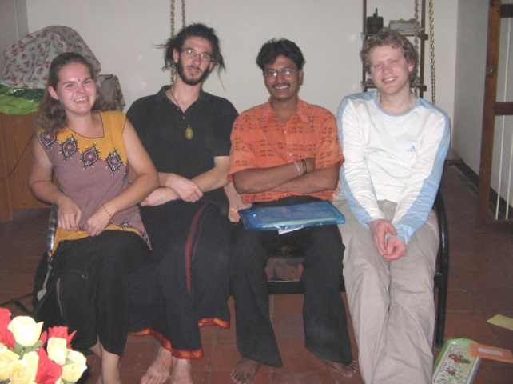
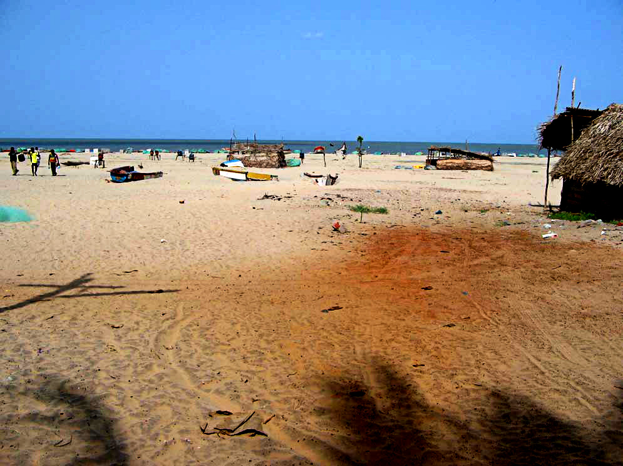
Part 1: Recalling the project
Idea born on December 27, 2004
Origins of Friend in Need : Created after the Tsunami of December 2004
To rehabilitate a fishing village in India significantly affected by the tsunami; and
Work towards ensuring economic and social security for the villagers,
through implementing a series of developmental projects;
in a Franco-Indian collaboration.
3
Notes:
3

Slide 4

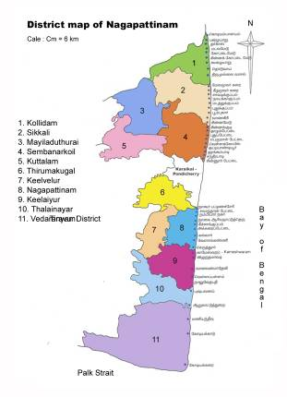
Where is Kameshwaram ? It is in the State of Tamil Nadu
In India along the Indian coast.
Physical features
Village in Nagapattinam district of Tamil Nadu
Isolated village (10 kms from Velankanni)
High-water table area
Heavy rain during the 3 months of the monsoon
Tsunami hit area
Demographic and economic features
5300 inhabitants – around 1450 families
Farmers, small-time fishermen, few traders & landless labourers
Farming and fishing based economy
Low productivity
No change in technology used since decades
Kameshwaram
Notes:
High-water table area: impossible to put pit latrines without polluting the ground-water
As people in the village are used to go for open defecation, during monsoon: flowing, mosquitoes and disease spreading
Tsunami hit area : fish market yard and fish solar dryer built by SCOPE : let’s see on Saturday.
Fishing community : 210 families

Slide 5
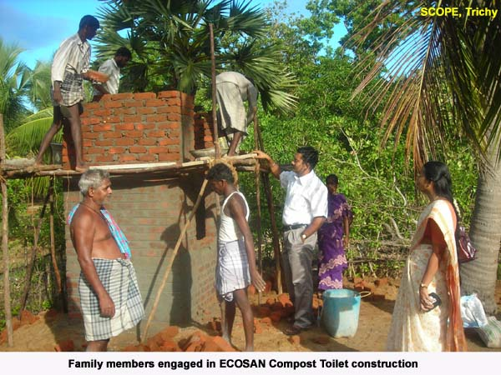
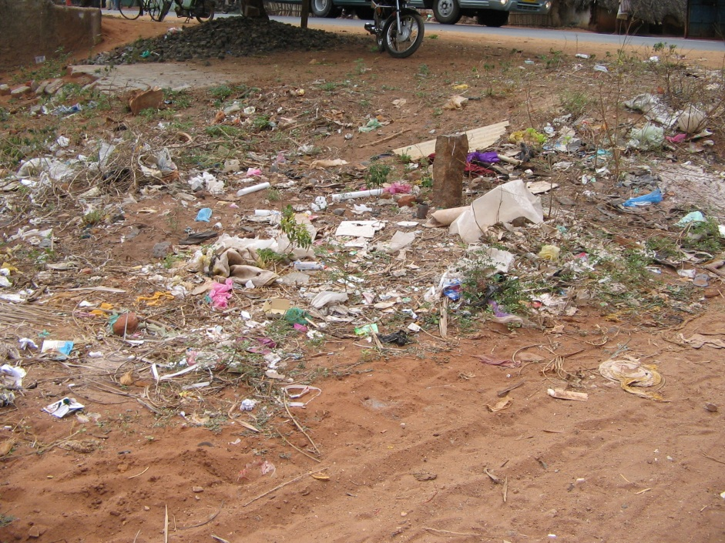

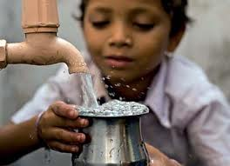
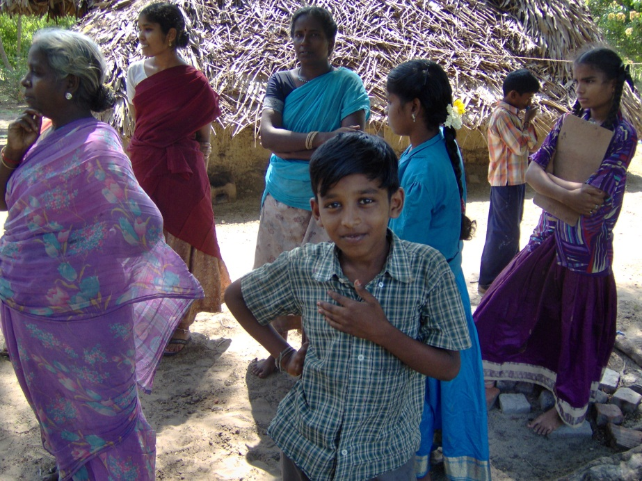
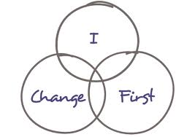
Evolution of objectives in 2006 for Kameshwaram
1
2
A clean village with decentralized solid waste management
A toilet for every home
3
Safe water
5
Documentation of costs and benefits and best practices. Free diffusion for maximum replication in other villages in India and the world.
4. Behavioural Change

Slide 6
Why toilets? Because lack of sanitation is a major challenge in rural India
Lack of individual household toilets in rural India: 67% of Indian rural households do not have access to functioning toilets and as a result they defecate wherever they can UNICEF (2012) .
More cell-phones and televisions than toilets: 53% of the total population of India of 1.2 billion has a cell phone; and 47% have a television set in their homes; but about 50% of the population (about 600 million people) still defecate in the open (Census, 2011)
Indian Government targets to make India open-defecation free by 2022: The ‘Nirmal Bharat Abhiyan’ (Pure India Campaign) programme was initiated in 2012.
The market for ‘toilet construction’ and ‘sanitation construction’ has developed: Incentives for the construction of toilets are provided by the government and large NGOs and micro-finance institutions (MFI) are very active as service providers.
Civil society is also involved: Friend in Need (India) and Association Un Ami (France) were founded by an academic to increase awareness and mobilise the student and academic communities to study the challenge of achieving complete sanitation coverage in rural India through action-research in Kameshwaram.
In addition to lack of toilets there are hundreds of abandoned toilets in India: For instance, Friend in Need (FIN) raised funds for the construction of toilets in Kameshwaram in the aftermath of the tsunami of December 2004. The main sponsors were UNICEF and WATER AID. Other large NGOs built the toilets. Due to bad construction and lack of adequate accompaniment, 60% of these toilets are in need of repair and lie abandoned.
Toilets can be used as an instrument for empowerment and development: Gaining access to a functional toilet empowers women and sanitation drives can be used to initiate waste management and bring about behavioural change in terms of hygiene.
Notes:
6

Slide 7
From 2005 to 2008 – Friend in Need basically acted as a financier raising funds for other NGOs to implement development projects
Lessons Learnt
Most NGOs building toilets overlook quality and effective maintenance of toilets.
To correct such mistakes, it is necessary to work more closely with NGOs from start to end.
For that we need local staff.
Hired 1 part time and 1 full time staff.
Donor funds from
families in France (mainly),
Europe, India and the USA
Use French
student volunteers
Give the funds to local NGOs active in construction of toilets
Generate Research;
Formulate project proposals;
Submit to local, national and international agencies for funding.
Generate funds from public agencies.

Slide 8
Then in 2009-2010 Friend in Need began to explore how to implement development projects itself.
Lessons Learnt
We have developed capabilities!
But we don’t have the critical mass of funds or personnel to undertake repairs of 350 decaying toilets.
There is an enormous socio-cultural mind-block against working on waste and toilets.
Households have got used to getting everything for free. Nobody wants to pay for anything.
Donor funds from
families in France (mainly),
Europe, India and the USA
Consultancy contracts to work with other bigger NGOs to create and circulate knowledge and information
Hire local staff
Use French students
Corrected all mistakes made by our former NGO partners except for massive repair of 350 toilets.
Developed networks within village;
Did a thorough study of the village;
Developed services of use for other NGOs.

Slide 9
Part 2 of the presentation
1.. Recalling the original project
2. Tackling the challenges in Kameshwaram (2011- 2012)

Slide 10

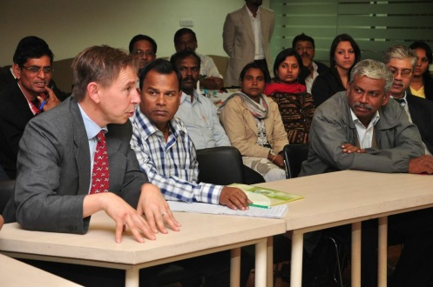
By 2010 it was clear that a number of installations that had been built by other NGOs, with funds that I had raised for the purpose for which they had been originally intended, were of poor quality or poor design.
There was no opportunism or dishonesty – simply poor planning, inefficient integration of beneficiaries, poor design – and the practice of NGOs to ‘tick boxes’ to prove completion of a project rather than work towards real, positive, sustainable, transformative change.
All the NGOs, which can be considered as service providing social enterprises, had left by this time and it was evident that a lot of things had to be put right. I was alone with Mr. Paranjothi as our sole staff, colleague and trusted friend.
At one point, I was so depressed that I decided
not to ask any of you or anyone for that matter, for funds
– till most of the mistakes were rectified. I started working
on consultancies on sanitation and ploughed the earnings
into Friend in Need to undertake the repairs
and support Mr. Paranjothi and other workers involved.
So that’s why I haven’t written any annual reports
or contacted anyone for funds during the last 1.5 years.
Many thanks to Valentin Post of WASTE (NL) for the research contracts

Slide 11

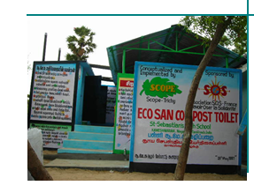
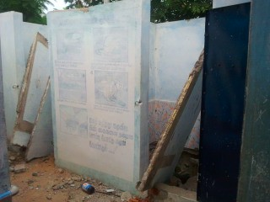
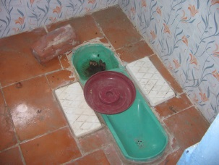
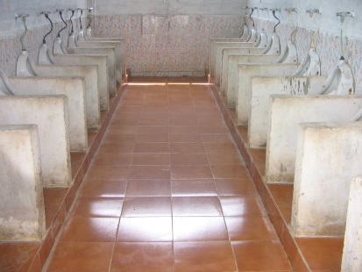
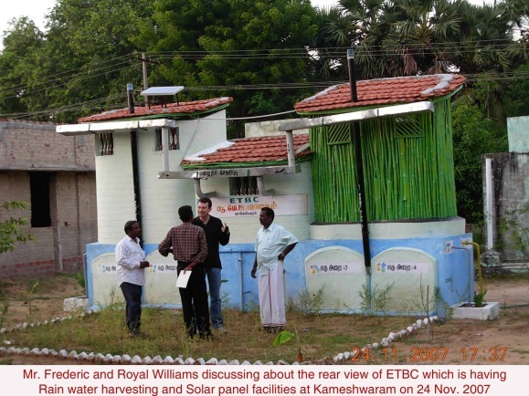
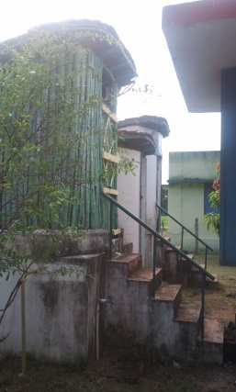
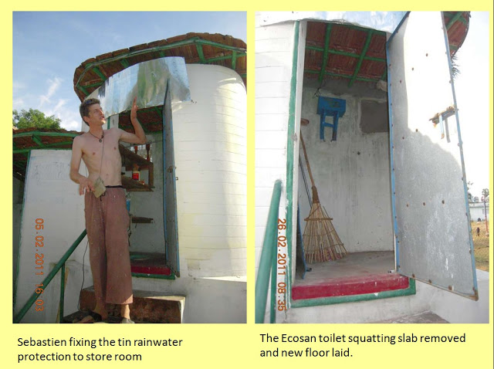
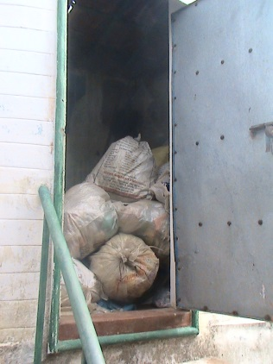
What we put right to the extent possible in 2011-2012…(1/3)
The full stories will be regularly posted on a blog during the coming year – details to follow
1
Not maintained – abandoned by 2009. Repairs undertaken by FIN
Ecological toilet complex built for Saint Sebastian school in 2006
FIN repairs all again in 2011 – and starts helping in maintenance as well.
School directors now willing to spend on maintenance of toilets but in 2012 they broke the ecological toilets to make them into conventional ones.
2
In 2007 we build a model ecological toilet complex on the premises of the village council.
By 2009 clear that nobody is using the model toilet and it is not being shown to anyone.
In 2011, Sebastien Gaumont, a visiting French tourist cleans and repairs it. We pay for the costs of repair. Now it is used to store our non-biodegradable waste.

Slide 12

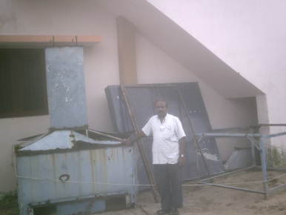
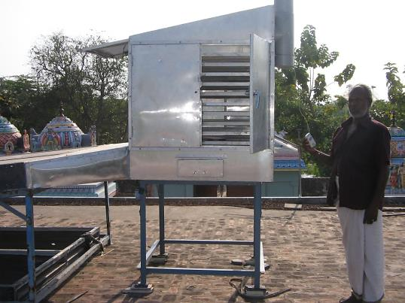
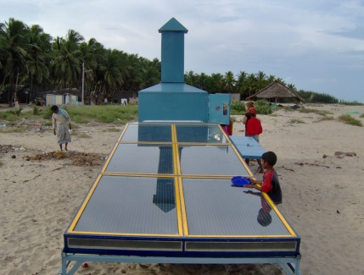
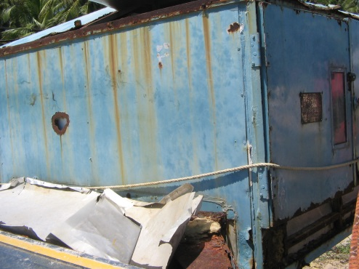
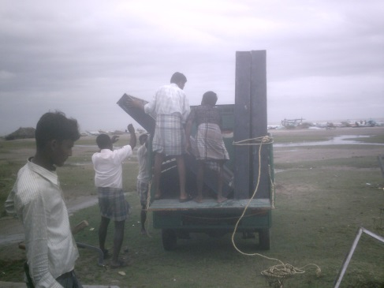
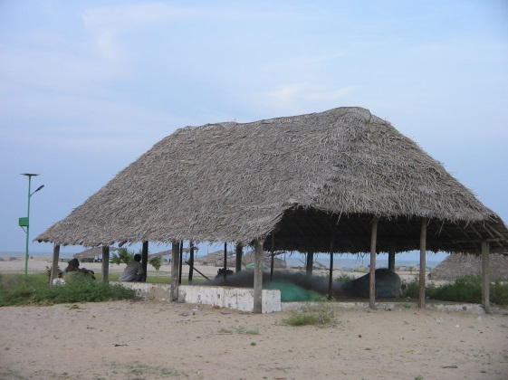
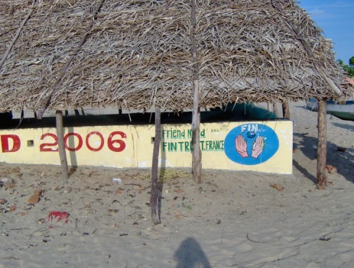
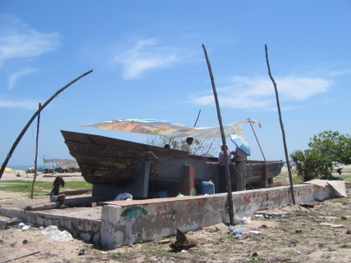
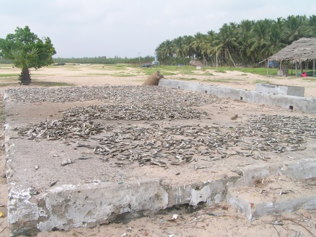
What we put right to the extent possible in 2011-2012…(2/3)
The full stories will be regularly posted on a blog during the coming year – details to follow
3
Dismantled and moved in 2010
Repaired and place on top of Vanjore temple in 2011 – where local unemployed youth dry flowers for perfuming oils
New solar drier in Kameshwaram beach in September 2006
Abandoned, broken, rusted, with essential parts stolen by 2009.
4
We discuss and work with the fishermen community to ensure that it is always intact even after storms through volunteers by 2010.
Fish market in September 2006
Roof blown away many times, sand surrounds platform, the wall breaks and market becomes a platform for repairing boats and drying fish by 2009

Slide 13
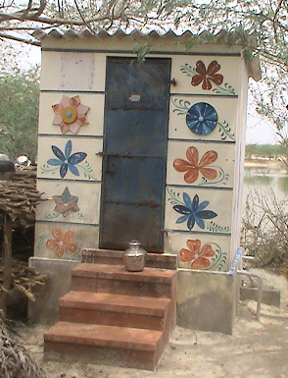

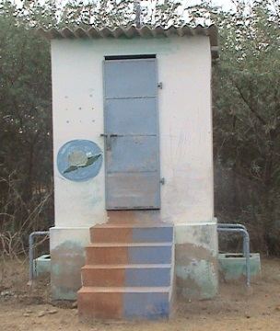
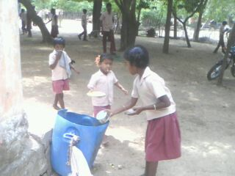
And we did some good things also and these I am proud to say that these are still working well …(2/3) – Why? Because we took care to ensure quality….because it was we who built them – we did not raise funds for another NGO to build them….
The full stories will be regularly posted on a blog during the coming year – details to follow
The toilets that we financed via a ‘Mason’s Innovation Contest’ in 2009, whereby masons were encouraged to build the toilets of their dreams for themselves are in good shape and still being used well in 2013.
The toilets that Paranjothi designed and supervised as a model toilet for the ‘Indian Bank’ in the nearby village of Vadagudy in 2010 is still in good condition and being used well.
- We have improved awareness of hygiene.
We have had a very modest but positive impact on behaviour – to throw into bins.
We have created a liking for good toilets among a few.

Slide 14
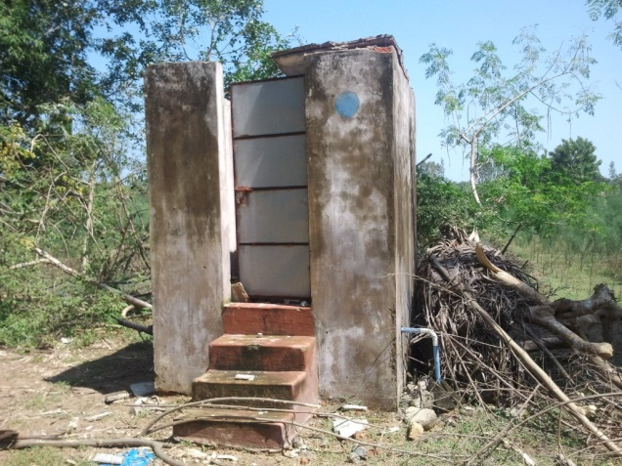
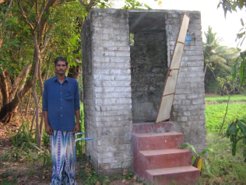
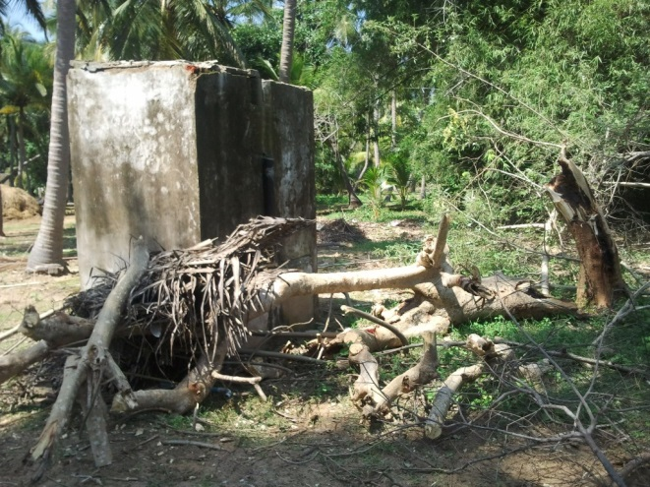
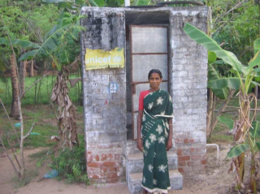
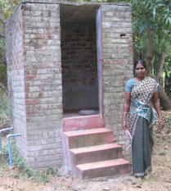
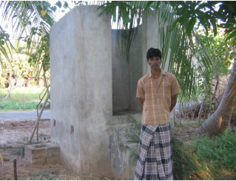
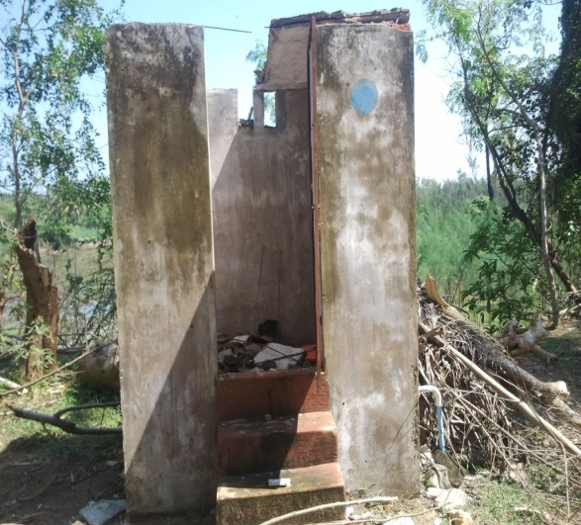
But the biggest challenge was that
toilets – an innovation introduced after the tsunami were being abandoned
because of : (i) lack of a repair agency; (ii) faulty construction; (iii) incomplete
construction; (iv) challenging weather conditions; (v) apathy.

Slide 15
So the biggest challenge was that toilets – an innovation introduced after the tsunami were being abandoned
Before 12/2004 Tsunami: Only a few septic tank toilets existed in Kameshwaram – (e.g. 1 septic tank toilet in Panchayat office and one in the house of the head of the Panchayat). After 12/2004 Tsunami: Many toilets have been constructed + Kameshwaram has won the ‘Nirmal Gram Puraskar award’ from Indian government for significant sanitation coverage. All toilets below have been constructed for nearly free.
Total: 675 toilets covering 43.93% of the households in the village | Year | Number of toilets completed
Drive 1 | 2006 | 150 Ecosan (Financier: UNICEF and FIN; Constructor: SCOPE)
Drive 2 | 2007 | 75 Ecosan (Financier: Student Association SOS of Grenoble school of Business and FIN; Constructor: SCOPE)
Drive 3 | 2008 | 100 Ecosan (Financier: Water Aid and FIN; Constructor: Gramalaya)
Drive 4 | 2008-2009 | 350 Septic tank toilets constructed by 2-3 Western religious organizations
But: About 200 of the existing toilets need to be repaired

Slide 16
Reasons for abandoning of toilets – not all at once – a dynamic process
3. No agency
to solve problem
1. Origins of problem
2. Toilet is seen as
being a problem
Toilet is abandoned
By some
Members of
family
Construction defect
Toilet stops
Functioning
properly
Loop
repeats
Lack of knowledge on
how to use
4. Bad toilet starts
Giving problem to
Neighbours -smell
Lack of willingness to
Use properly
Toilet becomes less
popular

Slide 17
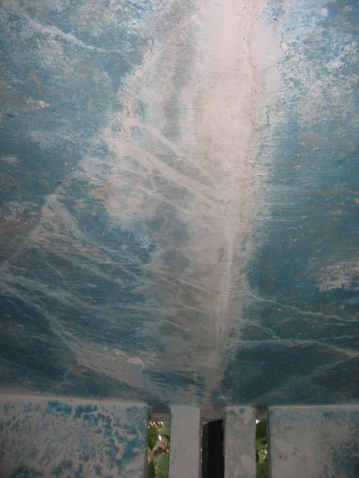
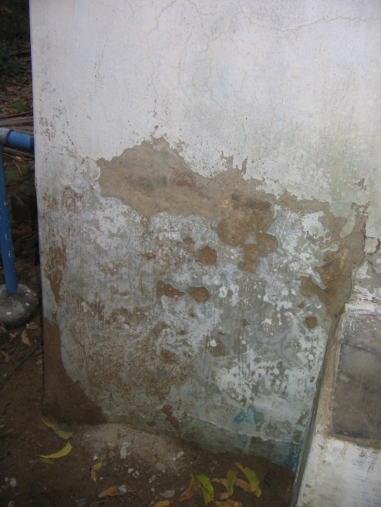
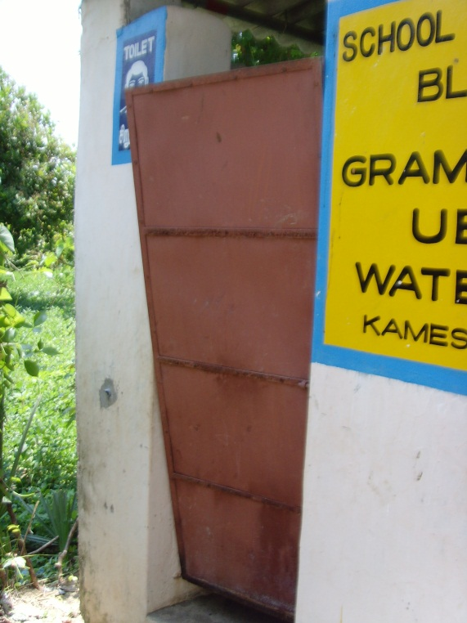
Common defects
Cracked celings
Peeling walls
Falling doors

Slide 18
1.4 Other contextual challenges in Kameshwaram
Unwillingness to pay for toilet repair & toilet construction: After the tsunami people got the toilets for free, during elections the politicians give out colour televisions, the government also gives financial aid for most essentials and so the villagers are willing to spend their disposable income only on ‘instant gratification giving goods’ like alcohol or ‘conscious consumption’ like costly weddings and family celebrations or education (of the boys mostly – but of course!) or motor bikes and cars….
Association of ‘social mobility’ with ‘non-ecological infrastructure’ – concrete, steel, plastic, toilets with attached pits that pass for septic tanks, internet purchases instead of with the village grocer , western toilets that are inappropriate, big cars…etc.
Social stigma associated with Ecological toilets: Ecological toilets need more maintenance and the compost formed needs to be emptied. Thus, though this is a very good model for high water table areas, without an agency for maintenance – this model is not popular.
Lack of rural artisans with technical knowledge: Any kind of manual work is considered ‘low brow’ – while desk jobs are coveted. There are no educational institutions ensuring artisanal skills such as plumbing, electrical work, masonry, pottery, weaving etc. So those in these professions enter it as a default option, learn on the job and do not have a solid conceptual understanding of their work.
Lack of a work culture of consistent work: All prefer to work when they need to or feel like - as temporary labour – and preferably for large companies with a big building with impressive array of computers, an office car and a front office.
Total lack of pride in their village – instead a shared culture of an inferiority complex.

Slide 19
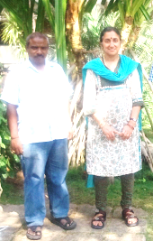
1.5 Finally – major Challenges within Friend in Need
Friend in Need had only two permanent staff till recently – Shyama in France and Paranjothi in Nagapattinam.
Paranjothi did all tasks , A to Z, starting with whatever was urgent first. On weekends he drove a taxi in 2012. No time management could be practised.
Shyama is a full time academic who works on FIN matters during the evenings and weekends. .
Paranjothi being a devoted colleague does NOT like to expose any problems in Kameshwaram to Shyama!
Shyama discovers all problems only when it is too late – but the sincerity of Paranjothi is always evident.
Paranjothi likes to help all people but intensely dislikes marketing a service or asking people for payments. Shyama is the same actually though she has to do it!
☹
Some major changes were necessary! A larger team – with expertise in marketing and funds raising! Team members who were willing to expose real problems as they occurred! Real masons and artisans! Someone who was willing to recruit locals – in short we needed a revolution ! Now see the next slide!!!

Slide 20

Part 3 of the presentation
1.. Recalling the original project
2. Tackling the challenge in Kameshwaram (2011- 2012)
3. The launching of FIN SWAM

Slide 21
The launching of FIN-SWAM
Sanitation, Waste And Management was born in July 2012!
(not sure of exact day though!)
Vision – To tackle the challenge of repairing 200 toilets
Create an agency SWAM – Sanitation, Waste And Management as a labor managed social enterprise.
Create qualified manpower that will provide SWAM services in Kameshwaram and nearby villages.
Develop standard environmentally sustainable designs of toilets.
Create new designs that make ecological toilets as attractive as those with septic tanks.
Waste Management: Collect waste from each of the beneficiary households; compost biodegradable waste and transport non-biodegradable waste to distributors for recycling companies in the nearby towns of Velankanni, Karaikal and Nagapattinam.

Slide 22
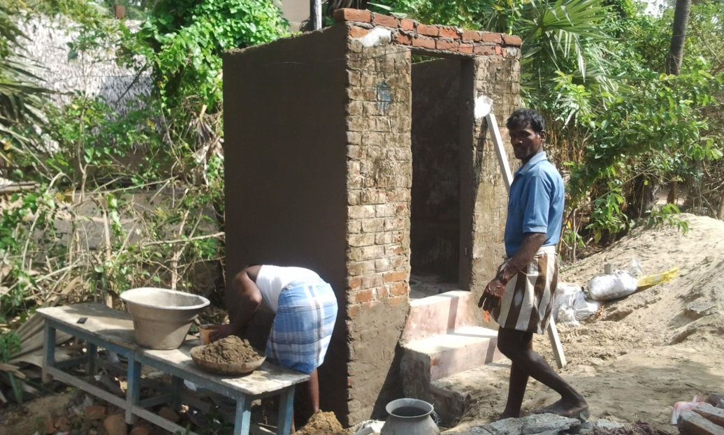
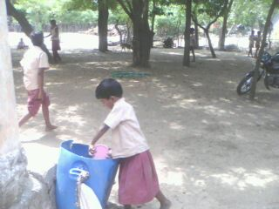
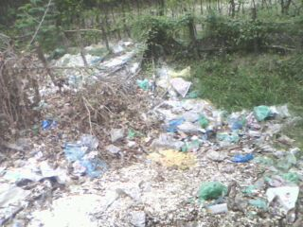

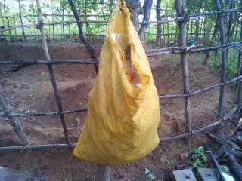
What are FIN-SWAM’s aims in terms of social impact in Kameshwaram?
Repair about 200 existing toilets and build 450 new ones – so that all have access to toilets
Change behaviour – induce young and old to throw litter into bins
Clean up open spaces where garbage is simply piled
Develop a waste management system compatible with local resources and skills

Slide 23
Friend in Need or FIN launches FIN-SWAM in July 2012
SWAM = Sanitation, Waste And Management
Our objective is to build local capabilities with locals to build and maintain toilets and implement waste management at a village level
Non-revenue generating activities
Positive transformational change
Livelihood of FIN staff
Activities of FIN in Kameshwaram
Revenue generating activities
FIN-SWAM Operating Model

Slide 24
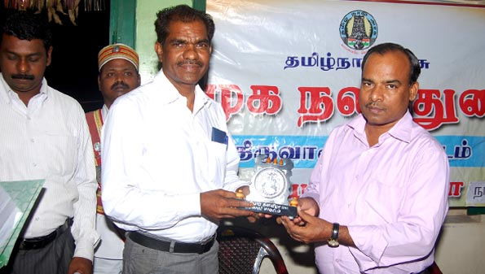
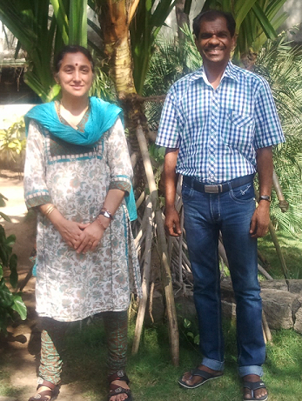
Expansion through collaboration with a micro-finance institution - BHARATHI
Skills Gap in FIN - Households Funds Mobilisation: No one with expertise on communicating with people to mobilize household funds towards investment in toilets.
I met Mr. Nagarajan, founder-director of the Bharathi, in a train ! Bharathi is a respected and renowned micro-finance institution based in a town called Thiruvarur near Kameshwaram,– and we talked and talked –and I told him how we just didn’t know how to mobilize funds from households towards toilets. Then he said he would help me – and indeed he has! Very much indeed!
http://bharathiwomen.org/micro.html
Mr. Nagarajan has kindly proposed the following:
His team of trained animators will mobilize funds from the households towards investment in toilets by providing them access to credit.
The FIN staff will facilitate the loans drive by accompanying the Bharathi team and organizing awareness campaigns and fairs.
He will train the FIN staff in basic time management, reporting and communication.

Slide 25

2.2 Raising funds through collaboration with a crowd funding start-up – United Donations
Skills Gap in FIN - FUND RAISING: I found it easier to work nights and weekends myself to earn money to support the staff and work at Kameshwaram rather than organize events to raise funds. I could not afford to pay any student or anyone else to help me raise funds. The support team was basically supporting me with small work from time to time. And I needed more funds than I could raise – we needed to expand. And I was becoming very tired from working all the time….
Well, I talk a lot and so a lot of people came to know of my problems. Then Dr. Akil Amiraly, who recently obtained his doctorate from the Ecole Polytechnique in Paris on water management introduced me to his colleagues/friends Sylvain and his wife Corine, who were about to create the crowd funding organization United Donations ………
http://www.uniteddonations.co/about/l-equipe
You can read about Corine and Sylvain from the link above. I found them to be very genuine and enthusiastic ! And I’m here to stay with them! They are supporting 10 projects in 8 countries and ours is one of them! We have 19 donors now and our target to increase that to 300 this year. I don’t believe in endless growth – but this target will make the project sustainable. Not aiming for more.
http://www.uniteddonations.co/

Slide 26








Support Team: FIN-SWAM will be supported by the existing “behind the scenes important people I count on” international team and some new members!
Raji Srikant: Financial administration on the Indian side , in Bangalore, India
Nico Rasters: Web master , in Maastricht, The Netherlands.
Christine Honore: Financial administration on the European side in Reims. France
S. Ganapathi, Auditor – auditing our accounts, in Karaikal, India.
Sandhya Thirunagari – Fundraising, in London, UK
Gaurav Balakrishnan, Writing, in Kolkota, India
Benjamin Lisan and other French friends to translate English into French.

Slide 27






Advisory Team: I have decided to have an advisory committee with whom I will be consulting 2-3 times a year! People with who have worked with me….
Timothée Fruhauf(USA) –
former FIN intern; now in Bill and Melinda Gates Foundation
Ajay Thutupalli (India and NL) - - my doctoral student at UNU-MERIT (Maastricht) who has come several times to the village.
Sangeeta Venkatesh (India) – Writer – Ecologist – Consultant - who’s supported me from the start!
Gita Balakrishnan (India) - Architect – Ethos - who’s supported me from the start!
Adam Walker (USA) – Young entrepreneur, who adopted me as a mentor! But I think I need his practical insight too!
Tamás Medovarszki (Hungary) – former FIN intern – now in Schiedner Consultancy

Slide 28
4. Our first results….

Slide 29
Challenges and Milestones since September 2012
 |  |  |  |  |  | Office is more organized. Routines are developed. First payments from waste collection obtained. Second round of toilet repairs occurs.
 |  |  |  | Waste management program is started. Karunanidhi not motivated. First toilet repairs occurs. |  | Mr. Shakthivel – a mason comes and leaves | Mr. Kanagarajan gets us Mr. Selvakumar.
 |  |  |  | Chance meeting with Mr.Nagarajan of Bharathi NGO. | Collaboration with Bharathi takes shape. Mr. Nagarjan gets us Mr. Kanagarajan. | Bharathi team is introduced to Kameshwaram. | Bharathi gives loans to 23 residents for sanitation and other household investment.
Start with our first recruit Shakthivel - it does not work. Look for office - but we do not find. Find it very difficult to persuade households to invest in toilet construction. |  |  | Mr. Paranjothi finds an office. He also recruits Mr. Vijaya Kumar for office maintenance and Karunanidhi for waste management.
1 October 2012 | November | December | 1 January 2013 | February | March | April | May

Slide 30

How our collaborators have helped us – many thanks to them!
The Bharathi team have mobilised funds from 23 households in 2 months.
They are very efficient communicators!
We have 19 donors and this gives us 19*6=114 € = 7900 INR! This is a big help – as it pays for mason’s helper*! Our target in 2013 – bring this to 300!
*A mason’s wage is 500-700 INR per day.

Slide 31









Present activities
Garbage collection from households and organizations
Social impact creating but not revenue generating
Revenue generating
Presently offering free labour for toilet construction and repair
Transport for 2 days a week
Cleaning up public spaces – first target: the bus stop outside the office.
Selling the non-biodegradable waste to distributors

Slide 32


Our team.
We are a core team of six people.
Below:
Shyama V. Ramani, Professor, who splits her time between Paris, London, and India.
Above - left to right in Kameshwaram : Paranjothi, Karunanidhi, Vijayakumar, Selvakumar and Kanagarajan.

Slide 33





Our office.
Our office is a large room above a grocery store in Kameshwaram.

Slide 34






Division of work between FIN-SWAM members
Paranjothi is in charge of:
- Administration of finance;
- Office supplies and maintenance;
- Maintenance of old projects;
- Transport services.
Karunanidhi is in charge of:
- Waste collection;
- Waste management;
- Inducing behavioural change;
- Waste management accounts;
Shyama V. Ramani is in charge of:
- Fund raising for salaries of others;
- Project development , accompaniment and coaching;
- Communicating about project to the outside world.
Kanagarajan:
Communications with
decision makers and villagers;
- Documentation;
- Inducing behavioural change.
Selvakumar is in charge of:
- Construction and repair of toilets;
- Promotion of environmentally
friendly technologies;
- Accounts related to construction.
Vijaya Kumar is in charge of:
- Office maintenance;
- Maintaining attendance
registers and monitoring progress;
- Receiving visitors.
**He is a stroke survivor and partially
paralyzed.

Slide 35







A typical week – everyone has to do all types of work – multi-tasking removes social stigma associated with waste management
Waste management
Discussions in
village
Writing
Transport
Telephone
team member
Team meeting via
Telephone
Toilet
construction
 | Mon | Tue | Wed | Thurs | Friday | Saturday
Paranjothi | transport | construction | Waste collection | Office admin | transport | Team meeting
Kanagarajan | Writing, discussion | Writing, discussion | Writing, discussion | construction | Waste collection | Team meeting
Vijaya Kumar | Office admin | Office admin | Office admin | Office admin | Office admin | Team meeting
Karunanidhi | Construction | Waste collection | construction | Waste collection | construction | Team meeting
Selvakumar | construction | Construction discussion | construction | construction Waste collect. | construction | Team meeting
Shyama | telephone | write | telephone | write | write | Team meeting

Slide 36
Toilet construction – before Bharathi joined us…from January – April 2013
 | grant from FIN | Household investment | FIN team involved | Time period | What was done | Type of toilet
Karunanidhi and Santhi | 3385 | 3600 | sakthivel + Paranjothi | completed in April | cement coating, pipe repair, roof repair , painting | Ecosan
Venkatachalam | 3200 | 3150 | Paranjothi + last touches sakthivel | Completed in March | roof coats, new pipes, cement coating with touch up, white paint, door grey colour | Ecosan
Ilango Muthulakshmi | 1000 |  | Sakthivel | March | incomplete - household has to give materials | septic tank
Dhanalaksmi | 2000 |  | Sakthivel | March-April | incomplete - household has to give materials | septic tank

Slide 37




Santhi and Karunanidhi – Our first ecosan repair project ambassadors!
Santhi and Karunanidhi are young farmers who had loved the ecological toilet and used the compost. But then it fell into disrepair. And they did not know how to repair it. Theirs was the first toilet we repaired. Now the asbestos roof has been replaced by a metal sheet. They found it difficult to climb the steps. So Paranjothi had the idea of putting more sand all around and thereby increasing the height – so instead of 3 steps – now they have only one step!
Falling apart/ cracked roof by 2010

Slide 38
Toilet construction so far – The first 23 households with Bharathi loans
1 | Vijaya
2 | Anjulam
3 | Revathi
4 | Sophia | Materials have been bought by the household
5 | Yogeshwari | Materials have been bought by the household
6 | Thenmuzhi
7 | Indira
8 | Kelvithi
9 | Vanita
10 | Jaya
11 | Saranya
12 | Aishvari
13 | Kalaka selvi | Materials have been bought by the household
14 | Deepa | FINISHED WITH FIN LABOUR
15 | Kanthivathi
16 | Vasantha
17 | RajKumari
18 | Kannaki
19 | Mahalakshmi | FINISHED WITH FIN LABOUR
20 | Usha | Finished toilet without FIN labour
21 | Maheshwari | Finished toilet without FIN labour
22 | Sindhiya | Finished toilet without FIN labour
23 | Kamali | Finished toilet without FIN labour
In May, 2013

Slide 39
Revenue from waste management so far in Indian Rupees
 | Jan | feb | March | April | May | Total revenue
garbage
Revenue from sales of non-biodegradable garbage |  | 86 | 0 | 0 |  | 86
How many registered | 22 | 22 | 22 | 22 | 36
How many have to pay (i.e. have passed their trial period) | 0 | 0 | 22 | 22 | 22
How many people paid | 0 | 0 | 16 | 8 | 10
Payment for waste collection | Free | Free | 480 | 240 | 300 | 1020
Grand total |  |  |  |  |  | 1106
**Every household has to pay Rs 30 per month for waste collection.

Slide 40

Revenue from the car
 | March | April | May | Total revenue
Car net revenue generation | -1900 | -1500 | 500 | -2900
Number of people transported in Kameshwaram | 4 | 4 | 7
In October 2011, Paranjothi – my sole permanent staff between 2006 and 2013, felt confident enough to purchase a car by taking a loan. His plan was to drive it during the weekend and rent it out during the week to generate extra earnings for his family. Paranjothi was not able to pay the loan interest with his weekend earnings. Hence, we are helping him out and serving Kameshwaram residents at the same time by letting him provide transport in Kameshwaram twice a week.

Slide 41
Our expenditures
Jan-May | Debit | Nature of expenditure | Comment
Shanthi/Karunanidhi | 3385 | Grant to household for toilet construction | This is prior to Bharathi
Venkatachalam | 3200 | Grant to household for toilet construction
Muthulakshmi Ilangovan | 1000 | Grant to household for toilet construction
Dhanalakshmi Papayan | 1000 | Grant to household for toilet construction | working
Meeting to present Bharathi and loan schemes in April | 4805
Masons - for temporary work | 7500
Karunanidhi -April | 3000
Vijaya kumar - April | 3000
Office + electricity | 1800
Office materials | 3140
Train tickets to look over toilet of handicapped couple | 1700
Office board | 1100
Car for waste management | 200
Telephone bill | 1400
Chukkalingam | 2900
Stationary | 80
Aarani trip | 1069
welding of bed | 300
Bharathi honorarium | 8000
Lunches Bharathi | 500
 | 49079
Fixed costs per month: salaries, infrastructure and materials
Paranjothi | 8,000
Vijaya kumar | 3000
Karunanidhi | 8000
Selvakumar (mason) | 10,000
Kanagrajan | 8000
Rent | 1500
Electricity | 300
Budget for other office supplies per month (maximum) | 1000
Total fixed costs | 39,400
Salaries in blue. All are in Indian Rupees or INR.

Slide 42
These results may not seem impressive – but they are indeed truthful and impressive given the contextual challenges, the nature of the work and the culture of empowerment with responsibility, transparency and accountability that I am trying to develop.
5. Now to the future……

Slide 43




Our social impact targets for the next 7 months
June to December 2013 = 7 months
Toilet repair: Repair about 50 toilets
Toilet quality control : Develop a certification for the quality of toilets
Awareness creation: Hold one meeting a month in FIN office
Awareness creation: Give one talk a week at the school
Waste management: Have at least 300 people registered and paying for waste management.
Waste management: Have developed a system to maintain the public space near bus-stop clean.
Capacity building: Sending FIN team for 1 week training in toilet construction, sending FIN team for 3 day training in waste management, making sure that all know how to use printer to photocopy documents, making sure that all know how to send and receive emails. Develop use of a phone system with mike and speakers for weekly meeting. Explore the use of skype – it will depend on network strength. Ensure that all can present the mission of FIN-SWAM well.
Transportation : Get to transporting between 35-45 Kameshwaram residents per month.
Computer browsing centre: Start it in FIN office

Slide 44


Our fundraising targets for the next 7 months
 | June to December 2013 = 7 months
 | Credit in Euros | Costs in INR | Credit in INR
Fixed costs (50,000 INR per month) |  | 245000
Variable costs for training and collaboration |  | 100000
Awareness meetings |  | 40000
Visits by experts |  | 50000
Crowd-funding through United Donations (19 people @ 6 euros per month) | 798 |  | 55860
Association Un-Ami (guardian angels) | 2000 |  | 140000
Target 100 more crowd-funders | 4200 |  | 294000
Raising funds from revenue generation activities of FIN (1000 Rs minimum over 7 months) |  |  | 7000
Total |  | 435000 | 496860

Slide 45



Future revenue generating activities we would like to try to develop
Computer browsing centre
Toilet maintenance
Photocopying using printer
Contracts to clean public spaces from village council

Slide 46




What we would like to do if we had more money…..our wish list….
Recruit one more person for waste management and toilet construction
Send our masons for training
Send our staff on training on composting
Get some experts to come to the village site
Build some more model toilets
Engage unemployed youth in cleaning up public spaces

Slide 47


Why I am continuing despite the very slow progress...
It is a wonderful to be engaged in bringing about positive transformative changes – it has led me to levels of self-discovery and depths of thinking that I never thought possible – and helped me to identify my values explicitly and act consciously according to them.
I am now committed to developing a social enterprise that mirrors the values I believe in: non-violence, tolerance, respect, empowerment and sustainable development.
It has had a deep and positive effect on my research and helped me to understand the value-added as well as limitations of economic theory for development practice.
Last but certainly not least - I had promised my father (who is no more) that I would not quit till every one in Kameshwaram had a toilet and it was as clean as any village in Europe. This promise hasn’t been fulfilled yet - indeed it is very challenging but I can’t stop now ….the future looks brighter and very interesting to plunge into!

Slide 48



And it’s FUN : Pictures from the FINISH conference where friends of the sanitation circle (!) organized a birthday surprise for me in the middle of the conference! Doing good things generates joy –doesn’t it ? Thanks for your help ! Shyama
www.finish.com

Slide 49




How you can support us – Thank you for your consideration!
If you can write, translate (English to Tamil / English to French) , do research, document, build toilets, make things from waste, compost waste, take care of stray dogs (all over the village), teach people who are technologically challenged to use a computer, organise fund raising events or teach first aid for snake bites – then write to Shyama at
shyama_ramani@yahoo.com
2. If you can make a monthly donation of 6.60€ = 8.80$ = 5.61£ - Please go the website of our crowd funding sponsors United Donations founded by academics Corine and Sylvain, and support the project ‘Sanitation Change Makers’
http://www.uniteddonations.co/
Those within India can send cheques and those outside India are requested to use the pay-pal option. THANK YOU!
2. If you can make a one shot donation for the year - Please go to our website http://www.friend-in-need.org/donate.htm

Slide 50

CONCLUSION
A very sincere thanks to all who are supporting us.
Your help will facilitate the Friend in Need team in Kameshwaram to make this village as clean as any in the world and eliminate open defecation in the village.

