Slide 1
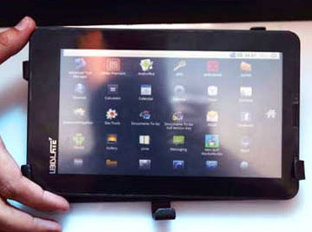
Presentation on Aakash tablet

Slide 2
Contents
Introduction to tablet pc’s.
Introduction to world’s cheapest tablet(Aakash).
Configurations of Aakash
Price of Aakash tablet
Pros and cons of Aakash

Slide 3
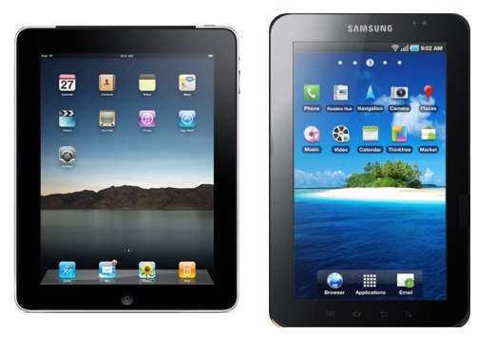
Tablet pc’s
A tablet personal computer or tablet PC is a tablet-sized computer that also has the key features of a full-size personal computer.

Slide 4
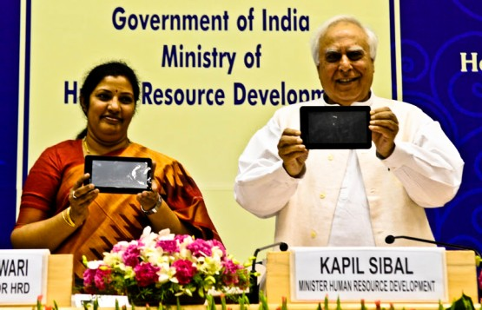
Aakash tablet
Aakash is the new name of India's aspiration to produce an Indian computing device. Announced by the MHRD on July 22, 2010 as "Sakshaat", it was launched in New Delhi on Oct 5, 2011.
Mr. kapil sibil (HRD minister) launched aakash tablet in India on 5th oct,2011. It is the world’s cheapest tablet ever made and launched.

Slide 5
Configurations
Hardware
7-inch 800x480 resistive touch screen
Rugged casing with a rubberized feel
Wi-Fi enabled (802.11 a/b/g Wi-Fi)
Mini and full USB
miniSD card slot
Subscriber Identity Module (SIM card) slot (UbiSlate 7 only)
Video out
Headphone jack
256MB of RAM
2 GB of storage memory. 32 GB Expandable Micro sd.
2 Watts of power consumption with solar charging option
366 MHz + HD video co-processor
HDMI port.
Audio out: 3.5mm jack / Audio in: 3.5mm jack
Display and Resolution: 7” display with 800x480 pixel resolution

Slide 6
Contd...
Software
Android froyo 2.2 operating system
Document Rendering
Supported Document formats: DOC, DOCX, PPT, PPTX, XLS, XLSX, ODT, ODP
Educational software developed at Indian Institute of Technology
Web browsing, video conferencing and word processing software
PDF viewer, Text editor
Multimedia and Image Display
Image viewer supported formats: PNG, JPG, BMP and GIF
Supported audio formats: MP3, AAC, AC3, WAV, WMA
Supported video formats: MPEG2, MPEG4, AVI, FLV
Communication and Internet
Web browser – Standards Compliance: xHTML 1.1 compliant, JavaScript 1.8 compliant
Separate application for online YouTube video
Safety and other standards compliance
CE certification / RoHS certification
150000+ applications

Slide 7
Aakash(price)
The Government of India purchased 100,000 units of the device at $50 each and will be subsidizing it to sell it at the originally promised price of $35. The tablet is expected to be sold for $60 for retail consumers.
The price in India for the tablet is going to be somewhere around 3000.
It will be provided to the students at an affordable price of 1125 Rs only.

Slide 8
Pros and cons of Aakash

Slide 9
Thanks for the cooperation

