Slide 1
Presenter:-
Pradeep Singha
Day
To
Day Current Affairs
AAkash Tablet

Slide 2

Introduction
The Aakash is an Android tablet computer jointly developed by the London-based company DataWind with the Indian Institute of Technology Rajasthan and manufactured by the India-based company Quad, at a new production centre in Hyderabad— under a trial run of 100,000 units.
The tablet was officially launched as the Aakash in New Delhi on Oct 5, 2011. A substantially upgraded second generation model called Aakash-2 is projected for manufacture beginning in early 2012.
Earlier it was referred to as the Sakshat table. Later the name has been changed as Aakash. The word Aakash has been derived from the Sanskrit word Akasha which means "aasman" in Hindi.

Slide 3
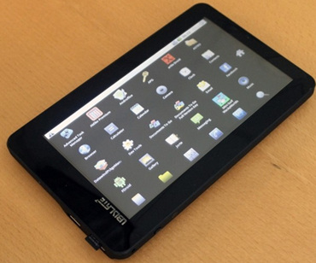
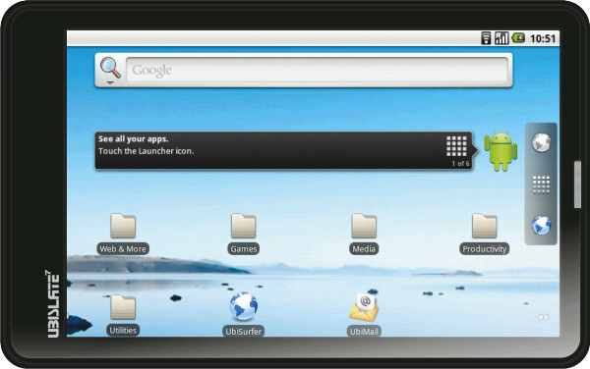
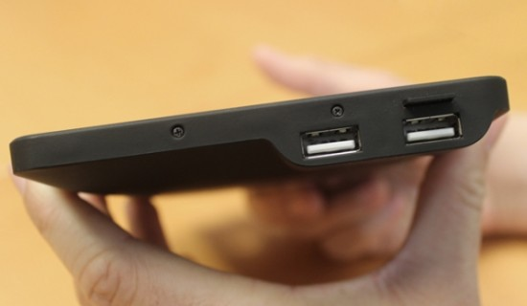
Have A Look……

Slide 4
Specifications of Aakash Tab
The Aakash features an overall size of 190.5 x 118.5 x 15.7mm with a 7” resistive screen, a weight of 350gms and using the Android 2.2 operating system with access to the proprietary marketplace Getjar (not the Android marketplace), developed by DataWind.
Specifications | Aakash | UbiSlate 7+
Price | Rs.2,500 | Rs.2,999
Central Processor speed | Arm11 – 366Mhz | Cortex A8 – 700 Mhz
Random Access Memory (RAM) | 256 MB RAM | 256 MB RAM
Battery | 2100 mAh | 3200 mAh
OS | Android 2.2 Froyo | Android 2.3 Gingerbread
Network | WiFi | WiFi & GPRS Phone network
Made in | India | Taiwan

Slide 5
Contd….
The processor is 366 MHz with Graphics Accelerator and HD Video Co-processor and the tablet features 256 MB RAM, a Micros SD slot with a 2GB Micro SD card (expandable to 32GB), two full-size USB ports, a 2100mAh battery, Wi-fi capability, a browser developed by DataWind, an internal cellular and Subscriber Identity Module (SIM) modem, using a power consumption of 2 watts with a solar charging option. The device features 3.5mm audio output and input jack.
The Aakash is designed to support various document (DOC, DOCX, PPT, PPTX, XLS, XLSX, ODT, ODP,PDF), image (PNG, JPG, BMP and GIF), audio (MP3, AAC, AC3, WAV, WMA) and video (MPEG2, MPEG4, AVI, FLV) formats and includes an application for access to YouTube video content.

Slide 6
Storage: Both tablets will have a micro-SD slot, and a 2GB micro-SD flash memory card, upgradable to 32GB. This is the storage for documents, photos, music, videos, etc. Used in Android devices, it is also a good substitute for USB flash memory drive.
Memory: ROM is a device's main memory, and is unannounced by Datawind, estimated to be the same ammount: 256MB. RAM is the secondary memory. It is used to run the Operating System and it's applications.Both tablets do have graphics processing card(GPU).
Google Android Market: Aakash-1 has too little processing power and no SIM card, therefore no access to Google's Android Market. It will have to suffice with GetJar Marketplace.
Network: Aakash-1 does not have Direct Internet connection, it only has a Wireless Local-Area Network(WiFi).
Browser:
Theoretically, if we assume a base speed of 5KB/s, that means already-compressed files(ZIP files, JPEG images, MP3 audio, MPEG video) will transmit at the 5KBps normal speed, uncompressed files at 15KBps (3x base speed), and pure text files at 30KBps (6x base speed).

Slide 7
Latest Updates Of Aakash Tab
Aakash Tablet reaches 14 Lakh Bookings in 14 days!!!
→ Aakash Tablet’s Upgraded Version, Ubislate 7, sold out till February. Prebooking open for March.
→ Datawind, which produces Aakash Tablet, is planning to set up two more factories in Cochin and Noida to meet the demand.
→ Aakash Tablet, available for sale online on December 15, was supposed to be delivered within a week of its booking.

Slide 8
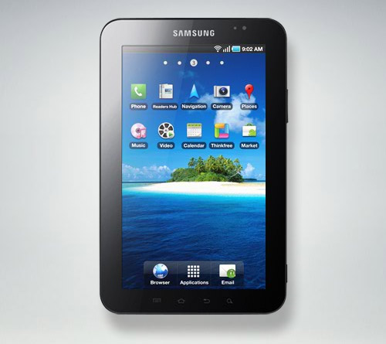
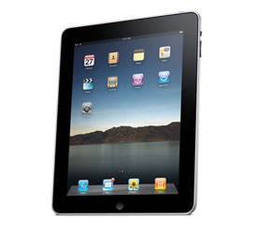
Sales Booking
1. Samsung Galaxy TAB:-
Price:- Rs.31,830
No of Unit sold:- 1 Million within 60 days
2. Apple I-PAD:-
Price:- Rs.29,500
No of Unit Sold:- 1 Million within 28 Days

Slide 9
AAKASH TAB:-
Price:- Rs.2500 only
No of units booked:- 1.4 million units within 14 days

Slide 10
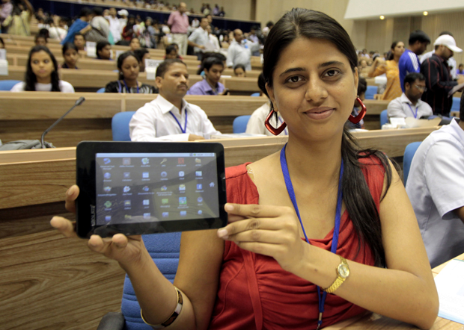
www.ubislate.com

Slide 11
Thank you……

