Slide 2
Computer Networking Infrastructure for dummies…
and school principals
Eric D. Wright
EDAD 685
Coastal Carolina University
Fall 2010

Slide 3
What is a Network?
A network consists of two or more computers that are linked in order to share resources, exchange files, or allow electronic communications.
The computers on a network may be linked through cables, telephone lines, radio waves, satellites, or infrared light beams.

Slide 4
The two basic types of networks include:
Wide Area Network (WAN)
Local Area Network (LAN)

Slide 5
WIDE AREA NETWORKS:
Wide Area Networks (WANs) connect large geographic areas, such as Florida, the United States, or the world.
Dedicated transoceanic cabling or satellite uplinks may be used to connect this type of network.

Slide 6
LOCAL AREA NETWORKS:
A Local Area Network (LAN) is a network that is confined to a relatively small area.
It is generally limited to a geographic area such as a writing lab, school, or building.
Rarely are LAN computers more than a mile apart.

Slide 7
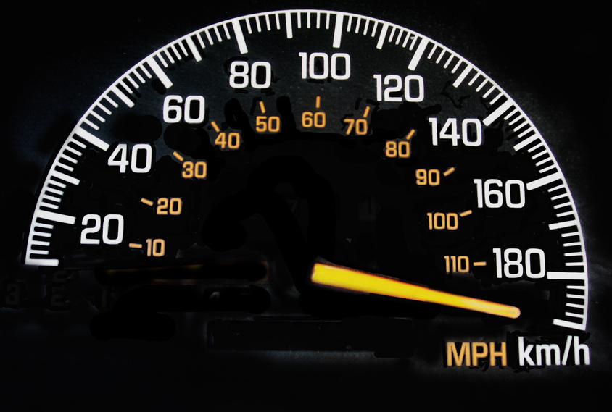
Advantages of a
School Network: Speed
Networks provide a very rapid method for sharing and transferring files.
Without a network, files are shared by copying them to memory cards or discs, then carrying or sending the discs from one computer to another.

Slide 8

Advantages of a
School Network: Cost
Networkable versions of many popular software programs are available at considerable savings when compared to buying individually licensed copies.

Slide 9

Advantages of a School Network: Resource Sharing
Most schools cannot afford enough laser printers, fax machines, modems, scanners, and CD players for each computer.
If these or similar peripherals are added to a network, they can be shared by many users.

Slide 10

Advantages of a School
Network: Flexible Access
School networks allow students to access their files from computers throughout the school.
Students can begin an assignment in their classroom, save part of it on a public access area of the network, then go to the media center after school to finish their work.
Students can also work cooperatively through the network.

Slide 11

Advantages of a School Network:
Workgroup Computing
Collaborative software allows many users to work on a document or project concurrently.
For example, educators located at various schools within a county could simultaneously contribute their ideas about new curriculum standards to the same document, spreadsheets, or website.

Slide 12

Disadvantages of a
School Network: Expense
Although a network will generally save money over time, the initial costs of installation can be prohibitive.
Cables, network cards, routers, and software are expensive, and the installation may require the services of a technician.

Slide 13
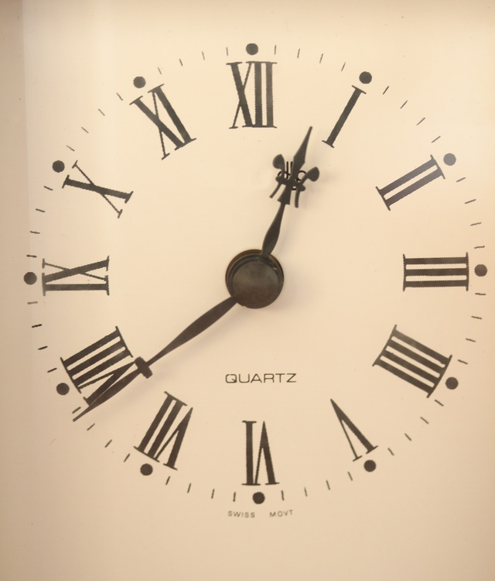
Disadvantages of a
Network: Time and Support
Proper maintenance of a network requires considerable time and expertise.
Many schools have installed a network, only to find that they did not budget for the necessary administrative support.

Slide 14
Disadvantages of a
School Network:
File Server May Fail
When the file server "goes down," the entire network may come to a halt.
When this happens, the entire school may lose access to necessary programs and files.

Slide 15
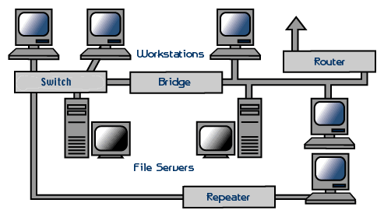
A TYPICAL SCHOOL NETWORK:

Slide 16
Parts of a School
Network: File Server
A file server is a very fast computer with a large amount of RAM and storage space, along with a fast network interface card.
The network operating system software resides on this computer, along with any software applications and data files that need to be shared.

Slide 17
Parts of a School
Network: File Server
The file server controls the communication of information between the nodes on a network.
For example, it may be asked to send a word processor program to one workstation, receive a database file from another workstation, and store an e-mail message during the same time period.
This requires a computer that can store a lot of information and share it very quickly.

Slide 18
Parts of a School
Network: Workstations
A typical workstation is a computer that is configured with a network interface card, networking software, and the appropriate cables.
Workstations do not necessarily need floppy disk drives because files can be saved on the file server.

Slide 19
Parts of a School Network:
Since a signal loses strength as it passes along a cable, it is often necessary to boost the signal with a device called a repeater.
The repeater electrically amplifies the signal it receives and rebroadcasts it.

Slide 20
Parts of a School Network:
Repeaters can be separate devices or they can be incorporated into a concentrator.
They are used when the total length of your network cable exceeds the standards set for the type of cable being used.

Slide 21
Parts of a School Network:
Bridges and Routers—Bridges and routers have the same basic purpose. Bridges and routers manage the traffic to maintain optimum performance on both sides of the network.
You might say that the bridges and routers are like a traffic cop at a busy intersection during rush hour. They keep information flowing on both sides of the network, but they do not allow unnecessary traffic through.

Slide 22
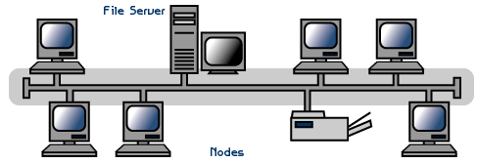
Topology: Linear Bus
A linear bus topology consists of a main run of cable with a terminator at each end.
All nodes (file server, workstations, and peripherals) are connected to the linear cable.

Slide 23
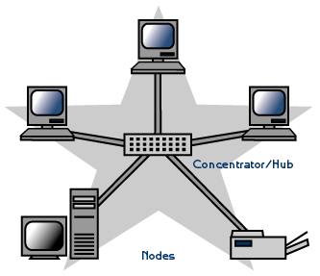
Topology: Star
A star topology is designed with each node (file server, workstations, and peripherals) connected directly to a central network hub, switch, or concentrator.

Slide 24
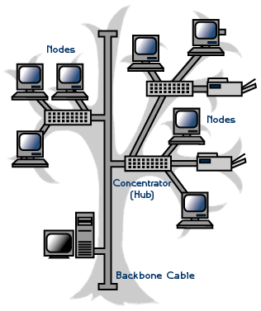
Topology: Tree or Expanded Star
A tree topology combines characteristics of linear bus and star topologies.
It consists of groups of star-configured workstations connected to a linear bus backbone cable.
Tree topologies allow for the expansion of an existing network, and enable schools to configure a network to meet their needs.

Slide 25

Wireless LANs
Wireless LANs use high frequency radio signals, infrared light beams, or lasers to communicate between the workstations and the file server or hubs.
Each workstation and file server on a wireless network has some sort of transceiver/antenna to send and receive the data. Information is relayed between transceivers as if they were physically connected.

Slide 26
Advantages of Wireless:
Mobility - With a laptop computer or mobile device, access can be available throughout the entire school.
Fast setup - If your computer has a wireless adapter, locating a wireless network can be as simple as clicking "Connect to a Network.“
Expandability - Adding new computers to a wireless network is as easy as turning the computer on (as long as you do not exceed the maximum number of devices).

Slide 27
Disadvantages of Wireless:
Security - Wireless networks are much more susceptible to unauthorized use. If you set up a wireless network, be sure to include maximum security.
Inconsistent connections - Wireless connections are not nearly as stable as those through a dedicated cable.
Speed - The transmission speed of wireless networks is improving; however, faster options are available via cables. If you set up a wireless network and you are connecting to the Internet via a modem, your wireless access to the Internet will have the same connection speed as the modem.

Slide 28
The bottom line…
It is important for principals and other school officials to have a basic understanding of the computer network in their building.
Disruptions in service can cause all kinds of problems from taking attendance to administering MAP testing.
If problems occur, often times we can solve the problem quickly if we have a basic working knowledge of the system.
Schools use computer networks more and more every day and keeping them running should be a top priority for all school officials.

Slide 29
REFERENCE:
http://fcit.usf.edu/network/default.htm
Eric D. Wright
Fall 2010

