Slide 1

BMC Control-M 8
The Power of Simple

Slide 2
BMC Control-M 8 Primary Goals
Enable users to accomplish tasks quicker with less training
  Single UI
  Simplify (streamline) high-frequency activities
  Extend collaboration
  Consistency across all “domains”
Preserve ALL core capabilities to maintain comfort level for existing users
Evolve User Interface using modern technology
  Windows Presentation Foundation
  Vibrant colors, icons
Reduce the overall TCO of the solution
  Increased processing throughput reduces hardware footprint
  Quicker and simpler installation and deployment options
Notes:
Do more, more quickly, with less training!
Single UI.
Login dialog with multiple environments
Planning, Monitoring, History, Forecast, Tools
Each domain has a “Home” with info about work in progress or available functions/views
Consistent layouts. Describe panes in Planning, Monitoring, Forecast and History. List displays all common (Alerts, Services, etc.). In all views when item is selected, the detail is presented in synopsis on right.
Planning
Workspace concept
Job Palette
Drag and Drop
Folder context
Job Synopsis and Properties
Condition Editing

Slide 3
Simple

Slide 4
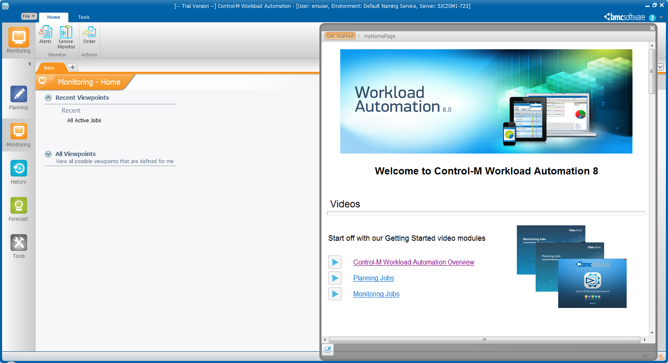
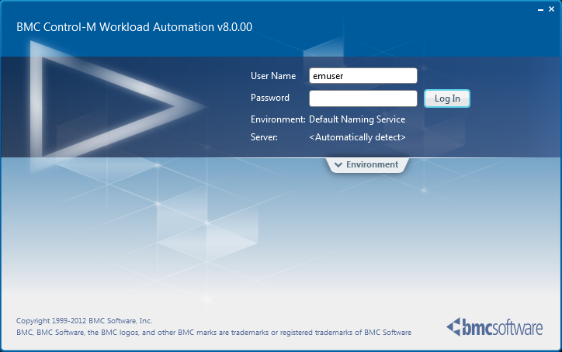
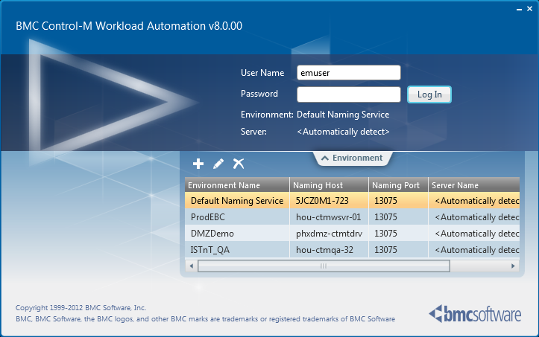
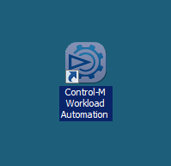
Single UI for most commonly used functions
Notes:
After installation, there is now a single icon for the combined Workload Automation User Interface.
CCM and Reporting are still separate and are available from the Start->BMC Software -> BMC Control-M menu
The Login dialog now provides the ability to define multiple environments simultaneously such as Test, Dev and Prod.
Select the desired environment, enter an ID and Password to launch the new UI.
One of the goals for Control-M 8 is to be easier to learn. One of the first features users encounter is easy-to-access, context sensitive help and instructional videos.
Here we see an example of the initial dialog that informs users that videos are available. Also notice the pop-up in the lower right hand that lets you know there is a Service alert that you may wish to investigate.
You can watch instructional videos from this initial welcome screen or from Help at any time.
NOTE TO SELF: This is the place to describe the general properties of the new UI.

Slide 5
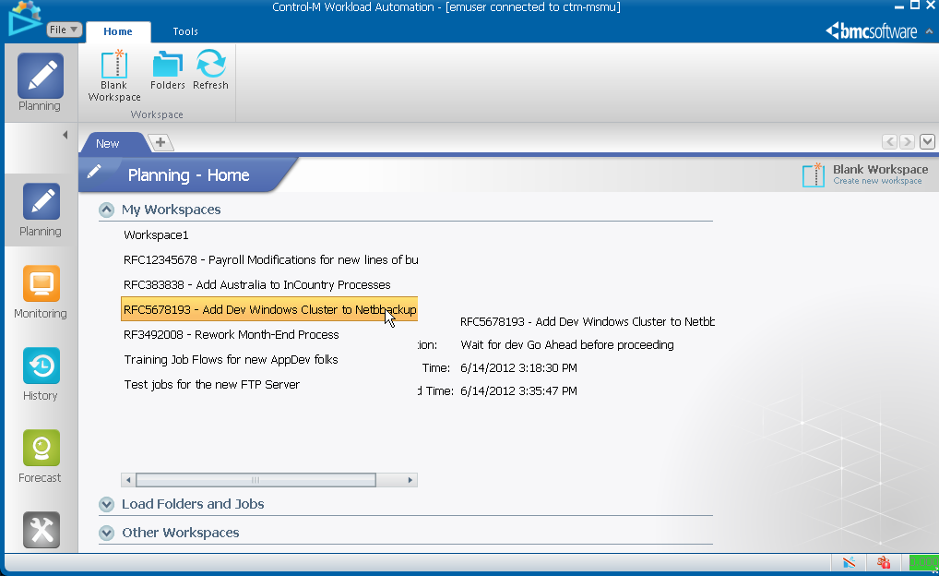
Planning: Managing Job Flows
Notes:
When you select a “domain” (Planning, Monitor, History, Forecast, Tools) from the navigation pane, you get the “Home” page for that domain that contains information about your recent work, options to select or functions to perform.
Here we see a list of Planning Workspaces. As you hover the pointer on an item, its description and “stats” are automatically displayed.
Some of the general characteristics: There is a Ribbon that is specific to the domain. When you select a domain, the domain icon appears in the upper left hand corner as the “current”. In the screen shot here, it is “Planning”.
Each domain is multi-tabbed (except for History).
Click one to open it or select “Blank Workspace” to start from scratch.

Slide 6
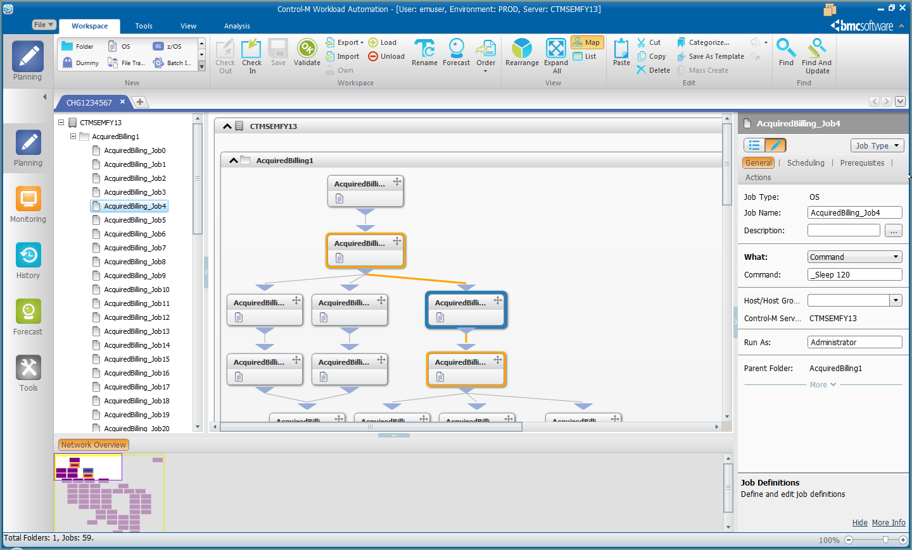
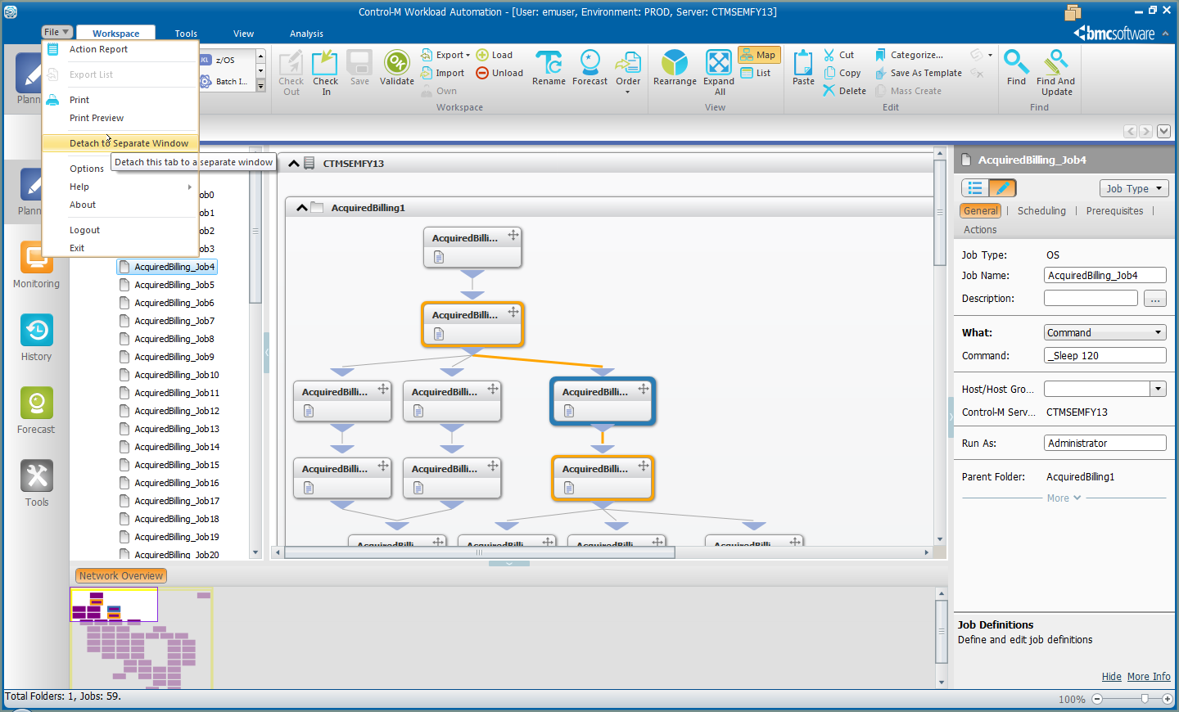
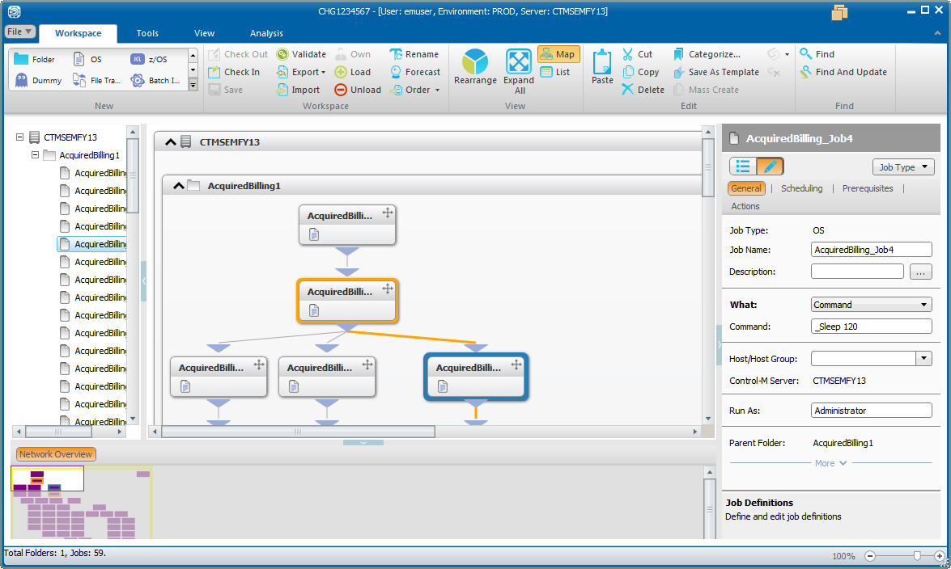
Domain Layout
Notes:
NOTE: Screen shots of the other domains appear later in this deck.
Talk about the elements of the layout:
Multi-tabbed
Tree view, network overview, detailed pane, job synopsis
All job elements are fully synchronized so navigation in one occurs in the other. Info updates in one appear in the other.
Tree, Network and Synopsis can be collapsed
Navigation Pane can be collapsed
Ribbon can be collapsed (<Ctrl> + <F1> just like in Office>
Detail Pane can be zoomed (currently there is a bug with the slider. Use <Ctrl>+ mouse wheel to zoom)
The Network Overview is also multi-tabbed. When validation or Check In is performed, the status messages appear in a separate tab here.
Some domains have lists (alerts, services, etc.). These too all have a consistent look & feel and when an entry is selected, its details appear in a synopsis on the right. This synopsis can also be collapsed.
Find Toolbar
[Build]
“Detach to Separate Window” is available in all domains to allow the current “view” to be “undocked” into a separate window
[Build]
This new window can be resized, moved, etc. so that several windows and objects can then be viewed side by side or together as necessary.

Slide 7
Planning Domain
Radically simplified job authoring
No need to be “architecture aware”
Common terminology
Load (into a Workspace) – Read-only, no locking
Check Out (the Workspace) – Lock and assume ownership
Check In
  Syntax validation enforced
Edit
Forecast
Save
Notes:
The Workspace concept in Control-M 8 is a significant re-working of and simplification of the job authoring process.
The user no longer has to be mindful of the fact that there is a database at the EM level and a different database at the Control-M server level and that job definitions have to be managed between these two environments. Now, Control-M takes care of this automatically.
Terminology and functions have been updated to reflect this change.
Tables are now called Folders. This reflects their function as simply a grouping of jobs rather than an object/entity in a database.
There is a new entity called a Workspace.
It is maintained in the EM database
Its life is from Check Out to Check In (more on that soon)
It can be accessed by the creator/author and others who have authorization to do so.
It can contain multiple folders and their jobs
The process now operates as follows:
If you want to just look at jobs, or in preparation for working on them, you still “Load” jobs. This is done either as part of creating a Workspace or afterwards using the Load function available in the Ribbon.
If you decide to make changes, you then Check Out these folders
If you wish to create a new folder modeled on an existing one, you can “Open as a Copy” ←--This is BIG Deal!
You can then work on changes with all the Workspace capabilities (will discuss further)
If you take a break (have to work on other things, go on vacation, etc.) you can save the Workspace.
Jobs in the Workspace do NOT have to be fully composed. This enables you to save “work in progress” even if it is not syntactically correct/finished.
Your peers (based on Authorizations) can take over your workspace and work on it in your absence
You can “Validate” the Workspace any time and any number of times). This checks syntax and identifies any missing mandatory fields.
You can FORECAST a Workspace (this operation is performed against the “Saved” copy in the database)
When you are done and ready to promote your work, you CHECK IN.
Validation is done as part of the Check In.
Check In writes the Workspace to the EM database. BIG DEAL!!!! If a folder has 10 jobs and you update only five in the Workspace you are checking in, Control-M updates ONLY the five you changed!!!!!!!!
Depending on your Synchronization option, jobs will also be pushed to the Control-M Server database. If the Control-M Server is not currently connected, the Check In process will report this error. It will either be corrected automatically (during New Day for that Datacenter) or you can correct it manually via the Folders function.
Common Terminology:
Folder
Sub Application
Output
Variables
Host
Order Method
Workspace
Check Out
Check In
Run As
Prerequisites
Actions

Slide 8
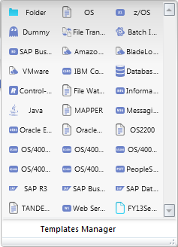
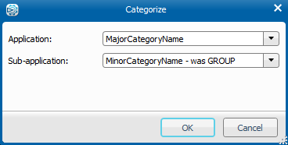
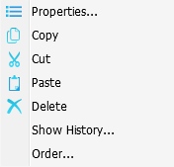
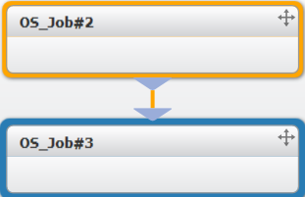

Job Authoring in the Workspace
Folder “Context”
  Datacenter Name and Platform
Job Palette
Drag and Drop
Cut & Paste
Categorize
Condition Editing
Notes:
Now let’s talk about how we build and modify jobs in this new environment.
We open a Blank Workspace.
We select a folder or job type from the Palette and drag it onto the “canvas”. The details for this object appear in the synopsis where we can “enrich” it. We now have a folder and something in it (unless we just started with a folder. In any case, this current folder has a context (Control-M, Application, Sub-Application.
We can now drop other jobs and folders into this one and they inherit this context.

Slide 9
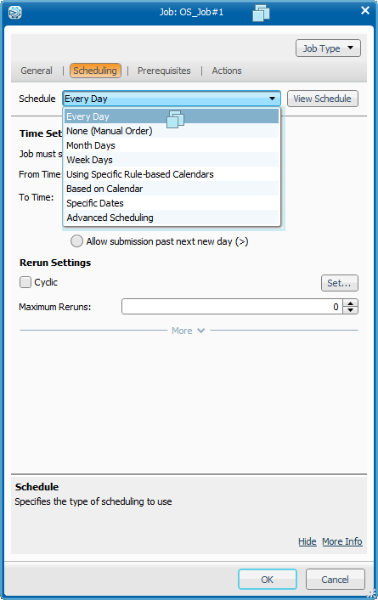
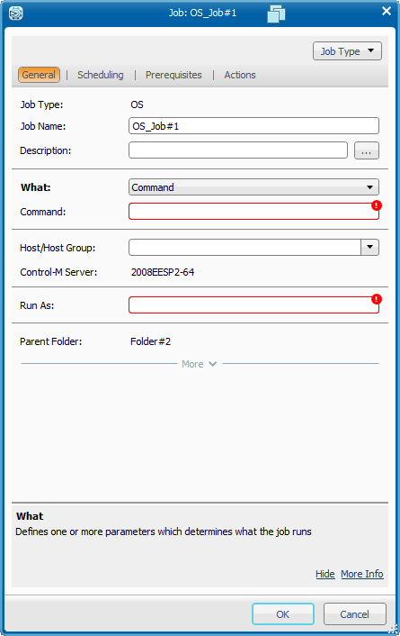
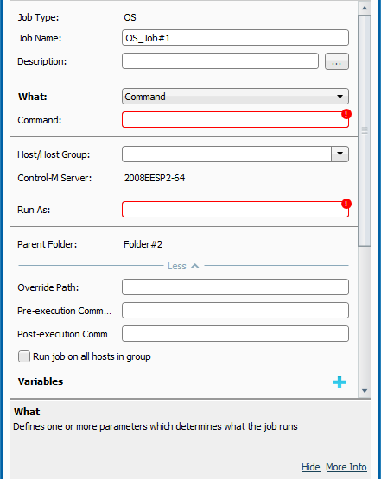
Job Details
Synopsis and Properties
  Sections, Links, Navigation, More/Less
Reduced mandatory fields
More/Less to expand or collapse sections
Navigation “links” to move to other sections

Slide 10
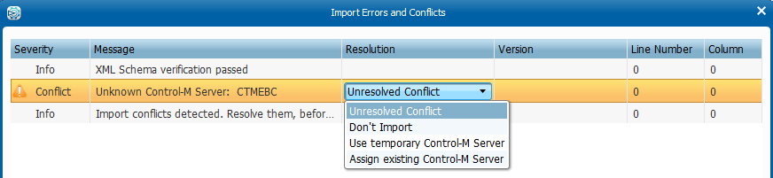
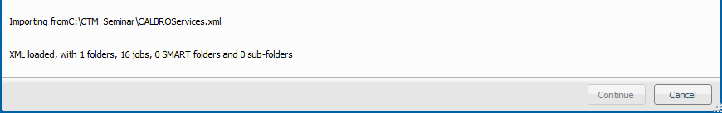
Import external job definitions
Import/Export XML
Resolution Dialog to correct issues on the fly

Slide 11
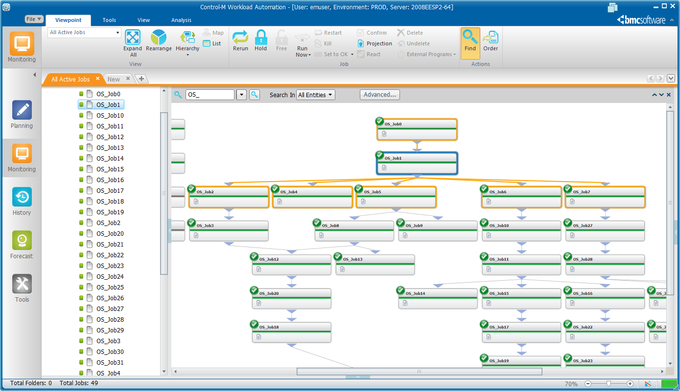
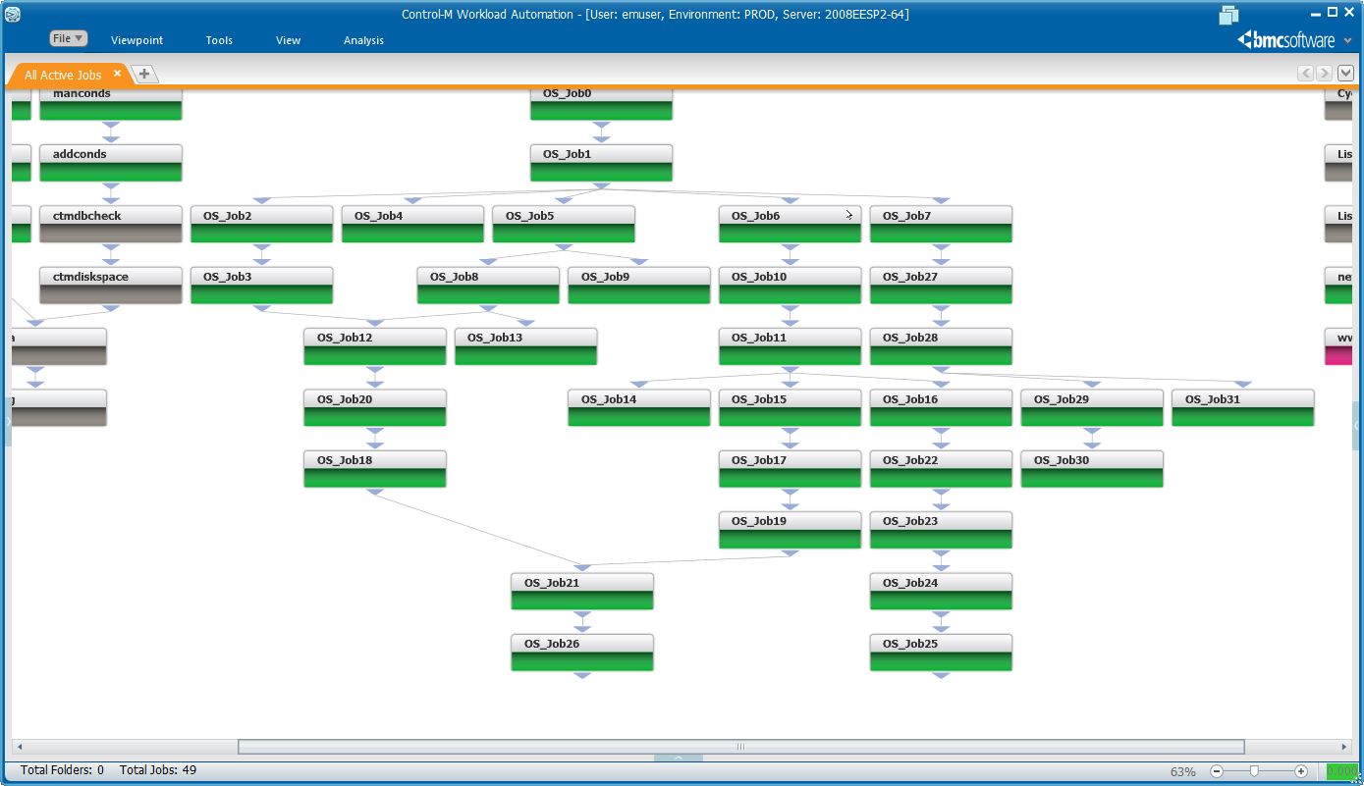
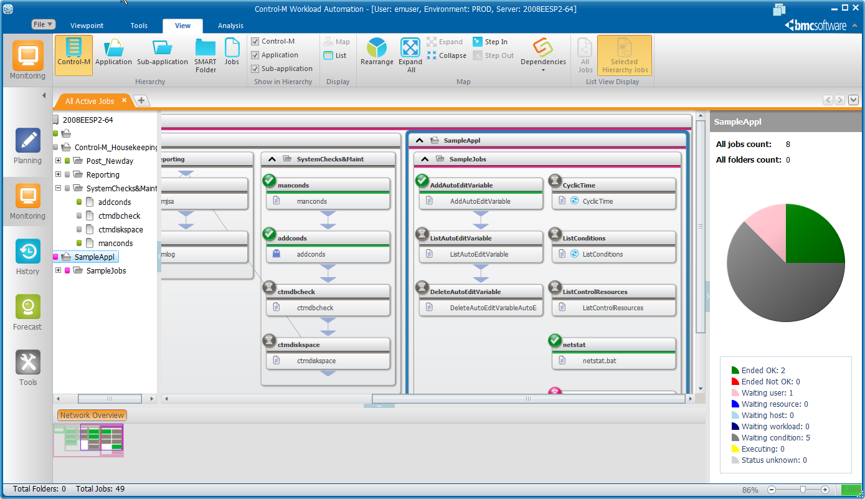
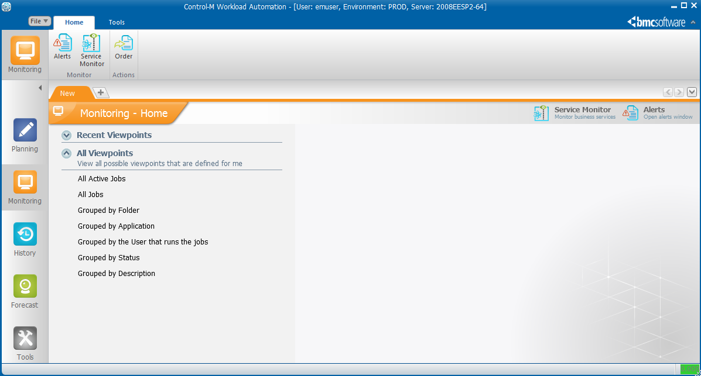
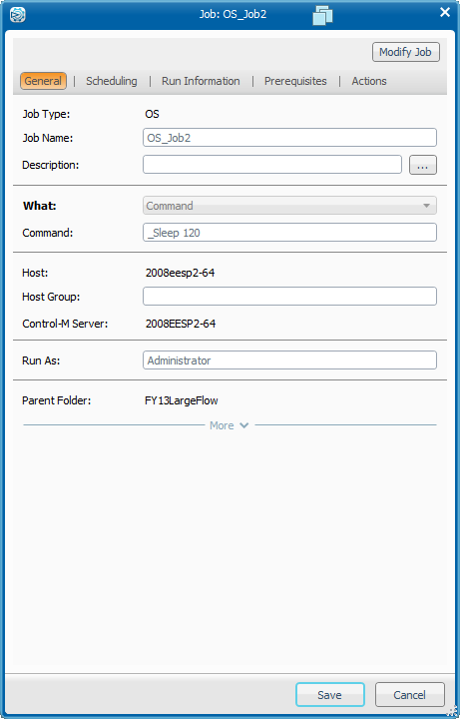
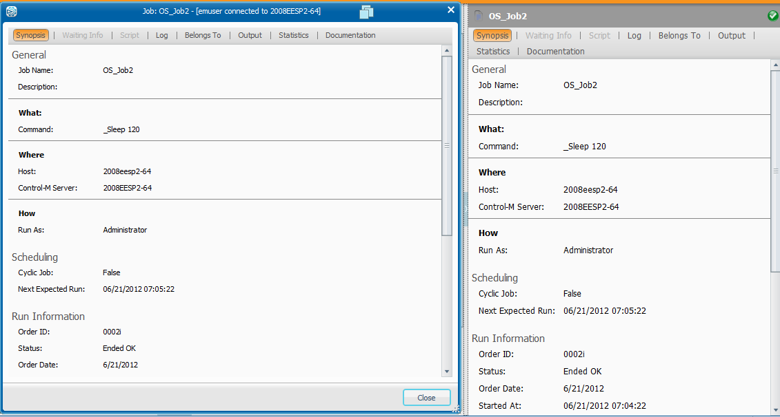
Monitoring Domain
Notes:
Functionality mainly unchanged but many look & feel/ organization changes:
Home:
List of Viewpoints
Next Build: This shows all panes and elements visible
Note the Pie Chart
Next Build: NONE of the elements visible except for primary (detail) pane. The collapsed elements include the Reibbon, Navigation, Tree, Network and Synopsis panes.
Next Build: This is the Analysis and Synopsis forms. The Synopsis, when visible, always shows the currently selected job. If you wish to see multiple jobs or the logs or output of multiple jobs, you can open the Analysis form and select the desired info from there.
Next Build: Job Properties with a new option called “Modify”. This is a single-step combination of Hold+Zoom&Save+Free
Next Build: The FIND dialog is new. It is available in all domains. It is by default, case insensitive (Advanced can change that) so when there are mainframe/distributed jobs, FIND will find both, and you can very quickly skip through all the occurances.

Slide 12
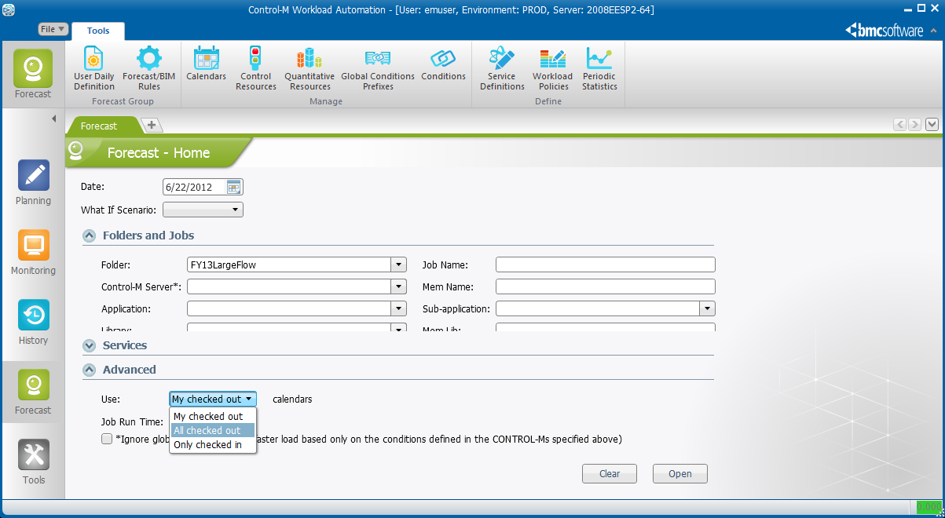
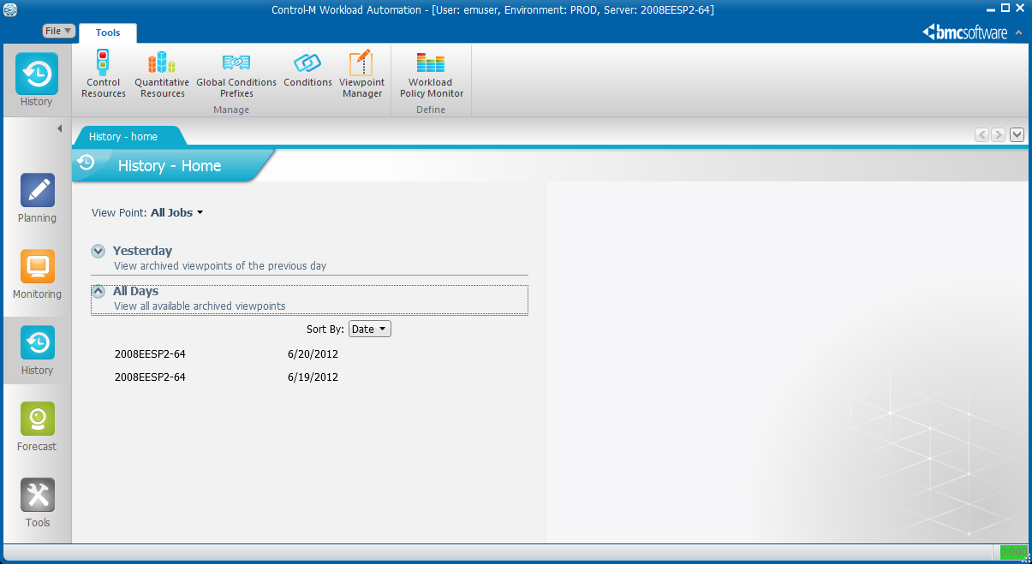
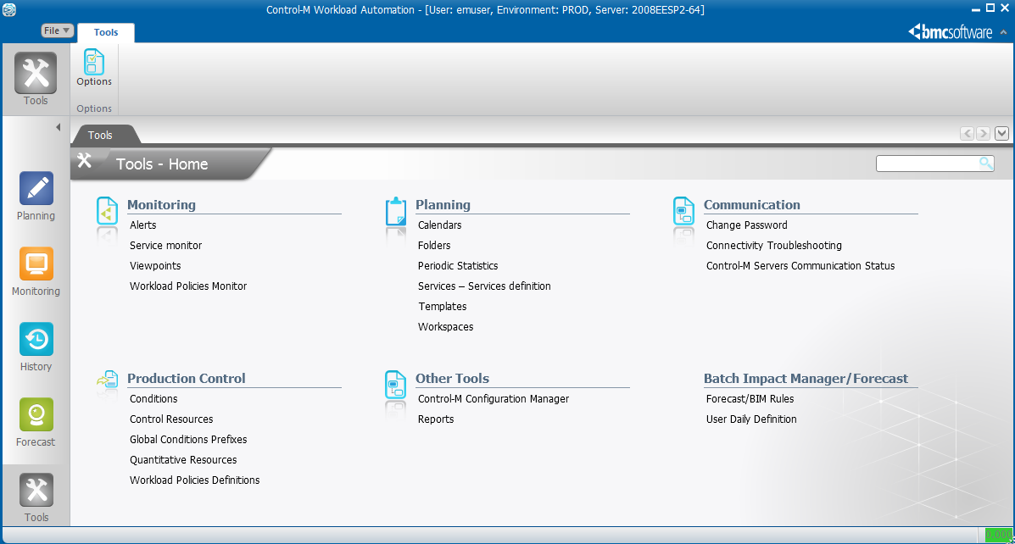
History Domain
Forecast Domain
Tools Domain
Notes:
A Separate Domain makes functionality more visible and accessible
The list of available data is organized by date
And once an archive is open, the Ribbon also makes available functions easier to see especially Playback

Slide 13
Powerful

Slide 14
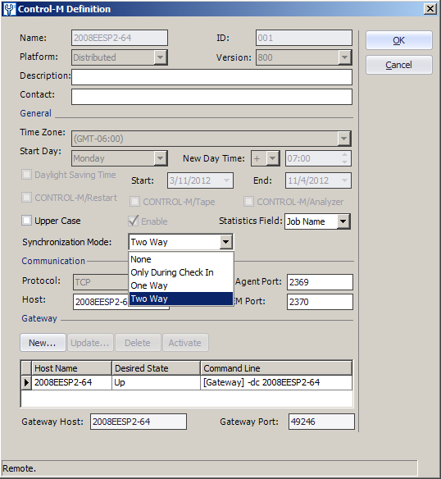
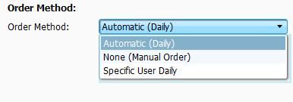
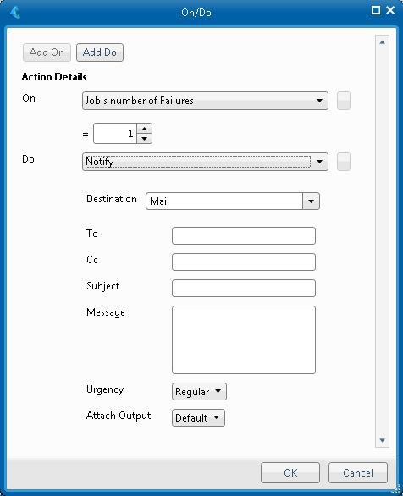
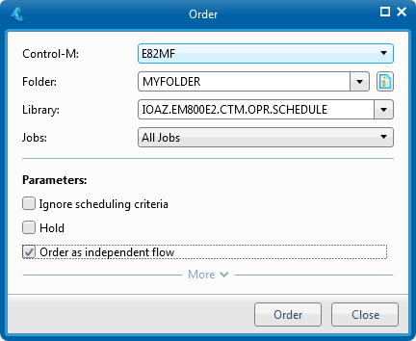
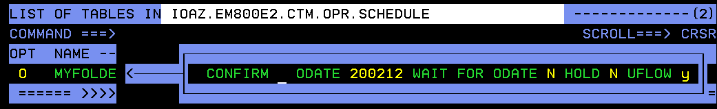
Simplified Management for the Enterprise
Synchronization
  Only During Check In
  One Way
  None
  Specified for each Control-M Definition
Order Method
  Automatic
  None (Manual or Ad Hoc)
  Default defined via System Parameter
Perform action after “x” failures
  Send Email after the third failure
  Open a remedy incident after the fifth failure
Order Unique Flow
  Dynamic at time of
  Order/Force
  No definition changes required

Slide 15
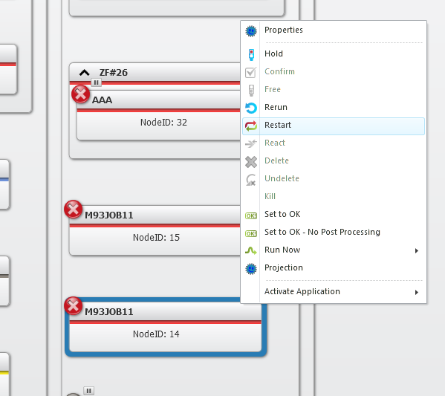
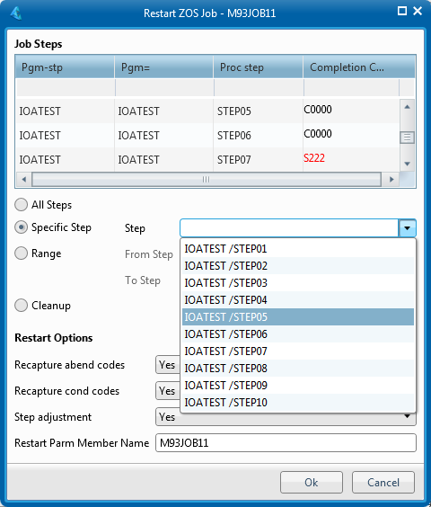

Enhanced Control-M for z/OS Restart Interface
Steps list
Step selection

Slide 16

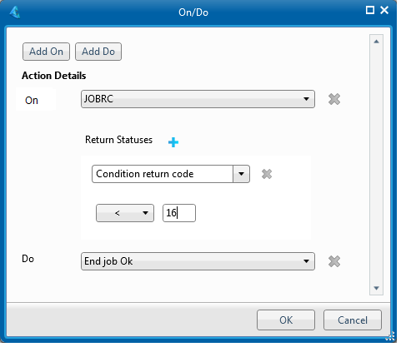
More Power and Lower TCO
Distributed
  Control-M/Server scalability and functionality enhancements
  “Zero outage” Agent Upgrade
  Remote Hosts (Agentless) now support Control-M utilities
z/OS
  Control-M for z/OS
    Enhanced job tracking using Event Notification Facility
    JOBRC Support
  zIIP exploitation
      Control-M Workload Automation
      Control-M Output Management (Control-D)
  Integrated Operations Architecture
    Cloning with SMP/E
    Enhanced upgrade process
Notes:
JOBRC is a new keyword (operation) on the JCL JOB card that allows users to define how the “Job Return Code” should be determined.

Slide 17
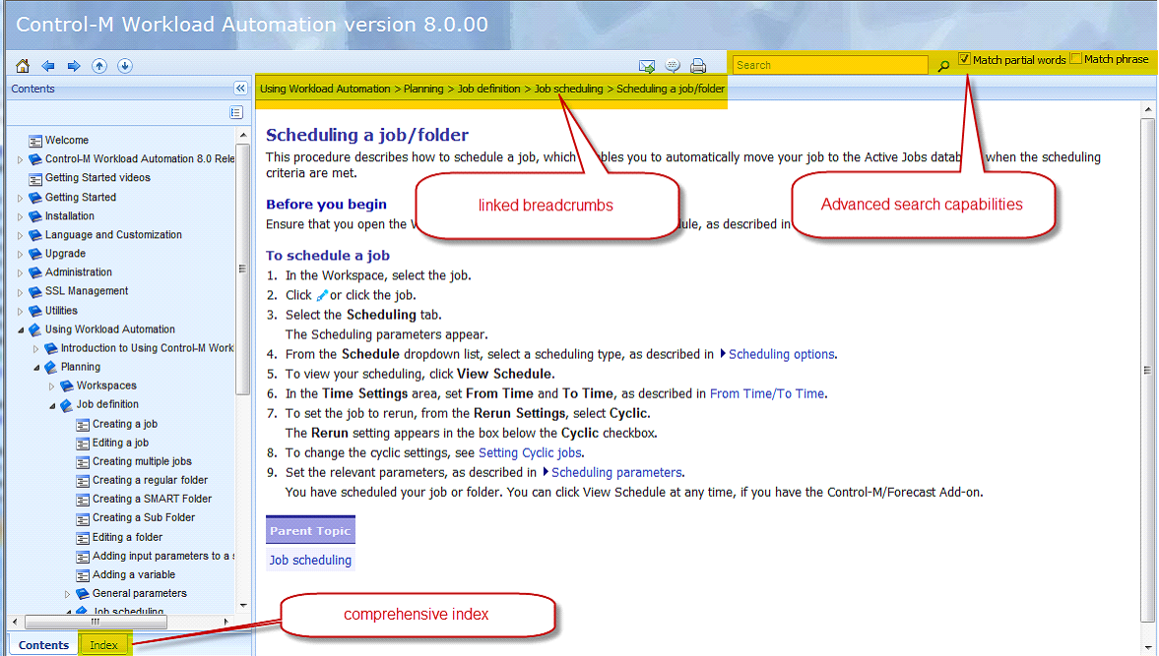
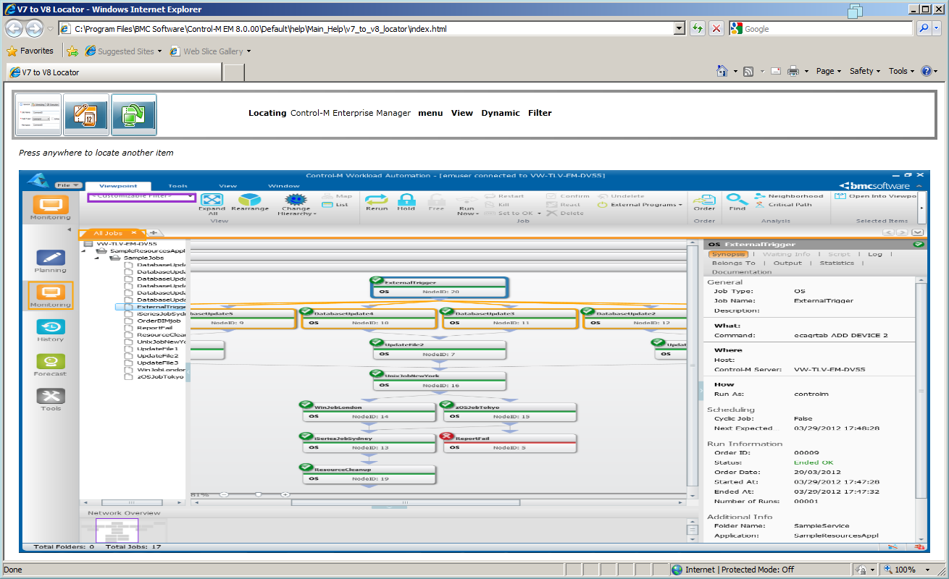
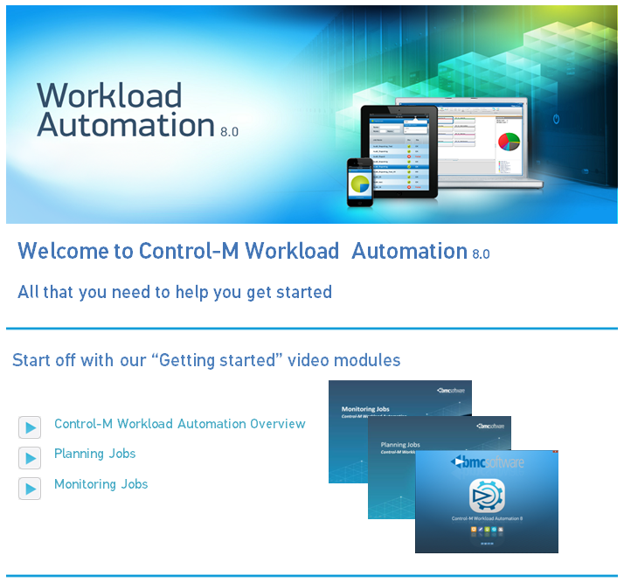
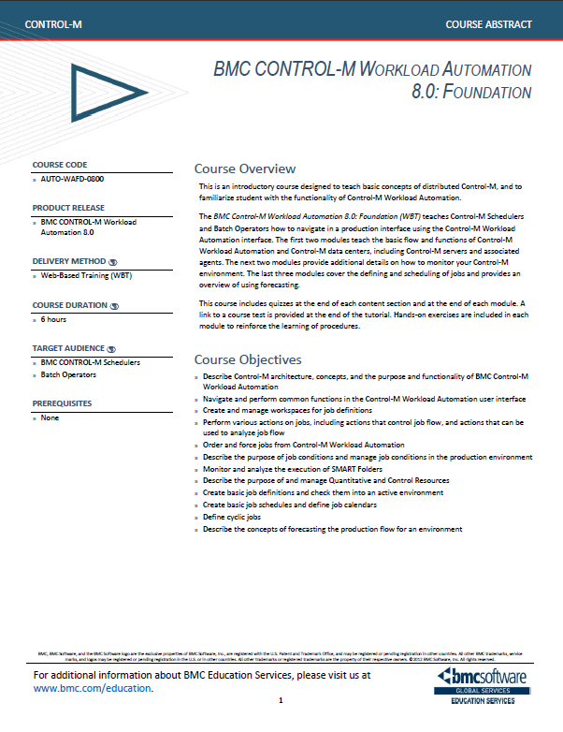
Helping customers upgrade to BMC Control-M 8
Enhanced Documentation
“V7 to V8” Locator
Instructional Videos
BMC Education
AMIGO Program

Slide 18
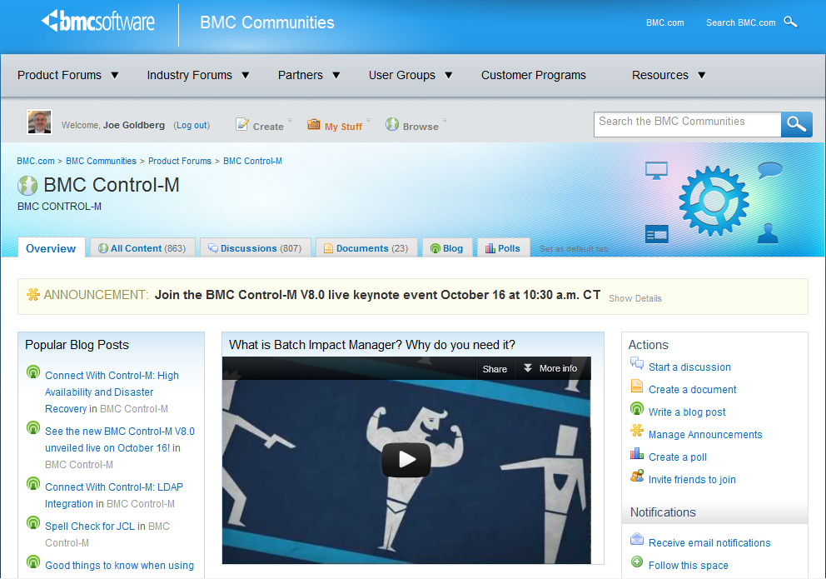
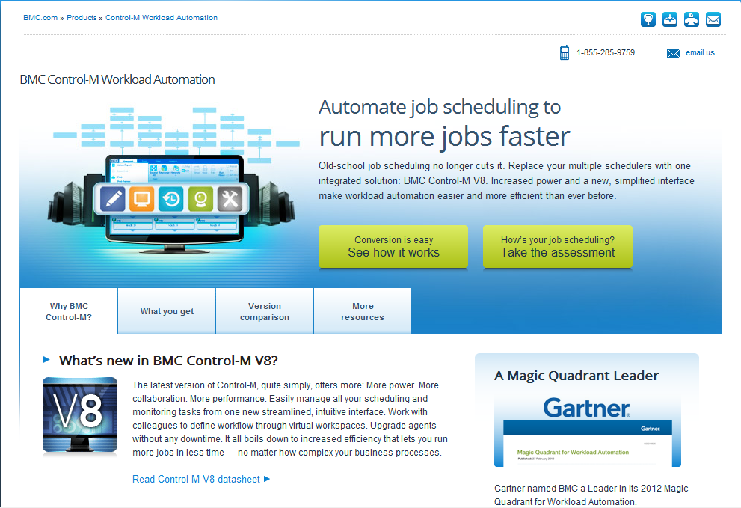
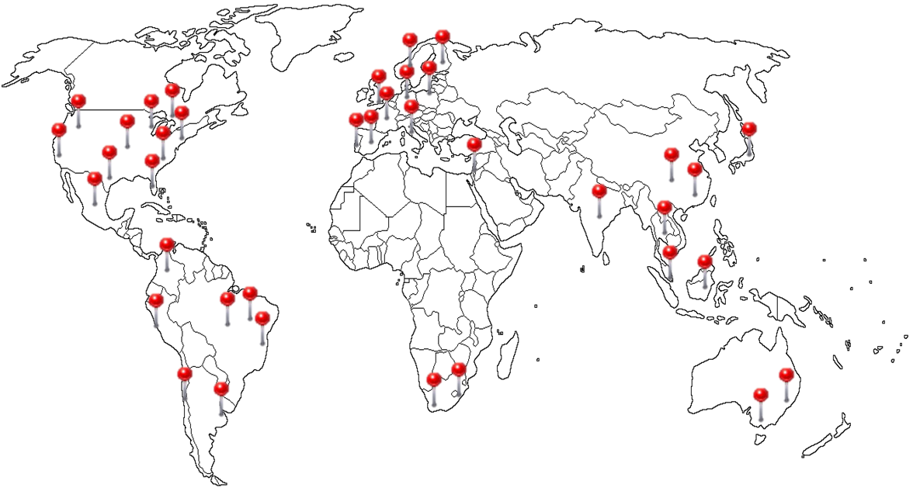
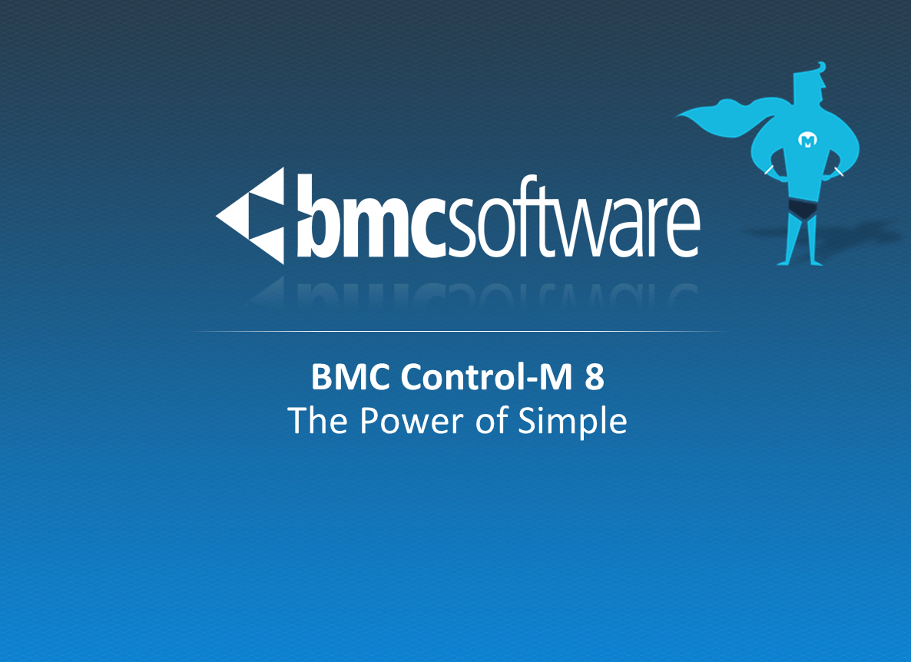
Helping customers upgrade to BMC Control-M 8
BMC Control-M 8 private community
Control-M Home Page
Seminars
Webinars

Slide 19
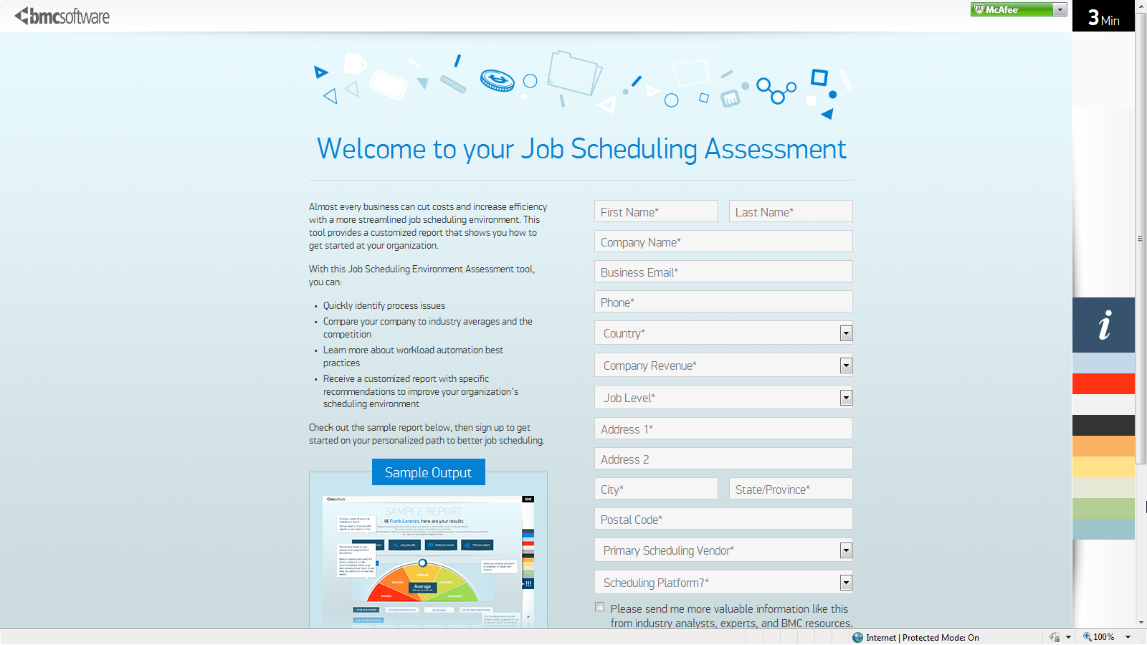
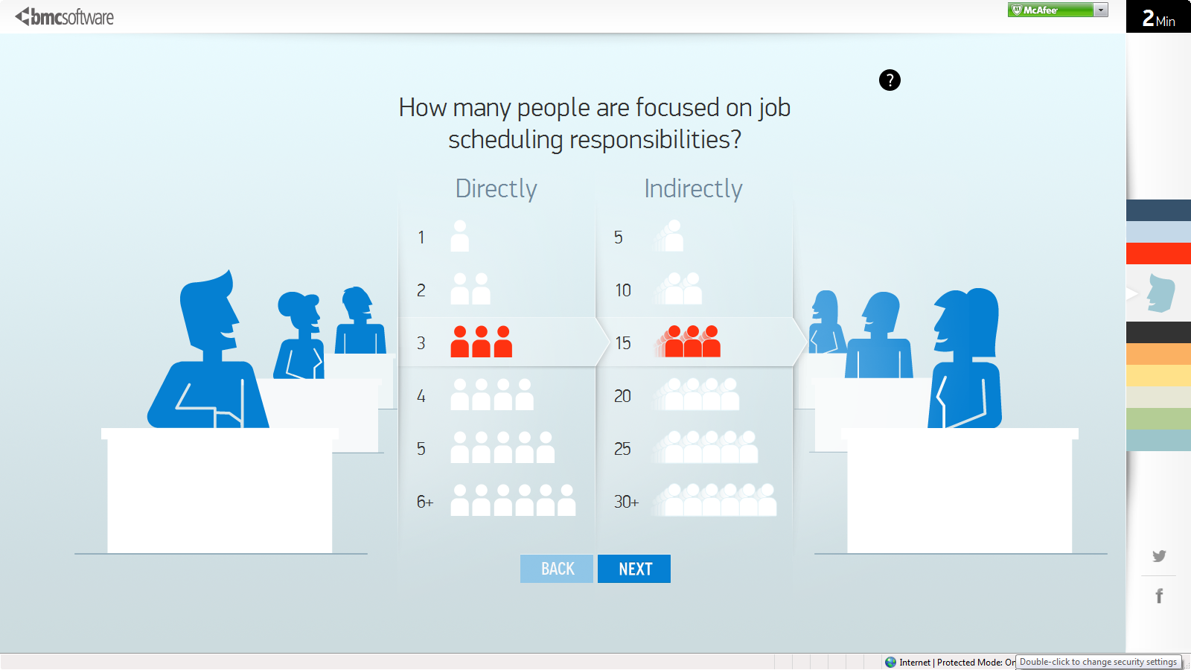
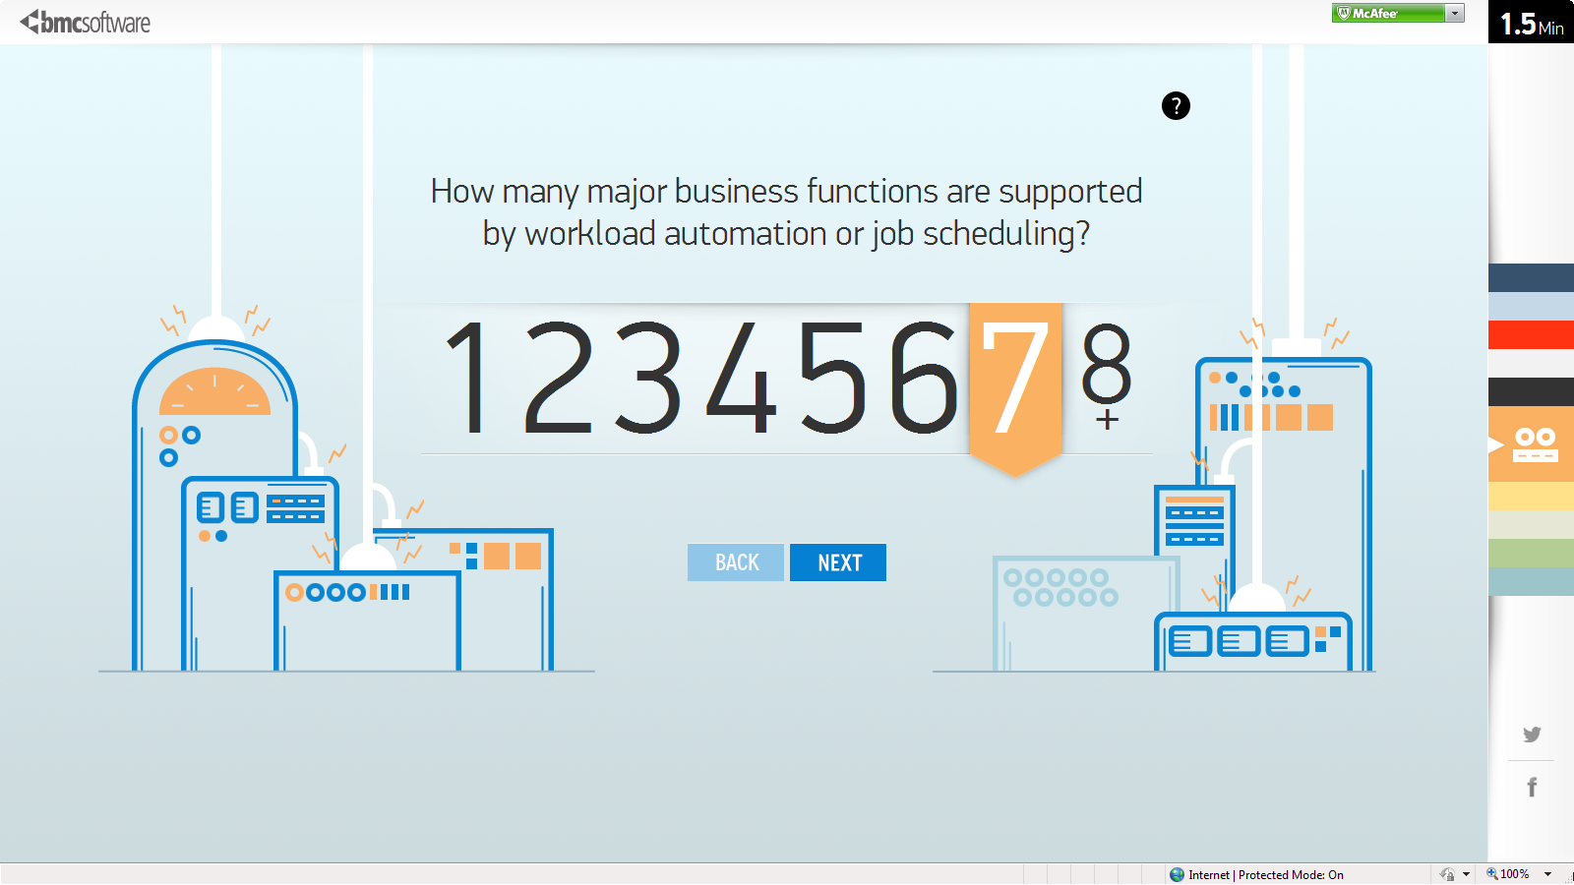
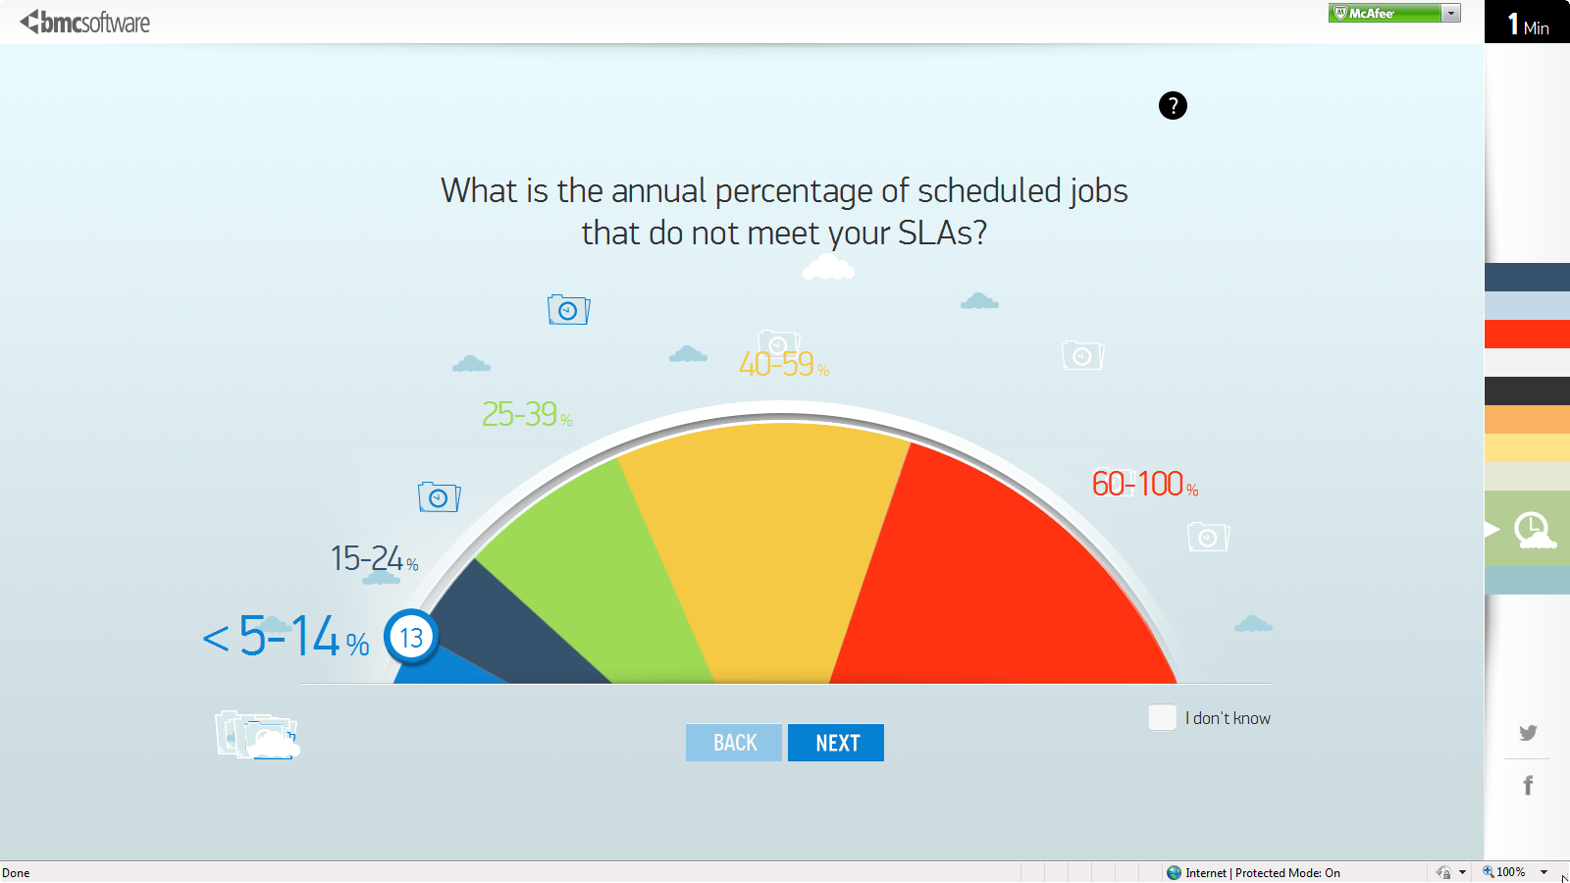
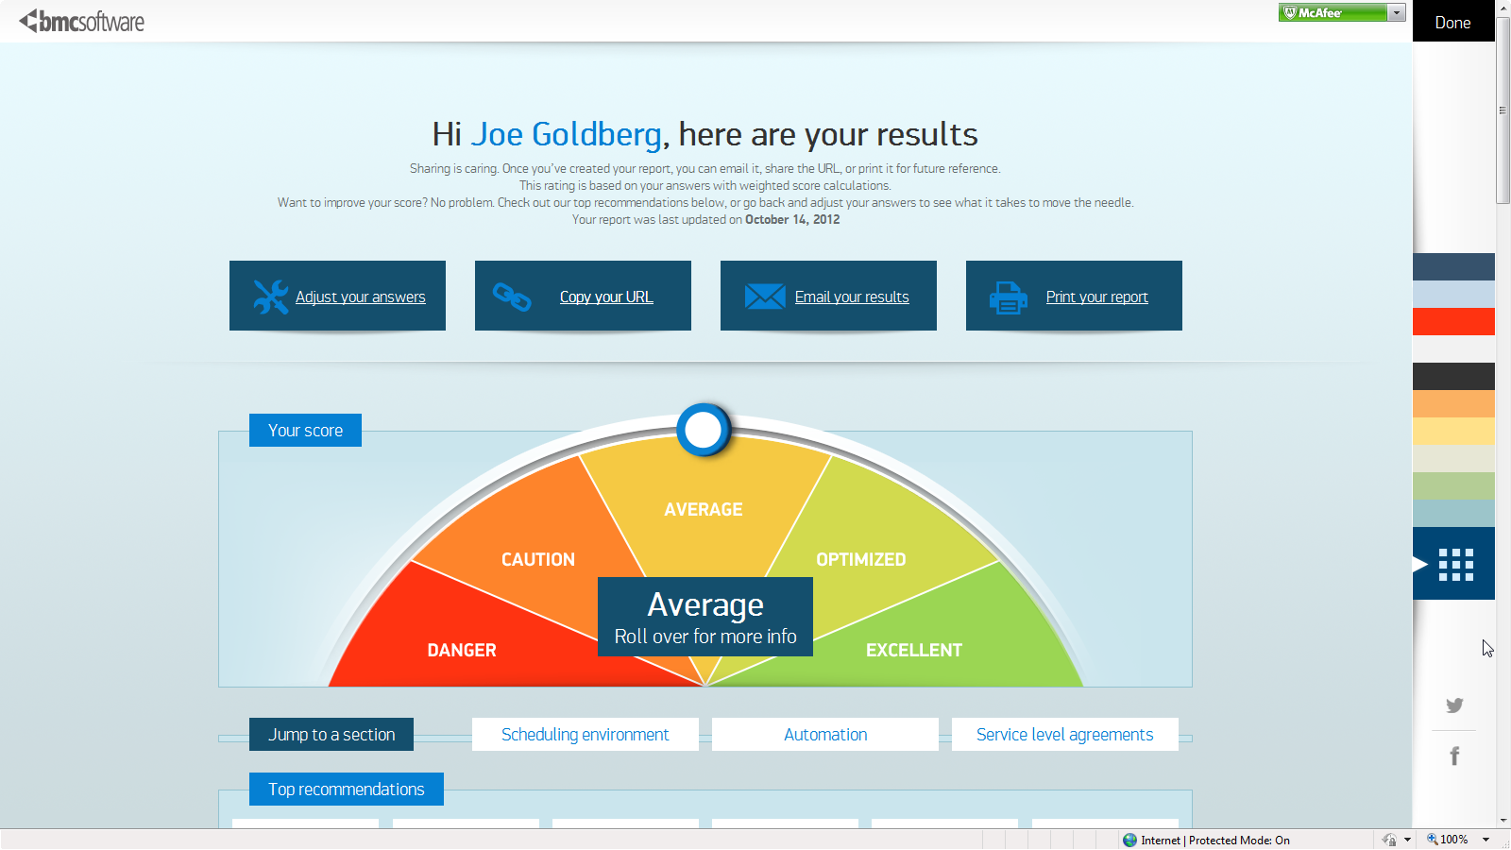
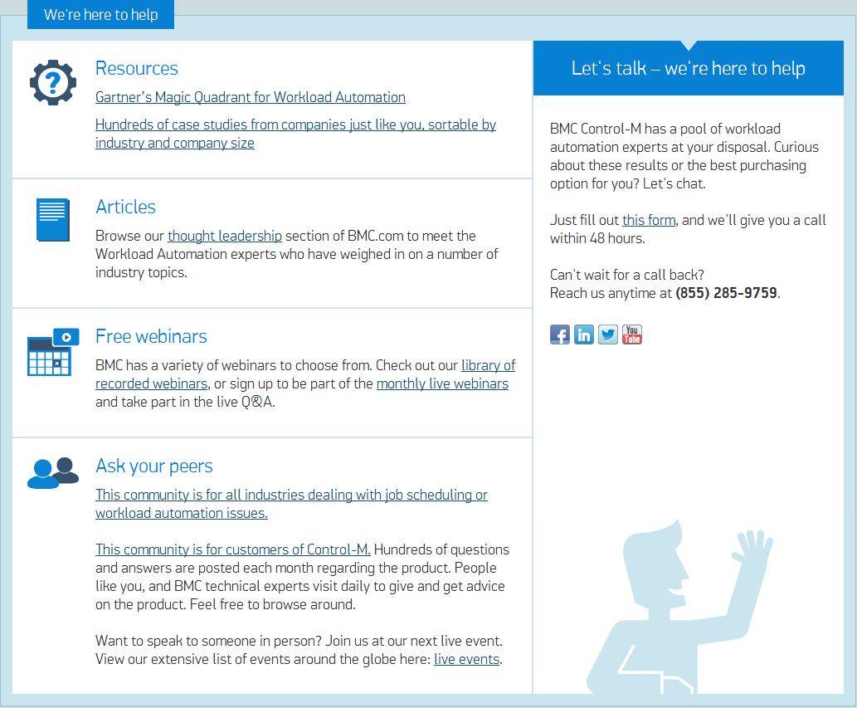
BMC Control-M Job Scheduling Assessment
Assess effectiveness of current environment
  BMC Control-M and others
Highlight areas you may not think of
Embedded Industry guidelines
Dynamic controls to adjust to your environment
Results customized for your specific input
Recommendations and Resources for next steps

Slide 20

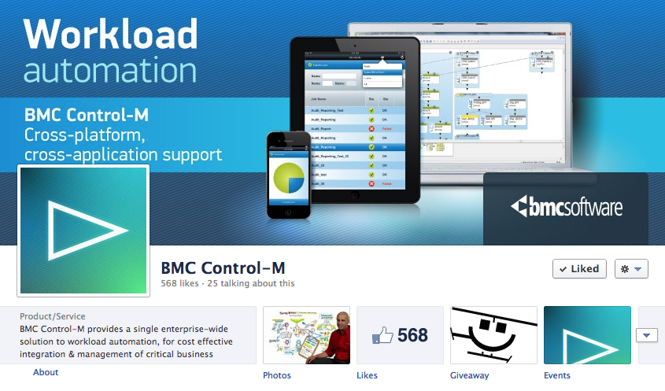
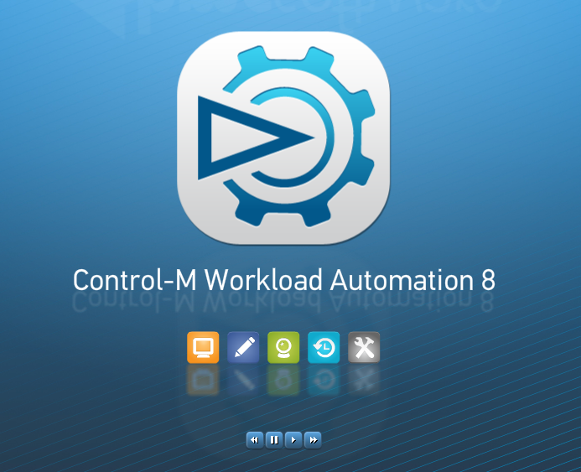




To learn more, go ocial

Slide 21
Questions
www.bmc.com/control-m
communities.bmc.com
@BMCControlM on Twitter
bmccontrolm on Facebook
BMC Control-M Group on LinkedIn

Slide 22
Thank You

