Slide 1
MICROSOFT WORD
Using different tools when working with MS Word…

Slide 2
Microsoft Word is excellent for creating different documents on your computer!
This presentation will cover the basic steps for the following:
Text Formatting
TABLES
GRAPHICS

Slide 3

Let’s say you have an essay to write…
First, you panic – your paper is due in 3 days
Then, you open your Microsoft Word
You start typing away… Words become sentences, sentences turn into paragraphs… And the formatting begins…
ABCDEFGHIJKLMNOPQRSTUVWXYZ

Slide 4
You can make text bold by clicking this button
You can underline your text by clicking this button
You can make your text italic by clicking this button
You can change colors by clicking these buttons below

Slide 5

You can use different formatting tools when creating the following:
School Papers
Class Newspapers
Resumes (for when you get MUCH older)

Slide 6

Whatever you type, just remember to always check spelling

Slide 7
You can also create tables in
MS Word

Slide 8
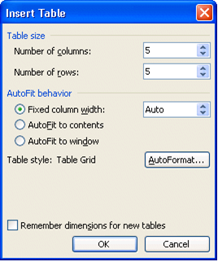
You can insert a table in your document by clicking on the Table button (top toolbar):

Slide 9
You can use tables in your documents for the following:
School presentations/projects
(math, for example)
Making calendars
Help with Math, anyone? (link)

Slide 10

You could also insert pictures, photos and clip art into your documents…

Slide 11
To insert a picture or clip art you would click on the Insert button (top toolbar):

Slide 12


You can transfer photos from your camera directly into your MS Word pages:

Slide 13

You can make fun birthday cards
Birthday Cards in MS Word (link)
Or, you can write a book…
Book Writing in MS Word (link)

Slide 14
So now, that you know a thing or too about different tools…
WHAT WOULD YOU USE MS WORD FOR?

Slide 15
THE END

Slide 16
CREDITS:
Evelina Girshovich (creative design, content)
U Learn Office (link)
MS Office Tutorial Training (link)
How To Teach MS Word to Kids (link)

