Slide 1
Microsoft Word 2010
Lesson 3

Slide 2
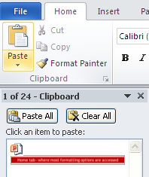
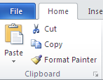
Use Home Ribbon to Format Text
Home tab—where most formatting options are accessed
Clipboard group. Notice the Launcher
After the Clipboard group launcher is depressed, the Clipboard pane appears.
Note: 24 items can be stored on the Clipboard.

Slide 3
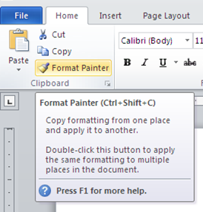
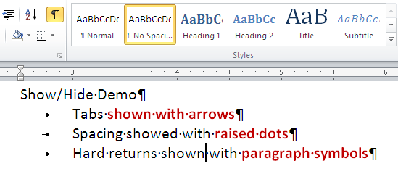
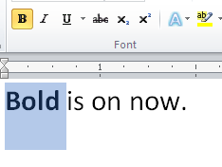
Use Home Ribbon to Format Text
I-beam: Insertion point
My personal favorite tool: Format Painter
Note: See ToolTip. When you hover over a tool, a short description will appear.
When a tool is being used, it appears shaded (toggles on and off)

Slide 4
Discuss
When might the Show/Hide command be useful?

Slide 5
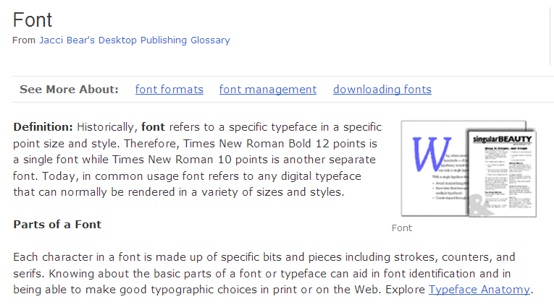
About Fonts
Source: http://desktoppub.about.com/od/glossary/g/font.htm
1 point = 1/72 of an inch
Character formatting: changing the appearance of letters, numbers, and symbols.

Slide 6
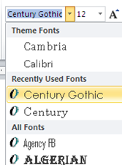
About Fonts Continued
Change Font
Change font type by clicking down arrow.
Did you know that you can “jump” to another font by typing the letters?
Example: Click in the font type and type Times New Roman .
Change Point Size
Change point size by clicking down arrow.
Did you know that you can customize a size?
Example: Type 15.5. Notice that this size isn’t an option available by default.

Slide 7
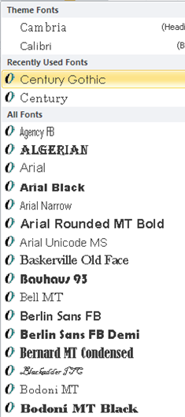
About Fonts Continued
Most commonly used and most frequently used fonts show up at the top.
All other fonts are shown in alphabetical order.
WYSIWYG
What you see is what you get. The fonts appear as they will in the document.
Live Preview
Select your text and then hover over a different font. You will see the selected text in the font selected.

Slide 8
Hot Keys (Shortcuts)
CTRL + B Apply Bold attribute
CTRL + I Apply Italic attribute
CTRL + U Apply Underline attribute
CTRL + SHIFT + F Change Font Face attribute
CTRL + SHIFT+ P Change Font Size attribute
CTRL + Shift + > Grow Font Size attribute
CTRL + Shift + < Shrink Font Size
Note:
Grow Font (means enlarge font). However, the vocabulary you must recall is Grow Font.
Notes:
Note: Lesson plans had error regarding grow and shrink font (left out SHIFT).

Slide 9
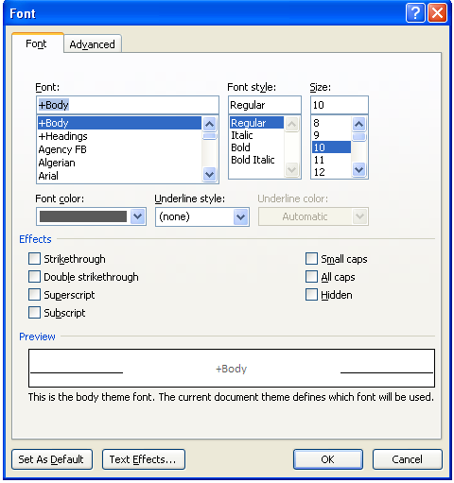
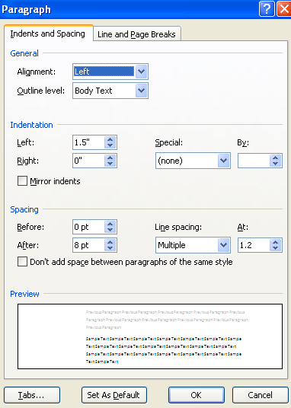
Font and Paragraph Launchers
Launching dialog boxes gives more options
Note: change tabs here too.
Notes:
Note: Lesson plans had error regarding grow and shrink font (left out SHIFT).

Slide 10
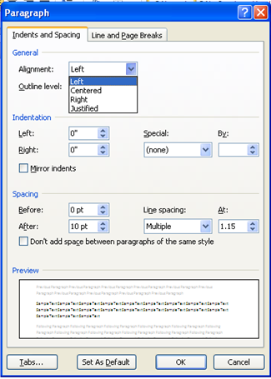
Aligning Text in a Document
Blank documents default to left alignment.
Left
Ctrl+ L
Right
Ctrl + R
Launch the Paragraph Group from the Home Tab
Center
Ctrl + E
Justify Ctrl + J
Notes:
Note: Lesson plans had error regarding grow and shrink font (left out SHIFT).

Slide 11
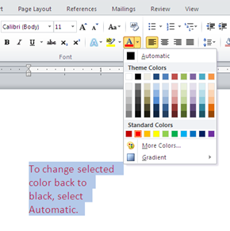
Discuss
Do you know what Select-It-And-Do-It-To-It means?
It means if you decide to make a change to text that has already been typed, you must first SELECT the text. Then you can DO whatever you want to it.

Slide 12
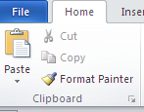
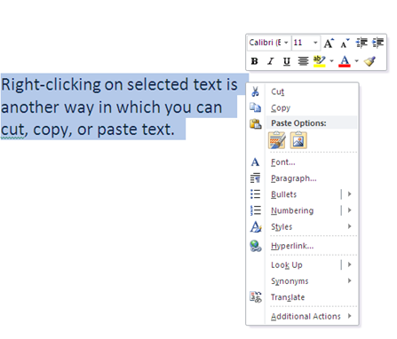
Cut and Paste Text
Cut a selected item: Ctrl + X
Copy a selected item: Ctrl + C
Paste an item: Ctrl + V
Right-clicking on selected text launches the short-cut menu
Notes:
Note: Lesson plans had error regarding grow and shrink font (left out SHIFT).

Slide 13
Discuss
Cut a selected item:
Ctrl + X
When an item is cut, where is it stored?
Hint

Slide 14
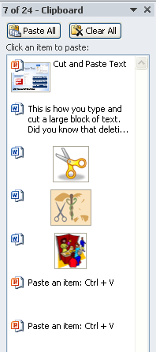
Office Clipboard
This is the Office Clipboard task pane.
The launcher in the Clipboard group actually opens the Clipboard.
Can you tell how many items are stored in this Clipboard? 
Launcher
You must use
CUT or COPY
to place items in the Clipboard.
Notes:
Note: Lesson plans had error regarding grow and shrink font (left out SHIFT).

Slide 15
Discuss
The Clipboard is available in all Office applications.
24
Do you recall how many TOTAL items can be stored in the Clipboard?
If you accidently cut the wrong thing, just click the button.

Slide 16
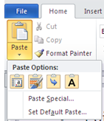
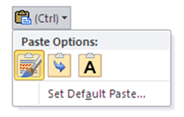
Paste Special
Image 2
Paste options appear with newly pasted text. (Image 1)
Another way to see Paste options is to click the drop-down menu on the Paste command from the Home tab. (Image 2)
Image 1
Notes:
Note: Lesson plans had error regarding grow and shrink font (left out SHIFT).

Slide 17
Paste Special Explained
Keep
Text
Only
T
Live Preview works with Paste Special options too.
Hover over each option to see how it affects the pasted text.
Keep Source Formatting
K
Merge
Formatting
M

Slide 18
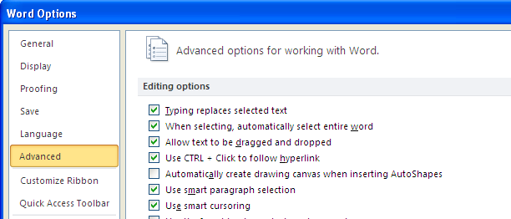
Drag and Drop to Edit Text
In order for Drag and Drop editing to be allowed, it must be turned on.
Turn Drag and Drop on in the Word Options—Advanced Tab

Slide 19
Drag and Drop Editing Demo
1
Text
2
Select it
3
Drag and Drop
Drag and Drop =
Cut and Paste
The result is the same.
The text changes location.
Drag and Drop
Moving and inserting selected item into a new location.

Slide 20
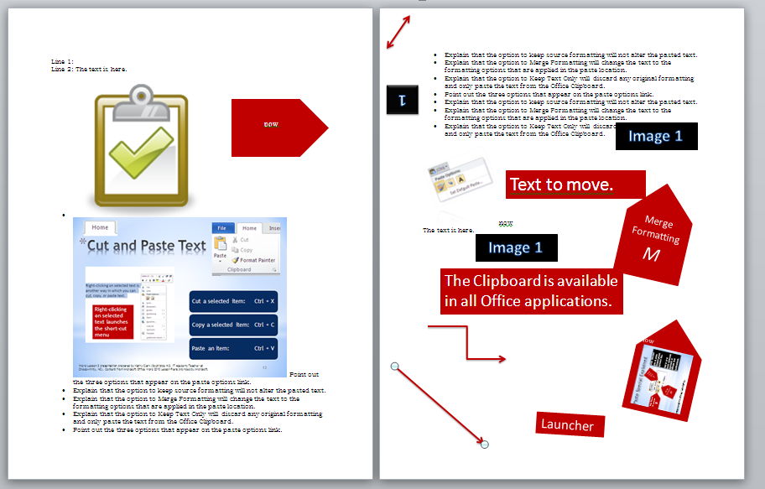
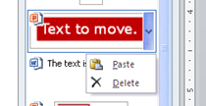
Collect and Paste Multiple Items
24 items
Example of many items pasted at once.
Arrow to right of “clipped” object gives options to Paste or Delete.

Slide 21
Discuss
The first item in the Clipboard will be deleted.
What do you think will happen when a 25th item is copied to the Clipboard?

Slide 22
Apply Styles
Styles are predefined formatting combinations of fonts, colors, and paragraph formatting that are designed to save time.

Slide 23
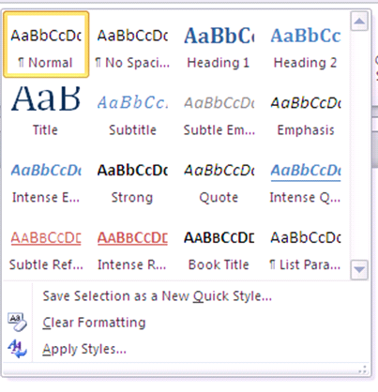
Apply Styles Continued
Click the down arrow in Styles group to see more options.

Slide 24
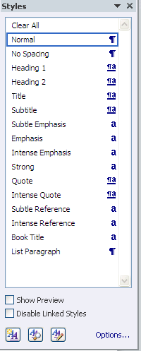
Apply Styles Continued
Click Launcher
in Styles group to see more options.

Slide 25
Apply Styles Continued
SS
DS
TS

Slide 26
Discuss
The No Spacing Styles is the closest style to plain text typing.

Slide 27
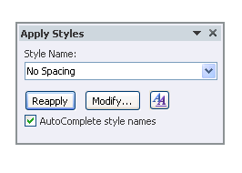
Apply Styles Continued
Ctrl + Shift + S

Slide 28
Borders
Paragraph borders: affects just the selected paragraph
Page border: affects the entire page (document)

Slide 29
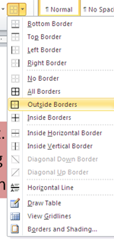
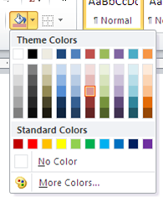
Paragraph Border and Shading
Shading Options
Did you know that if you click on Borders and Shading at the bottom, there are even more choices?

Slide 30
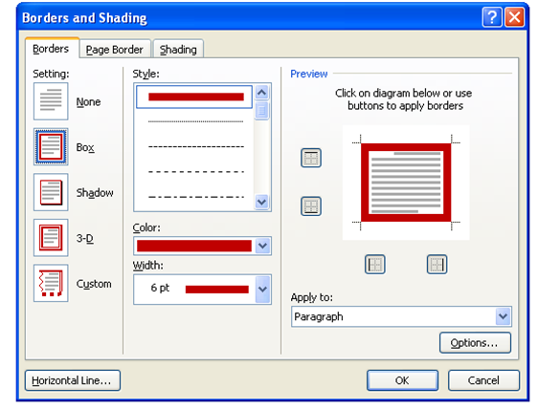
Borders and Shading
All 3
The Borders and Shading dialog box appears when you click on Borders and Shading from the Borders drop-down menu.
First things first: key all info first, and then format document.
This will eliminate many “issues” with some of the auto formatting features in Word.

Slide 31
Borders & Shading
Good To Know About
Both paragraph borders and shading help emphasize information.
Shading can be in color or gray (select a shade of gray if the document is to be printed using only black ink).
To remove the paragraph border, select the text and go to the drop-down menu and select No Border.
To remove shading, select the text and go to the drop-down menu and select No Color.

Slide 32
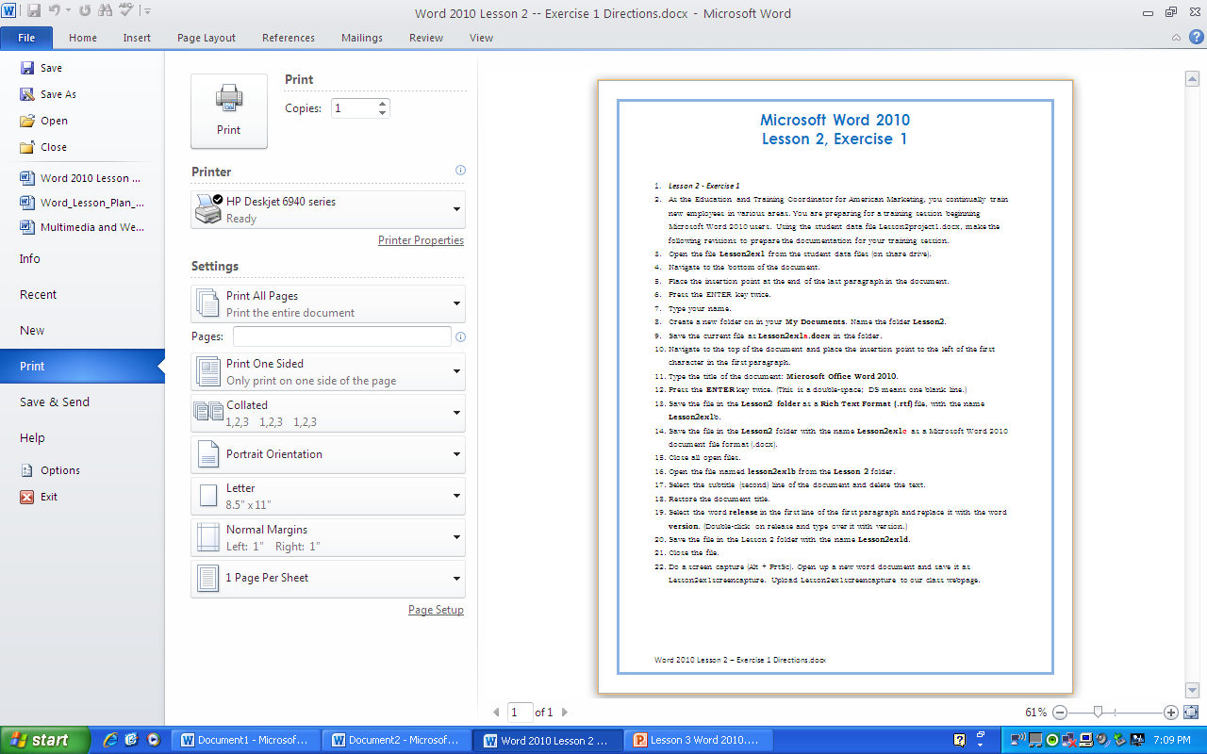
Previewing a Document
It is important to check documents before printing to conserve paper and to catch mistakes.
Print Preview should be used for your FINAL PROOF before printing.

Slide 33
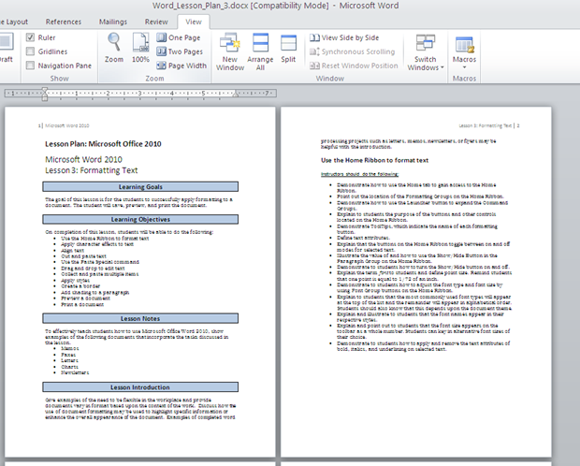
Print Preview
Can View multiple pages from the View Tab.

Slide 34
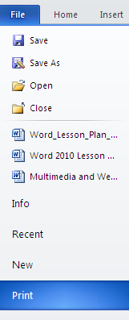
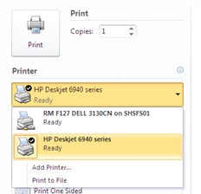
Printing
Tab
Hard Copy: printed document
Soft
Copy
Click this drop down menu to change printers.
Change print settings

Slide 35
Now it is time for you to practice. Please complete the following:
Word Lesson 3, Exercise 1
Word Lesson 3, Project 1
Quia Quiz, Word Lesson 3

