Slide 1
Microsoft Word 2010
Lesson 1

Slide 2
Five Ways to Start Word 2010
1
Use the Windows Start button
2
Use a desktop shortcut
3
Used Most Frequently Used Programs on left side of Start Menu
4
5
Right-click a Word document and left-click to open
Double-click a document already created in Word
#5
Fastest way for already created documents
Notes:
May want to tell students about Windows Key + E. This will launch the My Computer window. SHS students can no longer use this shortcut now that we have migrated at SHS from a Novel-based network to a Windows-based network. But, they can use it at home.

Slide 3
Exploring the
Word 2010 Window
Title Bar
The title bar text changes to display the name of the active document. When you first open a new document, the title bar will say Document #. After you save it, the new name will show on the title bar.

Slide 4
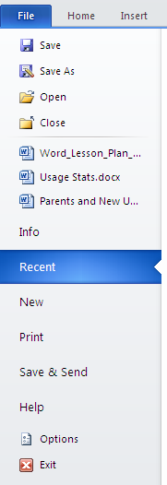
Exploring the
Word 2010 Window
File Tab
Microsoft brought back the File tab with Office 2010. (Office 2007 had a Microsoft Office button for file handling.)
Notice all the options available under the File tab. The next time you open Word 2010, click on each of the options to view what is available.

Slide 5
Exploring the
Word 2010 Ribbon
Insert Tab
Show/Hide Command
Font Group
On the Ribbon, you will find:
Tabs (File, Home, Insert, Page Layout, References, Mailings, Review, View)
Groups (Groups in File tab: Clipboard, Font, Paragraph, Styles, Editing)
Commands (Paste, Cut, Bold, Underline, Center, No Spacing Style, Find, etc.)

Slide 6
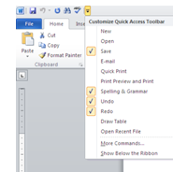
Exploring the
Word 2010 Window
Quick Access Toolbar
Located at the top left. You can customize the QAT to insert your most commonly used commands by clicking on the down arrow at the right.

Slide 7

Exploring the
Word 2010 Window
Insertion Point
Depending upon the action you are taking, the insertion point can take on many different forms. When you are inserting text, it is an I-beam.

Slide 8

Exploring the
Word 2010 Window
Ruler
The Ruler may or may not be turned on. If you don’t see the Ruler, click on the View menu.
Then click beside Ruler. This will turn it on.
The ruler above shows a 6.5-inch typing area.
Notes:
This is an optional component. By turning if off (when it isn’t needed), you have more typing area.

Slide 9
Exploring the
Word 2010 Window
Note:
Scroll bars appear when you have more than a screen’s worth of information.
Scroll Bars
Just like with any program (including Internet Explorer), the Scroll Bars allow you move left to right or up and down.
Vertical Scroll Bar
Moves the window up or down
Horizontal Scroll Bar
Moves the window left to right
Notes:
This is an optional component. By turning if off (when it isn’t needed), you have more typing area.

Slide 10

Exploring the
Word 2010 Window
View Buttons & Zoom Slider
Five different views are available (shown above, left to right order):
The Zoom Slider enlarges the current view to read what is on the screen. It DOES NOT change text size permanently.
Print Layout
Full Screen Reading
Web Layout
Outline
Draft
Notes:
This is an optional component. By turning if off (when it isn’t needed), you have more typing area.

Slide 11
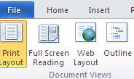
Using Ribbons & Tabs in Word 2010
The most common tabs show up first. The tabs File, Home, and Insert show up first in Word, Publisher, and PowerPoint
If a tab or command is not currently available, it will appear dimmed.
The Launcher button located to the right of some group names will show more available commands.
Notes:
This is an optional component. By turning if off (when it isn’t needed), you have more typing area.

Slide 12
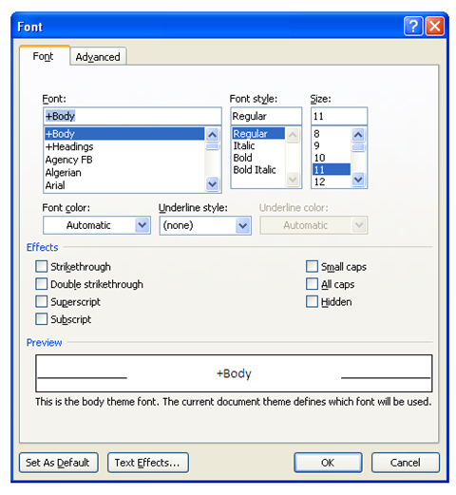
Using Ribbons & Tabs in Word 2010
The Launcher button on the Font group launches the Font dialog box.
Notice, you now have a Small caps option that is not available anywhere else.
Notes:
This is an optional component. By turning if off (when it isn’t needed), you have more typing area.

Slide 13
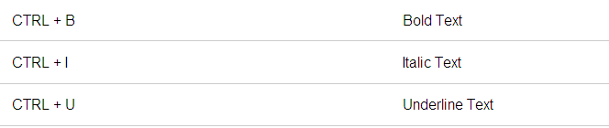
Shortcuts in Word 2010
A few popular shortcut keys are:
A few of my favorites (not listed on the site):
CTRL + 1 (single spacing)
CTRL + 2 (double spacing)
CTRL + 1.5 (1.5 line spacing)
For more shortcut keys, visit
http://www.addictivetips.com/windows-tips/microsoft-word-2010-shortcuts/
Notes:
This is an optional component. By turning if off (when it isn’t needed), you have more typing area.

Slide 14

Entering Text in Word 2010
Enter
Use the word wrap feature. Do NOT enter at the end of every line.
Only Enter to force a line ending (such as with address lines) or at the end of a paragraph. (A forced Enter is commonly called a hard return.)
With word wrap, should you decide to make your font smaller or larger, the text will automatically adjust to the best line ending.
Are you pressing the Enter key with your right pinky?
Notes:
This is an optional component. By turning if off (when it isn’t needed), you have more typing area.

Slide 15
Entering Text in Word 2010
Backspace
Backspace deletes to the left.
Delete deletes to the right.
Delete
Notes:
This is an optional component. By turning if off (when it isn’t needed), you have more typing area.

Slide 16
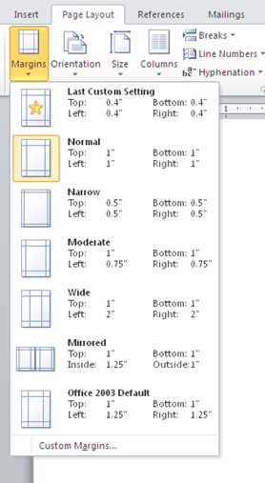
Entering Text in Word 2010
Margins
By default, Word 2010 uses one-inch (1”) for the top, bottom, left, and right margins.
You can customize the margins by clicking on the Page Layout tab and the down arrow on the Margins command.
Default: a selection automatically used by a computer program in the absence of a choice made by the user. Definition source: m-w.com
Notes:
This is an optional component. By turning if off (when it isn’t needed), you have more typing area.

Slide 17

Entering Text in Word 2010
Click & Type
You must be in Print Layout or Web Layout view for this to be available.
You are allowed to click anywhere and begin typing.
Notes:
This is an optional component. By turning if off (when it isn’t needed), you have more typing area.

Slide 18
Saving documents in Word 2010
Note: Word 2010 will automatically save without prompting you for a filename if the document has been saved at least once.
1
Click on File menu and Save command
2
Click the Save button on the QAT
3
CTRL + S launches Save As dialog box
4
Click File and Save As to save a different version or save to a new location
Shift + F12
5
Notes:
This is an optional component. By turning if off (when it isn’t needed), you have more typing area.

Slide 19
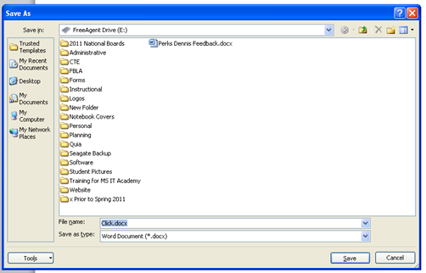
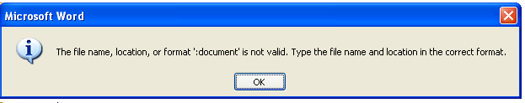
Save As Dialog Box
Click to change location.
Note: You can’t use some symbols in your filename. These symbols mean something specific to the software. If you do, you’ll get an error message, like this one.
Key a descriptive name.
Change document type. Do you need to make this a .doc file or .pdf for others to view?

Slide 20
Closing documents in Word 2010
1
Click on File menu and Close command
2
Click the X button at the right end of the title bar.
3
Press ALT + F4
Note: Word 2010 will automatically prompt you to save if you have edited the document.
If no edits to the document, it will just close.
Notes:
This is an optional component. By turning if off (when it isn’t needed), you have more typing area.

Slide 21
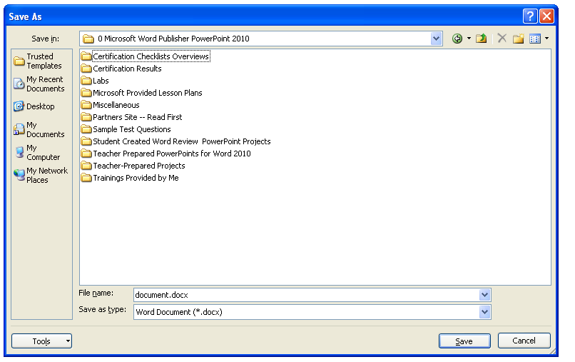
Folder Management
File management is very important for easy document retrieval.
Create a new folder with this command. It is suggested that you create a folder for each class that you are taking.
That way you can store all related files together.
Notes:
This is an optional component. By turning if off (when it isn’t needed), you have more typing area.

Slide 22
Now it is time for you to practice. Please complete the following:
Word Lesson 1, Exercise 1
Word Lesson 1, Project 1
Quia Quiz, Word Lesson 1

