Slide 1
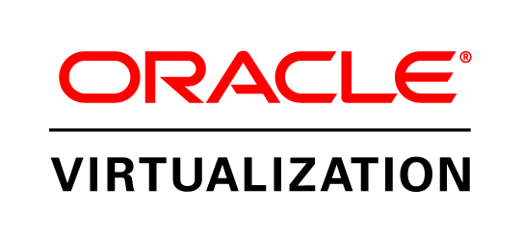
Virtualization Overview
Monica Kumar, Senior Director, Product Marketing
November 2011

Slide 2
Safe Harbor Statement
The following is intended to outline our general product direction. It is intended for information purposes only, and may not be incorporated into any contract. It is not a commitment to deliver any material, code, or functionality, and should not be relied upon in making purchasing decisions.
The development, release, and timing of any features or functionality described for Oracle’s products remains at the sole discretion of Oracle.
Notes:
2

Slide 3

Agenda
State of Virtualization
Oracle’s Virtualization Portfolio
Desktop Virtualization
Server Virtualization
Engineered for Oracle
Succeed with Oracle Virtualization

Slide 4
Evolving IT Needs
“Datacenters” are becoming “Service Centers”
Cloud computing is driving the need to deliver complete integrated stacks, not just components
On-going need for greater optimization & efficiency
Requirements are going beyond “just” operating systems provisioning
Isolated hypervisors are not good enough
Users need full stack provisioning and management
IT Needs to Deliver Ready to Run Services
Notes:
Information technology needs are rapidly evolving as data centers have now become service centers that have to deliver instantly, on demand, 24x7, responding to changing customer requirements with speed. Service level requirements have become more stringent. Cloud computing, as we all know, is becoming more pervasive in data centers, reflecting their end-users’ desire to get IT services “on-demand”.
So, the need for delivery of IT services are evolving as users are becoming less accepting of “build it yourself” philosophy and more demanding of resources “just in time, right when they need it”. There is an ongoing need for greater optimization and efficiency in how we deploy, manage and support software and solutions powering the data centers.
Virtualization is one of the key technologies used in data centers for optimization of resources. However, with the evolving needs of IT, you can no longer just consider “virtualization” as an isolated technology to solve a single problem.

Slide 5
Application-Driven Virtualization
The goal is not “virtualization” itself
Virtualization must enable the entire stack to be..
  Easier to DEPLOY
  Easier to MANAGE
  Easier to SUPPORT
Notes:
We want to make sure that it becomes very clear that virtualization is not a goal by itself. It is a means to a goal of enabling services-based IT.
Therefore, it is very important that users choose virtualization that is not a black box but choose virtualization that is application aware…virtualization that can enable their cloud environments and enable them to speed delivery of their IT services.

Slide 6
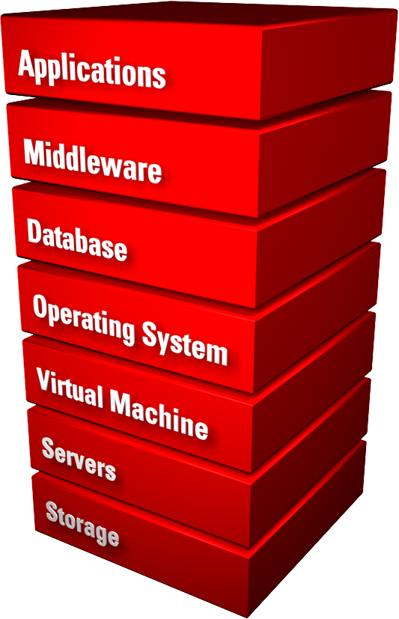
Oracle Virtualization
Most comprehensive
Fully tested with applications
Designed for full stack deployments
Integrated, full stack management
Integrated support
Notes:
This is where Oracle comes in. Only Oracle offers the industry's most complete and integrated virtualization solutions portfolio that can virtualize and manage the full hardware and software stack. With a focus on testing from applications to disk, integrated management and support, Oracle’s unique approach to virtualization enables IT to deliver on-demand services rapidly to their end-users.
I’d now like to invite Adam Hawley to give us more details on Oracle’s server virtualization solutions, and show how they deliver more value to users than VMware and the other virtualization technology providers.

Slide 7

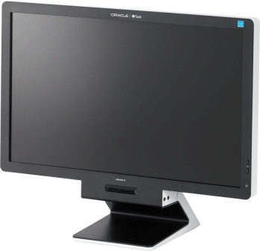
Oracle Virtualization
Industry’s Most Complete Product Line
S E R V E R V I R T U A L I Z A T I O N
D E S K T O P V I R T U A L I Z A T I O N
Oracle VM Server for x86
Oracle VM Server for SPARC (LDoms)
Oracle Solaris Containers
Dynamic Domains
Oracle Virtual Desktop Infrastructure
Sun Ray Clients
Oracle Secure Global Desktop
Oracle VM VirtualBox

Slide 8
Agenda
State of Virtualization
Oracle’s Virtualization Portfolio
Desktop Virtualization
Server Virtualization
Engineered for Oracle
Succeed with Oracle Virtualization

Slide 9
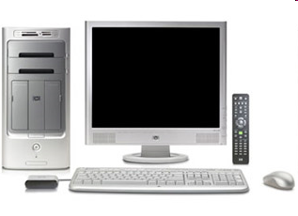

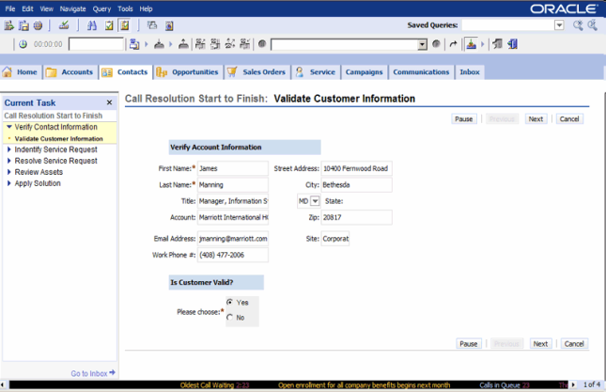
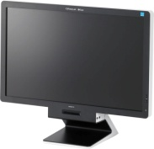

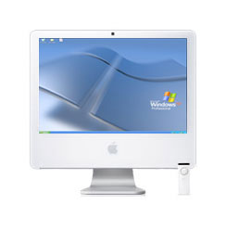
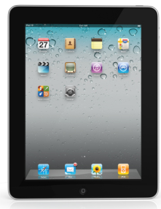
Oracle Virtualization
The Full Stack, End-to-End
DATA CENTER
USERS
Software Delivery Cloud
BROWSER
Enterprise applications
Industry applications
Solaris / Linux / Windows
Oracle Secure Global Desktop
Siebel
CRM
VMs
Solaris
Linux
Oracle Desktop Virtualization
THIN CLIENTS
Oracle VM
Siebel Contact Center
Oracle VM
Templates
&
Assemblies
Sun Servers & Storage
Oracle Sun Ray Client
Sun Servers & Storage
PCs, MACs,
MOBILE
DEVICES
Server Virtualization
Desktop Virtualization
Oracle Virtual Desktop Client
Provision the Full Stack…
…Provision User Access
Application-Driven Virtualization

Slide 10
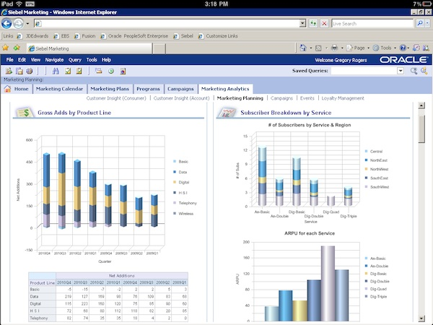
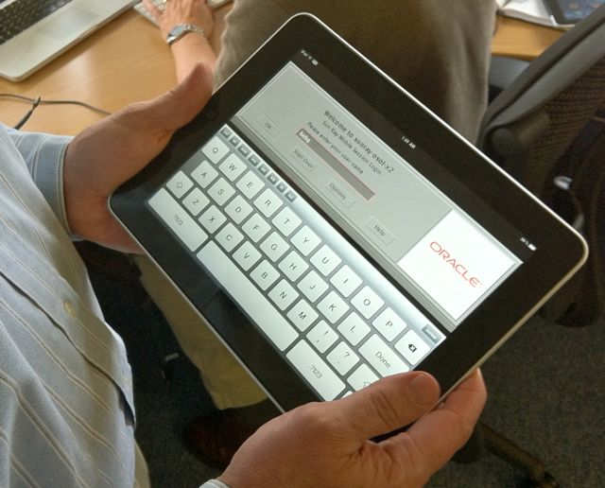
Oracle Virtual Desktop Client
Access Oracle Applications and Desktops from iPad & PCs
Access Siebel CRM, Oracle Enterprise Manager and more
Connects to Oracle Virtual Desktop Infrastructure or Sun Ray Software
Runs on Windows, Linux, Mac, iPad
On iPad, Intuitive, gesture-based interface and VPN support
Freely move sessions between Sun Ray Clients and any supported platform
Ideal for healthcare, contact centers, and public sector

Slide 11
Oracle Secure Global Desktop
Highly Flexible Application Publishing and Access Software
Allows applications to be hosted in the data center, enabling:
  High security
  Easier management
  Better performance
Open and Integrated, supporting RDP, X11, SSL/TLS, and other industry standards
Publish Windows, Oracle Linux, Oracle Solaris, Mainframe and midrange applications to nearly any device
Certified for use with all Oracle browser-based applications

Slide 12

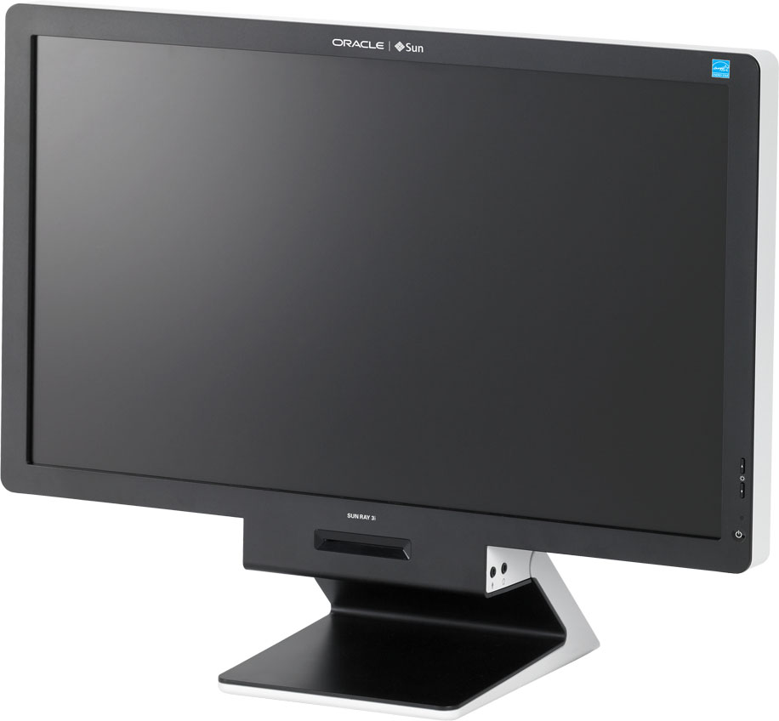
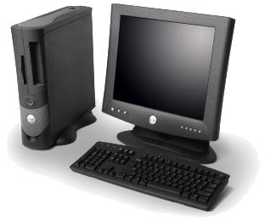

The Thinner, The Better
Lower Complexity, Reduce Cost
Standard PC
Embedded OS thin client
Sun Ray Client
Local Apps,
Local OS,
Memory, CPU,
Hard Drive
Local Apps,
Local OS,
Memory,
CPU
Nothing to
Manage!

Slide 13
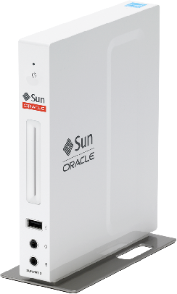
Sun Ray Clients
An Ideal Client for Virtual Desktops
No configuration necessary, connect immediately to servers
Displays full Windows, Oracle Linux, and Oracle Solaris desktops
Up to 1920x1080 HD resolution, 2 DVI ports, 5 USB ports, Gigabit Ethernet, fiber optic networking, two-way audio support and more
Energy efficient: as low as 6 watts, 98% recyclable and EPEAT Silver and Energy Star 5.0 qualified

Slide 14
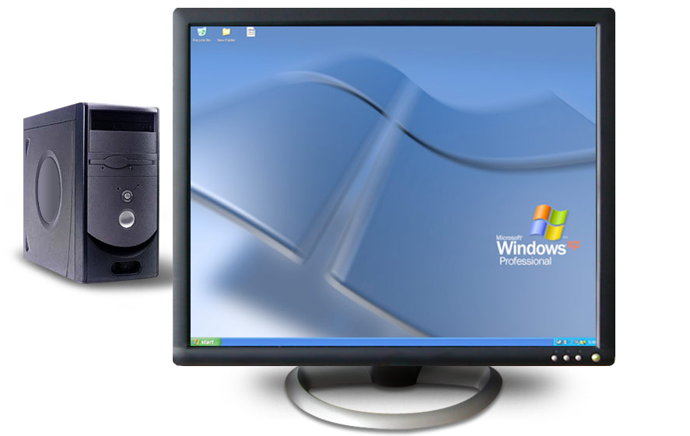

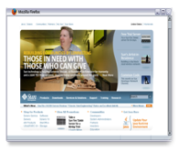
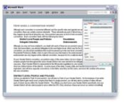

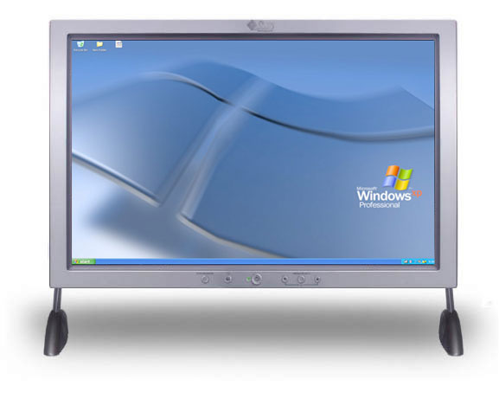
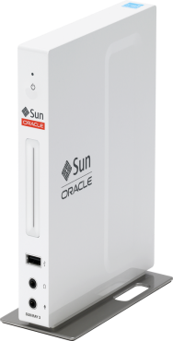
Oracle Virtual Desktop Infrastructure
Your Desktop on a PC
Your Desktop on a Mac
Your Desktop on a
Sun Ray client

Slide 15
Oracle Virtual Desktop Infrastructure
Highly Scalable, Cross-Platform VDI
Support for multiple VDI clusters, each supporting up to 100,000 users
Advanced multimedia allows video streaming, two-way audio with USB headsets
Choose between Windows, Oracle Linux, and Oracle Solaris virtual desktops

Slide 16
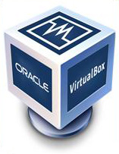
Oracle VM VirtualBox
The World’s Most Popular Open Source, Cross-Platform Workstation Virtualization
Run nearly any X86 OS
Run on any major X86 OS: Windows, Mac, Linux, Solaris
Supports iSCSI, local hardware acceleration, OpenGL, Windows Aero
Over 46 million downloads
Award winning workstation virtualization

Slide 17
Agenda
State of Virtualization
Oracle’s Virtualization Portfolio
Desktop Virtualization
Server Virtualization
Engineered for Oracle
Succeed with Oracle Virtualization

Slide 18
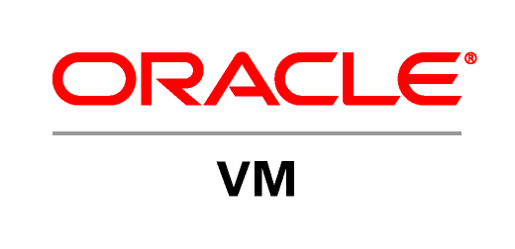
Oracle VM Server Virtualization
Available for both x86 and SPARC
Virtualization solution for both Oracle and non-Oracle applications
The only x86 server virtualization software supported and certified for all Oracle software
Free to download
Enterprise-quality support
Real-world deployment testing
Risk-free virtualization

Slide 19

Oracle VM 3.0
Application-Driven Virtualization
Transform the way you deploy and manage apps
Suitable for all datacenter workloads
  Linux, Solaris, and Windows
Engineered for Oracle
Lower Cost
Notes:
Speaker Notes:
“Oracle VM” includes both the Server and management components in one solution that is freely available, with no license cost.
Oracle VM Manager is the virtualization element manager included with Oracle VM
Oracle Enterprise Manager Grid Control is the system management product from Oracle for providing an integrated management environment for the full software stack together, whether on physical or virtual machines.

Slide 20
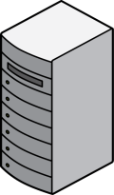
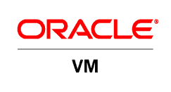

Oracle VM Server 3.0
Server Performance & Scalability
Support for Linux, Solaris, and Microsoft Windows on x86 servers
Support for PV- and hardware virtualized (HVM) virtual machines
Up to 128 vCPUs per guest
  4X VMware vSphere5
  Up to 160 physical CPUs per server tested
Up to 1TB memory per guest tested
  Up to 2TB physical per server tested
Notes:
Speaker Notes:
“Oracle VM” includes both the Server and management components in one solution that is freely available, with no license cost.
Oracle VM Manager is the virtualization element manager included with Oracle VM
Oracle Enterprise Manager Grid Control is the system management product from Oracle for providing an integrated management environment for the full software stack together, whether on physical or virtual machines.

Slide 21
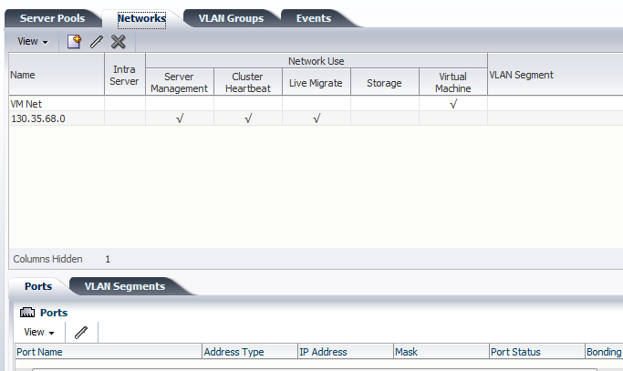
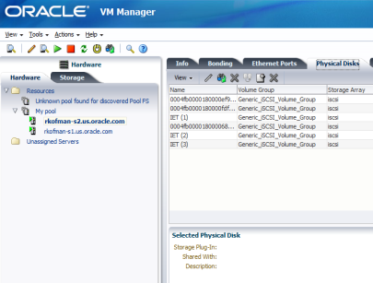
Oracle VM Manager 3.0
Scalability to Support Your Entire Datacenter
Manage hundreds or thousands of VMs centrally
Centralized management server
  Web browser-based: No client required
  Enterprise-grade scalability included
    WebLogic Server application server
    Oracle Database
Comprehensive
  Advanced virtualization management included
Notes:
Speaker Notes:
“Oracle VM” includes both the Server and management components in one solution that is freely available, with no license cost.
Oracle VM Manager is the virtualization element manager included with Oracle VM
Oracle Enterprise Manager Grid Control is the system management product from Oracle for providing an integrated management environment for the full software stack together, whether on physical or virtual machines.

Slide 22
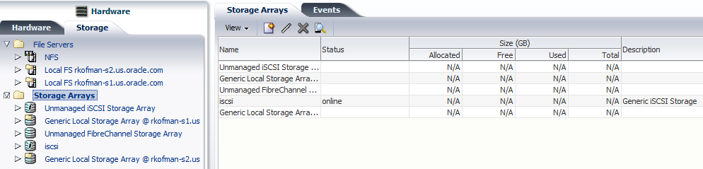

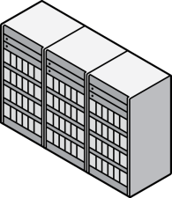


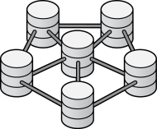
Oracle VM Storage Connect
Advanced Storage Operations
Storage Connect Plug-In Framework & API
Create LUN
Oracle Plug-In
Partner Plug-In
vendor_specific_command_CREATE_LUN
Sun Storage
Partner Storage
3.0
Storage Repositories
CLONE VM
OCFS2 Plug-In
_INSTANT_CLONE
More than just provisioning…
Create LUNs or Volumes
Expand LUNs or Volumes
Associate, share with VMs
OCFS2 Filesystem
Storage Connect Plug-Ins for Management…
Oracle and 3rd party storage…from the Manager UI
JBOD

Slide 23
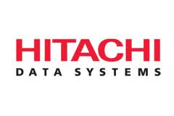

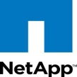
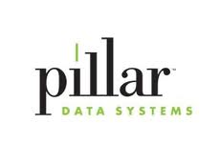


Oracle VM Storage Connect
Notes:
New Updates in RED…
We are working with the top vendors to deliver a number of plug-ins
Fujitsu will have their plug-in available at Oracle OpenWorld.
Pillar will release in Oct so they should be fine to mention
ZFS…YES! Available 2HOct
NetApp: ships Dec
EMC: NO…specifically requested NOT to mention/include
Hitachi: maybe

Slide 24
Oracle VM 3.0: Innovation Continues
More Features, More Integration
Windows PV drivers for Oracle VM 3.0 beta; includes support for the Oracle VM VMAPI
Oracle Linux VM API drivers and utilities (manager/guest communications)
Oracle VM 3.0.2 Released
  Support for Oracle Enterprise Manager 12c
  ISO release and update for 3.0.1 to 3.0.2

Slide 25


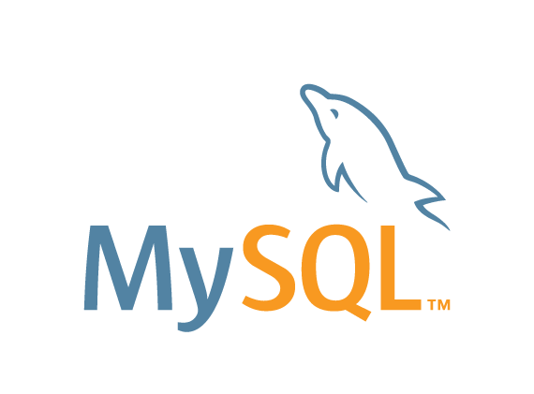


Oracle VM Server for SPARC
For your Enterprise Server Workloads
Isolated OS and applications in each logical (or virtual) domain
Firmware-based hypervisor
SPARC Hypervisor
Each logical domain runs in dedicated CPU thread(s)
T-Series
Server
Optimized for SPARC / Oracle Solaris
Notes:
25
Oracle VM Server for SPARC, previously called Sun Logical Domains, provides highly efficient, enterprise-class virtualization capabilities for Oracle’s SPARC T-Series servers.
Oracle VM Server for SPARC leverages the built-in hypervisor to subdivide system resources (CPUs, memory, network, and storage) by creating partitions called logical (or virtual) domains. Each logical domain can run an independent operating system.
Oracle VM Server for SPARC provides the flexibility to deploy multiple Oracle Solaris operating systems simultaneously on a single platform.
This is the virtualization solution that fully optimizes Oracle Solaris and SPARC for your enterprise server workloads.

Slide 26
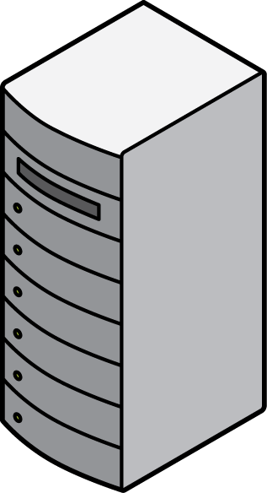
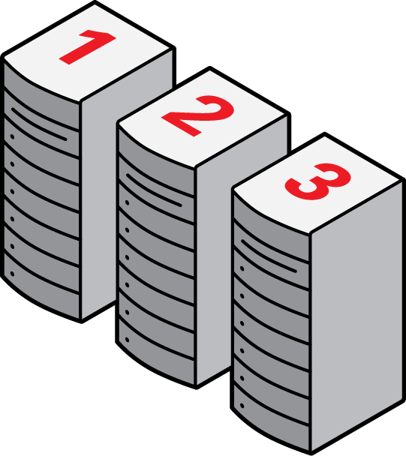
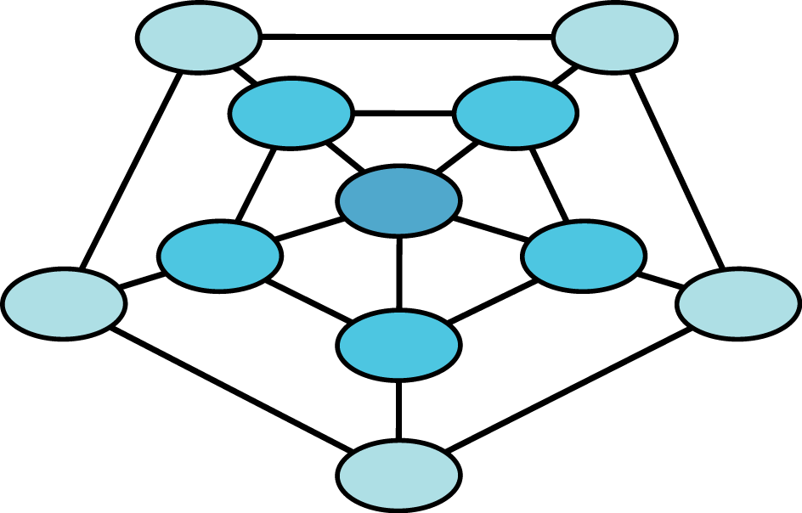
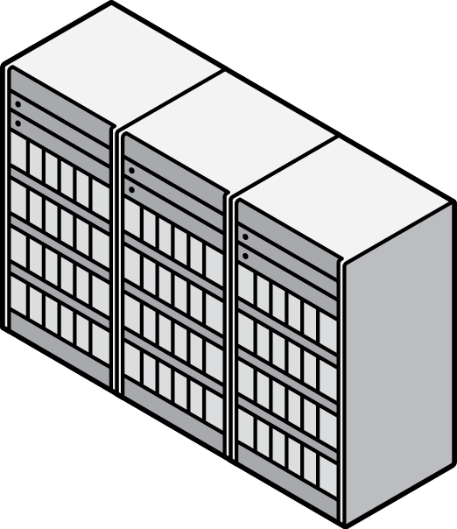

Secure Live Migration
Eliminates Application Downtime
Live migration now available on SPARC T-Series systems
  SPARC T4
  SPARC T3
  UltraSPARC T2 Plus
  UltraSPARC T2
On-chip crypto accelerators deliver secure, wire speed encryption for live migration
  No additional hardware required
  Eliminates requirement for dedicated network
Shared Storage
Notes:
Live migration: Enables users to migrate an active domain to another host machine while maintaining application services to users. Secure, encrypted migration included: On-chip cryptographic accelerators deliver secure, wire speed encryption capabilities for live migration – without any additional hardware investments.
Other products (including VMware) migrate VM data in the clear
Requires dedicated network
Leaves sensitive data vulnerable (passwords, account numbers, etc.)

Slide 27
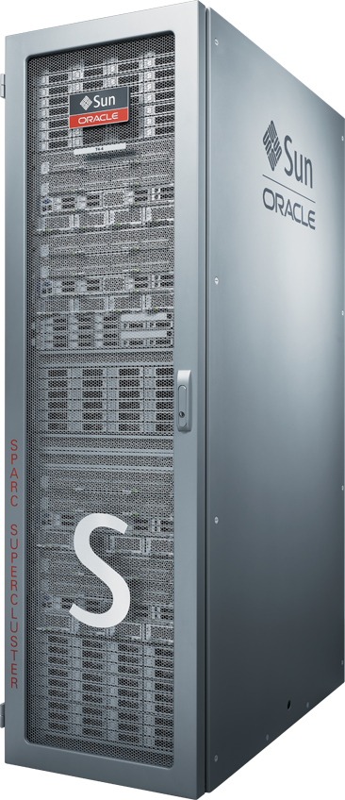
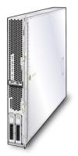
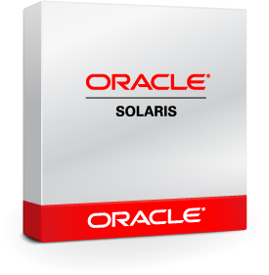
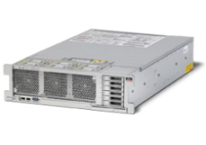
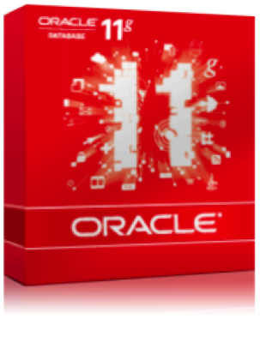

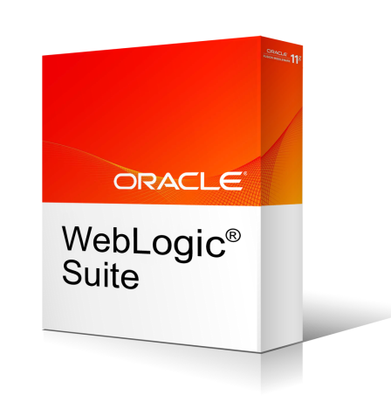
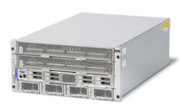
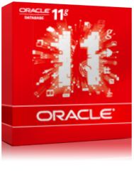
Oracle VM Server for SPARC
Optimized for SPARC T4
SPARC T4 Servers
  Use dynamic CPU threading controls to optimize workload performance, enabled by Oracle VM Server for SPARC
SPARC SuperCluster T4-4 System
  Integrates Oracle VM Server for SPARC to power many Oracle Solaris instances
NEW
Notes:
Starting with the Oracle VM Server for SPARC 2.1 patch release (147507-01), you can use dynamic CPU threading controls to optimize workload performance on SPARC T4 systems. These threading controls enable you to specify the number of hardware threads to be activated per core. CPU performance can be optimized for CPU-bound workloads by tuning CPU cores to maximize the number of instructions per cycle (IPC). Or, CPU performance can be optimized for maximum throughput by tuning CPU cores to use a maximum number of CPU threads. By default, the CPU is tuned for maximum throughput.
For each SPARC T4 in SPARC SuperCluster, up to 4 guest domains can be created, one per processor. The Oracle VM server configuration, and in particular the number of guest domains and type of each guest domain, is established during initial install and cannot be changed afterwards. CPU and memory can be changed by the customer within certain boundaries; a T4-4 reboot is required after such changes.
At the product RR, we're not supporting live migration of guest domain on SuperCluster T4-4. A single SPARC SuperCluster cabinet has full hardware redundancy, and can provide application availability by adding Oracle Solaris Cluster to the nodes.

Slide 28

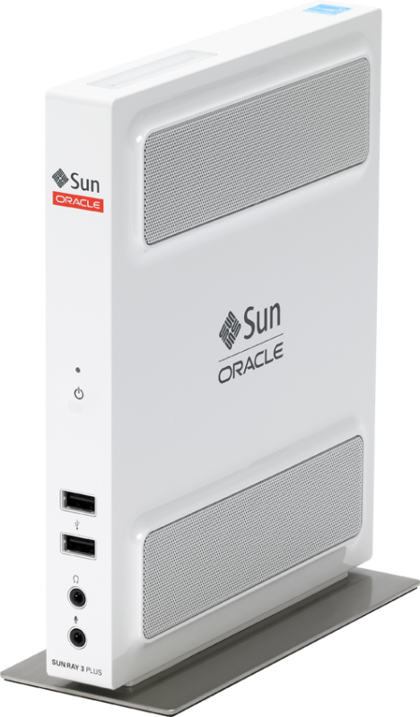
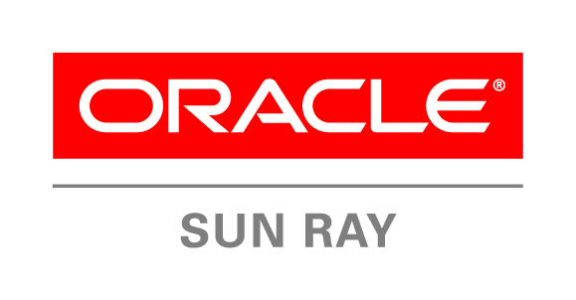
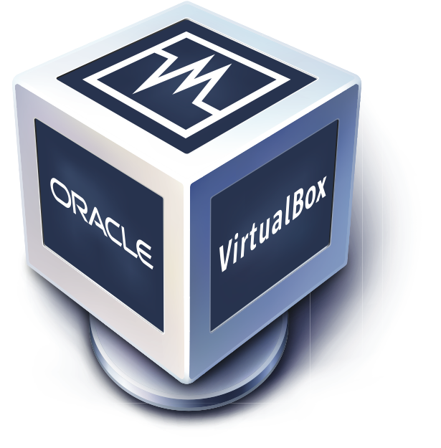
Oracle Server and Desktop Virtualization
Continuous Innovation
SERVER VIRTUALIZATION
Oracle VM Manager 3
Oracle VM 3 Server for x86
Oracle VM for SPARC 2.0
Oracle VM for SPARC 2.1
DESKTOP VIRTUALIZATION
Sun Ray 3+ Client
Sun Ray 3 Client
Sun Ray 3i Client
Oracle Virtual Desktop Client for iPad
Oracle Secure Global Desktop 4.6
Oracle VDI 3.2
Oracle VDI 3.3
Oracle Sun Ray Software 5.1
Oracle Sun Ray Software 5.2
Oracle VM VirtualBox 3.2
Oracle VM VirtualBox 4.0
Oracle VM VirtualBox 4.0
Q2 CY2010
Q3 CY2010
Q4 CY2010
Q1 CY2011
Q2 CY2011
Q3 CY2011
Notes:
I was referring to Oracle delivering more and better products than ever before, here is what we delivered during the past 12 months or so.
Go through the slide

Slide 29
Agenda
State of Virtualization
Oracle’s Virtualization Portfolio
Desktop Virtualization
Server Virtualization
Engineered for Oracle
Succeed with Oracle Virtualization

Slide 30
Oracle VM 3.0
Engineered for Oracle
At the core of Oracle’s middleware
and cloud strategy
Virtual platform for Oracle applications
Integrated management of the virtual stack with Oracle Enterprise Manager 12c
Rapid application deployment and management

Slide 31


Oracle VM Templates
Rapid Deployment; 90+ Templates Available
Download from Oracle
Pre-built, pre-configured, production-ready VM
Apps, Databases, Middleware, OS
Siebel CRM, Database 11g, Enterprise Manager, More…
Oracle VM
Servers
Siebel
CRM
Siebel
CRM
File
File
Siebel
CRM
VM 1
Software Delivery Cloud
Import to
Oracle VM
Manager
Server
Pool 2
Download
Start-up in
Oracle VM Pool
Customize & Save
as Golden Image
Notes:
Speaker Notes:
Faster Application Deployment with VM Templates – Download and import pre-configured virtual machines containing pre-installed Oracle enterprise applications or other software to get up and running in hours not weeks
Full-production licensed software

Slide 32


Oracle Virtual Assembly Builder
Standardize Configurations, Automated Provisioning
Capture Complete
Application Topology
Package Into
Single Assembly
Automate Deployment
Into OVM Pool
HTTP
HTTP
Oracle Enterprise Manager
OVM
OVM
WLS
OVM
DB
Metadata
OVM
Oracle VM Resource Pool
Package complex, multi-tier, multi-VM applications into single, portable assembly
Deploy assembly onto Oracle VM pool with automated configuration and late-binding parameters
Notes:
Position OVAB in the context of EM

Slide 33
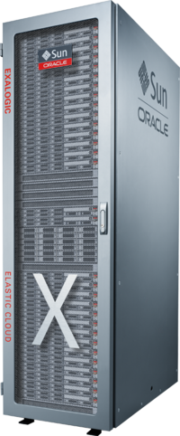
Oracle VM & Engineered Systems
Engineered to Work Together
NEW! Oracle SPARC SuperCluster T4-4
Engineered systems
  The ULTIMATE in performance
  Now with enhanced utilization, management, and flexibility with Oracle VM
SPARC SuperCluster T4
  Now using Oracle VM for SPARC 2.1
Future: Exalogic Elastic Cloud Software 2.0
  Using Oracle VM for x86 3.0
Virtualization engineered for optimum performance
Future: Oracle Exalogic Elastic Cloud

Slide 34


Oracle Enterprise Manager 12c
Complete VM and Cloud Lifecycle Management
Optimize
Plan
Applications
Meter and
Charge
PaaS
Setup
IaaS
Manage
and Support
Build, Test and
Deploy Apps
Monitor
Notes:
Not Just the VM but also the App Running Inside the VM
Plan
Identify all IT assets
Decide apps, cost models, policies, roles…
Consolidation planning (P2V, P2E, DB, App..)
Setup
Create pools, zones …
Setup shared components
Setup services (IaaS, DBaaS, PaaS, Apps)
Setup self service portal
Build, Test and Deploy Applications
Assemble using shared components
Test & deploy apps through self services
Monitor
End-user/business monitoring (BDAM: user exp, BT, BS, AS, business services, business KPIs…)
App monitoring (App uptime,/health, perf, SLM..)
Infrastructure monitoring (A2D, compliance, etc)
Manage and Support
Start/stop services
Policy driven scale up/down
Backup/recovery
Manage downtime: patch, upgrade…
Meter and Charge
Meter resource utilization and cloud usage
Optionally chargeback to users/departments
Optimize
Optimize cloud: performance, capacity, QOS, agility, geography, people, costs…

Slide 35
Agenda
State of Virtualization
Oracle’s Virtualization Portfolio
Desktop Virtualization
Server Virtualization
Engineered for Oracle
Succeed with Oracle Virtualization

Slide 36
Lower Cost: Oracle VM 3.0 vs. VMware vSphere5 250 2-Socket Servers for 3yrs, 96GB vRAM per server
 | Oracle VM 3 | VMware vSphere5
Virtualization: | Oracle VM (2-socket system, Premier Support, unlimited VMs, unlimited vRAM) License - $0 Support - $599 / server / yr | VMware vSphere5 Enterprise Plus Edition (per socket, 96GB vRAM) License - $3495 x 2 sockets = $6990 Support (Production) - $874 x 2 = $1748/yr
Management | Oracle VM Manager License - $0 Support - $0 | VMware vCenter Server Standard License - $4995 Support - $1249 (1yr Production SnS / instance)
Total Cost (Annual) | License: $0 Oracle VM (annual): $149,750 | VMware Lic (perpetual): $1,752,495 VMware Support (annual): $438,249
Total Cost (3 Years) | $499,250 | $3,067,242 (6.1X Oracle)
What could you do with the $2,567,992 you save with Oracle VM 3.0?
Source: http://www.vmware.com/files/pdf/vsphere_pricing.pdf

Slide 37
Oracle Delivers More Value Than VMware
Reason | Details
Application-Driven | Complete apps to disk stack with virtualization fully integrated into each layer of the stack. Oracle virtualization has full awareness of what’s running inside the VM and can provision and manage apps, middleware and database VMware offers hypervisor only, without integration with apps
Lower cost | Unlike VMware, Oracle VM is free to use, download and distribute Affordable support fees; simple licensing Oracle VM support included with Oracle’s Sun x86 systems support at no additional fees
Integrated Management | Single tool manages hypervisor, operating system, database and apps Single point of support from Apps to Disk VMware management can only manage the hypervisor
Faster App Deployment | Oracle VM Templates and Oracle Virtual Assembly Builder enable deployment of enterprise software in minutes as opposed to days, and help create multi-tier software assemblies quickly – eg. PSFT, Siebel, EBS, more VMware offers third party software appliances for testing and dev purposes
Scalability | With support for 128 vCPUs in each virtual machine, Oracle VM is 4 times more scalable than VMware which only supports 32 vCPUs per virtual machine. Useful for virtualizing heavy duty database and applications workloads

Slide 38
Oracle Delivers More Value Than VMware
Reason | Details
Architected for Efficiency | Oracle VM architected for low performance overhead when moving DB and Apps from physical to virtual servers Same engineering team for Xen and Linux; better integration Aggressive testing with real DB and Apps workloads VMware’s architecture is prone to high performance overhead
Better High Availability (HA) | Unlike VMware, Oracle offers HA for the entire stack, not just the hypervisor Oracle VM customers can use Oracle Clusterware for additional HA Clustering and virtualization complementary; RAC works with Oracle VM
Virtualization Built into the System | Included with Sun x86 systems Besides Oracle VM, Oracle also offers Solaris Containers, virtualization built into Oracle Solaris,. And Dynamic Domains built into the M-series hardware
Comprehensive Platform Support | While VMware only supports x86 architecture, Oracle VM supports both x86 and SPARC architectures.
Integrated Support | One call to Oracle for the complete stack; no finger pointing Faster time to resolution Better performance for virtual database and apps

Slide 39

UMASS Cuts IT Overhead by 60% with Oracle VM
“About 80 percent of our applications are from Oracle, so if Oracle can provide support from top to bottom, it makes sense for us to take advantage of that.”
Michael Poole
Chief Technology Officer, University of Massachusetts

Slide 40

“In the past, it used to take 6 to 10 weeks to provision a physical server. With Oracle VM, we can have a virtual machine up and running in 35 minutes.”
Christine Varga
Business Systems Analyst, Parks Victoria

Slide 41

“We can use existing Oracle VM Templates to build fully-blown, fully-installed, fully-configured environments to support specific new technologies or development requirements. We can simply grab a template and have a fully deployable system very quickly.”
Raymond Payne
Principal Systems Architect, Johns Hopkins Applied Physics Lab

Slide 42



Oracle Eco-Enterprise Innovation Awards
Prestigious award, recognizing customers using Oracle products to support sustainability initiatives and reduce environmental impact
Two desktop virtualization customers selected as 2011 award winners:
Denver Health Hospital
Gunsan City Hall

Slide 43
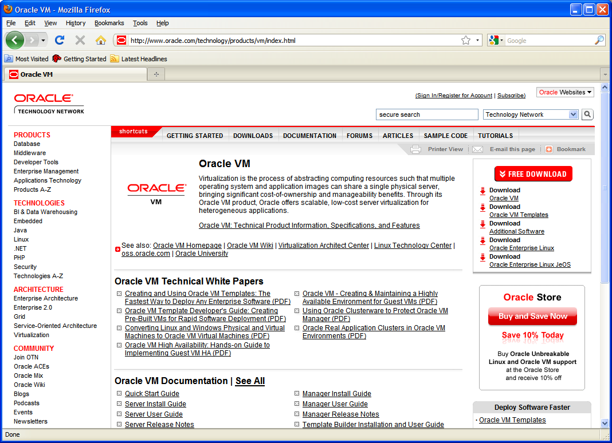
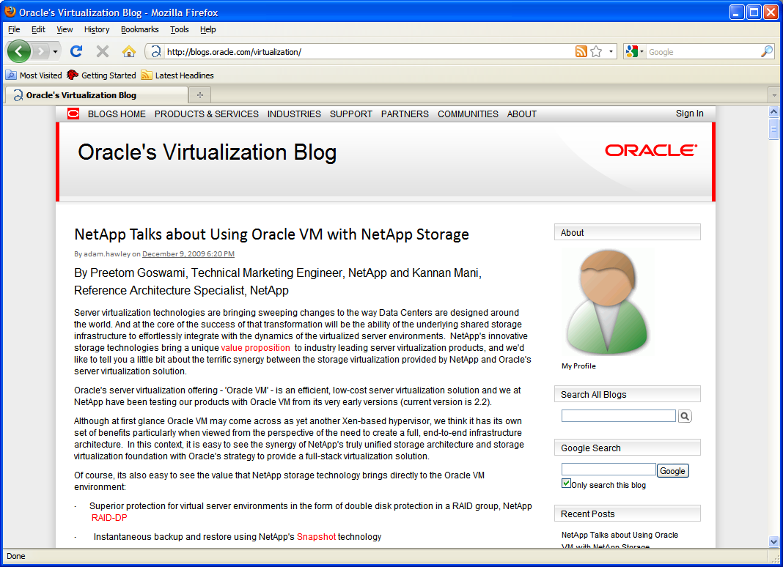
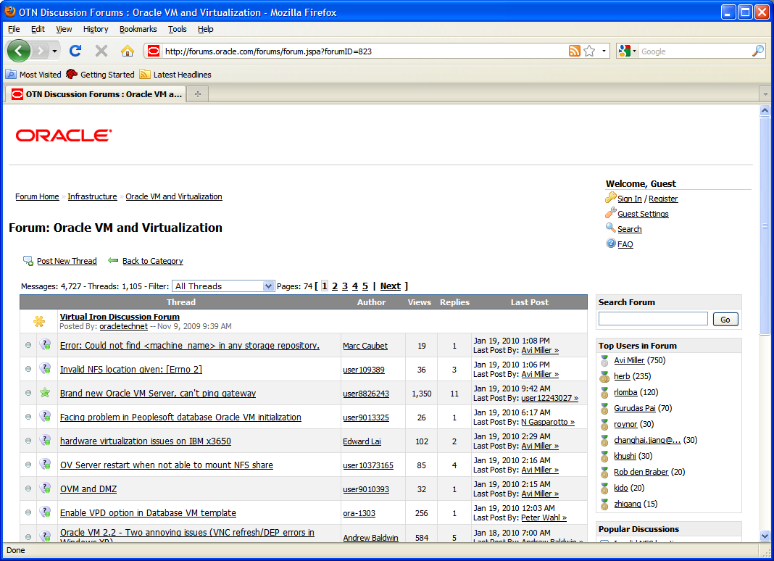
Oracle Virtualization
Home Page oracle.com/virtualization
Twitter twitter.com/orcl_virtualize
Facebook facebook.com/oraclevirtualization
Blog blogs.oracle.com/virtualization
Download edelivery.oracle.com/oraclevm

Slide 44



Slide 45
Q&A

