Slide 1
IT Trends and Industry Vision
Doug Bourgeois, Vice President, Chief Cloud Executive, VMware US Public Sector
Best Practices for Consolidation, Efficiency and Agility in the Data Center
June 26, 2013

Slide 2
Agenda
Background and IT Industry Trends
Journey to IT as a Service
Phase 1: Data Center Consolidation
Phase 2: Software Defined Data Center
Phase 3: Hybrid Cloud Computing
Transforming the Organization

Slide 3

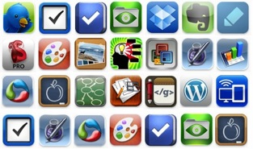



The Shifting Landscape
IT Trends
Transition to IT as a Service
Software Defined Data Center
Multi-device Mobility
Big Data
Application Ecosystem
Work Style
Applications
Devices
Delivery Methods
Notes:
We are facing considerable change in this new era:
New virtual and cloud sourced infrastructure models
New device form factors to support mobility, with enhanced user experiences born from consumer technology
Leading to a new class of mobile and SaaS applications
Supporting more real-time, collaborative work styles

Slide 4

The Journey to IT as a Service
Efficiency
Quality & Agility
IT–as-a-Service
% Virtualized
Reactive
Proactive
Many customers
Phase 1
IT Owned Apps
and Services
Phase 2
Mission Critical Apps
Standardize Services
Start Private Cloud
Phase 3
Automated Ops & Metrics
Choice of Cloud Models
Application Transformation
Consolidation
Automation
Optimization
OpEx savings
CapEx savings
Software-Defined Datacenter
Notes:
The NYSE and Revlon has created an IT organization that is agile, secure, automated, and competitive edge…what many companies experience as they move further along in their virtualization journey.
For many of our IT customers, what started out as CapEx savings in the data center grows to providing high value operational efficiencies in the business
In every phase of the journey, virtualization drives real value: cost, agility, ITaaS.
Reduce the Complexity by moving from discrete, siloed infrastructure components, and the management of silos, to pooled infrastructure that can be managed holistically.
In Phase 2: Dramatically Lower Costs through maximum utilization of resources by effective pooling, increased automation of operational processes, and the appropriate use of available public cloud services.
Enable Flexible, Agile IT Service Delivery through policy-driven automation and self-service capabilities, regardless of where these services are sourced from.
The net of these initiatives is to drive new levels of IT agility, and thus drive increased business value through IT.
Don’t want to trivialize what is behind each of these phases: a lot of effort, time, and money.
Many of our customers are in the early stages of phase 2 and poised to gain the capital and operational efficiencies in virtualizing their applications

Slide 5
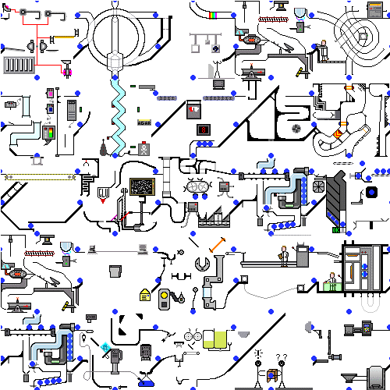

The Problem – Complexity, Inefficiency, Inflexibility
We spend too much time and money managing our data centers…
Our independent operating units need to be efficient and respond to customers….
How can we efficiently provide the mission with the agility they need and maintain security?

Slide 6
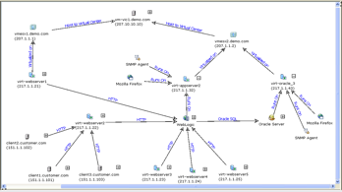



Phase 1: Data Center Consolidation
  Baseline
  Dependency mapping and logical groupings
  Workload performance baseline
  Capacity projections and optimization
  Architect target environment
ESX to VC Dependencies
Virtualized On Relationship
ESX server
VMs
Virtual to Virtual Dependencies
Physical to Virtual Dependencies
Discover instances of DBs, Application servers, etc
Replicated licenses and roles
  Virtualize
  Establish local consolidation points
  Build target environment
  Execute local consolidation
  Optimize virtual workloads
vCenter
Server
vCenter
Server
vCenter
Server
vCenter
Server
vCenter
Server
vCenter
Server
ESXi
ESX
ESX
ESXi
ESXi
ESXi
ESX
  Consolidate
  Re-establish dependencies
  Migrate vApps
  Complete regression testing
  Decommission source environments

Slide 7
Continue with Virtualization of Workloads
% of Workload Instances That Are Virtualized
Main Drivers are Significant Investments in:
  Performance and availability
  Uptime and reliability
  Extensibility
  Security and hardening
Source: VMware customer survey, Jan 2010, Jun 2011, Mar 2012
Question: Total number of instances of that workload deployed in your organization and the percentage of those instances that are virtualized.

Slide 8
Phase 2: The Journey From Virtualization to SDDC
Automated Service
Provisioning
SDDC
ITaaS
Software-Defined
Storage and Availability
Virtual Networking and Security
Performance
Operations
Management
Application Rationalization
Costs and Pricing
Virtual
Organization Design
Notes:
There are two ways to get there
Let break it down for you about how to get there
Here’s a logical path…

Slide 9


Major Roles of Operations Management
Ensure and Restore
Service Levels
Optimize for
Efficiency and Cost
Monitor
Isolate
Remediate
Plan
Automate
Optimize
Slow performance
Utilization / forecast
!
Problem
Maintenance
Rollback change
Config issue
Orchestrate changes
Reclaim capacity
Reactive
Proactive
Notes:
When we look at the day in the life of a cloud administrator, there are 2 major tasks to ensure the cloud is operating well.
One is Reactive Problem Solving and the other is Proactive maintenance.
Reactive Problem solving generally starts with an Alert if you have the right system in place or if you don’t, likely from the application team facing a performance problem. The job of the cloud admin is to Detect the problem in the cloud infrastructure (such as a slow performance in VM), Isolate the issue ( which could even be a config problem with a patch applied at the OS layer) and then Remediate the issue (by performing actions such as Rolling back the patch)
The other is Proactive Maintenance to avoid the problem from happening. This task involves Planning (such as looking at Utilization, forecasts), Optimize (such as reclaiming capacity) and even Automating the maintenance (via orchestration).
That’s where vCenter Operations comes in to provide Automated Operations management for the cloud. In the next few slides, we’ll take a look how vCenter Operations helps cloud administrators in both these tasks.

Slide 10
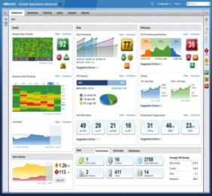



Virtualization Operations Predictive Analysis
Overview
Comprehensive dashboard for cloud operations
Single tool to manage performance and capacity across multiple servers
Benefits
End-to-end visibility into cloud infrastructure health and application services
Proactive incident avoidance
Optimize for efficiency and cost
Results
Reduce CapEx by up to 30%
Increase utilization by up to 40%
Improve MTTR by up to 26%
Sources: Forrester Consulting, “The Total Economic Impact of VMware vCenter Operations Management Suite,” December 2012; Management Insight Technologies, “The Benefits of VMware’s vCenter Operations Management Suite,” September 2012

Slide 11







Software Defined Storage
Software Defined Data Center
Abstract storage services
Pool local and external storage
Automated provisioning across local and external storage
Support needs of “new” apps
VDC
Software-defined
Datacenter Services
Software Defined Storage
Compute Virtualization Abstraction Layer
Physical
Infrastructure
Notes:
The solution, of course, if to virtualize away the network.

Slide 12






Transform the Network with Virtualization
Software-Defined Data Center
Programmatic provisioning
Run any workload anywhere
Decouple services from hardware
Operationally efficient
VDC
Software-defined
Datacenter Services
Network Virtualization Abstraction Layer
Compute Virtualization Abstraction Layer
Physical
Infrastructure
Notes:
The solution, of course, if to virtualize away the network.

Slide 13





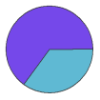






Automated Service Provisioning Improves Agility
VMware vCloud Director
Organization: Mission Program
Organization: Support Services
Users & Policies
Organization VDCs
Catalogs
Users & Policies
Organization VDCs
Catalogs
Provider Virtual Datacenters
(Gold)
(Silver)
(Bronze)
VMware vCenter Server
Resource Pools
Datastores
Port Groups
VMware vSphere
Secure Private Cloud
(Gold)
(Silver)
(Bronze)
Notes:
All icons separated out.

Slide 14

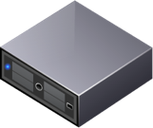









SDDC Improves Agility and Reduces Cost
Physical Provisioning
VM: Compute Becomes Software-Defined
Software Defined Datacenter: Logical compute, networking, security, storage, availability
But other services are still hardware delivered
Storage
VDC
+
VLAN networks
Time taken to provision datacenter services (weeks)
10 weeks
Firewall
Security, monitoring
$10,000
10 weeks
$1800
5 days
15 minutes
Availability
15 minutes
Physical provisioning
Virtualization
Software defined compute
The Software-defined
Datacenter
Notes:
Thanks to virtualization, compute became software-defined. A VM is very cost efficient today. And, because it’s a software-defined construct, it’s flexible, easy to automate, and deployable in minutes.
<click>
But VM’s are in reality today dependent on physical storage, physical networks, security and availability services that are largely delivered via hardware. These services are expensive, inflexible, manually configured and provisioned, and difficult to automate…. Resulting in higher total cost and decreased agility.
There’s clearly a mismatch.
So, here’s the opportunity: through a software-defined approach, VMware aims to reduce costs and increase the agility not just for the VM but across the entire datacenter.
How?
Through a couple of mechanisms:
#1. We’ll enable placing a VM into a pre-defined container that comes bundled with storage, networking, security, and availability services…. As such, by virtue of placing the VM into a predefined bundle, it’s going to be faster and easier to deploy your applications than it is today (against hardware-defined services)… thereby, reducing TCO and improving agility
#2. These datacenter services are going to be software-defined…
We’ll talk in this deep-dive session about how we enable these services at the VDC, how to manage the VDC and then how to enable consumers of the VDC.
ED Add:
Fundamentally, this “Virtual Datacenter” can provide services just like a physical datacenter does. A physical datacenter provides cooling services to physical machines. A Virtual Datacenter, though, can provide services like firewalling, data protection…in a much more efficient way than a physical datacenter can, because these services are defined in software.

Slide 15
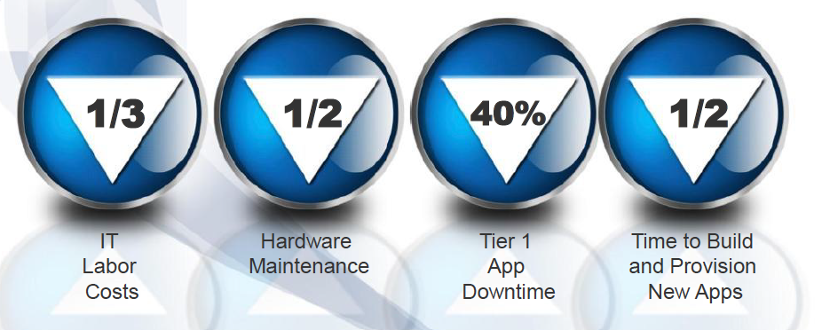
Benefits Achieved by SDDC (total customer base)

Slide 16

Phase 3: Hybrid Cloud Computing
Internal Private
Cloud
Cloud Service
Providers
Bridging
  Internal Private Cloud
  Operated solely for an Agency typically within the firewall
  Service Provider Clouds
  Accessible over various networks for customer consumption
  Hybrid Cloud
  Composition of two or more interoperable clouds, enabling data and application portability
Private and public clouds
Efficiencies vary widely
Commodity workloads
Common workloads
Option for new workloads
Greater control over security, compliance, QoS
Easier integration
Support existing applications
Optimal cost efficiency
Federated security model
Integrated management
Open standards for mobility
Notes:
A common mis-perception is that cloud computing implies an “external” cloud, based on public cloud services (e.g. Amazon or Google).
Ultimately, most Agencies will benefit from adopting cloud computing within their own datacenters, thus building “private clouds.”
This is where most Agencies will begin their initial cloud journeys – building the private cloud.
At the same time, service providers will also be migrating their architectures and services to a cloud approach.
Thus, VMware recognizes the critical need to ensure private and service provider clouds (both public and private) are interoperable.
It is our intent to make “hyrbrid clouds” a reality, through a common platform built on vSphere, with common management and security models to give the enterprise the confidence they need, in an environment that provides on-demand application portability.
VMware is committed to an open standards approach to application portability.

Slide 17




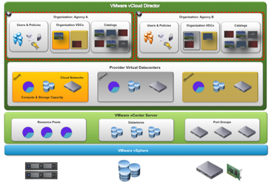

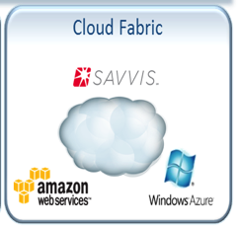

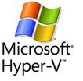







How Does the SDDC fit within the Hybrid Cloud?
Business Process
Automation
Self Service
Workflow
Portal
Service Catalog
Cloud Operations
Security & Compliance
Hardware
Hyper-
visors
Private Cloud
Private / Public Cloud

Slide 18

























A New Architecture for End User Computing
Apps & Data Everywhere
Diverse Access Points
Universal App Catalog and Workflow
Browser
Windows
Legacy Apps
Windows
SaaS
Services
Broker
Virtual Desktop
Mobile
Apps
iOS
Entitlements, Policies and Reporting
Data
Services
Android

Slide 19


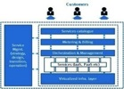

Best Practice: Transforming the Role of the Organization
Don’t Underestimate the Importance of Communications and Training
A NEW BUSINESS MODEL
Service Oriented
Customer Driven
Financial Transparency
Services Broker
PROCESS INNOVATION
Monitoring & Management
Planning & Architecture
Budget and Finance
Governance
ORGANIZATIONAL ALIGNMENT
“Front Office” Capabilities
Role Transformation
Incentives & Accountability
Communication
Notes:
The case for transformation is really rooted in our legacy – in how we’ve behaved, how we’ve been run, and how we’ve been organized in the past
IT-as-a-Service means taking that virtual hosting platform and layering on top of that some key capabilities involving extensive automation
The real goal is “optimizing IT production for business consumption” – what’s good for IT may not always be what’s good for the business
If we are going to compete with external IT service providers, we have to be organized and operate like IT service providers that can win the business
A New IT Business Model
Now we will focus on transforming to a model that looks more like a professional services organization than a customer services organization
We have to start with the services as opposed to the technology – our clients are not consuming a technology, they are consuming a “business capability”
Enabling Technology
This is probably the easiest of the three, and the main focus of our first two phases
DNA, Skills, Roles & Organizational Alignment – this is our focus now
Important to focus on “front office” capabilities – “front office” meaning the marketing and sale of IT services

Slide 20
Best Practice: Establish the Business Model
The Business Model Includes Services, Costs, Pricing, and Budget
SERVICE COSTING
PRICING ANALYSIS
METERING/INVOICING
1
2
3
4
5
6
7
8
Define Services Categories
Allocate
All Costs
Determine Unit Drivers
Derive Unit Costs
Determine Unit Prices
Measure
Service
Consumption
Invoice Business Units
Funds Transfer From BU
To IT
Phase 1
Design
Phase 2
Baseline
Phase 3
Operate

Slide 21

Benefits of Transformation to IT as a Service
IT PRODUCTION
Infrastructure Focus
BUSINESS PRODUCTION
Applications Focus
IT-AS-A-SERVICE
Business Focus
90
Days
Percentage of IT Spend On New Capabilities Vs. Lights-On
80
Days
42%
60
Days
40
Days
40%
30
Days
% VIRTUALIZED
25%
7
Days
23%
20%
21%
<1
Day
Approximate
Time-To-Provision App. Environments
20%
2004-08
2009-10
2011-2012+
Notes:
It gives us confidence that we are headed in the right direction.
In the past it took EMC IT very long to process simple requests – provision servers
We have gotten that process down to days and significantly reduced the time-to-provision application environments
We’ve increased our percentage of IT spend on new applications and functionalities instead of just “keeping the lights on” – the more and more efficient we get, the more we can reinvest in the business and new capabilities
The next challenge is making these resources “easy to consume”

Slide 22
Challenges to Expect on the Journey
What are your three biggest challenges
in creating an IT as a Service offering?
Management and
operations processes
80
Funding/chargeback
model
62
Culture
56
Service description &
self-service interface
46
Gartner Data Center Conference Poll
N = 167
Politics
40
Technology
36
Business/customer
relationship
31
Not sure
11
Notes:
Companies that have embarked on some form of Cloud are realizing that Cloud requires more than a technology purchase and installation.
Some of the largest challenges companies need to address for success are with the people, process and culture. To move toward a new cloud offering, companies will often require new processes and alignment of their staff to support a new service.

Slide 23

Experience Matters – VMware is the SDDC and EUC Leader

Slide 24
Questions???
Email: dbourgeois@vmware.com
Blog: VMwareDoug.com
Twitter: @VMwareDoug

