Slide 1
vCenter Site Recovery Manager 5
Name
Title
Q3 2011
SRM-SLS-1.7
Notes:
This is the vCenter Site Recovery Manager 5 sales overview presentation. It provides an overview of the SRM 5 product, value proposition, and key use cases. Use this presentation to:
- Provide a customer that already knows SRM with an update on key new capabilities of SRM 5
Provide a customer that does not know SRM with a business overview of the product

Slide 2
Introduction –
VMware for Business Continuity

Slide 3
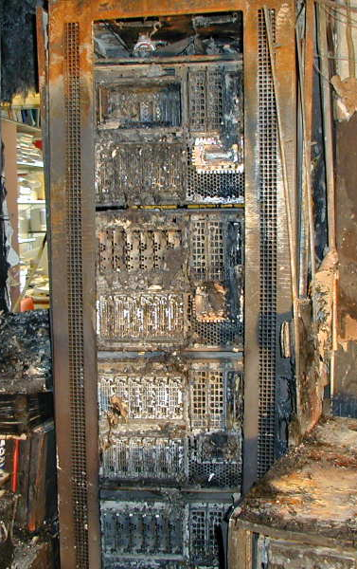
Disasters Happen. Do You Need Protection?
43% of companies experiencing disasters never re-open, and 29% close within two years. (McGladrey and Pullen)
93% of business that lost their data center for
10 days went bankrupt within one year.
(National Archives & Records Administration)
Top executives say 10 hours to recovery;
IT managers say up to 30 hours.
(Harris Interactive)
Notes:
Implementing Business Continuity is like buying insurance. You hope you’ll never have to use it. And until you do use it, it’s an unproductive cost. But when a disaster happens, it can be the difference between survival or bankruptcy.
Over the past few years, customers have experienced many widespread disasters – including hurricanes, floods, tornadoes, earthquakes, and tsunamis. These are the more dramatic examples that we hear about on the news, but there are also many examples of more localized outages – datacenter power outage, datacenter network down, host failures, etc.
Do you need protection against these outages? We believe it is an essential form of insurance, especially for businesses that rely on IT for day-to-day business operations.
<read through a few of the quotes>
Industry research has shown that companies who can’t recover their IT systems within a certain number of days after a major outage face bankruptcy. For the rest, there are certainly some serious financial consequences to each hour of prolonged outage.

Slide 4
Business-Critical Applications Require Business Continuity
% of Application Instances Running on VMware in Customer Base
67%
2011
53%
47%
42%
43%
2010
34%
28%
38%
28%
25%
25%
18%
MS
Exchange
MS SharePoint
MS SQL
Oracle
Middleware
Oracle
DB
SAP
Source: VMware customer survey, Jan 2010 and April 2011 interim results,
Data: Total number of instances of that workload deployed in your organization and the percentage of those instances that are virtualized
Availability Expectations on vSphere Continue to Increase
RTO’s decreasing from >24 hours to <12 hours
Notes:
4
4
vSphere is increasingly being used to run larger, business critical applications. For example, in the VMware customer base, 47% of MS SQL instances are running in virtual machines, 28% of Oracle databases, and 28% of SAP instances. We are seeing these numbers increase rapidly year over year, and vSphere is rapidly becoming the standard platform for these applications.
With the rapid adoption of vSphere for business-critical applications, the need for strong business-continuity solutions increases. Customers need robust solutions for local availability, data protection, and disaster recovery. From a disaster recovery standpoint, average Recovery Time Objectives (RTOs) have been continually decreasing, from an average of more than 24 hours just a few years ago, to less than 12 hours today.

Slide 5
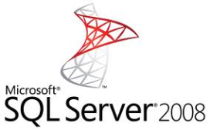
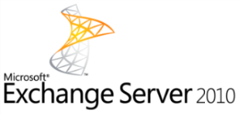


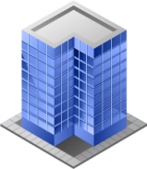
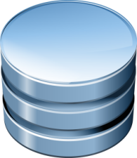
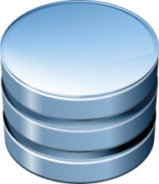
Tradeoffs Of Traditional Business Continuity Solutions
Application-level availability silos:
Complex and expensive
  Middleware / Java
  Oracle RAC
  MS Clustering
  DB Access Groups
  App Server Cluster
  Oracle DataGuard
  Session State Replication
  DB Mirroring
  CCR / SCR
  Backup
  Data replication
Data protection services:
Longer RTOs and RPOs
Notes:
Traditional business continuity solutions are complex and expensive.
Business continuity can be implemented at the application level with application-specific clustering solution such as Oracle RAC, MS clustering for SQL, Exchange Database Access Groups (DAG), etc. App-level clustering usually provides best-in-class availability, but at a very high cost and complexity.
There are also solutions that can be implemented at the infrastructure layer, typically backup and data replication. These tend to be more cost-efficient than app-level solutions, but can’t quite compare in terms of uptime and RTOs.

Slide 6
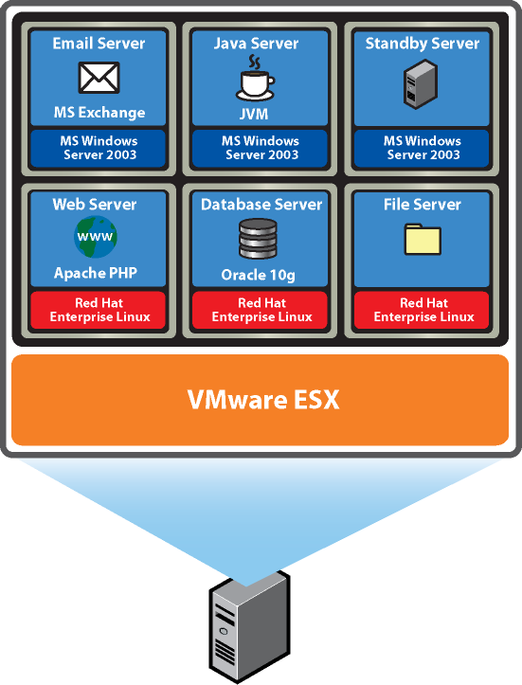


VMware Improves Business Continuity At All Levels
  Local Site
  Failover Site
vSphere
vSphere
vSphere
vSphere
vSphere
Improved
in 2011
Local Availability
vSphere High Availability
vSphere Fault Tolerance
vMotion and Storage vMotion
Data Protection
vSphere Data Recovery
Storage APIs for Data Protection
Disaster Recovery
vCenter Site Recovery Manager
Includes vSphere Replication
Improved
in 2011
New
in 2011
Improved
in 2011
Notes:
VMware provides a suite of Business Continuity solutions to offer holistic BCDR protection to all applications running on the vSphere platform. These solutions provide simple, cost-effective protection with a common solution for all your applications. The VMware BCDR solutions includes:
Local availability products to protect applications against downtime of individual hosts. This includes vSphere HA and FT for unplanned downtime, as well as vMotion and Storage vMotion for planned downtime.
Data protection solutions to back up entire VMs, including OS, application binaries, and application data, in a simple, non-disruptive manner. This includes the vSphere Data Recovery product, designed for smaller deployments, and the Storage APIs for Data Protection that enable third party backup vendors to integrate directly with vCenter and vSphere.
vCenter Site Recovery Manager and the new vSphere Replication product to protect applications against site failures.
The new Cloud Infrastructure Launch improves many of our BCDR capabilities, including vSphere HA, vSphere Data Recovery, vCenter Site Recovery Manager, and introduces the new vSphere Replication product.
VMware vSphere™ is the leading virtualization platform that forms the foundation for building cloud infrastructures. It is specifically designed to holistically manage large collections of infrastructure – CPUs, storage, networking – as a seamless, flexible and dynamic resource pools that can be allocated to the right users and applications on-demand.
vSphere comprises infrastructure services that transform server, storage and network hardware into a shared resource and application services that are built in and available to all applications that run on it.

Slide 7
Simple and Reliable DR with vSphere and SRM
Notes:
Let’s do a quick overview of SRM for disaster recovery

Slide 8
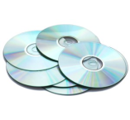



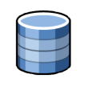
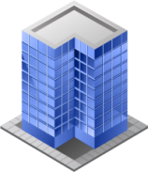
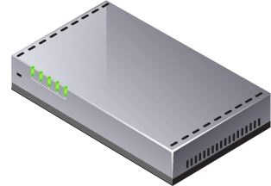


Challenges of Traditional Disaster Recovery
Expensive
Complex
Recovery Plans
Unreliable
Failovers
Software
Apps
?
?
Hosts
+
+
Hosts
?
?
Storage
?
Storage
?
?
Facilities
Network
?
>$10K per app
=
Failure to meet business requirements
  Long RTOs – days to weeks
  Too much time and resources consumed
Notes:
8
Key Points:
Disaster recovery in the traditional physical x86 world is hard for the following reasons:
Easiest and most reliable recovery requires complex server and recovery site infrastructure
The recovery process is also typically fairly complex due to hardware dependencies, application dependencies, etc.
Due to the complexity of the process, having accurate and up-to-date documentation (a disaster recovery “runbook”) is essential, as are ensuring that everyone is thoroughly trained on recovery procedures and executes them correctly when needed
As a result, recovery requirements often fail to be met: recovery takes too long, is often unsuccessful, and requires significant investment of IT $$ and staff
Script:
Traditional disaster recovery plans depend on a very complex set of processes and infrastructure: duplicate datacenters, duplicate server infrastructure, processes for getting data to a recovery site, processes for restarting servers, processes for reinstalling operating systems, and so on. Because disaster recovery can be some complex, organizations often find themselves unable to provide good protection to more than a privileged few of their production workloads, leaving other workloads (e.g. file/print servers, internal web servers, departmental applications) unprotected or poorly protected.
Because of the complexity of disaster recovery plans and infrastructure, organizations are heavily dependent on significant amounts of personnel training, on the accuracy and completeness of thick paper “runbooks” that document the recovery process, and on perfect execution of the recovery process when an outage does occur. Because testing is disruptive and expensive, organizations have a limited ability to ensure that all of their training, documentation, and execution is practiced and can successful recover their IT services.
As a result of these challenges, tests of recovery plans often fail; basic recovery of critical workloads – if successful at all – often takes days or weeks; and a significant amount of IT time and resources are consumed by managing and maintaining recovery plans. In short, most firms fail to meet the continuity requirements set by their organizations.
8

Slide 9







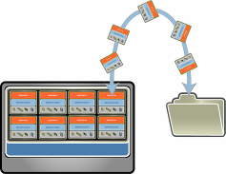
vSphere Provides The Best Foundation For Disaster Recovery
Consolidation
Cost-Efficient Infrastructure
  Reduced hardware requirements at recovery site
  Use recovery hardware to run low-priority apps
vSphere
Hardware
Independence
Flexible Infrastructure
  Eliminate need for identical hardware across sites
  Enable waterfalling of equipment to recovery site
vSphere
vSphere
Encapsulation
Simple Application Protection
  Entire system – including application, OS,
  and data – is stored as virtual machine files
  Entire system can be protected with data protection tools
Notes:
I want to review 3 key features of virtualization that lead to better disaster recovery.
Consolidation. Server consolidation means doing more with less. You’re reducing your physical footprint, which also means you can streamline your disaster recovery plans and standardize your recovery process.
Hardware Independence. This means being able to recover onto any x86 hardware. So, you have the flexibility to buy different servers for your recovery site, or even fewer servers. Continuing to virtualize your production site will free up additional machines that can then be moved over to your recovery site.
Encapsulation. Because virtualization captures everything about a server into just a few files on disk, the real benefit here is mobility. The ability to move your VMs wherever you want. You can back them up in the same way you currently protect your other files. You can also replicate them to your disaster recovery site, so that they will be available when you need to recover from an outage.

Slide 10








vCenter Site Recovery Manager Ensures Simple, Reliable DR
Site Recovery Manager Complements vSphere to provide the simplest
and most reliable disaster protection and site migration for all applications
  Provide cost-efficient replication
  Built-in vSphere Replication
  Broad support for storage-based replication
  Simplify management of recovery and migration plans
  Replace manual runbooks with centralized recovery plans
  From weeks to minutes to set up new plan
  Automate failover and migration processes
  Enable frequent non-disruptive testing
  Ensure automated failover and migration
  Automate failback processes
Site A (Primary)
Site B (Recovery)
VMware
vCenter Server
Site Recovery
Manager
VMware
vCenter Server
Site Recovery
Manager
VMware vSphere
VMware vSphere
Servers
Servers
Notes:
vCenter Site Recovery Manager is a product specifically designed to leverage the capabilities of vSphere to provide the simplest, most reliable DR for all applications. SRM complements vSphere and integrates tightly with vCenter to automate disaster protection and planned site migrations for all applications.
SRM essentially does 3 things:
1 – It provides simple and cost-efficient replication of applications to a failover site. With SRM 5, we now provide built-in vSphere Replication, the industry’s first hypervisor based replication product. We also continue to support a very broad range of storage-based replication products for business-critical environments.
2 – SRM dramatically simplifies the setup and on-going management of recovery and migration plans. It enables users to replace traditional, complicated, manual runbooks with centralized recovery plans. With SRM, users can cut down the time required to set up a recovery plan from weeks to minutes.
3- SRM automates the failover and migration process for highly reliable failovers. With SRM, users can test their recovery plans non-disruptively as frequently as required to measure their RTOs and identify any issues. The failover process is entirely automated to eliminate errors inherent with manual processes. And SRM can now automatically fail back applications to their original site.

Slide 11




SRM Momentum
Introduced in Q2’ 2008
> 5,000 customers
50% annual growth in 2010
“If your organization is already taking advantage of virtualization,
then adding Site Recovery Manager to handle disaster recovery
is a no-brainer.”
― Jerry Wilkin
Senior Systems Administrator, Dayton Superior Corp
Notes:
SRM has seen tremendous momentum since its introduction in 2008. To date, we have sold more than 125,000 licenses to more than 5,000 customers, and the product continues to grow at a 50% annual pace.
This growth is driven by the tremendous value that SRM adds to DR plans on the vSphere platform, for a relatively low incremental cost.
Many of our customers have leveraged SRM to quickly recover from real disasters, such as the recent tsunami in Japan, and hurricanes in the US.

Slide 12
What’s New In Site Recovery Manager 5.0?
Expand DR coverage to Tier 2 apps and smaller sites
vSphere Replication
Automated failback
Planned migration
Streamline planned migrations
(for disaster avoidance, planned maintenance, …)
Others
    More granular control over VM startup order
    Protection-side APIs
    IPv6 support
Notes:
12
SRM 5 is packed with a number of great new capabilities.
The most critical is vSphere Replication. vSphere Replication provides very simple, cost-efficient replication between vSphere clusters. vSphere Replication enables organizations to provide much more cost-efficient DR protection, and hence expand DR coverage to Tier 2 / 3 applications and smaller sites.
We are also providing automated failback and planned migration. Automated failback automates the fail back of applications to their original site, and coordinates all the required steps including reversal of the replication and leveraging the original recovery plan in reverse direction. Planned migration is a new workflow that can be applied to recovery plans. It ensures zero data loss, application-consistent recovery of virtual machines to the secondary site. Automated failback and planned migration enable SRM to provide much better support for routine migrations, for example for disaster avoidance and planned maintenance.
Finally, we also have a number of incremental improvements such as IPv6 support, protection-side APIs, and more granular control over VM startup sequence.

Slide 13
SRM 5 Editions Lineup
 | SRM 5
 | Standard | Enterprise
Price per protected virtual machine (license only) | $195 | $495
Scalability Limits
Maximum protected VMs | 75 virtual machines ⁽¹⁾ | Unlimited⁽²⁾
Features
Support for storage-based replication
Centralized recovery plans
Non-disruptive testing
Automated DR failover
vSphere Replication
Automated failback
Planned migration
  Maximum of 75 VMs per site and per SRM instance
  Subject to the product’s technical scalability limits
New in SRM 5.0
Notes:
SRM 5 now comes in two editions: Standard and Enterprise. Standard is designed for smaller environments, and can be used to protect up to 75 VMs (per site and per SRM instance). Enterprise is designed for larger environments with more than 75 VMs to protect. Both editions are full-featured and include vSphere Replication, automated failback, and planned migration.
The tiered SRM editions provide a particularly attractive price-point for SMBs and Remote Offices – at $195 per VM. This is a steep reduction from the standard SRM 4 list price of $450 / VM. This more attractive price-point will enable smaller organizations and sites to leverage vSphere Replication and significantly reduce the overall DR costs.
SRM Enterprise is priced at $495 / VM, a very small increment to SRM 4 which now includes vSphere Replication and the other new SRM 5 capabilities.
13

Slide 14

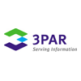











Key Components Of SRM 5
vCenter Server 5
  1 per site
  Standard or Foundation
Protected Site
Recovery Site
Site Recovery Manager 5
  1 per site
vCenter Server
Site Recovery Manager
vCenter Server
Site Recovery Manager
vSphere 3.5, 4.x or 5
  Standard, Enterprise or Enterprise Plus
  Replication Options
vSphere
vSphere
vSphere Replication
  Bundled with SRM
Storage-Based Replication (3rd party)
Storage
Storage
Notes:
14
SRM 5 requires several components. First, an instance of SRM is required at both the protected and failover sites. The SRM instance provides the management and automation capabilities through tight integration with vSphere and vCenter.
SRM also requires an underlying replication product to replicate virtual machines to the failover site. With SRM 5, customers have a choice of using either vSphere Replication or storage-based replication. vSphere Replication is bundled with SRM at no additional cost. Storage-based replication is provided by a 3rd party storage vendor, and integrates tightly with SRM through a Storage Replication Adapater (SRA) to enable SRM to coordinate replication and recovery activities with the storage layer.
Finally, SRM requires a vSphere cluster at both sites, and a separate vCenter instance at both sites.

Slide 15
SRM Provides Broad Application Coverage
RTO: 30 minutes to hours
RPO: Flexible based on storage replication
Continuous
App-level geo-clustering / load balancing
Tier 1 Apps
RTO
Hours
Tier 2 Apps
Site Recovery Manager
Days
Tier 3 Apps
Days
Hours
Synchronous
RPO
Notes:
SRM provides very broad application coverage.
The RPO is set by the replication product in use. Since SRM supports a very broad range of replication products, the RPO can be set anywhere from days to synchronous replication, depending on business needs, replication capabilities, and network bandwidth.
The RTO will depend on the actual configuration, but is typically in the range of 30 mins to a few hours. Factors that will influence this include the number of VMs that need to be recovered, the number of hosts available to recover those VMs, and the replication technology.
SRM can be used to protect the vast majority of applications. The only applications that can not be protected with SRM are applications that need better RTOs than 30 minutes to a few hours. Applications that need continuous or near-continuous RTOs will need to be protected using geo-clustering.

Slide 16
Cost-Efficient Replication To Expand DR Coverage

Slide 17

SRM Provides Broad Choice of Replication Options
Site A (Primary)
Site B (Recovery)
vCenter Server
Site Recovery Manager
vCenter Server
Site Recovery Manager
vSphere
vSphere
vSphere Replication
Storage-based replication
vSphere Replication
Simple, cost-efficient replication for Tier 2 applications and smaller sites
  Storage-based Replication
  High-performance replication for business-critical applications in larger sites
Notes:
17
As mentioned earlier, Site Recovery Manager now provides two replication options.
Traditional storage-based replication, which has been supported since the original release of SRM 1, continues to be supported. In many cases, this will still be the preferred option for larger, business-critical environments.
vSphere Replication, a new capability with SRM 5, provides another option for replicating VMs. It is a simple, cost-efficient mechanism to replicate between two sites, and in many cases is the better option for T2 / 3 apps and smaller sites.
Customers now have more options when it comes to replication, enabling better alignment between business needs and the replication solution. vSphere Replication and storage-based replication can be used in conjunction with each other on the same clusters, providing ultimate flexibility for more complex environments.

Slide 18


vSphere Replication Complements Storage-Based Replication
 | Replication Provider | Cost | Management | Performance
vSphere Replication | VMware | Low-end storage supported No additional replication software | VM’ granularity Managed directly in vCenter | 15 min RPOs Scales to 500 VMs File-level consistency No automated failback, FT, linked clones, physical RDM
Storage-based Replication |  | Higher-end replicating storage Additional replication software | LUN – VM layout Storage team coordination | Synchronous replication High data volumes Application consistency possible
Notes:
It’s useful to compare vSphere Replication and storage-based replication. When should a customer pick which option?
We believe that storage-based replication and vSphere Replication both have an important role to play. vSphere Replication is provided directly by VMware, and more cost-efficient and simpler than storage-based replication. Storage-based replication relies on a 3rd party storage vendor, is more expensive and complex to manage, yet provides more bells and whistles and enhanced performance. Storage-based replication can provide synchronous replication, support very high data volumes, and can ensure application-consistent replications – all capabilities that are not supported by vSphere Replication.
At the end of the day, it comes down to customer choice. We are providing customers more options to choose the right tool for their specific needs.

Slide 19









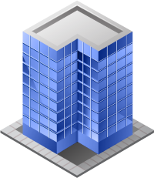
Expand DR Protection To Tier 2 Apps And Small Sites
Tier 1 Apps
Storage, Replication, and SRM Costs per Protected VM
$2,000/VM
$2,000
SRM
Enterprise
Storage Replication
Replication SW
$1,000
$600/VM
Tier 2 / 3 Apps
Tier 1 Storage Failover Site
SRM Standard
Tier 2 Storage Failover Site
vSphere
Storage Replication
Large site
vSphere Replication
Small site
vSphere Replication
Small Sites
vSphere Replication
Corporate Datacenter
Small Business
Remote Office / Branch Office
Notes:
19
vSphere Replication is a great way to expand DR protection to Tier 2 / 3 apps and smaller sites.
Storage-based DR protection is fairly expensive, with the cost mostly driven by storage capacity on Tier 1 storage arrays and additional replication licenses. The typical storage, replication and SRM cost is in the range of $2,000 per VM. While this is much better than physical DR, it is still fairly high and can be cost-prohibitive for less business-critical environments.
vSphere Replication is much more cost-effective. By supporting the use of lower-end storage arrays, eliminating the need for dedicated replication licenses, and offering lower-cost SRM Standard licenses, the cost per VM is reduced by 3X to approximately $600 / VM.
The much lower cost per VM enables organizations to expand their DR protection to many more applications and sites.
19

Slide 20
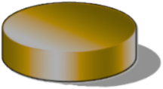
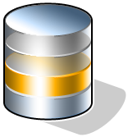
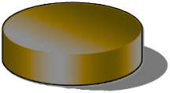


Simplify Replication Management With vSphere Replication
Storage-based Replication
Overview
SharePoint
Datastore Group
Web
VMFS A
  vSphere Replication provides simple management of replication
  Managed directly from vCenter
  Managed at the individual VM-level
Datastore
LUN 1
App
VMFS B
Datastore
Hub
SQL
LUN 2
vSphere Admin
Storage Admin
Benefits
vSphere Replication
SharePoint
  Eliminate complex interactions between vSphere and storage teams to set up replication
  Eliminate need to shuffle VMs between datastores to map applications to replicated LUNs
Web
App
vSphere Admin
SQL
Notes:
vSphere Replication is inherently simpler to manage than storage-based replication.
Setting up replication is the most complicated task in a new SRM deployment using storage-based replication. vSphere Admins have to sync up with storage admins to ensure the appropriate LUNs are replicated to the other site with the right replication schedule. vSphere Admins then have to group their VMs by main application or ‘protection group’, and map those VMs to the replicated LUNs. This can be a fairly involved and complicated task.
With vSphere Replication, things become much simpler. vSphere Admins can manage replication directly from vCenter, eliminating the dependency on storage admins. And replication is managed at the virtual machine level, eliminating the need for complex VM grouping and VM-to-LUN mapping.
This makes vSphere Replication particularly attractive when simplicity is key – for example for Tier 2 and 3 application protection.

Slide 21
Planned Migrations

Slide 22





Planned Migrations For App Consistency & No Data Loss
Planned Migration
Overview
  Two workflows can be applied to recovery plans:
  DR failover
  Planned migration
  Planned migration ensures application consistency and no data-loss during migration
  Graceful shutdown of production VMs in application consistent state
  Data sync to complete replication of VMs
  Recover fully replicated VMs
1
Shut down production VMs
3
Recover app-consistent VMs
Site A
Site B
vSphere
vSphere
Replication
Benefits
2
  Better support for planned migrations
  No loss of data during migration process
  Recover ‘application-consistent’ VMs at recovery site
Sync data, stop replication and present LUNs to vSphere
Notes:
Two different workflows can now be applied to a recovery plan: DR failover and planned migration. Planned migration is used when an organization knows a few hours ahead of time that it wants to move VMs, but the VMs are still up and running in the production site.
The planned migration workflow starts by initiating a graceful shutdown of the VMs at the failover site. Once the VMs are cleanly shut down, a ‘data sync’ operation is performed at the replication layer to ensure full migration of all VM data to the failover site. Once the replication is complete, VMs are brought back up at the recovery site.
Planned migration has two advantages over DR failover. One – it ensures zero data loss migrations, since the data is fully sync’ed prior to initiating the failover. Two – it ensures application-consistent recovery, regardless of the replication solution in use. The downside of planned migrations is that it takes longer to move VMs, but this is typically a relatively minor issue since the migration can be planned ahead of time.

Slide 23
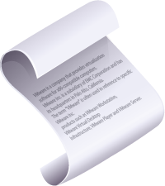
Automated Failback To Streamline Bi-Directional Migrations
Automated Failback
Overview
Re-protect VMs from Site B to Site A
  Reverse replication
  Apply reverse resource mapping
Automate failover from Site B to Site A
  Reverse original recovery plan
  Restrictions
  Does not apply if Site A has undergone major changes / been rebuilt
  Not available with vSphere Replication
Reverse original recovery plan
Site A
Site B
vSphere
vSphere
Benefits
Reverse Replication
Simplify failback process
  Automate replication management
  Eliminate need to set up new recovery plan
Streamline frequent bi-directional migarations
Notes:
Automated failback enables bi-directional migrations, so that VMs can automatically be migrated back to their original site with minimal user intervention. This is particularly useful to streamline frequent back-and-forth migrations between two sites.
Automated failback consists of two steps. First, applications are ‘re-protected’ from the failover site to the original site by reversing replication. SRM automatically coordinates replication activities with the storage-array so that the user is shielded from manually having to initiate the reversal of replication.
Secondly, SRM executes the original recovery plan in reverse direction. This eliminates the need to create a brand new recovery plan for failback.
Automated failback does have a few restrictions. It can only be used if Site A has not been destroyed and rebuilt. If Site A has undergone major changes, SRM will not be able to automate the failback process because it is unaware of those changes. At this time, automated failback is also unavailable with vSphere Replication.

Slide 24
Where Can I Learn More?
vCenter Site Recovery Manager
  Product Page – www.vmware.com/products/srm
  Overview, datasheet, webinars, docs, community links
  Free 60-day Evaluation – all you need to get started!
Business Continuity
  Solutions from VMware – www.vmware.com/solutions/continuity
External Resources
  Administering VMware Site Recovery Manager book by Mike Laverick – http://www.lulu.com/content/4343147
Notes:
VMware provides a lot of information on the web to help customers implement SRM. A free 60-day evaluation copy is also downloadable from the web. Finally, there is an excellent book by Mike Laverick on ‘Administering VMware Site Recovery Manager’.

Slide 25
Questions?

