Slide 1

Introducing: Infrascale VMware Backup

Slide 2



Infrascale by the Numbers
Introduction to your hosts: Ken Shaw & Stephane Fymat
Ken Shaw
Founder and CEO
Ken@infrascale.com
Stephane Fymat
Product Management
Stephane.Fymat@infrascale.com

Slide 3
Agenda
1
Infrascale Overview: Our Platform, technology and solutions
What Infrascale VMware Backup can do for you
How Infrascale stacks up: Competitive Pricing Comparison
How to get started today!
2
3
4

Slide 4

Infrascale Overview
Our platform, technology and solutions

Slide 5
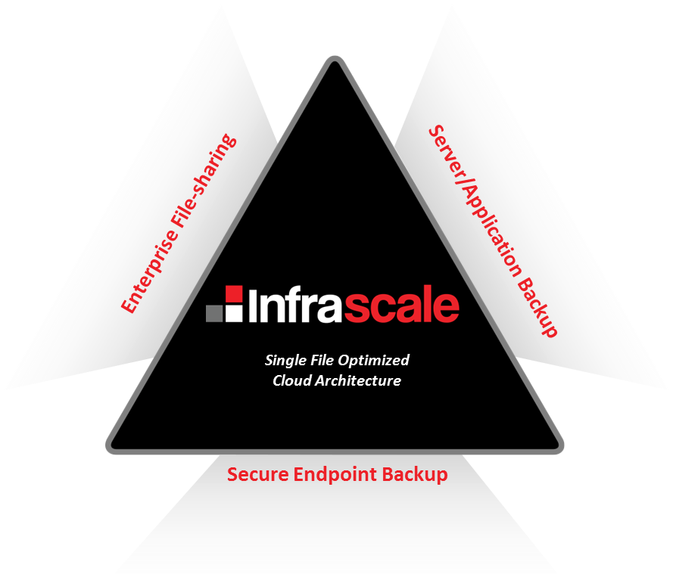

Our Business
Who are we?
Infrascale is a cloud software company in El Segundo CA – selling a platform to protect, archive and share business data securely and simply.
Proven product, proven team, optimized demand gen – ready to scale.
The Infrascale Platform
Infrascale’s platform sits at the center of three markets rapidly being transformed by Cloud computing. Massive growth drivers are behind Infrascale as BYOD and virtualization have fragmented data across the enterprise, and in light of recent focus data security and privacy has become paramount.
Filesharing & Collaboration
Endpoint
Backup
Server
Backup
Single File Optimized
Cloud Architecture

Slide 6
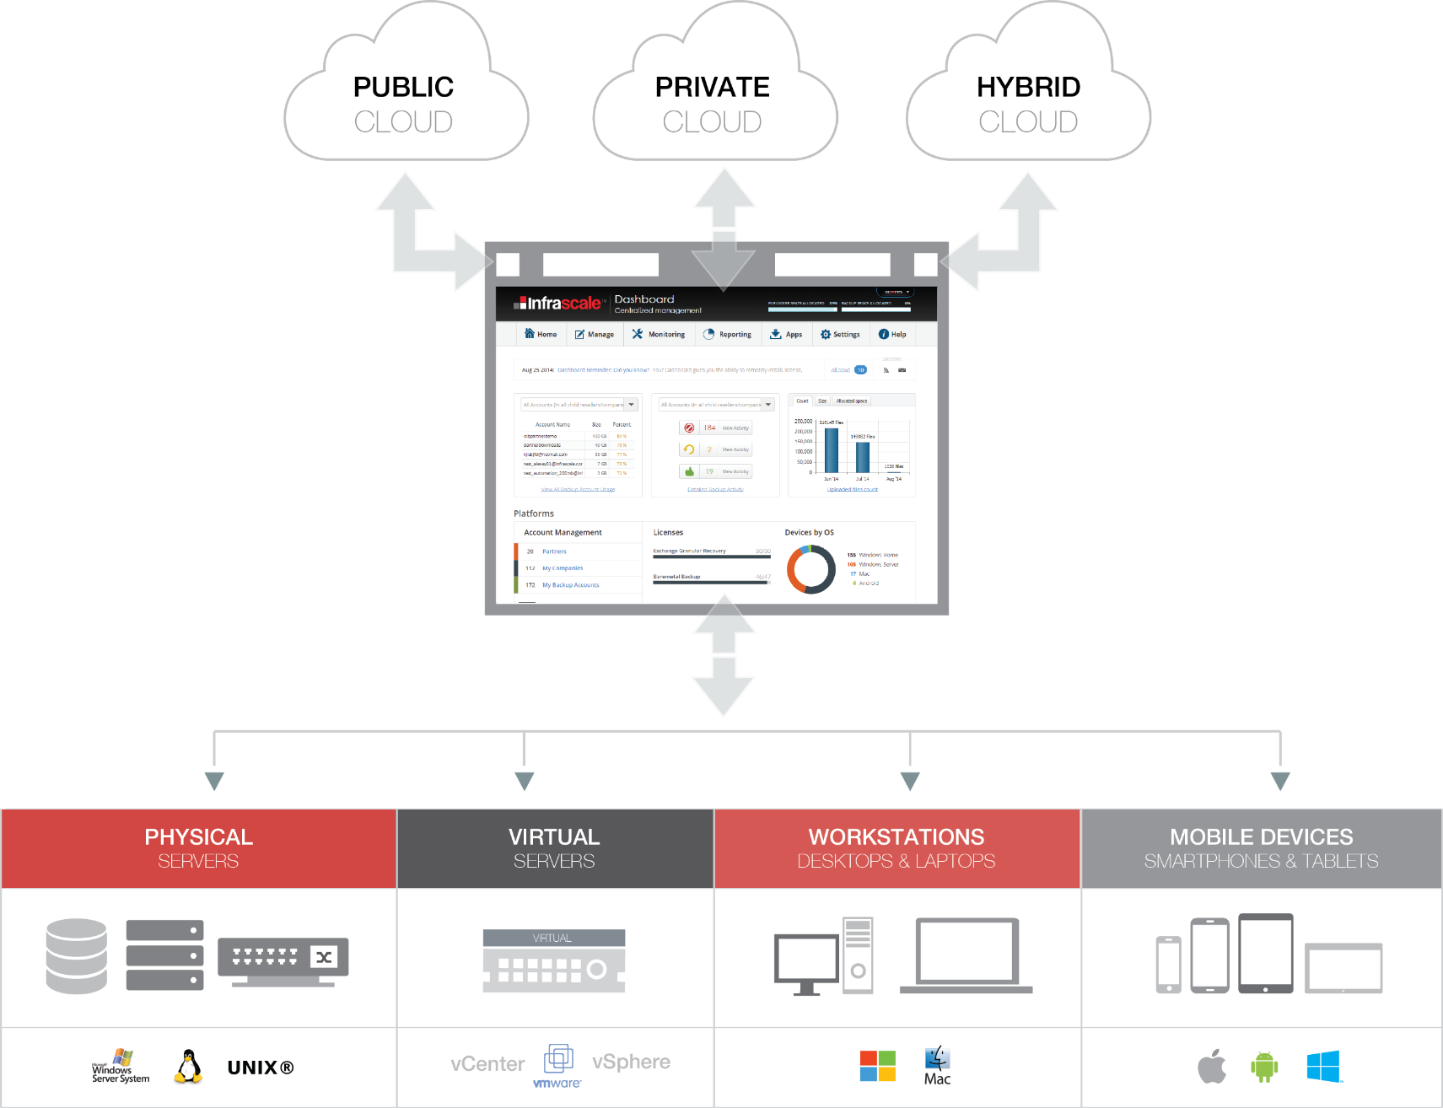
What does Infrascale’s software do?
Notes:
This slide shows the different places where our code automates.

Slide 7
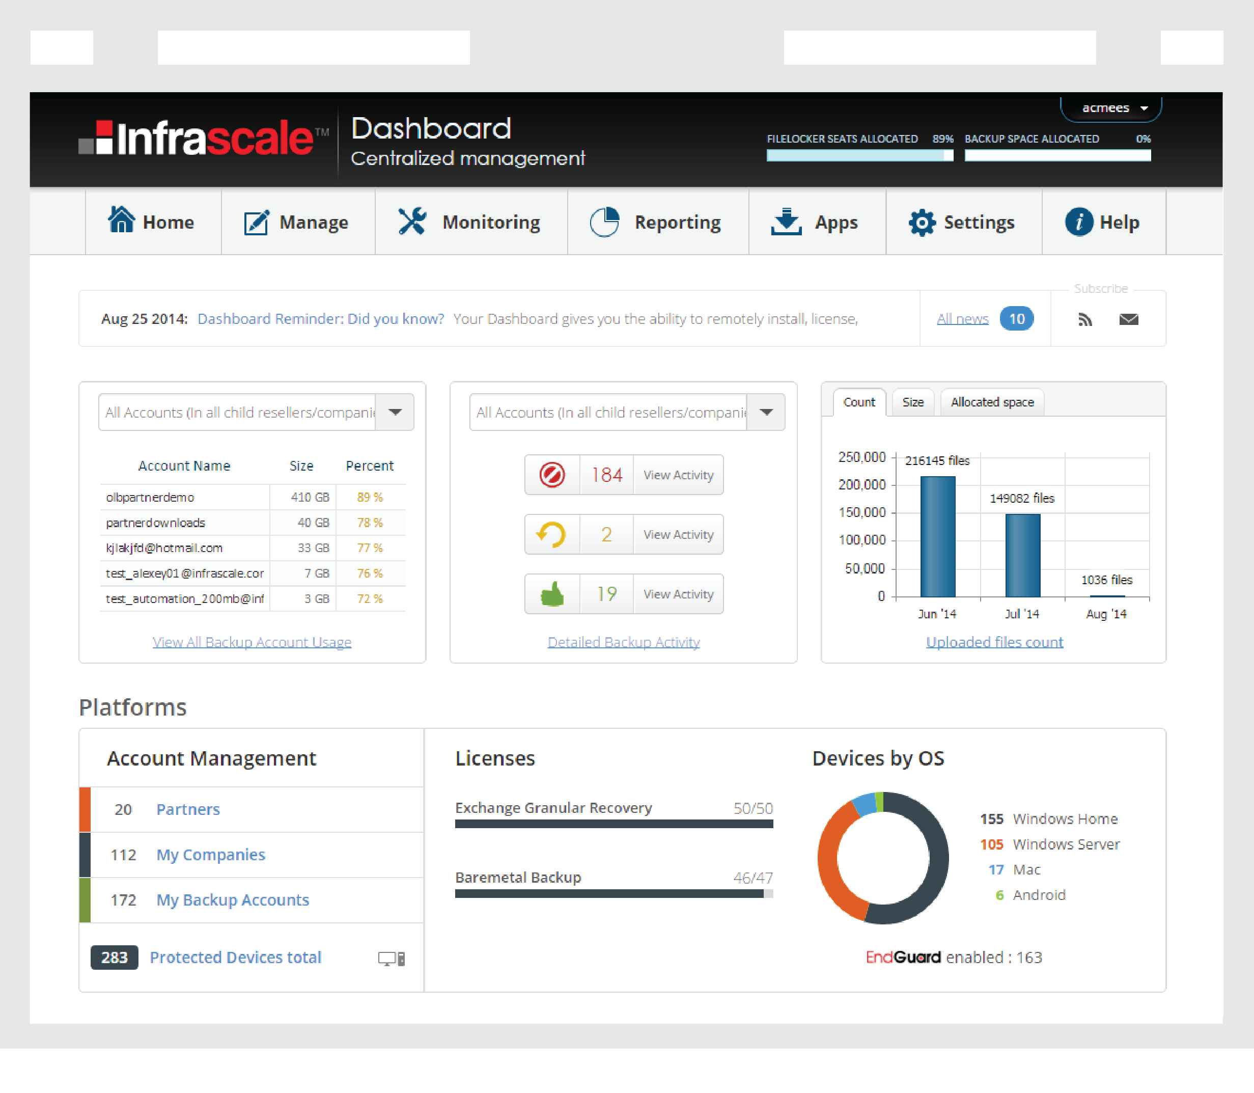
Infrascale Overview: Dashboard
Your Centralized Management Dashboard: Maintenance | Monitoring | Reporting
The Infrascale Dashboard dramatically simplifies management for large numbers of downstream customers.
The tool to manage your entire business, providing:
Account usage
Activity alerts
Reporting & monitoring
Rebranding tools
Policy settings
Dashboard is available via the web and iOS/Android mobile devices for anytime, anywhere management

Slide 8
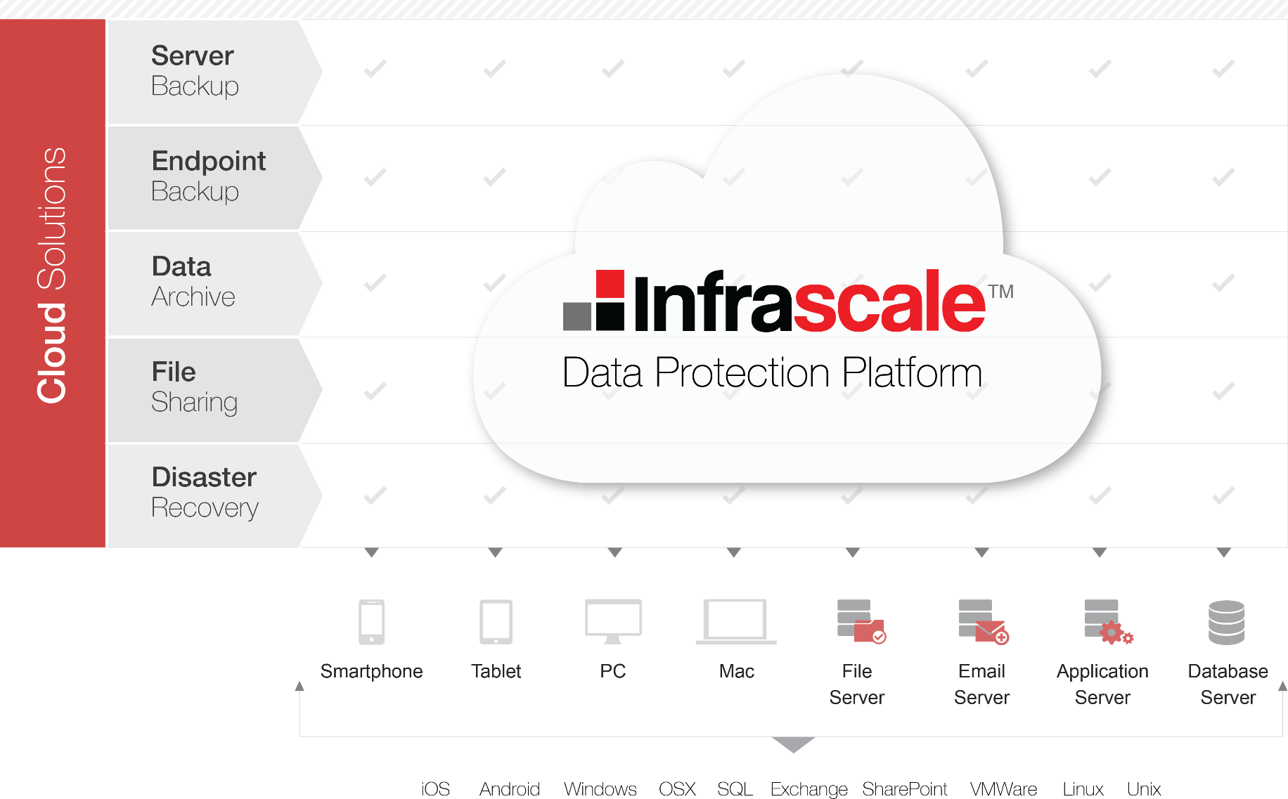
Infrascale Overview: The Platform
Comprehensive Data Protection Platform

Slide 9

Infrascale
VMware Backup

Slide 10
Why Address VMware directly?
Growing Rapidly
50%+
of business server workloads are now virtualized
}
Gartner Group
86%
of server workloads will be virtualized within 18 months
It’s a different animal
Per-machine backup agents are susceptible to Waste and Risk

Slide 11
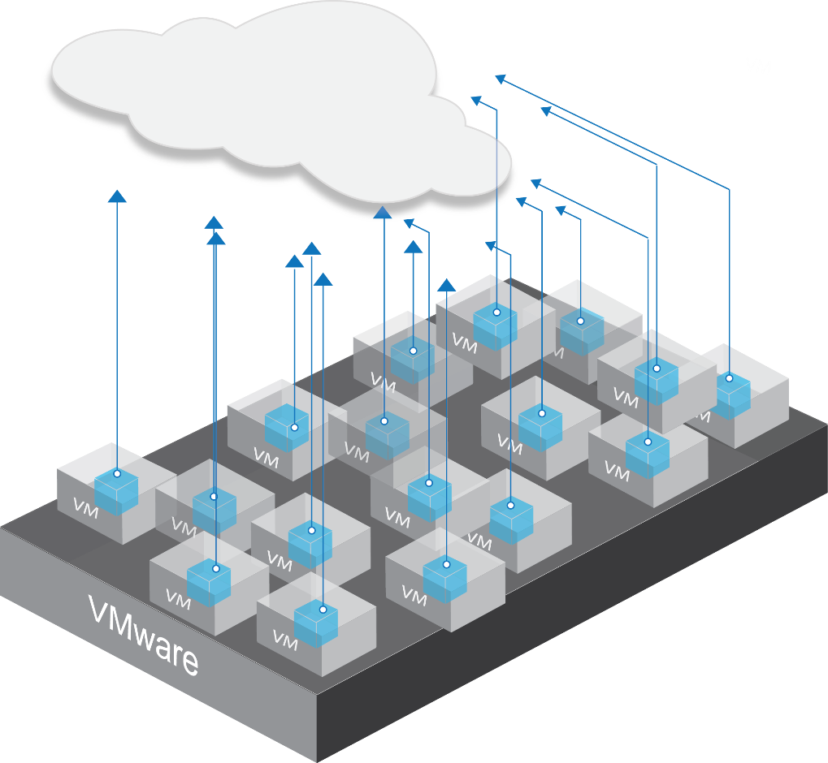
Waste: Time and money spent multiply by the number of VMs
Wasted man-hours
  Install, schedule, run and report on each VM backup individually
  Policy changes applied one agent at a time
  Manual task to track new and migrated VM’s
  Wasted money
  License fee for each virtual machine
VM’s easy to create, each with OS and other duplicate data
→ increased storage costs
Redo full backups on migrated VMs
→ increased storage costs

Slide 12
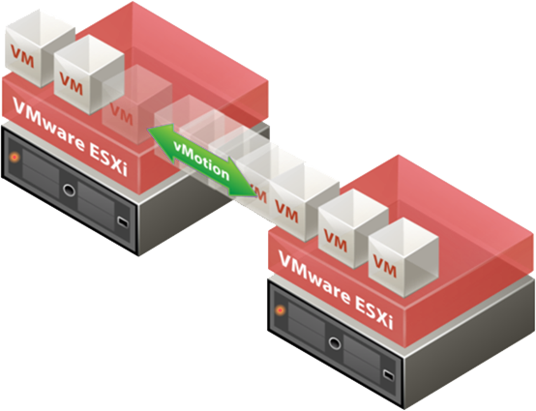
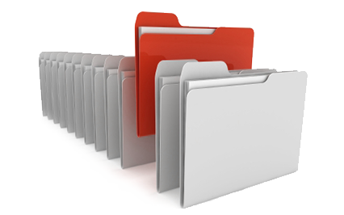
Risk: Undetected VMs and Long RTO
Difficult to detect new and migrated VMs → unprotected
2 step recovery process: spin up VM, run the restore → RTO measured in hours
Even if backup an entire VM, if you can’t look into the virtual disk to retrieve files in question, you must restore entire VM → long RTO

Slide 13
Why not just use VMware’s own backup tools?
after all, they develop VMware
VMware Data Protection needs vCenter to work, it cannot backup VMs on “standalone” hosts
Limits on backup repository size (2TB and 8TB)
Only works with VMware, so must have multiple backup tools for a mixed environment
Doesn’t work with free version of ESXi
Doesn’t work with VMware RDM (Raw Device Mapping) in Physical Compatibility Mode

Slide 14
The Infrascale Solution

Slide 15
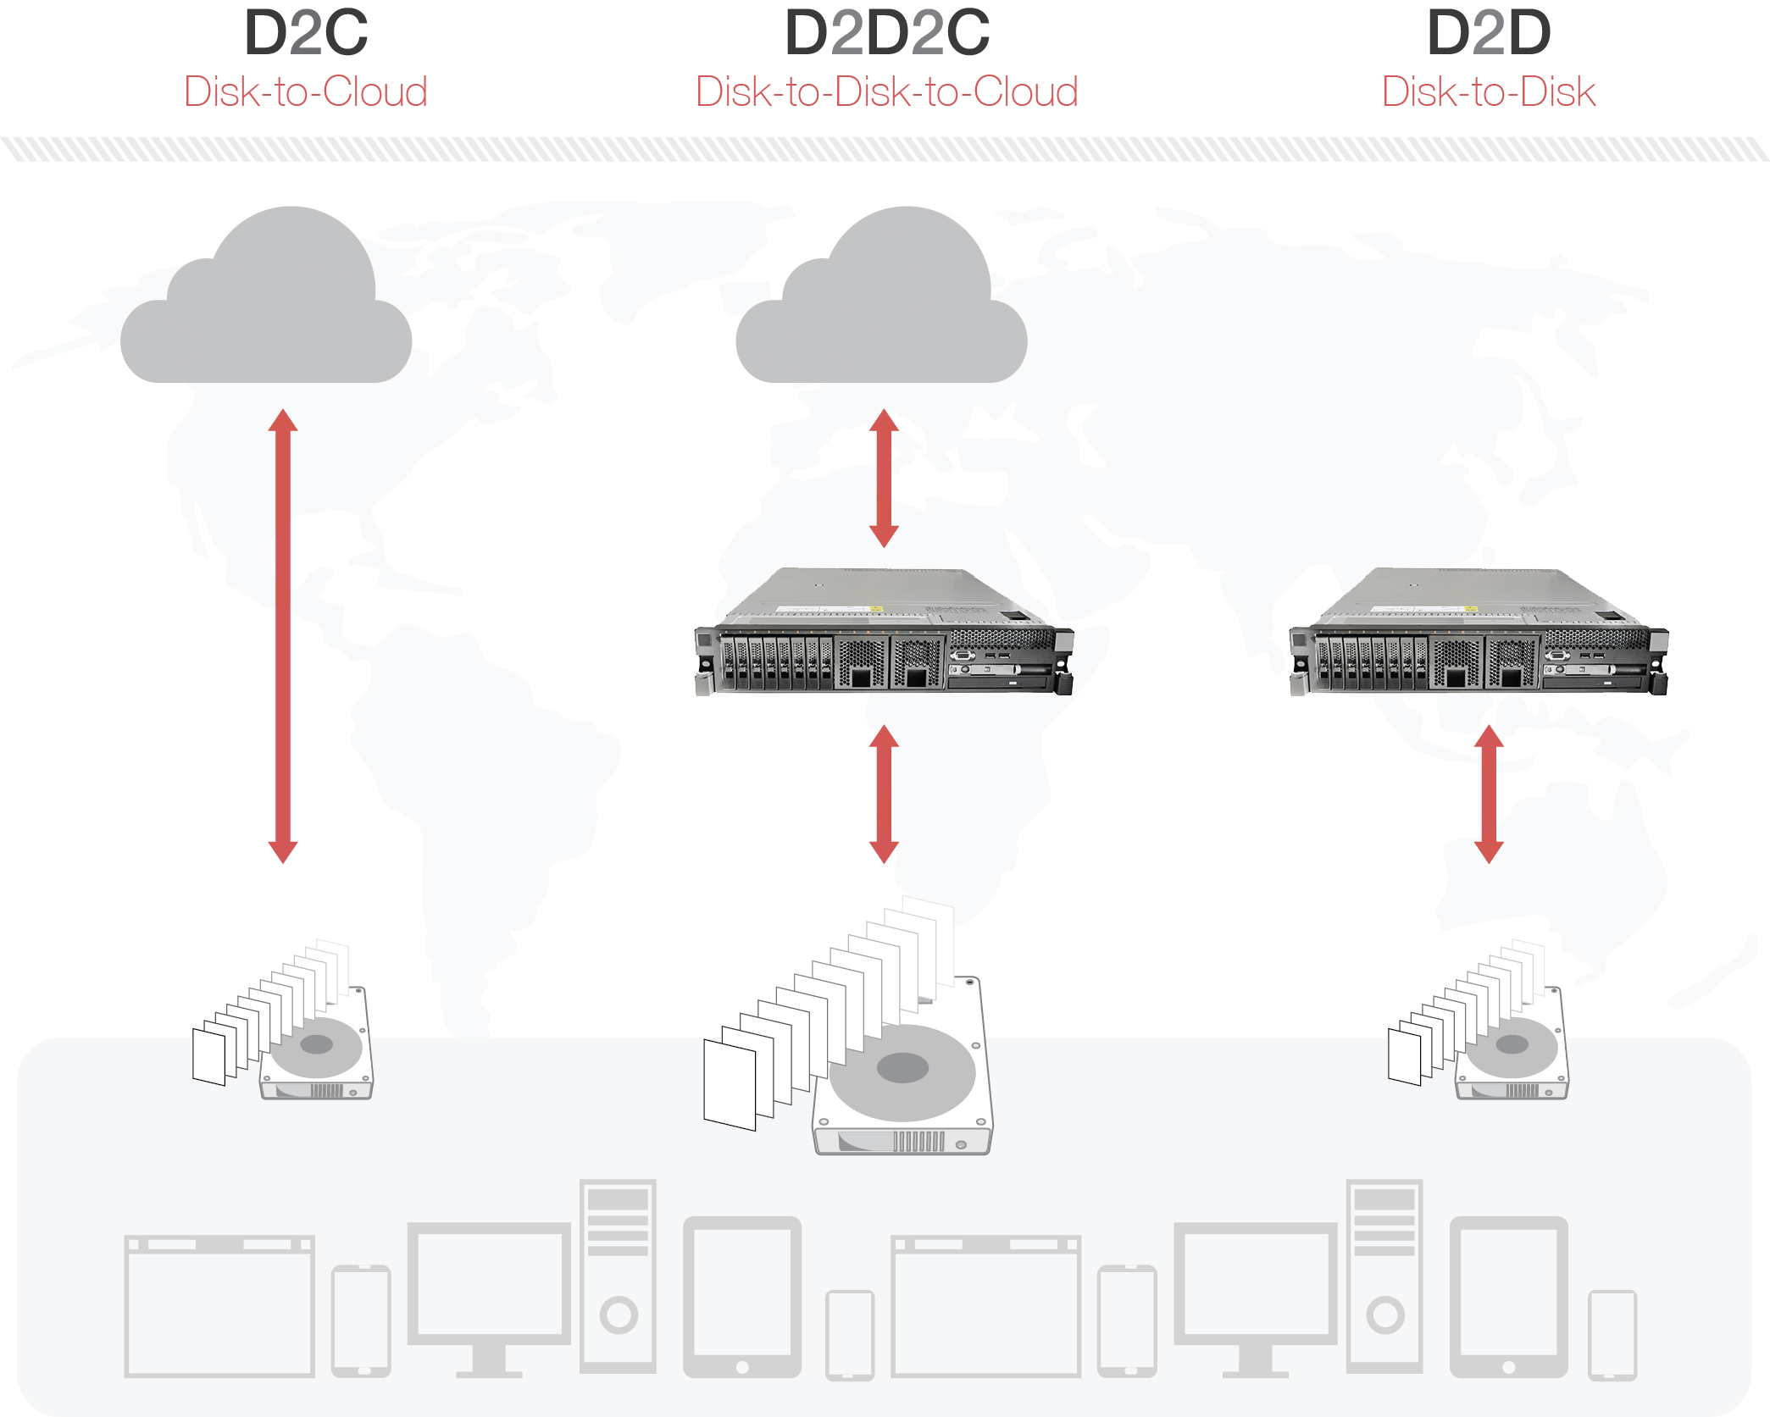
Infrascale: General Architecture

Slide 16
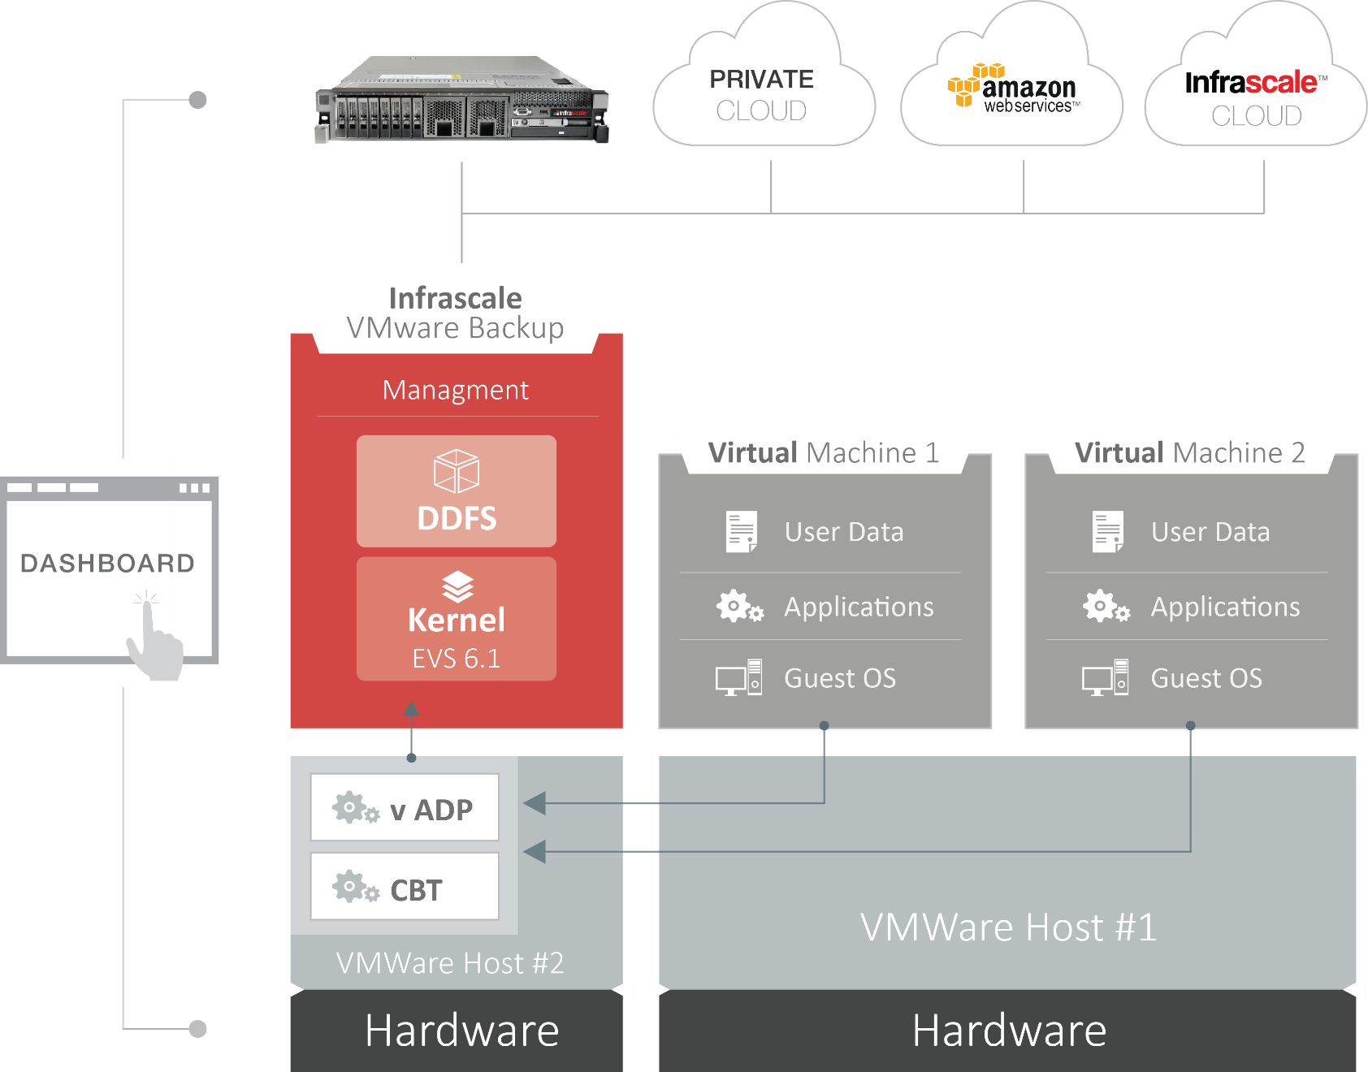
Infrascale: VMware Backup Architecture

Slide 17
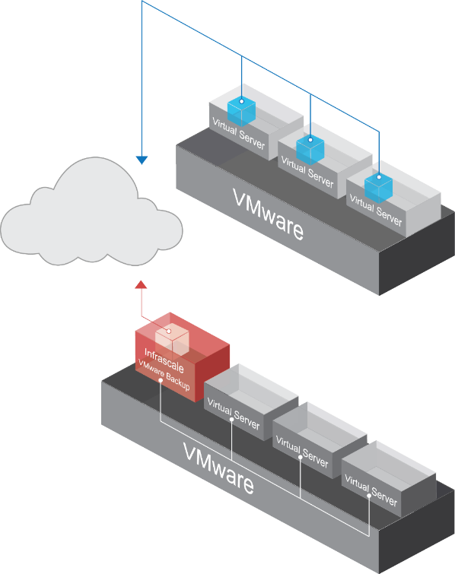
Infrascale: VMware Backup Architecture Details
vSphere integration
Eliminates need for guest OS-based agent backups
Look inside virtual disks, restore individual files/folders to virtual or physical servers
VM snapshots reduce strain on host resources and improve backup performance and enable instant restores
Track lifecycle of a VM
Automatically track and protect new VMs
vCenter integration
Auto-track migrating VMs, backups uninterrupted
Avoids repeating full backups of VMs on their new hosts
Consistent state of VMs maintained for restorability
Integrate with applications
SQL Server and Exchange integration enables item-level recovery
Integrate with vStorage APIs for Data Protection
Allows backup to skip unused sections of VMDKs
Allows differential and incremental backups of VMs
De-duplication
Leverage VMware’s CBT to capture differences
Use de-duplicate tech to remove wasteful duplicate data
vs.

Slide 18



Solution Benefits
Eliminate wasted man-hours
Install, schedule, run and report on one backup module across all VMs on all vSphere hosts
Apply backup policy across all VMs at once
Automatically detect new and migrated VM’s
Eliminate wasted money
One fee for each host, good for all VMs on that host
Use CBT to skip unused sections of VMDKs and do differential and incremental backups of VMs to reduce on-premise storage costs
Track migrating VMs to eliminate unnecessary full backups
Eliminate risk
Auto-detect new VMs and include in backups
Auto-track migrating VMs, backups uninterrupted
1-step restore in minutes, business continuity ensured
Look inside virtual disks, restore individual files/folders quickly

Slide 19
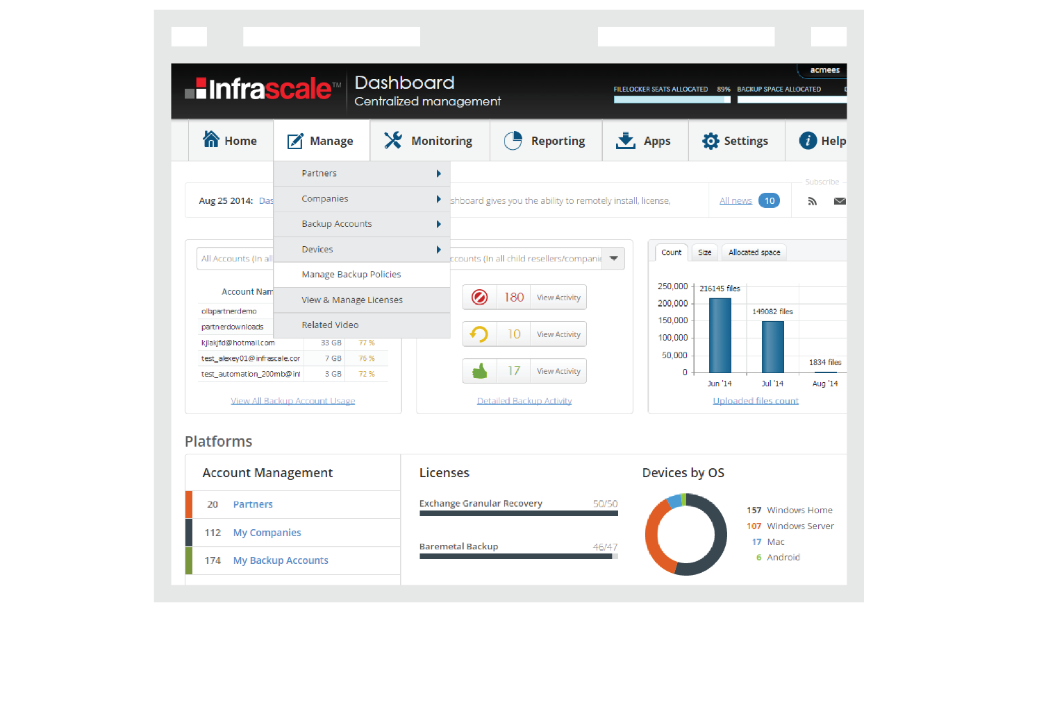
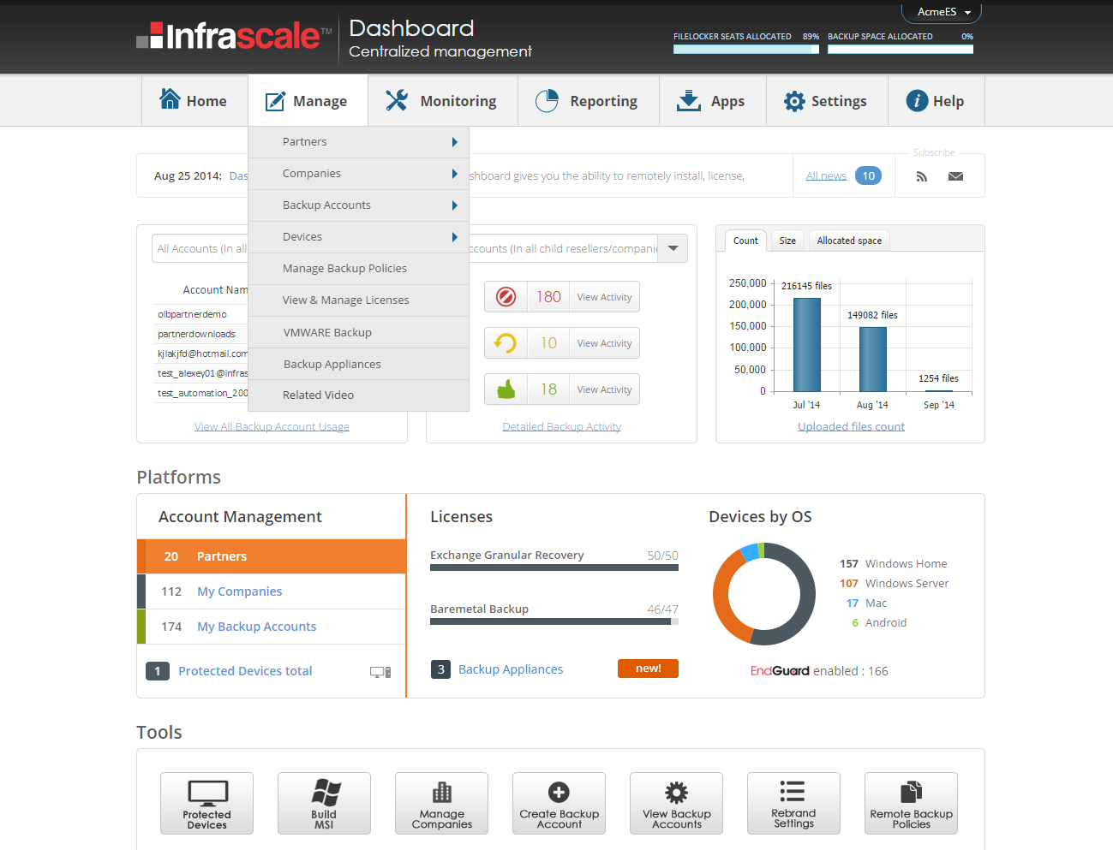
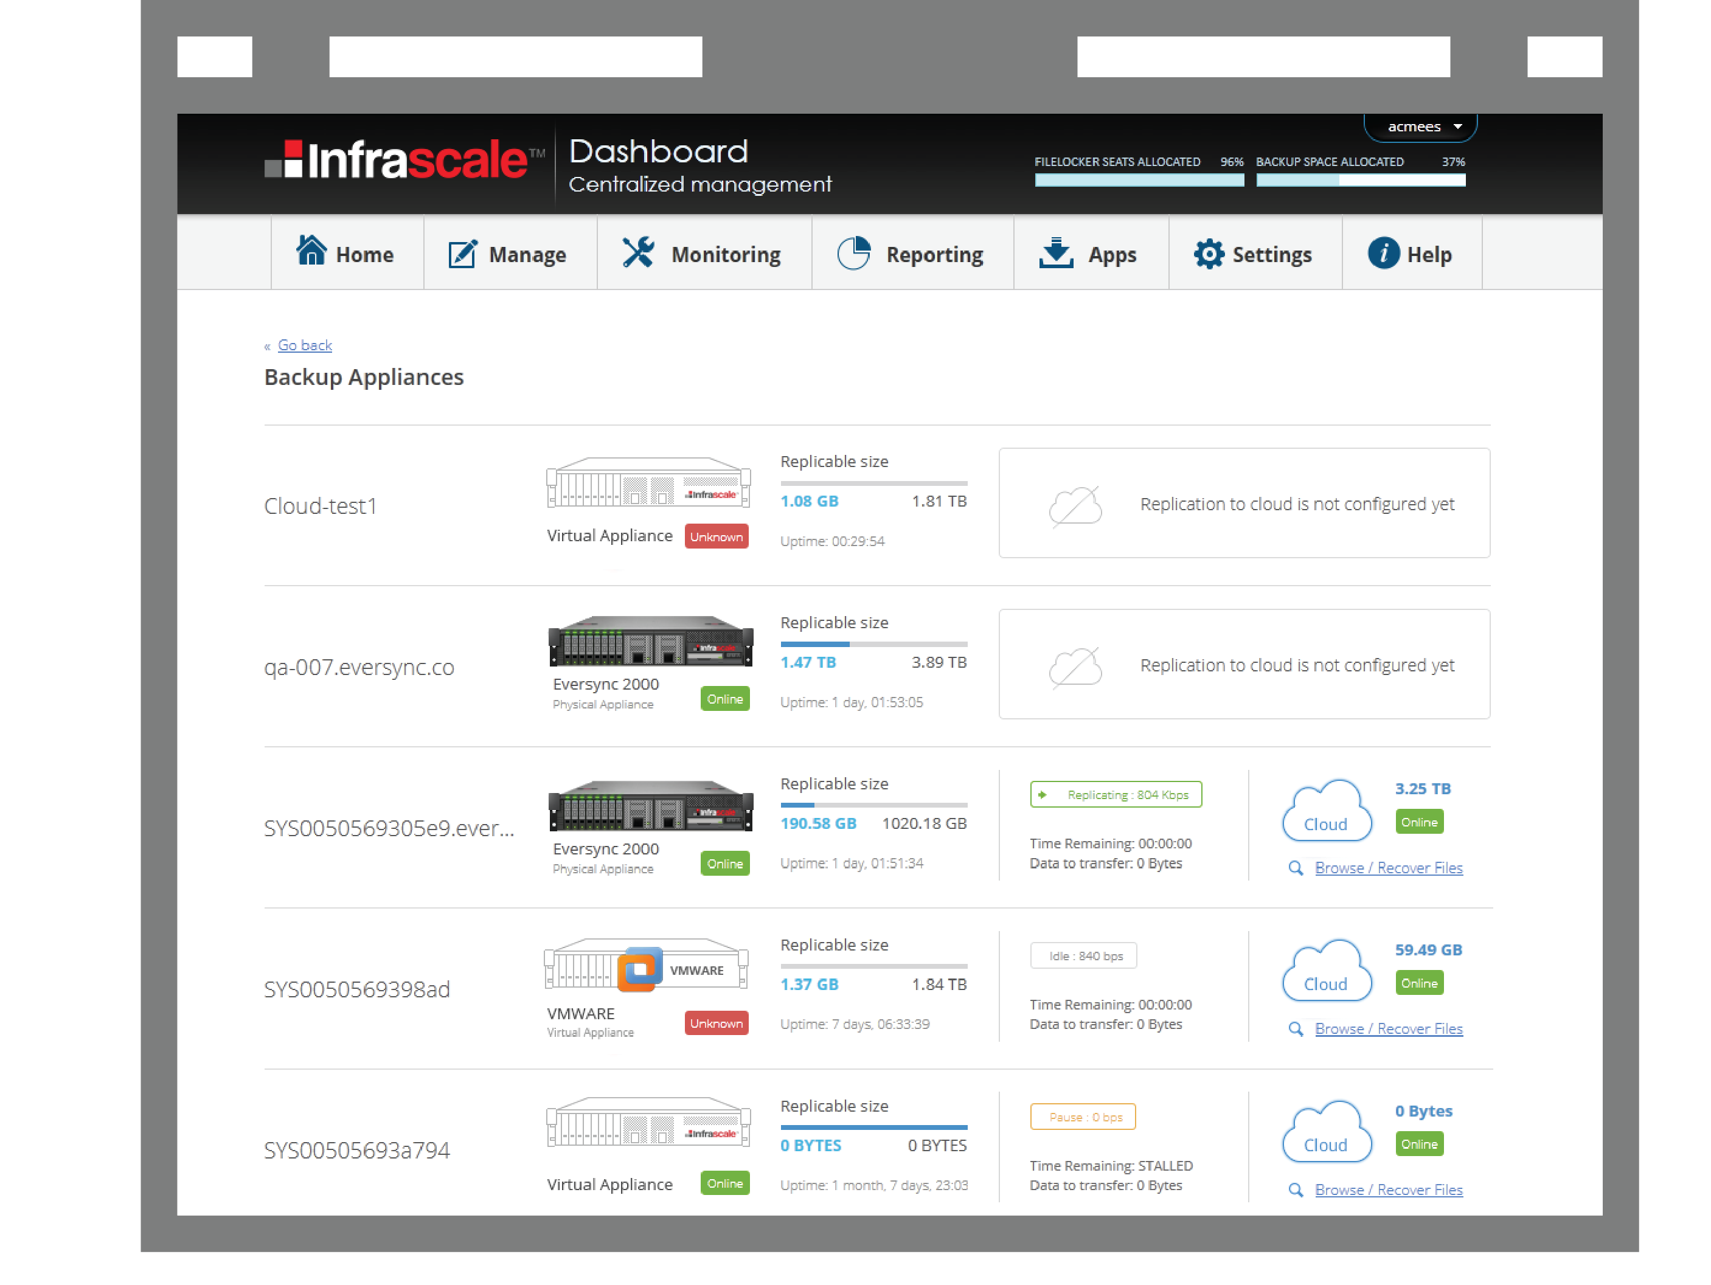
All from Dashboard…
VMware Backup

Slide 20
Demos
D2D2D Backup of VMware in 3 minutes
  a. Set up a backup of VMware
  b. Backup a VM locally, and then replicate to the cloud
2. Restore of a VM in 3 minutes
  a. Restore from a local backup in 3 minutes
  b. Restore from the cloud

Slide 21
Provides All Required Functionality
Backup
Manage through Infrascale Dashboard
one dashboard for virtual environments, physical servers and endpoints
Add, modify, delete VMware hosts
CBT and in-line block level de-duplication
Pre-defined host-level backup policies
Schedule and monitor backup at host-level
Recover
Can recover entire VMs or drill down inside a VMDK and recover individual files
Can restore just changed blocks
Application aware backup even of applications running inside VMware
Deployment
Benefits of on-site backup and off-site replication
Support for D2D and D2D2C backup patterns
Virtual seeding of cloud storage instance
Scales from simple ESX to complex vCenter environments

Slide 22
Money Matters

Slide 23
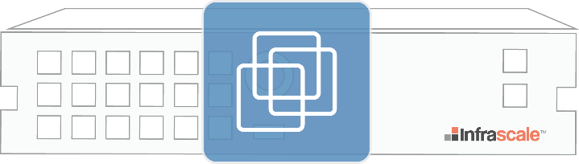
Pricing
Flexible and Compelling
$399
$129
$99
per month
per month
per month
Protects 1TB
per additional protected TB
per VMware host
Includes all virtual machines in one VMware host
Unlimited storage up to amount under contract
Dynamically allocate storage between VMware, physical servers and endpoints
Retroactive to storage already under contract
Simple contract upgrade

Slide 24
Fat Margins Await!
Protected Data Size (TB)
5
10
20
50
100
Infrascale Partner Price
$1,014 $1,509 $2,499 $4,969 $8,419
VEEAM Retail Price
$1,598 $3,196 $6,391 $15,979 $31,957
Gross Margin Available
36% 53% 61% 69% 74%
VEEAM Backup & Replication v7 – Enterprise Cloud Edition - $749 per 1 CPU socket per year
assume 200GB per socket to convert sockets to TB’s
Infrascale price includes cloud storage, VEEAM does not

Slide 25
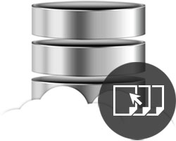
Ideal End-User for This Solution
Pinpoint your model customer:
these make an ideal end-user…
Have data on VMware environments
Have more than 3 VMware guests
Disparate VMware guest OS
Quick RTO and/or tight RPO
Desire redundant (replicated) backups
A mix of VMware and physical servers

Slide 26
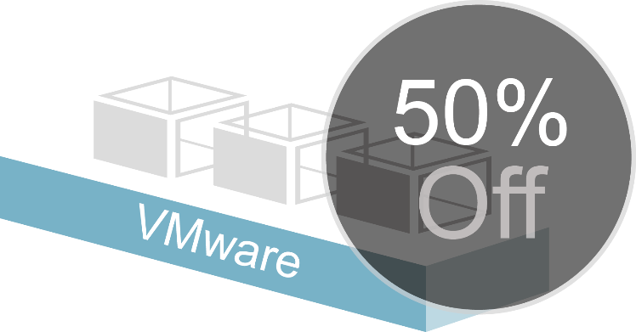
What’s Next?
Get to started with
VMware Backup with this promotional offer
For September only:
$250 per month
for 5 VMware backup host licenses
normally $495 per month
Thank you for joining us!
Go to:
www.infrascale.com/vmware-promo today!

