Slide 1

OpeN
SOLARIS

Slide 2
OpenSolaris is an open source computer operating system based on Solaris created by Sun Microsystems, now a part of Oracle Corporation. It is also the name of the project initiated by Sun to build a developer and user community around the software.

Slide 3
OpenSolaris is a descendent of the UNIX System V Release 4 (SVR4) codebase developed by Sun and AT&T in the late 1980s. It is the only version of System V available as open source.

Slide 4
OpenSolaris is developed as a combination of several software consolidations which were open sourced subsequent to Solaris 10. It includes a variety of free software, including popular desktop and server software. Sun has announced that future versions of its commercial Solaris operating system will be based on the OpenSolaris project.

Slide 5
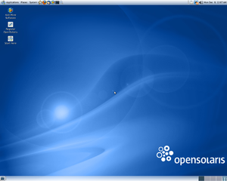
Picture of Open Solaris

Slide 6
History
OpenSolaris is based on Solaris, which was originally released by Sun in 1991. Solaris is a version of UNIX System V Release 4 (SVR4), jointly developed by Sun and AT&T to merge features from several existing Unix systems. It was licensed by Sun from Novell to replace SunOS.

Slide 7
Planning for OpenSolaris started in early 2004. A pilot program was formed in September 2004 with 18 non-Sun community members and ran for 9 months growing to 145 external participants. Sun submitted the CDDL (Common Development and Distribution License) to the OSI, which approved it on January 14, 2005.

Slide 8
The first part of the Solaris code base to be open sourced was the Solaris Dynamic Tracing facility (commonly known as Dtrace), a tool that aids in the analysis, debugging, and tuning of applications and systems. DTrace was released under the CDDL on January 25, 2005 on the newly launched opensolaris.org website. The bulk of the Solaris system code was released on June 14, 2005. There remains some system code that is not open sourced, and is available only as pre-compiled binary files.

Slide 9
On February 10, 2006 Sun approved The OpenSolaris Charter, which reestablished this body as the independent OpenSolaris Governing Board. The task of creating a governance document or "constitution" for this organization was given to the OGB and three invited members: Stephen Hahn and Keith Wesolowski (developers in Sun's Solaris organization) and Ben Rockwood (a prominent OpenSolaris community member).

Slide 10
March 19, 2007, Sun announced that it had hired Ian Murdock, founder of Debian, to head Project Indiana, an effort to produce a complete OpenSolaris distribution, with GNOME and userland tools from GNU, plus a network-based package management system. The new distribution was planned to refresh the user experience, and would become the successor to Solaris Express as the basis for future releases of Solaris.

Slide 11
On May 5, 2008, OpenSolaris 2008.05 was released, in a format that could be booted as a Live CD or installed directly. It uses the GNOME desktop environment as the primary user interface. The later OpenSolaris 2008.11 release included a GUI for ZFS' snapshotting capabilities, known as Time Slider, that provides functionality similar to Mac OS X's Time Machine.

Slide 12
In December 2008 Sun Microsystems and Toshiba America Information Systems announced plans to distribute Toshiba laptops pre-installed with OpenSolaris. On April 1, 2009, the Tecra M10 and Portégé R600 came preinstalled with OpenSolaris 2008.11 release and several supplemental software packages.

Slide 13
On June 1, 2009, OpenSolaris 2009.06 was released, with support for the SPARC platform.
On January 13, 2010, Sun discontinued the Solaris Express program to focus on the OpenSolaris distribution.

Slide 14
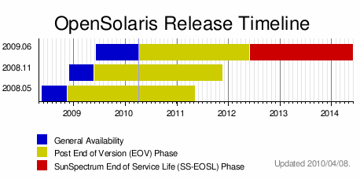

Slide 15
Release Model
OpenSolaris is offered as both development (unstable) and production (stable) releases.

Slide 16
Development releases are built from the latest OpenSolaris codebase (consolidations) and include newer techologies, security updates and bug fixes, and more applications, but may not have undergone extensive testing.

Slide 17
Production releases are branched from a snapshot of the development codebase (following a Code Freeze) and undergo a QA process that includes backporting security updates and bug fixes.

Slide 18
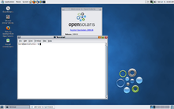

Slide 19
Installation
OpenSolaris can be installed from CD-ROM, USB drives, or over a network with the Automated Installer. CD, USB, and network install images are made available for both types of releases.

Slide 20
information
OpenSolaris uses a network-aware package system called the Image Packaging System (also known as pkg(5)) to add, remove, and manage installed software and to update to newer releases.

Slide 21
Packages for development releases of OpenSolaris are published by Oracle typically every two weeks to the /dev repository. Production releases use the /release repository which does not receive updates until the next production release. Only Sun customers with paid support contracts have access to updates for production releases.

Slide 22
A hardware compatibility list (HCL) for OpenSolaris can be consulted when choosing hardware for OpenSolaris deployment.
Extensive OpenSolaris administration, usage, and development documentation is available online, including community-contributed information.

Slide 23
OpenSolaris 2009.06 represents the most significant networking technology contribution from Sun in this decade. It provides advanced network resource management capabilities and enables OpenSolaris to take advantage of the latest multi-core, multi-CPU systems as well as next-generation network interface cards.

Slide 24
OpenSolaris includes a number of critical networking services, including a major update to IP Multipathing for High Availability network configurations. OpenSolaris also includes the IPFilter firewall and Quagga router services.

Slide 25
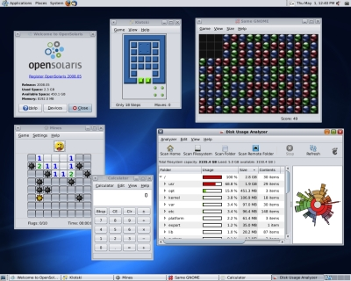
OpenSolaris Picture

Slide 26
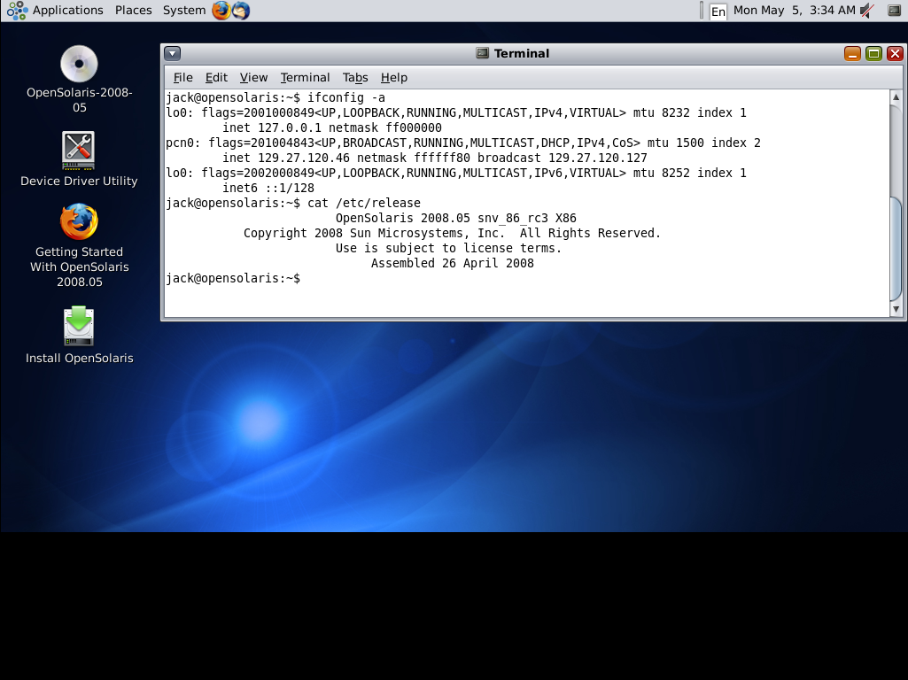

Slide 27
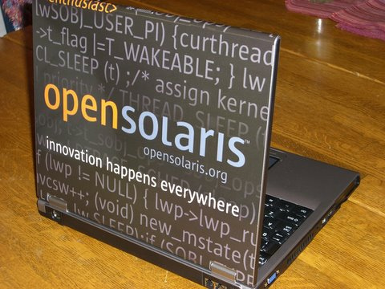

Slide 28
Prepared by:
That’s all…
Thank You!!
GROUP II
Janeth Carolino
Czarina Mae Barte
Eizelle Calim
Jastine Mendoza
Eliza Palmero

