Slide 1
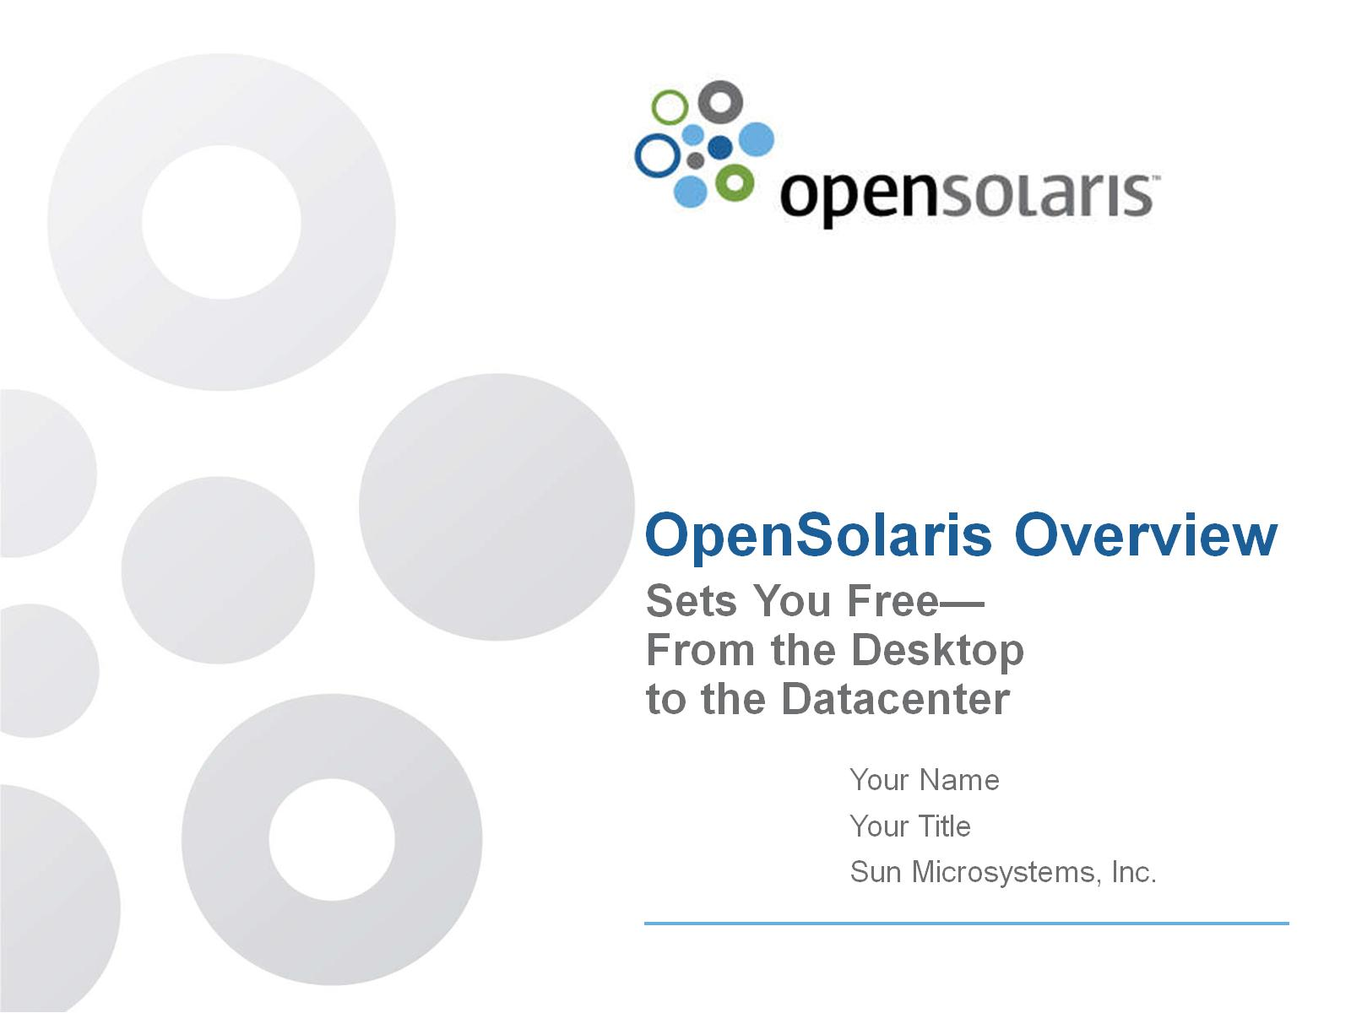
OpenSolaris Overview

Slide 2
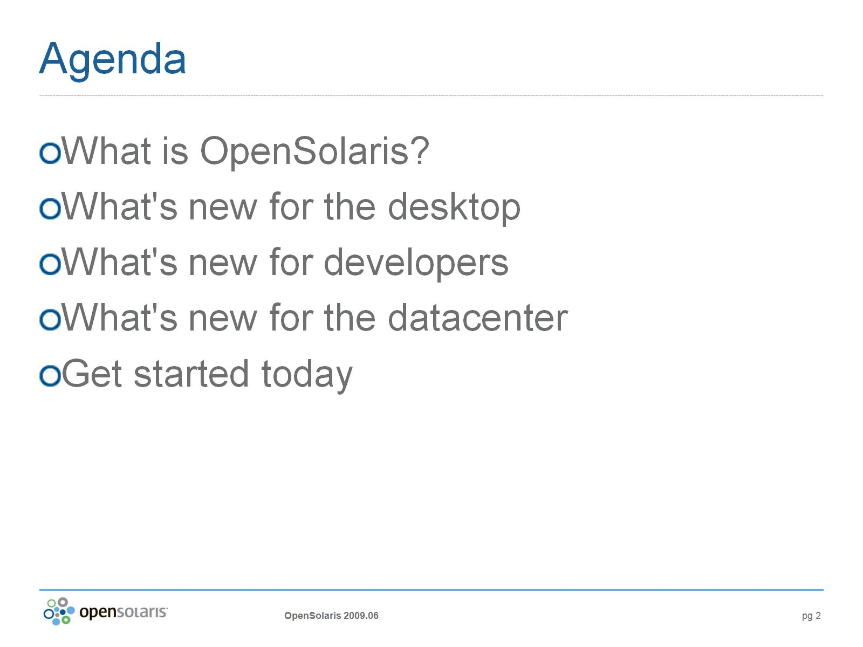
Agenda

Slide 3
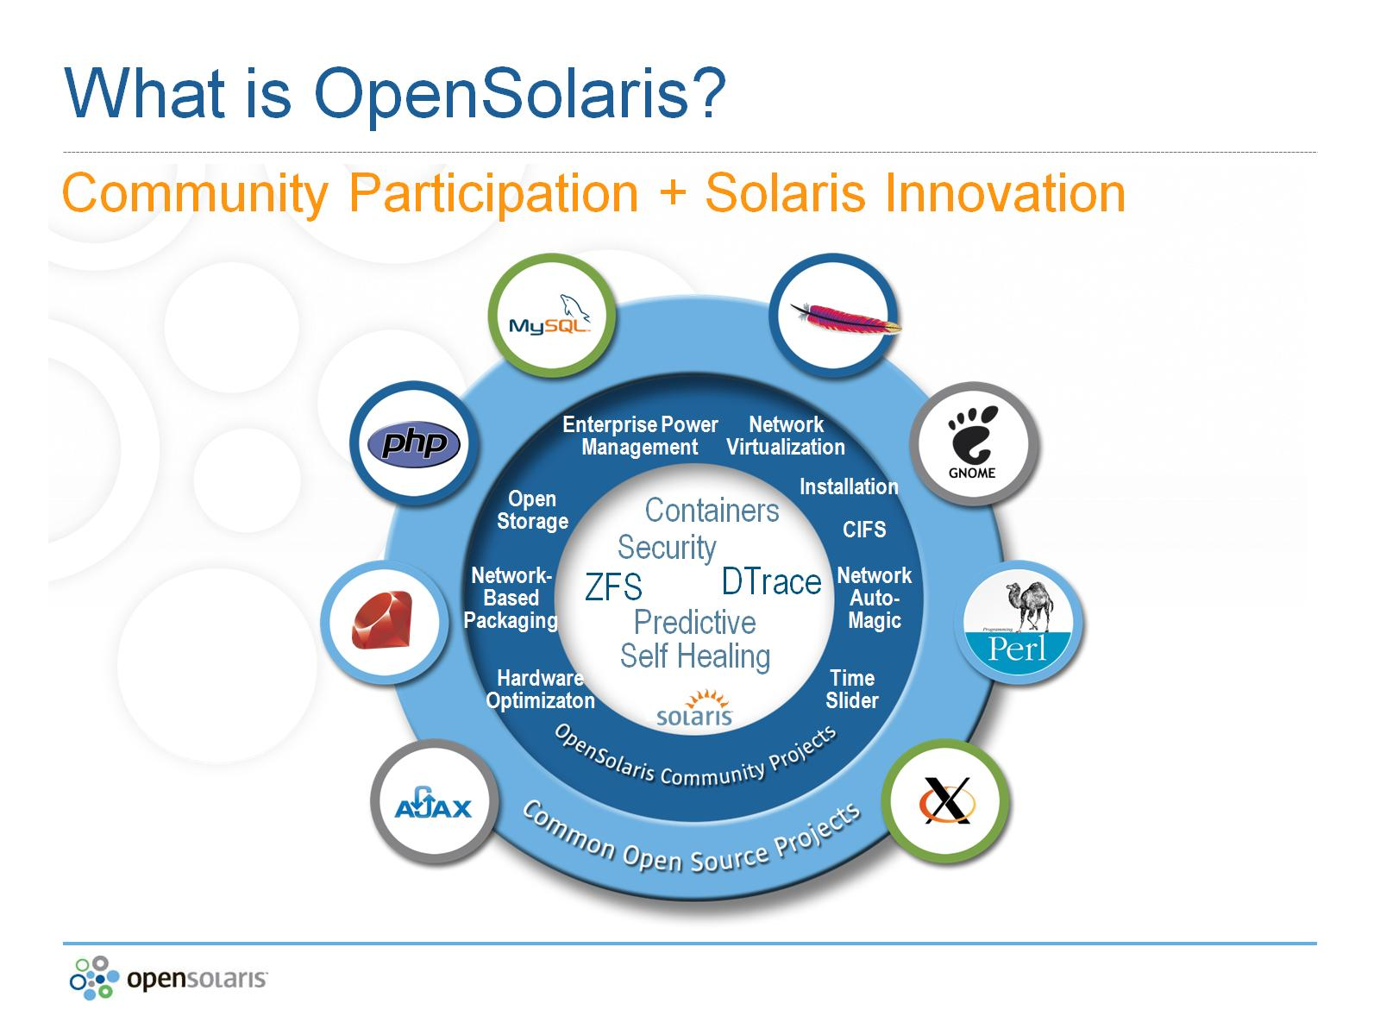
What is OpenSolaris?

Slide 4
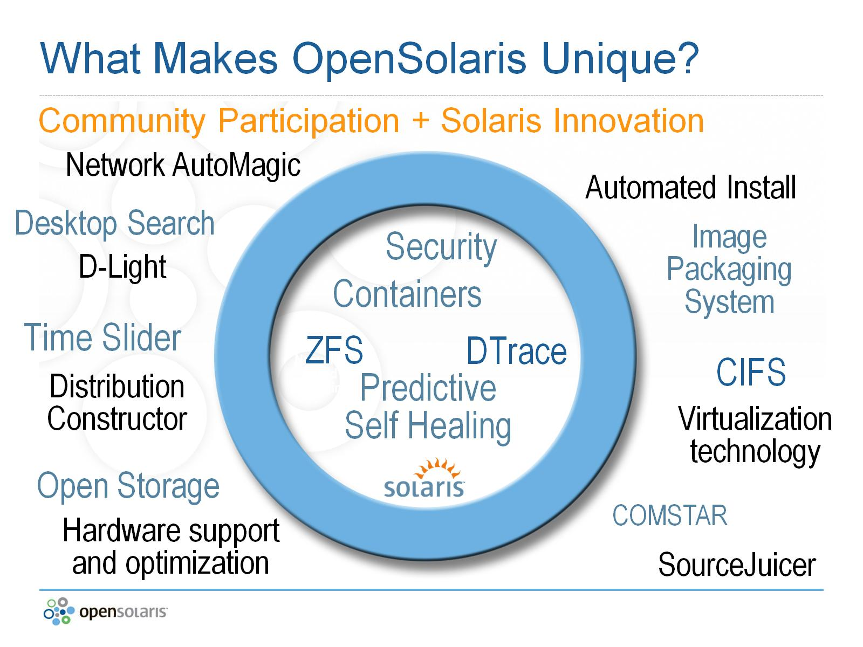
What Makes OpenSolaris Unique?

Slide 5
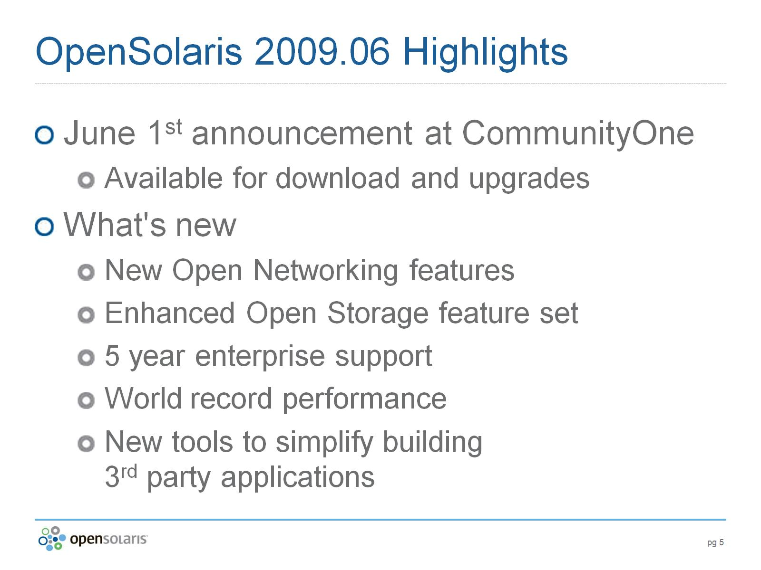
OpenSolaris 2009.06 Highlights

Slide 6
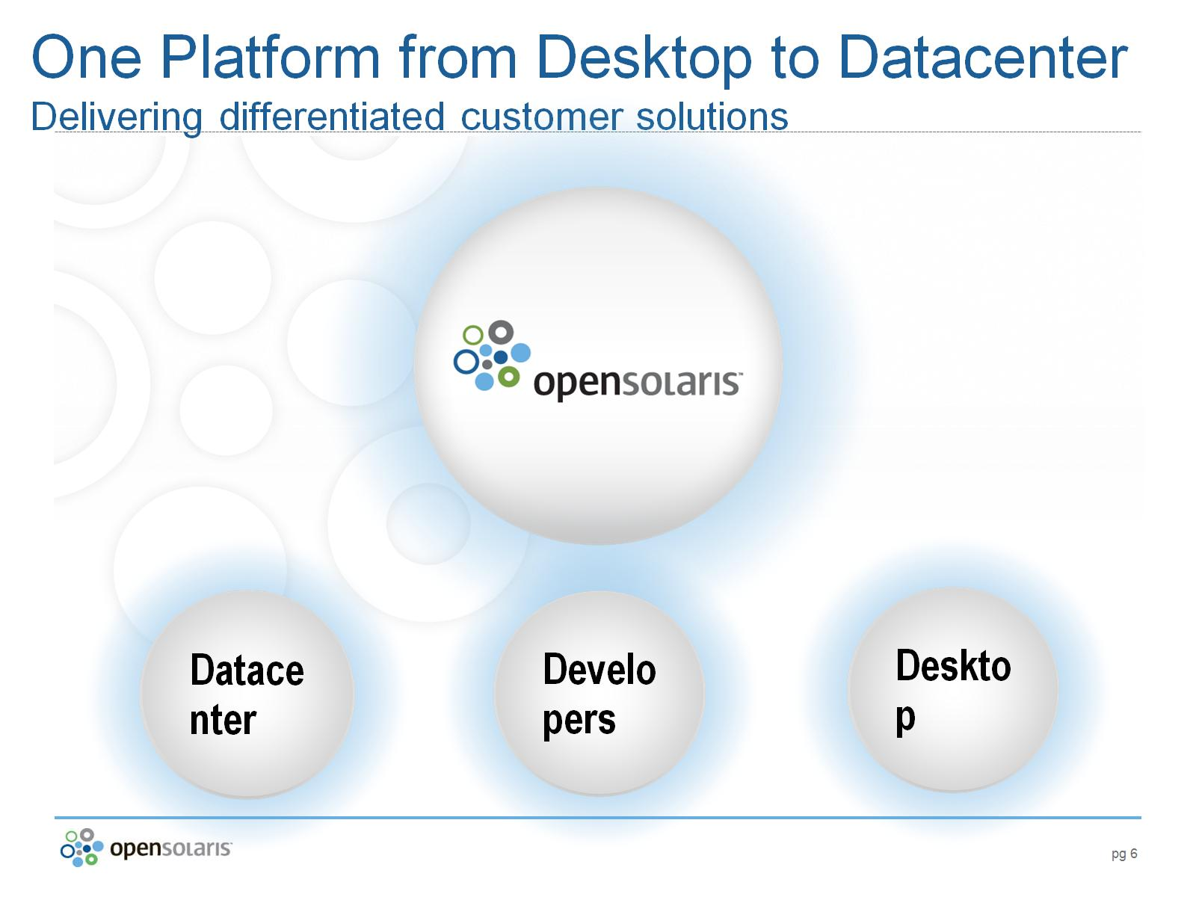
One Platform from Desktop to Datacenter
Delivering differentiated customer solutions

Slide 7
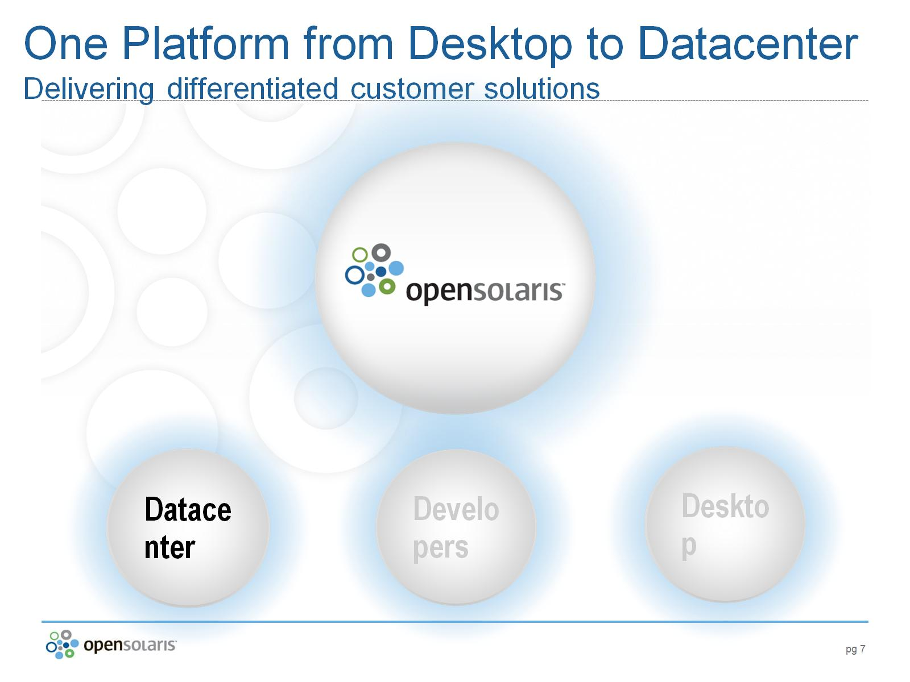
One Platform from Desktop to Datacenter
Delivering differentiated customer solutions

Slide 8
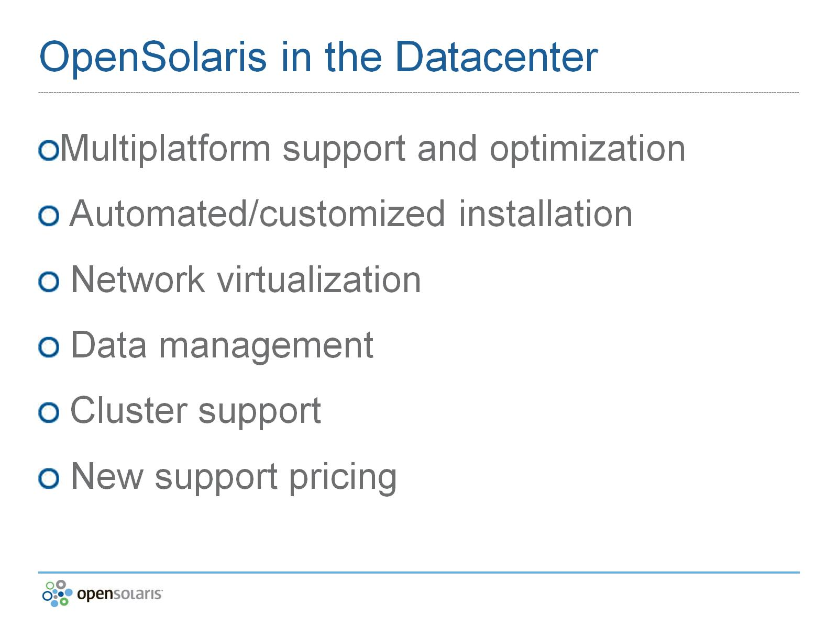
OpenSolaris in the Datacenter

Slide 9
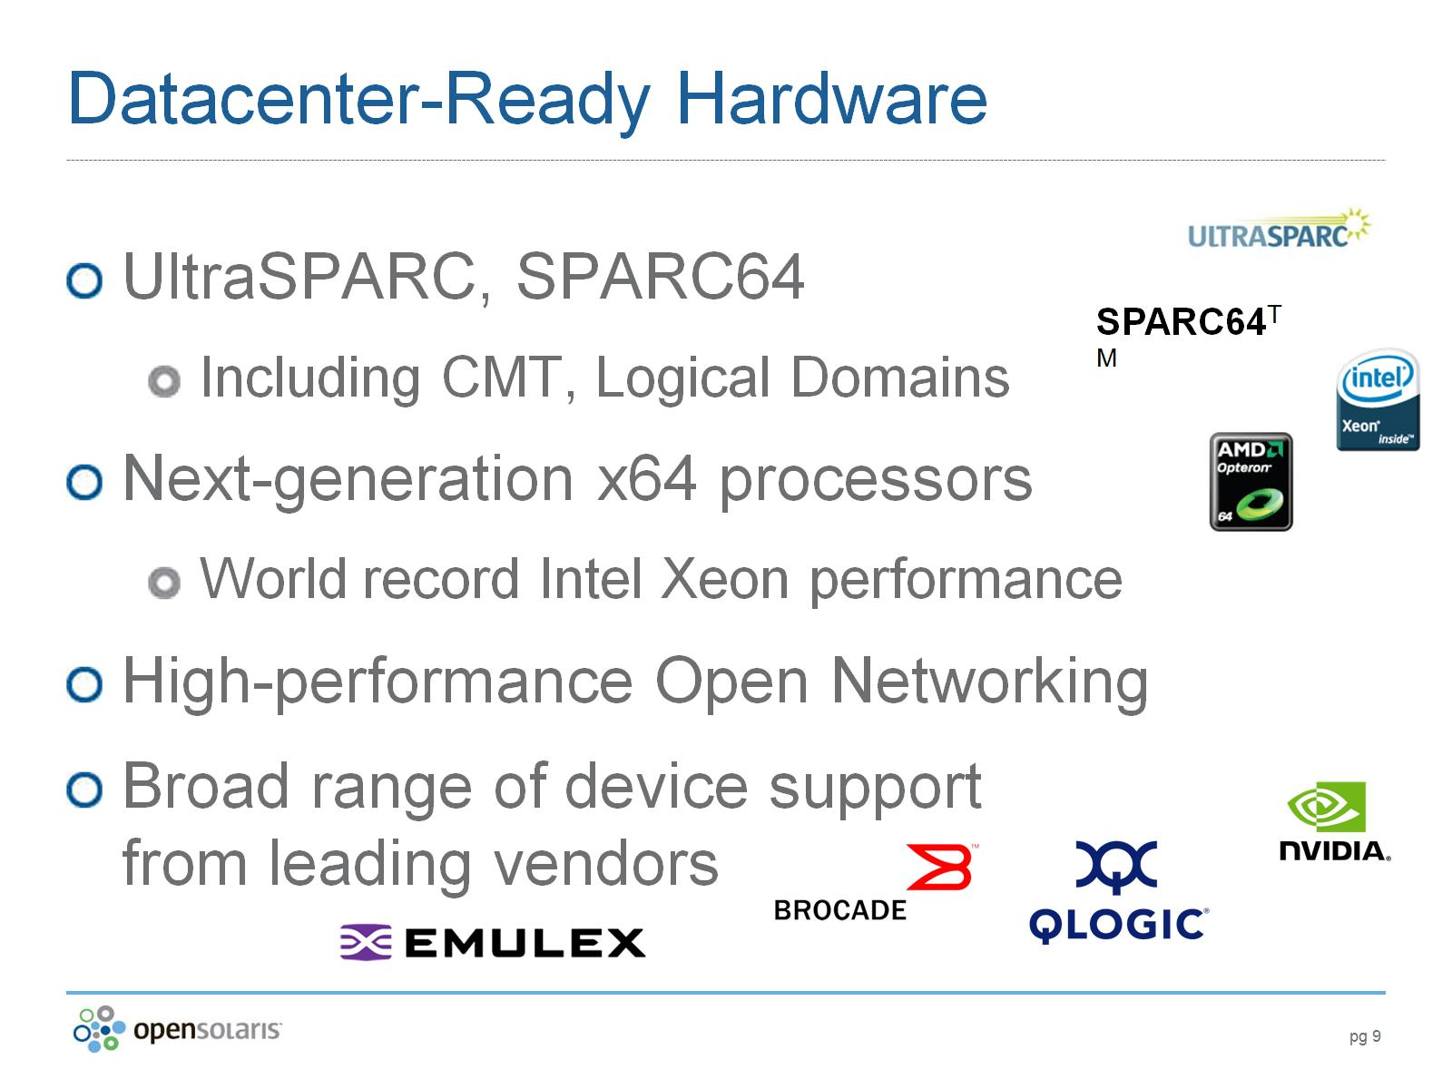
Datacenter-Ready Hardware

Slide 10
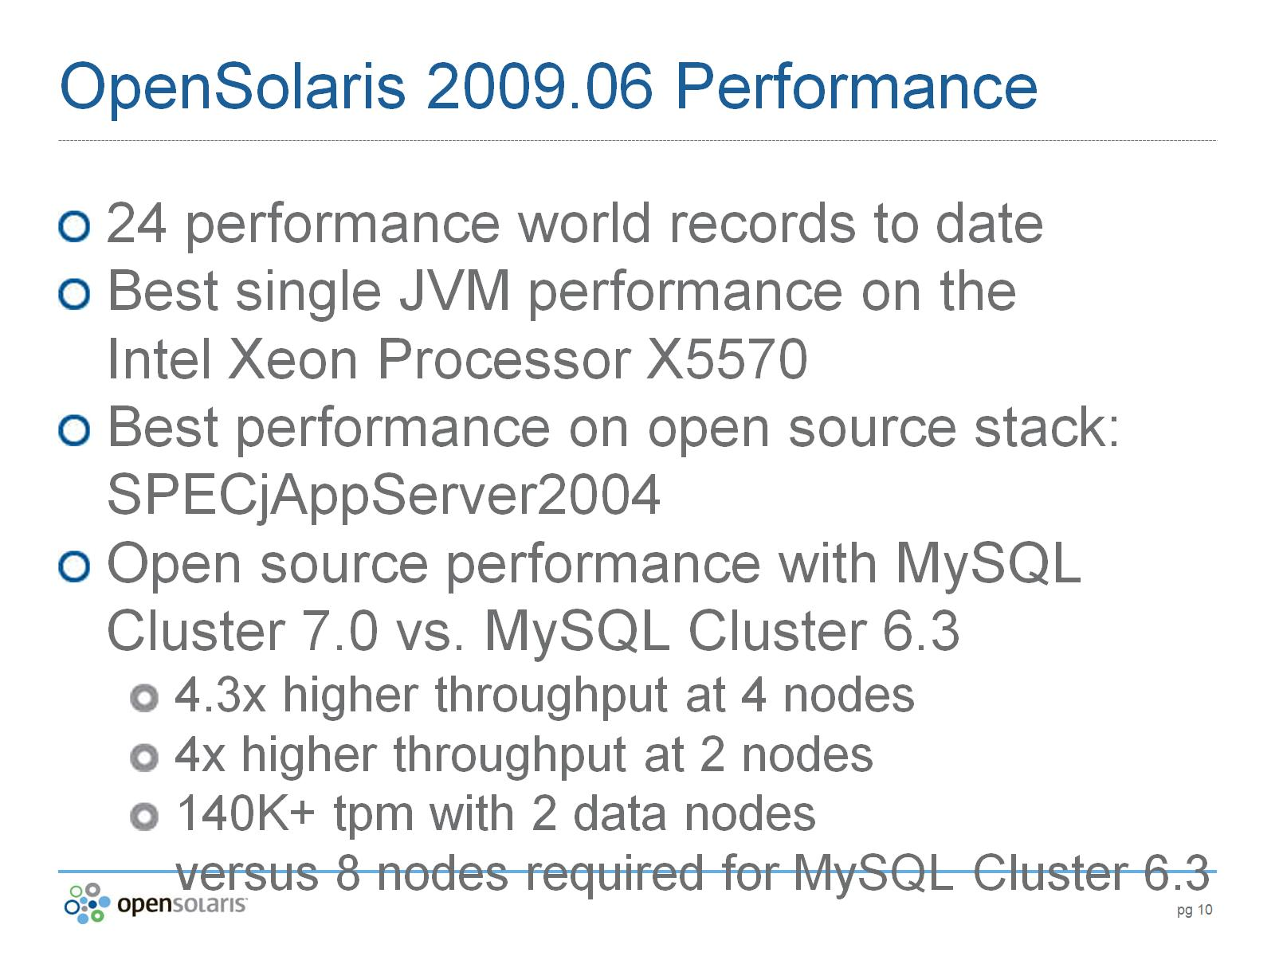
OpenSolaris 2009.06 Performance

Slide 11
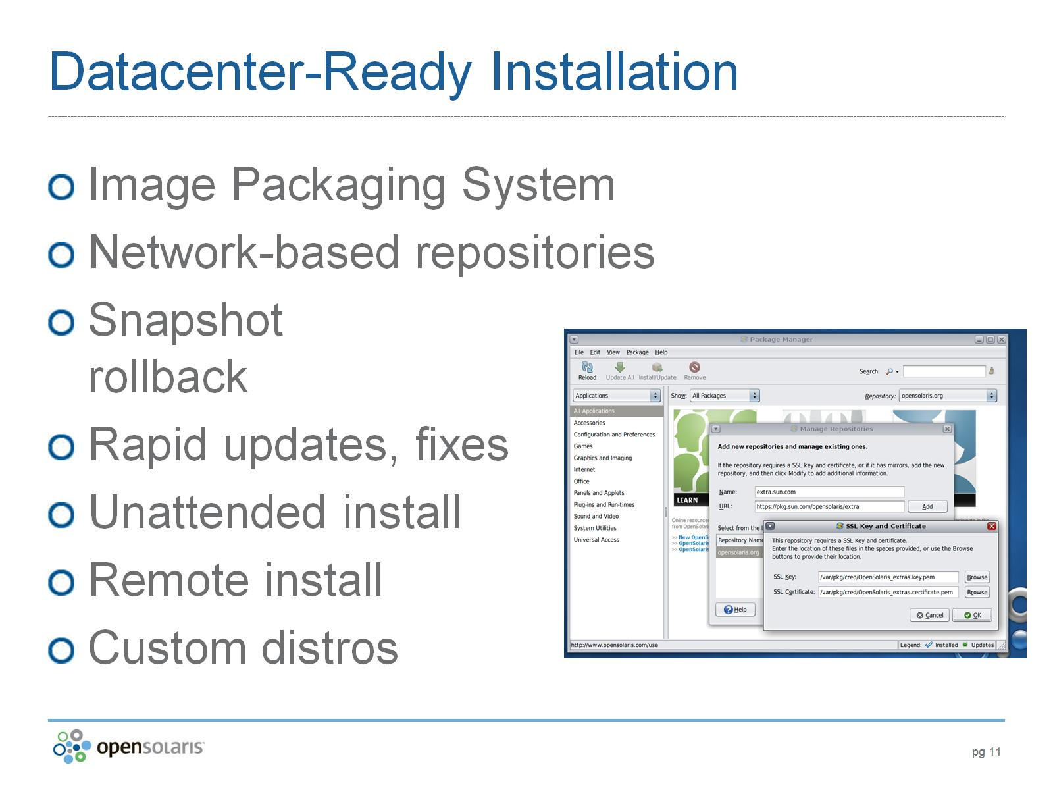
Datacenter-Ready Installation

Slide 12
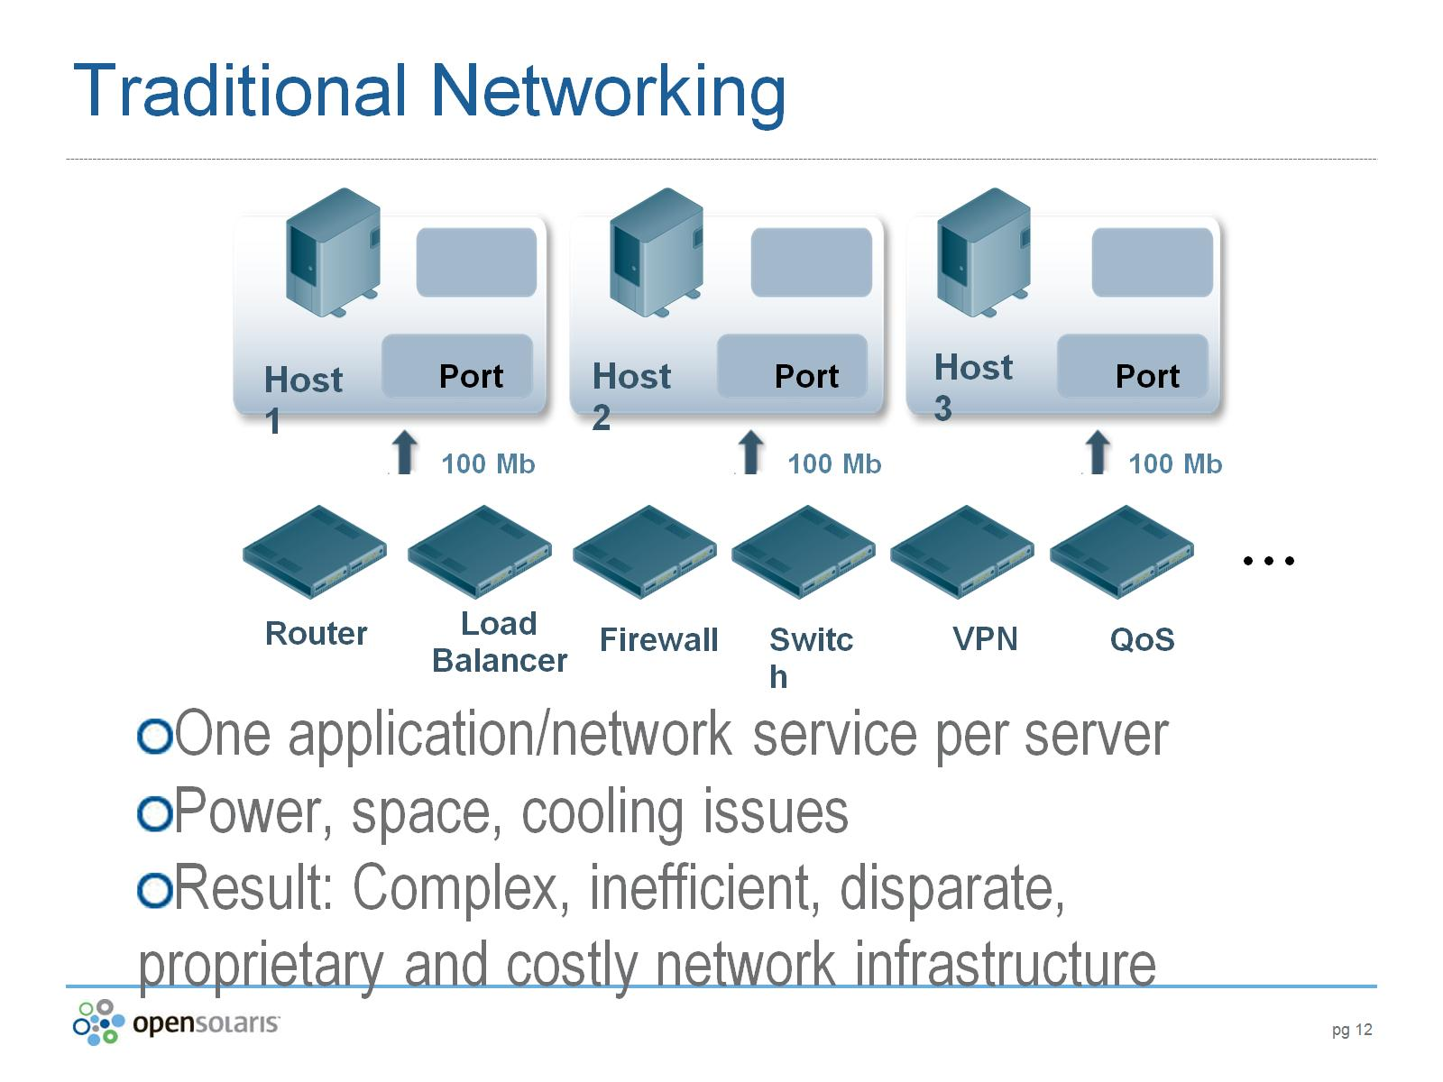
Traditional Networking

Slide 13
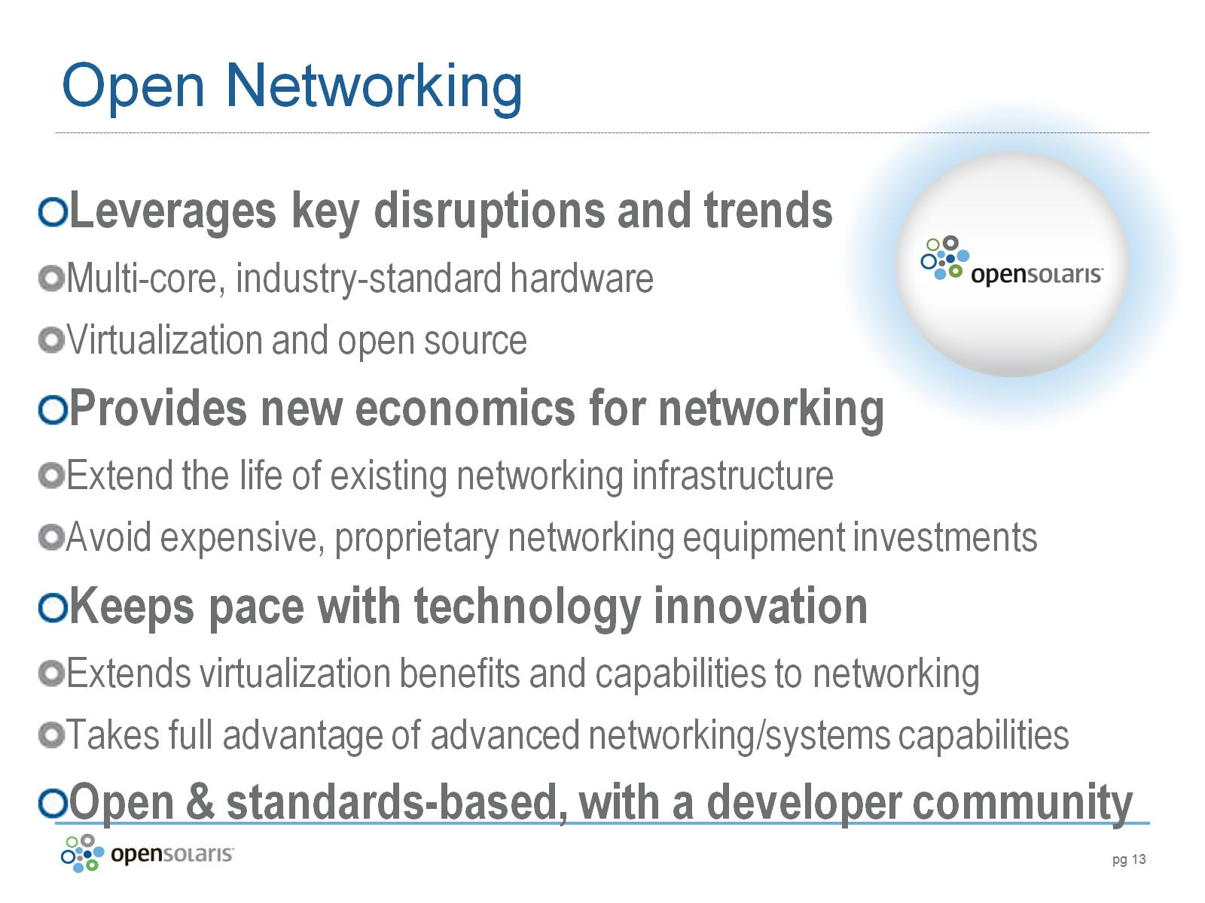
Open Networking

Slide 14
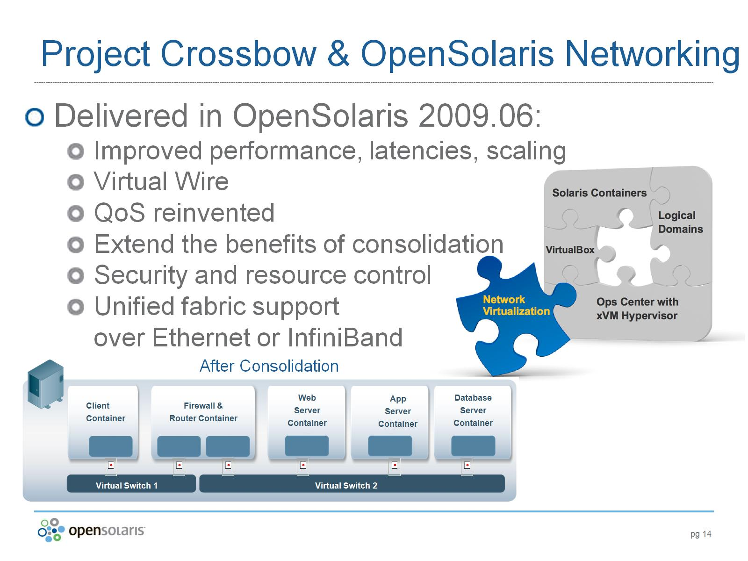
After Consolidation

Slide 15
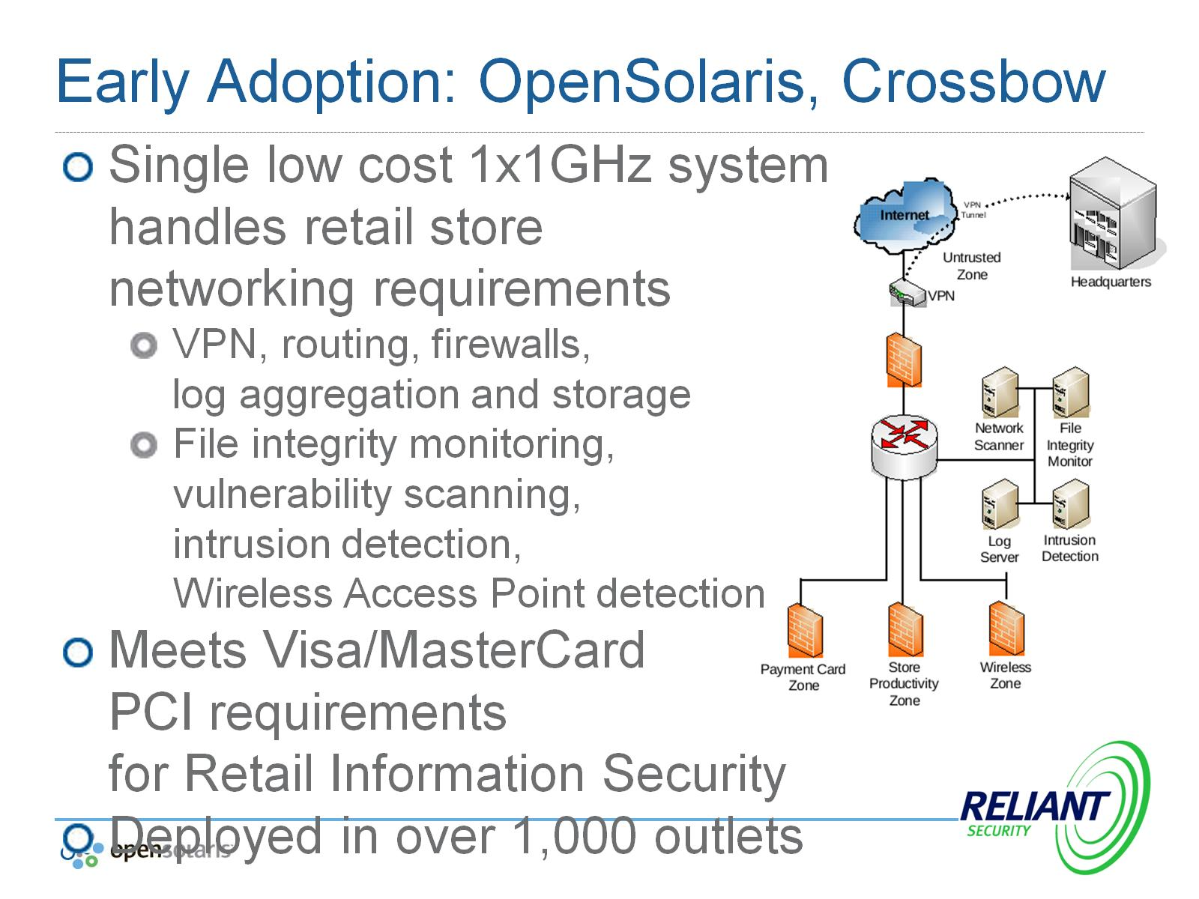
Early Adoption: OpenSolaris, Crossbow

Slide 16
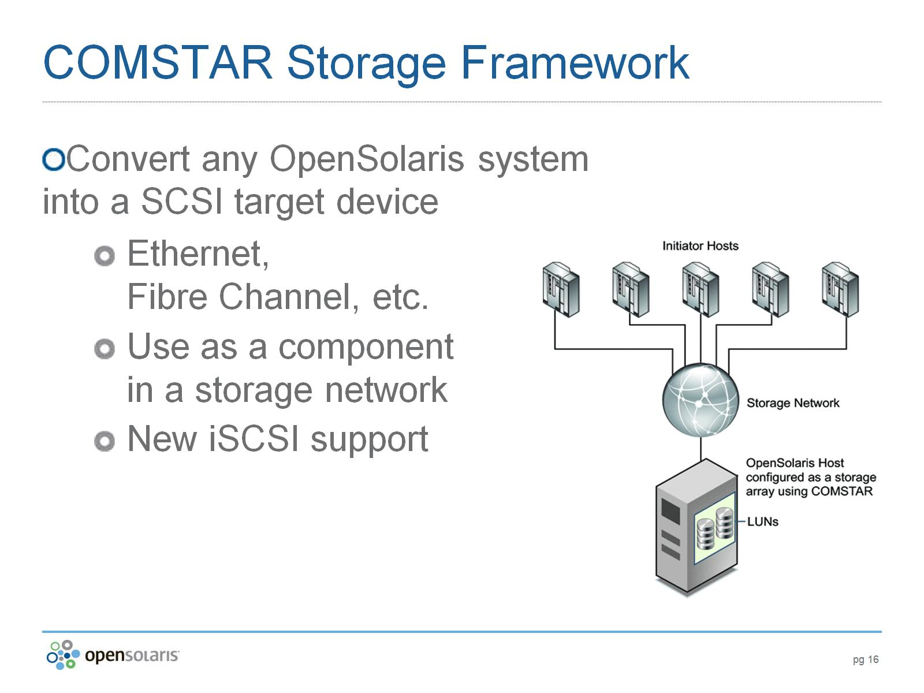
COMSTAR Storage Framework

Slide 17
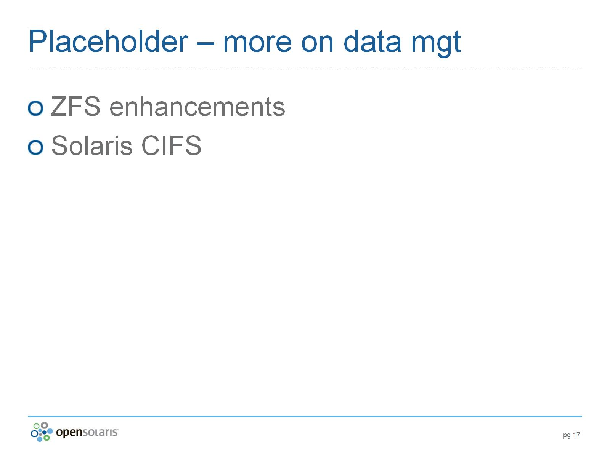
Placeholder – more on data mgt

Slide 18
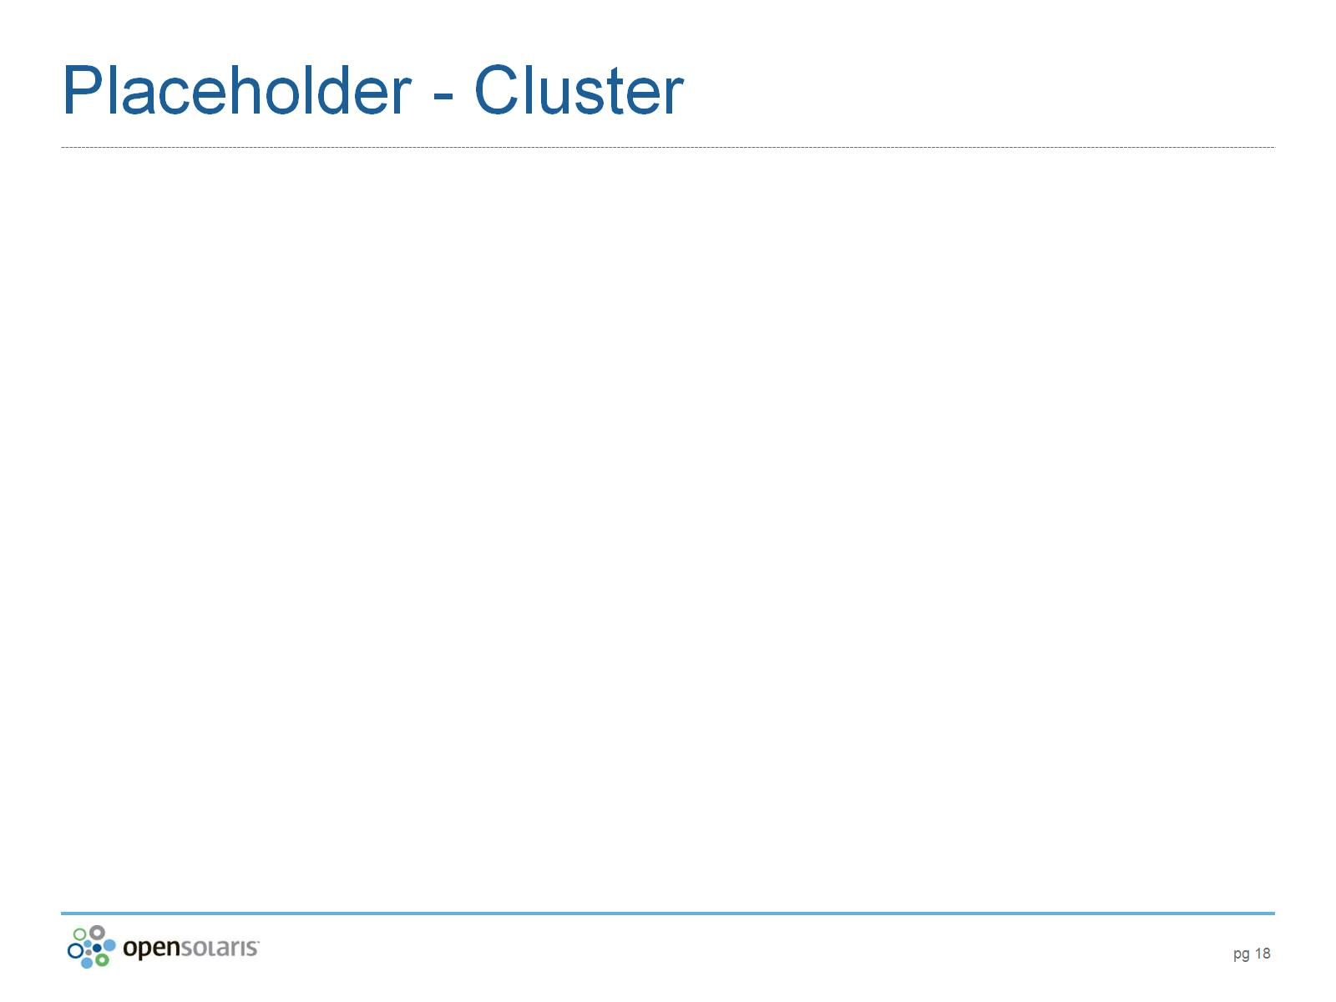
Placeholder - Cluster

Slide 19
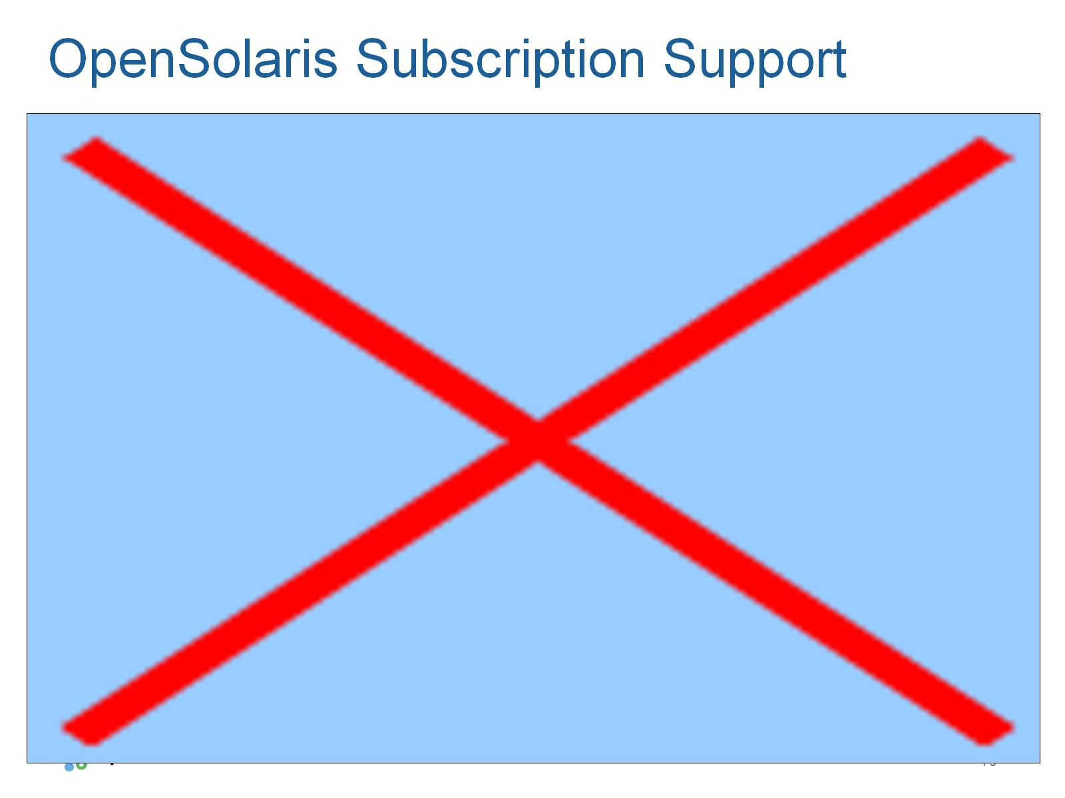
OpenSolaris Subscription Support

Slide 20
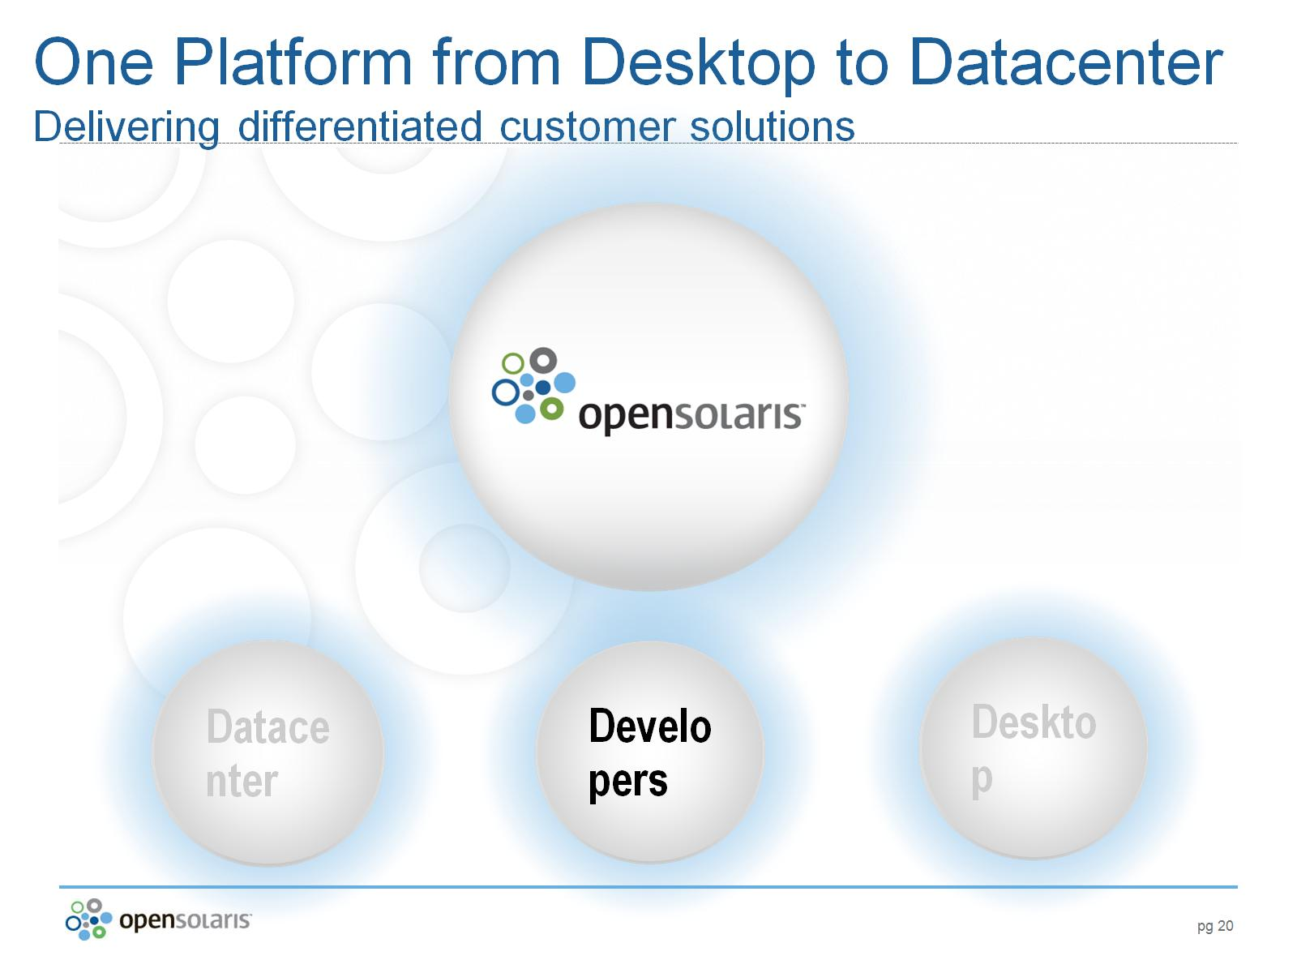
One Platform from Desktop to Datacenter
Delivering differentiated customer solutions

Slide 21
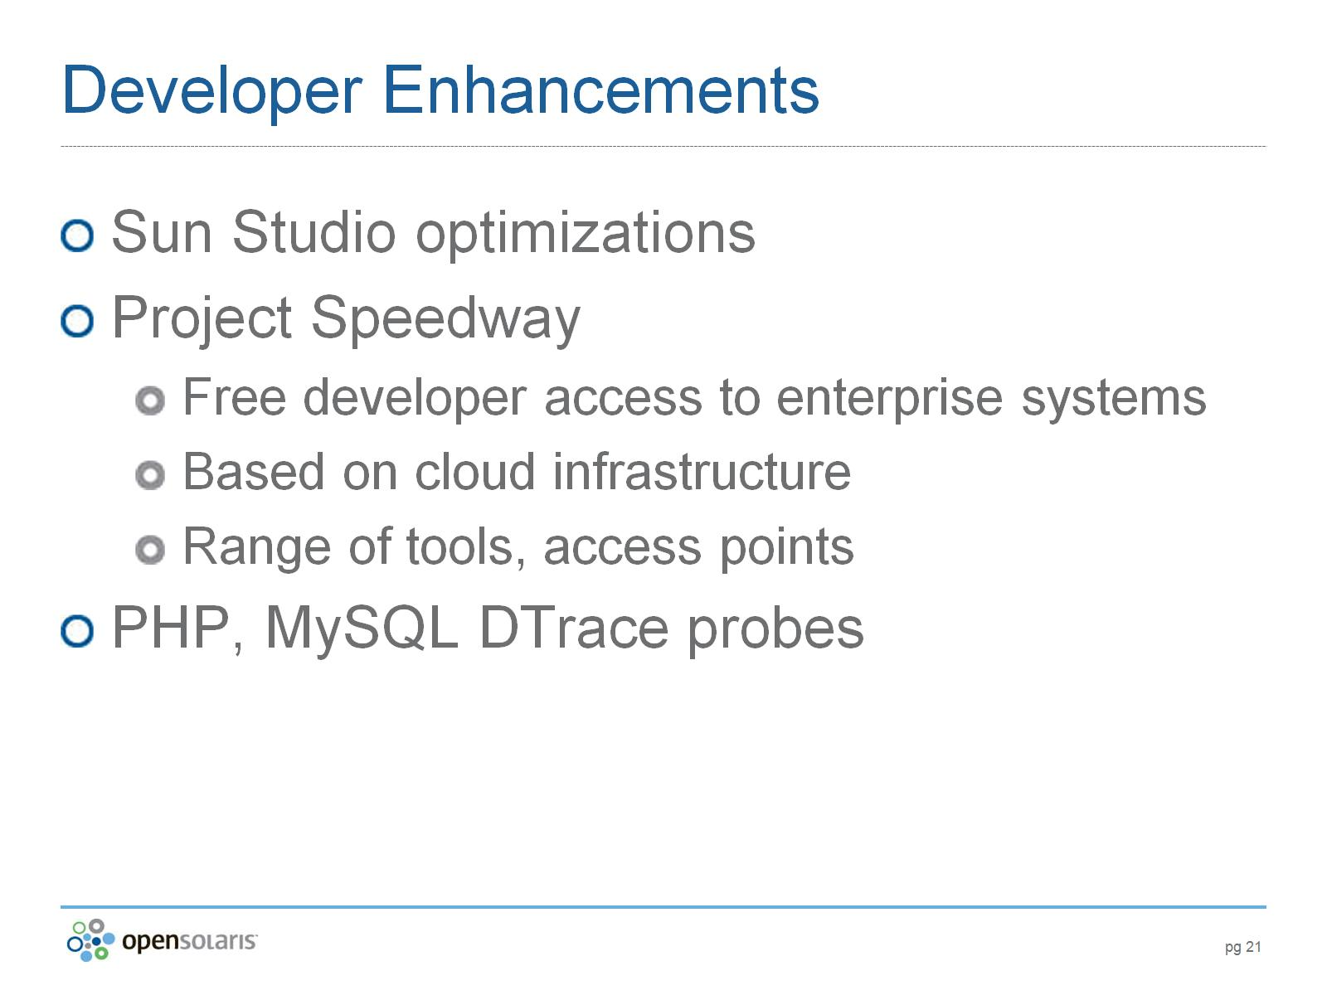
Developer Enhancements

Slide 22
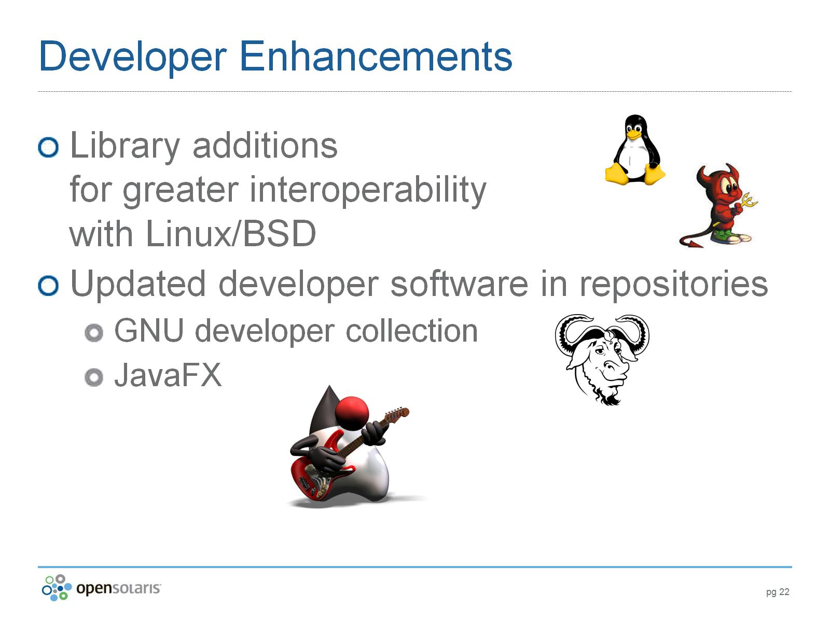
Developer Enhancements

Slide 23
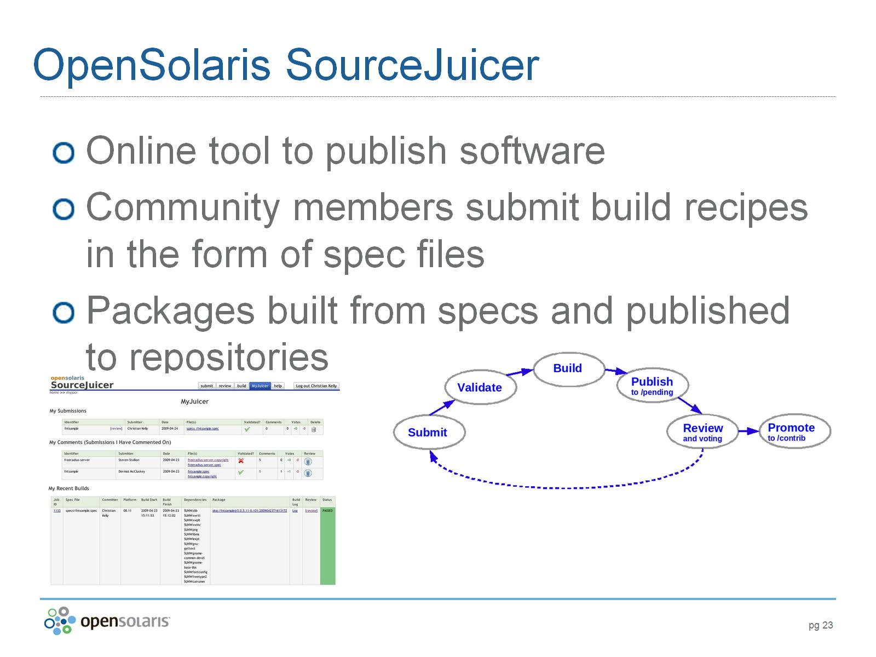
OpenSolaris SourceJuicer

Slide 24
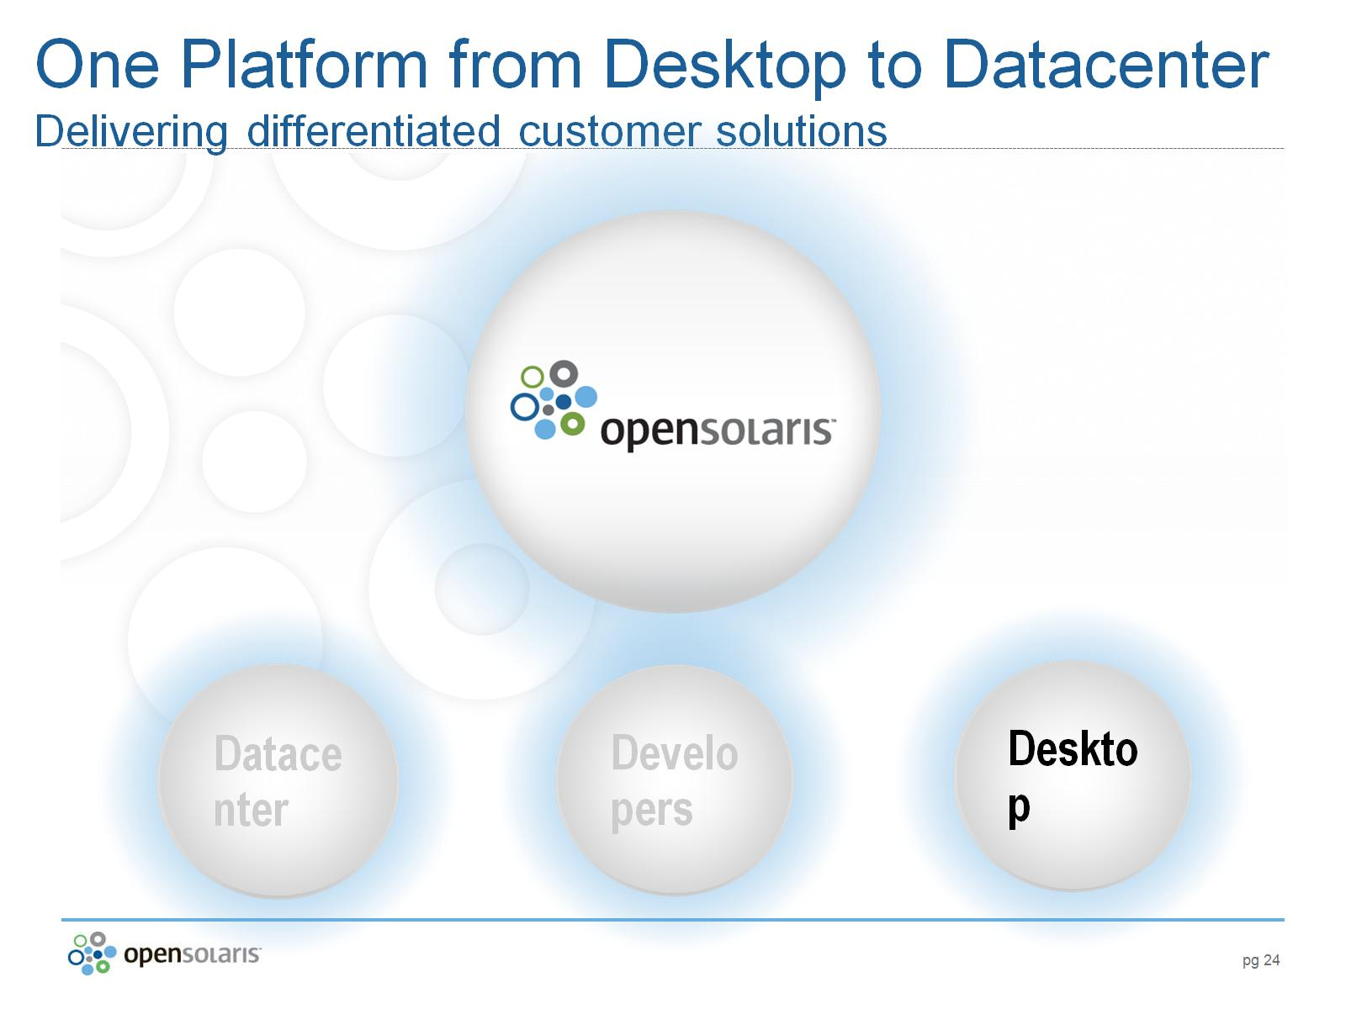
One Platform from Desktop to Datacenter
Delivering differentiated customer solutions

Slide 25
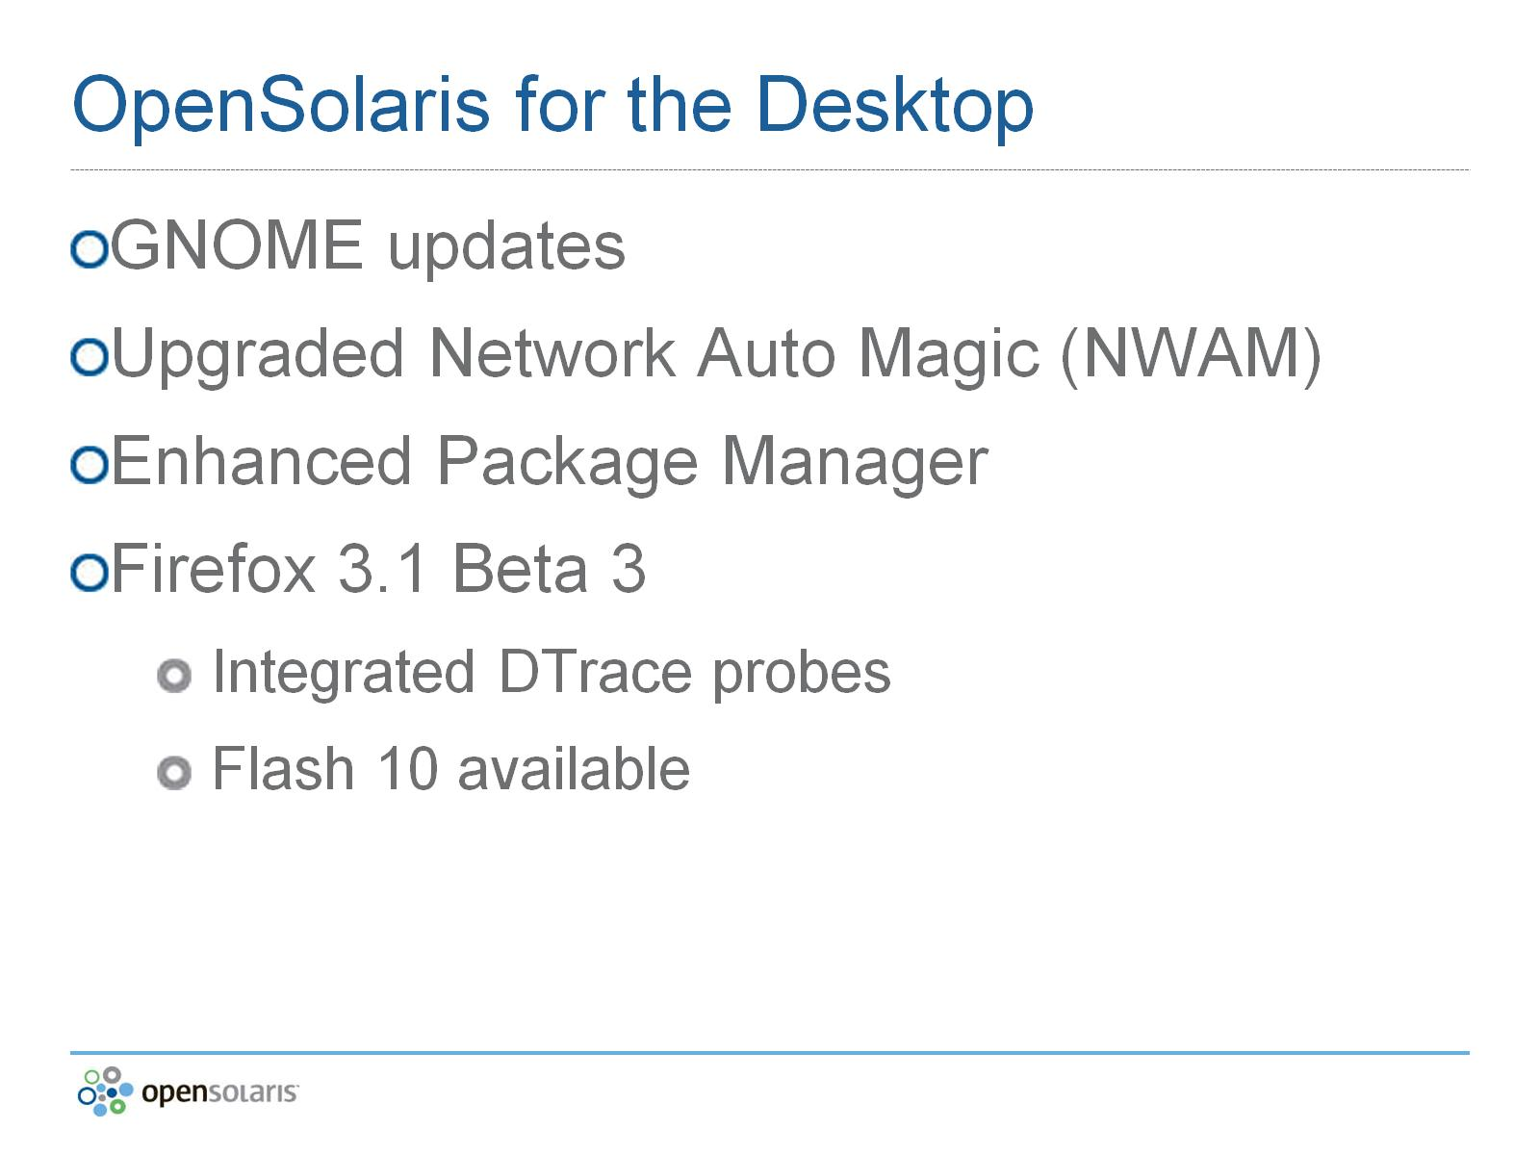
OpenSolaris for the Desktop

Slide 26
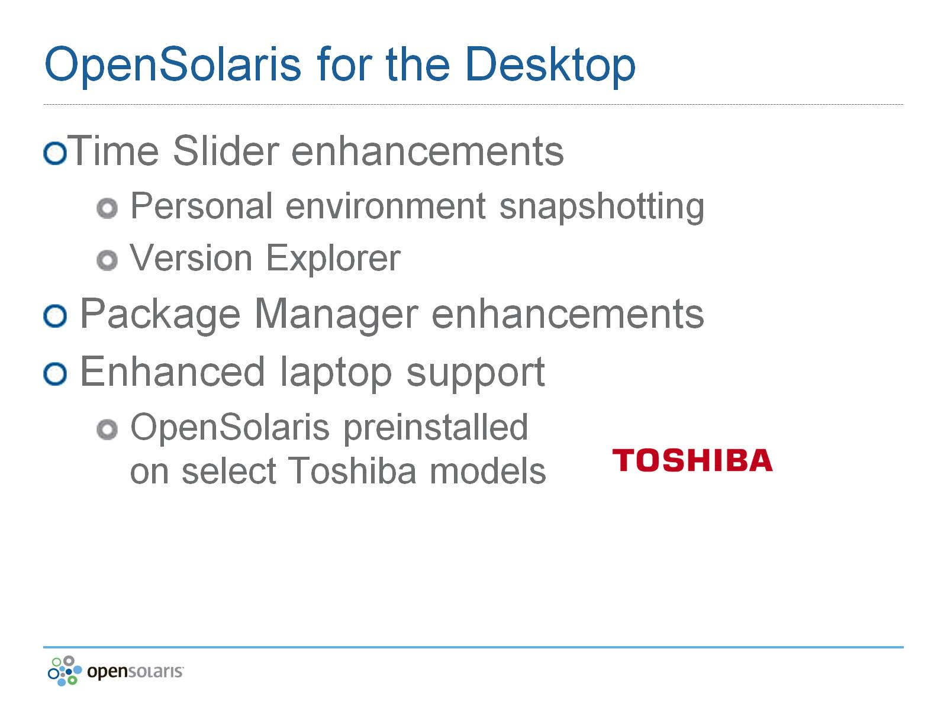
OpenSolaris for the Desktop

Slide 27
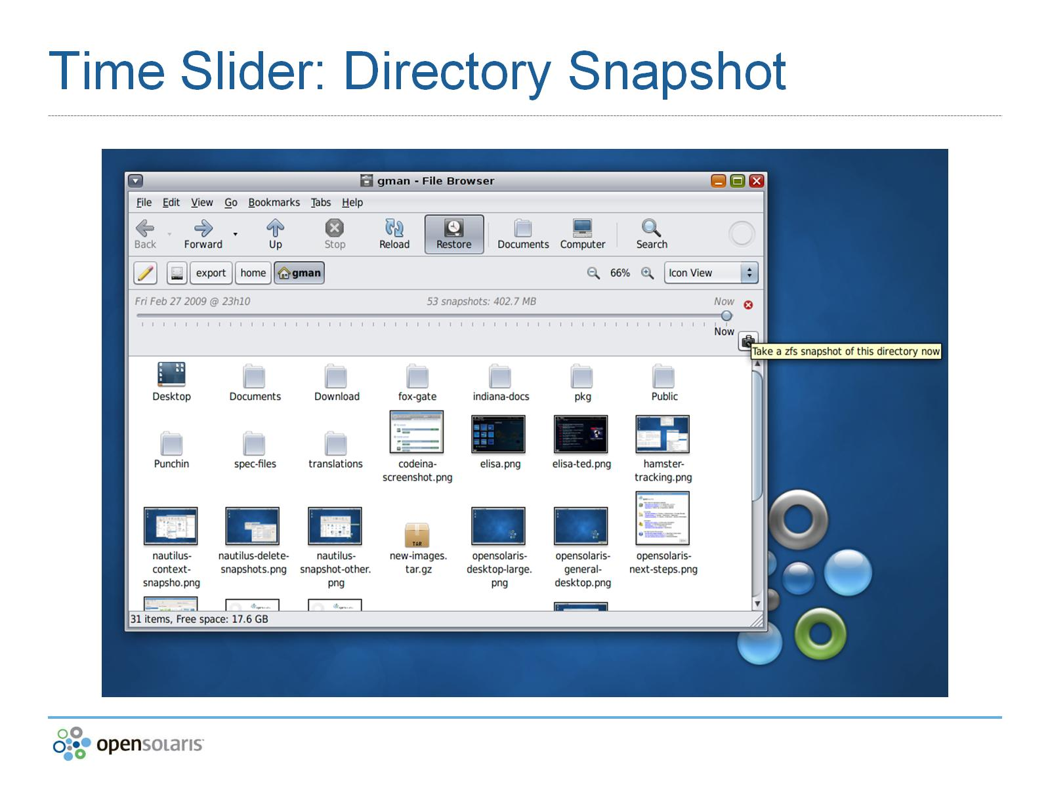
Time Slider: Directory Snapshot

Slide 28
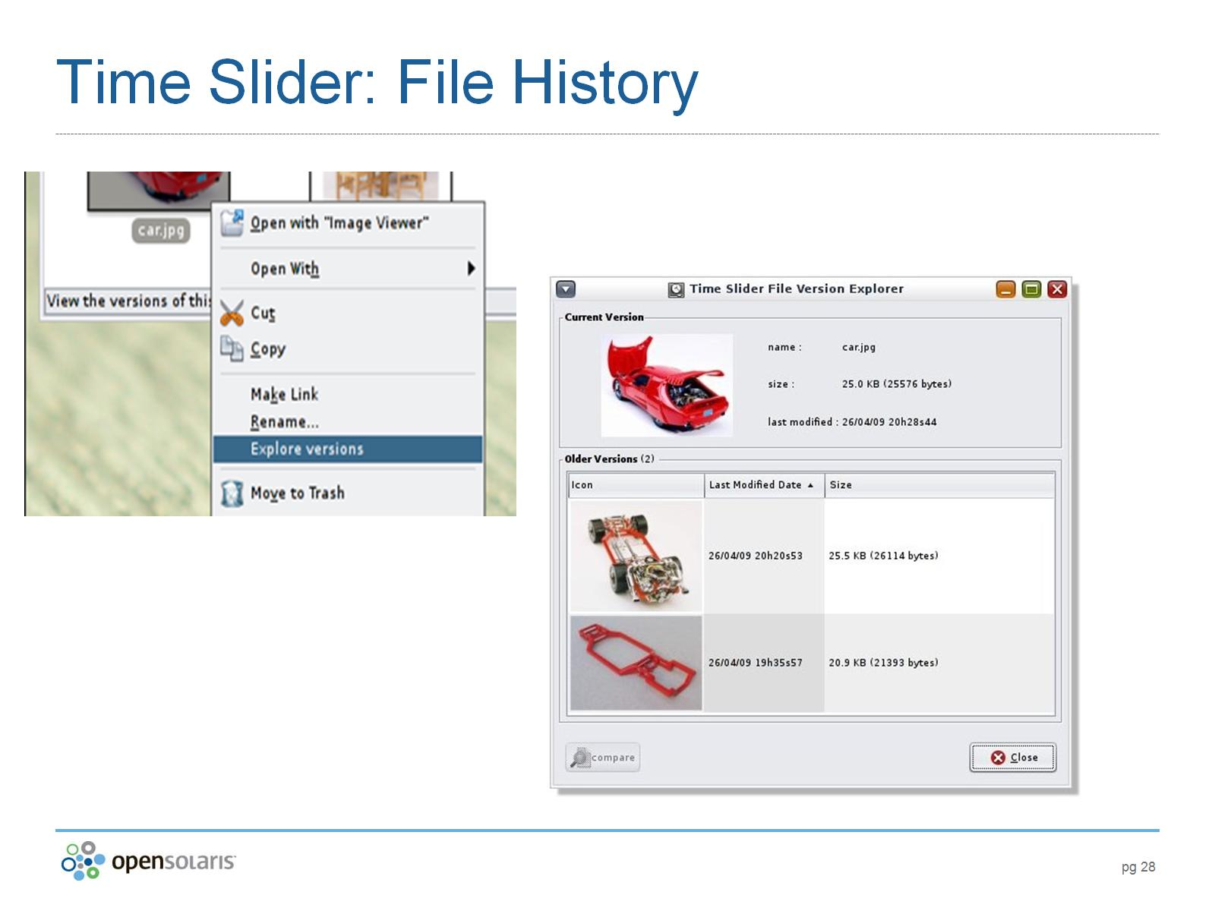
Time Slider: File History

Slide 29
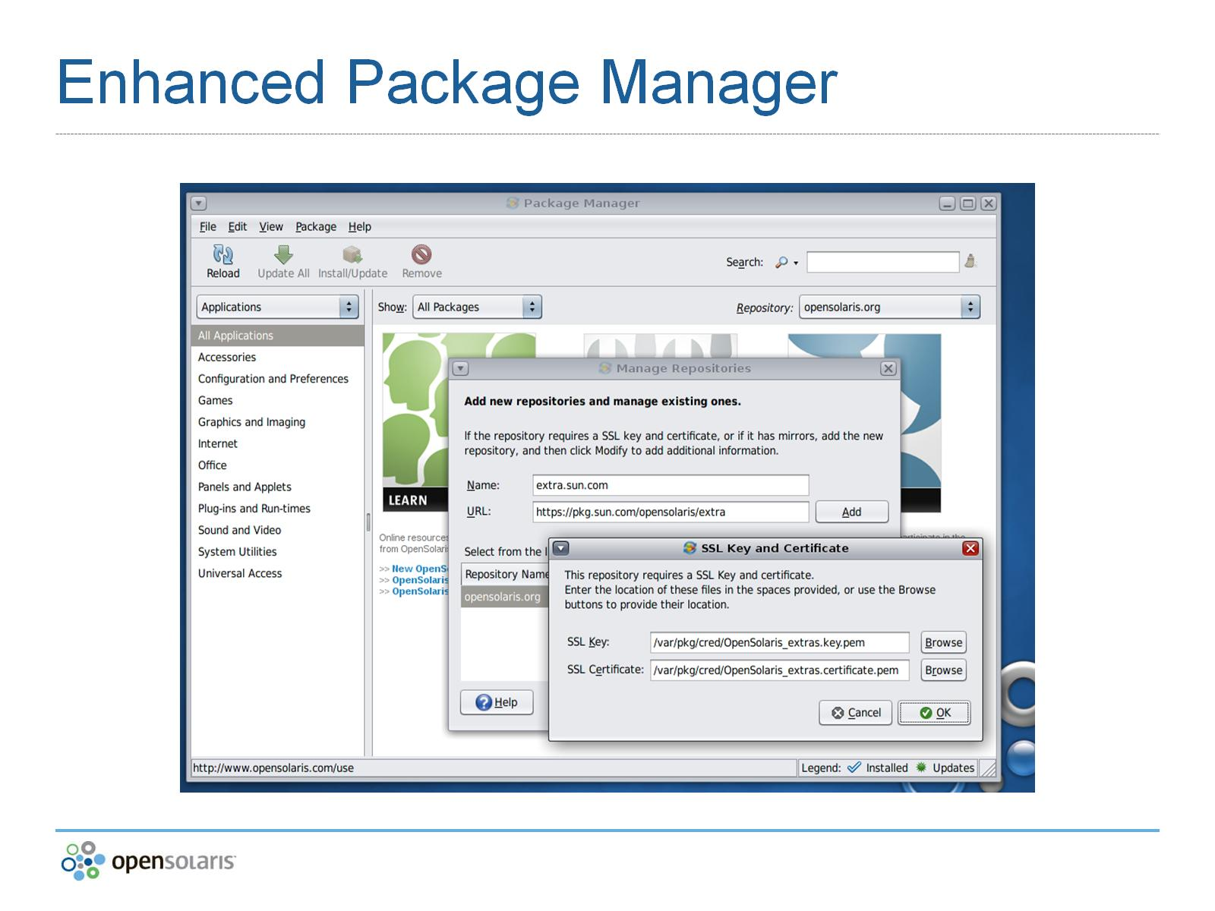
Enhanced Package Manager

Slide 30
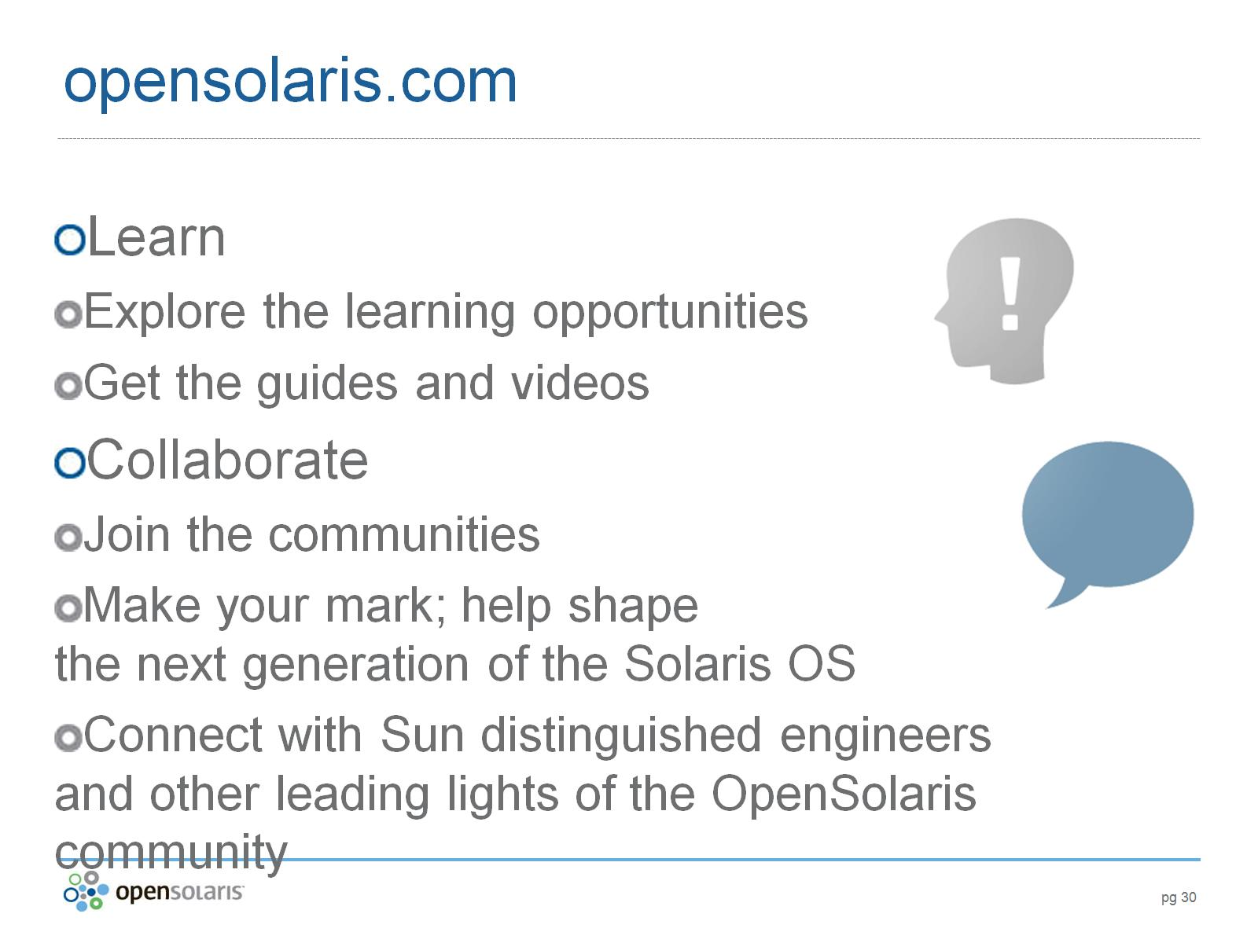
opensolaris.com

Slide 31

OpenSolaris Unlocks Your Potential

Slide 32

OpenSolaris Overview

