Slide 2
What's New in Microsoft SQL Server 2008 R2 Reporting Services
Chris Baldwin
Program Manager
Microsoft Corporation
Session Code: DAT201

Slide 3
Session Goal
Introduce new features in SQL 2008 R2 Reporting Services
Educate on the power of SQL Server Reporting Services
Provide some report design tips
Give you some design ideas…

Slide 4
Agenda
What is SQL Server 2008 R2
What’s new in Reporting Services
  Self service report authoring
  Reports as data feeds
  Maps
  Reporting against SharePoint lists
  Sparklines and indicators
  And more…

Slide 5




+
Empowering end users through “Managed Self-Service BI”
End User Empowerment
IT Management & Compliance
“Managed Self Service BI” delivered through:
  Self Service Analysis → Desktop Analytics
  Self Service Reporting → End User Reporting
  SharePoint Integration → Sharing, Collaboration & Management

Slide 6
Self Service Report Authoring
Empowering IT
  Deploy managed, shared report components
  Publish and share visualizations
  Expose data sets for reuse
  Leverage existing investments in report design
Enabling end users
  New getting started experience
  Reuse existing components and data sets
  Design reports is as simple as “Grab & Go”

Slide 7
Self Service Reporting
demo

Slide 8


Reports as Data Feeds
Data regions in reports are standards-compliant data feeds
With PowerPivot, IW can consume all the operational, corporate reports for their analysis.
Reports as the primary data source for information worker analysis
    IT provisioned. Secure, well-defined, optionally pre-cached
Build SSRS reports on top of Information Worker analysis models

Slide 9
Reports as Data Sources
PowerPivot Integration
demo

Slide 10
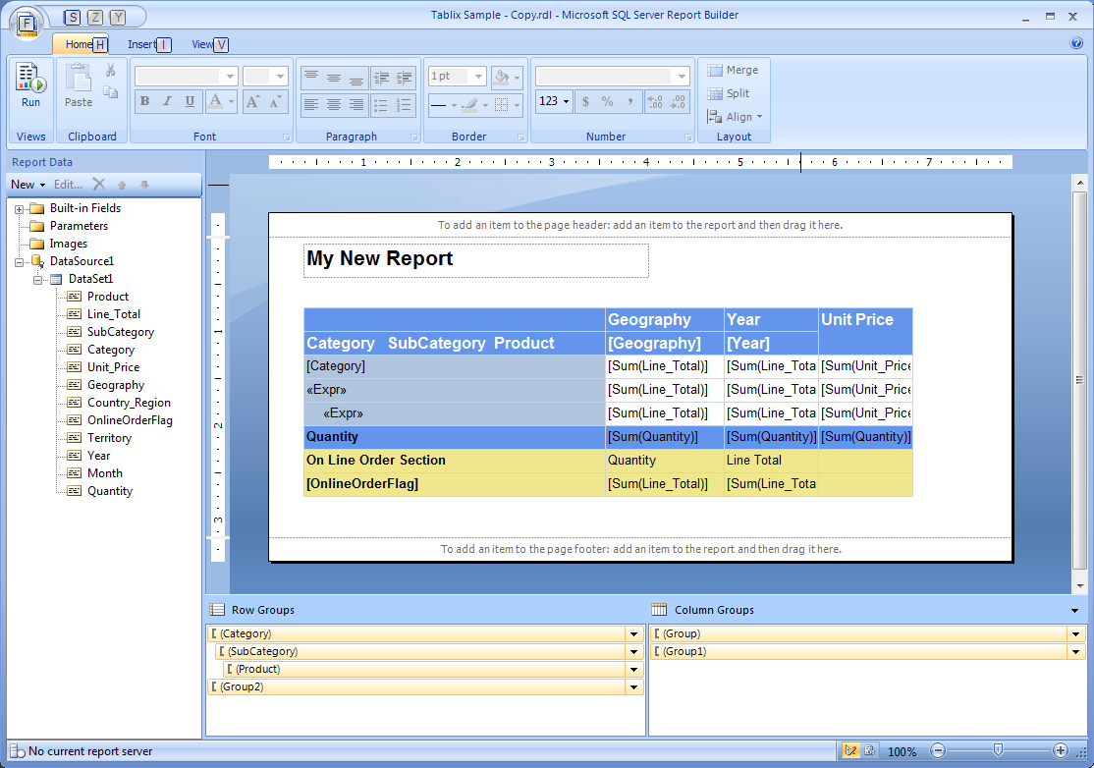
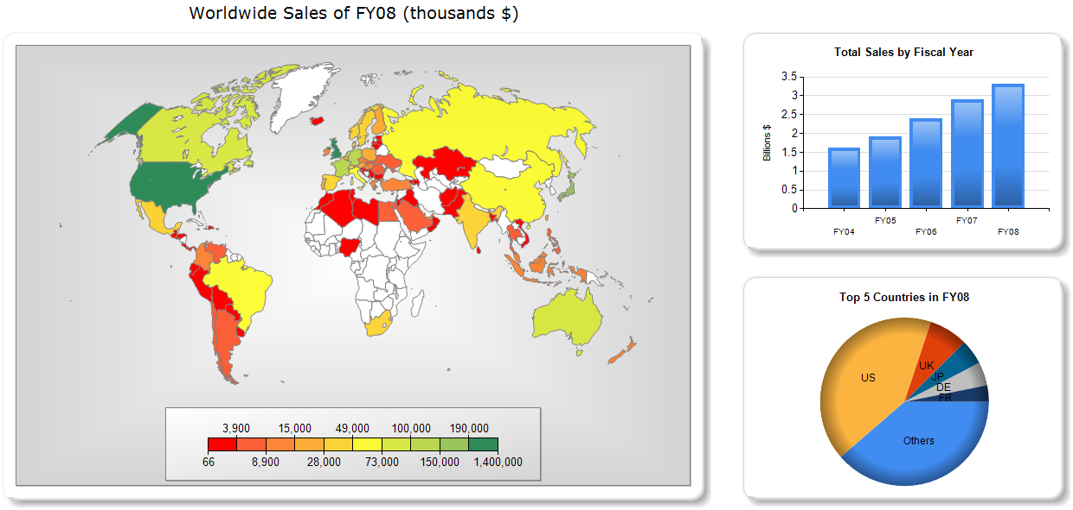
Enhanced Data Visualization
Many types of layout and visualizations
Layout
  Tables, Matrices or any combination of it…
  Parallel Groupings
  Asymetrical columns/rows
  Mix dynamics/static items
Visualizations
  Charts, Pyramids, Pie, Donuts, Gauges, Maps, Sparklines, Data bars, Indicators...

Slide 11
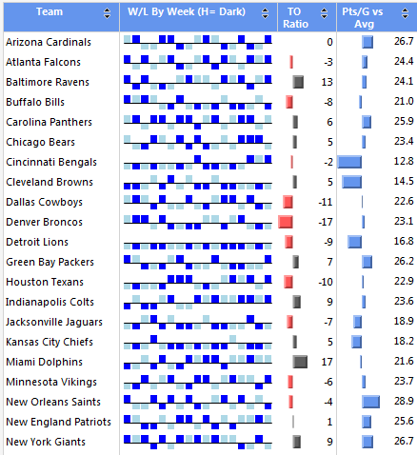
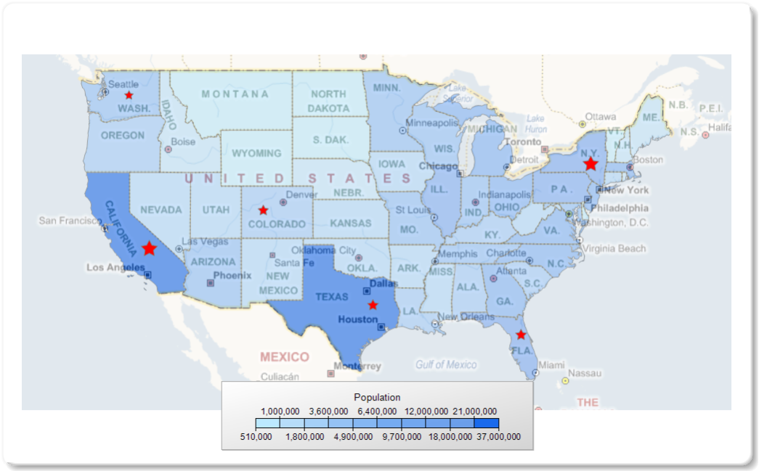
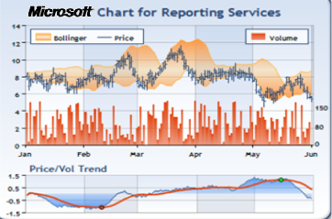
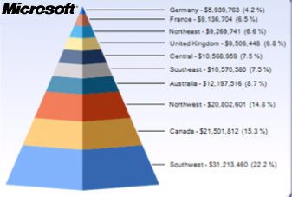
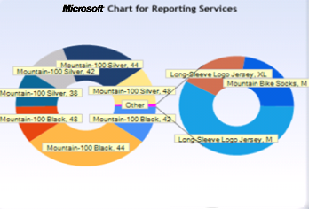
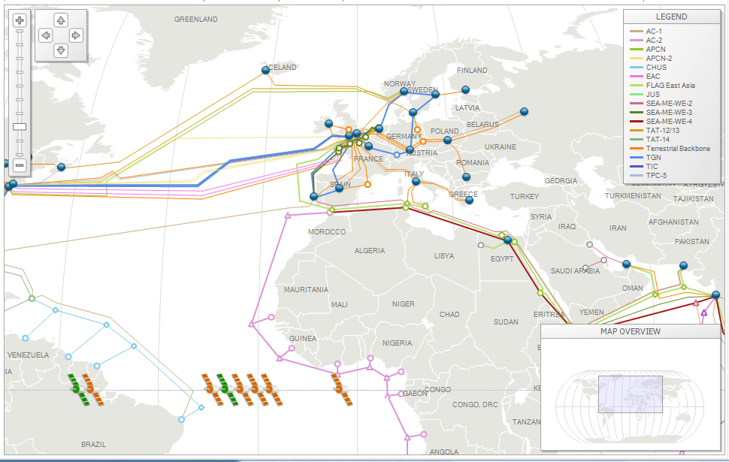
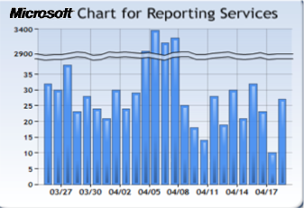
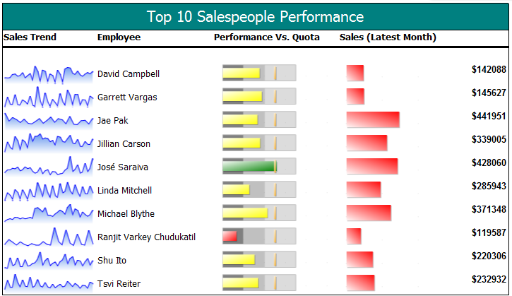
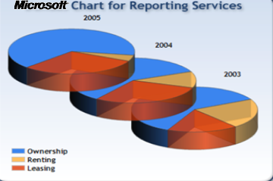
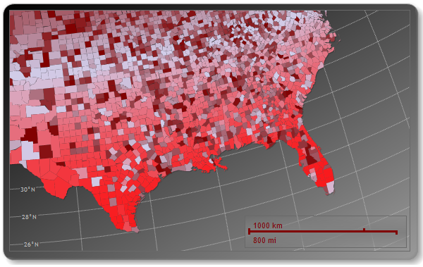
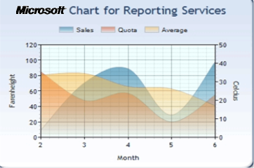
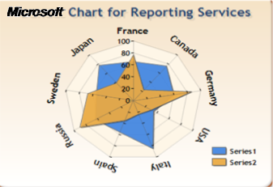
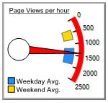

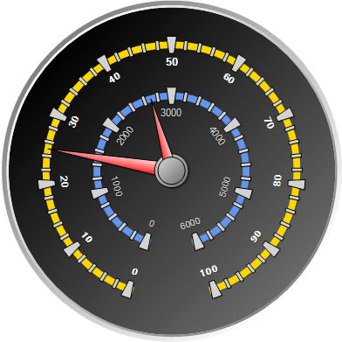
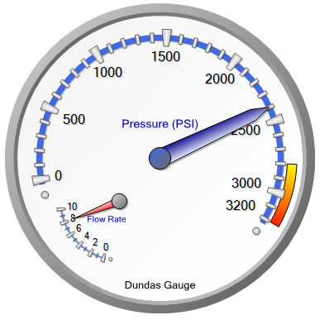
Building Reports
Many types of visualizations

Slide 12
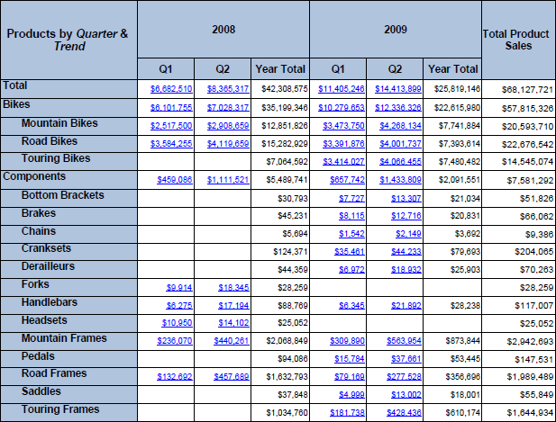
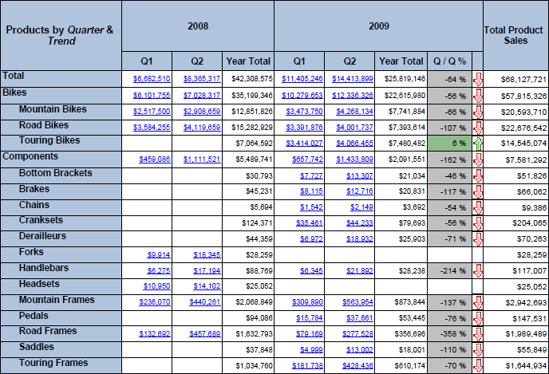
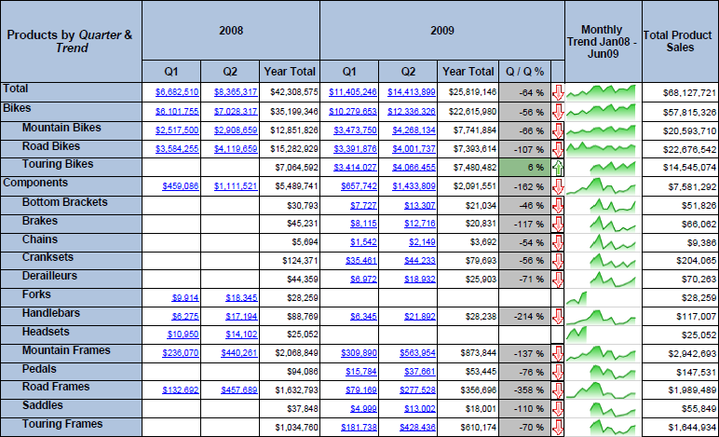
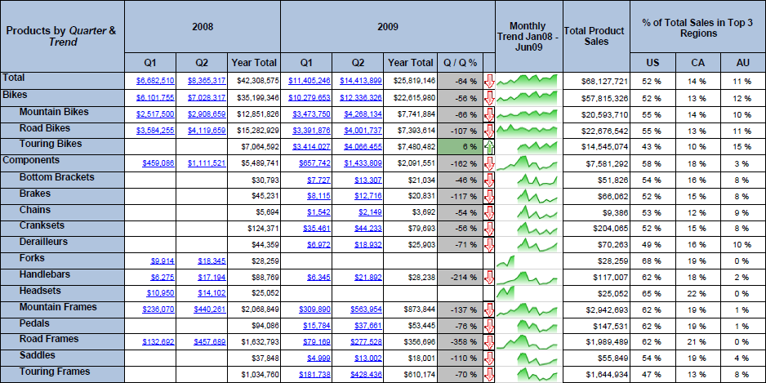
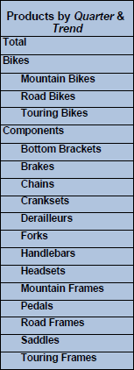

Building Reports
Many types of layouts
Custom
Subtotals
Non-pivot
columns
Custom
Headers
Pivot
Stepped or Block grouping
Nested controls
Multi-Pivot

Slide 13
Tablix Visualizations: Sparklines and Data Bars
Sparklines
  “Data intense, word-sized graphics” – Tufte
  Automatic axis alignment.
  Can be converted into full charts to support additional small multiple scenarios.
Data Bars
  Usually depicts a single value in a cell.
  Min and Max are automatically determined, but are configurable.
Sparklines
Data Bars

Slide 14
Map Features
Support for SQL Spatial
Integration with Virtual Earth tiles
Data Grouping
  Equal intervals, equal distribution, optimal, user-defined
Multiple Map layers

Slide 15
Cool looking Data Visualization: and soon…
Colored maps based on auto or user defined scales
Routes, pinpoint…

Slide 16
Enhanced Data Visualization
Demo

Slide 17
Report Layout enhancements
Lookup functions
Aggregate of aggregates
New Data sources: Madison, SQL Azure
Reset page number on groups
Expression-based page breaks
Excel worksheet tab naming
Session variables
Renderer-dependent layout
Bottom-to-top text rotation

Slide 18
Enhanced Report Viewer and report Manager Experience
Refreshed viewer look and feel
Smooth and fluid navigation experience (AJAX Report Viewer)
Updated Report Manager. Workflow optimized (no need to preview report to access its properties or manage it)
Updated Report Manager look and feel: More Office 14ish

Slide 19
Aggregates of Aggregates
Expressions now support nesting of aggregate functions
  Example: Average Monthly Sales
    =Avg(Sum(Sales, "Month"), "Year")
Enables “visual totals” scenarios
  Aggregates respect group filters

Slide 20
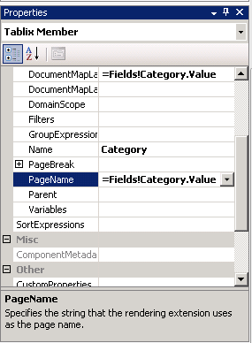
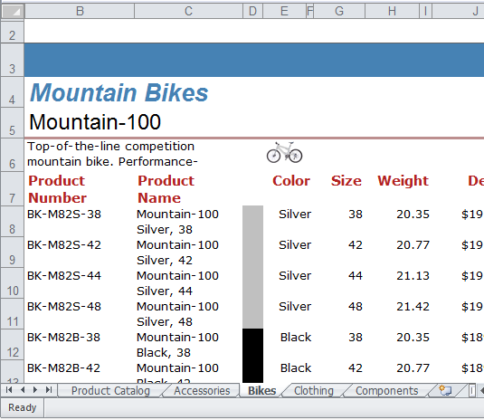
Excel Renderer Worksheet Tab Naming

Slide 21

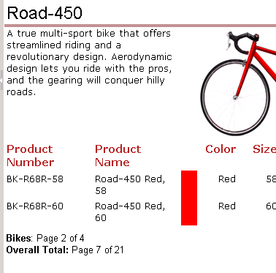
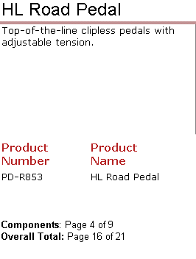
Reset Page Number on Group
Reset page number for each new group instance.
Get current page and total page count for each group, and overall

Slide 22
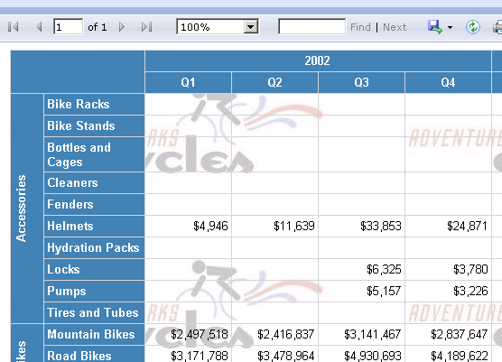
Bottom-to-Top Text Rotation
New text orientation option provides more flexibility to your report layouts

Slide 23
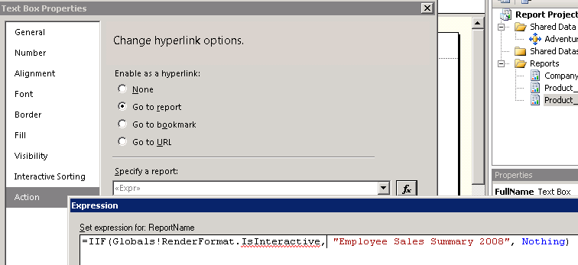
Renderer-based expressions
Control layout and write expressions that consider renderer format
Example, dynamically disable drillthrough expressions for non-interactive renderers and enable them for interactive ones

Slide 24
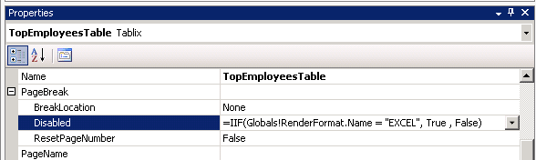
Dynamic page breaks
Use expressions to determine what renderer is being used
Dynamically disable/enable page breaks
Example, disable page breaks if exporting to Excel. Otherwise, enable them:

Slide 25
The Road Ahead
SQL Server 2008 available now
Innovation coming in H1 Calendar Year 2010
  SQL Server 2008 R2
  SQL Server 2008 R2 Parallel Data Warehouse
Continue to deliver innovation 24-36 months from the release of SQL Server 2008
  Next major release of SQL Server

Slide 26
question & answer

Slide 27




Resources
Required Slide
Speakers,
TechEd 2009 is not producing
a DVD. Please announce that
attendees can access session
recordings at TechEd Online.
www.microsoft.com/teched
  Sessions On-Demand & Community
www.microsoft.com/learning
Microsoft Certification & Training Resources
http://microsoft.com/technet
  Resources for IT Professionals
http://microsoft.com/msdn
  Resources for Developers

Slide 28
Related Content
DAT306 Microsoft SQL Server 2008 Reporting Services Best Practices
DAT206 Microsoft SQL Server 2008 R2 Demo Power Hour
BIN05-HOL Report Builder 3.0 Report Authoring and Microsoft SQL Server 2008 R2 Reporting Services
MGT25-HOL Utilizing SQL Server Reporting Services with Microsoft System Center Configuration Manager 2007 R2

Slide 29

Complete an evaluation on CommNet and enter to win an Xbox 360 Elite!

Slide 30


© 2008 Microsoft Corporation. All rights reserved. Microsoft, Windows, Windows Vista and other product names are or may be registered trademarks and/or trademarks in the U.S. and/or other countries.
The information herein is for informational purposes only and represents the current view of Microsoft Corporation as of the date of this presentation. Because Microsoft must respond to changing market conditions, it should not be interpreted to be a commitment on the part of Microsoft, and Microsoft cannot guarantee the accuracy of any information provided after the date of this presentation.
MICROSOFT MAKES NO WARRANTIES, EXPRESS, IMPLIED OR STATUTORY, AS TO THE INFORMATION IN THIS PRESENTATION.

