Slide 1
Presented by Jason Howell
Sr. Escalation Engineer
Microsoft SQL Server
Customer Support & Services
Date: 11/16/2011 6pm
Audience: Charlotte SQL Server Users Group
SQL Server Data Quality Services A knowledge driven Data Quality Solution

Slide 2
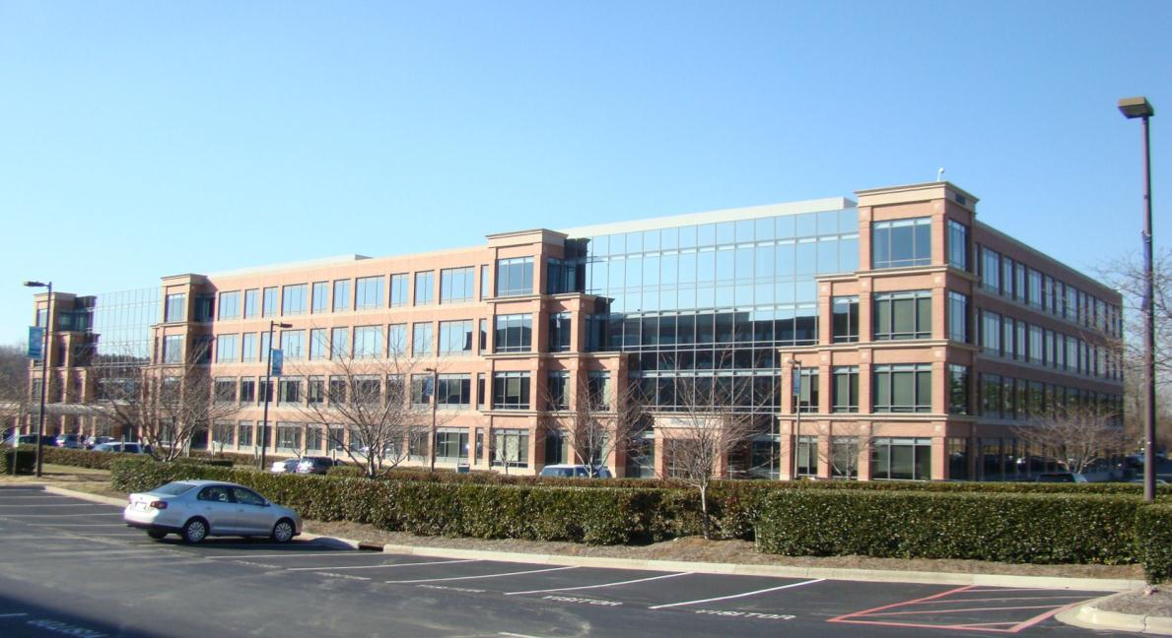
About This Office
Microsoft Charlotte, NC
Microsoft Charlotte has ~900 employees
CTS Support (Windows, Exchange, SQL, Visual Studio, .Net , Sharepoint, Office 365) , MCS Consulting, MS Sales, Premier Technical Account Managers, Premier Field Engineers, Premier Labs

Slide 3
Defining EIM – Enterprise Information Managements
The set of capabilities enabling the enterprise to get the right data to the right consumers, reliably, repeatably, efficiently & with high confidence.
Technology phrases you hear:
Enterprise Information Management , Data Governance, Data Stewardship, Metadata management Data Quality, Data Cleansing, Matching, Deduplication, Identity Resolution,Master Data Management, Dimension Management, Reference Data Management Data Integration, ETL, ELT, Replication, EII, Federated Query, IaaSCDC and more …

Slide 4
Enterprise Information Management in SQL Server “Denali”
DQS
MDS
SSIS
EIM
Data Quality Services Knowledge based Data Cleansing and Matching
Cleanse
Master Data Services Master and reference data Management
Manage
Audience Poll… how many of you use any of these 3 features today?
Integration Services
ETL and Data Integration Tool
Integrate

Slide 5
SQL Server Data Quality Services A knowledge driven Data Quality Solution

Slide 6
What is Data Quality ?
Data Quality represents the degree to which the data is suitable for business usages
Data Quality is built through People + Technology + Processes
Bad Bata → Bad Business

Slide 7
Common Data Quality Issues
Data Quality | Issue | Sample Data Problem
Standard | Are data elements consistently defined and understood ? | Gender code = M, F, U in one system and Gender code = 0, 1, 2 in another system
Complete | Is all necessary data present ? | 20% of customers’ last name is blank, 50% of zip-codes are 99999
Accurate | Does the data accurately represent reality or a verifiable source? | A Supplier is listed as ‘Active’ but went out of business six years ago
Valid | Do data values fall within acceptable ranges? | Salary values should be between 60,000-120,000
Unique | Data appears several times | Both John Ryan and Jack Ryan appear in the system – are they the same person?

Slide 8
What does Data Quality Look Like?

Slide 9
Who is involved with Data Quality
Audience Poll: who is responsible for Data Quality in your Organization?
DBA
BI Developer
Data Steward / Business Analyst

Slide 10
Requirements for Data Quality Solutions
Cleansing
Matching
Profiling
Monitoring
Monitoring Tracking and monitoring
the state of Quality
activities and Quality
of Data
Cleansing Amend, remove or enrich data that is incorrect or incomplete. This includes correction, standardization and enrichment.
Profiling Analysis of the data source to provide insight into the quality of the data and help to identify data quality issues.
Matching Identifying, linking or merging related entries within or across sets of data.

Slide 11
What is DQS ?
Data Quality Services (DQS) is a Knowledge-Driven data quality solution, enabling IT Pros and data stewards to easily improve the quality of their data

Slide 12
Microsoft’s DQS Solution Concepts
Knowledge-Driven
Based on a Data Quality Knowledge Base (DQKB)
Data Domains capture the semantics of your data
Support use of user-generated knowledge and IP by 3rd party reference data providers
Acquires additional knowledge the more you use it
Compelling user experience designed for increased productivity
Open and Extendible
Easy to use
Semantics
Knowledge Discovery

Slide 13
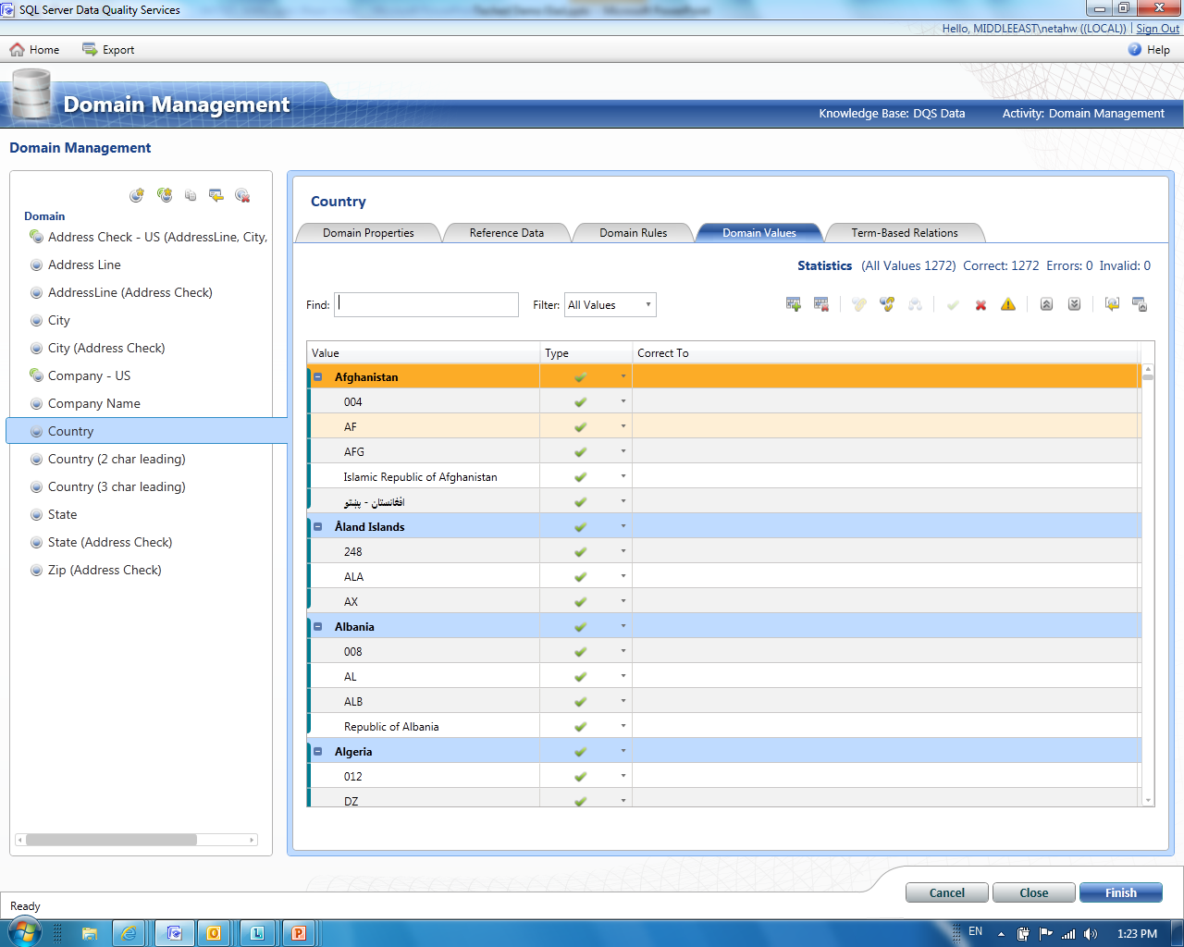
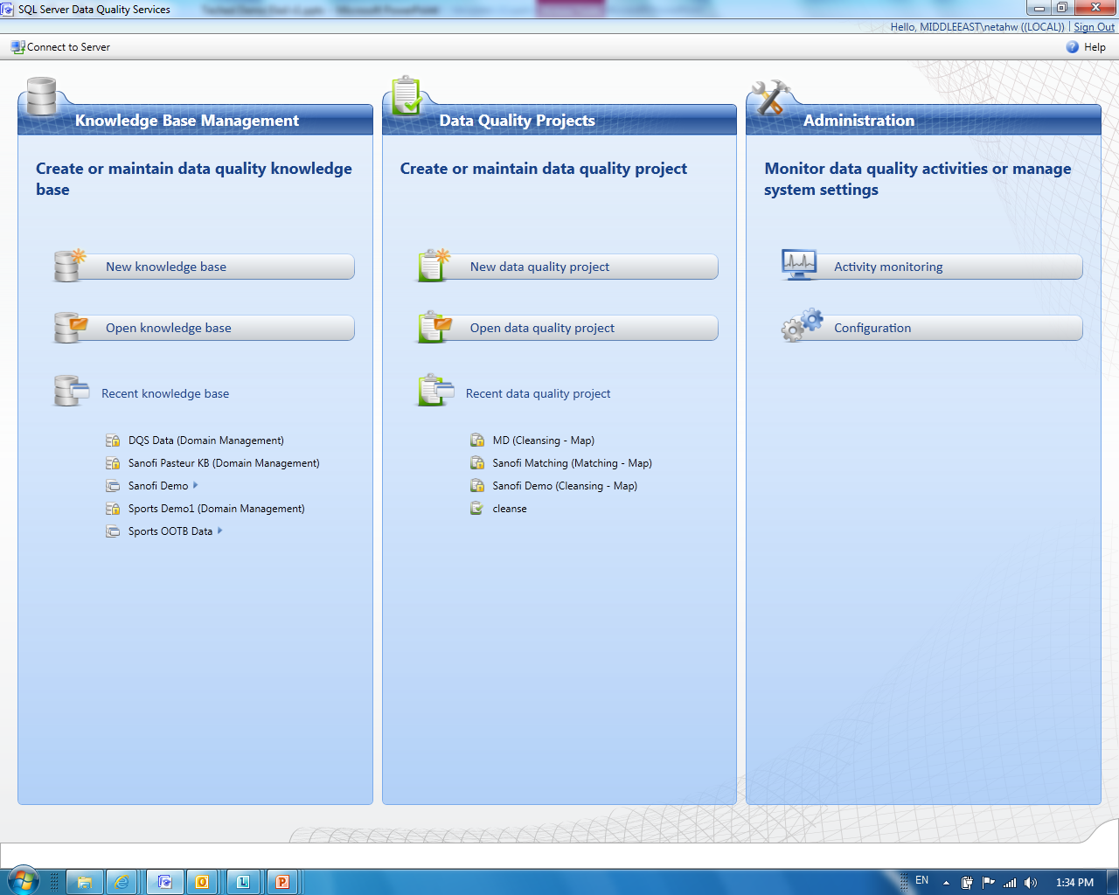
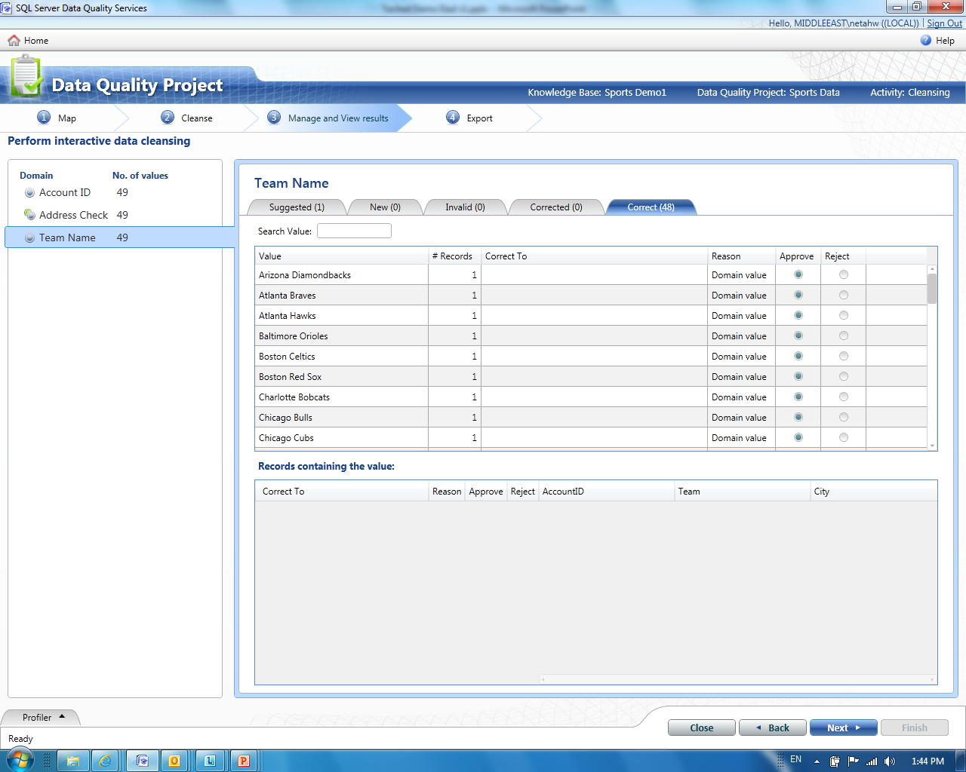
Make Data Quality Approachable To Everyone
Improve your data quality with DQS
Cleanse the data and keep it clean
Build confidence in your enterprise data
Share the responsibility for data quality
Remove Barriers for Data Quality
Designed for ease of use
Empowering the business users
See data quality results in minutes rather than months

Slide 14
DQS Process
Cloud Services
Knowledge
Management
Build
Reference
Data
Discover / Explore Data / Connect
Knowledge
Manage
Enterprise Data
Knowledge
Base
Integrated
Profiling
Status
Progress
Notifications
Correct
& standardize
Match & De-dupe
Use
DQ Projects

Slide 15
DQS High Level Scenarios
Knowledge Management & Reference Data
Creating and managing the Data Quality Knowledge Bases
Discover knowledge from your org’s data samples
Exploration and integration with 3rd party reference data
Cleansing & Matching
Correction, de-duplication and standardization of the data
Administration
Tools to monitor and control data quality processes

Slide 16
Getting Started – Install DQS
1. Run SQL Setup to add DQS features
Need to be Administrator
2. Run DQSInstaller.exe
Run as UAC elevated Admin
3. Setup Initial Security and Connectivity
Sysadmin add logins and users
One DQS server per SQL instance possible
Separate Checkboxes for Client and Server and SSIS
Enter Password
64-bit recommended
Be Windows Admin
Overwrite existing DQS?
Enable users in DQS_MAIN
Map to a to dqs_* roles
Enable TCP connectivity
Be SQL SysAdmin
Find DQSInstaller.exe
Enable Access to Data Sources
Excel 2010
32-bit

Slide 17
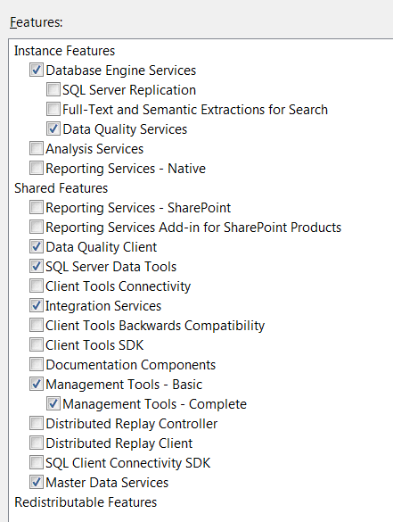
DQS Setup – 1. SQL Setup
1. Checkbox under Engine in Setup. Per Instance.

Slide 18
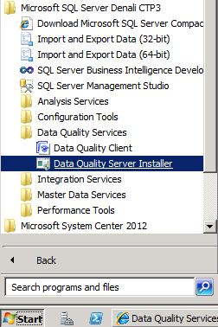
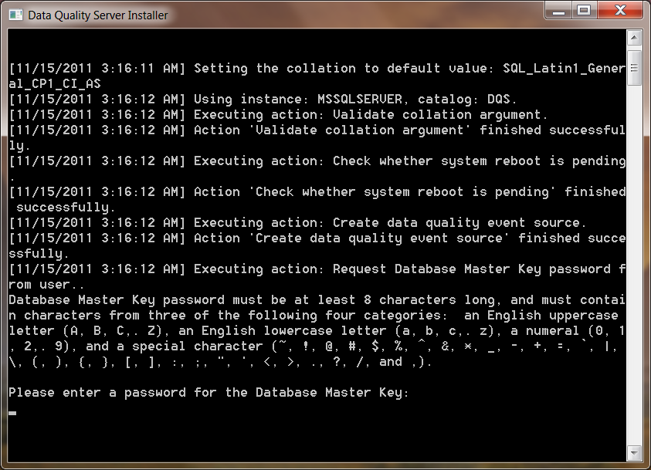
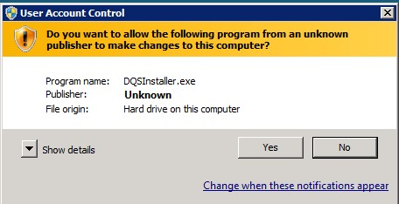
DQS Setup – 2. DQSInstaller
C:\Program Files\Microsoft SQL Server\MSSQL11.MSSQLSERVER\
MSSQL\Binn\DQSInstaller.exe

Slide 19
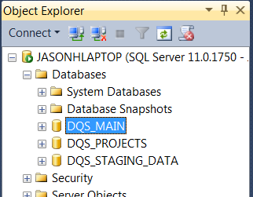
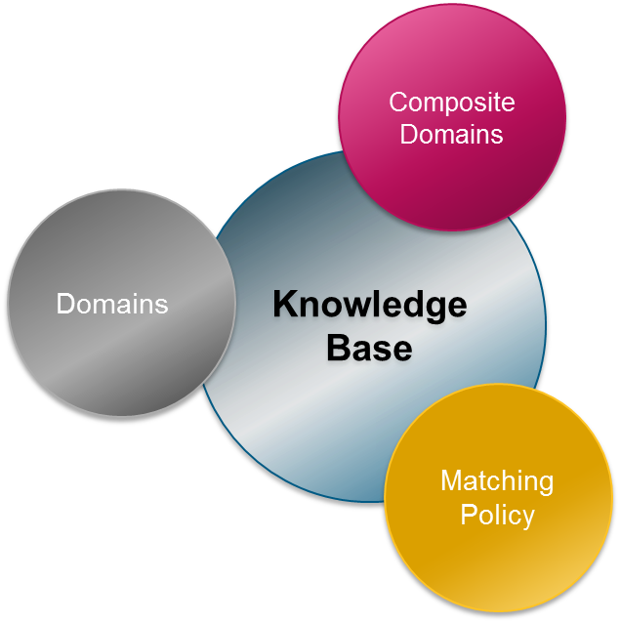
DQS State lives in catalogs

Slide 20
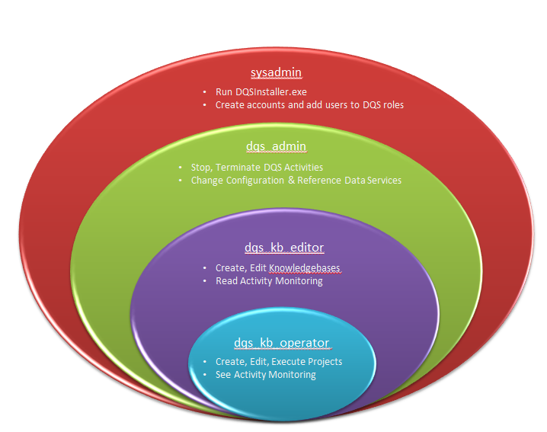
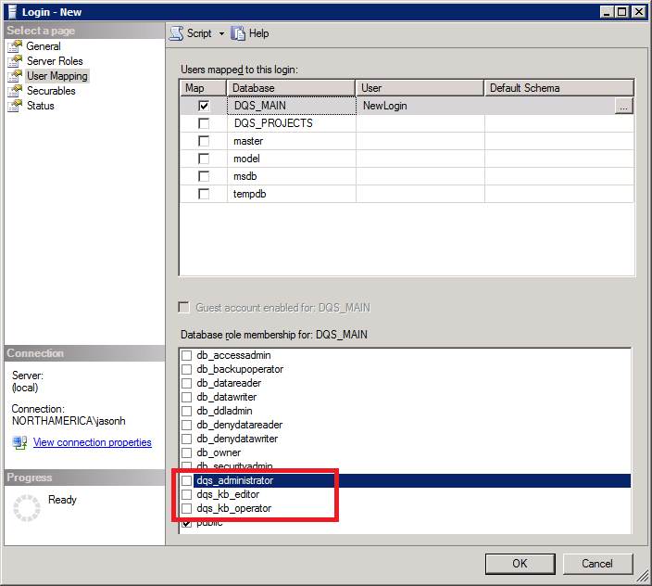
DQS – 3. Configure Security

Slide 21
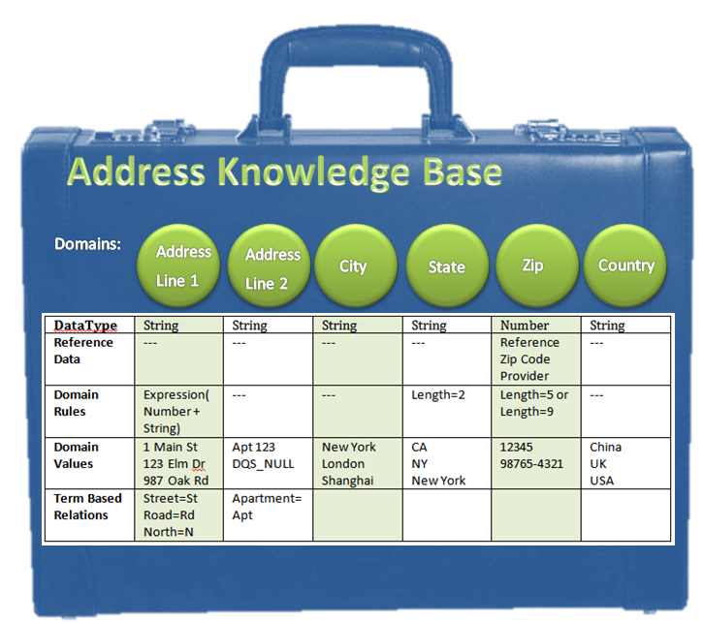
Example of a Knowledge Base

Slide 22
Data Quality Knowledge Base (DQKB)
Values
Composite Domains
Domains
Represent the data type
Knowledge Base
Domains
3rd party Reference Data
Rules & Relations
Matching Policy

Slide 23
DQS Build Workflow
Create a KB / Domain Management
Define Domains and their data types, rules, set up reference data, domain rules, term based relationships
Run Data Discovery
Prime the KB with knowledge values and terms into the various KB Domains
Define Composite Domains to combine multiple simple domains into a single complex domain entity
Correct data manually and define the standard for what is correct
Publish the KB
Define Matching Policy
Point to example source data
Define Matching Rules
Import clean knowledge data from a table or type in manual entries
You can go back and edit a KB as needed, but data projects cannot see edits until published again.
Data Projects can reference and use the KB once it is published
Create a new KB or open existing one

Slide 24
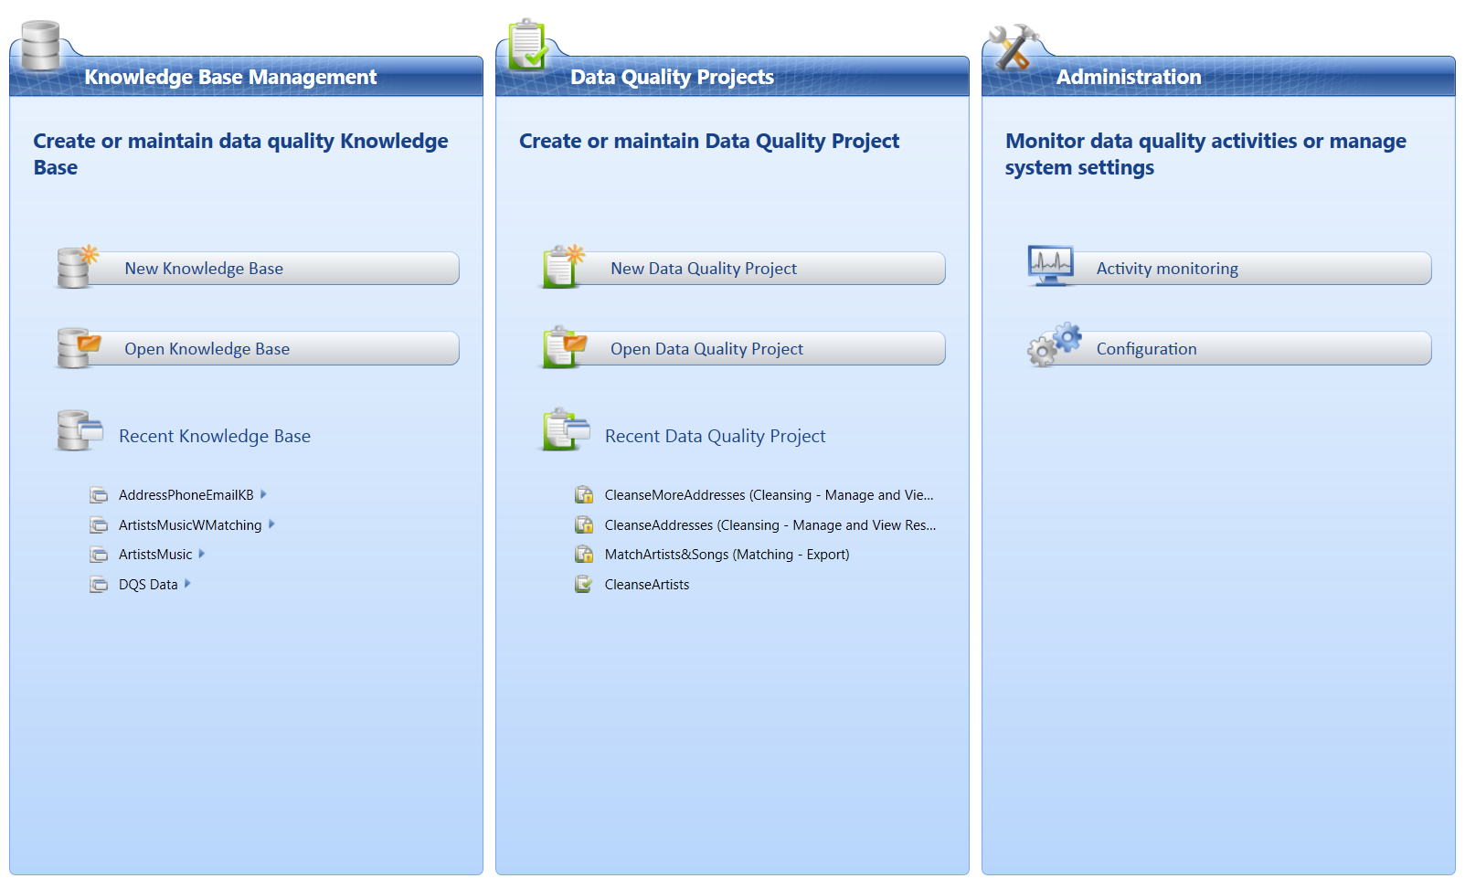
DQS Client – 3 panes
Build
Use
Monitor/Configure

Slide 25
DQS Use Workflow
Cleansing
Point to source data from a SQL table or Excel worksheet. Map source columns to KB domains
Run the Cleanse to find mistakes, empty values, non standard values, values that do not meet rule requirements
Manually Review the automatic suggestions and corrections. Tweak low confidence values.
Export to save the cleansed results to a SQL table or Excel
Matching
Point to the source data to import froma SQL table or Excel Workbook
Run Matching to find Similar Values
Review results and suggested synonyms
Export to save the results to a SQL Table or Excel workbook
Publish
Data Projects can reference and use the KB once it is published
You can go back and edit a KB as needed, but data projects cannot see edits until published again.

Slide 26
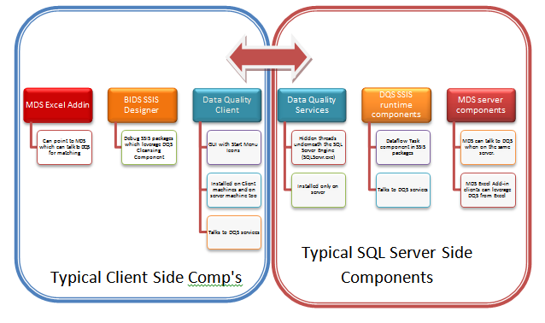
DQS Client & Server Separation

Slide 27
DQS Client Interaction & Server Algorithms
DQS Server Algorithms
DQ Client User Interaction
DQ Client User Interaction
Create/Open Project
Pick Source. Map Source columns to Domain
Run the Cleansing and review Profiler progress
Manage and View Results interactively
Export Results

Slide 28
Demo 1 – Introducing YOUR DATA
Account ID
A124324
7676862
4934235
Account ID | Home Team | Team Type | Revenue Type | Sales | Home Arena | Address Line | City | State | Zip
A124324 | Boston Celtics | Basketball | Food & Beverages | 655 | TD Garden | 100 Legends Way | Boston | MA | 2114
7676862 | New York Yankees | Baseball | Music | 389 | Yankee Stadium | East 161st Street & River Avenue | NY | NY
4934235 | Seattle Mariners | Baseball | Music | 443 | Safeco Field | 1516 First Avenue S | Seattle | WA | 98134
Team Type
Basketball
Baseball
MLB
Address Line | City | State | Zip
100 Legends Way | Boston | MA | 2114
East 161st Street & River Avenue | NY | NY
1516 First Avenue S | Seattle | WA | 98134
Building Your Knowledge
Account ID
Team Type
Address Line
City
State
Zip
Composite Domain - Full Address
Reference Data Service:
Composite Domain containing Address Line, City, State & Zip Domains

Slide 29
DQS Demo 1 - Interactive Cleanse & Knowledge Management
demo

Slide 30
DQS Architecture Overview
DQ Clients
Azure Market Place
Categorized Reference Data Services
Categorized Reference Data
MS DQ
Domains Store
DQS UI
Knowledge Discovery and Management
DQ Server
Reference Data API
(Browse, Get, Update…)
3rd Party
Interactive DQ Projects
RD Services API
(Browse, Set, Validate…)
Reference Data Services
DQ Engine
Data Exploration
Cleansing
Knowledge Discovery
Data Profiling & Exploration
Reference Data
Matching
Reference Data Sets
SSIS DQ Component
DQ Projects Store
Common Knowledge Store
Knowledge Base Store
DQ Active Projects
MS Data Domains
Local Data Domains
Published KBs
Future Clients –Excel, SharePoint…

Slide 31
DQS Knowledge Sources
DataMarket
Easily cleanse and enrich data with Reference Data Services from Azure MarketPlace
DQS Data Store
Website that contains DQS knowledge available for downloading
Organization Data
Discover knowledge from data samples of your organization
Out of the Box Knowledge
A set of data domains that come out of the box with DQS

Slide 32
Matching
Microsoft Corporation, Bill gates, 1 Microsoft way, Redmond, WA, 98052
Microsoft, Gates, One Microsoft way, Redmond WA
Microsoft Corp, William Henry Gates, 1 Microsfot way, Redmond, WA
Microsfot, W. H. Gates, Redmond, WA
Why Match ?
Identify duplicates within the data source
Create consolidated view of data
DQS Matching
Build a matching policy
Matching training
Create a matching project
Choose survivors
DQ Client – Match Results

Slide 33
DQS Demo 2 - Matching
demo

Slide 34
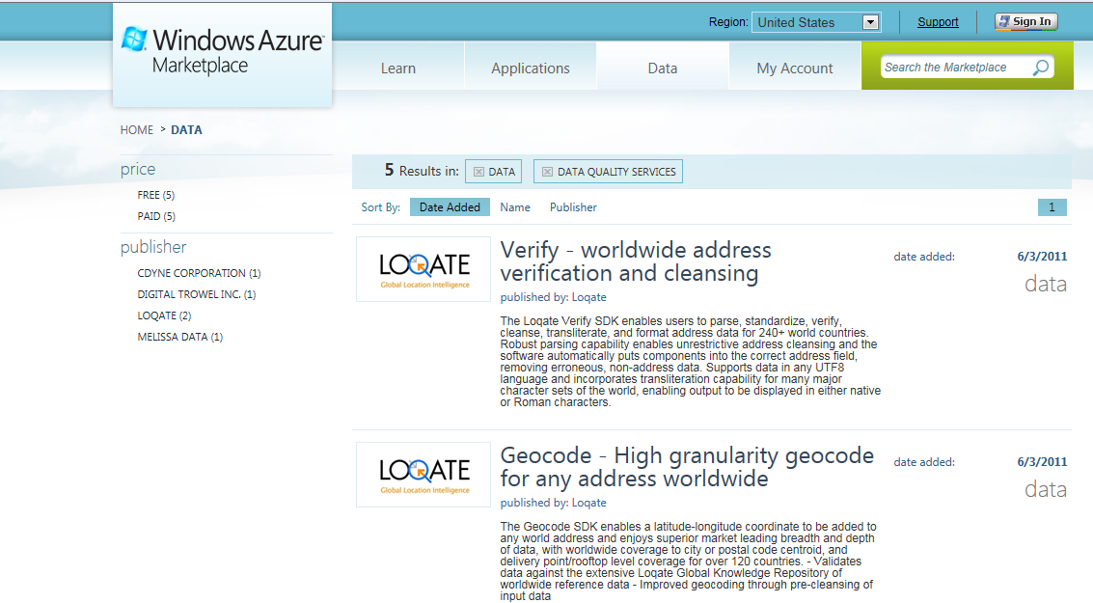
Reference Data Services (RDS)
DQS can use Reference Data Services for validating, cleansing and enriching your data

Slide 35
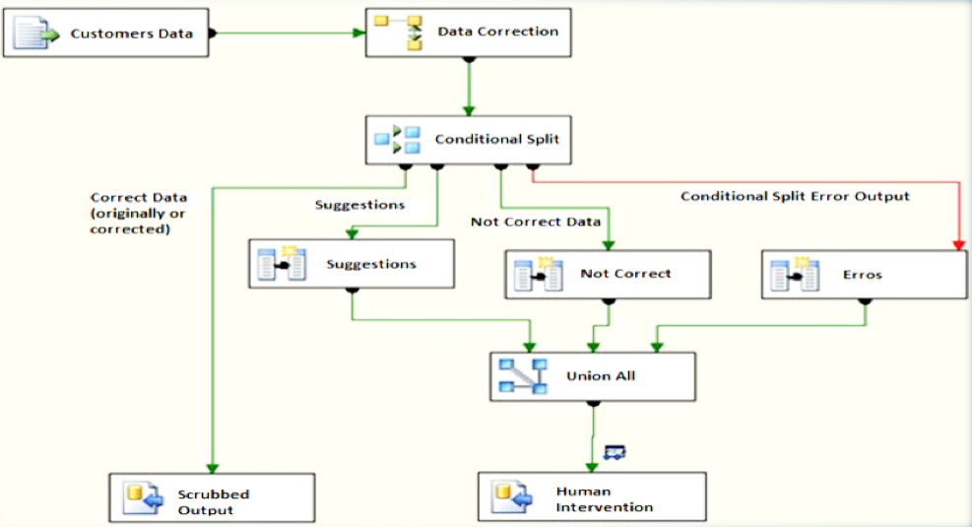
Batch Cleansing - Using SSIS
SSIS Data Flow
Reference Data Services
DQS Server
New
Knowledge Base
SSIS Package
Corrections & Suggestions
Values/Rules
Source + Mapping
DQS Cleansing
Component
Destination
Reference Data Definition
Correct
Invalid
Microsoft Confidential—Preliminary Information Subject to Change
Notes:
So you just so the interactive cleansing project in action. As you could see, the interactive project is very convenient in terms of reviewing and controlling the results.
But sometimes, what you really need is to run a cleansing project as a batch, or as part of a larger process. For such cases, the cleansing functionality is available also as an SSIS transformation component. This component is called DQS Cleansing.
In the most simple case a data flow will consist of a source component that represents the data that we would like to cleanse, it will also consist of the cleansing transformation component, and a destination component that is used to store the cleansed results. Of course, in real world data flows the DQS cleansing component can placed in the middle of several other transformations.
At runtime, the component sends the records to the DQS server for cleansing, and gets them back cleansed. So this is the general story.
Now, it’s important to understand that for cleansing the records, the DQS server uses a knowledge base, exactly like in the case of the interactive project. This means that having a suitable knowledge base is a prerequisite for running the component.
Note that when there are domains that attached to external reference data services, this external knowledge will be used as well.
Now, the component output contains not only the cleansed data itself, but also more information that enables to filter out certain records or values, according to business needs. Specifically, the component’s output contains a correction status (in the field level and in the record level) that enables to classify records to groups, as you can see.
In the following demo I will demonstrate how these groups can be used.

Slide 36
DQS Cleansing can be automated from SSIS

Slide 37
DQS Demo 3 - Cleansing using Reference Data Services & Composite Domains
demo

Slide 38
DQS – Value Proposition Summary
Knowledge-driven
Easy To Use
Open & Extendible
Rich Knowledge Base
Continuous improvement and knowledge acquisition
Build once, reuse for multiple DQ improvements
Focus on productivity and user experience
Designed for business users
Out-of-the-box knowledge
Focus on cloud-based Reference Data
User-generated knowledge
Integration with SSIS

Slide 39
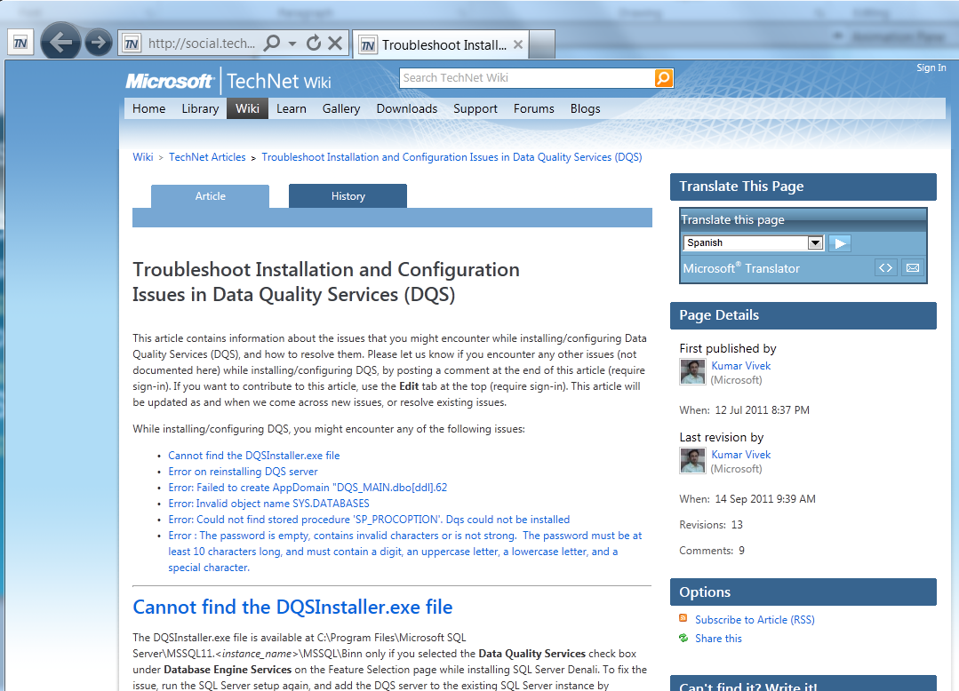
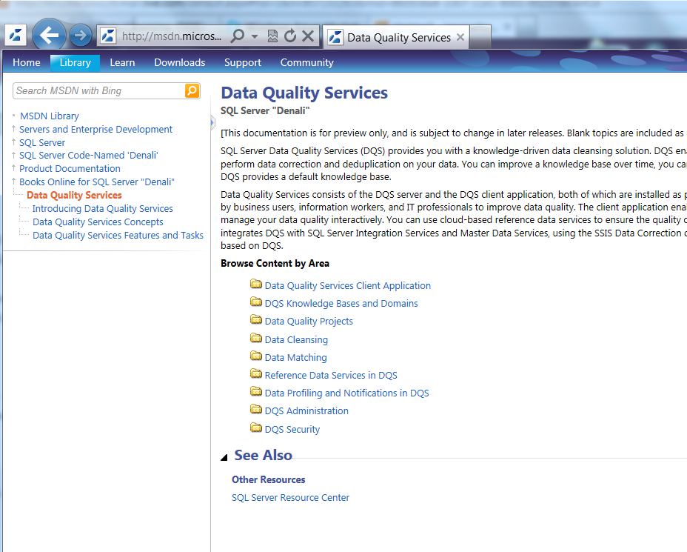
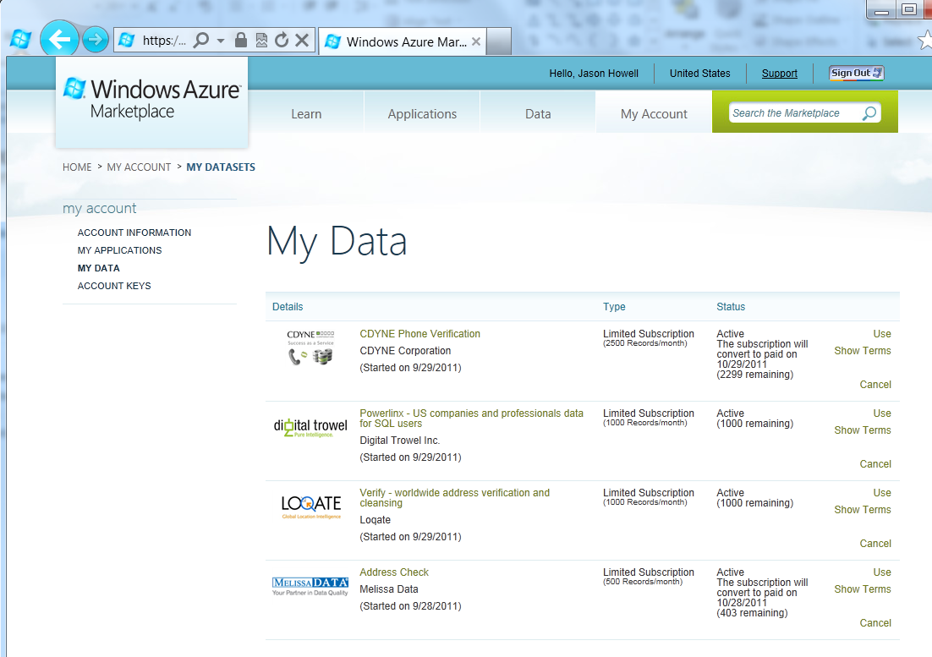
Links and Resources
DQS Technet Wiki will list major known issues
Install Issues: http://social.technet.microsoft.com/wiki/contents/articles/3776.aspx
Operational Issues: http://social.technet.microsoft.com/wiki/contents/articles/3777.aspx
DQS Documentation
http://msdn.microsoft.com/en-us/library/ff877925(v=sql.110).aspx
DQS Azure DataMarket
https://datamarket.azure.com/

Slide 40
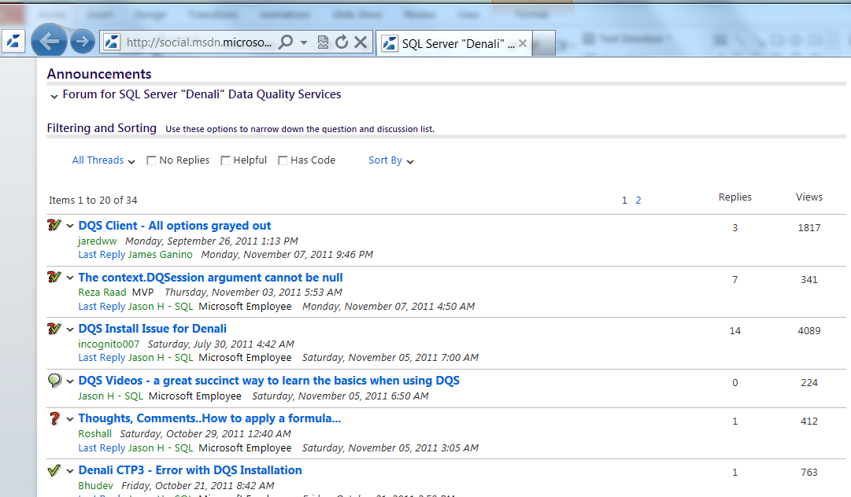
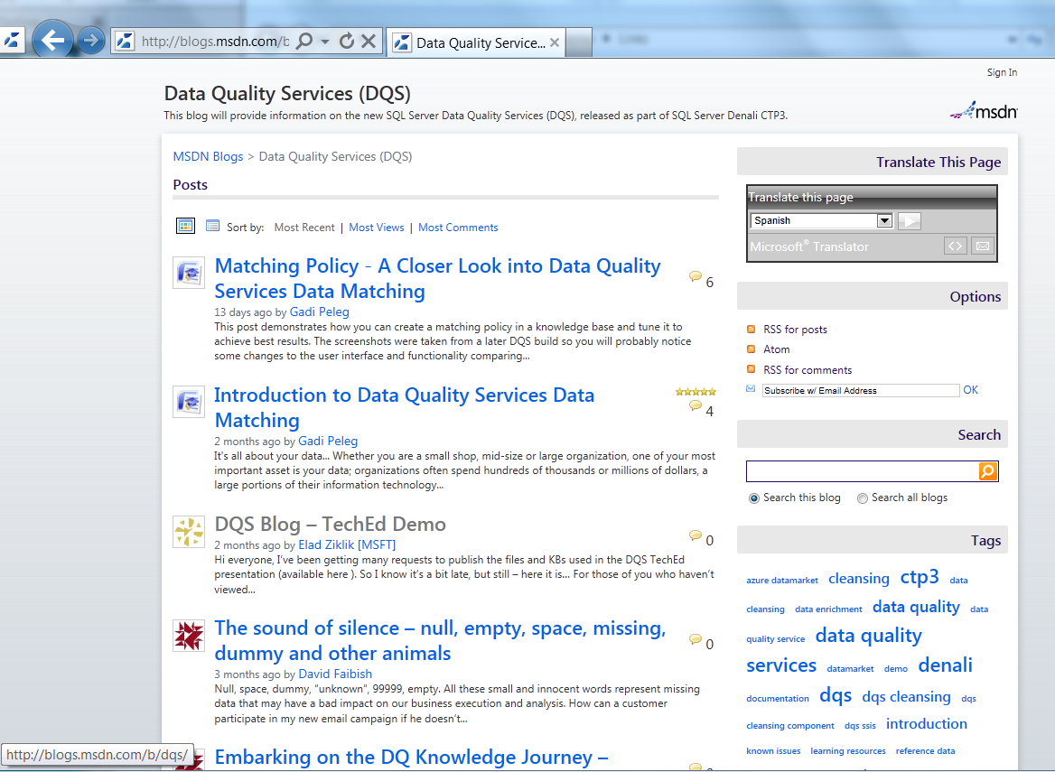
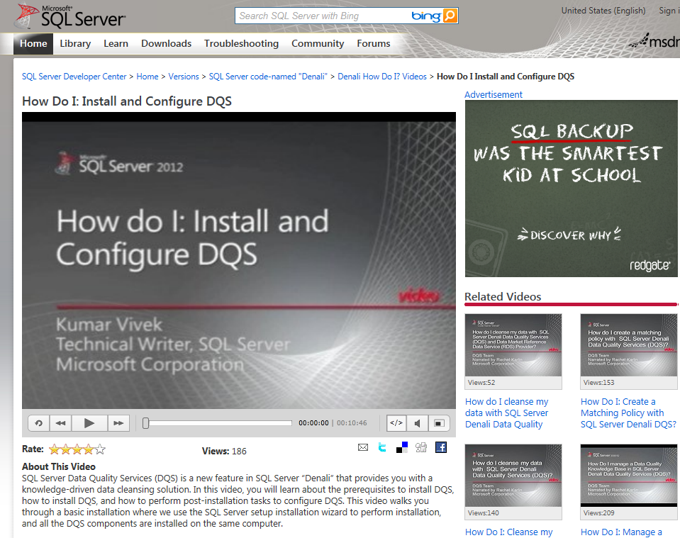
Links and Resources
DQS Blog
http://blogs.msdn.com/b/dqs/
DQS Forum
http://social.msdn.microsoft.com/Forums/en-US/sqldataqualityservices/
DQS Videos
http://msdn.microsoft.com/en-us/sqlserver/hh323828.aspx

Slide 41
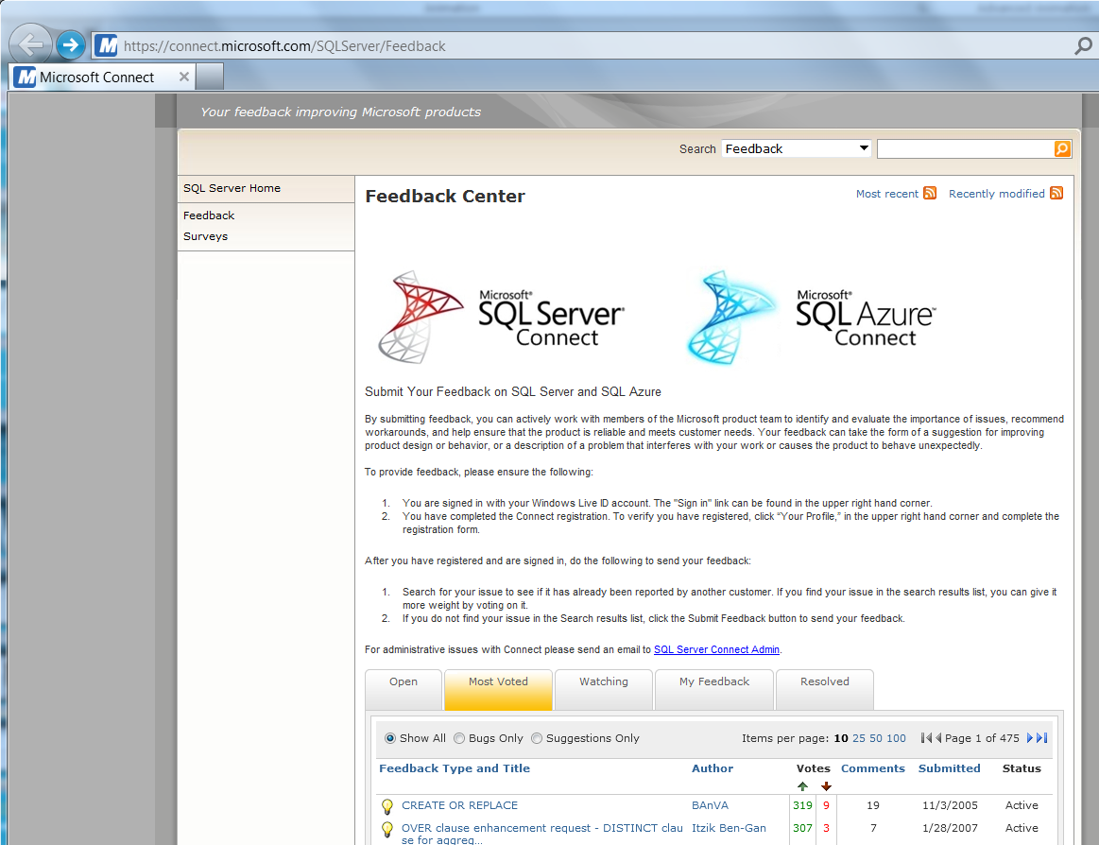
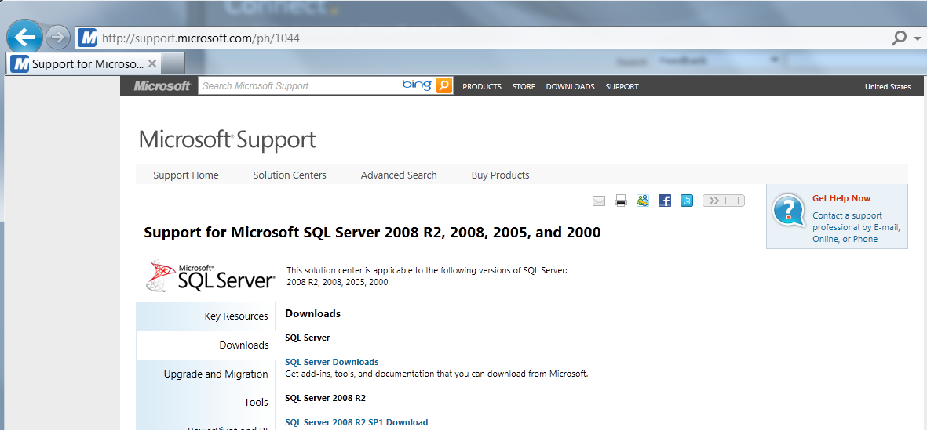
Links and Resources
SQL Connect
https://connect.microsoft.com/SQLServer/Feedback
SQL Support
http://support.microsoft.com

Slide 42
Cleanse and Match data with SQL Server 2012 Data Quality Services. Please enjoy DQS responsibly ☺
© 2011 Microsoft Corporation. All rights reserved. Microsoft, Windows, Windows Vista and other product names are or may be registered trademarks and/or trademarks in the U.S. and/or other countries.
The information herein is for informational purposes only and represents the current view of Microsoft Corporation as of the date of this presentation. Because Microsoft must respond to changing market conditions, it should not be interpreted to be a commitment on the part of Microsoft, and Microsoft cannot guarantee the accuracy of any information provided after the date of this presentation. MICROSOFT MAKES NO WARRANTIES, EXPRESS, IMPLIED OR STATUTORY, AS TO THE INFORMATION IN THIS PRESENTATION.

