Slide 1
In-Memory OLTP
The faster is now simpler
in SQL Server 2016

Slide 2









Our Main Sponsors:

Slide 3
Say Thank you to Volunteers:
They spend their FREE time to give you this event.
Because they are crazy. ☺
Because they want YOU
to learn from the BEST IN THE WORLD.

Slide 4

Paulo Matos:

Slide 5
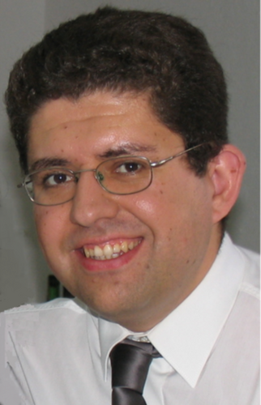
Pedro Simões:

Slide 6

André Batista:

Slide 7

Paulo Borges:

Slide 8

André Melancia:

Slide 9

Murilo Miranda:

Slide 10

Quilson Antunes:

Slide 11






About me
  Murilo Miranda
  Lead Database Consultant @ The Pythian Group
  http://www.sqlshack.com/author/murilo-miranda/
http://www.pythian.com/blog/author/murilo/
  @murilocmiranda
  http://pt.linkedin.com/in/murilomiranda/

Slide 12
Agenda
Introduction to In-Memory OLTP
  Motivation
  Overview
  Limitations
  Current version
SQL Server 2016
  In-Memory OLTP improvements
Notes:
https://msdn.microsoft.com/en-us/library/dn553125.aspx

Slide 13
Introduction
In-Memory OLTP

Slide 14

In-Memory OLTP - Motivation
HARDWARE EVOLUTION
CHANGED
Notes:
https://msdn.microsoft.com/en-us/library/dn553125.aspx

Slide 15
In-Memory OLTP - Motivation
Memory price is being cheaper from year-to-year.
  Low price per GB.
  Large memory modules are affordable.
DDR4 on Q2/2014.
  Higher module density.
  Lower voltage requirements.
  Higher data rate transfer
Notes:
https://msdn.microsoft.com/en-us/library/dn553125.aspx

Slide 16
In-Memory OLTP - Motivation
SQL 2000
SQL 2008 R2
SQL 2005
SQL 2008
SQL 2014
SQL 2012
Notes:
https://msdn.microsoft.com/en-us/library/dn553125.aspx

Slide 17
In-Memory OLTP - Motivation
CPU Clock speed
Problems caused by higher speeds
  Excessive power consumption
  Heat dissipation
  Leakage current
Power consumption is critical for mobile devices.
  Mobile computing platforms are increasingly important.
Notes:
https://msdn.microsoft.com/en-us/library/dn553125.aspx

Slide 18
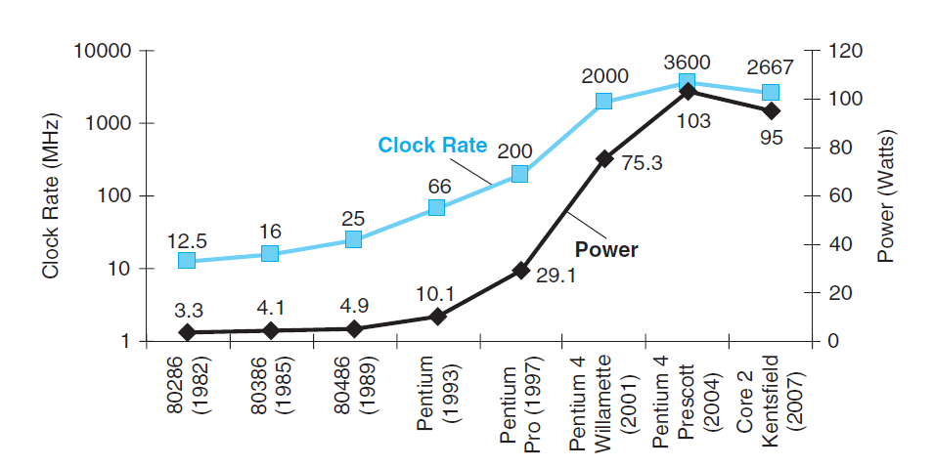
In-Memory OLTP - Motivation
Notes:
https://msdn.microsoft.com/en-us/library/dn553125.aspx

Slide 19
In-Memory OLTP - Motivation
Industry Solution
  Multi-Cores Processors
  Hyper-threading
  Lx Cache
Notes:
https://msdn.microsoft.com/en-us/library/dn553125.aspx

Slide 20
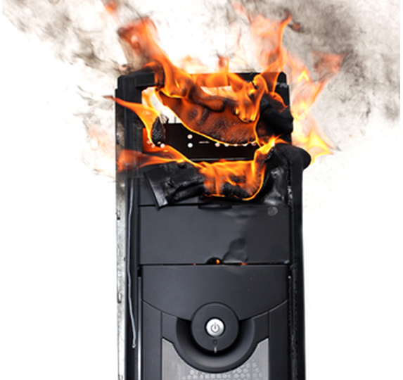

In-Memory OLTP - Motivation
TRADITIONAL
DB Systems
have limitations
Notes:
https://msdn.microsoft.com/en-us/library/dn553125.aspx

Slide 21
Problems to solve
Concurrency.
  CPU usage is inefficient in simultaneous access to shared structures.
  Pessimistic model causes too much contention for high levels of concurrency (locking and latching).
Transaction Log has a lot of overhead.
  SQL Server use a write-ahead logging (WAL) protocol.
    Log records might be generated before commit time.
  Index changes are logged.
Notes:
SQL Server uses a write-ahead log (WAL), which guarantees that no data modifications are written to disk before the associated log record is written to disk. This maintains the ACID properties for a transaction.

Slide 22
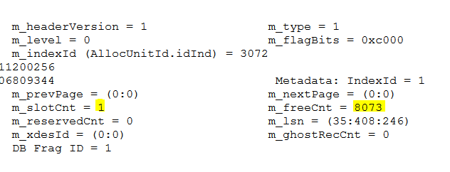
Overview of (no) latching
T1
T2
CONCURRENT INSERT
1) QUERY THE DATAPAGE HEADER
2) WRITE THE DATA RECORD
3) UPDATE HEADER (…)
1) QUERY THE DATAPAGE HEADER
2) WRITE THE DATA RECORD
3) UPDATE HEADER (…)
MSSQL Data Page
INSERT RECORD 3 STEP OPERATION
1) QUERY THE DATAPAGE HEADER
2) WRITE THE DATA RECORD
3) UPDATE HEADER (…)
Header (2)
Header (2)
Header (1)
Header
Data Record 1
Data Record 2
Data Record 3

Slide 23
Overview of latching
T1
T2
MSSQL Data Page
CONCURRENT INSERT
1) Take Page_Latch_EX
2) QUERY THE DATAPAGE HEADER
3) WRITE THE DATA RECORD
4) UPDATE HEADER (…)
5) Release page_Latch
1) Blocked by page latch
2) Take Page_Latch_EX
3) QUERY THE DATAPAGE HEADER
4) WRITE THE DATA RECORD
5) UPDATE HEADER (…)
6) Release page_Latch
Header (3)
Header (2)
Header (1)
Data Record 1
Data Record 2
Data Record 3

Slide 24
Introduction to InMemory OLTP
Where we are spending more execution time?
  Here are the results from Microsoft analysis.
I/O, Thread Management
Storage Engine
Relational Engine
Communication Stack
10%
80%
10%
Access Methods, Transaction, Lock, Log, Managers
T-SQL Interpreter, Query Execution, Expressions

Slide 25
Introduction to In-Memory OLTP
Hekaton Project - Greek word ἑκατόν (Houndred).
  The objective is to improve 100x the performance.
    Traditional strategy relies in structures focused on data stored in disk.
    By fully using memory capabilities we can have simpler structures.
Available from SQL Server 2014.
  Highly improved on SQL Server 2016.

Slide 26
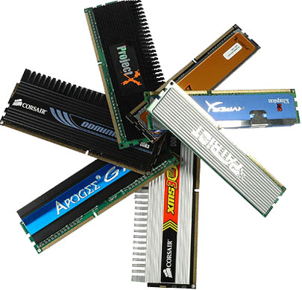
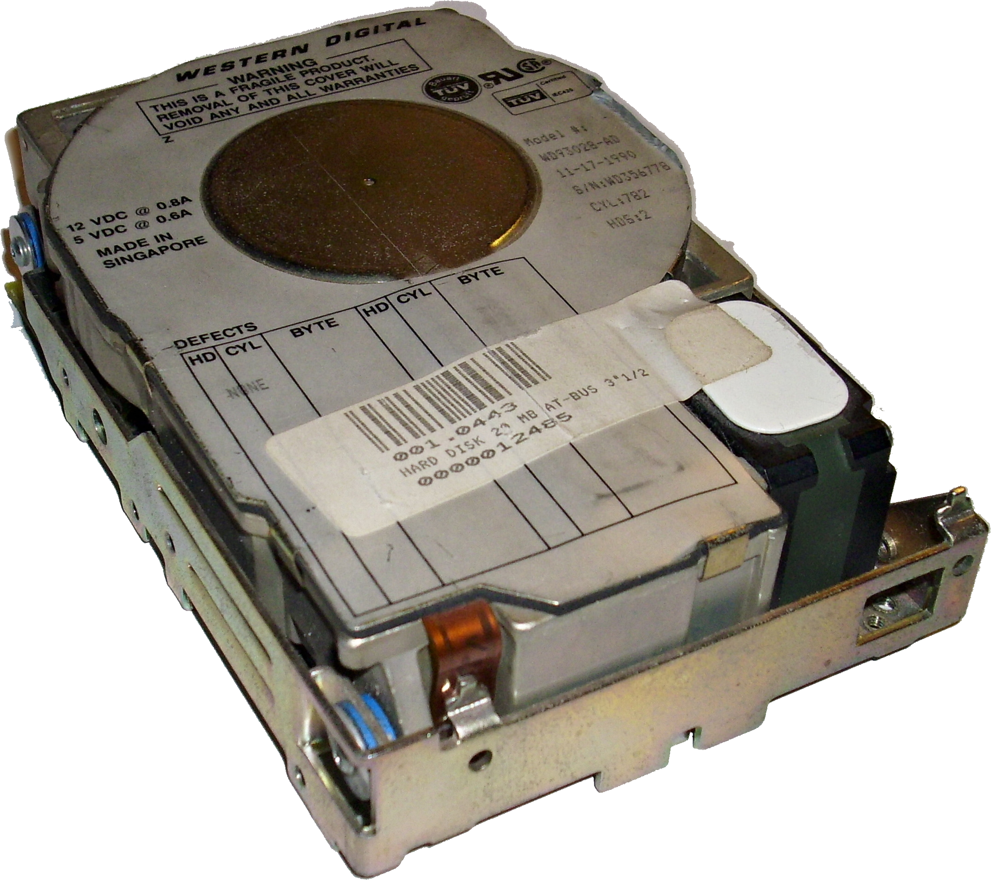
Why Hekaton is faster?
Memory is way faster then storage.
  Even SSD!

Slide 27
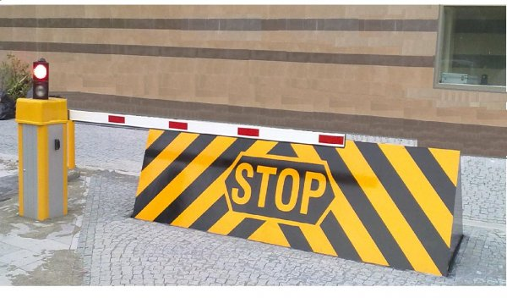
Why Hekaton is faster?
Eliminate locks and latching.
  Optimistic model.

Slide 28

Why Hekaton is faster?
New structures.
  We already use memory for traditional model.

Slide 29
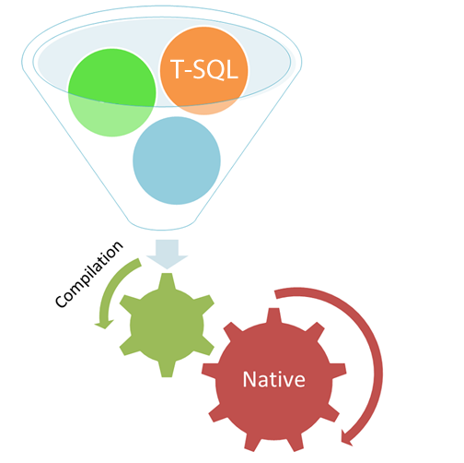
Why Hekaton is faster?
Compiled objects.
  All the steps to interpret code are avoided.

Slide 30
Architecture
Client Application
Tabular Data Stream (TDS) Handler / Session Management
Existing SQL Component
InMemory Native Compiler
Parser, Catalog and Optimizer
T-SQL Execution
Native Compiled Stored Procedures and Schema
InMemory Component
Generated DLL
Storage Engine for Memory Optimized Tables and Indexes
Query interoperability
Buffer Pool for Tables and Indexes
Sqlserv.exe
Checkpoint Files / Recovery
Memory Optimized Table Filegroup
Transaction Log
Data Filegroup

Slide 31

Hybrid Engine
Integrated queries & transactions.
Integrated HA and backup/restore.
Same database can have in-memory and on-disk.
Same manageability, administration & development experience.

Slide 32
Limitations
Enterprise only.
Total size for durable tables: 256 Gb.
Removal of In-Memory FG not allowed.
No table/index changes.
Row size limit is 8060 bytes.
A bunch of not supported T-SQL.
  https://msdn.microsoft.com/en-us/library/dn246937(v=sql.120).aspx
Good compilation: http://goo.gl/lPdh8Q

Slide 33
Improvements
SQL Server 2016

Slide 34

Size of In-Memory Tables
SQL Server 2014
  Size of durable tables in a database <= 256 GB
SQL Server 2016
  Supports 2TB of durable tables in the database

Slide 35
Checkpoint Files Garbage Collection
SQL Server 2014
  The Garbage Collector process is not efficient enough.
  This may cause an excessive disk usage.

Slide 36
Checkpoint Files Garbage Collection
The “RAM memory” is a volatile kind of “data storage”.
How DURABLE tables keep the data safe?
  Data is saved into checkpoint files.
  During recovery - checkpoint files are applied and remaining portion is applied from transaction log.
  Checkpoint Files ≠ Checkpoint operation.

Slide 37
Checkpoint Files Garbage Collection
Checkpoint files:
  A pair of DATA and DELTA special files.
  Stored in a checkpoint container FG
    Based on FILESTREAM.
Memory Optimized Table Filegroup

Slide 38
Checkpoint Files
CFP Lifecycle
0
∞
TIME
Only this part has valid data.
DATA
DELTA

Slide 39
Checkpoint Files
Merge Process
10
20
21
30
TIMESTAMP
TIMESTAMP
DATA
DELTA
DATA
DELTA

Slide 40
Checkpoint Files
Merge Process
10
20
21
30
2
10
20
21
30
30
TIMESTAMP
TIMESTAMP
TIMESTAMP
TIMESTAMP
TIMESTAMP
+
DATA
DELTA
DATA
DELTA

Slide 41
Checkpoint Files
New files with the valid data.
Merge Process
10
30
TIMESTAMP
REDUCES
USED SPACE
BETTER
RECOVERY
DATA
DELTA

Slide 42
Checkpoint Files
Merge Process
  The old files will remain in the disk
  Garbage Collector is responsible to remove
10
20
21
30
TIMESTAMP
TIMESTAMP
DATA
DELTA
DATA
DELTA

Slide 43
Checkpoint Files Garbage Collection
SQL Server 2014
  The Garbage Collector from Filestream is not efficient for this case.
SQL Server 2016
  Storage management is decoupled from FileStream.
  Unused file(s) can be re-used immediately after they are de-referenced from transaction log.

Slide 44
Security (TDE)
SQL Server 2014
  No support for TDE.
  You choose: Performance OR Security?
SQL Server 2016
  Supports Transparent Data Encryption.
  Now you have Performance AND Security ☺

Slide 45
Storage Scaling
SQL Server 2014
  Limited scaling: up to 2 socket / 64 cores.
  The more cores, the more log records are created.
  There’s only one “Offline Checkpoint” thread.
SQL Transaction log
Del Tran1
(TS150)
Log in SQL Table
Del Tran2
(TS 450)
Del Tran3
(TS 250)
Insert into Hekaton T1
Single Offline Checkpoint Thread
To update DATA and DELTA files.
disk

Slide 46
Storage Scaling
SQL Server 2016
  No more limitation!
  Now there are multiple “Offline Checkpoint” threads – one per container.
SQL Transaction log
Del Tran1
(TS150)
Log in SQL Table
Del Tran2
(TS 450)
Del Tran3
(TS 250)
Insert into Hekaton T1
Offline Checkpoint Thread
Offline Checkpoint Thread
Offline Checkpoint Thread
disk

Slide 47
Development/Maintainability Challenge
SQL Server 2014
  No modifications are allowed!
    Tuning application/database.
    Responding to shifting data patterns.
    Application development/modification.
    Agile/iterative development methods.
    Need to be able to modify the database schema.

Slide 48
Development/Maintainability Challenge
SQL Server 2016
  ALTER is now supported!!
    ALTER PROC and sp_recompile supported
    ALTER TABLE
      add/alter/drop column/constraint
    ALTER INDEX
      Add/drop index supported
      Change HASH index bucket_count through index REBUILD

Slide 49
Development/Maintainability Challenge
SQL Server 2016
  There are still some limitations...
    ALTER TABLE is an offline operation; requires 2X memory
    sp_rename not yet supported

Slide 50
Report queried challenge
SQL Server 2014
  Parallel plans are used for memory optimized tables.
    Optimized for OLTP.
  If you join a MOT with a columnstore it will use DOP=1.
    You lose the benefit of columnstore.

Slide 51
Report queried challenge
SQL Server 2016
  Parallel plans are now supported!
  Now you can take the benefit of columnstore while joining with MOT.
  Real-time analytics are now possible, in the speed of light!

Slide 52
Supported T-SQL
SQL Server 2016
  Easier to convert existing applications!
  Now supports:
    {LEFT|RIGHT} OUTER JOIN
    Disjunction (OR, NOT)
    UNION [ALL]
    SELECT DISTINCT
    Subqueries (EXISTS, IN, scalar)
    FOREIGN KEY
    CHECK
    UNIQUE constraints and indexes
    Nested Stored procedures (EXECUTE)
    Natively compiled scalar UDFs
    Indexes on NULLable columns

Slide 53
Supported T-SQL
SQL Server 2016
  Easier to convert existing applications!
  Now supports:
    DML Triggers are now supported.
      AFTER triggers, natively compiled.

Slide 54
Migration/Manageability
SQL Server 2016
  On SQL Server 2014 we had a collation limitation...
  Now the full range of collations is supported.
    Non-BIN2 collations in index key columns
    Non-Latin code pages for (var)char columns
    Non-BIN2 collations for comparison and sorting in native modules

Slide 55
Migration/Manageability
SQL Server 2016
  Migration Assistent for Stored Procedure.
  Best Practices Analyzer support.
  Table Designer supporter in SSMS.

Slide 56
Questions?
Thank you!
murilo.miranda@gmail.com | @murilocmiranda

