Slide 1
Optimize SQL Server for Private Cloud
N.Raja - nraja@microsoft.com
TSP – Data Platform
Gary Casham – garycas@microsoft.com
SSP – Data Platform

Slide 2
Agenda
Why Private Cloud ?
Optimize SQL Server for Private Cloud
  Consolidation
  Elasticity
  Self Service
  Control & Customization
Next Steps, Offerings and Resources

Slide 3


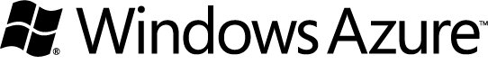




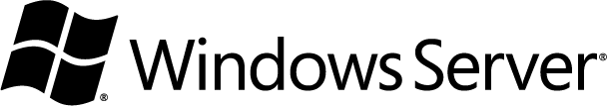

Deliver Best-in-Class Hybrid IT
Cloud Optimize Every Business
Public
Common
Technologies
Identity ▪ Virtualization ▪ Management ▪ Development
Private
The Microsoft
Difference
Private
Hybrid Support & the Commons
First-party Applications
Total Cost of Ownership
Public
Hybrid Support & the Commons
First-party Applications
Higher-level Services
Notes:
Key Points:
We’ve combined years of experience running apps at internet scale with our years of experience in on-premises software to create this broad and deep array of cloud solutions
We believe IT will be a hybrid world – a mix of on-premises and off-premises solutions – spanning private clouds (whether in your datacenter or a hosting company’s), public clouds and traditional IT.
Our solutions span private and public cloud environments – and our services span productivity, database, business applications, and infrastructure
In the world of hybrid IT, a distributed computing fabric that brings things together on behalf of your IT professionals and your developers writing applications – you need commonalties across identity, virtualization, management, and application development
Microsoft is uniquely positioned to provide these commonalities
Talk Track:
Let’s take a deeper look at how we’re approaching cloud. For Microsoft, our uber vision is to have a continuous cloud service for every person and every business -- kind of harkens back to Bill Gate's vision, a PC on every desktop. That grounds you in how broad we’re thinking about the importance of the cloud.
We want to cloud optimize every business – so EVERY business can employ cloud technologies in their own way -- at their own pace. To do this, we’re really taking all of the years of experience we have at running applications at Internet scale, which started with MSN in 1994 all the way to BING and Hotmail today, and combining that with our expertise in on-premises software.
We're pouring all of this into three cloud environments that run several distinct categories of services.
What are those cloud environments?
(1) private cloud – where businesses control their environment by using cloud-enabled on-premises products
(2) public cloud – where we manage the platform for you; and…
(3) a mix of the two – or what we call hybrid IT.
We’re anchoring the private cloud environment with a cloud-optimized operating system and management solution, Windows Server and System Center, which manages everything from infrastructure to applications to clouds – private and public -- making it possible for you to manage the world of hybrid IT.
By the same concept, Microsoft’s public cloud offerings are anchored by Windows Azure, which is a comprehensive IT platform across both compute, storage, network capabilities and higher-level services like relational databases.
CLICK - FIRST ANIMATION
Whether it's public or private, our services across both fall into a few categories:
(1) Productivity -- with Lync Server, Exchange Server and SharePoint Server on the private, and Office 365.
(2) Database -- with SQL Server private cloud enabled, and SQL Azure in the public cloud space
(3) Business Applications -- with Microsoft Dynamics enabled on the private cloud, and Dynamics CRM Online available through our public cloud.
(4) And last – Infrastructure -- there's Windows Intune providing desktop management & security running on the clopud, and the Windows Azure platform.
But, it's not just the fact that we have this deep and broad set of services and platform capabilities across public and private, it's the commonalities between the two that provides the real magic and uniqueness in Microsoft’s business cloud strategy.
CLICK – SECOND ANIMATION
Delivering Best-in-class Hybrid IT… I mentioned hybrid IT before. We believe all companies are going to have multiple cloud environments private, public cloud, service providers… welcome to the world of hybrid IT – a place businesses are going to call home for a long time to come.
In this hybrid world, you absolutely need a distributed computing fabric that brings things together on behalf of your IT professionals and your developers writing applications.
These commonalities of identity, virtualization, management, and application development are what makes Microsoft's platform very unique.
Common Identity – The majority of our enterprise customers use Active Directory (AD) to manage their identity infrastructure. Through federation, you can also extend AD to offer consistent/secure SSO experiences for applications spanning across private and public clouds. Coca Cola Enterprises set up an Office 365 solution with single sign on for their employees and business partners using a combination of on-premises and public cloud based components. (http://www.microsoft.com/casestudies/Case_Study_Detail.aspx?casestudyid=4000004584)
Common Virtualization – through capabilities like the Windows Azure VM role, we help you deliver application portability across private and public clouds.
Common Management – Through System Center 2012, which we’ll cover later, we offer full visibility and control for IT professionals across private and public clouds environments. At the same time, we continue to empower your application owners with self-service to make sure they can deliver agile app experiences to their businesses.
Common Development – The developer experience from Microsoft on the Windows Platform is unparalleled. The .NET framework allows developers to use the same set of skills to rapidly build great applications for the client, phone, browser, server and the cloud. Manage the entire application lifecycle with Visual Studios. Use the most popular languages for development so you don’t have to retrain your developer staff on a new paradigm.
CLICK – THIRD ANIMATION
This entire picture is one of the biggest advantages Microsoft offers our customers. To summarize, our private and public cloud technologies easily work with each other – creating synergies for a hybrid IT environment. From first-party applications, to higher-level services for public cloud, to providing better TCO on private cloud than our competitor like VMware, Microsoft is committed to delivering the Best-in-Class Hybrid IT solutions to its customers. I’ll go deeper on all of this as we continue our conversation.

Slide 4
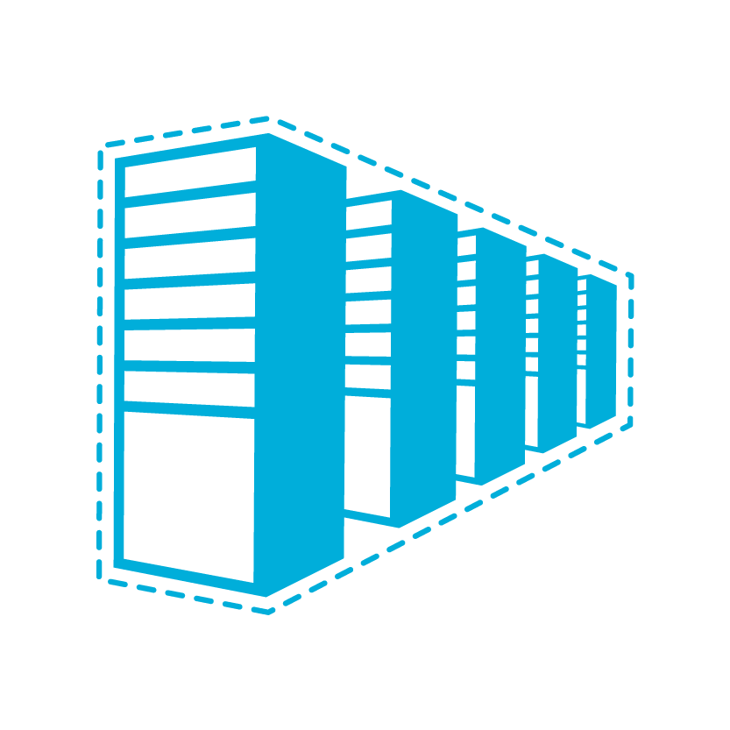


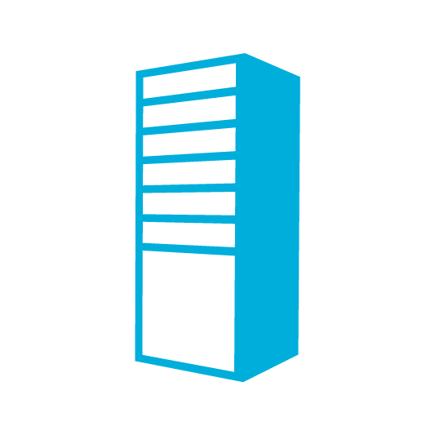

IT Continuum
Evolution towards highly virtual and beyond to cloud
Physical
Virtual
IaaS
PaaS
SaaS
Notes:
Transition from previous slide
Let’s talk about the transformation that's actually happening within IT.
Goal of this slide
Frames the enterprise cloud computing conversation by highlighting the evolution from traditional to cloud computing models. Define industry taxonomy around IaaS and PaaS.
Talking Points:
If you're in the infrastructure as a service layer (IaaS), you're thinking about your datacenter as a set of pooled virtual resources (including compute, network and storage), not in terms of individual hosts or VMs. That said, you still have to manage the virtual infrastructure, operating system and the full application stack.
When you're in the platform as a service layer (PaaS), you're talking about building applications which will then be delivered as a service – the platform providing all the required building blocks for your app. You don’t have to worry about the underlying infrastructure, operating systems or the application platform infrastructure. You can focus all your energies on your applications. With Windows Azure with primarily offer PaaS but are moving towards robust IaaS capabilities (more to come in this presentation with the Roadmap)
A couple of data points from internal Microsoft research:
41% of our customers are using services across on premise and public clouds
80% of our customers over next 3 to 5 years will use hybrid models

Slide 5
Cloud Services
  On Premises
  Infrastructure
(as a Service)
  Platform
(as a Service)
  Software
(as a Service)
  You manage
Applications
Applications
Applications
Applications
  You manage
Data
Data
Data
Data
Runtime
Runtime
Runtime
Runtime
  Managed by vendor
  You manage
Middleware
Middleware
Middleware
Middleware
  Managed by vendor
O/S
O/S
O/S
O/S
Virtualization
Virtualization
  Managed by vendor
Virtualization
Virtualization
Servers
Servers
Servers
Servers
Storage
Storage
Storage
Storage
Networking
Networking
Networking
Networking
Notes:
Slide Objectives:
Explain the differences and relationship between IaaS, PaaS, and SaaS in more detail.
Speaking Points:
Here’s another way to look at the cloud services taxonomy and how this taxonomy maps to the components in an IT infrastructure.
Packaged Software
With packaged software a customer would be responsible for managing the entire stack – ranging from the network connectivity to the applications.
IaaS
With Infrastructure as a Service, the lower levels of the stack are managed by a vendor. Some of these components can be provided by traditional hosters – in fact most of them have moved to having a virtualized offering.
Very few actually provide an OS
The customer is still responsible for managing the OS through the Applications.
For the developer, an obvious benefit with IaaS is that it frees the developer from many concerns when provisioning physical or virtual machines.
This was one of the earliest and primary use cases for Amazon Web Services Elastic Cloud Compute (EC2).
Developers were able to readily provision virtual machines (AMIs) on EC2, develop and test solutions and, often, run the results ‘in production’.
The only requirement was a credit card to pay for the services.
PaaS
With Platform as a Service, everything from the network connectivity through the runtime is provided and managed by the platform vendor.
The Windows Azure best fits in this category today.
In fact because we don’t provide access to the underlying virtualization or operating system today, we’re often referred to as not providing IaaS.
PaaS offerings further reduce the developer burden by additionally supporting the platform runtime and related application services.
With PaaS, the developer can, almost immediately, begin creating the business logic for an application.
Potentially, the increases in productivity are considerable and, because the hardware and operational aspects of the cloud platform are also managed by the cloud platform provider, applications can quickly be taken from an idea to reality very quickly.
SaaS
Finally, with SaaS, a vendor provides the application and abstracts you from all of the underlying components.

Slide 6
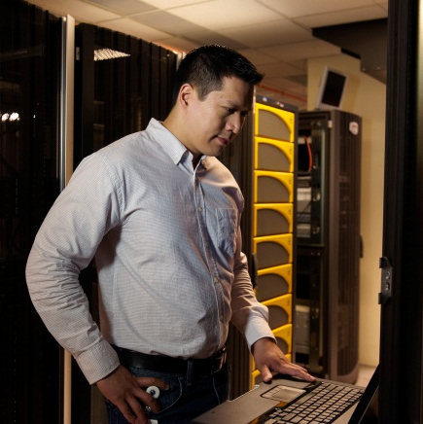




Microsoft Cloud Datacenters
Investments
$2.3B+ in cloud infrastructure
200+ services, delivered 24x7
Geo-distributed datacenters
Rapid modular model
30,000+ engineers involved in cloud-based activities
2,000+ people in cloud infrastructure engineering and operations
Operational Excellence
99.9% uptime, financially-backed SLAs
Federated operations
centers 24x7
Standardized cost reporting
Secure, compliant infrastructure
FISMA certified, SAS 70 and ISO 27001 compliant
Carbon footprint reduction
Notes:
NO OTHER company can match Microsoft today in our experience on running and building services. We know what it takes to do this, because we’ve been running services at Internet scale for years – from MSN in 1995, to Hotmail, Windows Live, and Bing, today.
For example, we handle:
9.9 billion messages a day via Windows Live Messenger
600 million unique users every month on Windows Live & MSN
1 Petabyte+ of updates served every month by Windows Update to millions of servers and hundreds of millions of PCs worldwide
5M LiveMeeting conference minutes per year
Forefront for Exchange filters 1B emails per month
To support this and our business cloud services, we’ve made and continue to make significant investments in our datacenter infrastructure that our cloud services run on – resulting in a number of advantages: financially backed SLAs, a standard cost operating model, industry-leading modular datacenter models, a consumption-based chargeback model, and the ability to achieve global targets like a Power Usage Effectiveness (PUE) of 1.25.
This is all alongside our full commitment in the engineering discipline and the operations discipline around delivering the cloud.
Deeper Details on Microsoft Global Foundation Services (GFS)
Infrastructure Services Operations – Microsoft Global Foundation Services (GFS) manages our global network of data centers and provides 1) Physical and Site Security 2)Critical Environments Support (Power, Water, Redundancy) and 3) Technical Support (Racks, Servers, Switches) with a focus on operational excellence to deliver lowest cost and highest service delivery globally.
Data Center Innovation – GFS continues to deliver effective and efficient DC and infrastructure designs that deliver the most value to our internal customers. Today this means our IT Pre-Assembled Components (ITPACs) for our future modular data centers will provide a lower cost CAPEX per Mega Watt, enhanced speed to market, and reduction in OPEX. ITPACs are a game changer.
Global Capacity – When choosing future datacenter sites, we take into account over 35 weighted criteria, including close proximity to an ample and stable power source and fiber optic networks, affordable pool of skilled labor, affordable energy rates, taxes, and capacity capabilities needed for our local, regional and global customers to determine the long-term viability of each site.
Utility pricing – this is how GFS charges its customers by consumptions units and Consumption statements are issued every 30 days to customers for: Compute (VM / hour), Storage ($ per GB), Network (traffic), Incidents (tickets)
SOC/NOC – GFS manages the Microsoft Operations Center (MOC) that is a Tier 1 federated Ops center with failover in Redmond, India and California to ensure business continuity 24 x 7 x 365. The MOC is focused on delivering a comprehensive incident management and service support, with world class quality of service for 200 + property groups supporting incident management in a highly cost efficient model. They process more than 150K tickets a month supporting incidents, change management, release management and problem management. They are the first line of operational support for our cloud properties. Turnkey operations take a service from on-boarding to tooling through support. MOC supports non-windows environment.
MOC uses MS Change as a primary change management tool (most universally recognized change management tool)
Consumption Reporting: New Cost Model focuses on measuring and forecasting capacity utilization, cost driver transparency and accountability, and investment optimization and is aligned with ‘Improve Cost’ strategic theme. Key measurements: $/kW, $/Mbps, $/Incident, $/Server to provide transparent, accurate volume & rate insight by cost pool aligned to native cost. Standard rates by region, where applicable, provide greater predictability for BGs’ online COGS
Hardware Services – GFS provisions hardware via various standards programs such as containers, ITPACs and the Azure and MACH server programs.

Slide 7








Compute
Storage
Database
CDN
Service Bus
Access Control
Caching
VMs
Reporting
Notes:
Windows Azure lets developers choose the framework and tools they want, with first-class support of .NET, Java, PHP and Node.js. Windows Azure consists of a set of foundational services - let’s take a quick tour, starting with 3 core services: Compute, Storage, Database
Compute:
Windows Azure offers highly-available Compute capacity that enables you to run application code in the cloud and allows you to quickly scale your applications up or down to meet your customer needs.
Each Compute instance is a virtual machine that isolates your application from other customers.
Once Compute resources are assigned to your application, Windows Azure automatically handles network load balancing and failover to provide continuous availability
Storage:
The design point is for the cloud is availability of storage, there are 3 replicas of data, and we implement guaranteed consistency. In the future there will be some transaction support and this is why we use guaranteed consistency.
There are 4 types of storage
Tables = Key value store
Queues = a simple queuing mechanism
Blobs = Binary file storage in the cloud
Drives = A mechanism that allows a VHD in a blob to be mounted as an NTFS drive into a Compute role
Authenticated access and triple replication to help keep your data safe
Easy access to data with simple REST interfaces, available remotely and from the data center
Database:
Simple to provision- create a logical server in the Portal, execute a create DB Command to create a new database
Can add and remove DBs easily from application to scale up and down
No need to install or patch software or other physical administration
Automatic high availability and fault tolerance
Support for T-SQL based familiar relational database model
Beyond these 3 core services, Windows Azure offers a growing set of additional services to help you bring your application, and your business, to the next level.
CDN:
The Windows Azure CDN provides edge nodes around the world, providing better performance and user experience for users who are farther from the source of the content stored in the Windows Azure Blob service.
Windows Azure Customers have control over how long data is cached.
Windows Azure CDN has 20 locations globally (United States, Europe, Asia, Australia and South America) and continues to expand
Service Bus:
The Service Bus is designed to provide a general purpose application bus, available on the internet at internet scale.
Fundamentally, the .NET Service Bus is about connecting applications across network and application boundaries and making key message exchange patterns such as publish and subscribe messaging very simple.
Access Control:
The Access Control service is designed to provide rules-driven, claims-based access control for applications.
Essentially, this allows you to define authorization rules for your applications using the claims-based approach that we are adopting within many Microsoft products and technologies and that is becoming adopted throughout the industry.
Caching:
Caching provides a distributed, in-memory, application cache service for Windows Azure applications.
Instead of relying on slower disk-based storage, applications gain high- speed access and scale to data that is kept in-memory.
VMs:
Transfer your existing apps easily to Windows Azure without modification
Deploy durable virtual machines on Windows or Linux (customer uploads Linux image) (Linux VM - CTP Spring 2012)
Reporting:
SQL Server Reporting provided as a service
Reports authored using existing tools (BIDS)
Reports can include rich Data Visualizations (Maps, Charts, Tablix) and exported to variety of formats
Traffic Manager
Improves app performance and resiliency by automatically routing traffic to the nearest deployed datacenter and provides seemless failover in the event of a failover
Networking
Windows Azure offers multiple levels of connectivity through Windows Azure Connect and Project Brooklyn

Slide 8
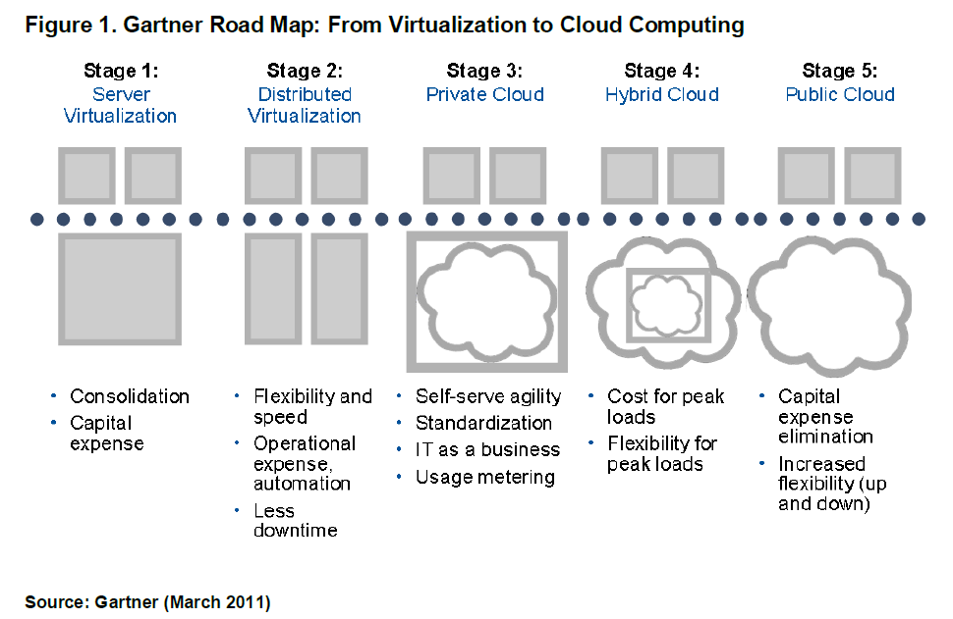
What is Private Cloud?

Slide 9
Private Cloud is happening …
70% customers are doing/planning private cloud¹
Half of federal agencies will be in the cloud within 12 months²
Adoption of virtualization and cloud computing to increase dramatically in the next 12 months³
Self-services are catching up with virtualization quickly⁴
¹ AFCOM 2011 study
² Information Week 2011 survey
³ Worldwide Executive Council 2011 survey on 100 CIOs
⁴ CompTIA 2011 cloud computing survey

Slide 10
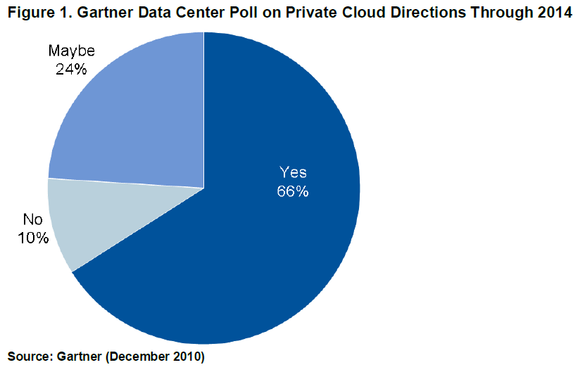
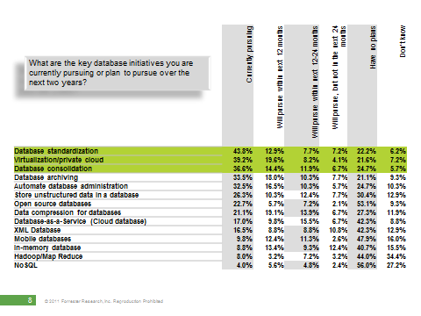
Private Cloud is happening …
90% respondent are doing it or planning to do it
Top 3 initiatives: Database standardization, Virtualization/Private Cloud, Database Consolidation
Microsoft Confidential

Slide 11
PRIVATE CLOUD DRIVERS
Resource Pooling
Elasticity
Self - Service
Control & Customize

Slide 12
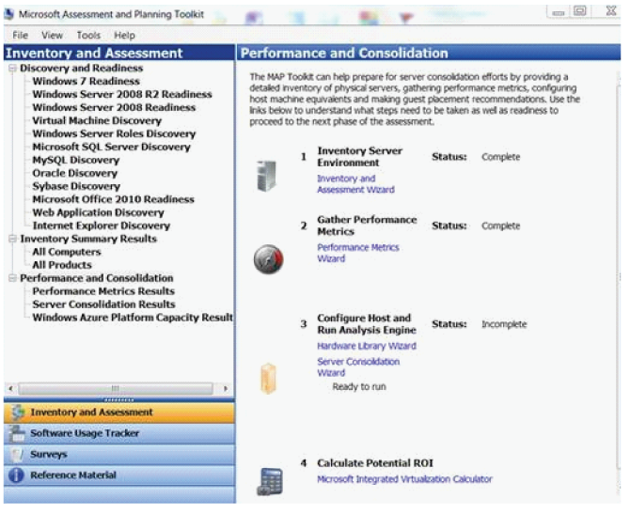

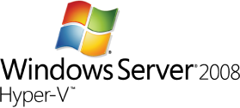

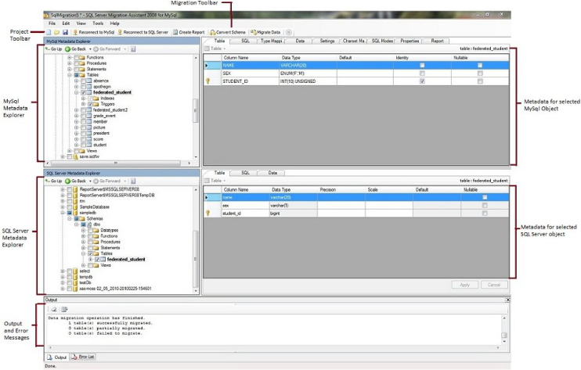
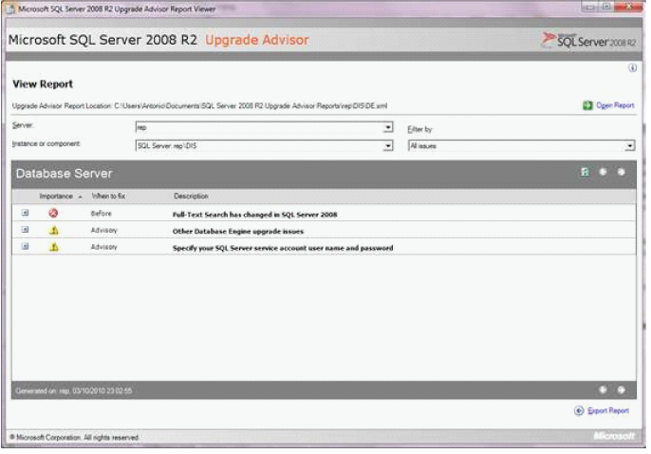

Resource Pooling Key Steps
Consolidate databases
STEPS | TOOLS OR FEATURES
Discover SQL sprawl and capacity planning | Microsoft® Assessment and Planning (MAP) Toolkit 5.5 Microsoft Consolidation Planning Tool for SQL Server v1.0
Consolidation options | Microsoft SQL Server® 2008 R2 Upgrade Advisor SQL Server Migration Assistant (SSMA)
STEPS | TOOLS OR FEATURES
Physical-to-Virtual Migration | Microsoft System Center Virtual Machine Manager 2008 R2
Virtualize and manage instances | Windows Server® 2008 R2 Hyper-V™ System Center Virtual Machine Manager 2008 R2
CONSOLIDATE
MAP Toolkit
Upgrade advisor
SSMA
SQL Server

Slide 13
When to virtualize and when not to virtualize SQL Server?
Customers should virtualize SQL Server
  Start from smallest workload
  Continue to larger workload over time with experience
  Microsoft support SQL Server virtualization http://support.microsoft.com/?id=956893
Customers should not virtualize SQL Server
  CPU: Need more than 4 logical processors
  Memory: Need more than 64 GB per virtual machine
Start small, learn, and continue to virtualize as customers test and learn how to manage.

Slide 14
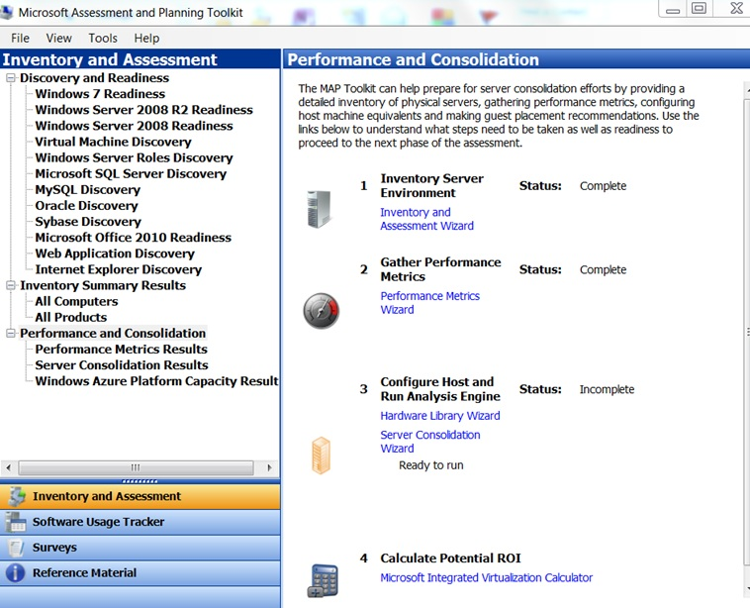
Discover Database Sprawl (MAP toolkit 5.5)
Performs discovery and inventory of SQL Server and other databases and instances (MySQL, Oracle, Sybase)
Generates reports (inventory, proposals)
Accelerate migration to the latest SQL Server

Slide 15
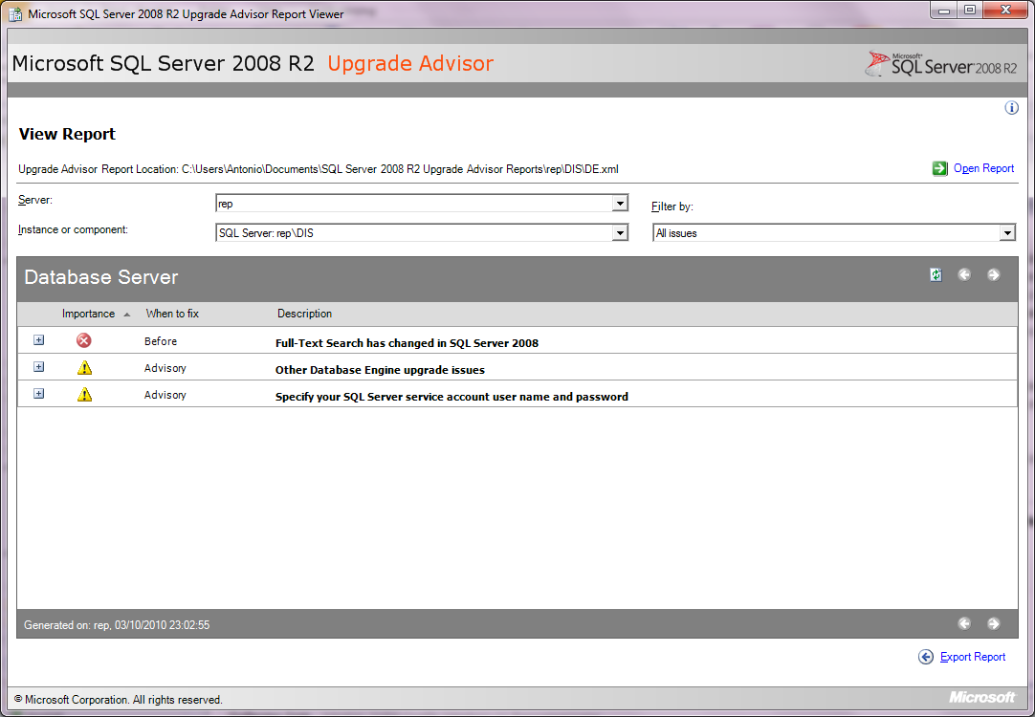

SQL Server Upgrade Advisor
Analyze SQL Server 2000, SQL Server 2005, SQL Server 2008
Identifies features and configuration changes before upgrade
Provide documentation (links) on resolving potential issues before upgrade

Slide 16
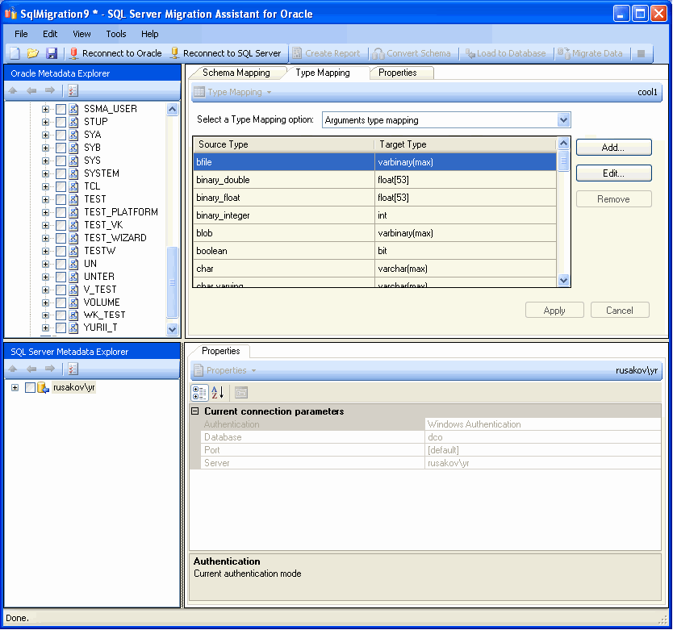
SQL Server Migration Assistant
Available for Oracle, MySQL, Sybase, Access
Automate migration of database objects, business logic (codes), and data to SQL Server
Proven tool

Slide 17
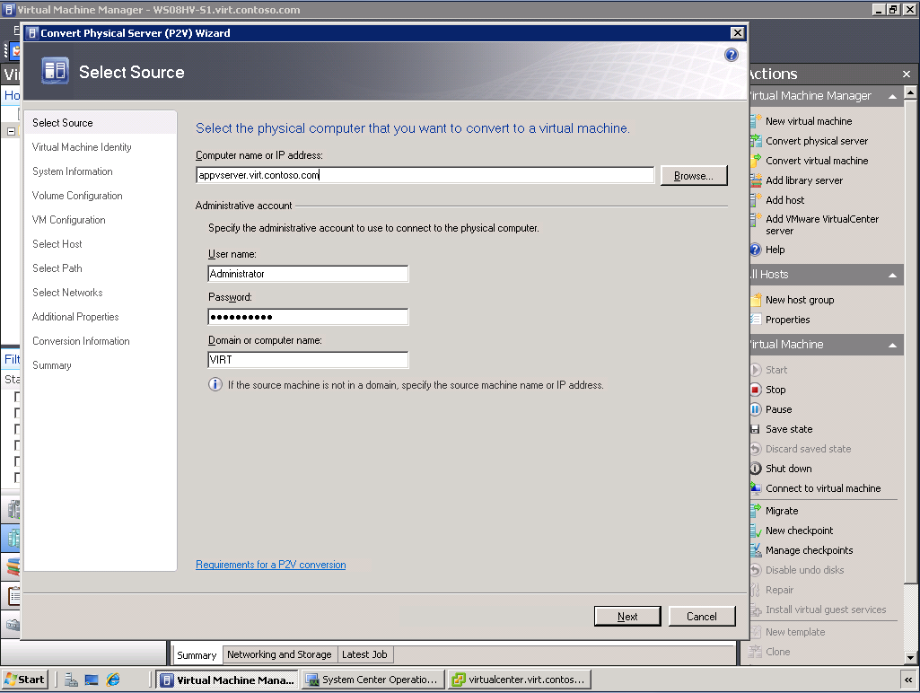
Physical to Virtual
Intuitive and easy to use
  Wizard-based
  Reconfigure storage, memory, CPU, etc.
  Preserves network settings and MAC addresses
  Script-able through PowerShell
Supported platforms
  Live: Windows XP, Windows Server 2003, Windows Vista, Windows 7, Windows Server 2008/R2
  Offline: Windows Server 2000

Slide 18

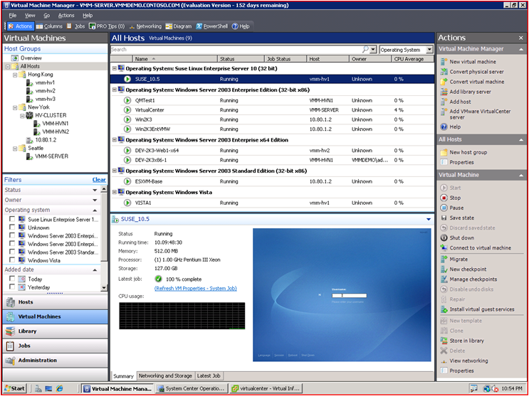

System Center Virtual Machine Manager 2008 R2
A centralized, heterogeneous management solution for the virtual datacenter
Maximize Resources
  Centralized virtual machine deployment and management for Hyper-V, Virtual Server, and VMware ESX servers
  Intelligent placement of Virtual Machines
  Fast and reliable P2V and V2V conversion
  Comprehensive application and service-level monitoring
  with Operations Manager
Increase Agility
  Rapid provisioning of new and virtual machines with templates
  Leverage and extend existing storage infrastructure and clusters
  Allow for delegated management and access of VMs
Leverage Skills
  Monitor physical and virtual machines from one console
  Fully scriptable using Windows PowerShell
Notes:
System Center Virtual Machine Manager 2008 R2
System Center Virtual Machine Manger is the centralized location where an Organization can administer their Virtualization environment. Virtual Machine Manger is a tool that allows you to manage your Hyper-V environments as well as your Virtual Server and VMware environments. VMM provides a common interface for deploying, managing and operating your Datacenter. By integrating with the other System Center Suite of Products an IT Organization has a consistent and coherent view of not only their Virtual Environments, but the physical hosts and applications as well. This increases the efficiency of an IT Organization to provide the best services it can to its customers.
Maximize Resources
Centralized virtual machine deployment and management for Hyper-V, Virtual Server, and VMware ESX servers
Intelligent placement of Virtual Machines
Fast and reliable P2V and V2V conversion
Comprehensive application and service-level monitoring with Operations Manager
Integrated Performance and Resource Optimization (PRO) of VMs
Increase Agility
Rapid provisioning of new and virtual machines with templates
Centralized library of infrastructure components
Leverage and extend existing storage infrastructure and clusters
Allow for delegated management and access of VMs
Leverage Skills
Familiar interface, common foundation
Monitor physical and virtual machines from one console
Fully scriptable using Windows PowerShell

Slide 19
Recap …
Control/discover your DB sprawl
  Run MAP toolkit to identify running DBs (SQL Server, MySQL, Oracle, Sybase)
Know when to virtualize or not
Capacity Planning
  Understand Isolation/security/HA requirements
  Determine software edition, version, & hardware requirements
  Use Consolidation Planning Tool for SQL Server to understand resource requirements
Choose consolidation options
  Upgrade using SQL Server Upgrade Advisor
  Migrate using SQL Server Migration Assistant
Begin conversion (virtualize)
  Use P2V to keep existing settings
  Create new VM to combine multiple apps
Benefits
Reduce capital expenses
  Standardize and consolidate
Reduce operational expenses
  Improve hardware utilization
  Manage IT infrastructure efficiently
Green IT
  Reduce space and power needs
  Tools
  MAP toolkit 5.5
  Consolidation Planning Tool for SL Server
  System Center Virtual Machine Manager 2008 R2
  SQL Server Upgrade Advisor
  SQL Server Migration Assistant

Slide 20
PRIVATE CLOUD DRIVERS
Resource Pooling
Elasticity
Self - Service
Control & Customize

Slide 21






Elasticity Key Steps
Scale resources efficiently
STEPS | TOOLS OR FEATURES
Setup clustering for fast recovery | Guest Failover Clustering with Windows Server 2008 R2 SQL Server 2008 R2
STEPS | TOOLS OR FEATURES
Increase virtual machine density | Windows Server 2008 R2 SP1 Hyper-V with Dynamic Memory
SQL Server
Guest Cluster
SQL Server
SQL Server
SQL Server
Guest Cluster
12Gb
8Gb
Shared Storage
iSCSI, SAS, Fiber
SCALE
Redundant Paths
to Storage
Virtual machine load balancing | System Center Virtual Machine Manager 2008 R2
Upgrade host with minimum downtime | Windows Server 2008 R2 Hyper-V Live Migration
SQL Server
SQL Server
SQL Server
Live Migration
SQL Server
Load Balancing
Hyper-V
Shared Storage
iSCSI, SAS, Fiber
Hyper-V

Slide 22
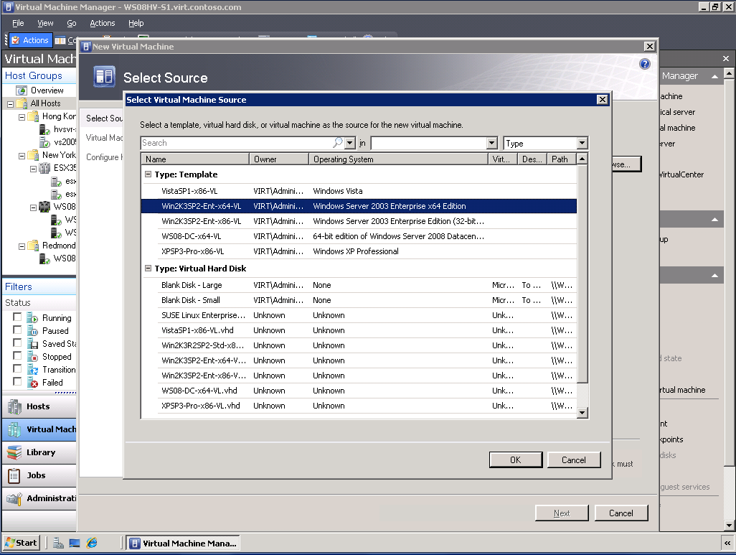
VM Templates
Rapid VM provisioning via templates
Create SQL Server templates using Sysprep support in SQL Server 2008 R2 (Database Engine and Reporting Services)
Support post provisioning actions (scripts, etc.)
Ensure standardization of VM

Slide 23
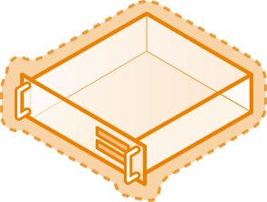

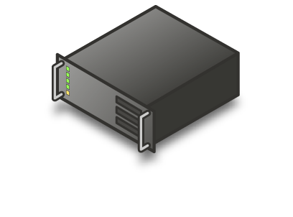


Better High Availability with Live Migration
VM
NO LOSS OF SERVICE
AVAILABILITY WITH LOWER COMPLEXITY
Live
Migration
MANAGE LOADS ON VMS ACROSS PHYSICAL MACHINE
1
2
EASIER MANAGEMENT THROUGH SYSTEM CENTER VMM
Host cluster
Shared Storage
iSCSI, SAS, Fiber

Slide 24
Guest Failover Clustering
Create failover cluster in Hyper-V environment
Cluster service runs inside Hyper-V guest
Application Mobility: Enable patching of guest OS without downtime
Support mixed clustering (host and guest)
Guest Cluster
Guest Cluster
1
2
Shared Storage
iSCSI
Redundant
Paths to storage

Slide 25
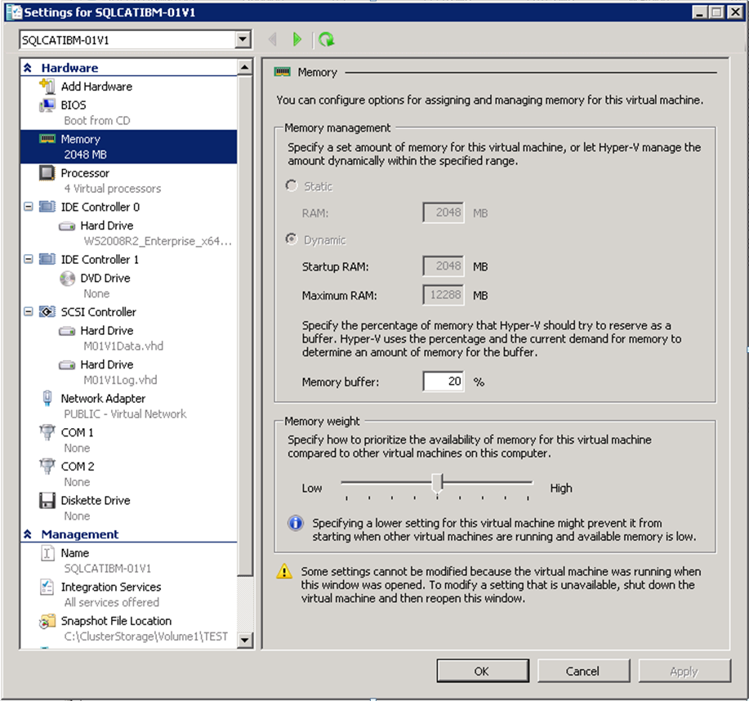
Dynamic Memory Overview
Part of Windows Server 2008 R2 SP1
Dynamic Memory is effective in managing memory of VMs and in the rebalancing necessary to ensure reasonable VM performance during overcommit scenarios (planned or unplanned failover).
Memory weight determines priority to memory resources across VMs.
To protect SQL VMs from potentially having memory taken away in an overcommitted scenario, give those VMs heavier memory priority.

Slide 26
Dynamic Memory Findings and Best Practices
Consideration: Adjusting memory weight of VMs may be necessary for Live Migrations to an overcommitted server.
Recommendation: Reduce SQL Server memory using ‘max server memory’ sp_configure setting prior to Live Migrations. May not always be possible.
Best Practice: Grant SQL Server service accounts ‘Lock Pages in Memory’.
  Prevents SQL Server memory from being paged out.
  Reduces overall impact on VM when the Guest OS has memory removed by relying on SQL Server memory management to release memory vs. having the working set paged out by Windows.
  Let SQL do the memory management when possible.
These settings combined, avoid performance drop offs for SQL Server, specifically in DM configurations, where Live Migrations occur with movement to an overcommitted host.

Slide 27
How does Dynamic Memory Benefit SQL Server?
Without Dynamic Memory VMs would have to be sized at 7.5GB (static).
More memory = Less I/O
Same SQL Throughput with only about 60% of the total IOPs.
Remember: This will be workload dependent.
8 VMs with 12GB Memory
8 VMs with 12GB Memory
VS.
8 VMs with 7.5GB Memory
8 VMs with 7.5GB Memory
Live
Migration
Live
Migration
1
1
1
1
Host cluster
Host cluster
Shared Storage
iSCSI, SAS, Fibre
Shared Storage
iSCSI, SAS, Fibre
~12,500 SQL Batches/sec
~7500 Sustained Read IOPs
(~11-13ms response time)
~12,500 SQL Batches/sec
~12,000 Sustained Read IOPs
(~11-13ms response time)

Slide 28
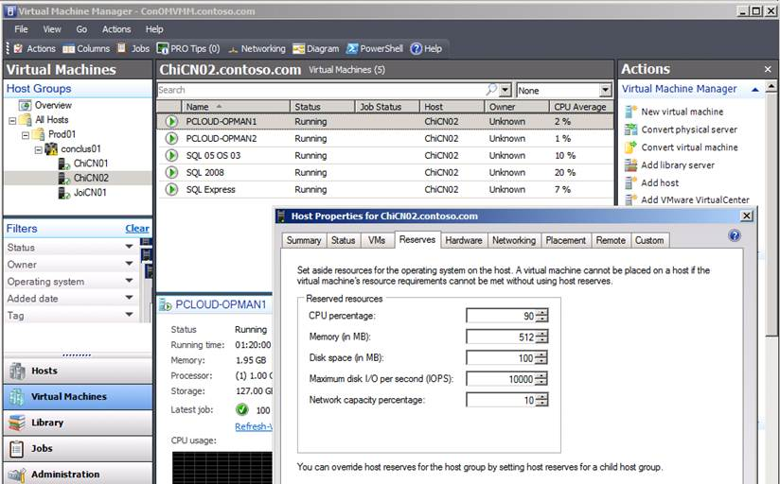
Load Balancing with Virtual Machine Manager
Use VMM to manage multiple hosts
Load balance VMs across multiple hosts via Live Migration for optimum performance

Slide 29
Video - Elasticity

Slide 30
Recap
Benefits
Greater agility
  Handle peak load scenarios faster
Dynamic Infrastructure
  Scale to efficiently meet demands
  Tools
  Live Migration
  Dynamic Memory
  Guest Failover Clustering
  System Center Virtual Machine Manager 2008 R2
IT develops VM templates
  Build and deploy SQL Server Sysprep templates
Minimize planned downtime using Windows Server 2008 R2 Hyper-V Live Migration
Manage unplanned downtime with Guest Failover Clustering
Increase virtual machine density with Dynamic Memory
Virtual machine load balancing with System Center Virtual Machine Manager 2008 R2

Slide 31
PRIVATE CLOUD DRIVERS
Resource Pooling
Elasticity
Self - Service
Control & Customize

Slide 32

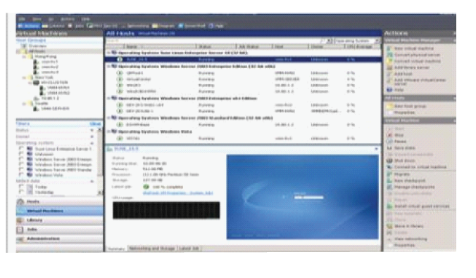


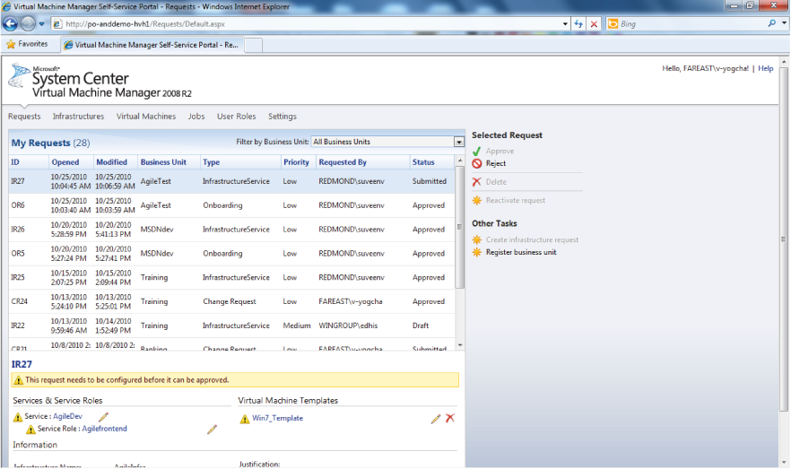
Self Service Key Steps
Deploy resources on demand
STEPS | TOOLS OR FEATURES
Virtual machine templates | System Center Virtual Machine Manager 2008 R2
Request business infrastructure
Create Roles
Map to Existing Templates
Create VMs
Create VM Templates
DEPLOY
Build automation | System Center Virtual Machine Manager Self-Service Portal 2.0
BUSINESS
IT
Approve/
Reject

Slide 33
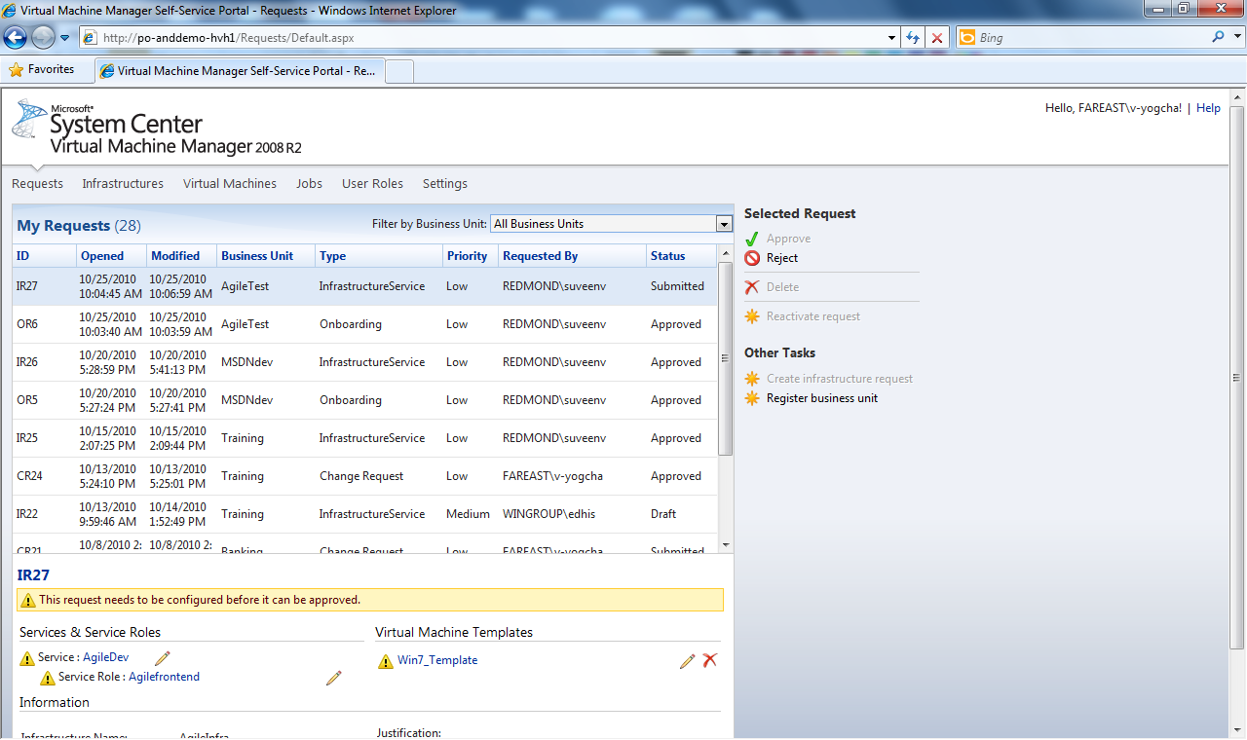
Self-Service Portal 2.0
IT Admin:
  Pooling resources
  User role management
  Create VM templates
  Validate requests from users
  Configure chargeback data
Business users:
  Request business infrastructure
  VM self-service (creates, remove, manage)

Slide 34
Video – Self Service

Slide 35
Recap
Use automation
  Leverage workflow service in SCVMM SSP 2.0
  Create & assign roles/permissions for business and IT admin
  Request and build business specific infrastructures (submit & approval)
  Map infrastructure to existing VM templates
  Create & retire VMs on-demand
Benefits
Faster time to market
  Automation without compromising control
Reduce administration overhead
Business units can request resources on demand
  Tools
  System Center Virtual Machine Manager 2008 R2
  System Center Virtual Machine Manager Self Service Portal (SCVMM SSP 2.0)

Slide 36
PRIVATE CLOUD DRIVERS
Resource Pooling
Elasticity
Self - Service
Control & Customize

Slide 37
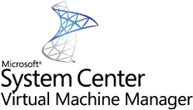



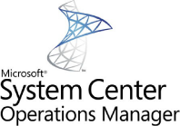
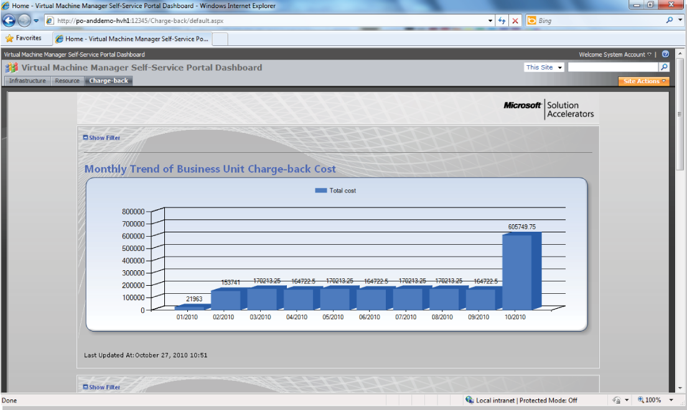
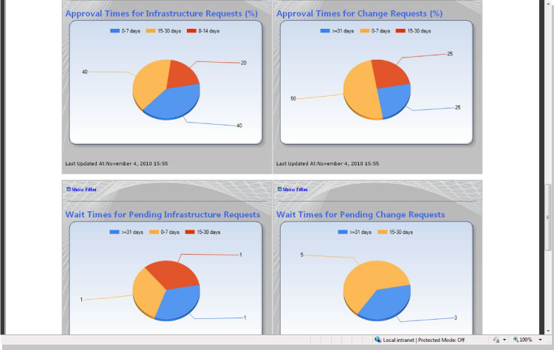


Control & Customize Key Steps
Drive standardization and compliance
STEPS | TOOLS OR FEATURES
Measure usage - Assign cost for each virtual machine template - Usage reporting - Charge back reporting | System Center Virtual Machine Manager Self-Service Portal 2.0
STEPS | TOOLS OR FEATURES
Manage private cloud | System Center Virtual Machine Manager 2008 R2 System Center Operations Manager 2007 R2 Management Packs
Chargeback
DRIVE
Usage Reporting
SQL Server
SQL Server
SQL Server

Slide 38
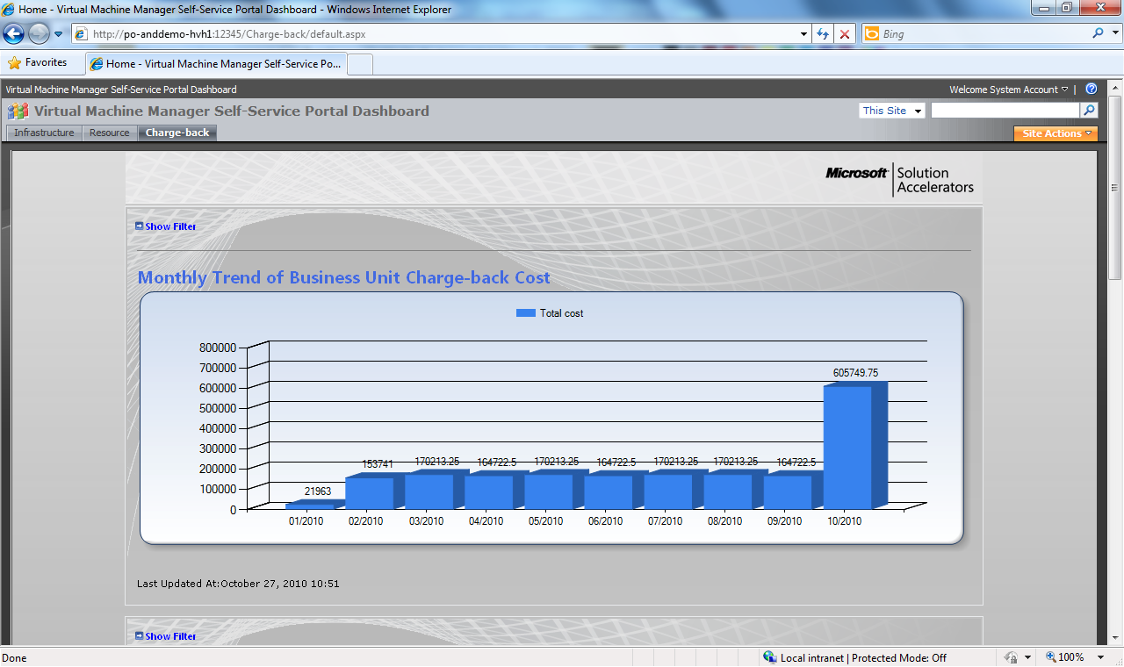
Measure Usage
Usage reporting by business units
Charge back costs by business units

Slide 39
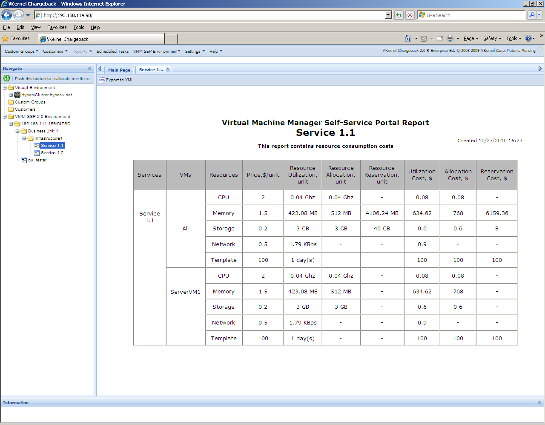
Advanced Measure Usage – vKernel plugin
Allocated and actual (utilized) costs
Custom fields for additional costs (power, space, cooling, support, etc.)
Automated, scheduled reporting via email
www.vkernel.com

Slide 40
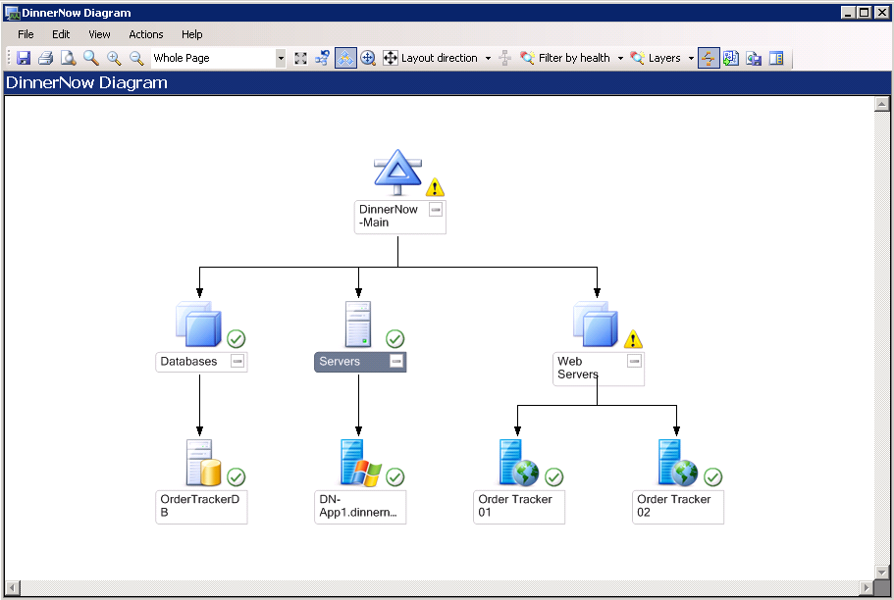
System Center Operations Manager (SCOM)
Monitor physical and virtual machines
Monitor entire stack (hardware, hypervisor, OS, database, application)

Slide 41
Video – Control & Customise

Slide 42
Recap
Measure usage
  Pre-build infrastructure by IT based on company standard and policy
  Assign cost recovery model for each virtual machine templates
  Monitor usage by users through reporting
  Chargeback to users
Manage private cloud
  Monitor & troubleshoot entire stack using SCOM
Benefits
Enforce and standardize based on policies
Measure service
  Meter resource usage and charge back to business units
Customize for your business needs
  Tools & Features
  System Center Virtual Machine Manager 2008 R2
  System Center Virtual Machine Manager Self Service Portal (SCVMM SSP 2.0)
  System Center Operations Manager 2007 R2 Management Packs

Slide 43
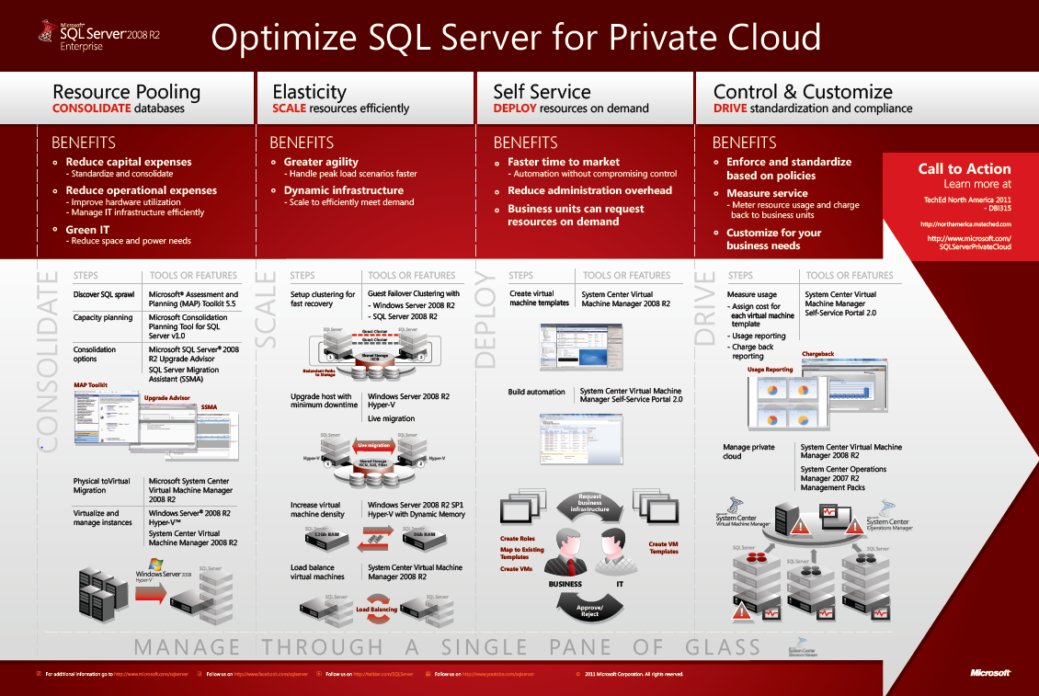
What is SQL Server for Private Cloud?

Slide 44

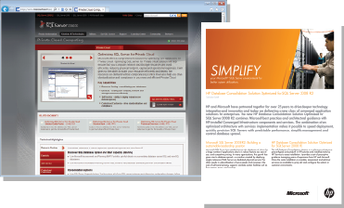
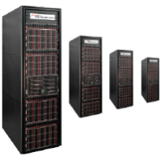
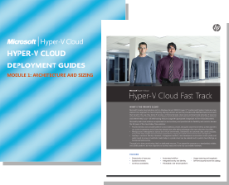
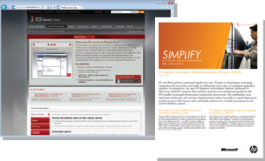
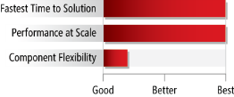
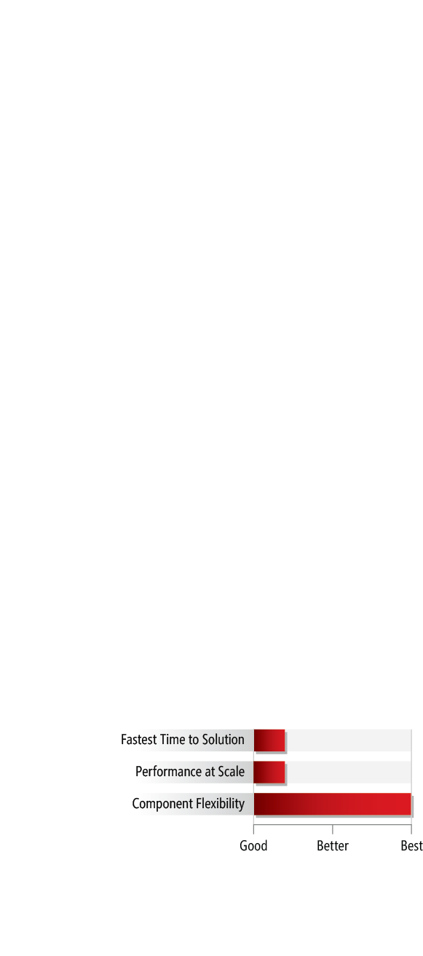
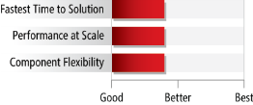
Available Offers
Self-Build
Reference Architecture
Appliance
OFFER
Hyper-V Fast Track Deployment Guide” and SQL Server Private Cloud Optimization guide.
“HP Database Consolidation Solution architecture guidance”
“Microsoft and HP database consolidation appliance”
optimized to deliver Private
Cloud benefits”
KEY POINTS
KEY POINTS
KEY POINTS
Proven performance & scalability
Software installed and tested at factory
Unique Appliance Features:
- Seamless scale 1/2 rack to multi-racks
- Load Balancing based on IO
- Optimization tools for Private Cloud
- Unified Health Monitoring
- Firmware, drivers, appliance utilities
Single point of support
“White Glove” delivery, configuration and support service
Software and hardware built and deployed on site
Some flexibility in components utilized
Faster Time to Solution than Self-Build
Tested Solution: HP specific guidance, tested by Microsoft and HP and supported by HP
Highest level of flexibility
Reuse existing hardware
Longest Time to Solution - requires in-house expertise, time and investment to design test and build
Call to Action Learn more at http://www.microsoft.com/SQLServerPrivateCloud
2011 Microsoft Corporation. All rights reserved.

Slide 45


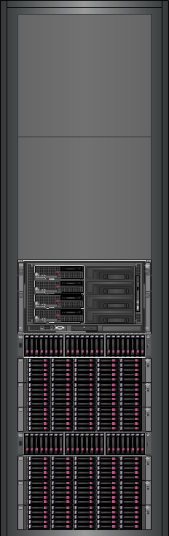

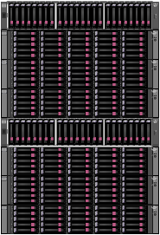

Solution Hardware specifications
Product Architecture tuned for SQL Server Workloads
1x Base Configuration
Dev/TEST
2x Full Configuration
Prod – SCC/BCC
(2) ProCurve E6600 10Gbps switches
(2) ProCurve E2910 1Gbps switches
4 Servers
8 cpu
1 TB RAM
28TB raw capacity
198 Spindles
25,000 IOPs
8 Servers
16 cpu
192 Cores
2 TB RAM
57 TB raw capacity
396 Spindles
50,000 IOPs
HP C3000 Enclosure with Flex-10
(4 to 8) BL 465c G7 Blades (2P):
• 256GB RAM
• 2x300GB HDD
(2 to 4) Storage Blocks – each with:
1 P2000 Disk Array
3 D2700 Disk Racks
(99) spindles
Storage
Block
Notes:
45

Slide 46
Solution Software Specifications
Component | Function | Cost
HP One-Touch Upgrade | Upgrade appliance firmware and drivers | Included in the HW
HP Storage Management Tool | Assign storage to VMs dynamically | Included in the HW
Windows Server Data Center 2008 R2 | Operating system for all VMs | Included in the HW
- Microsoft Hyper-V | Virtualization platform: unlimited VMs per rack | Included in the HW
- Windows Server Active Directory | Active Directory platform included
Database Consolidation Appliance 2012 + SA | Manage the appliance, from OS to DB, and all VMs | Required VL SKU, per proc
- System Center technologies, including:
- System Center VMM | Centralized virtual machine management
- System Center Operations Mgr. | End to end monitoring of the appliance
- System Center Configurations Mgr. | Remote control of VMs, remote patching, Inventory
- System Center Data Protection Mgr. | Backup and recovery for the appliance
- System Center Self Service Portal | Self service virtual machine management
- System Center Appliance Pro Pack | Detect DB issues inside the VM and recommend actions
- System Center Appliance Pack | Single health model for all appliance from HW to DB
- SQL Server technologies | To support System Center technologies
Database Consolidation Appliance tools |  | Included in the DBC 2012 SW
- Enhanced Appliance BPA toolkit | Configuration validation, pre and post install
- Enhanced MAP toolkit | Inventory of all DBs in the network, and sizing appliance
- Optimized templates | Used to create SQL Server VMs in minutes
SQL Server Enterprise edition + SA | Support any version of SQL Server, unlimited VMs | Required VL SKU, per proc
Notes:
This slide shows some of the technical specifications of the DBC appliance

Slide 47
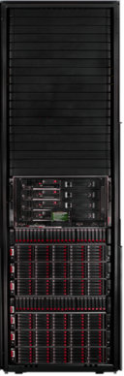
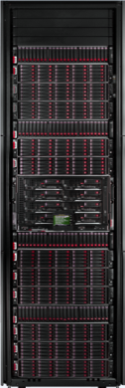
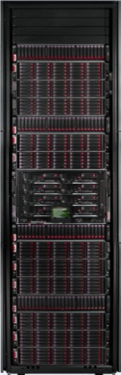
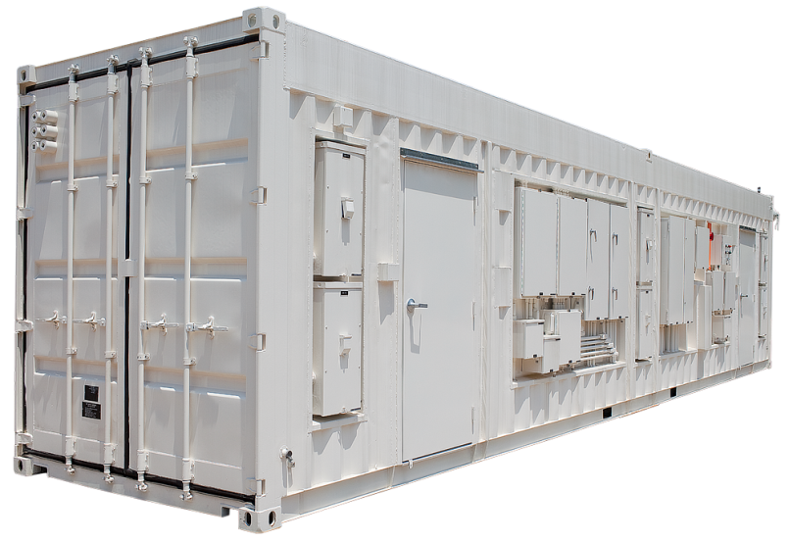


DBC Appliance – Performance @ Scale
Half Rack
Full Rack
Multi-Rack
Pod
100 VMs*
200 VMs*
200 VMs per rack*
2000 VMs*
A best of breed solution from the two
world leaders in database infrastructure
GREEN IT
DBC Appliance (200 VMs)
200 Servers (in racks)
*Based on typical database workloads and hardware running for 1 year

Slide 48

Solution Support
HP and Microsoft coordinated support, one phone number to call
Microsoft as First Point of Contact for all support needs.
Customers choose the service level from Microsoft and from HP to meet their business needs.
Microsoft
HP
Critical Advantage (CA)
A service to help get the most from your investment
Mission Critical Solution Center, HW & SW reactive support (level 1,2,3)
Account Management providing a support plan, review, activity reporting, and advice
HP Remote Support Solution
FW and SW Revision Analysis
Virtual & Physical Technology Review
CA Proactive Services tailored to BMO based upon Credits
Premier Mission Critical (PMC)
All features of underlying Premier Support contract plus
Faster reactive support response time with on-site solution engineering support
Response time guarantees backed by financial credits
Personalized coverage through Designated Support Engineer
Guaranteed critical on demand patch production
Immediate remote 24x7 access to deep product expertise
Solution supportability review and Health checks for maximum performance
Notes:
HP Critical Advantage
Explain each core proactive deliverables
Account Management. Annual frequency, but time scales for advice and assistance
HP Remote Support Solution. Mention IRS is a pre-requsitie, sometime we recommend IRSA. HP explains the features and benefits. HP assists the Customer with the setup and maintenance of the solution.
FW and SW Revision Analysis
Firmware and SW revisions needs to be current and compatible. Annually, HP reviews the products under the CA contract to verify that they are at the recommended revision levels. The HP account team provides a recommendation as to applicable software and firmware revisions and offers upgrade planning advice for the recommendations.
Virtual and Physical Technology Review
Annually, HP provides a review of the virtual and physical environment. The review provides a technical and supportability review of the IT environment, including product-specific compliance to environmental specifications. The environment review and Customer interviews identify key areas requiring further attention. The ASM works with the Customer to plan how to address these areas using appropriate proactive services with CA credits.
Explain credits grow with amount invested in CA, but more can be purchased optionally

Slide 49
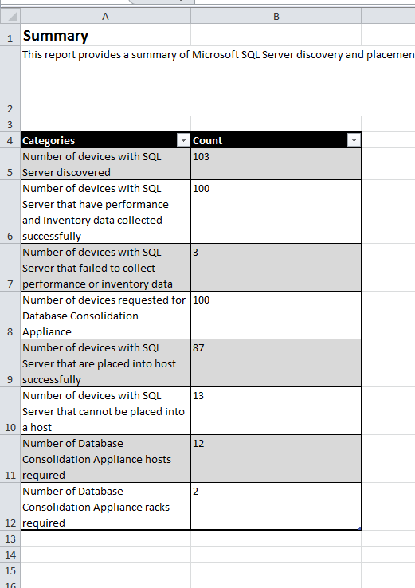
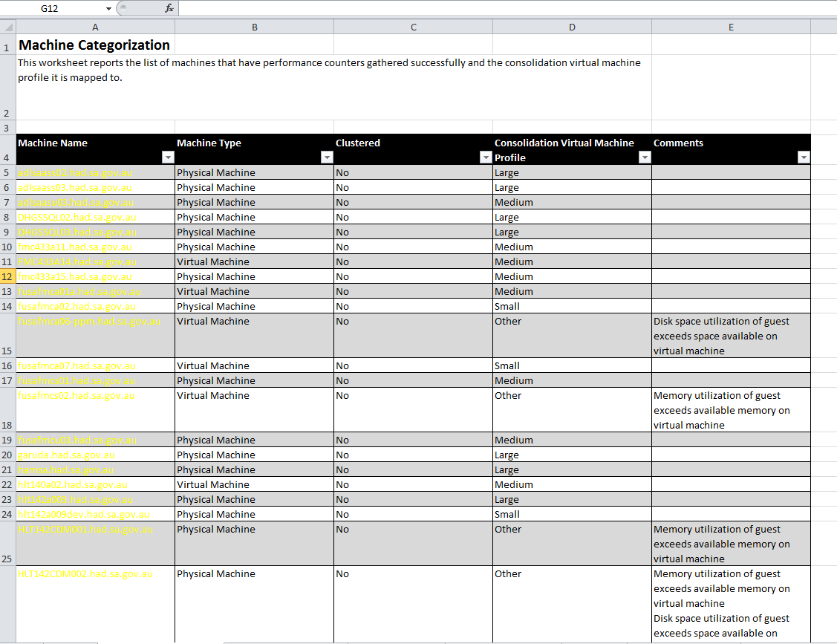
MAP Toolkit – DBCA Support

Slide 50
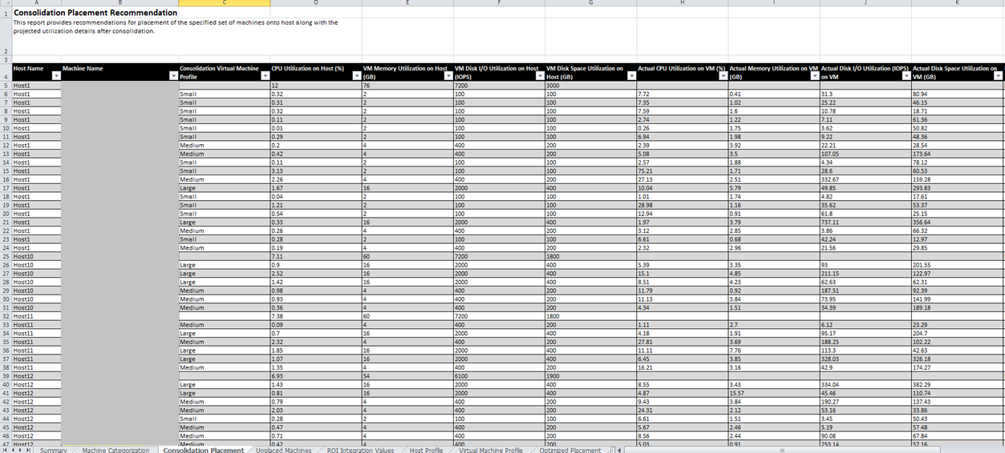
MAP Toolkit – DBCA Support

Slide 51
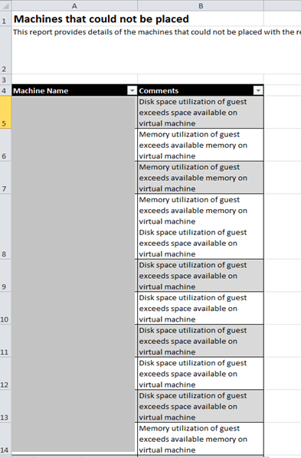


MAP Toolkit – DBCA Support

Slide 52

Next Steps
Build and deploy SQL Server for Private Cloud
  All software are available today for immediate deployment
  www.microsoft.com/SqlServerPrivateCloud
Optimized Database Consolidation Reference Architecture
  Optimized Database Consolidation Appliance
    Faster Time To Market – all software/hardware configured and tuned at factory
    Optimized for DB OLTP performance
    Can also run non-DB workloads
    Single point of contact for support

Slide 53
Next Steps:- On boarding

Slide 54
Interested in Reducing Expenses by 75% in Year 1? – Leverage on Offerings…
$453,000
typical savings
Sign up for an assessment workshop today
Notes:
The DBC appliance can help reduce your expenses by 75% in the first year.
The figures on this slide are based on typical real-world implementations of SQL Server on HP hardware with a mix of small, medium, and large database workloads. An Excel-based TCO calculator is available, and can be used to estimate savings for specific consolidation scenarios.
A whitepaper based on the TCO calculator, describes the scenario the example on the slide is based on:
Unconsolidated Solution
Current physical servers:
134 small database workloads (HP Proliant DL360 G5 1U Servers): Single processor, dual core, 4GB RAM, 2x 146GB 10k HDD RAID1 array, total available space 100GB, dual NIC, redundant fans and redundant power supplies
50 medium database workloads (HP Proliant DL380 G5 2U Servers): Quad core processor, 8GB RAM, 6x 146GB 10k HDD as 1xRAID1 array (boot) and 1xRAID5 array (data) plus hot spare, dual NIC, redundant hot-plug fans and redundant hot-plug power supplies
16 large database workloads (HP DL580 Proliant G5 4U Servers): Dual quad-core processor, 16GB RAM, 14x 72GB 15k HDD as RAID 0+1 array plus two hot spares, dual NIC, redundant hot-plug fans and redundant power supplies
Hardware Costs:
If the company remains with its current physical servers, then the hardware acquisition cost will be zero, as these computers are already fully depreciated. However, there is a hardware maintenance cost through a third-party provider, which typically costs 15% of the original purchase price of each computer and applies to the hard drives as well:
1U DL360: $510 per server
2U DL380: $1,050 per server
4U DL580: $2,130 per server
Total: $154,920
Software Costs:
If the company was to remain with their current environment, there would be no additional software costs. This assumption is on the basis that the company is not paying any form of Software Assurance or Enterprise Agreement fees. Hence, software costs for this option are $0.
Energy Costs:
The servers all consume energy and in turn create heat. This energy has to be provided and the heat removed, both of which incur costs. The energy consumption and heat output figures for each server type, including the fitted hard drives is:
1U DL360: Power Consumption = 295 Watts, Heat output = 1007 BTUs
2U DL380: Power Consumption = 526 Watts, Heat output = 1792 BTUs
4U DL580: Power Consumption = 1272 Watts, Heat output = 4777 BTUs
These figures translate into a total power demand of 86,182 watts and a cooling requirement of 301 MBTU (1MBTU = 1,000 BTUs) for the calculated server numbers. Taking representative power costs of $0.10 per KwH and cooling costs of $25 per MBTU per month, the company will be spending $75,547 each year on power and an additional $90,281 each year on cooling.
Space Usage Costs:
Although you may not be directly charged for the space that you use, it is worth considering these costs, even if just from the opportunity cost perspective. For any organization, space costs money and that space cost (and the consequent reduction in that expense) should be quantified.
To calculate these costs, consider the amount of racks that the physical servers will occupy. The number and mix of server sizes will fill a total rack height of 298 U. However, although a rack unit nominally holds 42U, you typically need to remove 4U from this total for switching and other ancillary equipment, so each rack holds 38U of servers. In this case, the 298U of servers fill a total of 8 racks (which is rounded up to the nearest full rack for floorspace calculations).
Each rack occupies 11 square feet of space (allowing for the physical footprint and access to front and rear). Hence, the total number of servers at WWI occupies 88 square feet of data center floor space. Taking an nominal charge of $20 per square foot per month, these 8 racks of physical servers would cost the organization $72,225 a year.
Administration Costs:
The cost of administering a physical server environment can also be significant. Assuming that an IT administrator costs $100,000 a year to employ (when including salary, employment taxes, pension and health plans), each administrator looks after 30 physical servers and that they spend 50% of their time on server administration, then the company needs to employ the equivalent of 4 full-time administrators just to maintain these physical servers. Hence, annual administrative costs are in the region of $400,000.
Consolidated on DBC Appliance
Hardware Costs:
200 physical servers can be consolidated to 1 single-rack DBC appliance. Hardware costs include the acquisition cost depreciated over the expected lifetime of the equipment (typically five years with the DBC appliance) and the maintenance costs. The software costs can also be depreciated over a similar lifetime.
The hardware acquisition cost for a full rack is $800,000 (and for a half-rack is $400,000.)
In this scenario, this hardware cost of £800,000 would be depreciated over five years, resulting in a hardware acquisition cost of $160,000 each year. Based on pre-production information. Final list price may differ from this figure.
Software Costs:
The DBC Appliance comes with a full management environment and the operating systems and database licenses to run the virtual machines. This software package consists of the following items:
Windows Server 2008 R2 Data Center edition. This is the operating system that provides the ability to run unlimited numbers of Windows Server 2008 R2 in the virtual machines. The Original Equipment Manufacturer (OEM) license price is included in the cost of the hardware.
SQL Server 2008 R2 Enterprise Edition. This is the per-processor licensed version of SQL Server, so as long as each physical processor is licensed, you can run a copy of SQL Server in each virtual machine. The license price is $27,495 per processor and software assurance is 25% of the acquisition price per year. Note that if you have existing transferable SQL Server 2008 R2 Enterprise Edition per-processor licenses, you can attach these licenses to the DBC appliance and thus reduce costs. Without including any transferable licenses, the SQL Server licensing cost comes to $439,920 and the SA cost is $109,980.
Management Suite. There is one SKU and price for the entire management suite, which provides you with all the software needed to manage the appliance. This package includes SQL Server 2008 R2 and custom versions of the System Center family of products, including System Center Configuration Manager 2007 R3, System Center Operations Manager 2007 R2, System Center Virtual Machine Manager 2008 R2 and System Center Management Suite Data Center. The complete package price is $140,000 with Software Assurance of 25% per year or $35,000.
HP Insight Control. HP Insight Control for overall management is included in the price of the hardware.
In this case, the only variable that can reduce the overall price you pay will be the number of unused transferable per-processor licenses of Microsoft SQL Server 2008 R2 Enterprise edition that you have available. In this scenario, assume that the company has 12 licenses available for transfer to the DBC appliance.
As with hardware, assume that the software is amortized across the expected lifetime of the device (5 years). The software costs then become $49,996 each year in depreciation and $144,980 in licensing maintenance, for a total cost of $194,976.
Energy Costs:
The DBC Appliance consists of the following main heat-generating components:
8 x HP ProLiant BL465 G7, 192 cores and 2048GB memory = 3,984 Watts, 13.58 BTUs
4 x HP P2000 storage (398 146GB 15K SFF disks, 57 TB raw capacity) = 1,522 Watts, 1.62 BTUs
12 x D2700 JBODS = 3,600 Watts, 0.96 BTUs
Total energy costs = $8,009 power + $3,879 cooling
$11,888
Space Usage Costs:
With 200 databases to consolidate and an achievable 200:1 consolidation ratio, the company can host all their current physical database instances on a single full-height DBC appliance. As with the previous space calculation, this single rack requires 11 square feet, which at the representative cost of $25 per square foot per month comes to $3,300 a year.
Administration Costs:
This paper assumes that each DBC appliance requires a dedicated full-time administrator who has no other responsibilities, which in this case will result in an overall administrative cost of $100,000 each year for the single DBC appliance.

Slide 55
SQL Private Cloud Assessment Workshop 1 - 4 Day Offer
Day 1
Day 2
Day 3
Day 4
Kick-off Meeting
Pre-Engagement Questionnaire
Prepare the Environment
Install the MAP Toolkit
Initiate MAP tool for discovery
Consider factors such as Security, High Availability, Resource Management, Manageability, Storage Requirements, Performance & Scalability
Discuss with the customer about
  Virtualization decision Points
  Consolidation Dependencies
  Virtualize Strategies
  Gather Other costs involved in maintaining their environment
  Review Identified Servers
  Gather data points for the Calculator
  Preliminary Instance Classification
  Consolidate Findings
  Document & Present Findings
  Discuss Next Steps
  Wrap up the Engagement
Notes:
The DBC appliance can help reduce your expenses by 75% in the first year.
The figures on this slide are based on typical real-world implementations of SQL Server on HP hardware with a mix of small, medium, and large database workloads. An Excel-based TCO calculator is available, and can be used to estimate savings for specific consolidation scenarios.
A whitepaper based on the TCO calculator, describes the scenario the example on the slide is based on:
Unconsolidated Solution
Current physical servers:
134 small database workloads (HP Proliant DL360 G5 1U Servers): Single processor, dual core, 4GB RAM, 2x 146GB 10k HDD RAID1 array, total available space 100GB, dual NIC, redundant fans and redundant power supplies
50 medium database workloads (HP Proliant DL380 G5 2U Servers): Quad core processor, 8GB RAM, 6x 146GB 10k HDD as 1xRAID1 array (boot) and 1xRAID5 array (data) plus hot spare, dual NIC, redundant hot-plug fans and redundant hot-plug power supplies
16 large database workloads (HP DL580 Proliant G5 4U Servers): Dual quad-core processor, 16GB RAM, 14x 72GB 15k HDD as RAID 0+1 array plus two hot spares, dual NIC, redundant hot-plug fans and redundant power supplies
Hardware Costs:
If the company remains with its current physical servers, then the hardware acquisition cost will be zero, as these computers are already fully depreciated. However, there is a hardware maintenance cost through a third-party provider, which typically costs 15% of the original purchase price of each computer and applies to the hard drives as well:
1U DL360: $510 per server
2U DL380: $1,050 per server
4U DL580: $2,130 per server
Total: $154,920
Software Costs:
If the company was to remain with their current environment, there would be no additional software costs. This assumption is on the basis that the company is not paying any form of Software Assurance or Enterprise Agreement fees. Hence, software costs for this option are $0.
Energy Costs:
The servers all consume energy and in turn create heat. This energy has to be provided and the heat removed, both of which incur costs. The energy consumption and heat output figures for each server type, including the fitted hard drives is:
1U DL360: Power Consumption = 295 Watts, Heat output = 1007 BTUs
2U DL380: Power Consumption = 526 Watts, Heat output = 1792 BTUs
4U DL580: Power Consumption = 1272 Watts, Heat output = 4777 BTUs
These figures translate into a total power demand of 86,182 watts and a cooling requirement of 301 MBTU (1MBTU = 1,000 BTUs) for the calculated server numbers. Taking representative power costs of $0.10 per KwH and cooling costs of $25 per MBTU per month, the company will be spending $75,547 each year on power and an additional $90,281 each year on cooling.
Space Usage Costs:
Although you may not be directly charged for the space that you use, it is worth considering these costs, even if just from the opportunity cost perspective. For any organization, space costs money and that space cost (and the consequent reduction in that expense) should be quantified.
To calculate these costs, consider the amount of racks that the physical servers will occupy. The number and mix of server sizes will fill a total rack height of 298 U. However, although a rack unit nominally holds 42U, you typically need to remove 4U from this total for switching and other ancillary equipment, so each rack holds 38U of servers. In this case, the 298U of servers fill a total of 8 racks (which is rounded up to the nearest full rack for floorspace calculations).
Each rack occupies 11 square feet of space (allowing for the physical footprint and access to front and rear). Hence, the total number of servers at WWI occupies 88 square feet of data center floor space. Taking an nominal charge of $20 per square foot per month, these 8 racks of physical servers would cost the organization $72,225 a year.
Administration Costs:
The cost of administering a physical server environment can also be significant. Assuming that an IT administrator costs $100,000 a year to employ (when including salary, employment taxes, pension and health plans), each administrator looks after 30 physical servers and that they spend 50% of their time on server administration, then the company needs to employ the equivalent of 4 full-time administrators just to maintain these physical servers. Hence, annual administrative costs are in the region of $400,000.
Consolidated on DBC Appliance
Hardware Costs:
200 physical servers can be consolidated to 1 single-rack DBC appliance. Hardware costs include the acquisition cost depreciated over the expected lifetime of the equipment (typically five years with the DBC appliance) and the maintenance costs. The software costs can also be depreciated over a similar lifetime.
The hardware acquisition cost for a full rack is $800,000 (and for a half-rack is $400,000.)
In this scenario, this hardware cost of £800,000 would be depreciated over five years, resulting in a hardware acquisition cost of $160,000 each year. Based on pre-production information. Final list price may differ from this figure.
Software Costs:
The DBC Appliance comes with a full management environment and the operating systems and database licenses to run the virtual machines. This software package consists of the following items:
Windows Server 2008 R2 Data Center edition. This is the operating system that provides the ability to run unlimited numbers of Windows Server 2008 R2 in the virtual machines. The Original Equipment Manufacturer (OEM) license price is included in the cost of the hardware.
SQL Server 2008 R2 Enterprise Edition. This is the per-processor licensed version of SQL Server, so as long as each physical processor is licensed, you can run a copy of SQL Server in each virtual machine. The license price is $27,495 per processor and software assurance is 25% of the acquisition price per year. Note that if you have existing transferable SQL Server 2008 R2 Enterprise Edition per-processor licenses, you can attach these licenses to the DBC appliance and thus reduce costs. Without including any transferable licenses, the SQL Server licensing cost comes to $439,920 and the SA cost is $109,980.
Management Suite. There is one SKU and price for the entire management suite, which provides you with all the software needed to manage the appliance. This package includes SQL Server 2008 R2 and custom versions of the System Center family of products, including System Center Configuration Manager 2007 R3, System Center Operations Manager 2007 R2, System Center Virtual Machine Manager 2008 R2 and System Center Management Suite Data Center. The complete package price is $140,000 with Software Assurance of 25% per year or $35,000.
HP Insight Control. HP Insight Control for overall management is included in the price of the hardware.
In this case, the only variable that can reduce the overall price you pay will be the number of unused transferable per-processor licenses of Microsoft SQL Server 2008 R2 Enterprise edition that you have available. In this scenario, assume that the company has 12 licenses available for transfer to the DBC appliance.
As with hardware, assume that the software is amortized across the expected lifetime of the device (5 years). The software costs then become $49,996 each year in depreciation and $144,980 in licensing maintenance, for a total cost of $194,976.
Energy Costs:
The DBC Appliance consists of the following main heat-generating components:
8 x HP ProLiant BL465 G7, 192 cores and 2048GB memory = 3,984 Watts, 13.58 BTUs
4 x HP P2000 storage (398 146GB 15K SFF disks, 57 TB raw capacity) = 1,522 Watts, 1.62 BTUs
12 x D2700 JBODS = 3,600 Watts, 0.96 BTUs
Total energy costs = $8,009 power + $3,879 cooling
$11,888
Space Usage Costs:
With 200 databases to consolidate and an achievable 200:1 consolidation ratio, the company can host all their current physical database instances on a single full-height DBC appliance. As with the previous space calculation, this single rack requires 11 square feet, which at the representative cost of $25 per square foot per month comes to $3,300 a year.
Administration Costs:
This paper assumes that each DBC appliance requires a dedicated full-time administrator who has no other responsibilities, which in this case will result in an overall administrative cost of $100,000 each year for the single DBC appliance.

Slide 56
Resources
Topic | Resource (Why consolidate)
Benefits on SQL Server consolidation/virtualization | SQL Server 2008 R2 Consolidation Datasheet SQL Server 2008 Consolidation Whitepaper SQL Server 2008 R2 Virtualization Datasheet SQL Server 2008 R2 Licensing and web site Support policy for SQL Server virtualization SQL Server Consolidation Guidance
Topic | Resource (Comparison)
Compare | Cost Comparison Calculator Hyper-V Calculator Why Hyper-V for existing VMware customers? Hyper-V vs. VMware operational cost comparison Hyper-V vs. VMware cost comparison white paper Hyper-V vs. VMware cost comparison video Hyper-V vs. VMware ongoing cost comparison Debunk VMware cost calculator from Taneja Group Hyper-V is the best virtualization for SQL Server
Topic | Resource (How to Plan & Deploy)
Windows / Hyper-V | Windows Server Virtualization Guide Hyper-V VM Processor Compatibility
Partner resources | SQL Server Consolidation on IBM x3850 servers NetApp SQL Server Consolidation/Virtualization
Tools | Consolidation Planning Tool for SQL Server MAP Toolkit Offline Virtual Machine Servicing Tool 2.1
Plan & Deploy | Consolidation using SQL Server 2008 SQL Server Virtualization with Hyper-V Managing SQL Server Virtual Appliances Analysis Services Consolidation Guidance Onboarding SQL Server Private Cloud Environment

Slide 57
Resources
Topic | Resource (What to consider)
Security | Hyper-V Security Guide
HA | Hyper-V Live Migration Architecture
Resource Management | Server Memory Options Affinity mask Option Resource Governor Whitepaper Managing SQL Server with Resource Governor Support Statement for Dynamic Memory in SQL Server Virtualization
Manageability | System Center VMM Self-Service Portal 2.0 P2V in System Center VMM Virtualization with Hyper-V How to: Extract a DAC
Storage Requirements | Data Compression Strategy for SQL Server 2008 SQL Server Compression Datasheet SQL Server Compression Whitepaper Unicode compression in SQL Server 2008 R2 Pre-deployment I/O Best Practices Disk Alignment Best Practices for SQL Server
Performance & Scalability | SQL Server in Hyper-V Best Practice High Performance SQL Server on Hyper-V Virtual Hard Disk Performance White Paper Hyper-V R2 Performance By ESG Hyper-V R2 SP1 Workload Performance By ESG
Web site:
SQL Server for Private Cloud
Blogs:
Windows Virtualization Team Blog SQLOS Team Blog

Slide 58
© 2011 Microsoft Corporation. All rights reserved. Microsoft, Windows, Windows Vista and other product names are or may be registered trademarks and/or trademarks in the U.S. and/or other countries.
The information herein is for informational purposes only and represents the current view of Microsoft Corporation as of the date of this presentation. Because Microsoft must respond to changing market conditions, it should not be interpreted to be a commitment
on the part of Microsoft, and Microsoft cannot guarantee the accuracy of any information provided after the date of this presentation. MICROSOFT MAKES NO WARRANTIES, EXPRESS, IMPLIED OR STATUTORY, AS TO THE INFORMATION IN THIS PRESENTATION.

Slide 59
Hyper-V is the best virtualization solution for SQL Server
Built-in Virtualization – Low TCO & Foundation for Cloud
  Virtualization built into the operating system with Windows Server® 2008 R2 Hyper-V™ virtualization technology
  Virtualization in the management platform with the System Center suite of solutions
  Microsoft (existing knowledge and skills) vs. VMware (more training, support, costs)
Unified, In-Guest Management and Non-invasive
  Virtualized Cloud infrastructures need comprehensive, physical, and virtual management
  Only Microsoft System Center suite delivers
    Unique Heterogeneous Management (Hyper-V and VMware)
    Host and Unique in-guest management of applications and services
    Integrated Physical and Virtual
    Single infrastructure, Single license
  Coexistence with no rip and replace for existing VMware customers
Single vendor to deal with : licensing, management tools, skillset, support (CDW paper)
Faster to market: with upcoming HP Database Consolidation Appliance (CY2011-H2)

Slide 60

Licensing Cost Comparison* - Microsoft and VMware
Side-By-Side Comparison Virtualizing 5 Servers,
2-processor Hosts, with Management Server Costs,
2 year Maintenance and No Operating System Costs
*Based on a comparison of Microsoft® System Center Server Management Suite Datacenter with VMware® vSphere Enterprise Plus with VMware vCenter Server.. Assumes a five host configuration, 2 processors on each host, 2 years support costs for both products, and no operating system costs included.. The Microsoft solution can use either the
free Microsoft Hyper-V Server 2008 R2 hypervisor or an existing Windows Server 2008 R2 hypervisor. Based on
Microsoft estimated retail prices and published VMware prices available at https://www.vmware.com/vmwarestore
as of 08/04/2009 for purchases in the United States. Actual reseller prices may vary.
*http://www.microsoft.com/virtualization/en/us/cost-advantage.aspx

Slide 61



Ongoing Production Labor costs – By Maturity
VM Labor Cost Per Annum (by Virtualization Technology, by estimated Maturity Ratio)
Basic
Standardized
Rationalized
29.3%
less
13.5%
less
37.8%
less
TAKEAWAYS
When maturity %’s are used to review Labor Cost per VM – again Hyper V is cheaper per VM
The variances observed are inline with prior datacenter research Labor per Server ratios
http://download.microsoft.com/download/1/F/8/1F8BD4EF-31CC-4059-9A65-4A51B3B4BC98/Hyper-V-vs-VMware-ESX-and-vShpere-WP.pdf

Slide 62
Why Hyper-V is the best virtualization for SQL Server (mission critical workloads)
On-par Performance – SQL Server on Hyper-V or VMware
  Very close to native performance for Hyper-V and VMware running SQL Server
  Both products uses the latest features from Intel (EPT) and AMD chip (NPT)
Windows Clustering is the Key HA Technology
  Windows Clustering is a mature technology and part of Windows Server
  More SQL Server customers implemented Failover Clustering for SQL Server over DB Mirroring & Log Shipping (especially in high-end mission critical SQL Server applications)
  Upcoming SQL Server “Denali” HA (AlwaysOn) make use of Windows Clustering
Customers Lose Key VMware Features in Failover Clustering*
  VM mobility: No vMotion (Key reason to virtualize http://www.vmware.com/virtualization/why-virtualize.html )
  Dynamic Resource Allocation:
    No automation level for VMware DRS (Dynamic Resource Scheduling)
    No Virtual Machine Restart Priority
  Zero-loss: No VMware Fault Tolerance
  Virtual SAN: No N-Port ID virtualization (NPIV)
  Memory overcommit not recommended
Customers Retain ALL Hyper-V Features in Failover Clustering – Live Migration, NPIV^, Dynamic Memory, Mixed Guest/Host Clustering, and many more
Hyper-V is best for SQL Server
Customer ready white paper
*VMware publication (page 11) http://www.vmware.com/pdf/vsphere4/r41/vsp_41_mscs.pdf
^Needs SCVMM for NPIV support

Slide 63



















We have many case studies (over 50+)
Different industries, countries, all running SQL Server
Hyper-V is Enterprise Ready
(3rd party study – ESG)
(Workload study – ESG)
Migration from VMware
Win from VMware
http://www.microsoft.com/virtualization/en/us/case-studies-featured.aspx?sortBy=name&switched=switched
http://www.microsoft.com/casestudies/Case_Study_Search_Results.aspx?Type=1&Keywords=hyper-v%20vmware%20sql%20server&LangID=46
http://download.microsoft.com/download/C/F/B/CFB498D0-37B0-4805-9B41-EE2FCA3F1196/SQL%20Sustainability%20Technical%20White%20Paper.doc

