Slide 1
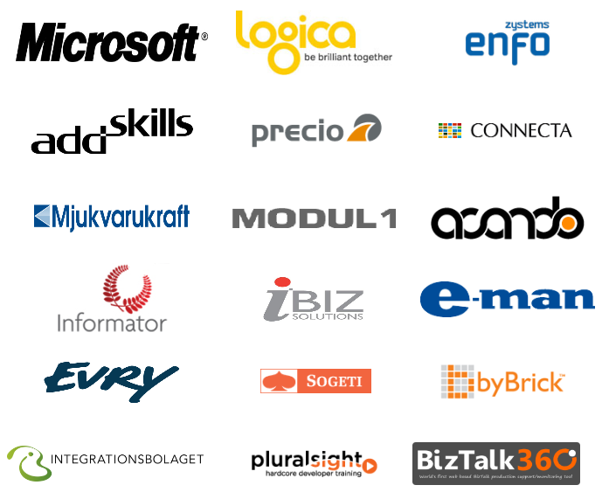
Våra sponsorer

Slide 2
Microsoft Integration Story
Mikael Håkansson - Enfo Zystems
MVP BizTalk
http://blogical.se/blogs/mikael
Twitter: @wmmihaa
Johan Hedberg- Enfo Zystems
MVP BizTalk
http://blogical.se/blogs/johan
Twitter: @JoHed
Notes:
Please use this slide as your first slide. It means a lot to start and end all presentation generic to give an event a strong identity. Thank you!

Slide 3
Kommande events…
24-26:e April
TechDays Örebro
8:e Maj
REST/OData/Entity Framework & BizTalk Certification Cram
23:e Maj
BizTalk - EDI & B2B
Sommar Kollo with Johan Hedberg
Helsingborg 26:e Juni, Stockholm 27:e Juli + 21:a Aug

Slide 4
Challenges
Enterprise Connectivity and Processing
Event Driven Architecture
Data flow and Data warehouse ETL
Master Data Management and Data Quality
High throughput and low latency
Cloud and inter-enterprise Connectivity
Data Access from a Unified User Interface
Burst scenarios & Sometimes connected clients/scenarios
Integration as a service
Notes:
2 min

Slide 5
Product and frameworks
Microsoft BizTalk Server 2010
Microsoft Stream Insight
SQL Server Integration Services
SQL Server Master Data Services
Windows Server AppFabric
Windows Azure Service Bus Relayed Messaging
SharePoint Business Connectivity Services
Windows Azure Service Bus Brokered Messaging
Windows Azure Service Bus EAI & EDI

Slide 6
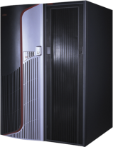
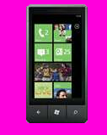
Evolving Integration Needs
2010 Cloud
2000 SOA
1990 Web
1980 Client-Server
1970 Mainframe

Slide 7
Enterprise Connectivity and Processing
Web Client
SQL
LOB

Slide 8
Microsoft BizTalk Server 2010
“Microsoft BizTalk Server is used to simplify and automate the exchange of information between publishers and subscribers, to orchestrate business processes and to supply insight into processes”
BizTalk
System
System

Slide 9
Evolution of BizTalk Server
BizTalk Server
2010
CONTINUOUS INNOVATION EVERY 2-3 YEARS
BizTalk Server
2009
BizTalk Server
2006 R2
Workflow Integration
ESB 2.1
SharePoint 2010 BCS
Data Mapper
TPM
Secure FTP
Updated Swift and HIPAA
SQL Server 2008 R2
Windows Server 2008 R2
HIS 2010
BizTalk Server
2006
ALM Support
B2B Enhancements
RFID Mobile
Adapter Pack 2.0
ESB 2.0 Toolkit
BAM+
Hyper-V Support
HIS 2009
BAHS 2.0
BizTalk Server
2004
SOA/ESB
EDI/AS2
RFID
WCF
Adapter Pack
Adapter SDK
HIS 2006
BAHS
BizTalk Server
2002
Simple configuration
Adapters in box
Runtime+
BAM+
BizTalk Server
2000
VS + .NET
Messaging + Orchestration
BRE
Routing
BAM
Scale-out
Deployment Tools
XSD
EAI (partner adapters)
Vertical B2B
Messaging
XML tools
XLang
500 Customers
2,000 Customers
4,000 Customers
7,000 Customers
8,500 Customers
10,500 Customers

Slide 10
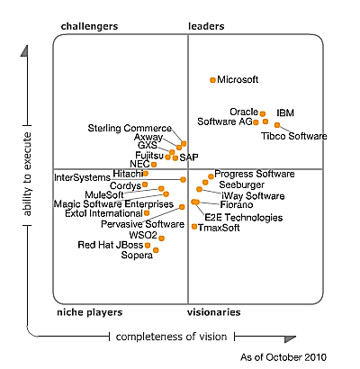
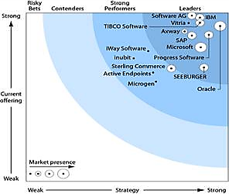
Recognized Industry Leadership
Gartner MQ for App Infrastructure for Systematic App Integration Oct 2010
Forrester Comprehensive Integration Wave Q4 2010
CRN 2010 Annual Report Card: Middleware Nov 2010
Gartner recognized Microsoft as one of the top Leaders in the integration market
Recognized for:
Brand recognition, global reach, mind share and install base
Availability of skills, services and add-ins that fit within the environment.
Value leader of all commercial offerings that Gartner analyzed
Forrester has recognized Microsoft as one of the top Leaders in the integration market
Recognized for:
Highest score on market presence of any vendor
Second highest score of any vendor for overall strategy
Top-level scores for integration server & app development support
Largest install base
Microsoft recognized as “the runaway winner”
Increased average scores in the Support category to 71.2 (from 62.6 in 2009) and in Partnership to 75.4 (from 70.7 last year); top scores across every Support and Partnership criteria
Recognized for tight Visual Studio integration enabling solution providers to perform custom development and integration

Slide 11
IWT
HIS
LOB
Throttling
SCOM Management
SSO
Adapters &
Adapter SDK
Business Rules
Engine
Enterprise Service Bus
Adapters &
Adapter SDK
Trading
Partner
Management
EDI/B2B
Process Engine
Pipeline
Pipeline
RFID
Business
Activity
Monitoring
Message
Transform
Accelerators
(SWIFT/HL7)
UDDI
Message
Transform
Pub/Sub Message Engine

Slide 12
BizTalk 2010 – Adapters
Core Adapters
FILE
FTP
SFTP
MQ
SOAP
MSMQ
SMTP
POP3
...etc
WCF Adapters
WCF-BasicHttp
WCF-WsHttp
WCF-NetTcp
WCF-NetNamedPipe
WCF-NetMsmq
WCF-Custom
LOB Adapters
SQL Server
Oracle DB
Oracle EBS
Siebel
SAP
Notes:
Johan pratar

Slide 13
BizTalk 2010 – Adapters
Core Adapters
FILE
FTP
SFTP
MQ
SOAP
MSMQ
SMTP
POP3
...etc
WCF Adapters
WCF-BasicHttp
WCF-WsHttp
WCF-NetTcp
WCF-NetNamedPipe
WCF-NetMsmq
WCF-Custom
Notes:
Johan pratar

Slide 14
Windows Communication Foundation (WCF)
Binding
public class MyService
{
public int Add(int x, int y)
{
return x + y;
}
public int Subtract(int x, int y)
{
return x - y;
}
}
Web Service
HTTP
SOAP
Operation Invoker
HTTP
NetTcp
MQ
etc
SOAP
Text
Binary
JSON
Transport
Encoding
?
Operation Invoker
Client

Slide 15
BizTalk 2010 – Line Of Business Adapters (LOB)
BizTalk
Client
NetTcpBinding
LOB Adapter
SqlBinding
Notes:
Johan pratar

Slide 16
BizTalk 2010 – Adapters
Line Of Business Adapters (LOB)
SQL Server
Oracle DB
Oracle eBusiness Suite
Siebel eBusiness Applications
SAP
sqlBinding
oracleBinding
oracleEbsBinding
siebelBinding
sapBinding
Works for any .Net application!
Just Bindings!
Notes:
Johan pratar

Slide 17
Enterprise Connectivity and Processing
Using Microsoft BizTalk Server 2010
Notes:
Skapa Quote WCF-SQL LOB adapter

Slide 18
Microsoft BizTalk Server 2010
Strengths:
Reliable messaging solution
High level of connectivity
Effective and proven message transformations
Workflow/Orchestration business process capabilities
Feature rich; RFID, EDI, BRE, BAM, LOB etc. etc.
Mature product

Slide 19
Future and evolution
Key Themes
Platform Support
Stay up-to-date with the latest platform.
Improved B2B
Industry standards support, performance improvements.
Ready for the Cloud
Start enjoying the benefits of the cloud.

Slide 20
Platform Support
New Platforms and Infrastructure
Windows Server 8
SQL Server 2012 (“Denali”)
Continued support for Windows Server 2008 R2, SQL Server 2008 R2
Increased Developer and IT Productivity
Visual Studio 11 and Windows 8 to develop solutions
In-place migration from BizTalk Server 2010
Extended Platform Integration
DB2 client connectivity to SQL Server, conversion of commands to T-SQL, migration of packages to stored procedures
Adapter connectivity to new data sources, including IBM Informix V11 and IBM IMS/DB V11
Improved B2B
Agile Response to Industry Standards
Regular updates to schemas, accelerators certifications and adapters. Highlights include:
Healthcare: HIPPA 5010 extensions: 2777CA, 999, HL7 2.5.1
Finance: SWIFT SRG 2011 support, SWIFT SRG 2012, SWIFTNet 7.0 (new messaging platform)
Improved Performance and Scalability
HL7 MLLP adapter performance improvements
Better performance with ordered send ports
Enhanced scale out configuration with multiple hosts
Expanded adapter options for faster batch processing
Ready for the Cloud
BizTalk Server on Windows Azure
Enable running BizTalk Server on a Windows Azure virtual machine
Enjoy the benefits of IaaS scale and elasticity
Leverage Windows Azure services, such as Service Bus
Extend on-premises solution to the cloud
Easily extend your on-premises BizTalk Server solution to the cloud in a secure manner
Tighter integration of on-premises BizTalk Server applications with Windows Azure Service Bus
Improved Licensing
Adjustments to licensing that are geared towards cloud hosting, including:
Purchase from a hoster on a monthly basis (SPLA)
Register your existing license with a hoster (License Mobility)

Slide 21
Timeline
5/2011 Cumulative Updates
+6 months
BizTalk Server 2010 R2
11/2010 BizTalk Server 2010
Windows Server 8
In addition, regular cumulative updates that include performance improvements, updates to schemas and accelerators and bug fixes will continue to be delivered on a quarterly basis as needed

Slide 22
Event Driven Architecture
Stock values
Stream Insight
BizTalk
News
SQL
?
LOB
Other
events

Slide 23
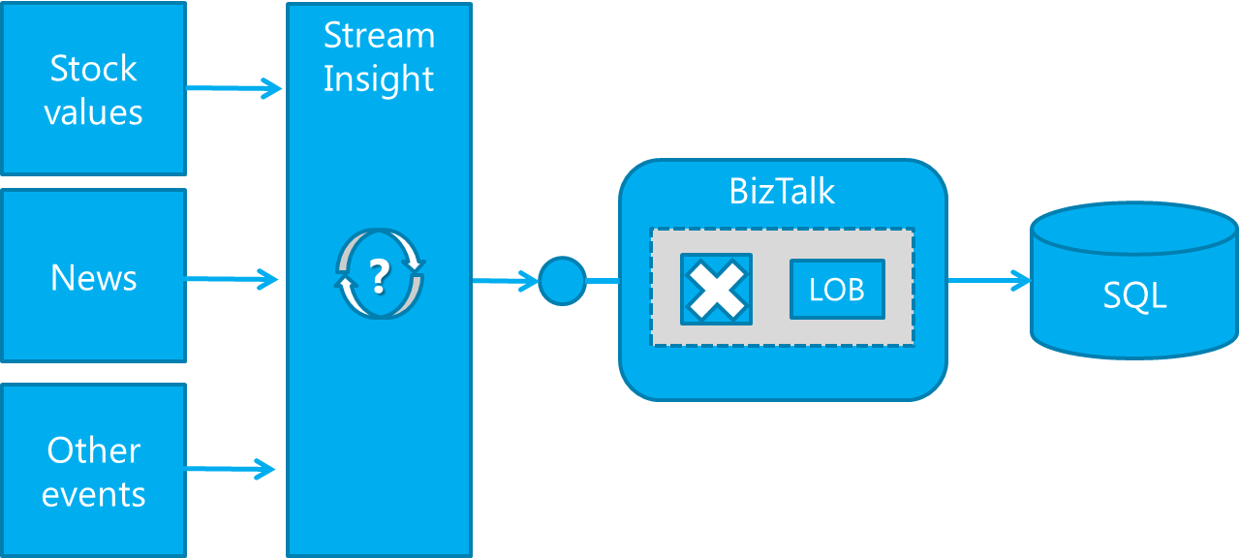
Microsoft StreamInsight
“Using StreamInsight, you can develop complex event processing (CEP) applications that derive business value from analyzing, filter and correlating raw data”

Slide 24
Event Driven Architecture
Using Microsoft StreamInsight

Slide 25
Microsoft StreamInsight
Strengths:
Monitor your data from multiple sources for meaningful patterns, trends, exceptions, and opportunities
Analyze and correlate data incrementally while the data is in-flight
Future & evolution:
Adoption of CEP is expecting to grow as organizations gets more dependent on volatile and momentary information.

Slide 26
Data flow and Data warehouse load
Source
SSIS
SQL

Slide 27
SQL Server Integration Services (SSIS)
“SSIS is an Extract, Transform, Load (ETL) framework that allows you to integrate different data sources using a workflow like designer and a set of tasks.”

Slide 28
SQL Server Integration Services (SSIS)
“SSIS is a scalable enterprise data integration platform with exceptional ETL and integration capabilities, enabling organizations to more easily manage data from a wide array of data sources”
Source
SSIS
SQL

Slide 29
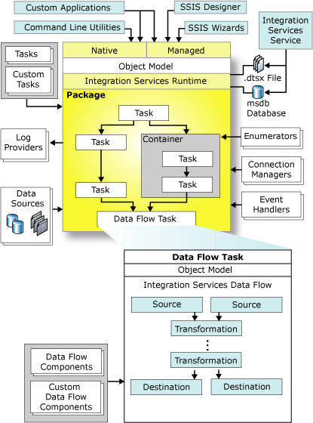
Notes:
http://msdn.microsoft.com/en-us/library/bb522498(v=sql.105).aspx
Of the components shown in the previous diagram, here are some important components to using Integration Services succesfully:
SSIS Designer
SSIS Designer is a graphical tool that you can use to create and maintain Integration Services packages. SSIS Designer is available in Business Intelligence Development Studio as part of an Integration Services project.
Runtime engine
The Integration Services runtime saves the layout of packages, runs packages, and provides support for logging, breakpoints, configuration, connections, and transactions.
Tasks and other executables
The Integration Services run-time executables are the package, containers, tasks, and event handlers that Integration Services includes. Run-time executables also include custom tasks that you develop.
Data Flow engine (also known as the pipeline) and Data Flow components
The Data Flow task encapsulates the data flow engine. The data flow engine provides the in-memory buffers that move data from source to destination, and calls the sources that extract data from files and relational databases. The data flow engine also manages the transformations that modify data, and the destinations that load data or make data available to other processes. Integration Services data flow components are the sources, transformations, and destinations that Integration Services includes. You can also include custom components in a data flow.
API or object model
The Integration Services object model includes managed application programming interfaces (API) for creating custom components for use in packages, or custom applications that create, load, run, and manage packages. Developer can write custom applications or custom tasks or transformations by using any common language runtime (CLR) compliant language.
Integration Services Service
The Integration Services service lets you use SQL Server Management Studio to monitor running Integration Services packages and to manage the storage of packages.
SQL Server Import and Export Wizard
The SQL Server Import and Export Wizard can copy data to and from any data source for which a managed .NET Framework data provider or a native OLE DB provider is available. This wizard also offers the simplest method to create an Integration Services package that copies data from a source to a destination.
Other tools, wizards, and command prompt utilities
Integration Services includes additional tools, wizards, and command prompt utilities for running and managing Integration Services packages.

Slide 30
Data flow and Data warehouse load
Using SQL Server Integration Services (SSIS)

Slide 31
SQL Server Integration Services (SSIS)
Strengths:
Populating data warehouse
Clean, standardize and improve data
Merge data from different sources
Automating administrative data tasks
Future & evolution:
Lots of updates and improvements in SQL Server 2012
CDC, DQS tasks, ODBC support, UI improvements, Flat File handling improvements, powershell management improvements, troubleshooting and logging, data taps, performance and more.
Remains the premier ETL tool for data warehouse loading

Slide 32
Master Data
Products
Customers
People
Things
Places
Abstracts
…
MDS
Notes:
People (Customer, Vendor etc.)
Things (Products, Parts, Documents etc.)
Places (Stores, Oil Wells, Departments etc.)
Abstract (Contracts, Warantiees etc.)
Master data
Giving names to something
Key Nouns of the business
a Product, a Customer and so on
Master vs Meta data
There is alot of meta data in master data
Meta data is data about data
data types
data meaning
Master data
What is my product catalog
What is this product we call HP 8540w
There is metadata around it
Master data is the instance of data
Metadata are the properties around it
Date warehousing is about having one truth for reporting
MAster data is about managing the change of the nouns in your business across different (system) boundaries
People (Customer, Vendor etc.)
Things (Products, Parts, Documents etc.)
Places (Stores, Oil Wells, Departments etc.)
Abstract (Contracts, Warantiees etc.)
Master Data Managemet
Giving an authoritive view of the business
This requires supplying a way to
Creating the view
Managing the view
Managing the software and the process
In many ways MDM is not primarily a software issue
Most (80%) is about processes and peoples
Microsoft has been extending what its data platform is
The more you extend it the more you need master data management
MDM part of SQL Server 2008 R2
Master data management is built on the concept of not integrating with the applications. but integrating with their data
Fundamental to MDM
Almost anyone can export data to SQL and almost anyone can import data from SQL
SAP to Siebel for example
Do you need a technology that can connect to directly to SAP and Siebel?
In that case you need a technology that can bridge almost any system out there.
How do you make changes to Customer in SAP and make them appear in Siebel
Customer is exported to staging area by SAP, MDM does its thing transforming the data, and Siebel can pick it up
Master data management is about managing input staging areas and output staging areas, and in between the MDM architecture
Change notifications
Workflows that are triggered when data changes
Worflow example, if you cannot update customer in Siebel when its updated in SAP, perhaps you should suspend the customer in both systems so we don't sell stuff to someone we cannot deliver it to
WCF and WCF are used
MDM has an API that LOB or Custom apps can integrate with, through WCF interfaces
En model består av olika entiteter och hierarkier
Simple Business Rules
If
Then
Validation Rules on the data
(Sharepoint integration
Exporting models to sharepoint lists)
Master data is a methodology
Software isn't the most important
Designing and defining your model is a large part
The tooling and developing is just one small part of it
stabilizing and evaluating is also important
The process is the hardest part to affect and change

Slide 33
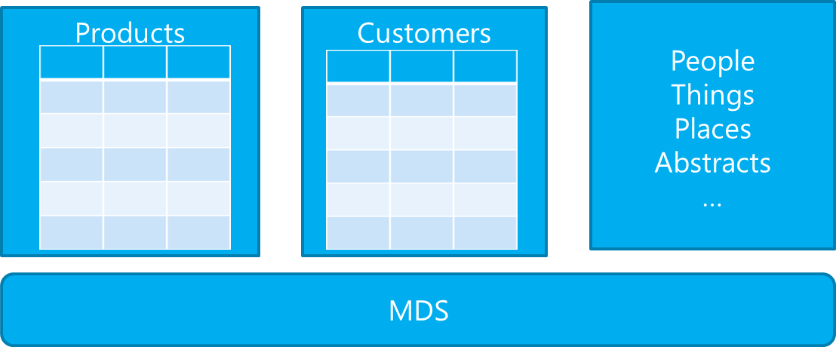
SQL Master Data Services
“Master Data Services (MDS) is the SQL Server solution for master data management (MDM); the efforts made by an organization to discover and define non-transactional lists of data, with the goal of compiling maintainable master lists”

Slide 34
SQL Master Data Services (MDS)
Strengths:
Defining data models and entities
Collecting , storing and maintaining master data
Improving data quality
Distributing Master Data
Notes:
http://social.technet.microsoft.com/wiki/contents/articles/5648.whats-new-in-master-data-services-mds-in-sql-server-2012.aspx
Read also DQS (in SQL Server 2012):
http://msdn.microsoft.com/en-us/library/ff877925.aspx

Slide 35
MDS Future and evolution
Building the foundation
V1 product
Empowering IW through Excel Add-in and improved Web UI (Silverlight)
Enhanced performance and scalability
Improved quality (usability, robustness, security)
A Service
Enhance curation
Enhanced collaboration and sharing
Improved data quality (DQS)
Further empowering business users through simplified, advanced modeling capabilities
Better productivity
Improved productivity through external IP (data types and models)
Sharing and reuse
Post SQL2012
SQL2012
SQL 2008R2

Slide 36
High throughput and low latency
Web Client
SQL
LOB

Slide 37
Windows Server AppFabric
“Microsoft AppFabric for Windows Server is a set of integrated technologies that makes it easier to build, scale, and manage Web and composite applications that run on IIS”

Slide 38
High throughput and low latency
Using Windows Server AppFabric

Slide 39
Windows Server AppFabric
Strengths:
Offers hosting capabilities for Windows Workflow Foundation workflows.
Monitoring capabilities for workflows and services
Caching capabilities to off-load storage and services
With the option of not persist any data, Windows Server AppFabric offers in-memory processing .
Future & evolution:
Windows Server AppFabric is likely to undergo a large remake, as capabilities from Azure Service Bus will become available on-prem.

Slide 40
Cloud and inter-enterprise Connectivity
Queue
Relay
Client
Client
LOB

Slide 41
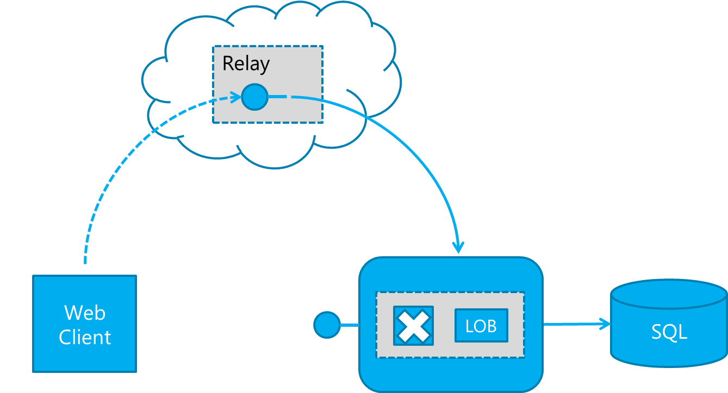
Cloud and inter-enterprise Connectivity

Slide 42
The story of ”AppFabric”
”Dublin”
”Velocity”
”Oslo”
”M” & ”Quadrant”
Service Bus
”BizTalk Services”
2007
2008
2009
2010
2011
2012

Slide 43
Service Bus Relayed Messaging
“Organizations can use the Service Bus Relay to extend the reach of their on-prem services, to the outside world, in a secure and reliable way.”

Slide 44
Service Bus Relayed Messaging
Client
WebHttpBinding
WCF Service
WebHttpRelayBinding
Notes:
Mikael pratar

Slide 45
Cloud and inter-enterprise Connectivity
Windows Azure Service Bus Relayed Messaging

Slide 46
Service Bus Relayed Messaging
Scenario #2 – Exposing BizTalk services to the cloud
RelayBinding
BizTalk
Client
Notes:
Mikael pratar

Slide 47
Cloud and inter-enterprise Connectivity
Exposing BizTalk services to the cloud as relay services

Slide 48
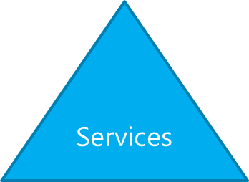
Unified UI and SharePoint Integration
User Interface
Data
Components
Etc

Slide 49
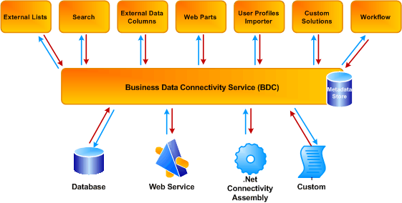
Business Connectivity Services
“Microsoft Business Connectivity Services (BCS) is designed to enable easy interaction with external systems from within SharePoint”
Notes:
http://msdn.microsoft.com/en-us/library/ee557646.aspx
SharePoint is a system which facilitates Human Interaction, not system interaction
Connectivity services is in the product to help connect SharePoint to other systems, but is not a robust integration solution
SharePoint BCS good for simple connectivity, but it is not an enterprise service bus or middleware server.

Slide 50
Using Just SharePoint & BCS
SharePoint
LOB A
LOB B
LOB C
LOB D
LOB E
LOB F
Notes:
Talk about how this is deceptively easy at first glance
Usually it is assumed that Web Services are going to be used
Usually it is assumed that this will be point to point
Usually assume the services match the business needs
Don’t think about what ifs
What if an interface changes
What if an interface moves
What if an LOB system is swapped out for a different one
What if we can’t connect via web services
What if we have security requirements not easily supported by BCS
And on and on…

Slide 51
SharePoint + BizTalk options
BizTalk WSS Adapter
Sharepoints Web Services
Limitations of WSS Adapter – Document Library centric
You have options:
ASMX Web Services
WCF REST Services
Ideal when manipulating Lists
Business Connectivity Services (BCS)

Slide 52
Using SharePoint & BizTalk
SharePoint
BizTalk Server
LOB A
LOB B
LOB C
LOB D
LOB E
LOB F
Notes:
When leveraging BizTalk
You can create aggregated services which expose business services not granular services. So instead of add customer info, add customer address, add customer products, etc. You would have one add Customer Service.
This insulates you from backend system changes allowing the LOB systems to version, change, etc. while greatly reducing the downstream impact of those changes.
This provides adaptability so developers, whether on the LOB system side or the SharePoint side, don’t have to code and web service API if one isn’t provided.

Slide 53
Unified UI and SharePoint Integration
Using SharePoint Business Connectivity Services

Slide 54
Business Connectivity Services
Strengths:
Integration of external data into SharePoint
With BizTalk, easily expose and edit data from any LOB system in SharePoint
Integration of SharePoint Online (Office 365) with on-premise data sources

Slide 55
Cloud and inter-enterprise Connectivity
Queue
Client
SQL
LOB

Slide 56
Azure Service Bus – Queues & Topics
“Service Bus Queues offer a reliable, highly scalable way to store messages as they travel between systems without losing messages in the event of connectivity failure.”
Queue

Slide 57
Service Bus Brokered Messaging - Queues
Exposing BizTalk services to the cloud as Queues
BizTalk
Client
Notes:
Mikael pratar

Slide 58
Cloud and inter-enterprise Connectivity
Exposing BizTalk services to the cloud as Queues

Slide 59
Sometimes connected clients
Queue
System
Client

Slide 60
Sometimes connected clients
Sending data to Queues

Slide 61
Windows Azure Service Bus – Relayed and Brokered messaging
Strengths:
Secure firewall traversal for inter-enterprise connectivity
Interoperability across platforms
Highly scalable pay-per-use messaging as a service
No investment, easy to start, low threshold , easily accessible
Future & evolution:
Service Bus will continue to receive quarterly updates
More on EAI and EDI later in this presentation

Slide 62
Comparing features Service Bus Queues and Message Buffers
Queues | MessageBuffer
FIFO | FIFO
Durable, built on top of SQL Azure | In memory
Unlimited TTL | Max 10 minutes
Topics/Subscriptions | n/a
Large Messages through sessions | 64kb

Slide 63
Comparing features Service Bus Queues and Storage Queues
Queues | Azure Storage
FIFO | Best attempt, not guaranteed
Durable, built on top of SQL Azure | Durable, built on Azure Tables
Unlimited TTL | Max 7 days
TryReceive wait with timeout etc | Polling
Topics/Subscriptions | n/a
WCF/REST/APIs | REST/APIs
PeekLock/ReceiveDelete | PeekLock
Large Messages through sessions | 8kb
Secured using ACS | Secured using Azure Credentials
Server and client side transactions | n/a

Slide 64
Integration as a service
Bridge
LOB
Client
SQL
Notes:
46-47

Slide 65
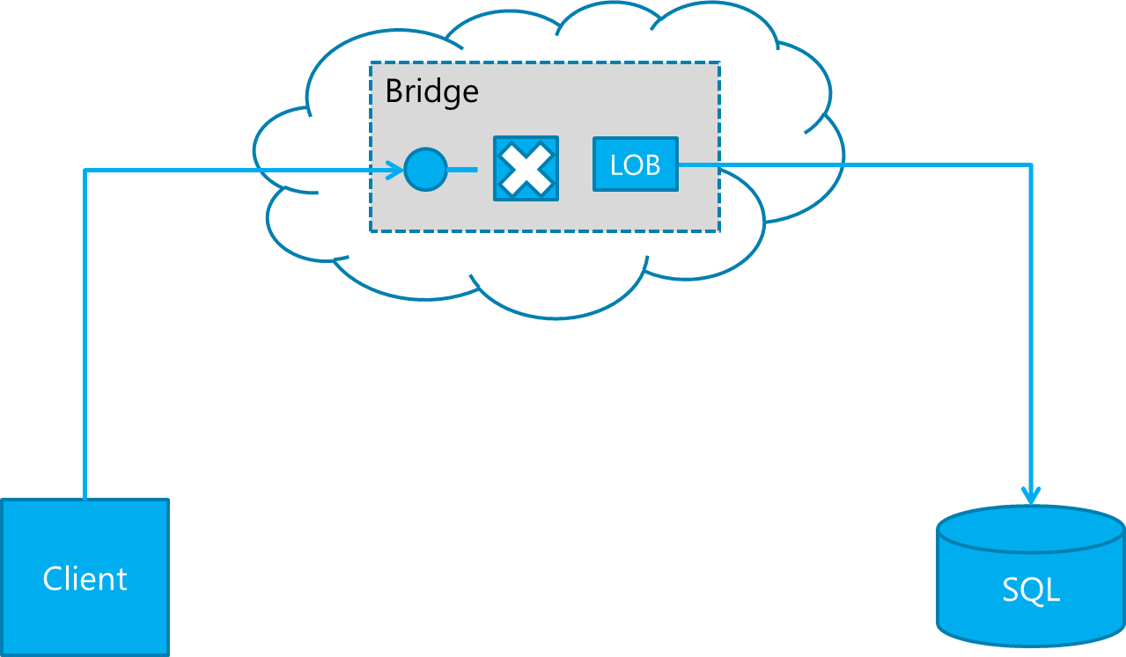
Windows Azure Service Bus EAI
“Windows Azure Service Bus EAI Labs provides common integration capabilities for the Windows Azure Platform to extend on-premises applications to the cloud”
Notes:
47-48

Slide 66
Azure Service Bus – Enterprise Application Integration (EAI)
Bridge
Bridge
customerType == “VIP”
LOB Target
BizTalk
IIS
Client
customerType == “Default”
SapBinding
RelayBinding
Notes:
Johan pratar
Det är bara en binding
Manegerat sätt att exponera en LOB operation/endpoint via ServiceBus – Windows Azure ServiceBus Connect
Visa Visual Studio och Server Explorer – Service Bus Connect Servers
Ta upp IIS och visa services, ManagementService, under en speciell site ligger SBConnect
Varje relay motsvarar en IIS applikation
Varje LOB target motsvarar en relay endpoint (address)
Dialogen är samma som BizTalk, konfigurera bindingen, samma binding som BizTalk
Konfigurera SAP, BAPI och RFC synkron/req-resp.
Det finns en massa. Vi ska hämta information om anställda. Så Vi ska gå till Human Resource och Employee Get Data
Vi skapar de schemas som behövs för kommunikationen med SAP
Sista steget är att konfigurera var någonstans vi ska exponera detta; vilken ServiceBus adress
Vi visar internet explorer och labbmiljön
Skapar en ny relay, Visa IIS och att det skapats en IIS applikation
En relay motsvarar det del av ServiceBus namespacet som kommer att användas av de target som delar samma relay
Skapa target som är ett godtyckligt namn som utgör den sista delen i en servicebus adress
Kör vidare presentation
Öppna SAP_Demo Solution
Solutionen innehåller ett antal förskapade artifakter för exponering av vår bridge, de externa formaten
Det först vi ska göra är att skapa upp SAP schemana
Vi behöver ange credentials, sen genereras det åt oss
Vi öppnar och kollar på schemana – där är det tydligt att dessa scheman inte är lämpliga webservice interface
Visa schemas vi vill exponera, de förskapade
Visa mappningarna, prata om mappern och att detta grundar sig på samma mapper designer som BizTalk, men innehåller annan funktionalitet
Ett begränsat antal functoider, fler kommer sannolikt att komma
Dock finns och planeras inte för någon scripting functoid
Betalningsmodell transfer men inte compute
Öppna Bridge konfiguration
Vi kan välja antingen att skapa en one-way eller two-way bridge
Vi skapar two way
Prata om innehållet I en bridge. VTR
Vi ska välja vilka scheman som ska användas, hur vårt kontraktser ut
Lägg till transformeringar
Om man vill skulle man kunna göra Enrich – enrich betyder att lyfta upp det context för att tillgängliggöra det för t ex routing
Tillbaka I designern, lägg ut en SAP LOB, koppla ihop dem
SAP LOB är en SOAP endpoint, för att veta vilken operation som vi ska använda kan vi kolla vår LOB target
Vi behöver sedan konfigurera connection med den operationen, en Route Action
Och ett Filter condition, 1 == 1, eller så skulle vi kunna filtrera på saker som har gjorts enrich på
Den sista konfigurationen är att tala om vilken bakomliggande endpoint som vår SAP LOB ska ansluta mot, vilket är den relativa adressen till den LOB target vi skapat
Gå till projeket och visa Deploy, men vi gör det inte…. Det är redan deployat
Kör demot
-- Demo

Slide 67
Integration as a service
Using Windows Azure Service Bus EAI
Notes:
48-58

Slide 68
Windows Azure Service Bus EAI
Strengths:
Elastic pay-as-you-go model
Highly scaleable
Builds on top of Service Bus
Future & evolution:
Notes:
58-60

Slide 69
Windows Azure Connect
Worker Role
Worker Role
Web Role
Instance
Instance
Instance
DevMachine
DevMachine
Server

Slide 70
Comparing features ServiceBus and Azure Connect
ServiceBus | Azure Connect
Messaging, Pub/Sub, Filters | n/a
Pipelines, Adapter, Maps | n/a
Orchestrations, etc. | n/a
n/a | IPSec connectivity
n/a | Domain join with Azure role instances
Connectivity through messaging | Connectivity on network level

Slide 71
Azure Service Bus – Cost model
€ 0,00672 / 10 000 Messages
€ 7,5 / 10 000 Relay hours
# Messages
# Relay hours
*
64Kb Message size
*
Message size
€ 0,0672
+ € 0,54
100 000 msgs
720 Relay hours
1Mb/64Kb = 16
Total
100 000 1Mb messages =
= € 0,60
* 16
= € 9,6
* Service Bus Relay is currently free. These prices starts from 31st of May

Slide 72
Azure Service Bus – EDI
Integration as a service
Bridge
EDI
TPM
AS2
BAM
EDIFACT
X12
FTP
10.000+ EDI schemas
Notes:
Johan pratar
Det är bara en binding
Manegerat sätt att exponera en LOB operation/endpoint via ServiceBus – Windows Azure ServiceBus Connect
Visa Visual Studio och Server Explorer – Service Bus Connect Servers
Ta upp IIS och visa services, ManagementService, under en speciell site ligger SBConnect
Varje relay motsvarar en IIS applikation
Varje LOB target motsvarar en relay endpoint (address)
Dialogen är samma som BizTalk, konfigurera bindingen, samma binding som BizTalk
Konfigurera SAP, BAPI och RFC synkron/req-resp.
Det finns en massa. Vi ska hämta information om anställda. Så Vi ska gå till Human Resource och Employee Get Data
Vi skapar de schemas som behövs för kommunikationen med SAP
Sista steget är att konfigurera var någonstans vi ska exponera detta; vilken ServiceBus adress
Vi visar internet explorer och labbmiljön
Skapar en ny relay, Visa IIS och att det skapats en IIS applikation
En relay motsvarar det del av ServiceBus namespacet som kommer att användas av de target som delar samma relay
Skapa target som är ett godtyckligt namn som utgör den sista delen i en servicebus adress
Kör vidare presentation
Öppna SAP_Demo Solution
Solutionen innehåller ett antal förskapade artifakter för exponering av vår bridge, de externa formaten
Det först vi ska göra är att skapa upp SAP schemana
Vi behöver ange credentials, sen genereras det åt oss
Vi öppnar och kollar på schemana – där är det tydligt att dessa scheman inte är lämpliga webservice interface
Visa schemas vi vill exponera, de förskapade
Visa mappningarna, prata om mappern och att detta grundar sig på samma mapper designer som BizTalk, men innehåller annan funktionalitet
Ett begränsat antal functoider, fler kommer sannolikt att komma
Dock finns och planeras inte för någon scripting functoid
Betalningsmodell transfer men inte compute
Öppna Bridge konfiguration
Vi kan välja antingen att skapa en one-way eller two-way bridge
Vi skapar two way
Prata om innehållet I en bridge. VTR
Vi ska välja vilka scheman som ska användas, hur vårt kontraktser ut
Lägg till transformeringar
Om man vill skulle man kunna göra Enrich – enrich betyder att lyfta upp det context för att tillgängliggöra det för t ex routing
Tillbaka I designern, lägg ut en SAP LOB, koppla ihop dem
SAP LOB är en SOAP endpoint, för att veta vilken operation som vi ska använda kan vi kolla vår LOB target
Vi behöver sedan konfigurera connection med den operationen, en Route Action
Och ett Filter condition, 1 == 1, eller så skulle vi kunna filtrera på saker som har gjorts enrich på
Den sista konfigurationen är att tala om vilken bakomliggande endpoint som vår SAP LOB ska ansluta mot, vilket är den relativa adressen till den LOB target vi skapat
Gå till projeket och visa Deploy, men vi gör det inte…. Det är redan deployat
Kör demot
-- Demo

Slide 73
Upcomming Events:
19th April - Microsoft Integration Story
25-26 April – TechDays - Microsoft Integration Story & more
8th May - REST/OData/Entity Framework & BizTalk Certification
23rd May - BizTalk - EDI & B2B
Sommarkollo
Helsingborg 26th June, Stockholm 27th July + 21st Aug
Thank You
Johan Hedberg
johan.hedberg@enfo.se
http://blogical.se/blogs/johan
@JoHed
Mikael Håkansson
mikael.hakansson@enfo.se
http://blogical.se/blogs/mikael
@wmmihaa

