Slide 1
Administering SQL Server 2012 Jump Start
George Squillace | Senior Technical Trainer – New Horizons Great Lakes
Richard Currey | Senior Technical Trainer – New Horizons United

Slide 2
Meet George SQUILLACE
Senior Technical Trainer–New Horizons Great Lakes (20 Years)
“SQL” is in his name!
Focused on database technologies
MCT Since 1997
28 Years Industry Experience
SQL Server 2012: certified as MCSA, MCSE: Data Platform, and MSCE: Business Intelligence
Certified in every version of SQL Server since SQL 2000
Certified in every version of Windows Server from NT 4.0 through Windows Server 2008
Certified in Exchange Server 5.5 through Exchange Server 2007

Slide 3
Meet Richard Currey
Senior Technical Trainer – New Horizons United
Focused on database and development technologies
MCDBA, MCITP Dev / Admin / BI, MCSE Data Platform, BI
MCSD, MCPD Web Developer, ASP .NET Developer, Windows Developer
28 Years Industry Experience
Designed, developed and managed BI-centric projects at several Fortune 500 organizations
Extensive consulting and Project Management background

Slide 4
Course Topics
Administering SQL Server 2012 Jump Start
01 | Install and Configure SQL Server | 04 | Manage Data
02 | Maintain Instances and Databases | 05 | Implement Security
03 | Performance Optimization and Troubleshooting | 06 | High Availability Options

Slide 5
Setting Expectations
Target Audience
Database professionals new to Microsoft SQL Server
“Accidental DBAs” and new database professionals
Database professionals who want to take exam 70-462 to get certified in administering Microsoft SQL Server 2012 databases
Suggested Prerequisites/Supporting Material
Basic familiarity with Microsoft SQL Server and relational databases
Windows Server user interface and administration experience
Course 10775, Administering Microsoft SQL Server 2012 Databases
MS Press Book: Training Kit (Exam 70-462): Administering Microsoft SQL Server 2012 Databases

Slide 6
Join the MVA Community!
Microsoft Virtual Academy
Free online learning tailored for IT Pros and Developers
Over 1.3M registered users
Up-to-date, relevant training on variety of Microsoft products
“Earn While You Learn!”
Get 50 MVA points for this event!
Visit http://aka.ms/MVA-Voucher
Enter this code: AdminSQL (expires 11/18/2013)

Slide 7
01 | Install and Configure SQL Server
George Squillace | Senior Technical Trainer – New Horizons Great Lakes
Richard Currey | Senior Technical Trainer – New Horizons United

Slide 8
Module 1 Overview
Installation Decisions
Design the Storage for New Databases
Plan for Growth and Capacity
Service Account Configuration

Slide 9
Topic: Installation Decisions

Slide 10
Topic: Installation Decisions
Determine the Appropriate Hardware
Select the Appropriate Windows Operating System Edition
Select the Appropriate Edition of SQL Server
Determine if a Separate Instance Is Required
Select the Appropriate Collation

Slide 11
Determine the Appropriate Hardware
To virtualize or not to virtualize?
CPU sockets and cores
Memory
Memory support is a function of the Windows operating system or the chosen edition
DAS versus SAN
Consider solid state storage
Free, unsupported tools are available to help test I/O workloads:
SQLIO “disk subsystem benchmark tool”
SQLIOSIM

Slide 12
Select the Appropriate Windows Operating System Edition
Specific editions of SQL Server are supported on specific versions and editions of Windows Client and Windows Server
One way or another, the following operating systems are supported:
Windows Server 2012
Windows Server 2008 R2 and Windows Server 2008 SP2
Windows Vista, Windows 7, and Windows 8
SQL Server 2012 is supported on Windows Server 2012 core and Windows Server 2008 R2 core
No need to memorize all the combinations for the certification exam

Slide 13
Select the Appropriate Edition of SQL Server 2012
Editions to choose from are:
Principal Editions
Enterprise
Business Intelligence
Standard
Evaluation
Specialized Edition(s)
Web
Breadth Editions
Express
Developer

Slide 14
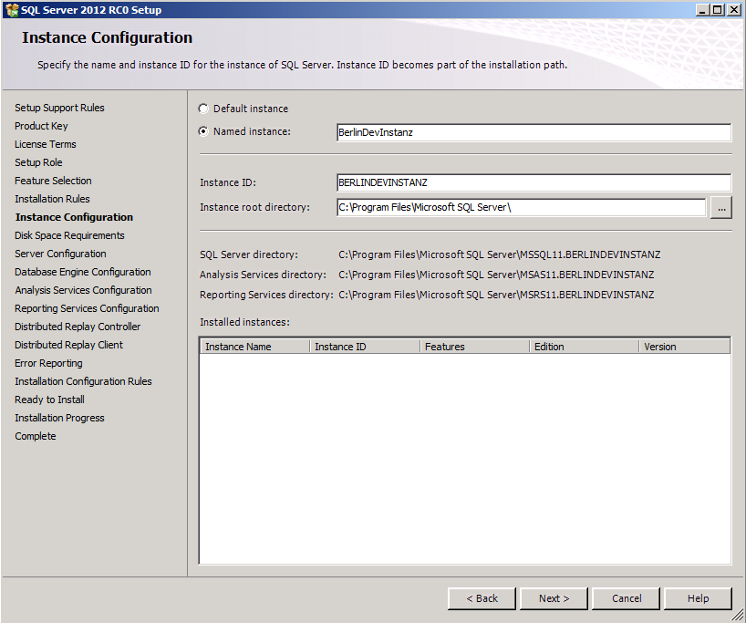
Determine if a Separate Instance Is Required
Each instance will have its own set of services and service settings
Separate administration requirements
Separate instance-level configuration settings
Separate SLAs
Support for separate collations
Support for multiple versions of SQL Server
Know which features can be installed as instances

Slide 15
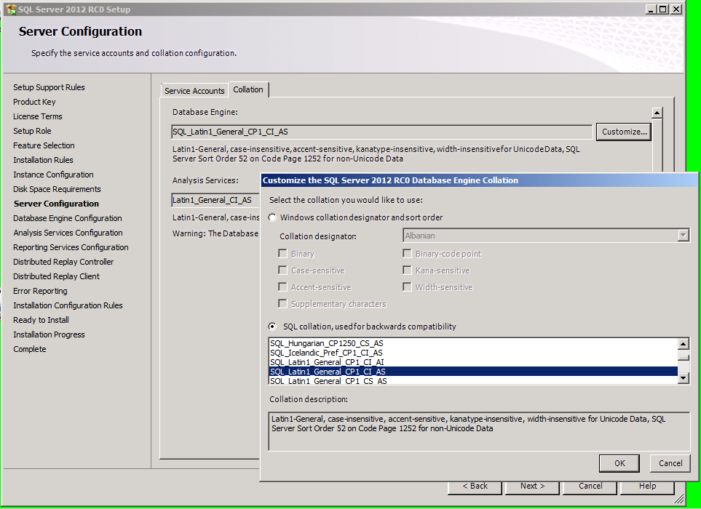
Select the Appropriate Collation
What is a collation?
What is the impact of collation choice during installation?
Where can collation be specified?

Slide 16
Specifying Collation at the Instance, Database, Column and Query Levels

Slide 17
Topic: Design the Storage for New Databases

Slide 18
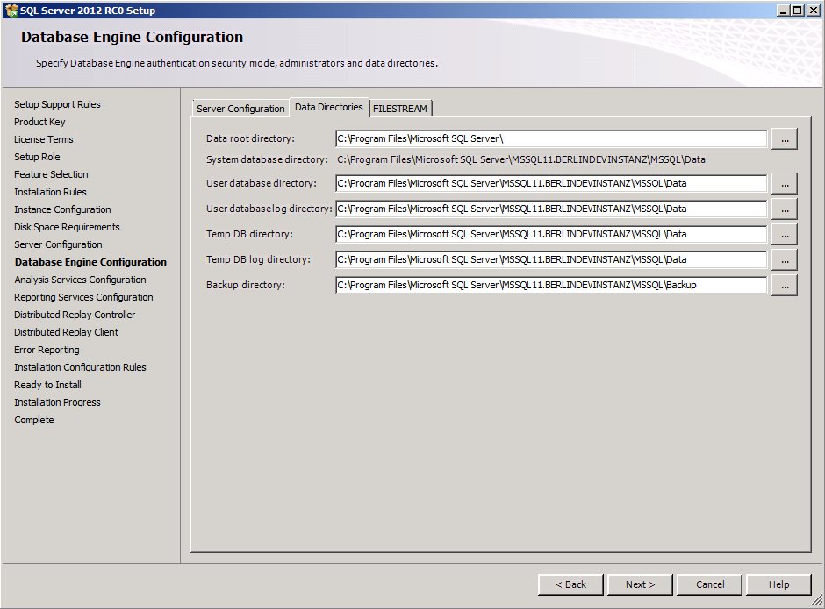
Topic: Design the Storage for New Databases
Drive Layout: Design Windows File System for Expected I/O Patterns
Consider Multiple Filegroup and Multiple Data File Designs
Table Partitioning Design

Slide 19
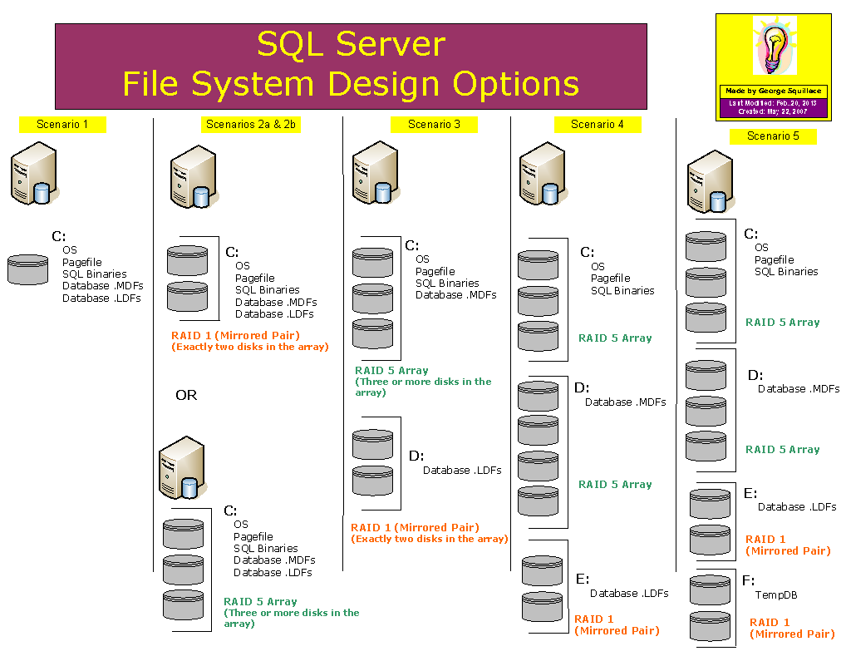
Drive Layout: Design Windows File System for Expected I/O Patterns
Separate I/O activity on systems with heavy workloads:
OS vs. data file(s) vs. log file
Consider separating TempDB workload
Consider adding multiple data files to TempDB
Use appropriate RAID levels and parity when appropriate
Consider adding multiple data files to TempDB for large workloads

Slide 20
Consider Multiple Filegroup and Multiple Data File Designs
Use this advanced design technique for two reasons:
Performance
More read/write heads involved in reading and writing
Maintenance
Smaller units of data backed up/restored, indexes reorganized/rebuilt

Slide 21
Table Partitioning Design
Table partitioning spreads the data of a single table over multiple filegroups
Purpose
Use more read/write heads to separate I/O activity over separate partitions
Efficiently load new data into a (large) table
Perform index maintenance on a partition by partition basis
Concept of index “alignment”
References
Designing Partitions to Manage Subsets of Data
SlidingWindow example

Slide 22
Creating a Database with an Advanced Design

Slide 23
Topic: Plan for Growth and Capacity

Slide 24
Topic: Plan for Growth and Capacity
Two DBA Cardinal Sins
Manual File Growth
File Autogrow Options
Growth Monitoring
Shrinking Databases and Files

Slide 25
Two DBA Cardinal Sins
Running out of space in a SQL Server data or log file
Allowing a data or log file to fill up a volume when autogrow is used

Slide 26
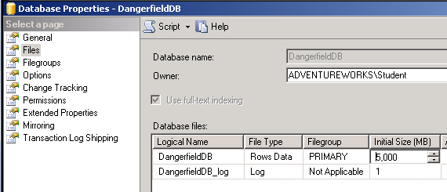
Manual File Growth
Why manual?
Timing and control
Methods
GUI
Code

Slide 27
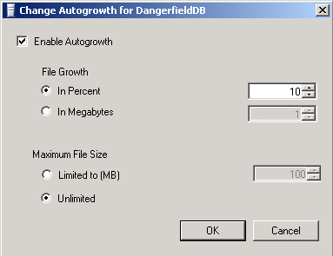
File Autogrow Options
Why autogrow?
Percent vs. fixed size
Should “maximum file size” be set?
Methods
GUI
Code

Slide 28
Growth Monitoring
If/when to shrink or grow
Monitoring tools and techniques
Code in agent jobs
Performance object alert
Management Data Warehouse
Catalogs and DMVs
sys.database_files
sys.dm_os_volume_stats
Stored procedures
sp_SpaceUsed
sp_Databases
DBCC SQLPerf (logspace)

Slide 29
Shrinking Databases and Files
Databases (all files) can be shrunk
Individual data and log files can be shrunk
Autoshrink can be set as a database option
Just say “No”
Turned off by default
Manual shrinking only relevant in one context

Slide 30
Growing File Size Manually Using the GUI and Code

Slide 31
Topic: Service Account Configuration

Slide 32
Topic: Service Account Configuration
Account Selection During Installation
Changing Account Choices After Installation
Which tool? Why that tool?
On What Basis Do I Select Accounts to Run Services?

Slide 33
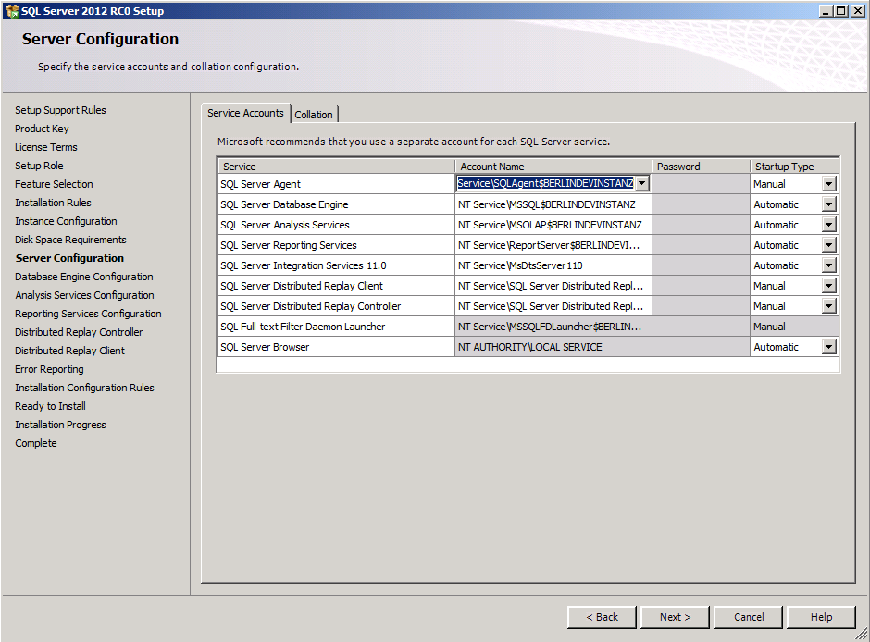
Account Selection During Installation
Builtin Account
Local Service
Network Service
Local System
Created Account
Machine Local
Domain
General rule: create a separate account for each service, for each instance…really!

Slide 34
Changing Account Choices After Installation
Use SQL Server Configuration Manager
Don’t use the Services management console in Windows

Slide 35
On What Basis Do I Select Accounts to Run Services?
Database engine can use a low-privileged account
Browser and Full-Text Services shouldn’t require a domain account either
SQL Server Agent may need access to:
Mailbox
UNC shares and file systems
Other SQL Servers
Reference: Configure Windows Service Accounts and Permissions

Slide 36
Changing Service Account Assignment

