Slide 1
Tools for Teaching Security+
Mark Ciampa
Western Kentucky University

Slide 2
Teaching & Presentation Philosophy
Broad vs. Deep

Slide 3
Teaching Security+
CompTIA Security+ is more broad than deep
No single domain or topic is significantly in depth
When teaching Security+ very important to keep moving
Going too deep in a topic means you won’t be able to cover the material

Slide 4
Presentation Security+ Tools
This presentation of Tools for Teaching Security+ is more broad than deep
Will not go into deep dive on any single tool
Going too deep in a tool means we won’t be able to cover the material
Some tools will be demonstrated while others will be introduced
None of these in Security+ Guide to Network Security Fundamentals 5e Hands-On Projects
Presented where fall in current chapter

Slide 5
Chapter 1
Introduction to Security
Tools for Teaching Security+

Slide 6
Chapter 1 Projects Security+ Guide 5e
Project 1-1: Examine Data Breaches (The Privacy Rights Clearinghouse)
Project 1-2: Scan for Malware Using the Microsoft Safety Scanner
Project 1-3: Create a Virtual Machine of Windows 8.1 for Security Testing—Part 1
Project 1-4: Create a Virtual Machine of Windows 8.1 for Security Testing—Part 2 (VirtualBox)

Slide 7
Your Privacy
Google Location History
Immersion

Slide 8
Real Time Attack Trackers
FireEye Cyber Threat Map
Norse IPViking
Arbor Networks Digital Attack Map
Kaspersky Cyberthreat Real-time Map
Anubis Network Cyberfeed
F-Secure World Map
Trend Micro Global Botnet Threat Activity Map
Team Cymru Graphs
OpenDNS Global Network
Madiant IPew Attack
Alien Vault Global Dashboard

Slide 9
Create & Run VM from USB Flash Drive
Fork of VirtualBox called Portable VirtualBox
Run VM from USB flash drive as application running under Windows (like a virtualized version Windows 8 Enterprise Windows to Go option)
Caveats
  Requires administrator privileges to run
  Consumes hard drive space, RAM (can adjust), processing power
  Need licensed copy of OS
  Format USB drive as an NTFS file system (FAT32 on some USB drives have file size limit to 4GB)

Slide 10
Create & Run VM from USB Flash Drive
Download Portable VirtualBox (http://www.vbox.me/)
Extract and launch Portable-VirtualBox.exe
Click Download installation files of VirtualBox
Click Extract files box for 32-bit or 64-bit operating systems
Check Start Portable-VirtualBox after the extract and/or compress
IMPORTANT: Click OK button in bottom left corner (NOT Exit button)

Slide 11
Create & Run VM from USB Flash Drive
Launch Portable-VirtualBox.exe to enter VirtualBox
Network and USB support are disabled by default
Can create VM of Windows, Linux Mint (http://www.linuxmint.com/), Android (https://code.google.com/p/android-x86/downloads/list)
Can also be used in Chapter 10 Mobile Device Security

Slide 12
Chapter 2
Malware & Social Engineering Attacks
Tools for Teaching Security+

Slide 13
Chapter 2 Projects Security+ Guide 5e
Project 2-1: Write-Protecting and Disabling a USB Flash Drive (Thumbscrew)
Project 2-2: Scan for Rootkits Using a Basic Tool (TDSSKiller)
Project 2-3: Scan for Rootkits Using an Advanced Tool (GMER)
Project 2-4: Use a Software Keylogger (Spyrix)

Slide 14
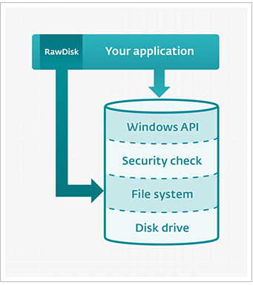

Slide 15
RawDisk
“RawDisk library offers software developers direct access to files, disks and partitions of the disks (hard drives, flash disks etc.) for user-mode applications, bypassing security limitations of Windows operating systems”
Direct access to disks and protected files from user-mode applications in Windows 8/7/Vista/XP
Can read/write disks sector by sector without operating-system-imposed restrictions
“Comes in handy for development of data recovery, undelete and forensic applications”
https://www.eldos.com/rawdisk/

Slide 16
Microsoft Attack Surface Analyzer
“Understand how the attack surface of Windows systems change as a result of installing software”
Can take snap shot of multiple security related information elements on a system, then after the system changes can take another snap shot;
Compares the before and after snap shots and show what changed in an HTML report
http://www.microsoft.com/en-us/download/details.aspx?id=24487

Slide 17
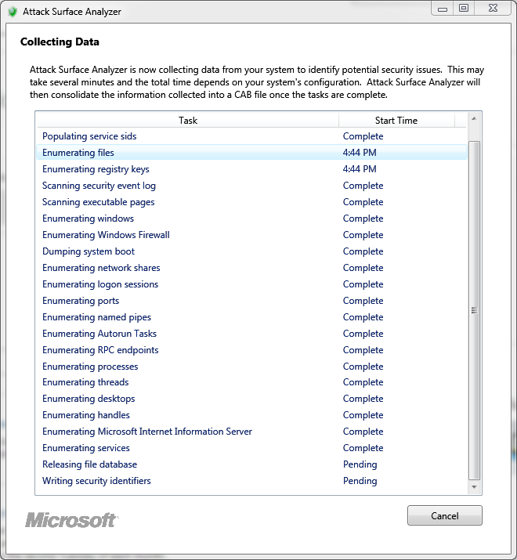

Slide 18
DVWA
DVWA is PHP/MySQL vulnerable web application
Install Apache Webserver
Install Mysql Server
Install PHP
Install and configure DVWA
Can perform XSS, SQL injection attacks
http://www.dvwa.co.uk/

Slide 19
WebGoat
WebGoat - Deliberately insecure web application designed to teach web application security lessons
Install and practice with WebGoat in either J2EE or WebGoat for .Net in ASP.NET.
Users demonstrate their understanding of a security issue by exploiting a real vulnerability in the WebGoat applications
Example: User must use SQL injection to steal fake credit card numbers
https://www.owasp.org/index.php/Category:OWASP_WebGoat_Project

Slide 20
Chapter 3
Application & Network-Based Attacks
Tools for Teaching Security+

Slide 21
Chapter 3 Projects Security+ Guide 5e
Project 3-1: Scan Web Browser Plug-ins (Qualys Browser Check)
Project 3-2: Configure Microsoft Windows Data Execution Prevention (DEP)
Project 3-3: Set Web Browser Security
Project 3-4: Hosts File Attack
Project 3-5: ARP Poisoning
Project 3-6: Create an HTTP Header
Project 3-7: Manage Flash Cookies

Slide 22
Enhanced Mitigation Experience Toolkit (EMET)
Strengthens the security of non-Microsoft applications by using defenses built within Windows
Includes “Attack Surface Reduction” can block some of an application’s modules or plugins that might be abused
EMET tell Internet Explorer to halt an SSL connection if an untrusted certificate is detected without sending session data
http://www.microsoft.com/en-us/download/details.aspx?id=43714

Slide 23
Chapter 4
Host, Application, and Data Security
Tools for Teaching Security+

Slide 24
Chapter 4 Projects Security+ Guide 5e
Project 4-1: Test Antivirus Software
Project 4-2: Setting Windows Local Security Policy
Project 4-3: Viewing Windows Firewall Settings
Project 4-4: Analyze Files and URLs for Viruses Using VirusTotal

Slide 25
pfSense
Free network firewall distribution
Based on the FreeBSD with custom kernel and including third party software packages
Web interface for the configuration of all included components; no command line needed
10-20 Mbps - Less than 4 year old CPU at least 500MHz
21-100 Mbps - 1.0 GHz CPU
101-500 Mbps – Server-class hardware with PCI-e network adapters and CPU 2.0 GHz.
501+ Mbps - Server class hardware with PCI-e network adapters and multiple cores at > 2.0GHz
https://www.pfsense.org/

Slide 26
Chapter 5
Basic Cryptography
Tools for Teaching Security+

Slide 27
Chapter 5 Projects Security+ Guide 5e
Project 5-1: Using OpenPuff Steganography
Project 5-2: Running an RSA Cipher Demonstration
Project 5-3: Installing Command-Line Hash Generators and Comparing Hashes
Project 5-4: Installing GUI Hash Generators and Comparing Digests
Project 5-5: Using Microsoft’s Encrypting File System (EFS)
Project 5-6: Using TrueCrypt

Slide 28
Febooti Hash & CRC
GUI-based file hash and CRC generator
http://www.febooti.com/products/filetweak/members/hash-and-crc/

Slide 29
TrueCrypt Alternatives
TrueCrypt suddenly ceased operations 2014
TrueCrypt v7.1a still available (https://www.grc.com/misc/truecrypt/truecrypt.htm)
VeraCrypt (https://veracrypt.codeplex.com/)
DiskCryptor (https://diskcryptor.net/wiki/Main_Page)
CipherShed (https://ciphershed.org/)
BestCrypt (http://www.jetico.com/)

Slide 30
Chapter 6
Advanced Cryptography
Tools for Teaching Security+

Slide 31
Chapter 6 Projects Security+ Guide 5e
Project 6-1: SSL Server and Client Tests
Project 6-2: Viewing Digital Certificates
Project 6-3: Viewing Digital Certificate Revocation Lists (CRL) and Untrusted Certificates
Project 6-4: Downloading and Installing a Digital Certificate
Project 6-5: Using a Digital Certificate for Signing Documents

Slide 32
Virtru
End-to-end email and attachment encryption using existing email (Chrome, Firefox, Outlook, Mac Mail, iOS and Android)
Install Virtru in browser, mobile device, or email application using Trusted Data Format (TDF)
When composing “flip the Virtru switch” to encrypt message and attachments
Recipients can read your message without installing software after verify identity
Sender can revoke messages at any time, see and control forwarding, set expiration dates
https://www.virtru.com/get-secure-email

Slide 33
End-To-End
End-To-End is Chrome extension to encrypt, decrypt, digital sign, and verify signed messages within the browser using OpenPGP
Built on JavaScript-based crypto library
Enables key generation, encryption, decryption, digital signature, and signature verification
https://github.com/google/end-to-end

Slide 34
Fiddler
Web Debugging - Debug traffic to ensure the proper cookies, headers and cache directives are transferred between the client and server (supports .NET, Java, Ruby, etc. framework)
Performance Testing – View HTTP caching and compression
HTTP/HTTPS Traffic Recording - Web debugging proxy that logs all HTTP(s) traffic between computer and Internet
Web Session Manipulation - Edit web sessions by setting breakpoint to pause the processing of the session and permit alteration of the request/response; can also compose own HTTP requests to run through Fiddler
http://www.telerik.com/fiddler

Slide 35
Chapter 7
Network Security Fundamentals
Tools for Teaching Security+

Slide 36
Chapter 7 Projects Security+ Guide 5e
Project 7-1: Configuring the Windows Firewall
Project 7-2: Using Behavior-Based Monitoring Tools
Project 7-3: Using an Internet Content Filter
Project 7-4: Configure a Windows Client for Network Access Protection

Slide 37
GlassWire
Network monitor - Visualizes current and past network activity by traffic type, application, geographic location; can go back in time up to 30 days
Threat monitoring - Reveals hosts that are known threats, unexpected network system file changes, unusual application changes, ARP spoofing, DNS changes; can remotely monitor servers or other computers and block activity
Firewall – Shows new application or service accessing the Internet for the first time
Detailed log - Shows current and past servers communicating with
Remote server monitoring - Monitor all server network activity
Internet/Bandwidth usage monitoring - Can see amount bandwidth using; can block bandwidth hogging apps or privacy violators
Incognito mode – Prevents network activity from being logged
https://www.glasswire.com/

Slide 38
Chapter 8
Administering a Secure Network
Tools for Teaching Security+

Slide 39
Chapter 8 Projects Security+ Guide 5e
Project 8-1: Using an Application Sandbox
Project 8-2: Create a Virtual Machine from a Physical Computer
Project 8-3: Load the Virtual Machine
Project 8-4: View SNMP Management Information Base (MIB) Elements
Project 8-5: Viewing Logs Using the Microsoft Windows Event Viewer
Project 8-6: Creating a Custom View in Microsoft Windows Event Viewer
Project 8-7: Creating a Subscription in Microsoft Windows Event Viewer

Slide 40
DNS Services
Recursive (not authoritative) DNS services are “middlemen” between browser and website content with offer additional functionality for both users and network administrators
Content filtering - Block adult sites and other unwanted content, while requiring no software on the computers and devices
Malware and phishing blocking - Block sites containing malware, scams and other dangerous content
Protection against botnets - Blocks communication with known botnet servers
Advertisement blocking - Another type of content filtering
URL typo correction – Change gogle.com correct to google.com

Slide 41
DNS Services
Commodo Secure DNS (https://www.comodo.com/secure-dns/)
Dyn Internet Guide (http://dyn.com/labs/dyn-internet-guide/)
FoolDNS (http://www.fooldns.com/fooldns-community/english-version/)
Green Team DNS (http://members.greentm.co.uk/)
Norton ConnectSafe (https://dns.norton.com/)
OpenDNS (https://www.opendns.com/)

Slide 42
Chapter 9
Wireless Network Security
Tools for Teaching Security+

Slide 43
Chapter 9 Projects Security+ Guide 5e
Project 9-1: Viewing WLAN Security Information with Vistumbler
Project 9-2: Substitute a MAC Address Using SMAC
Project 9-3: Use Microsoft Windows 7 Netsh Commands
Project 9-4: Configuring Access Points—WPA2 and WPS

Slide 44
Kali Linux
www.kali.com
Formerly “Backtrack”
Open source Debian Linux distribution
Designed for penetration testing: has 300 built-in pen testing tools
Regularly updated and customizable
Different options
  Bootable ISO (Live Distro)
  Virtual machine
  Natively installed
  ARM devices (Raspberry Pi)

Slide 45
Kali Linux Wireless Tools
Kismet – Display wireless networks
Airmon-ng – Capture wireless packets, inject packets into wireless network
Ifconfig/iwconfig – Part of Linux for configuration of wireless interfaces
Wireshark – Protocol analyzer
Nmap – Network scanner (ZenMap GUI)
Kali Linux menu

Slide 46
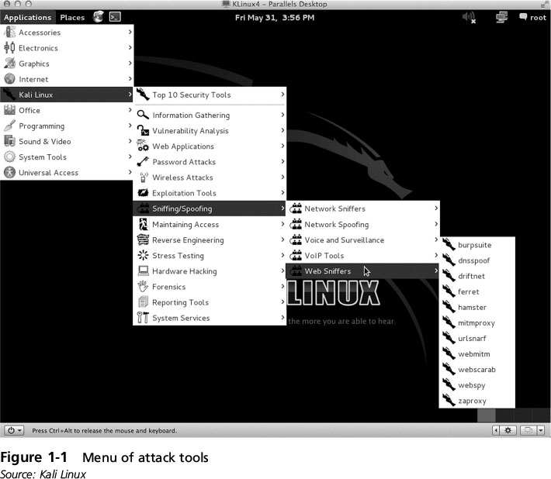

Slide 47
Wireless Adapters for Kali Linux
Wireless USB adapter
Hawking HD45U 3x3x3 USB 3.0
  Uses Ralink chipset
  $40
  802.11n only
Edimax AC-1200
Edimax EW-7822UAC

Slide 48
Organizational Systems Wireless Auditor (OSWA-Assistant)
Associated certifications
Wi-Fi, Bluetooth, and RFID penetration testing tools
Supports web interface
http://securitystartshere.org/page-training-oswa-assistant.htm

Slide 49
OSWA-Assistant: Wi-Fi
Afrag; Aircrack-ng; Airfart; Airpwn; Airsnort; Airsnarf; Airtraf; AP-Hopper; AP-Radar; AP-Utils; Asleap; ChopChop; CoWPAtty; EapMD5pass; FakeAP; Freeradius Pwnage Edition; HostAPD; Hotspotter; Karma; Kismet; Leapcracker; MDK3; MoocherHunter; Probemapper; Pyrawcovert; Rcovert; Ska; SSIDsniff; SSLstrip; Wardrive; Wavemon; WEPlab; WEP0ff; Wi-Find; Wi-Spy Tools; WifiTap; WifiZoo; WPA-attack; WPA Buddy; WPA Supplicant; Wireless Extensions & Wireless Tools package (iwconfig/iwpriv, etc); Zulu

Slide 50
OSWA-Assistant: Bluetooth
Bluebugger; Bluediving Suite; Bluemaho Suite (lite); Blueper; Blueprint; Bluescanner; Bluesmash; Bluesnarfer; Bluesquirrel Suite; BT-Audit; Btfs; Btscanner; Carwhisperer; Ghettotooth; Obexpush-dos; HIDattack; Redfang; Spooftooph; T-Bear; Ussp-push; Vcardblaster; Bluez Bluetooth package with hcitool/hciconfig

Slide 51
OSWA-Assistant: RFID & Other
RFID Tools: Rfdump; RFIDiot; Rfidtool
Miscellaneous: Macchanger; Metasploit Framework; SET; Wireshar

Slide 52
Reaver
Reaver implements a brute force attack against Wi-Fi Protected Setup (WPS) registrar PINs in order to recover WPA/WPA2 passphrases
On average Reaver can recover the target AP's plain text WPA/WPA2 passphrase in 4-10 hours
May only take half this time to guess the correct WPS pin and recover the passphrase
https://code.google.com/p/reaver-wps/

Slide 53
Wifiphisher
Social engineering attack that as easy way for obtaining credentials from captive portals and third party login pages or WPA/WPA2 secret passphrases.
Attack in three phases:
Victim deauthenticated from AP: Wifiphisher continuously jams all target AP devices by sending deauth packets to the client from the AP, to AP from client, and to broadcast address
Victim joins a rogue access point: Wifiphisher copies target AP settings to creates rogue AP; sets up a NAT/DHCP server and forwards the right ports so clients start connecting to the rogue AP
Victim served a realistic router configuration page: Wifiphisher sets up web server that responds to HTTP & HTTPS requests; when victim requests Internet page Wifiphisher responds with a realistic fake page that asks for credentials due to router firmware upgrade
https://github.com/sophron/wifiphisher

Slide 54
Chapter 10
Mobile Device Security
Tools for Teaching Security+

Slide 55
Chapter 10 Projects Security+ Guide 5e
Project 10-1: Creating and Using QR Codes
Project 10-2: Software to Locate a Missing Laptop
Project 10-3: Installing Bluestacks Android Emulator
Project 10-4: Installing Security Apps Using Bluestacks Android Emulator

Slide 56
Mobile Tracking Software
Monitoring Software
mSpy (www.mspy.com)
MobileSpy (http://www.mobile-spy.com/)
Mobistealth (http://www.mobistealth.com/)
MBL Stealth (http://www.mblstealth.com/main/)

Slide 57
Prey
Lock down devices
Delete stored passwords
https://preyproject.com/

Slide 58
Confide
Free iOS & Android app
Can send email along with an attached document/photo (Word, Excel, PowerPoint and PDF files stored on Dropbox, Box, Google Drive, OneDrive and other document-storage services) that gets encrypted
When the recipient opens it the content is blurry and unreadable
Can only be read by touching the screen, and only the line under the finger is readable
If someone snaps a picture of the screen only the one exposed line is captured (cannot see whole message at once)
When recipient finished and taps "close" message is deleted irretrievably

Slide 59
Confide
If recipient not have Confide app installed a button on the message opens the Apple App Store or Google Play Store on the Confide page so can download
Both the recipient and the sender have the ability to delete a message
Sender can change the amount of time a message will last before it self-destructs (set message to be viewable for week but change mind after sending it you can adjust life span remotely or instantly delete it
Confide for Business will have address book integration, distribution lists and other features and desktop version coming
https://getconfide.com/

Slide 60
Dstrux
Dstrux similar to Confide to send messages & documents encrypted and self-destructing
It enables sharing over Facebook or Twitter, but only a link to the secure content in the cloud is shared
Can apply controls to a message before you send it (how long before it self-destructs, whether it's blurry upon opening, if recipient can forward)
Message can be viewed, but not printed, copied, saved or captured with a screen capture

Slide 61
Dstrux
Before sending decide how long the message will last before it self-destructs (days, hours or minutes), to blur content, allow/disallow forwarding
To see a full image have to rapidly swipe all over the screen, then look fast before it vanishes
Confide more polished, Dstrux more options
https://dstrux.com/

Slide 62
Disconnect
Blocks malicious tracking and malvertising threats disguised as legitimate ads
Privacy icons - See how websites collect and use data
Disconnect - Visualize & block invisible websites that track
https://disconnect.me/disconnect

Slide 63
Other Android Apps
VT View Source – View HTML, CSS, JavaScript, XML sources of webpages and remotely located files (https://play.google.com/store/apps/details?id=com.tozalakyan.viewsource)
kWS Android Web Server - https://play.google.com/store/apps/details?id=org.xeustechnologies.android.kws
Hacker’s Keyboard – Full keyboard (https://play.google.com/store/apps/details?id=org.pocketworkstation.pckeyboard&feature=search_result)

Slide 64
Chapter 11
Access Control Fundamentals
Tools for Teaching Security+

Slide 65
Chapter 11 Projects Security+ Guide 5e
Project 11-1: Using Windows Local Group Policy Editor
Project 11-2: Using Discretionary Access Control to Share Files in Windows
Project 11-3: Enabling IEEE 802.1x
Project 11-4: Explore User Account Control (UAC)

Slide 66
Chapter 12
Authentication and Account Management
Tools for Teaching Security+

Slide 67
Chapter 12 Projects Security+ Guide 5e
Project 12-1: Use an Online Rainbow Table Cracker
Project 12-2: Keystroke Dynamics
Project 12-3: Download and Install a Password Management Program
Project 12-4: Use Cognitive Biometrics
Project 12-5: Create an OpenID Account
Project 12-6: Use an OpenID Account

Slide 68
Password Management Applications
Dashlane
LastPass
KeePass
1Password
Blur
PasswordBox
RoboForm
StickyPassword

Slide 69
HashCat
Optimum password cracking program
Brute-Force attack, combinator attack, dictionary attack, fingerprint attack, hybrid attack, mask attack, permutation attack, rule-based attack
Multi-GPU (up to 128 gpus)
Multi-Hash (up to 100 million hashes)
Multi-OS (Linux & Windows native binaries)
http://hashcat.net/oclhashcat/

Slide 70

Security+ 5e
Security+ Guide to Network Security Fundaments, 5e from Cengage Learning (9781305093911)
Published August, 2014
Maps completely to new SY0-401 exam objectives
Retains popular format
Increased from 14 to 15 chapters (new chapter on Mobile Device Security)
Increased chapter length by 2-3 pages

Slide 71
Security+ 5e
Cryptography moved up to Chapters 5-6
New “Today’s Attacks & Defenses” openers
New sectional units
New and updated Review Questions, Hands-On Projects, Case Projects
New lecture videos
New material on companion web site to be updated regularly

Slide 72
Tools For Teaching Security+
Mark Ciampa
Western Kentucky University
mark.ciampa@wku.edu

Slide 73
