Slide 1
Technology in Action
Alan Evans • Kendall Martin
Mary Anne Poatsy
Tenth Edition

Slide 2
Technology in Action
Chapter 9
Securing Your System: Protecting Your Digital Data and Devices
Notes:
This chapter covers threats to your computer such as viruses and the hardware and software we can use to help protect against them.

Slide 3
Chapter Topics
Cybercrime and Identity Theft
Protecting Yourself from Computer Viruses
Protecting Digital Assets from Hackers
Managing Online Annoyances
Keeping Your Data Safe
Protecting Your Physical Computing Assets
Notes:
Topics in this chapter include the following:
Cybercrime and Identity Theft
Protecting Yourself from Computer Viruses
Protecting Digital Assets from Hackers
Managing Online Annoyances
Keeping Your Data Safe
Protecting Your Physical Computing Assets

Slide 4
Cybercrime and Identity Theft
Cybercrime: Any criminal action perpetrated primarily through the use of a computer
Programs damaging computers
Stealing identities online
Attacking corporate websites
Cybercriminals: Individuals who use computers, networks, and the Internet to perpetrate crime.
Notes:
The media is full of stories about malicious computer programs damaging computers, criminals stealing people’s identities online, and attacks on corporate websites that have brought major corporations to a standstill. These are examples of cybercrime.
Cybercrime is any criminal action perpetrated primarily through the use of a computer. The existence of cybercrime means that computer users must take precautions to protect themselves.
Cybercriminals are individuals who use computers, networks, and the Internet to perpetrate crime. Anyone with a computer and the wherewithal to arm himself or herself with the appropriate knowledge can be a cybercriminal.

Slide 5
Cybercrime and Identity Theft (cont.)
Top categories of complaints
FBI-related scams
Identity theft
Nonauction/nondelivery of merchandise
Advance fee fraud
Complaints not related to fraud
Computer intrusions
Child pornography
Blackmail
Notes:
The Internet Crime Complaint Center (IC3) is a partnership between the FBI and the National White Collar Crime Center (NW3C). In 2011 (the latest year for which data was available at this book’s publication), IC3 received almost 314,000 complaints related to Internet crime.
The top four categories of complaints received were FBI-related scams, identity theft, nonAuction/nondelivery of merchandise, and advance fee fraud.
Although the top four complaints all relate to some type of fraud, other complaints received involve equally serious matters such as computer intrusions (hacking), child pornography, and blackmail.

Slide 6
Cybercrime and Identity Theft (cont.)
Notes:
This figure shows the top four categories of complaints received.

Slide 7
Cybercrime and Identity Theft (cont.)
Identity theft: Occurs when a thief steals personal information such as your name, address, Social Security number, birth date, bank account, and credit card information and runs up debt in your name
Notes:
Theft of personal data such as bank account numbers and credit or debit card numbers is of most concern to individuals because this information is usually used for fraudulent purposes.
Identity theft occurs when a thief steals personal information such as your name, address, Social Security number, birth data, bank account, and credit card information and runs up debt in your name.
Many victims of identity theft spend months, or even years, trying to repair their credit and eliminate fraudulent debts.

Slide 8
Cybercrime and Identity Theft (cont.)
Acts perpetrated by identity thieves
Counterfeiting existing credit and debit cards
Requesting changes of address on bank and credit card statements
Obtaining new credit cards and bank account in your name and writing bad checks and not paying off credit card balances
Obtaining medical services in your name
Buying a home with a mortgage in your name, then reselling the house
Notes:
The nefarious acts perpetrated by identity thieves cover a wide range:
Counterfeiting your existing credit and debit cards,
Requesting changes of address on your bank and credit card statements, which makes detecting fraudulent charges take longer,
Opening new credit cards and bank accounts in your name and then writing bad checks and not paying off the credit card balances (ruining your credit rating in the process),
Obtaining medical services under your name (you might lose coverage later if the thief’s treatment exceeds the limits of your policy’s covered services),
Buying a home with a mortgage in your name, then reselling the house and absconding with the money (leaving you with the debt).

Slide 9
Cybercrime and Identity Theft (cont.)
Other methods used to obtain personal information
Stealing purses and wallets
Stealing mail or looking through trash for bank statements and credit card bills
Posing as bank or credit card company representatives
Installing skimming devices on ATM machines to record information
Notes:
Many people believe that the only way your identity can be stolen is by a computer. However, the Federal Trade Commission has identified other methods thieves use to obtain others’ personal information:
Stealing purses and wallets, in which people often keep personal information such as their ATM PIN codes
Stealing mail or looking through trash for bank statements and credit card bills
Posing as bank or credit card company representatives and tricking people into revealing sensitive information over the phone
Installing skimming devices on ATM machines that record information, such as account numbers and access codes

Slide 10
Cybercrime and Identity Theft (cont.)
MAAWG found that half of e-mail users in North America and Europe have opened spam
46% of people who opened spam did so intentionally
Notes:
Although most people are aware of spam, a survey by the Messaging Anti-Abuse Working Group (MAAWG) found that half of e-mail users in North America and Europe have opened spam, some of which is designed to trick you into divulging sensitive information.
The MAAWG also discovered that 46% of people who opened spam did so intentionally, out of idle curiosity, to follow links to unsubscribe to unwanted e-mails (which only brings more spam), or because they are interested in the product being touted.

Slide 11
Cybercrime and Identity Theft (cont.)
Theft of computer equipment is larceny, not cybercrime
On the rise
Resale value is high and equipment can be sold online
Notes:
Although theft of computer equipment is not classified as cybercrime (it is considered larceny), the theft of tablets, cell phones, notebook computers, and other portable computing devices is on the rise.
The resale value for used electronic equipment is high, and the equipment can be easily sold online.

Slide 12
Computer Viruses
Computer virus: A program that attaches itself to another computer program
Attempts to spread to other computers when files are exchanged
One of the most widespread types of cybercrimes
Notes:
A computer virus is a computer program that attaches itself to another computer program (known as the host program) and attempts to spread to other computers when files are exchanged.
Creating and disseminating computer viruses is one of the most widespread types of cybercrimes. Some viruses cause only minor annoyances, but others cause destruction or theft of data. Many viruses are now designed to gather sensitive information such as credit card numbers.
Everyone, even Apple users, needs to worry about viruses. As the OS X and iOS operating systems have gained market share, the amount of virus attacks against Apple operating systems is on the rise.

Slide 13
Computer Viruses (cont.)
Main purpose
Replicate themselves and copy code to as many other files as possible
Secondary objectives
Slow down networks
Display annoying messages
Destroy files or contents of hard drive
Notes:
A computer virus’s main purpose is to replicate itself and copy its code into as many other host files as possible.
Although there might be a virus in a file on your computer, a virus normally can’t infect your computer until the infected file is opened or executed.
Although virus replication can slow down networks, it’s not usually the main threat.
The majority of viruses have secondary objectives or side effects, ranging from displaying annoying messages on the computer screen to destroying files or the contents of entire hard drives.

Slide 14
Computer Viruses (cont.)
If a computer is exposed to an infected file, the virus will try to copy itself and infect a file on your computer
Sources of virus infection
Downloading infected audio and video files
Shared flash drives
Downloading or executing a file attached to e-mail
Notes:
If your computer is exposed to a file infected with a virus, the virus will try to copy itself and infect a file on your computer.
Downloading infected audio and video files from peer-to-peer file sharing sites is a major source of virus infections. Shared flash drives are also a common source of virus infection, as is e-mail. Just opening an e-mail message won’t usually infect your computer with a virus, although some new viruses are launched when viewed in the preview pane of your e-mail software. Downloading or running (executing) a file that’s attached to the e-mail are common ways that your computer becomes infected. Thus, be extremely wary of e-mail attachments, especially if you don’t know the sender.

Slide 15
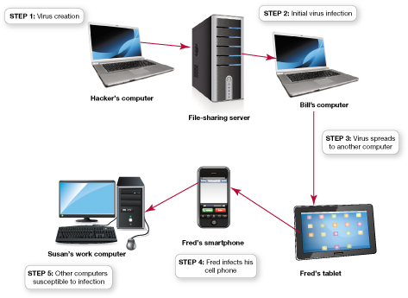
Computer Viruses (cont.)
Notes:
This figure illustrates the steps by which computer viruses are often passed from one computer to the next:
An individual writes a virus program, attaches it to a music file, and posts the file to a file-sharing site.
Unsuspecting Bill downloads the “music file” and infects his computer when he listens to the song.
Bill sends his cousin Fred an e-mail with the infected “music file” and contaminates Fred’s tablet.
Fred syncs his phone with his tablet and infects his phone when he plays the music file.
Fred e-mails the file from his phone to Susan, one of his colleagues at work. Everyone who copies files from Susan’s infected work computer, or whose computer is networked with Susan’s computer, risks spreading the virus.
Computer viruses are passed from one unsuspecting user to the next.

Slide 16
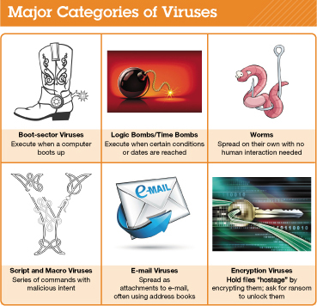
Computer Viruses (cont.)
Viruses can be grouped into six categories based on behavior and method of transmission
Notes:
Although thousands of computer viruses and variants exist, they can be grouped into six broad categories based on their behavior and method of transmission.
This figures summarizes the major categories of viruses.

Slide 17
Computer Viruses Boot-Sector Viruses
Boot-sector viruses
Replicate into hard drive’s master boot record
Master boot record is a program that executes whenever a computer boots up
Notes:
A boot-sector virus replicates itself onto a hard drive’s master boot record. The master boot record is a program that executes whenever a computer boots up, ensuring that the virus will be loaded into memory immediately, even before some virus protection programs can load. Boot-sector viruses are often transmitted by a flash drive left in a USB port. When the computer boots up with the flash drive connected, the computer tries to launch a master boot record from the flash drive, which is usually the trigger for the virus to infect the hard drive.

Slide 18
Computer Viruses Logic Bombs and Time Bombs
Logic bombs and time bombs
Logic bomb: Triggered when certain logical conditions are met
Time bomb: Triggered by the passage of time or on a certain date
Notes:
A logic bomb is a virus that is triggered when certain logical conditions are met, such as opening a file or starting a program a certain number of times. A time bomb is a virus that is triggered by the passage of time or on a certain date.

Slide 19
Computer Viruses Worms
Worms
Use transport methods like e-mail and networks to spread without human interaction
Notes:
Although often called a virus, a worm is subtly different. Viruses require human interaction to spread, whereas worms take advantage of file transport methods (e.g., e-mail or network connections) to spread on their own. A virus infects a host file and waits until that file is executed to replicate and infect a computer system. A worm, however, works independently of host file execution and is much more active in spreading itself.

Slide 20
Computer Viruses Script and Macro Viruses
Script and macro viruses
Script is miniprogram hidden on websites that is executed without user’s knowledge
Macro virus attaches itself to a document that uses macros
Notes:
Some viruses are hidden on websites in the form of scripts. A script is a series of commands—actually, a miniprogram—that is executed without your knowledge.
A macro virus is a virus that attaches itself to a document (e.g., a Word or Excel file) that uses macros. A macro is a short series of commands that usually automates repetitive tasks.

Slide 21
Computer Viruses E-Mail Viruses
E-mail viruses
Melissa virus: First practical example
Use the address book to distribute the virus
Notes:
The Melissa virus was the first practical example of an e-mail virus.
E-mail viruses use the address book in the victim’s e-mail system to distribute the virus.

Slide 22
Computer Viruses Encryption Viruses
Encryption viruses
Run program that searches for common types of data files
Compress files using a complex encryption key that makes files unusable
Asks for payment to receive the program to decrypt your files
Notes:
When encryption viruses infect your computer, they run a program that searches for common types of data files (such as Microsoft Word and Excel files) and compresses them using a complex encryption key that renders your files unusable. You then receive a message that asks you to send money to an account if you want to receive the program to decrypt your files.

Slide 23
Computer Viruses Additional Virus Classifications
Viruses can also be classified by methods they take to avoid detection
Polymorphic viruses
Periodically rewrite themselves to avoid detection
Multipartite viruses
Infect multiple file types
Stealth viruses
Erase their code from the hard drive and reside in active memory
Notes:
Viruses can also be classified by the methods they take to avoid detection by antivirus software:
A polymorphic virus changes its code (or periodically rewrites itself) to avoid detection. Most polymorphic viruses infect one particular type of file such as .EXE files, for example.
A multipartite virus is designed to infect multiple file types in an effort to fool the antivirus software that is looking for it.
Stealth viruses temporarily erase their code from the files where they reside and hide in the active memory of the computer. This helps them avoid detection if only the hard drive is searched for viruses. Fortunately, current antivirus software scans memory as well as the hard drive.

Slide 24
Computer Viruses Virus Symptoms
Symptoms your computer might be infected with a virus
Existing program icons or files suddenly disappear
You start your browser and it takes you to an unusual home page or has new toolbars
Odd messages, pop-ups, or images are displayed or strange music or sounds play
Notes:
Sometimes it can difficult to definitively tell whether your computer is infected with a virus. However, if your computer displays any of the following symptoms, it might be infected with a virus:
Existing program icons or files suddenly disappear. Viruses often delete specific file types or programs.
You start your browser, and it takes you to an unusual home page (one you didn’t set), or it has new toolbars.
Odd messages, pop-ups, or images are displayed on the screen, or strange music or sounds play.

Slide 25
Computer Viruses Virus Symptoms (cont.)
Symptoms your computer might be infected with a virus (cont.)
Data files become corrupt
Programs stop working properly
System slows down or takes a long time to boot up
Notes:
Sometimes it can difficult to definitively tell whether your computer is infected with a virus. However, if your computer displays any of the following symptoms, it might be infected with a virus:
Data files become corrupt. (However, note that files can become corrupt for reasons other than a virus infection.)
Programs stop working properly, which could be caused by either a corrupted file or a virus.
Your system slows down or takes a long time to boot up.

Slide 26
Preventing Virus Infections
Antivirus software is designed to detect viruses and protect your computer
Popular antivirus software companies
Symantec
Kaspersky
AVG
McAfee
Comprehensive Internet security packages protect you from other threats
Notes:
Antivirus software is specifically designed to detect viruses and protect your computer and files from harm. Symantec, Kaspersky, AVG, and McAfee are among the companies that offer highly rated antivirus software packages.
Antivirus protection is also included in comprehensive Internet security packages such as Norton Internet Security, Kaspersky Internet Security, and McAfee Total Protection. These software packages also help protect you from threats other than computer viruses.

Slide 27
Preventing Virus Infections Antivirus Software
Run an active virus scan on entire system once a week
If you suspect a problem, scan immediately
Notes:
Although antivirus software is designed to detect suspicious activity on your computer at all times, you should run an active virus scan on your entire system at least once a week.
Most modern antivirus programs run scans in the background when your central processing unit (CPU) is not being heavily utilized. You can also configure the software to run scans at times when you aren’t using your system; for example, when you’re asleep. Antivirus software scans files for these signatures and thereby identifies infected files and the type of virus that is infecting them. Alternatively, if you suspect a problem, you can launch a scan and have it run immediately.

Slide 28
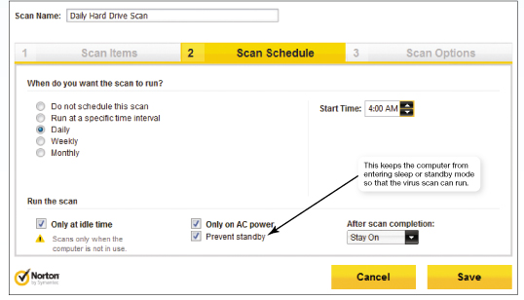
Preventing Virus Infections Antivirus Software (cont.)
Notes:
In Norton Internet Security, you can set up virus scans to run automatically. This computer will be scanned every day at 4 a.m.

Slide 29
Preventing Virus Infections Antivirus Software (cont.)
Main functions of antivirus software
Detection: Looks for virus signatures in files
Virus signature is a portion of the virus code that’s unique to a particular virus
Stopping virus execution
Quarantining places the virus in a secure area of your hard drive so it won’t spread
Preventing future infection
In inoculation, the antivirus software records key attributes about your computer files and keeps these stats in a safe place
Notes:
The main functions of antivirus software are as follows:
Detection: Antivirus software looks for virus signatures in files. A virus signature is a portion of the virus code that’s unique to a particular computer virus. Antivirus software scans files for these signatures when they’re opened or executed and identifies infected files and the type of virus infecting them.
Stopping virus execution: If the antivirus software detects a virus signature or suspicious activity, such as the launch of an unknown macro, it stops the execution of the file and virus and notifies you that it has detected a virus. It also places the virus in a secure area on your hard drive so that it won’t spread to other files; this procedure is known as quarantining. Usually, the antivirus software then gives you the choice of deleting or repairing the infected file. Unfortunately, antivirus programs can’t always fix infected files to make them usable again. You should keep backup copies of critical files so that you can restore them in case a virus damages them irreparably.
Prevention of future infection: Most antivirus software will also attempt to prevent infection by inoculating key files on your computer. In inoculation, the antivirus software records key attributes about your computer files, such as file size and date created, and keeps these statistics in a safe place on your hard drive. When scanning for viruses, the antivirus software compares the attributes of the files with the attributes it previously recorded to help detect attempts by virus programs to modify your files.

Slide 30
Preventing Virus Infections Antivirus Software (cont.)
To combat unknown viruses, programs search for suspicious virus-like activities and virus signatures
Keep your antivirus software up to date
Notes:
Antivirus software catches known viruses effectively. However, new viruses are written all the time. To combat unknown viruses, modern antivirus programs search for suspicious virus-like activities as well as virus signatures.
To minimize your risk, you should keep your antivirus software up to date.

Slide 31
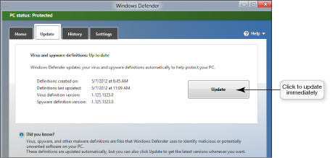
Preventing Virus Infections Antivirus Software (cont.)
Most new computers come with preinstalled antivirus software
Usually trial versions
Most antivirus programs have automatic update features
Notes:
Most new computers do come with antivirus software preinstalled. However, these are usually trial versions of the software that only provide updates to the software for a limited period of time, usually 90 or 180 days.
Most antivirus programs have an automatic update feature that downloads updates for virus signature files every time you go online.
Also, the antivirus software usually shows the status of your update subscription so that you can see how much time you have remaining until you need to buy another version of your software.
Antivirus software, such as Windows Defender, provides for automatic updates but also allows manual updates.

Slide 32
Preventing Virus Infections Antivirus Software (cont.)
If you think your computer is infected
Boot up using antivirus installation disc
If a virus is detected, research it to determine if your antivirus software will get rid of it
Antivirus company websites contain archives on viruses
Notes:
If you think your computer is infected with a virus, boot up your computer using the antivirus installation disc. This should prevent most virus programs from loading and will allow you to run the antivirus software directly from your disk drive. (Note: If you download your antivirus software from the Internet, copy it to a DVD in case you have problems in the future.)
If the software does detect viruses, you might want to research them further to determine whether your antivirus software will eradicate them completely or whether you’ll need to take additional manual steps to eliminate the viruses.
Most antivirus company websites, such as the Symantec site, contain archives of information on viruses and provide step-by-step solutions for removing them.

Slide 33
Preventing Virus Infections Antivirus Software (cont.)
Smartphones and other mobile devices are susceptible to viruses
Antivirus software designed for mobile devices
Trend Micro’s Mobile Security for Android
Notes:
Because smartphones and other mobile devices run operating systems and contain files, they are susceptible to infection by viruses. Cybercriminals are now hiding viruses in legitimate-looking apps for download to mobile devices.
Many antivirus software companies now offer antivirus software specifically designed for mobile devices, like Trend Micro’s Mobile Security for Android.

Slide 34
Preventing Virus Infections Software Updates
Drive-by download is a type of attack that exploits weaknesses in operating systems
Make sure antivirus software and your operating system are up to date and contain latest security patches
Windows operating system has automatic update utility called Windows Update
Mac OS X has similar utility
Notes:
Many viruses exploit weaknesses in operating systems. Malicious websites can be set up to attack your computer by downloading harmful software onto your computer.
According to research conducted by Google, this type of attack, known as a drive-by download, affects almost 1 in 1,000 web pages.
To combat these threats, make sure your OS is up to date and contains the latest security patches. You can update your Windows OS with an automatic update utility called Windows Update. When you enable automatic updates, your computer searches for updates on the Microsoft website every time it connects to the Internet. Mac OS X has a similar utility for gathering updates.

Slide 35
Preventing Virus Infections Software Updates (cont.)
Default option in Windows is to receive updates automatically
Other options are available
Notes:
The default option in Windows is to receive updates automatically. There are several other options you can choose from in Windows.
The following are noteworthy:
Option 1: Install updates automatically. Selecting this option will automatically download and install updates at a time you have specified. We strongly recommend that you select this option.
Option 2: Check for updates but let me choose whether to download and install them. This is an appropriate choice only if you have low-bandwidth Internet access. Because downloads over dial-up can take a long time, you need to control when they will occur. But you need to be extra vigilant with this option because you might forget to install important updates.
Option 3: Give me recommended updates. This option ensures you receive recommended (optional) updates as well as critical (necessary) updates.
Option 4: Microsoft Update. This option ensures you receive updates for other Microsoft products besides Windows, such as Microsoft Office.
If you keep both your antivirus and OS software up to date, you’ll help prevent viruses from infecting your computer.

Slide 36
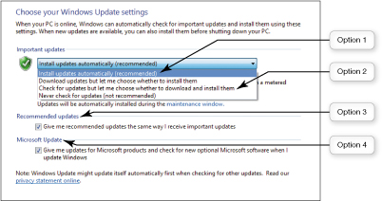
Preventing Virus Infections Software Updates (cont.)
Notes:
The Windows Update screen makes it easy for users to configure Windows to update itself.
To enable automatic updates, access the Control Panel, select System and Security, click the Windows Update link, and then click the Change Settings link.

Slide 37
Hackers
Anyone who unlawfully breaks into a computer system
Types of hackers
White-hat or ethical hackers – break in to systems for nonmalicious reasons
Black-hat hackers – break into systems to destroy information or for illegal gain
Grey-hat hackers – break into systems merely to flaunt their expertise
Notes:
Although there’s a great deal of disagreement as to what a hacker actually is, especially among hackers themselves, a hacker is most commonly defined as anyone who unlawfully breaks into a computer system—either an individual computer or a network.
Some hackers are offended by being labeled as criminals and therefore attempt to classify different types of hackers, as follows:
White-hat hackers (or ethical hackers) break in to systems for nonmalicious reasons such as to test system security vulnerabilities or to expose undisclosed weaknesses. They believe in making security vulnerabilities known either to the company that owns the system or software or to the general public, often to embarrass a company into fixing a problem.
Black-hat hackers break into systems to destroy information or for illegal gain. The terms white hat and black hat are references to old Western movies in which the heroes wore white hats and outlaws wore black hats.
Grey-hat hackers are a bit of a cross between black and white—they often illegally break into systems merely to flaunt their expertise to the administrator of the system they penetrated or to attempt to sell their services in repairing security breaches.
Regardless of the hackers’ opinions, the laws in the United States and in many other countries consider any unauthorized access to computer systems a crime.

Slide 38
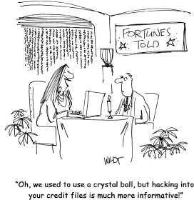
Hackers (cont.)
Notes:
Hackers can find lots of personal information about you on the Internet.

Slide 39
Hackers Problems Hackers Can Cause
Steal credit and debit card information from hard drives
Break into sites that contain credit card information
Capture login ID and password using packet analyzer or keylogger
Notes:
Hackers often try to break into computers or websites that contain credit card information. If you perform financial transactions online, such as banking or buying goods and services, you probably do so using a credit or debit card. Credit card and bank account information can thus reside on your hard drive or an online business’s hard drive and could be detectable by a hacker.
Aside from your home computer, you have personal data stored on various websites. For example, many sites require that you provide a login ID and password to gain access. Even if this data is not stored on your computer, a hacker might be able to capture it when you’re online by using a packet analyzer (sniffer) or a keylogger (a program that captures all keystrokes made on a computer).

Slide 40
Hackers Problems Hackers Can Cause (cont.)
Data travels through the Internet in packets
Identified with IP address
Packet analyzer (sniffer): Program deployed by hackers that looks at each packet
Once a hacker has your debit or credit card information they can start purchasing or sell the information to someone else
Notes:
Data travels through the Internet in small pieces called packets. The packets are identified with an IP address, in part to help identify the computer to which they are being sent. Once the packets reach their destination, they’re reassembled into cohesive messages.
A packet analyzer (sniffer) is a program deployed by hackers that looks at (or sniffs) each packet as it travels on the Internet—not just those addressed to a particular computer, but all packets coming across a particular network.
For example, a hacker might sit in a coffee shop and run a packet sniffer to capture sensitive data (such as debit or credit card numbers) from patrons using the coffee shop’s free wireless network. Wireless networks such as these can be particularly vulnerable to this type of exploitation if encryption of data isn’t enabled when the networks are set up.
Once a hacker has your debit or credit card information, he or she can use it to purchase items illegally or can sell the number to someone who will. If a hacker steals the login ID and password to an account where you have your bank card information stored (e.g., eBay or Amazon), he or she can also use your account to buy items and have them shipped to himself or herself instead of to you.
If hackers can gather enough information in conjunction with your credit card information, they might be able to commit identity theft.
Although this sounds scary, you can easily protect yourself from packet sniffing by installing a firewall and using data encryption on a wireless network.

Slide 41
Hackers Trojan Horses and Rootkits
A Trojan horse appears to be useful but while it runs it does something malicious in background
Rootkits are programs (or sets of programs) that allow hackers to gain access to your computer and take control without your knowledge
A zombie is a computer controlled by a hacker
Notes:
Hackers often use individuals’ computers as a staging area for mischief. To commit widespread computer attacks, for example, hackers need to control many computers at the same time.
To this end, hackers often use Trojan horses to install other programs on computers. A Trojan horse is a program that appears to be something useful or desirable, like a game or a screen saver, but while it runs does something malicious in the background without your knowledge.
Often, the malicious activity perpetrated by a Trojan horse program is the installation of a backdoor program or a rootkit. Backdoor programs and rootkits are programs (or sets of programs) that allow hackers to gain access to your computer and take almost complete control of it without your knowledge.
Using a backdoor program, hackers can access and delete all the files on your computer, send e-mail, run programs, and do just about anything else you can do with your computer. A computer that a hacker controls in this manner is referred to as a zombie. Zombies are often used to launch denial-of-service attacks on other computers.

Slide 42
Hackers Denial-of-Service Attacks
In a denial-of-service (DoS) attack, users are denied access to a computer system because a hacker is making repeated requests
When flooded with requests, the system shuts down
Notes:
In a denial-of-service (DoS) attack, legitimate users are denied access to a computer system because a hacker is repeatedly making requests of that computer system through a computer he or she has taken over as a zombie. A computer can handle only a certain number of requests for information at one time. When it is flooded with requests in a DoS attack, it shuts down and refuses to answer any requests for information, even if the requests are from a legitimate user. Thus, the computer is so busy responding to the bogus requests for information that authorized users can’t gain access.
Launching a DoS attack on a computer system from a single computer system from a single user is easy to trace. Therefore, most savvy hackers use a distributed denial-of-service (DDoS) attack, which launches DoS attacks from more than one zombie (sometimes thousands of zombies) at the same time. A hacker creates many zombies and coordinates them so that they begin sending bogus requests to the same computer at the same time.

Slide 43
Hackers Denial-of-Service Attacks (cont.)
Distributed denial-of-service (DDoS) attack launches attacks from more than one zombie computer
Botnet is a large group of software programs that runs autonomously on zombie computers
Notes:
Administrators of the victim computer often have a great deal of difficulty stopping the attack because it comes from so many computers. Often, the attacks are coordinated automatically by botnets. A botnet is a large group of software programs (called robots or bots) that runs autonomously on zombie computers. Some botnets have been known to span 1.5 million computers.
Because many commercial websites receive revenue from users, either directly (such as via subscriptions to online games) or indirectly (such as when web surfers click on advertisements), DDoS attacks can be financially distressing for the owners of the affected websites.

Slide 44
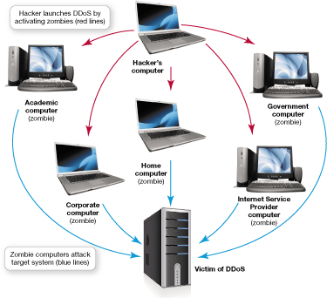
Hackers Denial-of-Service Attacks (cont.)
Notes:
Zombie computers are used to facilitate a DDoS attack.

Slide 45
Hackers How Hackers Gain Computer Access
Direct access
Installing hacking software
Indirect access
Through Internet connection
Logical ports are virtual communications gateways or paths that allow a computer to organize requests for information
Notes:
Hackers can gain access to computers directly or indirectly:
Direct access involves sitting down at a computer and installing hacking software. It is unlikely that such an attack would occur in your home, but it’s always a wise precaution to set up your computer so that it requires a password for a user to gain access.
The most likely method a hacker will use to access a computer is to enter indirectly through its Internet connection.
Many people forget that their Internet connection is a two-way street. Not only can you access the Internet but also people on the Internet can access your computer.
Logical ports are virtual—that is, not physical—communications gateways or paths that allow a computer to organize requests for information, such as web page downloads or e-mail routing, from other networks or computers. Unlike physical ports, such as USB ports, you can’t see or touch a logical port; it’s part of a computer’s internal organization.
Logical ports are numbered and assigned to specific services. For instance, logical port 80 is designated for Hypertext Transfer Protocol (HTTP), the main communications protocol for the web.
Thus, all requests for information from your browser to the web flow through logical port 80. Unless you take precautions to restrict access to your logical ports, other people on the Internet might be able to access your computer through them.
Fortunately, you can thwart most hacking problems by installing a firewall.

Slide 46
Restricting Access to Your Digital Assets
Keep hackers out
Prevent them from accessing computer
Protect your digital information
Use passwords
Hide activities from prying eyes
Notes:
Keeping hackers at bay is often just a matter of keeping them out. You can achieve this by:
Preventing hackers from accessing your computer (usually through your Internet connection).
Protecting your digital information in such a way that it can’t be accessed (e.g., by using passwords).
Hiding your activities from prying eyes.
In the next section, we explore strategies for protecting access to your digital assets and keeping your Internet surfing activities from being seen by the wrong people.

Slide 47
Restricting Access to Your Digital Assets Firewalls
Firewall: Software program or hardware device designed to protect computers from hackers
Personal firewall: Specifically designed for home networks
Notes:
A firewall is a software program or hardware device designed to protect computers from hackers.
A firewall specifically designed for home networks is called a personal firewall. Using a personal firewall, you can close open logical ports to invaders and potentially make your computer invisible to other computers on the Internet.
Both hardware and software firewalls will protect you from hackers. One type isn’t better than the other.
Although installing either a software or a hardware firewall on your home network is probably sufficient, you should consider installing both for maximum protection.

Slide 48
Restricting Access to Your Digital Assets Firewalls (cont.)
Both Windows and OS X include firewalls
Security suites also include firewall software
You can also buy and configure hardware firewall devices
Notes:
Both Windows and OS X include reliable firewalls. The Windows Action Center is a good source of information about the security settings on your computer, including the status of your firewall.
Security suites such as Norton Internet Security, McAfee Internet Security, and ZoneAlarm Internet Security Suite also include firewall software.
You can also buy and configure hardware firewall devices. Many routers sold for home networks include firewall protection. Just like software firewalls, the setup for hardware firewalls is designed for novices, and the default configuration on most routers keeps unused logical ports closed.

Slide 49
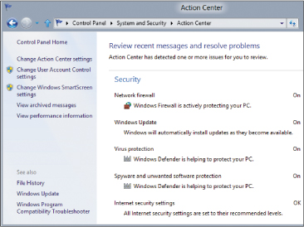
Restricting Access to Your Digital Assets Firewalls (cont.)
Notes:
The security section of the Windows Action Center provides the status of programs protecting your computer.
To view the Action Center, access the Control Panel, select System and Security, and then click the Action Center link.

Slide 50
Restricting Access to Your Digital Assets How Firewalls Work
Firewalls protect in two major ways
Blocking access to logical ports
Keeping computer’s network address secure
Packet filtering is a process of configuring a firewall to filter out packets sent to logical ports
Notes:
Firewalls are designed to restrict access to a network and its computers. Firewalls protect you in two major ways:
By blocking access to logical ports,
And by keeping your computer’s network address secure.
Certain logical ports are very popular in hacker attacks. To block access to logical ports, firewalls examine data packets that your computer sends and receives. Data packets contain information such as the address of the sending and receiving computers and the logical port the packet will use.

Slide 51
Restricting Access to Your Digital Assets How Firewalls Work (cont.)
Logical port blocking: Firewalls are configured to ignore requests that originate from the Internet asking for access to certain ports
Notes:
Firewalls are also configured to ignore requests that originate from the Internet asking for access to certain ports. This process is referred to as logical port blocking. By using filtering and blocking, firewalls keep hackers from accessing your computer.

Slide 52
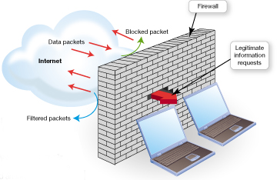
Restricting Access to Your Digital Assets How Firewalls Work (cont.)
Notes:
Firewalls are designed to restrict access to a network and its computers. Firewalls protect you in two major ways:
By blocking access to logical ports
By keeping your computer’s network address secure
Certain logical ports are very popular in hacker attacks. To block access to logical ports, firewalls examine data packets that your computer sends and receives. Data packets contain information such as the address of the sending and receiving computers and the logical port the packet will use.
Firewalls can be configured so that they filter out packets sent to specific logical ports in a process known as packet filtering.
Firewalls are also configured to ignore requests that originate from the Internet asking for access to certain ports. This process is referred to as logical port blocking. By using filtering and blocking, firewalls keep hackers from accessing your computer.

Slide 53
Restricting Access to Your Digital Assets How Firewalls Work (cont.)
Internet Protocol address (IP address): Unique address for every computer connected to the Internet
Network address translation (NAT): A process used by firewalls to assign internal IP addresses on a network
Notes:
Every computer connected to the Internet has a unique address called an Internet Protocol (IP) address. Data is routed to the correct computer on the Internet based on the IP address.
If a hacker finds out the IP address of your computer, he or she can locate it on the Internet and try to break into it.
Your IP address for your home network is assigned to your router by your Internet service provider (ISP), but each device on your home network also has an IP address. Firewalls use a process called network address translation (NAT) to assign internal IP addresses on a network.
The internal IP addresses are used only on the internal network and therefore can’t be detected by hackers. For hackers to access your computer, they must know your computer’s internal IP address.
With a NAT-capable router/firewall installed on your network, hackers are unable to access the internal IP address assigned to your computer, so your computer is safe.
You can use NAT in your home by purchasing a hardware firewall with NAT capabilities. Many routers sold for home use are also configured as firewalls, and many feature NAT.

Slide 54
Restricting Access to Your Digital Assets Knowing Your Computer Is Secure
Websites test computer’s vulnerability
Gibson Research
ShieldsUP
LeakTest
If vulnerabilities are detected
Install a firewall if you don’t have one
If you have a firewall, check how to close or restrict access to ports
Notes:
For peace of mind you can visit several websites that offer free services that test your computer’s vulnerability. One popular site is Gibson Research (www.grc.com). The company’s ShieldsUP and LeakTest programs are free and easy to run and can pinpoint security vulnerabilities in a system that is connected to the Internet. If you get a clean report from these programs, your system is probably not vulnerable to attack.
If the testing program detects potential vulnerabilities and you don’t have a firewall, you should install one as soon as possible. If the firewall is already configured and common ports are identified as being vulnerable, consult your firewall documentation for instructions on how to close or restrict access to those ports.

Slide 55
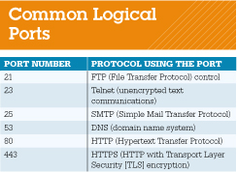
Restricting Access to Your Digital Assets Knowing Your Computer Is Secure (cont.)
Notes:
If the firewall is already configured and common ports are identified as being vulnerable, consult your firewall documentation for instructions on how to close or restrict access to those ports.

Slide 56
Restricting Access to Your Digital Assets Creating Passwords
Strong passwords are difficult to guess
Not easily associated with you (birth date, name of pet, nickname)
At least 14 characters, including numbers, symbols, and upper- and lowercase letters
Not a single word or a word from a dictionary
Notes:
Strong passwords are difficult for someone to guess. Follow these guidelines to create strong passwords:
Don’t use easily deduced components related to your life, such as parts of your name, your pet’s name, your street address, or the name of the website or institution for which you are creating the password (i.e., don’t use “Wells Fargo” for your online banking password).
Use a password that is at least 14 characters long. Longer passwords are more difficult to deduce.
Don’t use words found in the dictionary.

Slide 57
Restricting Access to Your Digital Assets Creating Passwords
Strong passwords are difficult to guess (cont.)
Use a mix of upper- and lowercase letters and symbols
Never tell anyone or write down password
Change password regularly (every month)
Use different passwords for different websites
Notes:
Strong passwords are difficult for someone to guess. Follow these guidelines to create strong passwords:
Use a mix of upper- and lowercase letters and symbols (e.g., # or %).
Never tell anyone your password or write it down in a place where others might see it, like in your wallet or purse.
Change your passwords on a regular basis, such as monthly or quarterly. Your school or your employer probably requires you to change your password regularly. This is also a good idea for your personal passwords.
Don’t use the same password for every account you have.
If you have trouble thinking of secure passwords, there are many password generators available for free, such as the Strong Password Generator.

Slide 58
Restricting Access to Your Digital Assets Creating Passwords (cont.)
Notes:
Strong passwords are difficult for someone to guess. Follow these guidelines to create strong passwords.

Slide 59
Restricting Access to Your Digital Assets Creating Passwords (cont.)
Password strength tests evaluate your passwords
Password Meter
Operating systems have built-in password protection
Windows 8 allows you to use picture passwords
Notes:
You can use online password strength testers, such as the Password Meter, to evaluate your passwords.
To restrict access to your computer, Windows, OS X, and most other operating systems have built-in password (or passcode) protection for files as well as the entire desktop.
After a certain period of idle time, your computer is automatically password locked, and your password must be entered to gain access to the computer. This provides excellent protection from casual snooping if you need to walk away from your computer for a period of time.
It’s an especially good idea to use passwords on laptop computers, smartphones, and tablets because this provides additional protection of your data if your device is lost or stolen.
Windows 8 allows you to use picture passwords. You select a picture then draw three gestures on it: either straight lines, circles, or taps. This picture then works as an additional method for accessing your computer. You just unlock your computer by repeating the gestures.

Slide 60
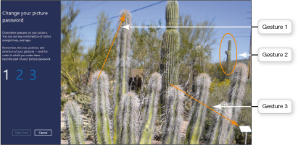
Restricting Access to Your Digital Assets Creating Passwords (cont.)
Notes:
Drawing three gestures on your picture (and repeating them three times) sets your picture password options in Windows 8.

Slide 61
Restricting Access to Your Digital Assets Managing Your Passwords
Well-constructed passwords can be hard to remember
Password management software remembers passwords for you
Most security suites and web browsers provide password management tools
Notes:
Good security practices suggest that you have different passwords for all the different websites that you access and that you change your passwords frequently.
The problem with well-constructed passwords is that they can be hard to remember. Fortunately, password management tools are now widely available. They take the worry out of forgetting passwords because the password management software does the remembering for you.
Most current Internet security suites and web browsers make it easy to keep track of passwords by providing password management tools.
For example, Internet Explorer (IE) 10 will remember passwords for you. When you go to a website that requires a login, IE 10 will display a dialog box prompting you to have IE remember the password for the site. Then, when you return to the site and type in your user name, IE will fill in the password information for you using a process known as auto complete. However, there are some passwords that you shouldn’t have your browser remember, such as your online banking password.

Slide 62
Restricting Access to Your Digital Assets Managing Your Passwords (cont.)
Notes:
The password bar in IE 10 displays whenever you type in a password for a website for which IE hasn’t yet stored the password.

Slide 63
Restricting Access to Your Digital Assets Anonymous Web Surfing: Hiding from Prying Eyes
Current versions of Google Chrome, Firefox, and Internet Explorer include privacy tools that help you surf the web anonymously
Incognito
Private Browsing
InPrivate
Notes:
If you use shared computers in public places such as libraries, coffee shops, or student unions, you never know what nefarious tools have been installed by hackers on a public computer. When you browse the Internet, traces of your activity are left behind on that computer, often as temporary files. A wily hacker can glean sensitive information long after you have finished your surfing session. In addition, many employers routinely review the Internet browsing history of employees to ensure that workers are spending their time on the Internet productively.
The current versions of Google Chrome, Firefox, and Internet Explorer include privacy tools (called Incognito, Private Browsing, and InPrivate, respectively) that help you surf the web anonymously. When you choose to surf anonymously, all three browsers open special versions of their browser windows that are enhanced for privacy. When surfing in these windows, records of websites you visit and files you download don’t appear in the web browser’s history files. Furthermore, any temporary files that were generated in that browsing session are deleted when you exit the special window.

Slide 64
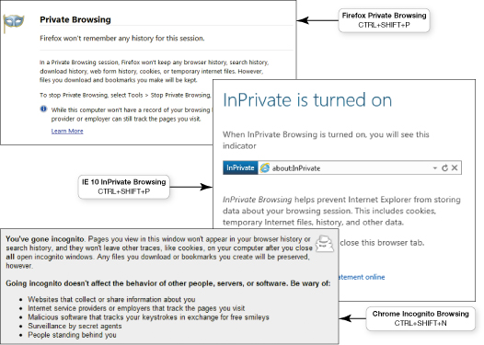
Restricting Access to Your Digital Assets Anonymous Web Surfing: Hiding from Prying Eyes (cont.)
Notes:
The current versions of the Firefox, Internet Explorer, and Google Chrome browsers all feature privacy tools for web surfing.

Slide 65
Restricting Access to Your Digital Assets Anonymous Web Surfing: Hiding from Prying Eyes (cont.)
Portable privacy devices provide an even higher level of surfing privacy
Imation Personal Flash Drive
Store sensitive Internet files
Preload Linux OS on a flash drive to avoid using the public or work computer’s OS
Notes:
Portable privacy devices, such as the Imation Personal Flash Drive, provide an even higher level of surfing privacy. Simply plug the device into an available USB port on the machine on which you’ll be working.
All sensitive Internet files, such as cookies, Internet history, and browser caches, will be stored on the privacy device, not on the computer you’re using.
Privacy devices such as these often come preloaded with software designed to shield your IP address from prying eyes, making it difficult (if not impossible) for hackers to tell where you’re surfing the Internet. These privacy devices also have password management tools that store all of your login information and encrypt it so it will be safe if your privacy device falls into someone else’s hands.
Another free practical solution is to take the Linux OS with you on a flash drive and avoid using the public or work computer’s OS.

Slide 66
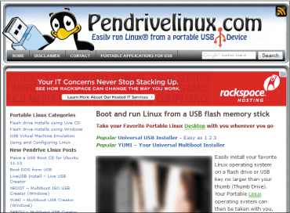
Restricting Access to Your Digital Assets Anonymous Web Surfing: Hiding from Prying Eyes (cont.)
Notes:
Pendrivelinux.com can help you load a version of Linux onto a flash drive.

Slide 67
Restricting Access to Your Digital Assets Anonymous Web Surfing: Hiding from Prying Eyes (cont.)
Third-party software developers offer apps to enhance tablet security
hidePad
Notes:
Tablets like the iPad run their own proprietary operating systems that differ from the operating systems deployed on laptop and desktop computers. Although tablet operating systems do contain security features, they might not be robust enough to satisfy business users who have a great deal of confidential information on their tablets, especially when the devices are connected to wireless networks.
Third-party software developers are now offering many apps to enhance tablet security. Comprehensive suites like hidePad offer features such as government-grade encryption of data, enhanced e-mail security, and anonymous web surfing. Look for security apps that are specifically designed for your tablet device if you often deal with sensitive data on your tablet, such as online banking.

Slide 68
Restricting Access to Your Digital Assets Biometric Authentication Devices
Read unique personal characteristics
Fingerprint
Iris pattern in eye
Voice authentication
Face pattern recognition
Provide high level of security
Eliminate human error
Notes:
A biometric authentication device is a device that reads a unique personal characteristic such as a fingerprint or the iris pattern in your eye and converts it to a digital code.
When you use the device, your pattern is read and compared to the one stored on the computer. Only users who have an exact fingerprint or iris pattern match are allowed to access the computer.
Because no two people have the same biometric characteristics (fingerprints and iris patterns are unique), these devices provide a high level of security.
They can also eliminate the human error that can occur in password protection. Some notebooks, such as Lenovo models, feature built-in fingerprint readers, and companies like Secure produce computer mice and keyboards that include built-in fingerprint readers.
Other biometric devices, including voice authentication and face pattern recognition systems, are now widely offered in notebook computers.

Slide 69
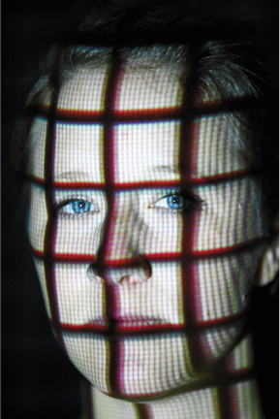
Restricting Access to Your Digital Assets Biometric Authentication Devices (cont.)
Notes:
Face recognition software is now available on laptops. You might forget your password, but you won’t forget to bring your face!

Slide 70
Managing Online Annoyances Malware: Adware and Spyware
Malware: Software that has a malicious intent
Three primary forms: adware, spyware, and viruses
Known collectively as grayware, most malware is intrusive, annoying, or objectionable online programs downloaded to your computer
Adware: Software that displays sponsored advertisements
Notes:
Malware is software that has a malicious intent (hence the prefix mal). There are three primary forms of malware: adware, spyware, and viruses. Adware and spyware are not physically destructive like viruses and worms, which can destroy data.
Known collectively as grayware, most malware is intrusive, annoying, or objectionable online programs that are downloaded to your computer when you install or use other online content such as a free program, game, or utility.
Adware is software that displays sponsored advertisements in a section of your browser window or as a pop-up box. It’s considered a legitimate, although sometimes annoying, means of generating revenue for those developers who do not charge for their software or information. Fortunately, because web browsers such as Firefox, Safari, and Internet Explorer have built-in pop-up blockers, the occurrence of annoying pop-ups has been greatly reduced.

Slide 71
Managing Online Annoyances Malware: Adware and Spyware
Some pop-ups are legitimate and increase functionality of the originating site
Notes:
However, some pop-ups are legitimate and increase the functionality of the originating site. For example, your account balance might pop up on your bank’s website. To control which sites to allow pop-ups on, you can access the pop-up blocker settings in your browser and add websites for which you allow pop-ups. Whenever a pop-up is blocked, the browser displays an information bar or plays a sound to alert you. If you feel the pop-up is legitimate, you can choose to accept it.

Slide 72
Managing Online Annoyances Malware: Adware and Spyware (cont.)
Spyware: An unwanted piggyback program that usually downloads with other software you install form the Internet and runs in the background
Transmits information about you
Use tracking cookies
Keystroke logger: Monitors keystrokes to steal passwords, login IDs, or credit card information
Notes:
Spyware is an unwanted piggyback program that unusually downloads with other software you install from the Internet and runs in the background of your system.
Without your knowledge, spyware transmits information about you, such as your Internet-surfing habits, to the owner of the program so that the information can be used for marketing purposes.
Many spyware programs use tracking cookies (small text files stored on your computer) to collect information. One type of spyware program known as a keystroke logger (key logger) monitors keystrokes with the intent of stealing passwords, login IDs, or credit card information.

Slide 73
Managing Online Annoyances Malware: Adware and Spyware (cont.)
Anti-spyware software: Detects unwanted programs and allows you to delete them
It’s a good idea to install one or two additional stand-alone anti-spyware programs
Notes:
Anti-spyware software detects unwanted programs and allows you to delete the offending software easily. Most Internet security suites now include anti-spyware software. You can also obtain standalone anti-spyware software and run it on your computer to delete unwanted spyware.
Because so many variants of spyware exist, your Internet security software might not detect all types that attempt to install themselves on your computer. Therefore, it is a good idea to install one or two additional standalone anti-spyware programs on your computer.
Because new spyware is created all the time, you should update and run your anti-spyware software regularly.

Slide 74
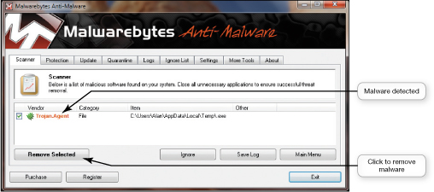
Managing Online Annoyances Malware: Adware and Spyware (cont.)
Windows Defender: Windows program that scans your system for spyware and other unwanted software
Notes:
Windows comes with a program called Windows Defender, which scans your system for spyware and other potentially unwanted software. Malwarebytes Anti-Malware, Ad-Aware, and Spybot-Search & Destroy are other anti-spyware programs that are easy to install and update.

Slide 75
Managing Online Annoyances Spam
Spam: Unwanted or junk e-mail
Spim: Unsolicited instant messages
Create a free e-mail address you use only when you fill out forms or buy items on the web
Notes:
Companies that send out spam—unwanted or junk e-mail—find your e-mail address either from a list they purchase or with software that looks for e-mail addresses on the Internet.
Unsolicited instant messages are also a form of spam, called spim. If you’ve used your e-mail address to purchase anything online, open an online account, or participate in a social network such as Facebook, your e-mail address eventually will appear on one of the lists that spammers get.
One way to avoid spam in your primary account is to create a free e-mail address that you use only when you fill out forms or buy items on the web. If your free e-mail account is saturated with spam, you can abandon that account with little inconvenience.

Slide 76
Managing Online Annoyances Spam (cont.)
Spam filter: An option you can select in your e-mail account that places spam into a special folder
Third-party programs available
SPAMfighter
Notes:
Another way to avoid spam is to filter it. A spam filter is an option you can select in your e-mail account that places known or suspected spam messages into a special folder (called “Spam” or “Junk Mail”). Most web-based e-mail services, such as Hotmail and Yahoo!, offer spam filters. Microsoft Outlook also features a spam filter.
You can also buy third-party programs that provide some control over spam, including SPAMfighter, which you can download at www.download.com
Spam filters and filtering software can catch as much as 95% of spam by checking incoming e-mail subject headers and senders’ addresses against databases of known spam.
Spam filters also check your e-mail for frequently used spam patterns and keywords, such as “for free” and “over 21.” Spam filters aren’t perfect, and you should check the spam folder before deleting its contents because legitimate e-mail might end up there by mistake.
Most programs let you reclassify e-mails that have been misidentified as spam.

Slide 77
Managing Online Annoyances Spam (cont.)
Other ways to prevent spam
Read website privacy policies and don’t give the site permission to pass on your e-mail address
Don’t reply to spam
Subscribe to an e-mail forwarding service
VersaForward
Sneakemail.com
Notes:
Here are a few other ways you can prevent spam:
Before registering on a website, read its privacy policy to see how it uses your e-mail address. Don’t give the site permission to pass on your e-mail address to third parties.
Don’t reply to spam to remove yourself from the spam list. By replying, you’re confirming that your e-mail address is active. Instead of stopping spam, you might receive more.
Subscribe to an e-mail forwarding service such as VersaForward or Sneakemail.com. These services screen your e-mail messages, forwarding only those messages you designate as being okay to accept.

Slide 78
Managing Online Annoyances Cookies
Cookies: Small text files that some websites automatically store on your hard drive
Provide websites with information about your browsing habits
Notes:
Cookies are small text files that some websites automatically store on your hard drive when you visit them. When you log on to a website that uses cookies, a cookie file assigns an ID number to the computer. The unique ID is intended to make your return visit to a website more efficient and better geared to your interests. The next time you log on to that site, the site marks your visit and keeps track of it in its database.
Cookies can provide websites with information about your browsing habits, such as the ads you’ve opened, the products you’ve looked at, and the time and duration of your visits.
By tracking such information, cookies enable companies to identify different users’ preferences.

Slide 79
Managing Online Annoyances Cookies (cont.)
Cookies don’t search for personal information
Only collect personal information you supply when filling out forms
Some sites sell the information cookies collect
Cookies pose no security threat
Notes:
Cookies do not go through your hard drive in search of personal information such as passwords or financial data. The only personal information a cookie obtains is the information you supply when you fill out forms online.
Some sites sell the personal information their cookies collect to web advertisers who are building huge databases of consumer preferences and habits, collecting personal and business information such as phone numbers, credit reports, and the like.
The main concern is that advertisers will use this information indiscriminately, thus invading your privacy.
Cookies pose no security threat because it is virtually impossible to hide a virus or malicious software program in a cookie. Because they take up little room on your hard drive, and offer you small conveniences on return visits to websites, there is no great reason to delete them.
Deleting your cookie files could actually cause you the inconvenience of reentering data you have already entered into website forms.

Slide 80
Keeping Your Data Safe
People are often too trusting or careless when it comes to their private information or digital data
Notes:
People are often too trusting or just plain careless when it comes to protecting private information about themselves or their digital data.
In this section, we discuss ways to keep your data safe from damage, either accidental or intentional, and to keep unscrupulous individuals from tricking you into revealing sensitive information.

Slide 81
Keeping Your Data Safe Protecting Your Personal Information
Reveal as little information as possible
Notes:
A good rule of thumb is to reveal as little information as possible, especially if the information would be available to everyone.
Your Social Security number, phone number, date of birth, and street addresses are four key pieces of information that identity thieves need to steal an identity. This information should never be shared in a public area on any website.
Social networking sites like Facebook make privacy settings available in your profile settings. If you’ve never changed your default privacy settings in Facebook, you’re probably sharing information more widely than you should.
To protect your information on Facebook, you need to change your privacy settings from some of the default options. In general, it’s a bad idea to make personal information available to the public, although this is a default setting for some items in Facebook. It’s a good idea to set most of the options in your profile’s Basic information section to Friends or to Only Me because, presumably, these are personal details you should wish to share only with friends.
In the Contact Information section, restricting this information only to friends or to yourself is imperative. You don’t want scammers contacting you via e-mail or snail mail and trying to trick you into revealing sensitive information.

Slide 82
Keeping Your Data Safe Backing Up Your Data
Data on your computer faces three major threats
Unauthorized access
Tampering
Destruction
Backups are copies of files that you can use to replace the originals If they’re lost or damaged
Notes:
The data on your computer faces three major threats:
Unauthorized access
Tampering
Destruction
As noted earlier, a hacker can gain access to your computer and steal and alter your data. However, a more likely scenario is that you’ll lose your data unintentionally. You might accidentally delete files. You could drop your laptop on the ground, causing the hard drive to break and resulting in complete data loss. A virus from an e-mail attachment you opened might destroy your original file. Your house might catch fire and destroy your computer.
Because many of these possibilities are beyond your control, you should have a strategy for backing up your files. Backups are copies of files that you can use to replace the originals if they’re lost or damaged.

Slide 83
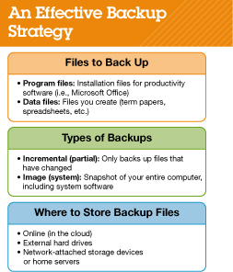
Keeping Your Data Safe Backing Up Your Data (cont.)
Two types of files need backups
Program files: Files used to install software
Data files: Files you’ve created or purchased
Notes:
Two types of files need backups:
Program files include files used to install software, usually found on DVDs or downloaded from the Internet. As long as you have the DVDs in a safe place, you shouldn’t need to back up these program files. However, if you have downloaded a program file from the Internet, you should make a copy of the program installation files on a removable storage device such as a backup.
Data files include files you’ve created or purchased, such as research papers, spreadsheets, music and photo files, contact lists, address books, e-mail archives, and your Favorites list from your browser.
You should have a strategy for backing up your files.

Slide 84
Keeping Your Data Safe Backing Up Your Data (cont.)
Two main options for backing up files
Incremental backup (partial backup): Backing up only files that have changed or been created since the last backup
More efficient
Image backup (system backup): All system, application, and data files are backed up
Makes an exact copy of the setup
Notes:
There are two main options for backing up files:
An incremental backup (or partial backup) involves backing up only files that have changed or been created since the last backup was performed. Using backup software that has an option for incremental backups will save time because backing up files that haven’t changed is redundant.
An image backup (or system backup) means that all system, application, and data files are backed up, not just the files that changed. Although incremental backups are more efficient, an image backup ensures you capture changes to application files, such as automatic software updates, that an incremental backup might not capture. The idea of imaging is to make an exact copy of the setup of your computer so that in the event of a total hard drive failure you could copy the image to a new hard drive and have your computer configured exactly the way it was before the crash.

Slide 85
Keeping Your Data Safe Backing Up Your Data (cont.)
Backups must be stored away from where your computer is located and should be stored in at least two different places to be truly secure
Three main choices
Online (in the cloud)
External hard drives
Network-attached storage (NAS)
Notes:
To be truly secure, backups must be stored away from where your computer is located and should be stored in at least two different places.
You have three main choices for where to back up your files:
Online (in the cloud): The beauty of online storage is that you don’t need to be at your home computer or lug around your external hard drive to access your data. More important, because the information is stored online, it’s in a secure, remote location, so data is much less vulnerable to the disasters that could harm data stored in your computer or external hard drive. Free storage options include Microsoft SkyDrive and Adrive. However, image backups probably won’t fit within the storage limits offered by free providers. For a fee, companies such as Carbonite and iBackup provide larger storage capacity.
External hard drives: External hard drives, or even large-capacity flash drives, are popular backup options that are usually connected to a single computer. Although convenient and inexpensive, using external hard drives for backups still presents the dilemma of keeping the hard drive in a save location. Also, external hard drives can fail, possibly leading to loss of your backup data. Therefore, using an external hard drive for backups is best done in conjunction with an online backup strategy for added safety.
Network-attached storage (NAS) devices and home servers: NAS devices are essentially large hard drives that are connected to a network of computers instead of one computer, and they can be used to back up multiple computers simultaneously. Home servers also act as high-capacity NAS devices for automatically backing up data and sharing files.
You should back up your data files every time you make changes to them, which can be difficult to remember to do. Fortunately, most backup software can be configured to do backups automatically so you don’t forget to perform them.
Because your program and OS files don’t change as often as your data files, you can perform image backups on a less frequent basis. You might consider scheduling an image backup of your entire system on a weekly basis, but you should definitely perform one after installing new software.

Slide 86
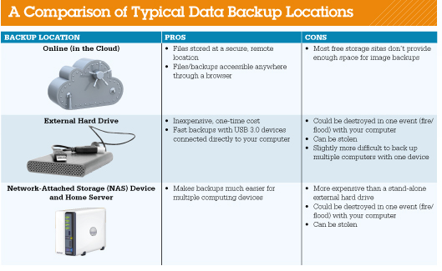
Keeping Your Data Safe Backing Up Your Data (cont.)
Notes:
You have three main choices for where to back up your files.

Slide 87
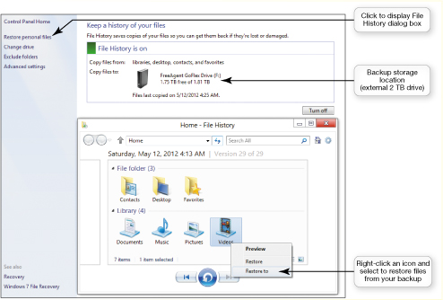
Keeping Your Data Safe Backing Up Your Data (cont.)
Windows 8 includes the Windows 7 File Recovery utility
Notes:
Windows 8 includes the Windows 7 File Recovery utility, which provides a quick and easy way to schedule regular image backups. You can access the utility from the Windows 7 File Recovery link on the File History screen.
You can use the Windows 8 File History utility to back up files and restore files from a previous backup.
Access the Control Panel, select the System and Security group, and then click the File History link.

Slide 88
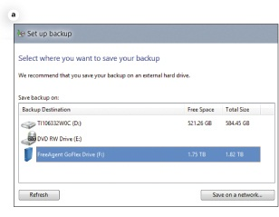
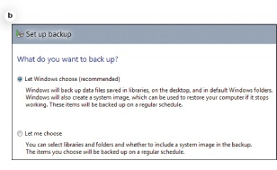
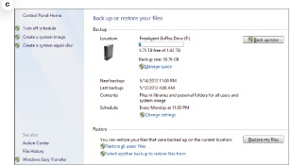
Keeping Your Data Safe Backing Up Your Data (cont.)
Notes:
Before starting the Windows 7 File Recovery utility, make sure your external hard drive or NAS device is connected to your computer or network and is powered on. To set it up, follow these steps:
When you start the Windows 7 File Recovery utility for the first time, no backups will have ever been configured. Select the Set up backup option to launch the Set up backup dialog box and display a list of available backup devices. Select a device, and click Next to proceed.
On the next screen you have the option to let Windows choose what to back up or to choose for yourself what you want to back up. If you let Windows choose, your backup will include your data files as well as a system image backup. Click Next to proceed.
On the following screen, you can review your settings and set up a schedule for the backups. When you click the Save settings and exit button, you are returned to the Back up or restore your files screen, which now shows the scheduled backup. You can also choose to restore backed-up files you have backed up from this screen.
From the Back up or restore your files screen, you can also create a system repair disk by clicking on the appropriate link. A system repair disc is a DVD that you can use to boot your computer in case of a serious Windows error. You can also use this disc when you need to restore your computer from an image backup, so it’s a good idea to create the repair disc before you begin using your computer heavily.

Slide 89
Keeping Your Data Safe Backing Up Your Data (cont.)
For OS X users, the Time Machine feature in OS X that detects when an external hard drive is connected
Files stored on a school’s network are most likely regularly backed up – check with your school’s network administrators
Notes:
For OS X users, backups are very easy to configure. The Time Machine feature in OS X detects when an external hard drive is connected to the computer or a NAS device is connected to your network. You’re then asked if you want this to be your backup drive.
If you answer yes, all of your files (including OS files) are automatically backed up to the external drive or NAS device.
Most likely, if you’re allowed to store files on your school’s network, these files are backed up regularly. You should check with your school’s network administrators to determine how often they’re backed up and how you would request that files be restored from the backup if they’re damaged or deleted.

Slide 90
Social Engineering
Social engineering: Any technique that uses social skills to generate human interaction that entices individuals to reveal sensitive information
Often doesn’t involve computers or face-to-face interaction
Most use pretexting, creating a scenario that sounds legitimate
Notes:
Social engineering is any technique that uses social skills to generate human interaction that entices individuals to reveal sensitive information.
Social engineering often doesn’t involve the use of a computer or face-to-face interaction.
Most social engineering schemes use a pretext to lure their victims. Pretexting involves creating a scenario that sounds legitimate enough that someone will trust you.
For example, you might receive a phone call during which the caller says he is from your bank and that someone tried to use your account without authorization. The caller then tells you he needs to confirm a few personal details such as your birth date, Social Security number, bank account number, and whatever other information he can get out of you. The information he obtains can then be used to empty your bank account or commit some other form of fraud. The most common form of pretexting in cyberspace is phishing.

Slide 91
Social Engineering Phishing and Pharming
Phishing: Lures Internet users to reveal personal information such as credit card numbers, Social Security numbers, or other sensitive information
Scammers send e-mails
Pharming: Malicious code is planted on your computer, either by viruses or by visiting malicious websites
Alters browser’s ability to find web addresses
Notes:
Phishing (pronounced “fishing”) lures Internet users to reveal personal information such as credit card numbers, Social Security numbers, or other sensitive information that could lead to identity theft.
The scammers send e-mail messages that look like they’re from a legitimate business such as an online bank. The e-mail usually states that the recipient needs to update or confirm his or her account information. When the recipient clicks the provided link, he or she goes to a website. The site looks like a legitimate site but is really a fraudulent copy the scammer has created. Once the e-mail recipient enters his or her personal information, the scammers capture it and can begin using it.
Pharming is much more insidious than phishing. Pharming occurs when malicious code is planted on your computer, either by viruses or by visiting malicious websites, which then alters your browser’s ability to find web addresses.
Users are directed to bogus websites even if they enter the correct address of the real website. You end up at a fake website that looks legitimate but is expressly set up for the purpose of gathering information.

Slide 92
Social Engineering Phishing and Pharming (cont.)
Guidelines to avoid schemes
Never reply directly to e-mails asking for personal information
Don’t click on links in e-mails to go to a website
Never give personal information over the Internet unless the site is secure
Use phishing filters
Use Internet security software
Notes:
Follow these guidelines to avoid falling prey to such schemes:
Never reply directly to any e-mail asking you for personal information.
Don’t click on a link in an e-mail to go to a website. Instead, type the website address in the browser.
Check with the company asking for the information and only give the information if you’re certain it’s needed.
Never give personal information over the Internet unless you know the site is secure. Look for the closed padlock, https, or a certification seal such as Norton Secured to help reassure you that the site is secure.
Use phishing filters. The latest versions of Firefox, Chrome, and Internet Explorer have phishing filters built in, so each time you access a website, the phishing filter checks for the site’s legitimacy and warns you of possible web forgeries.
Use Internet security software on your computer that’s constantly being updated.

Slide 93
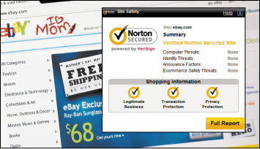
Social Engineering Phishing and Pharming (cont.)
Internet security packages can detect and prevent pharming attacks
McAfee or Norton
Notes:
Most Internet security packages can detect and prevent pharming attacks. The major Internet security packages—for example, McAfee and Norton—also offer phishing protection tools.
Not sure whether you’re on the eBay website or a cleverly disguised phishing site? Norton Site Safety reassures you that all is well.

Slide 94
Social Engineering Scareware
Scareware: Malware that’s downloaded onto your computer and tries to convince you that your computer is infected with a virus or other malware
Directed to website to buy fake removal or antivirus tools with little or no value
Uses people’s fear
Notes:
Scareware is a type of malware that’s downloaded onto your computer and tries to convince you that your computer is infected with a virus or other type of malware. Pop-ups, banners, or other annoying types of messages will flash on your screen saying frightening things like, “Your computer is infected with a virus! Immediate removal is required.”
You’re then directed to a website where you can buy fake removal or antivirus tools that provide little or no value.
Scareware is a social engineering technique because it uses people’s fear of computer viruses to convince them to part with their money. Scareware is often designed to be extremely difficult to remove from your computer and to interfere with the operation of legitimate security software.

Slide 95
Social Engineering Scareware
Scareware: (cont.)
Usually downloaded onto your computer
Most Internet security suites, antivirus, and anti-malware packages now detect and prevent the installation of scareware
Notes:
Scareware is usually downloaded onto your computer from infected websites or Trojan horse files.
Most Internet security suites, antivirus, and anti-malware software packages now detect and prevent the installation of scareware.
Make sure you never click on website banners or pop-up boxes that say “Your computer might be infected, click here to scan your files” because these are often starting points for installing malicious scareware files on your computer.

Slide 96
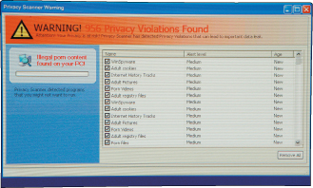
Social Engineering Scareware (cont.)
Notes:
Preying on people’s fears, scareware attempts to convince you that your computer is infected with a virus and you need to purchase a “solution.”

Slide 97
Protecting Your Physical Computing Assets
Computers, tablets, and phones aren’t useful if damaged
Protect them from environmental factors, power surges, and theft
Notes:
Your computer, tablet, and phone aren’t useful to you if they’re damaged. Therefore, it’s essential to select and ensure a safe environment for these devices. This includes protecting them from environmental factors, power surges, power outages, and theft.

Slide 98
Protecting Your Physical Computing Assets Environmental Factors
Make sure computer sits flat on a level surface
Carry laptops or tablets in a protective case
Don’t leave computing devices and phones in a car in extreme temperatures
Chill mats are useful accessories for laptops
Notes:
Computers are delicate devices and can be damaged by the adverse effects of abuse or a poor environment.
Sudden movements, such as a fall, can damage your computing device’s internal components. You should make sure that your computer sits on a flat, level surface, and if it’s a laptop or a tablet, you should carry it in a protective case.
Electronic components don’t like excessive heat or excessive cold. Don’t leave computing devices and phones in a car during especially hot or cold weather because components can be damaged by extreme temperatures.
Unfortunately, computers generate a lot of heat, which is why they have fans to cool their internal components. Chill mats that contain cooling fans and sit underneath laptop computers are useful accessories for dissipating heat.

Slide 99
Protecting Your Physical Computing Assets Environmental Factors
Place desktops where the fan’s intake vent is unblocked
Keep computer rooms as clean as possible
Don’t consume food or beverages near your computer
Notes:
Make sure that you place your desktop computer where the fan’s intake vents, usually found on the rear of the system unit, are unblocked so that air can flow inside.
Naturally, a fan drawing air into a computer also draws in dust and other particles, which can wreak havoc on your system. Therefore, keep the room in which your computer is located as clean as possible. Finally, because food crumbs and liquid can damage keyboards and other computer components, consume food and beverages away from your computer.

Slide 100
Protecting Your Physical Computing Assets Power Surges
Power surges: Electrical current is supplied in excess of normal voltage
Old or faulty wiring
Downed power lines
Malfunctions at electric company substations
Lightning strikes
Notes:
Power surges occur when an electrical current is supplied in excess of normal voltage. Old or faulty wiring, downed power lines, malfunctions at electric company substations, and lightning strikes can all cause power surges.
A surge protector is a device that protects your computer against power surges. To use a surge protector, simply plug your electrical devices into the outlets of the surge protector, which in turn plugs into the wall outlet.
Note that you should replace your surge protectors every two to three years. Also, after a major surge, the surge protector will no longer function and must be replaced.

Slide 101
Protecting Your Physical Computing Assets Power Surges (cont.)
Surge protector: Device that protects your computer against power surges
Replace every two to three years
Use with all devices that have solid-state components
Notes:
All electronic devices in the home that have solid-state components, such as TVs, stereos, printers, and cell phones (when charging), should be connected to a surge protector. However, it can be inconvenient to use individual surge protectors on everything. A more practical method is to install a whole-house surge protector. Whole-house surge protectors function like other surge protectors, but they protect all electrical devices in the house. Typically, you will need an electrician to install a whole-house surge protector, which will cost $300 to $400 (installed).
Surge protectors won’t necessarily guard against all surges. Lightning strikes can generate high voltages that can overwhelm a surge protector. As tedious as it sounds, unplugging computers and peripherals during an electrical storm is the only way to achieve absolute protection.

Slide 102
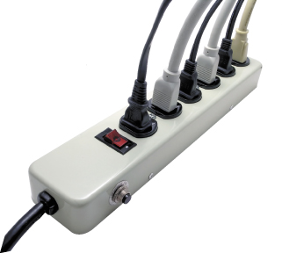
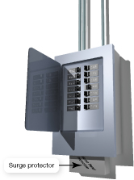
Protecting Your Physical Computing Assets Power Surges (cont.)
Notes:
Surge protectors such as this one are critical for protecting your electronic devices.
A whole-house surge protector usually is installed at the breaker panel or near the electric meter.

Slide 103
Protecting Your Physical Computing Assets Deterring Theft
Four main security concerns with mobile devices
Keeping them from being stolen
Keeping data secure in case they are stolen
Finding a device if it is stolen
Remotely recovering and wiping data off a stolen device
Notes:
Because they’re portable, laptops, tablets, and phones are easy targets for thieves. You have four main security concerns with mobile devices:
Keeping them from being stolen
Keeping data secure in case they are stolen
Finding a device if it is stolen
Remotely recovering and wiping data off a stolen device

Slide 104
Protecting Your Physical Computing Assets Keep Them Safe: Alarms
Motion alarm software: Good inexpensive theft deterrent
LAlarm: Free software for laptops
SuperAlarm and Alarmomatic secure iPad or iPhone
Detects motion and sets off an alarm
Notes:
Motion alarm software is a good inexpensive theft deterrent. Free software such as LAlarm is effective for laptops. Apps such as SuperAlarm and Alarmomatic help secure your iPad or iPhone.
Software detects motion, like your device being picked up, then sets off an ear-piercing alarm until you enter the disable code.

Slide 105
Protecting Your Physical Computing Assets Keeping Mobile Device Data Secure
Encrypting the data on your mobile device can make it extremely difficult, if not impossible, for thieves to obtain sensitive data from your stolen equipment.
Encryption involves transforming your data using an algorithm that can only be unlocked by a secure code (or key)
Safe: An app that provides 256-bit encryption
DataLock and SafeHouse are available for laptop computers
Notes:
Encrypting the data on your mobile device can make it extremely difficult, if not impossible, for thieves to obtain sensitive data from your stolen equipment. Encryption involves transforming your data using an algorithm that can only be unlocked by a secure code (or key).
Safe is an app that provides 256-bit encryption, which is very hard to crack, for data and images on your iPhone or iPad. If your password is not entered, no one can access the data and images on your iPhone or iPad. Data Protection is a similar app for Android devices.
DataLock and SafeHouse are available for laptop computers to provide encryption for files or even entire hard drives.

Slide 106
Protecting Your Physical Computing Assets Software Alerts and Data Wipes
Theft-tracking software enables your computer to alert authorities to a computer’s location if it is stolen
Computrace LoJack for Laptops
PC PhoneHome
MacPhoneHome
Notes:
You’ve probably heard of LoJack, the theft-tracking device used in cars. Similar systems now exist for computers. Tracking software such as Computrace LoJack for Laptops, PC PhoneHome, and MacPhoneHome enables your computer to alert authorities to the computer’s location if it is stolen. A similar app for Android and iOS devices is iHound.
To enable your mobile device to help with its own recovery, you install the tracking software on your device. The software contacts a server at a software manufacturer’s website each time the device connects to the Internet. If your device is stolen, you notify the software manufacturer. The software manufacturer instructs your device to transmit tracking information, such as an IP address, WiFi hotspot, or cell tower location, that will assist authorities in locating and retrieving the mobile device.
The files and directories holding the software aren’t visible to thieves looking for such software, so they probably won’t know the software is there. Furthermore, the tracking software is written in such a way that even if the thieves tried to reformat the hard drive, it would detect the reformat and hide the software code in a safe place in memory or on the hard drive.

Slide 107
Protecting Your Physical Computing Assets Software Alerts and Data Wipes (cont.)
If your laptop can’t be recovered, software packages are available that provide for remote recovery and deletion of files
Computrace LoJack for Laptops
Apple offers Find My iPhone service
Notes:
In the event that your laptop can’t be recovered, software packages are available that provide for remote recovery and deletion of files. Computrace LoJack for Laptops has these features and allows you to lock your device to keep the thieves from accessing it or to remotely wipe its contents by deleting all your data from your laptop.
For all iOS devices, Apple offers the Find My iPhone service, which is now part of iCloud. Enabling this service on your device provides you with numerous tools that can assist you in recovering and protecting your mobile devices.
Did you forget where you left your iPad? Just sign in with your Apple ID at the iCloud website to see a map showing the location of your iPad. You can also remotely send a message to be displayed on your lost device, such as your phone number and a reward offer, so that someone who finds it will know what to do. If you can’t recover the device, you can remotely password lock it so no one can use it or, if necessary, wipe all the data off the device to completely protect your privacy.

Slide 108
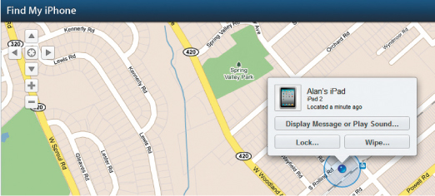
Protecting Your Physical Computing Assets Software Alerts and Data Wipes (cont.)
Notes:
The Find My iPhone app can help you if your iOS device goes astray.

Slide 109
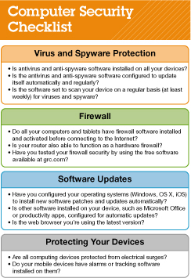
Protecting Your Physical Computing Assets Software Alerts and Data Wipes (cont.)
Checklist guide to ensure security
Notes:
The checklist shown is a guide to ensure you haven’t missed any critical aspects of security. If you’ve addressed all these issues, then you can feel reasonably confident that your digital data and devices are secure.

Slide 110
Chapter 9 Summary Questions
What is cybercrime and who perpetrates it?
Notes:
1. What is cybercrime and who perpetrates it?
Cybercrime is any type of crime that is perpetrated via a computer or a website. Major types of cybercrime are identity theft, credit card fraud, computer viruses, illegal access of computer systems, and auction fraud. Cybercriminals use computers, the Internet, and computer networks to commit their crimes.

Slide 111
Chapter 9 Summary Questions
What are the types of viruses from which I need to protect my computer?
Notes:
2. What are the types of viruses from which I need to protect my computer?
A computer virus is a program that attaches itself to another program and attempts to spread to other computers when files are exchanged. Computer viruses can be grouped into six categories: (1) boot-sector viruses, (2) logic bombs and time bombs, (3) worms, (4) scripts and macro viruses, (5) e-mail viruses, and (6) encryption viruses. Once run, viruses perform their malicious duties in the background and are often invisible to the user.

Slide 112
Chapter 9 Summary Questions
What can I do to protect my computer from viruses?
Notes:
3. What can I do to protect my computer from viruses?
The best defense against viruses is to install antivirus software. You should update the software on a regular basis and configure it to examine all e-mail attachments for viruses. You should periodically run a complete virus scan on your computer to ensure that no viruses have made it onto your hard drive.

Slide 113
Chapter 9 Summary Questions
How can hackers attack my computing devices, and what harm can they cause?
Notes:
4. How can hackers attack my computing devices, and what harm can they cause?
A hacker is defined as anyone who breaks into a computer system unlawfully. Hackers can use software to break into almost any computer connected to the Internet, unless proper precautions are taken. Once hackers gain access to a computer, they can potentially (1) steal personal or other important information, (2) damage and destroy data, or (3) use the computer to attack other computers.

Slide 114
Chapter 9 Summary Questions
What is a firewall, and how does it keep my computer safe from hackers?
Notes:
5. What is a firewall, and how does it keep my computer safe from hackers?
Firewalls are software programs or hardware devices designed to keep computers safe from hackers. By using a personal firewall, you can close to invaders open logical ports and potentially make your computer invisible to other computers on the Internet.

Slide 115
Chapter 9 Summary Questions
How do I create secure passwords and manage all of my passwords?
Notes:
6. How do I create secure passwords and manage all of my passwords?
Secure passwords contain a mixture of upper- and lowercase letters, numbers, and symbols, and are at least 14 characters long. Passwords should not contain words that are in the dictionary or easy-to-guess personal information, like your pet’s name. Online password checkers can be used to evaluate the strength of your passwords. Utilities built into web browsers and Internet security software can be used to manage your passwords and alleviate the need to remember numerous complex passwords.

Slide 116
Chapter 9 Summary Questions
How can I surf the Internet anonymously and use biometric authentication devices to protect my data?
Notes:
7. How can I surf the Internet anonymously and use biometric authentication devices to protect my data?
The current versions of popular browsers include tools, such as Google Chrome’s Incognito feature, that hide your surfing activities by not recording websites that you visit, or files that you download, in your browser’s history files. Biometric authentication devices use a physical attribute that is not easily duplicated to control access to data files or computing devices. Some laptops today feature fingerprint readers and facial-recognition software to control access.

Slide 117
Chapter 9 Summary Questions
How do I manage online annoyances such as spyware and spam?
Notes:
8. How do I manage online annoyances such as spyware and spam?
The web is filled with annoyances such as spam, pop-ups, cookies, spyware, and scams such as phishing that make surfing the web frustrating and sometimes dangerous. Installing anti-malware software tools helps to prevent, detect, and/or reduce spam, adware, and spyware.

Slide 118
Chapter 9 Summary Questions
What data do I need to back up, and what are the best methods for doing so?
Notes:
9. What data do I need to back up, and what are the best methods for doing so?
Data files created by you, such as Word and Excel files, or purchased by you, such as music files, need to be backed up in case they’re inadvertently deleted or damaged. Application software, such as Microsoft Office, may need to be reinstalled if files are damaged, so backups, such as the DVDs the application came on, must be maintained. An incremental backup means only files that have changed or been created since the last backup was performed will be backed up. Image backups copy all system, application, and data files regardless of whether they changed since the last backup. Websites such as ADrive and SkyDrive are great for backing up individual files. External hard drives are popular choices for holding image backups of your entire system, as are online (cloud) storage sites. Windows and OS X contain solid backup tools that help automate backup tasks.

Slide 119
Chapter 9 Summary Questions
What is social engineering, and how do I avoid falling prey to phishing?
Notes:
10. What is social engineering, and how do I avoid falling prey to phishing?
Social engineering schemes use human interaction, deception, and trickery to fool people into revealing sensitive information such as credit card numbers and passwords. Phishing schemes usually involve e-mails that direct the unwary to a website that appears to be legitimate, such as a bank site, but that is specifically designed to capture personal information for committing fraud. To avoid phishing scams, you should never reply directly to any e-mail asking you for personal information and never click on a link in an e-mail to go to a website. Don’t fall for scareware scams that attempt to frighten you by pretending there is something wrong with your computer.

Slide 120
Chapter 9 Summary Questions
How do I protect my physical computing assets from environmental hazards, power surges, and theft?
Notes:
11. How do I protect my physical computing assets from environmental hazards, power surges, and theft?
Computing devices should be kept in clean environments free from dust and other particulates and should not be exposed to extreme temperatures (either hot or cold). You should protect all electronic devices from power surges by hooking them up through surge protectors, which will protect them from most electrical surges that could damage the devices. Mobile devices can be protected from theft by installing software that will (1) set off an alarm if the computer is moved; (2) help recover the computer, if stolen, by reporting the computer’s whereabouts when it is connected to the Internet; and/or (3) allow you to lock or wipe the contents of the digital device remotely.

Slide 121
All rights reserved. No part of this publication may be reproduced, stored in a retrieval system, or transmitted, in any form or by any means, electronic, mechanical, photocopying, recording, or otherwise, without the prior written permission of the publisher. Printed in the United States of America.
Copyright © 2014 Pearson Education, Inc.
Publishing as Prentice Hall

