Slide 1
Anonymous
Who are they ? What are they doing ? What are they looking for ?
English presentation made by Paul and Nasser

Slide 2
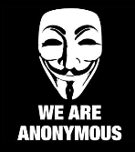
Anonymous
Plan of the presentation
Who are they ?
Presentation of the group
Ideas defended by Anonymous
« Symbols » of Anonymous group
What they did, What they do, What they will do ?
List of operations and explications
In the past, present and in the future
Conclusion, What can we think of the group?

Slide 3
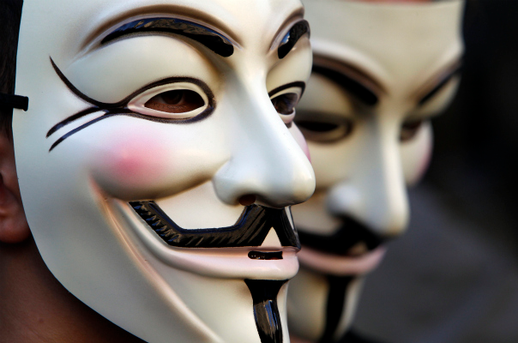
Anonymous
WHO ARE THEY ?

Slide 4
Anonymous
Who are they ? - Presentation of the group
Some people on the internet :
Hackers, computer scientists, students, ordinary people from 4Chan
Anonymous does not have a leader or controlling group, but operates as a loose collective which share similar ideals and aims.
Nobody knows How much members exist !
They define themself as the new superconsciousness of the Internet.
“Anonymous is a group, in the sense that a flock of birds is a group. How do you know they're a group? Because they're traveling in the same direction. At any given moment, more birds could join, leave, peel off in another direction entirely.”
Anonymous member

Slide 5
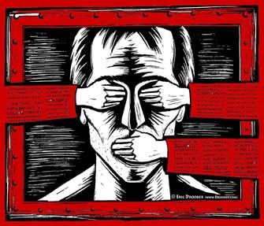
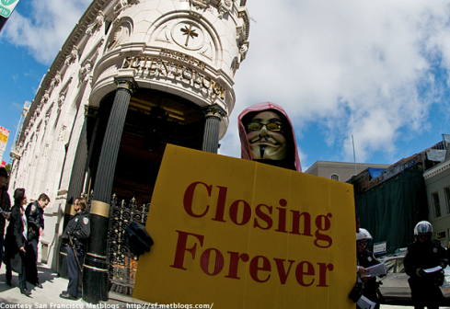
Anonymous
Who are they ? - Ideas defended by Anonymous
Defends all « Freedom » on the Internet
Against censors
Against enemies of the piracy on Internet
Against dictator
“Freedom online and of course in life”
Expose the dangers of cults
Church of Scientology
Westboro Baptist Church
Try to demonstrate, any governement can’t gouvern The internet
#AntiSec - #SOPA - #Hadopi - #OpMegaupload

Slide 6
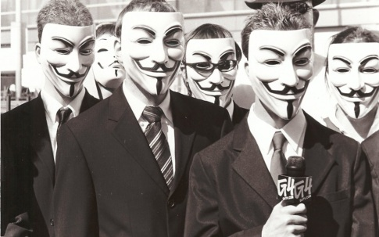
Anonymous
Who are they ? - « Symbols » of Anonymous group
V for Vendetta’s Mask
Express the revenge against censorship
Black suit and black tie
Express the “Anonymous” term : “We are everybody”
Their slogan
“We are anonymous, We are legion. We do not forgive. We do not forget, expect us”
Their logo
Their robotic voice on their video

Slide 7
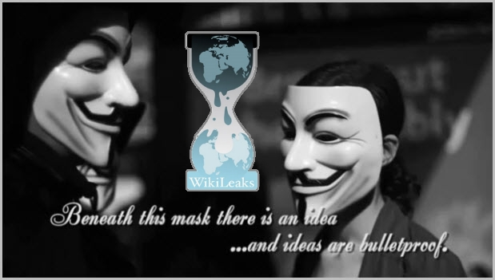
Anonymous
WHAT THEY DID / DO / WILL DO ?

Slide 8
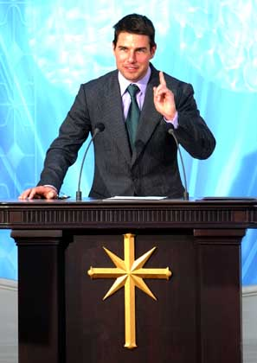
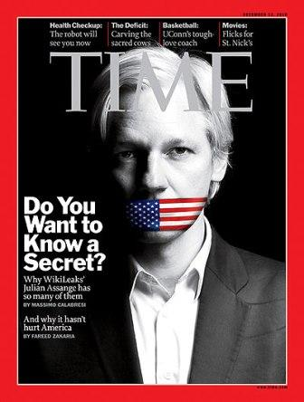
Anonymous
What they did ?
January 2008 :
Church of Scientology - Projet Chanology
Against censorship of a video of Tom Cruise
http://www.dailymotion.com/video/xagw2n_tom-cruise-scientologue-interview-
i_shortfilms
Doing some manifestation and putting down officials website
of Scientology
October 2010 :
Wikileaks and Julian Assange - Operation Payback
Against censorship of the Wikileaks website
Attacked Websites / Entreprises who abandon WL
(Visa / PostFinance.ch / PayPal)

Slide 9
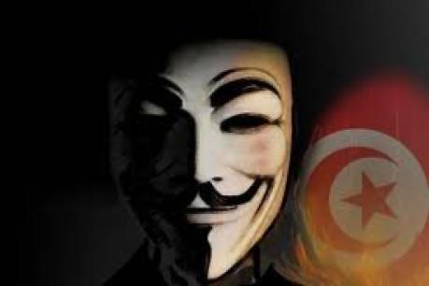
Anonymous
What they did ?
January 2011 :
Tunisia - Operation Tunisia
Against governements censorship and black-out
Attack Officials Websites
Set up proxy to bypass websites censored by the government
(Like Youtube/Tweeter/FaceBook)
March 2011 :
Sony - Operation Sony
Against Sony's lawsuit against George Hotz
Attack Officials Sony websites

Slide 10
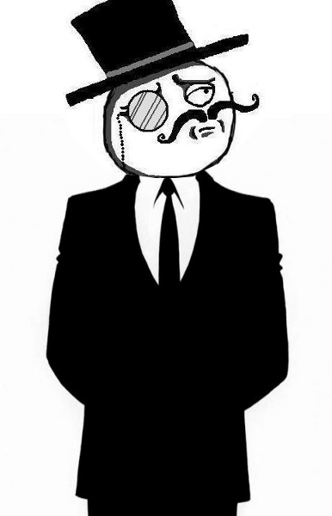
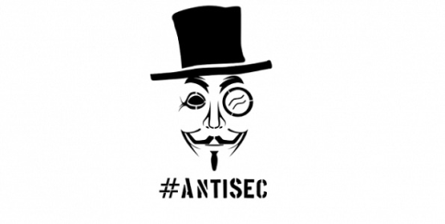
Anonymous
What they did ?
June 2011 :
ANTI SECURITY - Operation AntiSec
Alliance with a famous group of hacker : Lulzec.
A spirit alliance.
Anonymous goal : Freedom, free speaking, no censorship
Lulzec : Just do it … for fun !
The first and unique goal of this operation : Steal and publish government information and demonstrate a simple thing : “Any government or enterprise can’t have or censure the internet”,

Slide 11
Anonymous
What they did ?
June 2011 – … today and tomorow :
Resume of all action on Operation AntiSec
June : The group released a collection of documents stolen from the
Arizona Department of Public Safety, these document included officers forwarding racist chain emails, a Fraternal Order of Police member who is also a convicted sex offender.
July : Operation : « Turkish Takedown Thursday », who brought down and replaced the content of 74 official Turkish website for denouncing supposed attempts at internet censorship by the Turkish government.
On 21 July, Anonymous released two PDFs purportedly taken from servers belonging to NATO. The first two documents released relate to outsourcing communication and information services (CIS) in Kosovo and the funding request for the project.
August : On 16, Anonymous gained access to the email account of Richard Garcia, former Assistant director in Charge of the FBI field office in Los Angeles and Senior Vice President of Vanguard Defense Industries, The group released 1 gigabyte of information three days later, all of it taken from Garcia's personal email account.
More than 50 actions on 6 month :
For the complet list : go to http://en.wikipedia.org/wiki/Operation_AntiSec

Slide 12
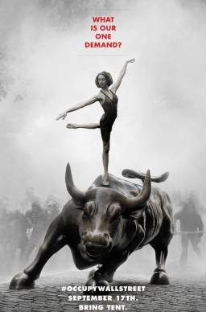
Anonymous
What they did ?
September 2011 – December 2011 :
Occupy Wall Street
It’s a protest movement
began September 17, 2011 in Zuccotti Park, located in New York City's Wall Street financial district.
The protests are against social and economic inequality, high unemployment, greed, as well as corruption, and the undue influence of corporations—particularly from the financial services sector—on government.
The protesters' slogan “We are the 99%” refers to the growing income and wealth inequality in the U.S. between the wealthiest 1% and the rest of the population.
Member of Anonymous group have given vocal support to the
Occupy Wall Street movement, with vast numbers of members attending local protests and several blogs run by members covering the movement extensively

Slide 13
Anonymous
What they do now ?
They continue their actions by regularly posting messages on various means of expression available on the Internet :

Slide 14
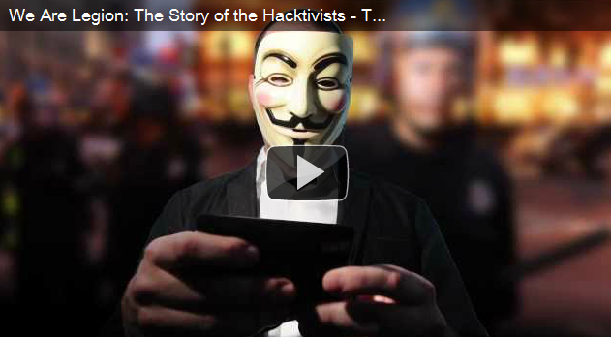
Anonymous
What they will do ?
WHO KNOWS ?
And to sum up that : A trailer about a new documentary : “We are legion”

Slide 15
Anonymous
Conclusion, What can we think of the group?
A group which born in 2008.
We don't actually know how many people it concern.
The anonymous is an anachist group without known leader
Their activities range from computer hacking to manifestations in the street
It’s a phenomenon which has interested the media since the 2008 crisis

Slide 16
Anonymous
Conclusion, What can we think of the group?
And have you got any question ?
Thank you for listening to us

