Slide 1
Cyber Security Challenges in Developing Countries
Serah Francis
MSc Student, Gjøvik University
Norway

Slide 2
Introduction
ICT has become an integral part of our life for productivity, growth and innovation.
How we protect our privacy & freedom and maintain an open and innovative cyberspace will determine how effective our society functions.
Challenge
The complexity of evolving trends: Social media, Mobile, Cloud computing, Advanced Persistent Attacks.
Cyber crime costs global economy $445 billion a year
“How can we better manage and respond to cyber threat?“

Slide 3
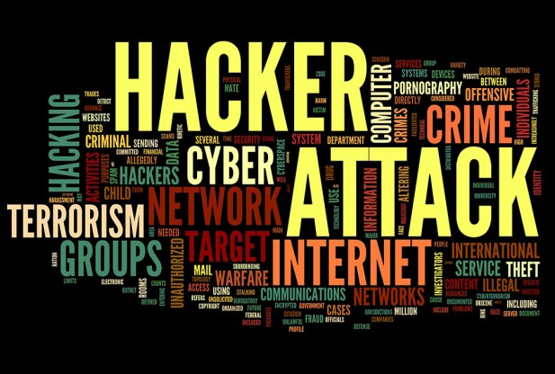
Global Cyber Threats

Slide 4

Recent Cyber Attacks
In hours, thieves took $45 Million in A.T.M. Scheme (May 9, 2013, New York Time)
Target apologizes for data breach, retailers embrace security upgrade (Mon 13, Jan, Noston/New York)
Canadian teen arrested in Heartbleed hack attack (The Washington Times)
eBay urges users to change passwords after cyber attack (May 21, 2014, BBC News)
5 in China Army Face U.S. Charges of Cyber attacks (May 2014, New York Times)
“Always remember: amateurs hack systems, professionals hack people.” - Bruce Schneier
Notes:
Cyber crime costs global economy $445 billion a year: report
LONDON Mon Jun 9, 2014 6:38am EDT
Hackers steal Dominos Pizza customer data in Europe, ransom sought
BOSTON Mon Jun 16, 2014 11:18am EDT
Target apologizes for data breach, retailers embrace security upgrade
BY ROSS KERBER, PHIL WAHBA AND JIM FINKLE
BOSTON/NEW YORK Mon Jan 13, 2014 3:43pm EST
Canadian teen arrested in Heartbleed hack attack
By Jessica Chasmar The Washington Times
A 19-year-old Canadian student at Western University has been charged for allegedly using the Heartbleed Internet bug to hack into the country’s tax agency, forcing it to delay its tax-filing deadline
Cyber crime costs global economy $445 billion a year: report
LONDON Mon Jun 9, 2014 6:38am EDT
EBay asks 145 million users to change passwords after cyber attack
BY JIM FINKLE, SOHAM CHATTERJEE AND LEHAR MAAN
5 in China Army Face U.S. Charges of Cyberattacks
By MICHAEL S. SCHMIDT and DAVID E. SANGERMAY 19, 2014
The NEW YORK TIMES
Israel’s Cyber Shot at Syria
by WARD CARROLL on NOVEMBER 26, 2007

Slide 5
“Cyber Security is a global issue and requires a collaboration of all nations”
Internet Security Threat Report 2014 :: Volume 1 (Symantec Corporation)

Slide 6
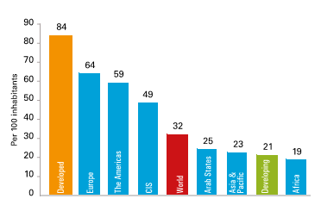
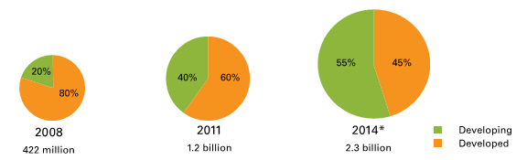
World Internet Penetration by 2014
*Estimated
Source: ITU World Indicator Database
Internet Penetration in Africa is still low compared to the rest of the world
By 2014, 55% of Mobile Broadband subscription is expected to be in the developing world compared with only 20% in 2008

Slide 7
What is Cyber Security Strategy?
“A national plan of action based upon a national vision to achieve a set of objectives that contribute to the security of the cyberspace domain”
Strategy defines
  the goals, milestones and metrics in addressing the issues
  Legal/Regulatory to support the role
  Education and Awareness Campaign
  Roles of the Stakeholders – governmental & non-governmental agencies
  Funding & budgets
  R & D Investment
  Support for local, national and international cyber security ecosystem
We need to create a culture where users are aware of the risks involved in cyberspace

Slide 8
ICT situation in developing countries
Used effectively, ICT can help to accelerate integration into the world economic community.
An opportunity to improve citizens life by generating wealth on global Ecommerce.
The stakes are high for developing countries. Foreign direct investment, confidence, and trust in a developing country depends upon a secure and effective implementation of technology and infrastructure.
They need to understand and acknowledge that cyber threats are real and create an environment where appropriate actions are taken to minimise these threats.

Slide 9
Kenya – ICT Overview
To support many activities aimed at achieving their 2030 Millennium development goals, the government has recently launched ICT Master Plan & Cyber Security Strategy.
The main goals for both master plan and cyber security is to support the Vision 2030 in making sure that every Kenya is connected to the internet and through secure cyberspace.
Kenya population is 43.5m, estimate of 2013. 31 million connected to mobile services & more than 16 million on the internet.
ICT contributes to 2.9% of Kenya’s GDP. Estimated to contribute 8% by 2017 and create 180,000 direct jobs

Slide 10
Kenya Cyber Threat Landscape
Kenya has had its share of cyber threat attacks with attacks increasing from 2.6 million in 2012 to 5.4 million in 2013.
This has been attributed by high usage of the internet where the systems are very weak and security awareness is very low.
Kenya loses $23.3 m (Estimate) annually through cyber crime.
  1 in 4 in Kenya mobile users are faced with malware when surfing the net.
Year | PBX Attack | Malware | Botnet | Proxy | Trojan
2012 | 450,000 | 1,000,000 | 900,000 | 50,000 | 200,000
2013 | 780,000 | 1,750,000 | 1,800,000 | 290,000 | 580,000
% increase | 73% | 75% | 100% | 480% | 290%
Kenya Threat Landscape 2013

Slide 11
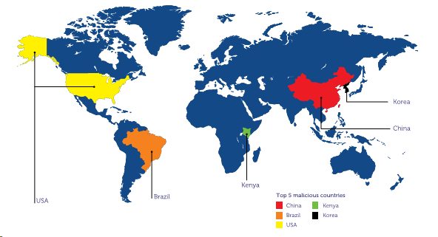
Source: Kenya Cyber Security Report
Kenya is in the top 5 countries for Malicious Activities (2013)

Slide 12
Factors that influence cyber security in Kenya
Absence of clear legal and regulatory famework and approach to cybercrime
High rate of unemployment with 50% being the youth
High level of poverty
High level of corruption
Inadequate of cyber security skills in government agencies and businesses especially small businesses
Lack of cyber security awareness in the society which leads to social engineering attacks.
The gorwth of e-government initiatives and e-commerce
Lack of national databases which makes it more difficult to track criminals
Increasing adoption of online banking without adequate security deployed by the banks
Use of unsecure or outdated hardware and software

Slide 13
Kenya Cyber Security Strategy
Strategic Objectives:
Develop comprehensive governance structures and policies
Raise awareness in public and private sectors
Expand cyber security education to build the Kenyan workforce
Foster information sharing and collaboration both nationally & internationally

Slide 14
Initiatives
Launched Public Key infrastructure & K-Cert
Registration of sim cards and switching off counterfeit phones is now complete
A public website to raise awareness
Established the National Cyber Security Steering Community (NCSSC)
The government is working on ‘The Data Protection Bill 2013’
Government is working together with the Universities and Businesses to develop a cyber security curriculum for higher education.
Urgent need for professionals who can be champions for cyber security (Technical, Legal & Policy) to move forward the above initiatives and create awareness.

Slide 15

Discussion
A worldwide partnership should be established to build capacity in this field i.e Technical, Legal & Policies
To identify critical technology gaps within the networks in developing countries and how those loopholes can be closed.
For developing nations, ICT is a key component in improving the quality of life and participation in global economics activities. Failure to recognize the above could limit their economic and social goals, widening the gap between the rich and the poor.
An attack on one unsecured system could affect the rest of the cyberspace

Slide 16
Conclusions
Cyber security is like a cat and mouse game where the game is never ending.
Seems current cyber models are not working and we need to consider secure, vigilant and resilient cyber models that can manage risks and drive innovation in the cyber world.
Cyber models should also be based on culture diversities.
People and culture play a bigger role in managing cyber risks and their engangment would help in understanding the security and privacy challenges on cyberspace.
Such models could minimise emerging cyber threats globally and increase trust on cyberspace and especially in emerging economies where ICT plays an important part in future economy, and where cyber security is at early stages.
“We can evade reality but we cannot evade the consequences of evading reality.” –Ayn Rand

Slide 17
Conclusion
Seems current cyber models are not working and we need to consider secure, vigilant and resilient cyber models that can manage risks and drive innovation in the cyber world.
Cyber models should also be based on culture diversities.
People and culture play a bigger role in managing cyber risks and their engangment would help in understanding the security and privacy challenges on cyberspace.
Such models could minimise emerging cyber threats globally and increase trust on cyberspace and especially in emerging economies where ICT plays an important part in future economy and cyber security is at its early stage.

Slide 18

Thank you

