Slide 1
Outlook 2013
TARA BYERS, PAYNEGROUP, INC.

Slide 2
www.thepaynegroup.com
TARA BYERS
PAYNEGROUP
Vice President Development
Leads team for Workflow and Productivity products (Forms and Numbering Assistants)
With PayneGroup >16 years!
Started in Training Department
Co-author of many books and articles on Microsoft Office
Software – Forms, Numbering, Metadata, Outlook Send, Redact Assistants
Professional Services – Provide training, consulting, project management, courseware and more.
International presence.

Slide 3
Introduction
Overview
Interface changes
New and improved features
Behind the scenes enhancements
A few known bugs
Features no longer available
Notes:
OUTLOOK 2013 IS EASY TO USE, OFFERS IMPROVEMENTS OVER PREVIOUS VERSIONS AND IS A GREAT STARTER APPLICATION TO GET YOUR FEET WET WITH 2013
Noticeably Faster on Startup and Exit

Slide 4
Improved Interface
Notes:
Cleaner design, less cluttered and easier-to-find
All Caps for the Tabs
Very White

Slide 5
Message List
Message List
Know in a glance which ones to read and tackle first
Mini Preview (replaces AutoPreview)
Delete or Flag right from Message List
Inline Replies
Reply right from Message Pane
Notes:
Preview Message choice of number of lines
Pop Out or Discard

Slide 6
All Elements AT Your Fingertips
Navigation Bar
Sneak Peek
Docking
Navigation Options
Notes:
Quickly move between main items in Outlook without switching windows
Hover in Sneak Peek to view appts for a day
If you close an item you docked in one view, it will not be closed in the other views
Calendar not only shows you the month, if you hover you can see the details of a particular day

Slide 7
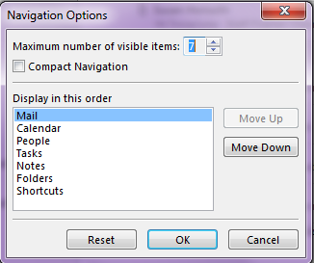
Navigation Folder Options
Change the number of visible items on the navigation pane
Change the order of the items
Select Compact Navigation

Slide 8
Message List Time SaveRs
Mini Preview
Delete or Flag right without opening message
Inline Replies
All or Unread
Notes:
Know in a glance which ones to read and tackle first
Tasks on Navigation Bar show upcoming tasks and flagged items
Quick clicks

Slide 9
Time-Savers
Don’t open a message to reply or delete it.
Reply to a message In Line in the Message List.

Slide 10
All or Unread
Quickly toggle between All email messages or those that are Unread without having to use Search folders.

Slide 11
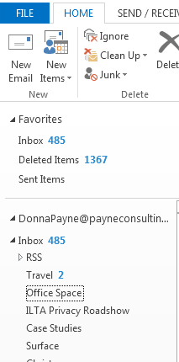
Customize your Inbox
Drag and drop email folders anywhere you want them within your Inbox.
They no longer have to be in alphabetical order!

Slide 12
Show the Weather - Anywhere
Display the weather within your calendar view
Weather for next 3 days is displayed
Notes:
Must have internet connection.
Weather for next 3 days is displayed.

Slide 13
Configure Weather Settings
Choose to show weather or not
Change or add up to 3 cities.
Select Celsius or Fahrenheit
Notes:
Weather settings saved per user profile.
These weather settings can roam depending on account type:
Weather On or Off
Celsius or Fahrenheit
Weather locations
Currently displayed weather location
If you have same Exchange account on multiple computers, you will see same weather on all computers
Firm administrators can control this setting using Outlook Group Policy template (Outlk15.admx). The settings are under User Configuration\Administrative Templates\Microsoft Outlook 2013\Outlook Options\Preferences\Calendar Options.

Slide 14
Holidays and Bells
Microsoft turned off the Reminder bell icon for a cleaner, less cluttered appearance.
Holidays list includes dates through 2022 for movable holidays, 2031 for some with fixed dates.
Notes:
To enable the bell for day, week and schedule view, choose File, Options, Calendar. Check the option 'Show bell icon on calendar for appointments and meetings with reminders'

Slide 15
Improvements to Sending Email

Slide 16
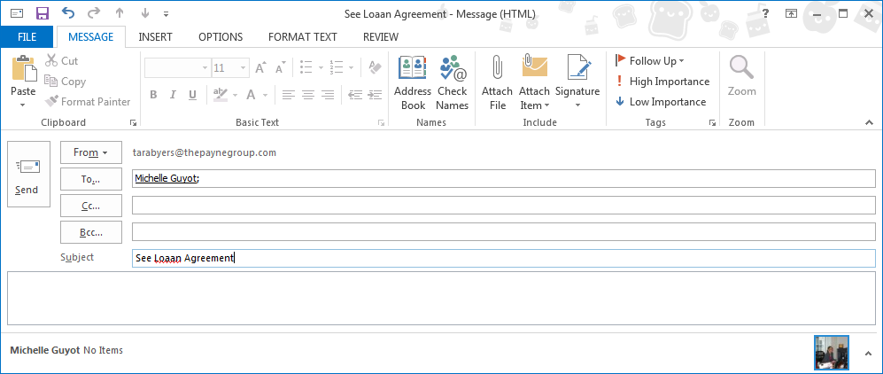
Spellcheck Subject Line
Outlook 2013 will automatically spell check your Subject line
Notes:
To enable the bell for day, week and schedule view, choose File, Options, Calendar. Check the option 'Show bell icon on calendar for appointments and meetings with reminders'

Slide 17
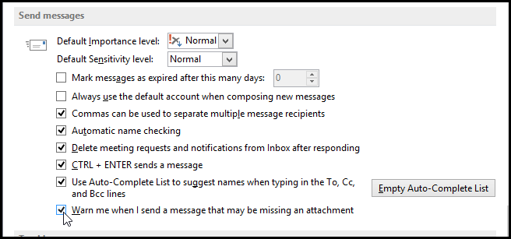
Forget the Attachment?
Outlook will prompt you when the word attachment is used in body of message and no attachment exists.
Breaks down sentence most of the time so it’s in context and doesn’t prompt for, “the plaintiff has an unhealthy attachment”
To enable or disable, go into Options and select the Mail tab. The option is in the Send Messages section

Slide 18
People HUB
New People card offers a one-stop shop for all communication with your contact
It stores regular contact info as well as social media updates and whether they are available
Call the contact, schedule a meeting, or send an instant message right from the card

Slide 19
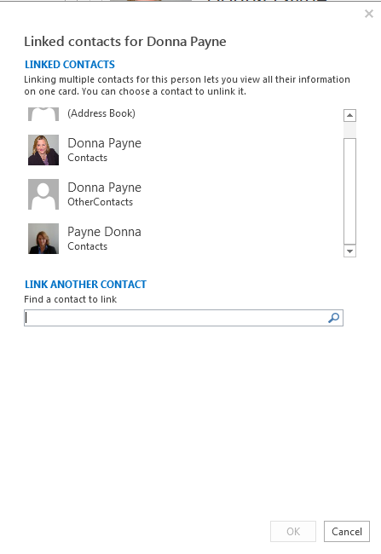
Linked Contacts
Notes:
What’s New
Link and unlink
This replaces the Contacts Activities Tab which is removed in 2013

Slide 20
No More Suggested Contacts
Suggested Contacts are no longer
If you upgrade, any existing ones will be retained but read only
If you install new, they will not exist
Notes:
If you install Microsoft Outlook 2013 as an update Outlook 2010 or 2007 then you can still use the suggested contacts that were created with previous versions of Outlook but as a read only.

Slide 21
Improved Search
Outlook 2013 features improved search across all Outlook items.

Slide 22
Site Mailboxes
Leverage your use of Sharepoint and Exchange by creating a Site Mailbox to give everyone in your department or on your team access to a group/team folder, calendar and task list
Improves collaboration and productivity because you will be using one interface to access both Sharepoint 2013 documents and email
Site mailboxes require Exchange Server 2013 and SharePoint Server 2013 integration and configuration
Notes:
A site mailbox consists of SharePoint 2013 site membership (owners and members), shared storage through an Exchange Server 2013 mailbox for email messages and a SharePoint 2013 site for documents, and a management interface that addresses provisioning and life-cycle needs.

Slide 23
Behind the Scenes Improvements

Slide 24
Cached Exchange Mode
Two new features are available when you use Cached Exchange mode:
Sync Slider allows the user to:
Limit the number of email messages that are synchronized locally in an .OST file
The default is to remove anything older than 12 months
If this is turned on the, user can view
Users can also change how much email to keep offline.
From an administration standpoint, you can use Group Policy or the Office Customization Tool to change these defaults.
Exchange Fast Access provides a better experience for the user by:
Displaying items such as most recent email and up to date calendar items while it continues to cache items in the background
This is most noticeable during an initial synch, returning from vacation, etc. where there would previously be a delay before seeing anything while Outlook prepares the cached items
Notes:
For more information, see Exchange Fast Access and Sync Slider and Plan a Cached Exchange Mode deployment in Outlook 2013.
Sync Slider - Users can view messages that were removed from the local cache by scrolling to the end of an email list in a folder and clicking the message Click here to view more on Microsoft Exchange.
Both of these can be configured via Group Policy
To check the sync settings, open File, Account Settings dialog and double click on the email account. Slide the control to determine how much older email is stored

Slide 25
Slow or Problem Add-Ins?
Outlook 2013 turns off any add-in that adversely affects performance, resiliency or reliability
These can be viewed and re-enabled under File, View Disabled Addins
From an administrative standpoint, you can use the Outlook Group Policy template (Outlk15.admx) to prevent Outlook from automatically disabling an add-ins
Notes:
List of managed add-ins. You can find this setting under User Configuration\Administrative Templates\Microsoft Outlook 2013\Miscellaneous. For more information, see Add-ins in Plan feature customizations in Outlook 2013

Slide 26
OST Compression
Outlook 2013 creates a new compressed version of the Outlook data file (.ost)
This new compressed version of the .ost is up to 40% smaller than the .ost files that were created by earlier versions of Outlook.
Notes:
Be aware that users' local .ost files can increase 50 percent to 80 percent over the size of the mailbox that is reported in Exchange Server. The format that Outlook uses to store data locally for Cached Exchange Mode is less space-efficient than the server data file format. This means that more disk space is used when mailboxes are downloaded to provide a local copy for Cached Exchange Mode.
If you really don’t want this new smaller sized OST, you can change this in the Outlook Group Policy

Slide 27
Exchange ActiveSync
No add-ins needed to connect to Outlook.com (Hotmail)
Tasks now sync to Outlook.com as well

Slide 28
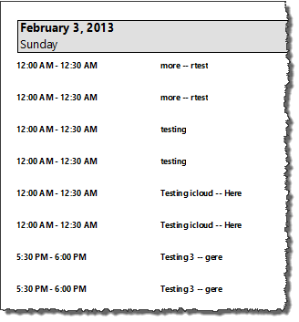
Known Issues
Printing Bug
If you print your calendar in details view, the appointments are duplicated!
Folders Disappear
Multiple KB articles made it difficult to determine resolution

Slide 29
Other Features Removed
Classic Offline Mode is no longer supported
Deliver Exchange mailboxes to PST removed. Now must use Rules to accomplish.
Calendar Publishing to Office.com (PubCal)
Import/export of Outlook data is now limited to .CSV or .PST
Outlook Mobile Service protocol (used for sending text messages from within Outlook) removed
Journal hidden and scaled down but available with Ctrl+8.
Notes:
When upgraded, they will be upgraded to Cached Mode with 2013 (with OST file)
Older versions of calendar sharing will be shutting down as well.
ACT. Doc, XLS, Outlook Express no longer supported
Other items removed: Meeting Workspaces

Slide 30
Questions?
Thank you for attending.
For more information on PayneGroup, visit www.thepaynegroup.com

