Slide 1
How To Use Microsoft Outlook
Presented by the Academic and Career Advisement Center

Slide 2
Why should I use Outlook?
To sort and keep track of emails.
Organize and retrieve information quickly.
When are you scheduled to work?
Keep track of class schedule.
Keep track of appointments.
When is your next test/quiz?
Keep track of project due dates.

Slide 3
How can I organize my E-mails?
Make folders to categorize
(Ex: Classmates, Professors, Superior Edge, Volunteer Center, Mom & Dad, Important, Not Important, etc.)
Use search box to search for certain emails.
Maybe you misplaced an email that contained important info.
A classmate needs a copy of an email sent out by the professor.
Maybe you sent an email, and want to verify that it was sent.

Slide 4
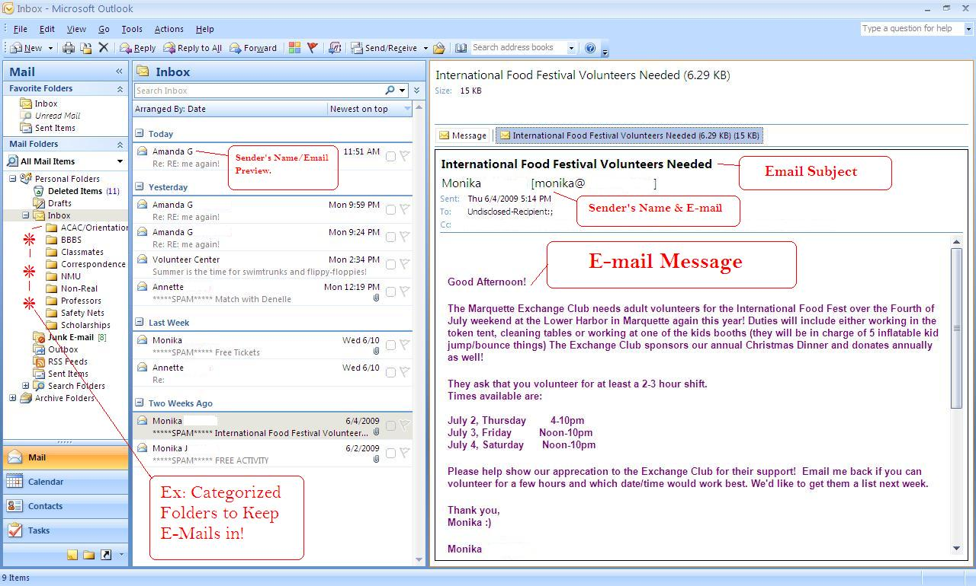
Example of Inbox

Slide 5
What can I do with E-mails in Outlook?
Personalize E-mails with custom signatures.
Personalize with themes.
Insert files, folders, pictures, etc.
Attachments
Importance/Priority Ratings
Spell Check
Scheduled Delivery

Slide 6
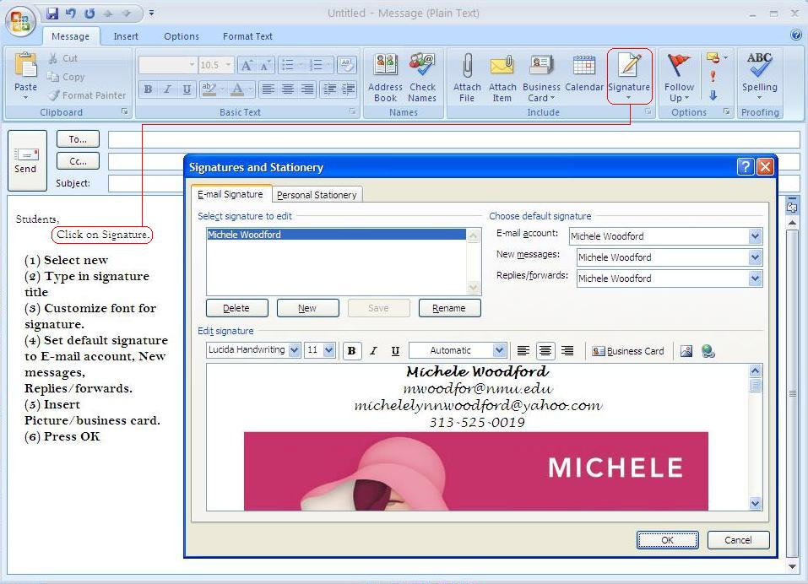
How to Create a Signature

Slide 7
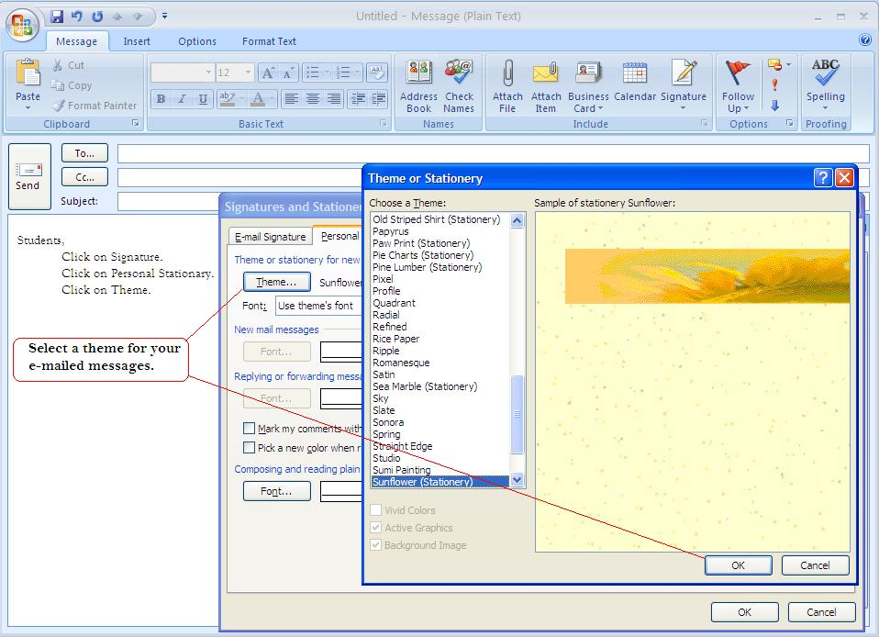
How to Set up a Personalized Theme

Slide 8
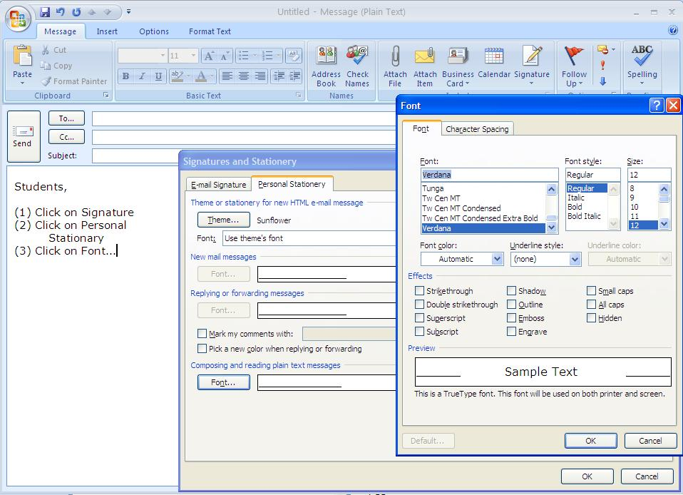
How to Create Custom Font

Slide 9
What else?
Manage your schedule by making appointments.
Let Outlook remind you of class meetings, dues dates, bills, or anything else you ask it to.
Invite others to appointments you make.
View the calendars of other Outlook users.

Slide 10
How do I make an appointment?
(1) On the blank calendar screen, click New on the upper left hand side of Outlook.
(2) A box will pop-up.

Slide 11
Step-by-step Instructions for Making an Appointment
Example: SUBJECT; write Class
In LOCATION; write Jamrich
START TIME/END TIME; select Monday 8/24/2009, 3:00pm as Start time, and 4:30pm as End time.
Hit SAVE & CLOSE on the top left.

Slide 12
Your Appointment is Now on Your Calendar!
The next slides will show you how to advance your appoint-ment-making skills.

Slide 13
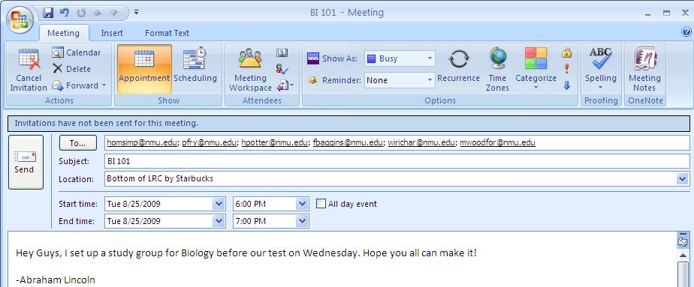
Invite Attendees
WHY YOU’LL USE IT: Let’s say you wanted to start a study group for one of your classes and wanted to invite people.
On appointment sheet, click “Invite Attendees”
The picture above is an example of what the box will look like.
To cancel, simply click cancel invitation & a cancelation e-mail will be sent.
Type the email addresses of members of your class into the box next to “To..” button
Type what class the session is for in Subject
Type where the study group will be in Location
Include start time and end time
Include a note for the email recipients

Slide 14
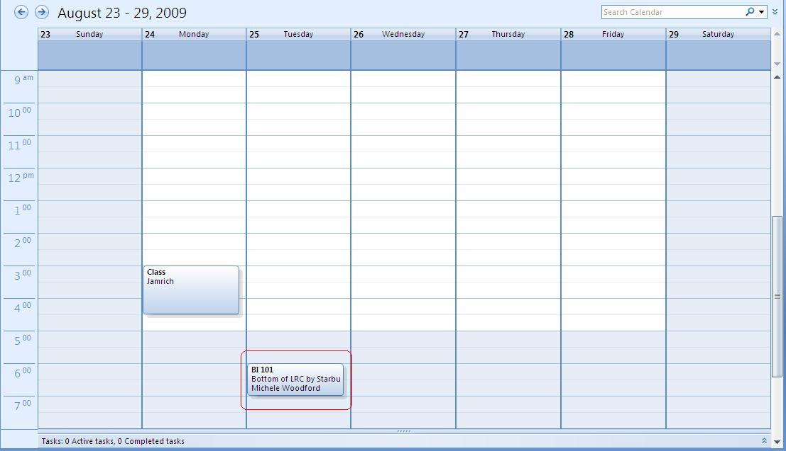
Your study session saves itself as an appointment on your calendar!
*On the invitee’s calendar the name of the sender shows up, so they know who planed the study group!

Slide 15
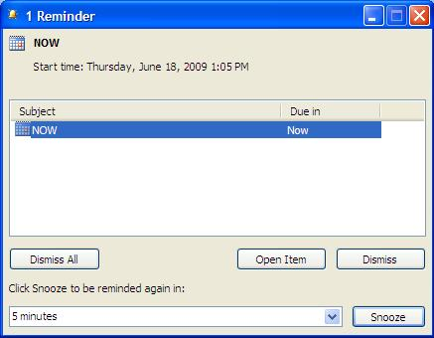
Show As & Reminder
Show As:
Free, Tentative, Busy, Out of Office
Reminder: Set to have a pop up remind you of an appointment!

Slide 16
Recurrence
WHY YOU’LL USE IT: If you input your class schedule, you don’t want to have to schedule every single week separately. You can set up a recurring appointment and it will show up each week automatically.

Slide 17
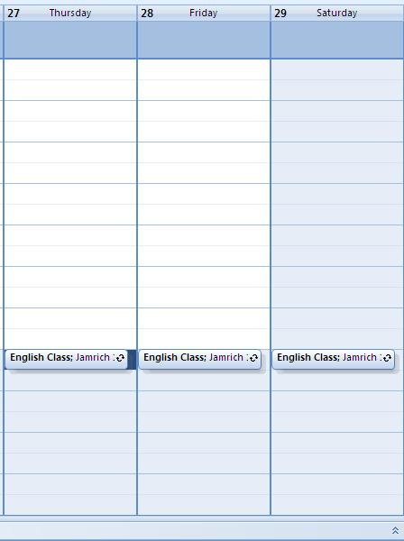
Example of Recurring Appointment
Select New
In Subject, type: English Class
In Location, type: Jamrich 201
Select Reoccurrence
Under Appointment time change:
Start Time: 5:00 PM
End Time: 5:30 PM
Duration: 30 minutes
Under Recurrence Pattern change:
Change to Weekly
Select Thursday, Friday, Saturday
Under Range of Reoccurrence change:
Start: Thursday 8/27/2009
Change to Weekly
Select Thursday, Friday,
End After: 3 occurrences

Slide 18
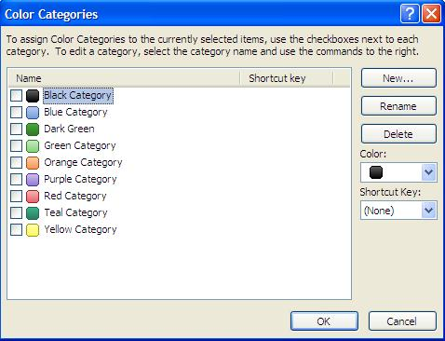
Categorize Appointments
Appointment is Color Coordinated
If you select All Categories this box pops-up.
You can rename color categories, add more colors, etc.

Slide 19
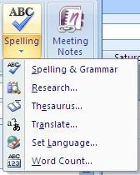
Private, High/Low Importance, and Spell Check
Mark your messages as:
Private, High Importance, Low Importance
Spell Check your appointments to make them easier to find

Slide 20
This PowerPoint presentation is the property of Northern Michigan University’s Academic & Career Advisement Center. It may not be reproduced without written consent.
www.nmu.edu/acac
Special thanks to Michele Woodford for her input and design help with this presentation.

