Slide 1
Microsoft® Outlook® 2010 Training
Getting Started with Outlook
NaveenKumar Namachivayam
Founder - testTalk Academy
http://naveenkumarn.in
Notes:
[Notes to trainer:
This presentation must be viewed in PowerPoint 2010. If you don’t have PowerPoint 2010, the videos included in the presentation will not play. If you don’t have PowerPoint 2010, download the PowerPoint Viewer to view these files (http://www.microsoft.com/downloads/details.aspx?displaylang=en&FamilyID=cb9bf144%2D1076%2D4615%2D9951%2D294eeb832823).
If the yellow security bar appears at the top of the screen in PowerPoint, or if a Codec Unavailable message appears in the video playback window, the presentation might have opened in Protected View. To enable video playback, in the yellow security bar at the top of the PowerPoint window, click Enable Editing.
To browse other downloadable Outlook training presentations, see the “Download Office 2010 training” page (http://office.microsoft.com/en-us/powerpoint-help/download-office-2010-training-HA101901726.aspx).
For detailed help in customizing this template, see the very last slide. Also, look for additional lesson text in the notes pane of some slides.]

Slide 2
Course contents
Introduction
The Outlook Interface
Outlook Today
Identify the Backstage
Use the Ribbons and the Quick Access Toolbar
Customize the Ribbons and the Quick Access Toolbar
Summary

Slide 3
Course goals
The Outlook Interface
Customization of Ribbons and the Quick Access Toolbar

Slide 4
Introduction
Microsoft Outlook is a personal information manager from Microsoft.
The latest version is Microsoft Office Outlook 2010 for Windows and Microsoft Office Outlook 2011 for Mac.
Although often used mainly as an email application, it also includes a calendar, task manager, contact manager, note taking, a journal and web browsing.

Slide 5
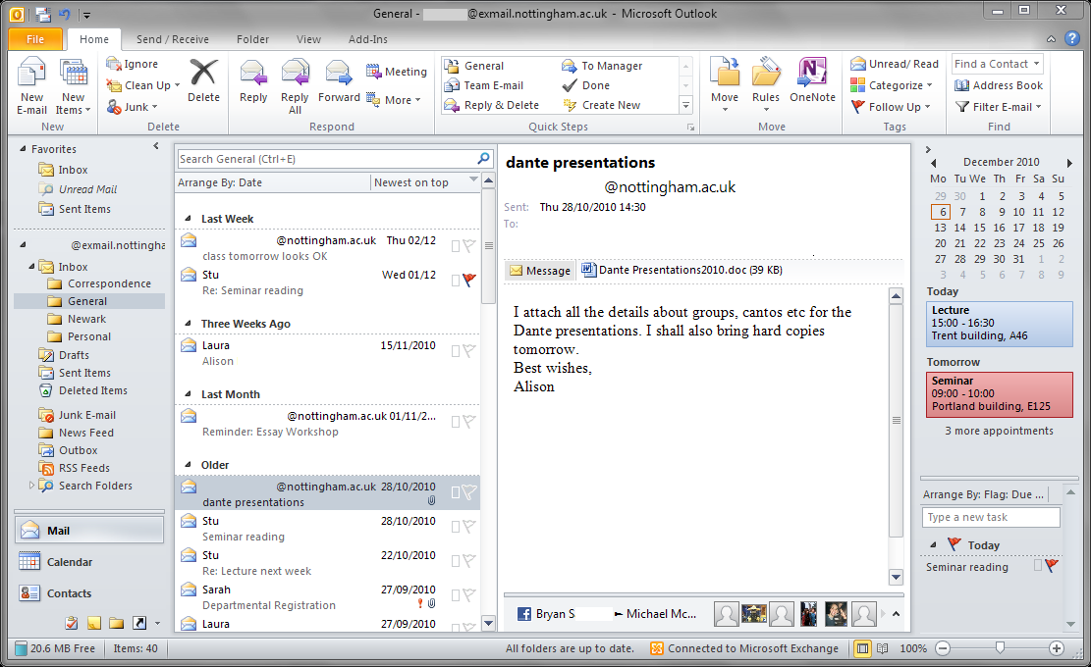
The Outlook Interface
Notes:
http://en.wikipedia.org/wiki/Microsoft_Outlook

Slide 6
Outlook Today
The Outlook Today page provides a preview of your day.
By using Outlook Today, you can see a summary of your appointments, a list of your tasks, and how many new e-mail messages you have.
Click on the root of your folder set

Slide 7
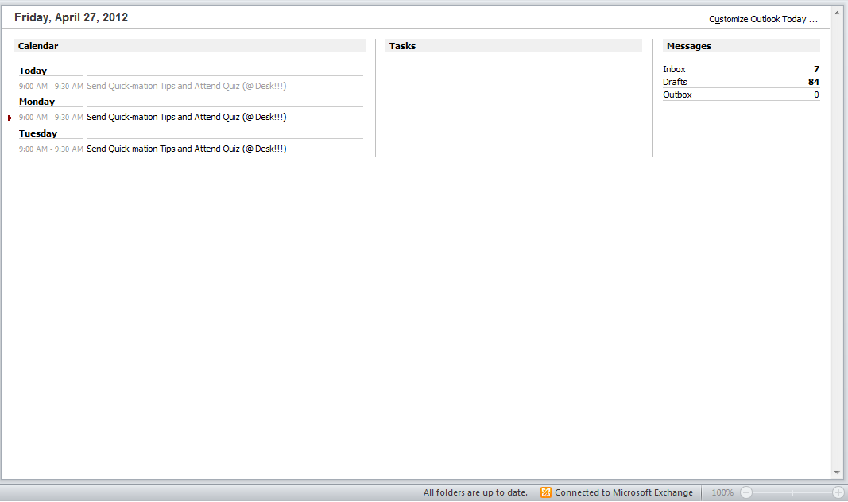
Outlook Today

Slide 8
Identify the Backstage
The Office Backstage view is where you manage your files and the data about them.
Creating, saving, inspecting for hidden metadata or personal information, and setting options. In short, it is everything that you do to a file that you don't do in the file.

Slide 9
Where is the File tab located?
The File tab is the colored tab, for example, the blue tab in Microsoft Word 2010, located in the upper-left corner of Microsoft Office 2010 programs.

Slide 10
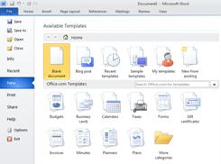
What do I see when I click the File tab?
When you click the File tab, you see many of the same basic commands that you saw when you clicked the Microsoft Office Button or on the File menu in earlier releases of Microsoft Office, such as Open, Save, and Print.

Slide 11
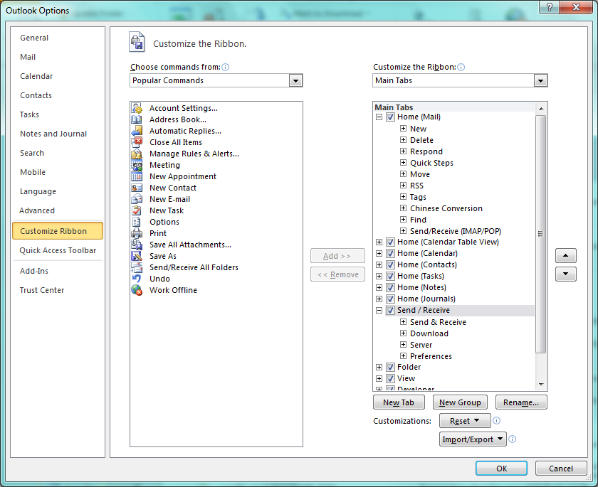
Ribbons
Use customizations to personalize the ribbon the way that you want it.
E.g. you can create custom tabs and custom groups to contain your frequently used commands.

Slide 12
Quick Access Toolbar
The Quick Access Toolbar is a customizable toolbar that contains a set of commands that are independent of the tab on the ribbon that is currently displayed.
You can move the Quick Access Toolbar from one of the two possible locations, and you can add buttons that represent commands to the Quick Access Toolbar.

Slide 13
Quick Access Toolbar

Slide 14
Summary
Outlook Today
Identify the Backstage
Customization the Ribbons and the Quick Access Toolbar

Slide 15
Test question 1
Where do you find the button that opens the Outlook Options dialog box? (Pick one answer.)
In the Layout group on the View tab of the ribbon.
On the Windows Start menu.
In the left pane in Backstage view.
On the Quick Access Toolbar.

Slide 16
Test question 1
Where do you find the button that opens the Outlook Options dialog box?
Answer:
In the left pane in Backstage view.
It’s right there in Backstage view.

Slide 17
Test question 2
How do you view Outlook Today? (Pick one answer.)
Clicking on the folder
Clicking on the root folder
View > Folder
File > Outlook Today

Slide 18
Test question 2
How do you view Outlook Today?
Answer:
Clicking on the root folder

Slide 19
Using this template
See the notes pane or view the full notes page (View tab, Notes Page) for detailed help on this template.
Notes:
Using This Template
This Microsoft PowerPoint® template has training content about using conditional formatting in Microsoft Outlook® 2010 to help manage your Inbox, calendar, and to-do list. Its content is adapted from the Office.com Training course called “Manage your mail and more with conditional formatting.”
PowerPoint version: The template must be viewed in PowerPoint 2010. If you don’t have PowerPoint 2010, the videos included in the presentation will not play. If you don’t have PowerPoint 2010, download the PowerPoint Viewer to view these files (http://www.microsoft.com/downloads/details.aspx?displaylang=en&FamilyID=cb9bf144%2D1076%2D4615%2D9951%2D294eeb832823). Video playback: If the yellow security bar appears at the top of the screen in PowerPoint, or if a Codec Unavailable message appears in the video playback window, the presentation might have opened in Protected View. To enable video playback, in the yellow security bar at the top of the PowerPoint window, click Enable Editing.
Slide layouts: Each slide has a custom layout. To apply the custom layout to a new slide, right-click the slide thumbnail, point to Layout, and click the layout from the Layout gallery. To alter the layouts, open master view and alter the specific master layout in that view. You can find the layout’s title by pointing to its thumbnail.
Animations: Custom animation effects are applied throughout the presentation. These include Float In (Up or Down option), Fade, and Zoom. To alter animation effects, click the Animations tab, and use the Add Animation gallery and Timing options. Effect Options gives you choices about the effect; click Animation Pane on the Animations tab to work with multiple animations.
Transitions: One transition, Doors, is used to emphasize sections of the slide show. It’s applied on the Course Contents slide, Lesson slide, and the first test slide.
Hyperlinks to online course: The template contains a link to the online version of this training course that takes you to the Quick Reference Card that is published for the course.
Headers and footers: The template contains a footer that has the course title. To add footers such as the date or slide numbers, click the Insert tab, and click Header & Footer.

