Slide 1

Version 09.2014
Notes:
You can use this presentation to educate your fellow faculty and staff, as well as parents, about the value of Microsoft Office Specialist certification.

Slide 2

Why Should You Become Certified
Certification gives you the tools to build a brighter future
Achieve industry-recognized certification
Prove you have the skills employers are looking for
Boost your workforce resume
Gain valuable experience and confidence
Enhance your higher education prospects
Prepare yourself for a successful future
Notes:
MOS certification gives you tools to build a brighter future
It’s not just another test, it is a credential that adds credibility to your knowledge of the Office applications

Slide 3



What is Microsoft Office Specialist Certification
Microsoft Office Specialist (MOS) is a premier industry recognized certification that provides validation of students’ knowledge, skills and abilities relating to the Microsoft Office applications.
Microsoft Office Specialist (MOS) certification features a series of certification levels, providing a continuum for skills qualification and validation.
Master Series
More than a single certification, the Microsoft Office Specialist Master certification demonstrates an individual’s overall comprehension and deep expertise of Microsoft Office programs. Earning this distinguished credential for 2013 requires passing four exams in a designated track and for 2010 requires passing Word Expert, Excel Expert, PowerPoint, and an elective exam (Access or Outlook).
Expert Series
Microsoft Office Specialist Expert certification validates advanced skills in a specific Microsoft Office application. Gaining the Expert credential requires passing one or both of these exams: Word Expert or Excel Expert.
Specialist Series
The Microsoft Office Specialist core certification validates skills with the Microsoft Office suite. Exams are available on these Microsoft Office products: Word, Excel, PowerPoint, Outlook, Access, SharePoint, OneNote, and Office 365
Notes:
Common certifications are among the specialist series where a student passes a core exam in a particular certification. They earn a certification in the particular application. Students who seek a higher level, may want to explore the expert level in Word or Excel or even advance to become a Master.
Challenge your students – create a special award for those who reach the Master Certificate

Slide 4
Certification = Employability for Students
91% of hiring managers consider employee certification as a criterion for hiring¹
79% of hiring managers feel that certified individuals are more efficient ¹
89% of supervisors say that Microsoft Office certified employees are more proficient users of Microsoft Office programs ³
81% of hiring managers feel that certified individuals perform better ¹
50% of individuals believe obtaining a certification makes them more marketable ²
“It’s truly a global marketplace, especially in the IT world. If you don’t have a certification that validates you have the needed skills, you’re at a significant disadvantage.”
Bill Doherty, @ONE Project,
College System of California
Sources
1 MCP Program Satisfaction Study 2010
2 Intrepid Survey
3 Certiport Research 2009
4
Notes:
Surveys that have been conducted over the years confirm that a certification adds weight to job applications.
A story that was conveyed to me by Certiport: A small business woman conducted interviews for a job which required a knowledge-base of Word and PowerPoint. The person she interviewed stated that she was proficient in both Word and PowerPoint. This person was hired based on her interview response. She was let go few weeks later due to her lack of skill in Word and PowerPoint. After that experience, this small business woman will only hire someone with a Microsoft Office Specialist certification.

Slide 5
Microsoft Skills Make a Difference
It is not merely enough to understand which occupations will be high growth and high salary; today's educators must impart the skills that will be required for those jobs, too. To determine those skills, IDC examined 14.6 million job postings between April and September 2013 from 25,000 job boards and staffing companies' corporate web sites.
The only software package called out within the top 20 skills across high growth/high salary occupations was Microsoft Office, ranking #2 in top skills.
Source: IDC, based on WANTED Analytics and U.S. Bureau of Labor Statistics data, October 2013
Notes:
International Data Corporation (IDC) is an American market research, analysis and advisory firm specializing in information technology, telecommunications, and consumer technology.

Slide 6
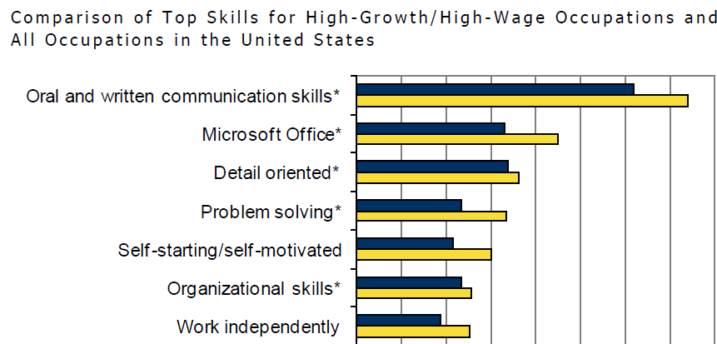
Microsoft Skills Make a Difference

Slide 7
The Key to a Good Paying Job
“Want a job that promises a living wage and a good shot at a middle-class life? Learn Microsoft Excel and other basic digital skills.”*
Some 78% of these jobs, or about 6.3 million open positions, call for some fluency with technology.*
The most promising in terms of pay and job creation, including occupations in healthcare, technology, and operations.
The most commonly required skills are spreadsheet and word-processing software such as Microsoft Word and Excel.
Excel expertise has become critical for office and administrative positions, retail supervisors, and store managers, among other jobs.**
Sixty-seven percent of middle-skill jobs demand proficiency with these tools.
“Effectively, entire segments of the U.S. economy are off-limits to people who don’t have basic digital skills,” the report notes.
Positions that require basic digital skills tend to pay 13% more than jobs that require no digital skills: median pay of $22.66 per hour versus $20.14 per hour.
*Burning Glass
**Plant Money
Notes:
A report released Thursday by Burning Glass Technologies, a labor-market analysis firm that reviewed millions of job postings to understand which skills companies expect workers to have. The report focuses on middle-skill jobs – roles that require a high school diploma but not necessarily a college degree.

Slide 8
MOS Mapping to Key Job Roles by Application
Specialist | Administration | Sales | Marketing | Public Relations/ Affairs | Accounting | Finance | Operations | Legal | Training
Word |  | x | x | x |  |  |  | x
Excel |  | x | x | x | x | x |  | x
PowerPoint |  | x | x | x | x | x |  | x
Outlook |  | x | x | x | x | x |  | x
Access |  |  |  |  | x | x
SharePoint |  | x | x | x | x | x |  | x
Expert
Word |  |  |  |  |  |  |  | x
Excel |  |  |  |  | x | x
Master* | x |  |  |  |  |  | x |  | x
*Master Cert requires Word Expert, Excel Expert, PowerPoint, and either Outlook, Access, SharePoint, or One Note
Notes:
No matter your future job role or career path, Microsoft Office will be a key skill set for initial career placement and future career advancement.

Slide 9

Job Board Requirement
Now Hiring:
Experienced Accountant
Technical Skills and Prior Experience
Five to seven years prior supervisory experience in the financial reporting/general ledger area
Experience working in a law firm or professional services firm is preferred
Experience with Intuit Accounting system or other automated accounting system a plus
*Must be PC proficient and able to thrive in a fast-paced setting
*Must have strong experience with Microsoft Excel, Access & Word
*Certification validates these requirements
Notes:
Go to any job board (Example: www.indeed.com) and filter by Microsoft Office –see how many jobs require proficiency in Microsoft Office applications.

Slide 10
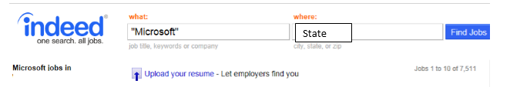
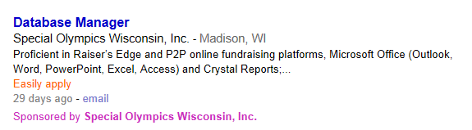
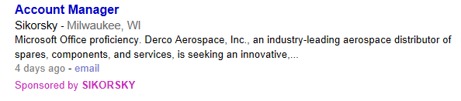
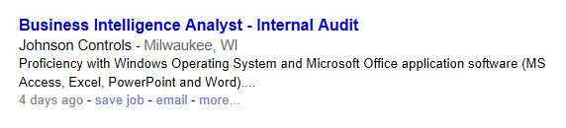

Jobs Beyond Office Administration

Slide 11

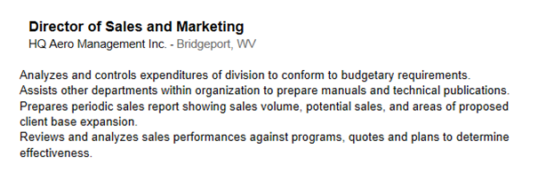
Where are the Office Skills?
Excel
Word
PowerPoint
Excel

Slide 12


Disagree >
Disagree <
Neutral
Agree <
Agree >
My MOS certification has made me more efficient in my school work.
88%
Agree!
My MOS certification enables me to produce higher quality school work.
87%
Agree!
I am known (at least in some circles) for my knowledge and skills In the MS Office application(s) that I became certified in prior.
70%
Agree!
MOS certification improved my overall school readiness.
77%
Agree!
Being MOS certified has given me more confidence in my abilities as a student.
79%
Agree!
With regard to some of the MS Office features and tools that I use, I probably wouldn’t have known about them hadn’t it been for the MOS certification(s) that I obtained prior.
70%
Agree!

Slide 13

MOS US & World Championships
Prove your skills in Microsoft Word, Excel, and PowerPoint
and you could win an invitation to compete in the MOS Championships for a chance to become a MOS champion!
Prizes include scholarship money, a medal, trophy, certificate, and
more!
For more information visit: moschampionship.com
Notes:
Details for the 2016 World Championship to be communicated around October/November Next year, even if a student earns a certification in an application, they can retake the exam over and over again to improve their score/time

Slide 14
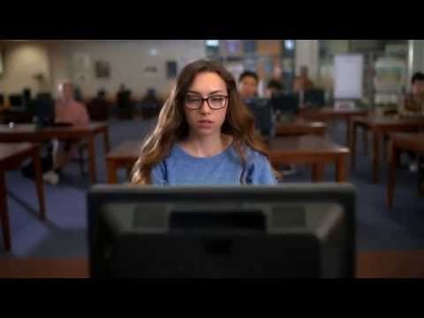
Microsoft Office 2016 World Championship Video

Slide 15
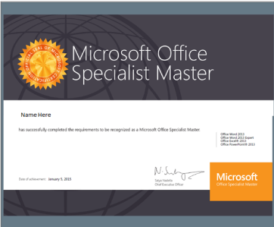
Become a MOS Master
As a Microsoft Office Master, you will:
Build credibility through proof of skills in multiple applications
Set yourself apart as a desktop computing expert
Differentiate yourself from your peers
Possess a professional recognition accepted around the world
3 Exam Tracks for Office 2013:
Word Expert + Excel Core + Elective
Excel Expert + Word Core + Elective
Word Expert + Excel Expert
Notes:
Requirements to become a MOS Master have recently changed. Please visit www.Certiport.com/MOS for the most recent updates and an explanation of each of the MOS Master Exam Tracks.

Slide 16
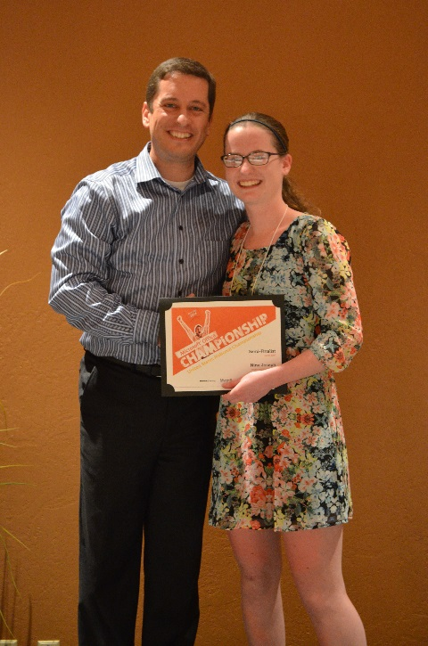

My MOS Story
Nina Joseph
Cary, NC, United States
MOS US National Champion
Last summer, my MOS certification qualified me for the MOS National Competition from which I was invited to the World Competition. Both events were unforgettable experiences filled with wonderful people and wonderful memories. Since then, my certification has helped me get a job where I get to use my Excel knowledge, and it has helped me get into an amazing college! I could not be more grateful! Thank you, Microsoft and Certiport!
I would recommend MOS certification to anyone that uses Microsoft applications since working towards certification can greatly improve understanding and efficiency within the applications. Even more, the certifications are proof for employers that you are knowledgeable and proficient in the Microsoft products, and they make you stand out from others.
Notes:
Don’t just take my word, here are some examples of “real stories” from students around the US on how earning a certification helped them. You can submit your story also through “My MOS Story”.

Slide 17
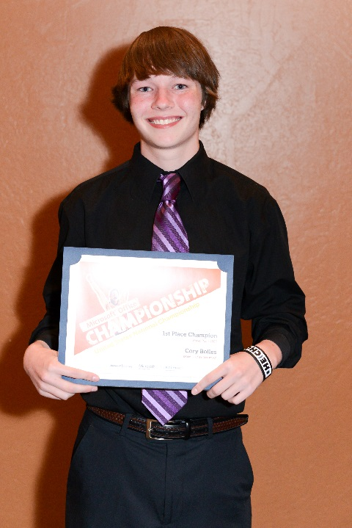
My MOS Story
Jonathan Cory Bolles
Bradenton, FL, United States
MOS World Champion, 3rd Place
My MOS certifications allowed me to compete in Certiport’s MOS U.S. and World Championships, placing third in the world for PowerPoint 2007 during the summer of 2013. That in itself helped me in a tremendous way, opening up potential job opportunities. In fact, after the competition, my winning position landed me a job as a marketing assistant at a web development company near my home town.
I highly recommend MOS certification to anyone. It can open a multitude of opportunities in the lives of everyone who earns one.

Slide 18

MOS Success Story
Reagan Beavers
Fayetteville, GA, United States
Student at FCHS
At just 16 years old, I currently possess eight MOS certifications, including the MOS Master title. With these certifications I have earned opportunities to be interviewed by news media, have had several job interviews, and have been asked to create items for important local events. Most importantly I have gained confidence to be strong and apply my knowledge in the business field.
I would highly urge friends to take a MOS exam. MOS opens up an abundance of doors. There are so many job and volunteer opportunities with an MOS certification under your belt. You will not be disappointed by obtaining one; at the very least you would gain confidence, knowledge, and the ability to navigate efficiently around your computer.

Slide 19
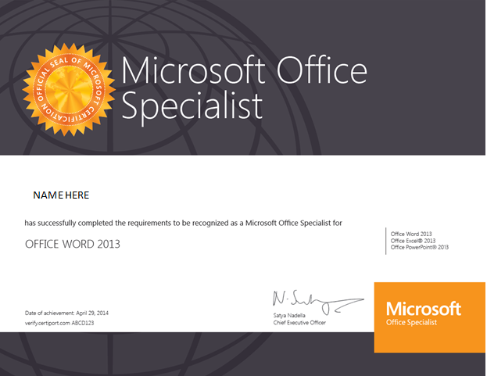
Become Certified
Notes:
Earn your Certificate – add to your resume – be proud of what you have accomplished – be the one to help others!!!

