Slide 1
Google Drive / Microsoft Office
Plus: online collaboration & more!

Slide 2
Google Drive
documents / presentations / spreadsheets / forms

Slide 3
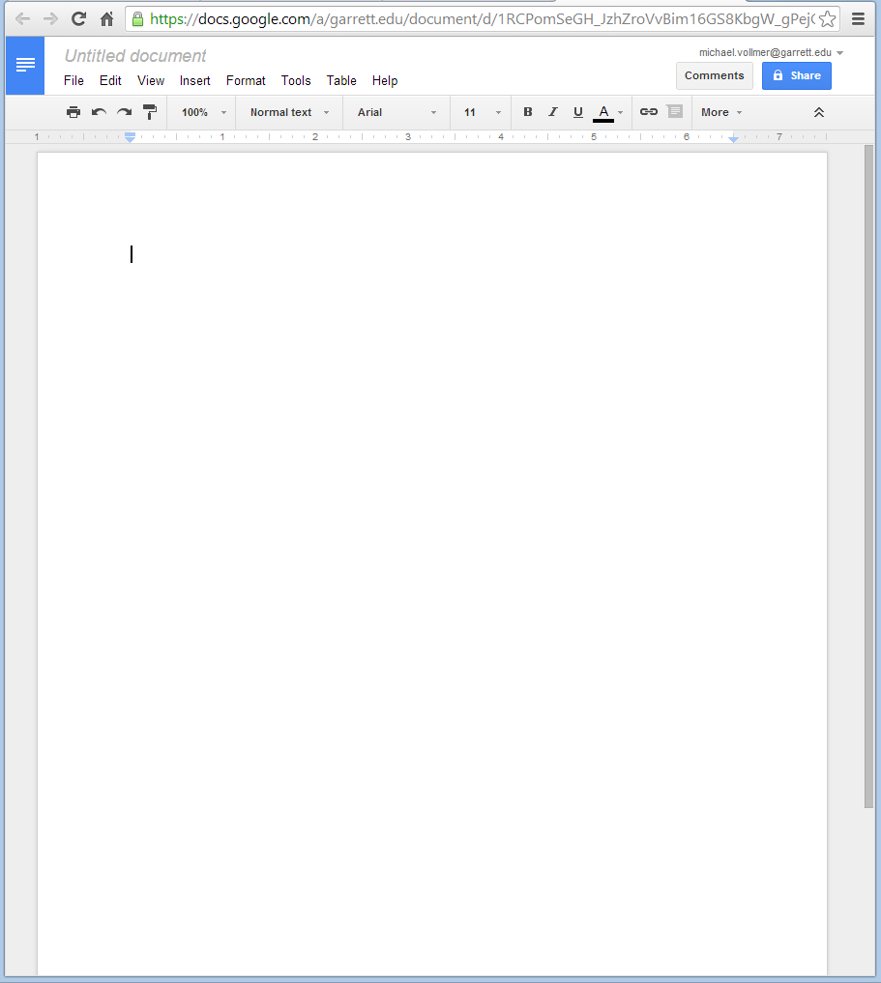
Google Documents
Create documents
Most formatting supported
Share & collaborate
Track changes
Use citations
Export to .docx / .pdf
Works almost just like Microsoft Word

Slide 4
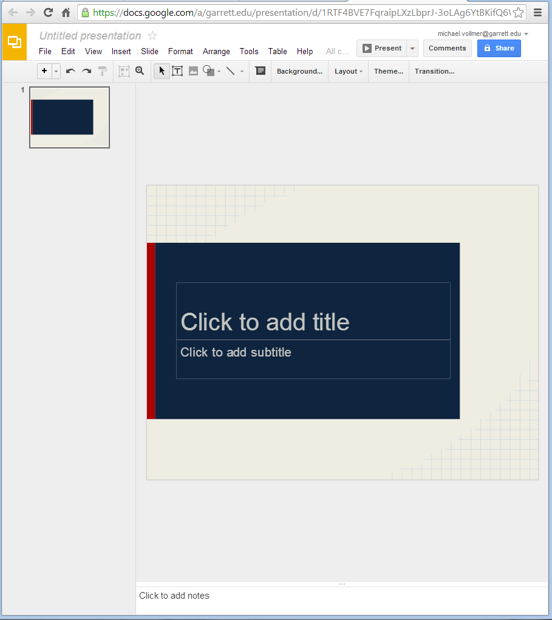
Google Presentations
Create presentations
View and show presentations without additional software
Share & collaborate
Supports most formatting
Export to .pptx / .pdf
Very similar to Microsoft PowerPoint

Slide 5
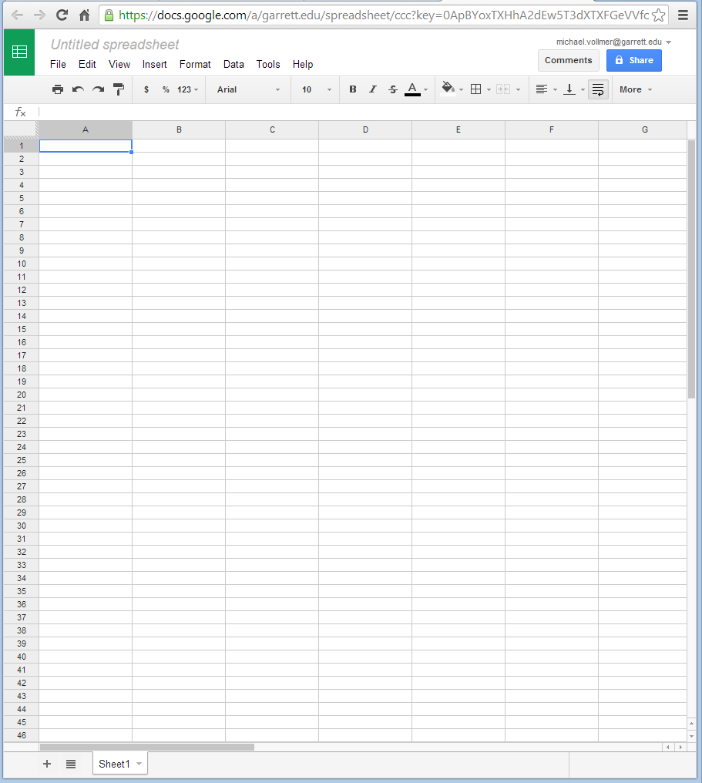
Google Spreadsheets
Create spreadsheets
Run calculations and reports
Share & collaborate
Works very similar to Microsoft Excel
Less advanced features than Microsoft Excel

Slide 6
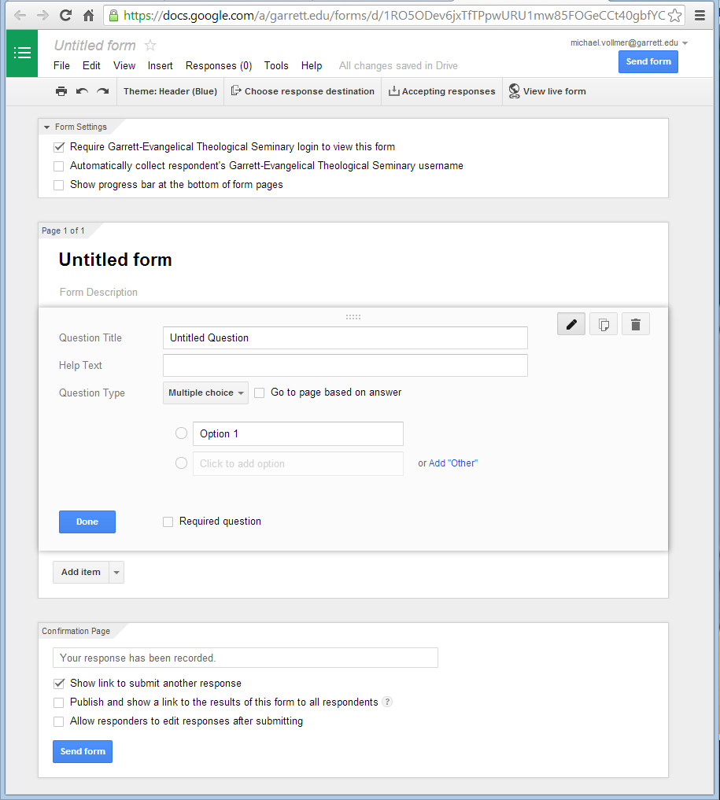
Google Forms
Create online web forms to collect information
Information saved in spreadsheet format
Publish to website, social media, & more
Limit access to control responses

Slide 7
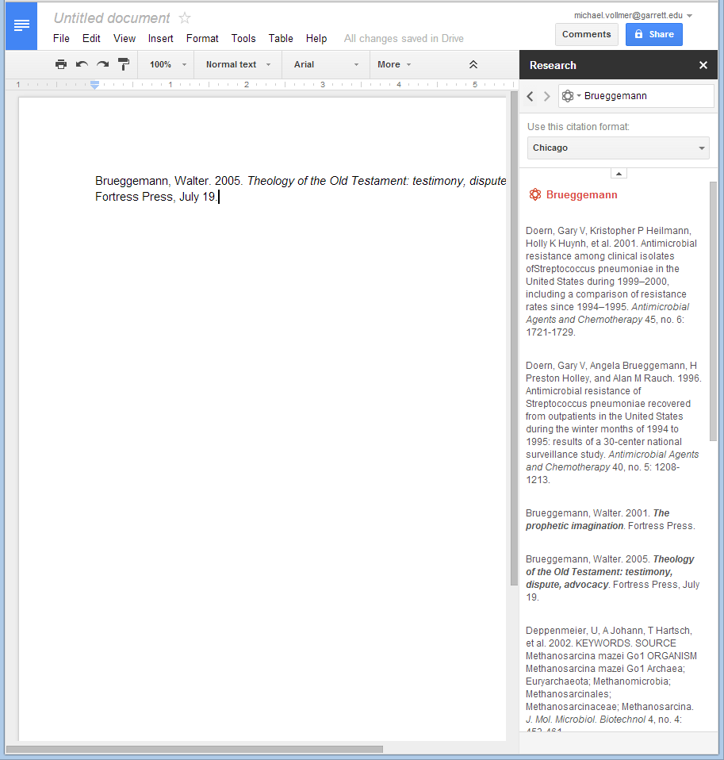
Google Citations
Google Drive has built-in citation
Select “Research” from the “Tools” menu or right-click a word and select Research
Choose “Scholar” in the search bar
Click on “Cite as Footnote”

Slide 8
Google Best Practices
You can attach Google Drive files in Gmail emails
See keyboard shortcuts (Shift+/)
View revision history using Ctrl+Alt+G
Check out helpful extensions for Chrome
You can add descriptions to your docs
Access templates via https://drive.google.com/templates
Tools > Spelling
Download multiple files at once in zip file

Slide 9
Microsoft Office
documents / presentations / spreadsheets

Slide 10
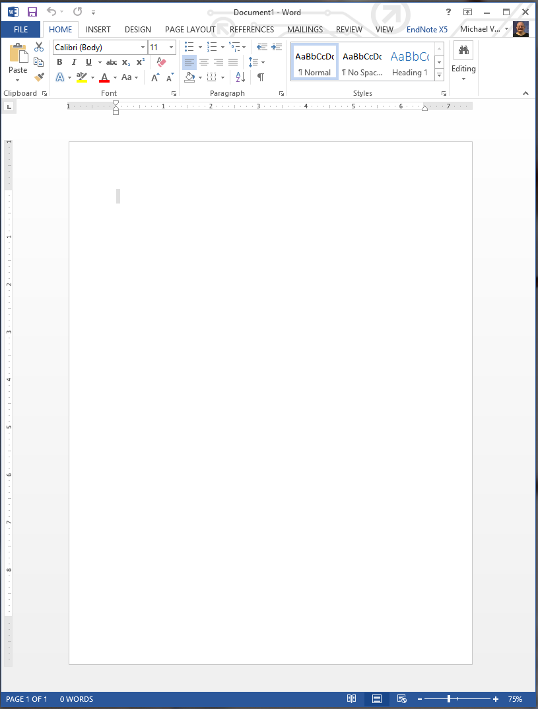
MS Office Documents
Full word processing suite
Many templates built-in & more online
Most used worldwide
Track changes
Built-in citation or can integrate with Endnote software

Slide 11
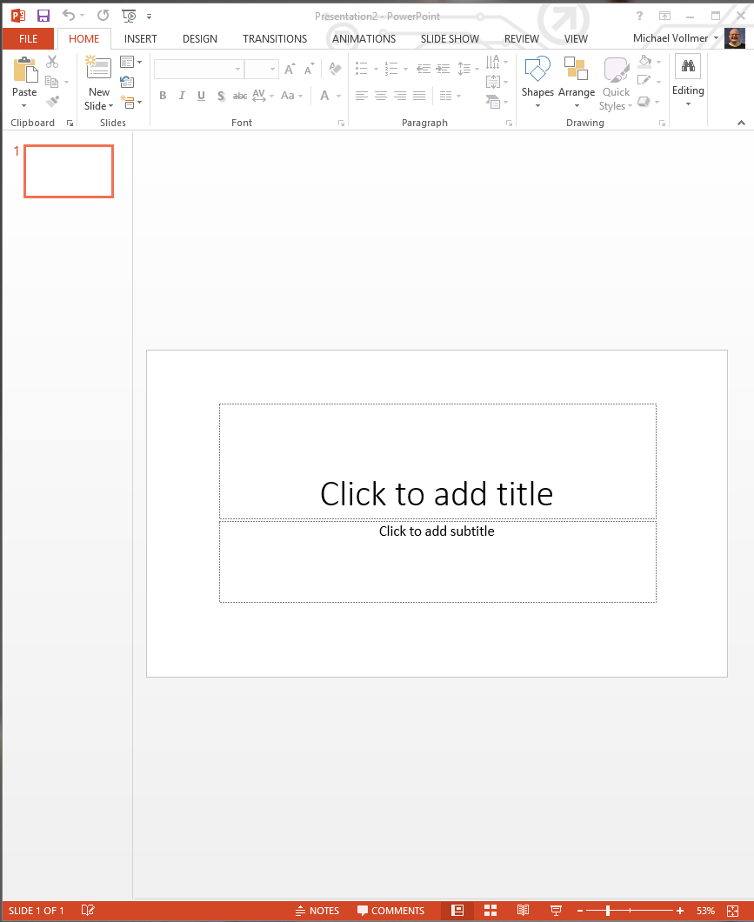
MS Office Presentations
Full presentation suite
Many templates built-in and more online
Most used worldwide
Built-in image editing tools
Numerous export options

Slide 12
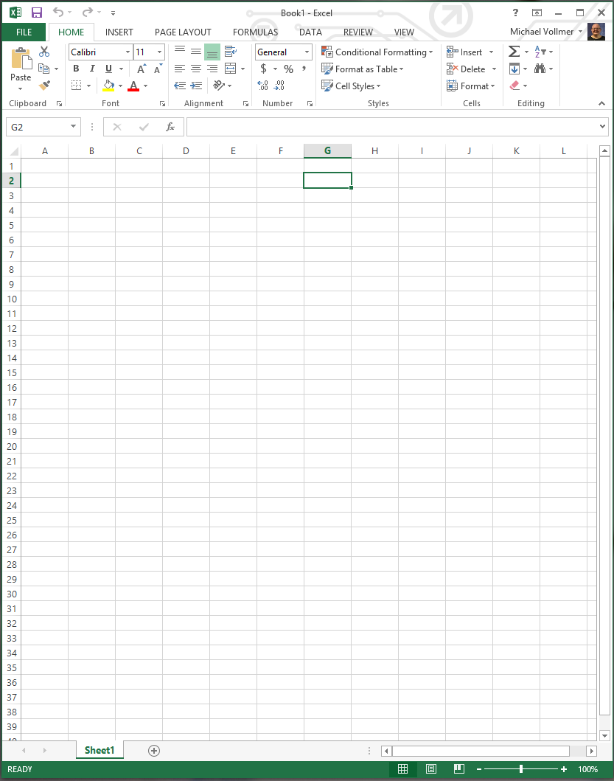
MS Office Spreadsheets
Full spreadsheet / data suite
Many templates built-in and more online
Advanced calculation
Most used worldwide
Powerful data analysis tools built-in

Slide 13
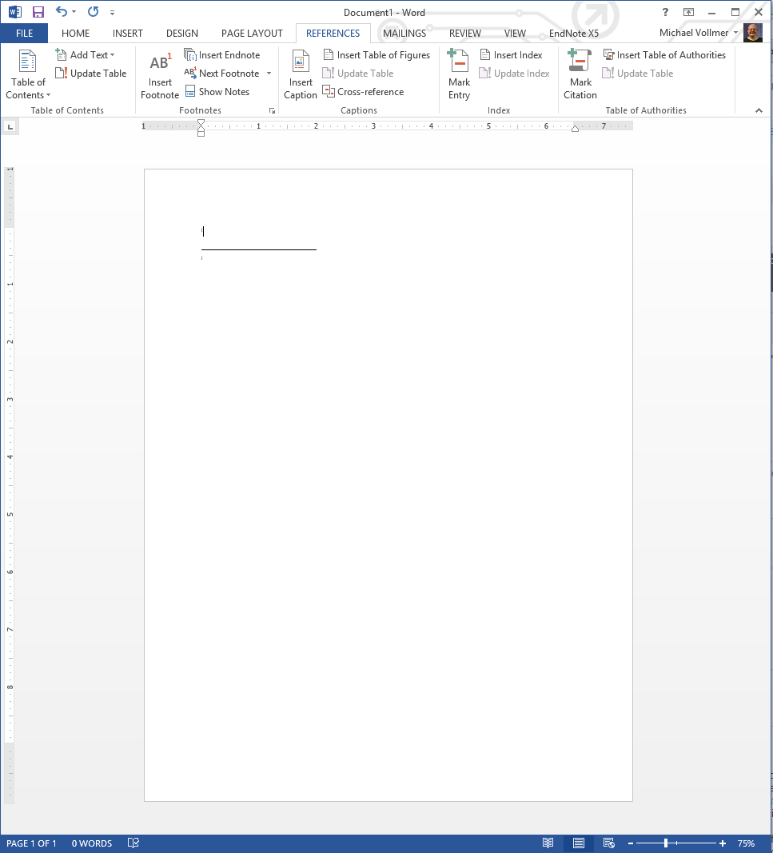
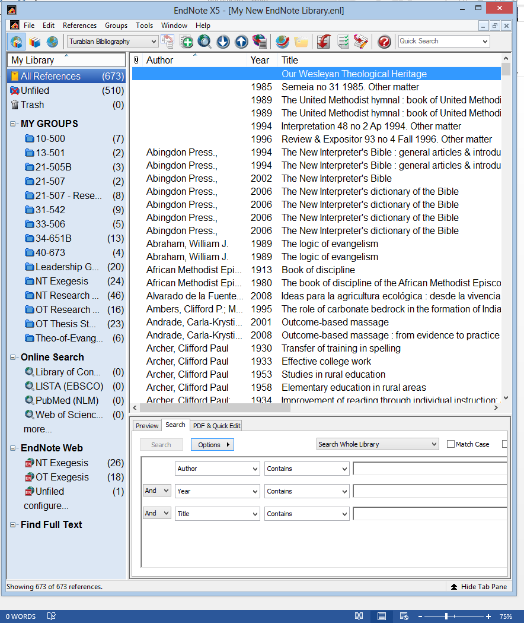
MS Office Citations

Slide 14
MS Office Best Practices
Use 10 point font or higher
Use standard fonts whenever possible
Avoid lots of graphics on one page
Avoid unnecessary animations and sounds
Learn key commands to work faster
Avoid clipart please!!
Save constantly!
Use Paste special to drop formatting
You can create a chart in Excel and drag and drop it into Word or PowerPoint

Slide 15
Google Drive vs. Microsoft office
comparisons / cloud storage & sharing files / collaboration

Slide 16
General Comparisons
Google Drive
Microsoft Office
Requires Google Account
Free to use
Compatible with most document formats
Can be accessed anywhere, even mobile
Collaboration tools
No software to download
Requires purchase
Office365 offers online access to software
Office365 accessible anywhere, even mobile
Office365 collaboration tools
Most popular office suite in the world

Slide 17
Cloud Storage / Sharing
Google Drive
Microsoft Office
30GB of storage included
Easily add anyone to share document
Integrated track changes, including per user
Chat window integrated into document view
Sync with local computer
7GB free storage (SkyDrive), 20GB additional with Office365 subscription
Easily add anyone to share document
Integrated track changes, including per user
Sync with local computer

Slide 18
Collaboration
Google Drive
Microsoft Office365
Track changes per user
Built-in chat window
Multiple users can access same document at once
Changes show up in almost real-time
Track changes per user
Chat in separate window
Multiple users can access same document at once
Changes not shown in real-time, refresh needed

Slide 19
Resources & guides

Slide 20
Google Drive
Google Drive Help
CNET Complete Guide To Google Drive
Google Drive And Docs In 30 Minutes
GCFLearnFree.org Google Tutorials
Palomar College Google Docs Webinar
Mactuts+ The Complete Guide to Google Drive on a Mac
Google Mobile Google Drive

Slide 21
Microsoft Office
Microsoft Office Support
makeuseof.com Microsoft Office 2010: Ultimate Tips & Tricks
How-To Geek Microsoft Office How-Tos
Getting Started w/ Microsoft Office Mobile
Investintech.com Everything You Wanted to Do With Office…But Didn’t Know How
WonderHowTo Microsoft Office Help

Slide 22
Questions?

